Slide 1
Project Presentation
2022/12/15
Team Cyan
Notes:
안녕하세요,
팀 cyan project presentation 시작하겠습니다.

Slide 2
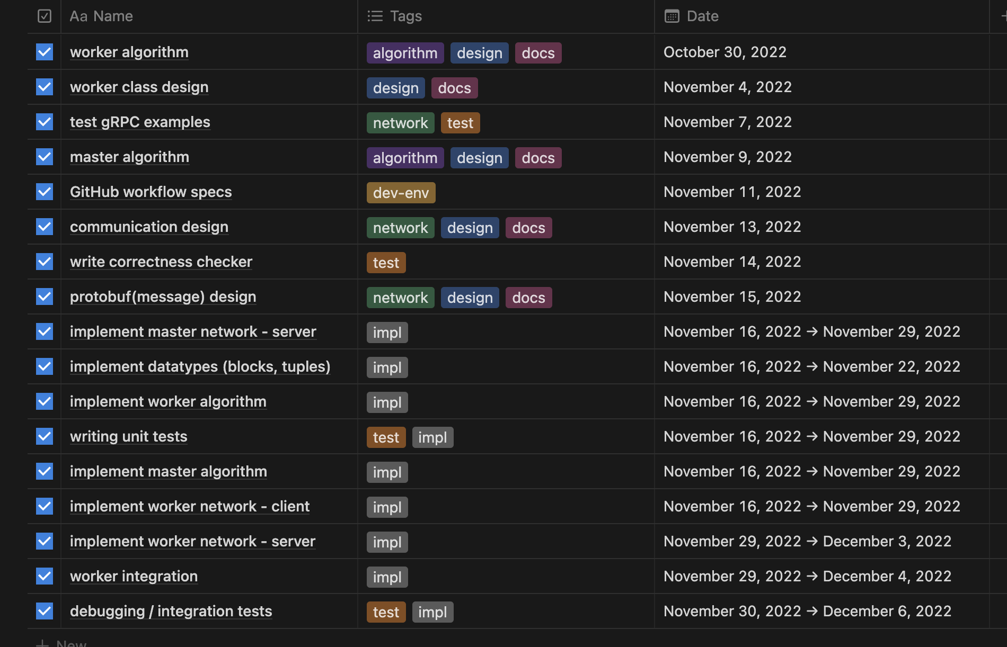
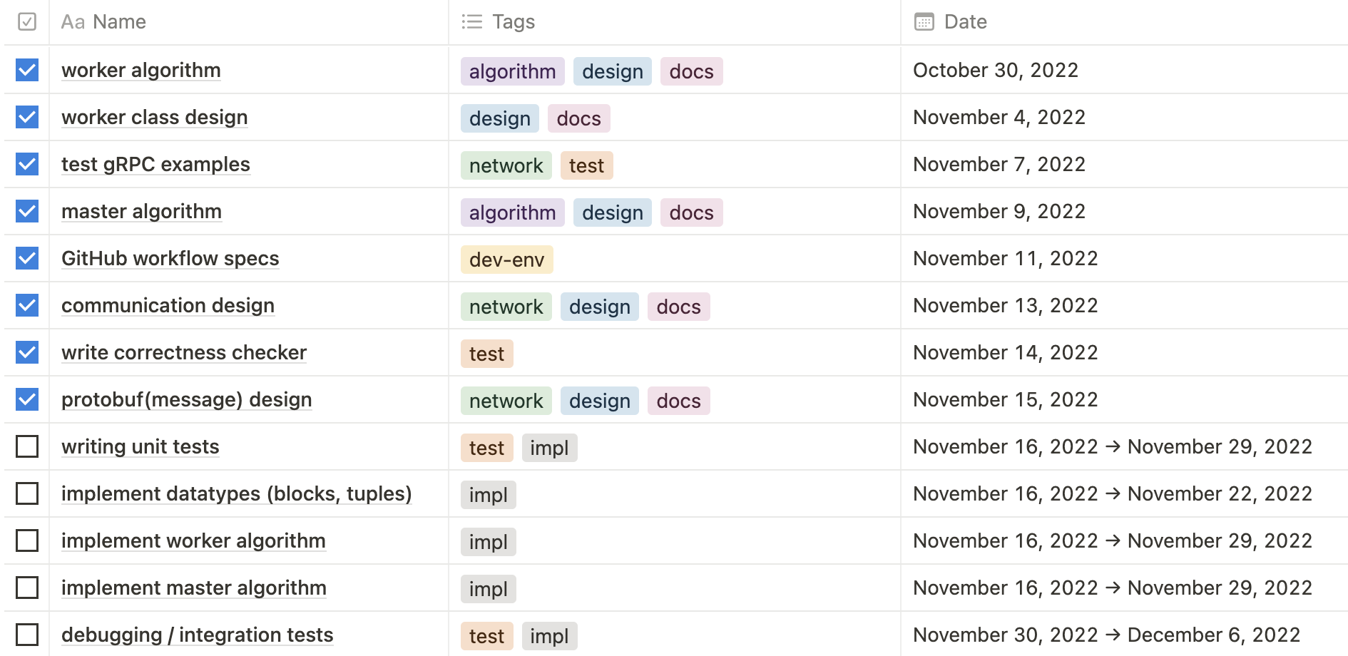
Project Management - Milestone
Notes:
진행함에 따라 imple milestone 세분화됨
Server, worker for master, worker and more integration test

Slide 3
Project Management - Milestones
Implementation
Data types (block, typles)
Master (algorithm, integration)
Worker (algorithm, integration)
Network (master server, worker client, worker server)
Test
Unit test
Debugging & integration tests

Slide 4
Project Management – Who did what
seonghyun26
Network Design, Impl.
Network Test
lemonwater
Master Design, Impl.
Environment setting
Debugging
dongyeop3813
Worker Design, Impl.
Integration Test
Debugging

Slide 5
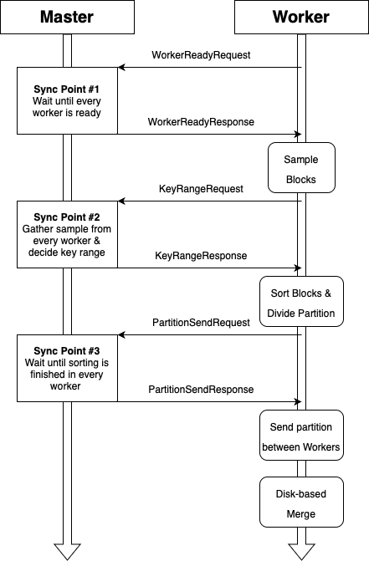
Weekly Progress
5주차
Network Implementation
Master-Worker gRPC
Worker Implementation
Master Implementation
Interface between master and network

Slide 6
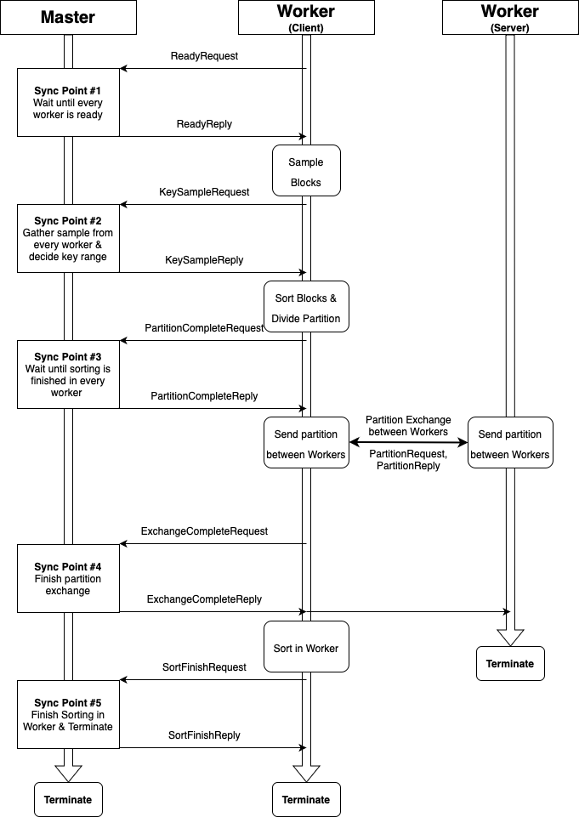
Weekly Progress
6주차
Modification on Network diagram
Additional sync points
Worker-Worker
Worker Implementation
Sorting Algorithm
Master Implementation

Slide 7
Weekly Progress
7주차
Test
System test code Implementation
Integration test script
Debugging
Bug fix in master
Debugging.. Debugging.. Debugging..

Slide 8
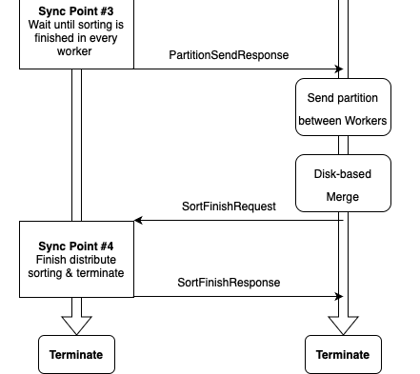
Design Modifications – Network
Additional sync points, messages and information

Slide 9
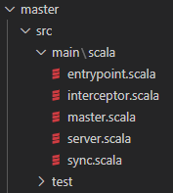
Design – Master
entrypoint.scala
Implements the CLI specs.
Runs an RPC server.
server.scala
class DistSortServerImpl
Implements RPC handlers.
master.scala
class Master
Implements an algorithm that calculates key ranges

Slide 10
Design – Master
interceptor.scala
Extracts IP address of incoming requests
sync.scala
Utility functions and datatypes for syncing.

Slide 11
Design – Master
class Master
Consumes the samples from the workers, calculates the key ranges, and broadcast them back to the workers.

Slide 12
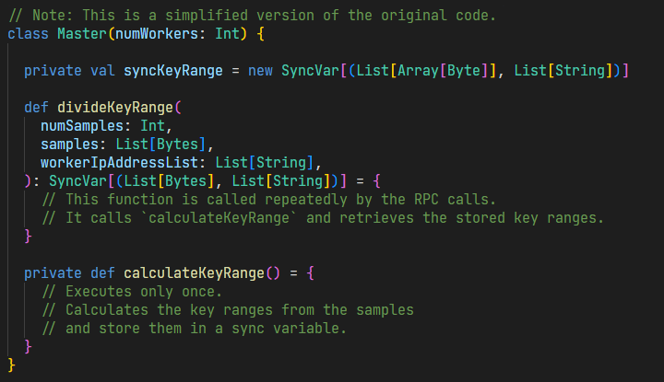
Design – Master

Slide 13
Design – Master
class DistSortServerImpl
Extends an abstract class defined in network module.
The RPC logic of the master.
Manages the sync points among several phases (ready phase, sampling phase, sorting phase, …)

Slide 14
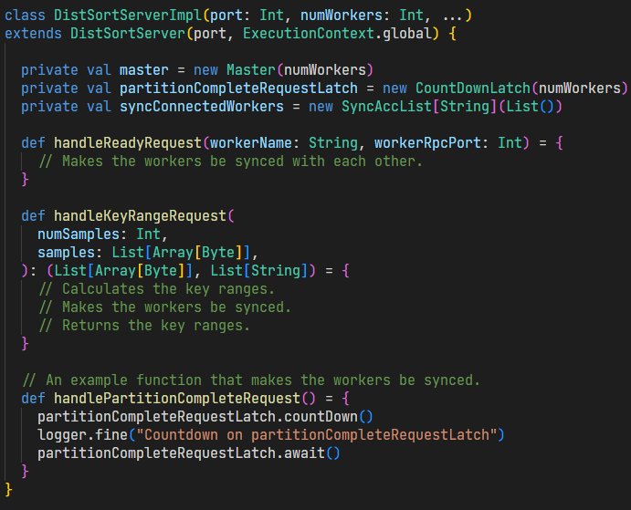
Design – Master

Slide 15
Design - Worker
Worker class
Worker have their own working directories
Do their own work with multiple blocks
Block class
Represent 32MB block(file)
Tuple class
Represent each tuple
Change internal data structure from List[Byte] to String

Slide 16
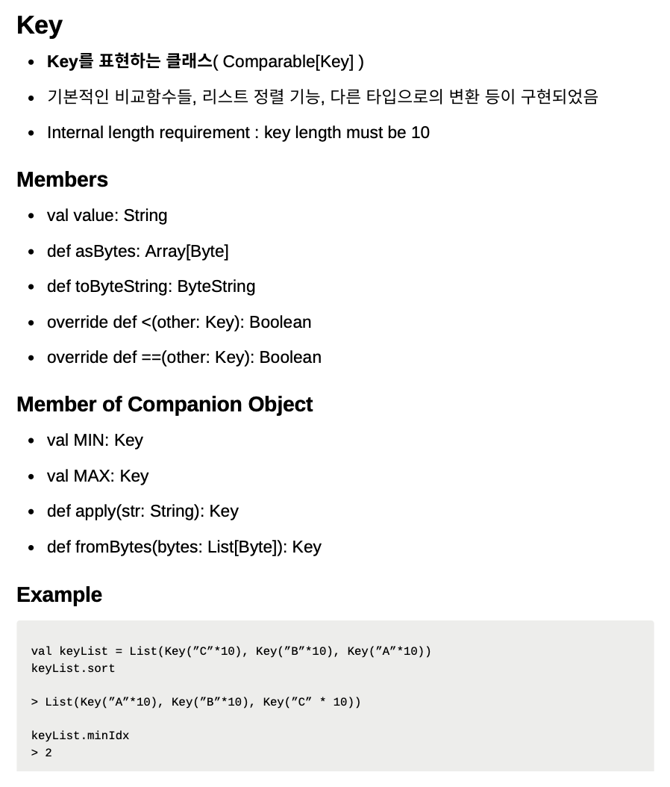
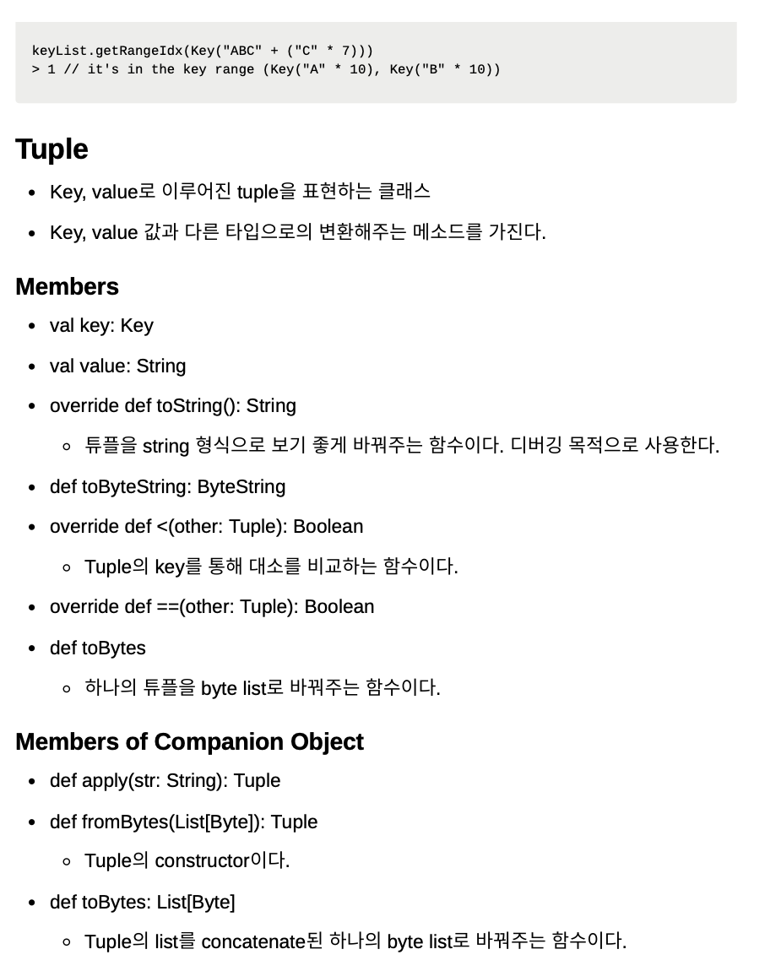

Slide 17
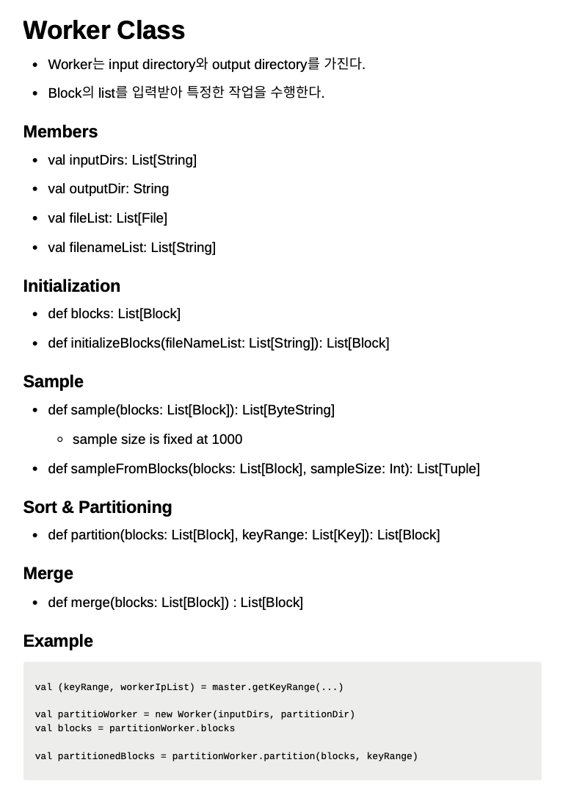
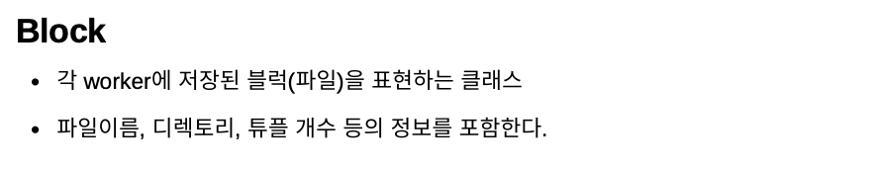
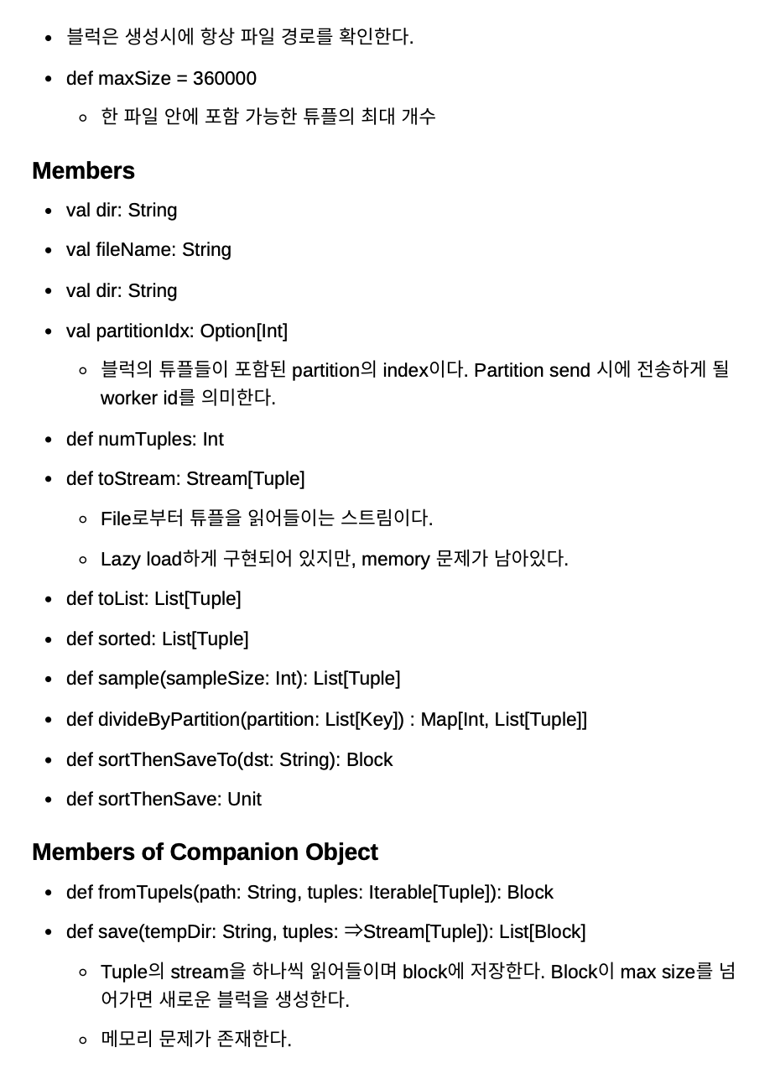

Slide 18
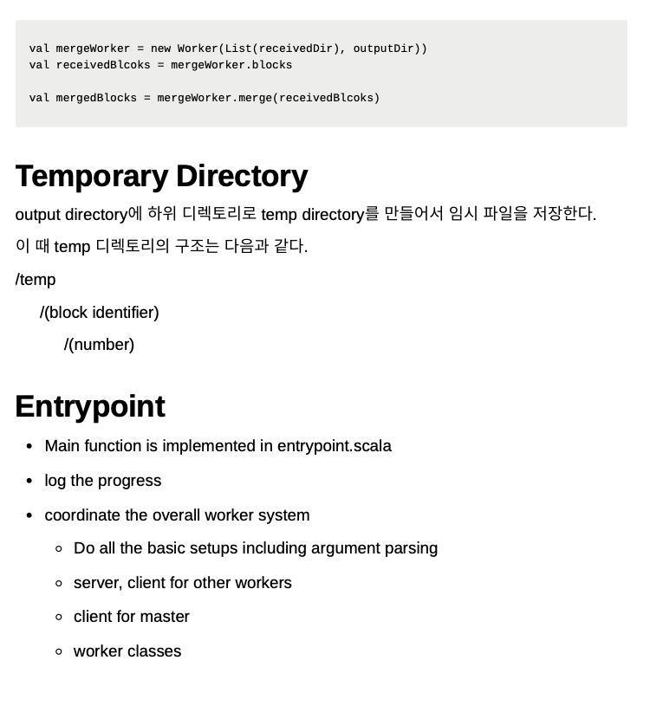

Slide 19
Design Modifications – Worker
Block doesn’t have working directory information
Worker class가 working directory를 가짐
Block들을 working directory에 저장함
Key Datatype: “List[Byte]” -> “String”
Out of Memory Issue
Too much overhead for list pointer, class overhead per 1 byte data.
Comparable trait
Provide sorting function for list of that types

Slide 20
Experiments - # of blocks
Conditions
3.2MB of data (32000 keys) per block
3 workers
10 blocks (32MB)
33 seconds
33 blocks (105.6MB) (x3.3)
136 seconds (x4.1)
100 blocks (320MB) (x10)
2056 seconds (x62.3)
Notes:
- condition - 4+ workers - 2+ input blocks per worker - each block 32MB

Slide 21
Experiments – heap size
Conditions
3.2MB of data (32000 keys) per block
3 workers
+12G JVM heap
33 blocks (105.6MB)
153 seconds
100 blocks (320MB)
2121 seconds
Even increased!
256MB heap (previous)
33 blocks
136 seconds
100 blocks
2056 seconds
Notes:
- condition - 4+ workers - 2+ input blocks per worker - each block 32MB

Slide 22
Experiments – block size
Conditions
32MB of data (320000 keys) per block
3 workers
+12G JVM heap
3 blocks (96MB)
130 seconds
9 blocks (288MB)
260 seconds
33 blocks (1056MB=1GB)
1324 seconds
3.2MB blocks (previous)
33 blocks (105.6MB)
153 seconds
100 blocks (320MB)
2121 seconds
Notes:
- condition - 4+ workers - 2+ input blocks per worker - each block 32MB

Slide 23
Experiments – conclusion
Assuming a fixed amount of data…
Smaller block size is slower because N time many blocks cause an N times larger time complexity in the disk-mased merge sort.
Heap size matters when the whole data doesn’t fit into the memory. (we’ve encountered several GC errors in such cases)
Notes:
- condition - 4+ workers - 2+ input blocks per worker - each block 32MB

Slide 24
Conclusion
dongyeop3813
Memory usage가 scalability에 있어서 중요한 요소임에도 미리 세심하게 고려하지 못했던 점이 아쉬웠다
디자인 문서를 작성하지 않고 코딩한 경우 의사소통의 문제가 있다는 것을 실감했다
Assert와 require, Unit test를 잘 작성해 놓으니 optimize나, 코드의 일부분을 변경한 경우에도 빠르게 작업이 가능했다.
seonghyun26
Assert을 통해 debugging 작업이 편해졌다
Network 관련 오류는 reproduction이 어려워 대처를 잘 못한 것이 아쉽다
lemonwater
RPC server를 master가 아닌 worker가 구현하는 것이 더 좋은 디자인이라고 생각한다. 현재 디자인의 sync point보다 future와 premise를 사용했더라면 더 깔끔하고 좋은 코드를 짤 수 있었을 것이다.

Slide 25
Thank you
Notes:
감사합니다.

Slide 26
Q & A

