Slide 1
Comparison of Bidding Algorithms for Simultaneous Auctions
Seong Jae Lee

Slide 2










Introduction
Bidding Problem
Simultaneous Auctions
Substitutable & Complementary Goods
Notes:
Simultaneous auctions raise challenges to bidders,
especially when there substitutable or complementary goods are on sale.
Suppose you want a travel package to Miami.
[ANIMATION]
Of course, you need a hotel room, but among various hotels, you need just one of them.
Purchasing Hilton and Radisson on same day does not increase your value that much.
Therefore, hotels are substitutes in this case.
[ANIMATION]
In the same way, flight tickets are also substitutes in this case.
But, we need both of the flight tickets and hotel for your trip.
For example, a travel package with two flight tickets and no hotel has no value.
Therefore, flight tickets and hotels are complements.
[ANIMATION]
And, when we have to purchase them from simultaneous auctions,
it raises a complicated problem to bidders.

Slide 3
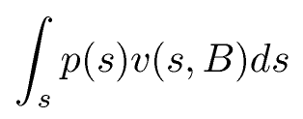
Bidding Problem: Goal
Introduction
The goal of bidding problem is
to find a set of bids B that maximizes:
  s : clearing price.
  p(s) : probability that the clearing price is s.
  v(s,B) : value when the clearing price is s, and bid is B.
Notes:
the expected value across the distribution of clearing prices.

Slide 4








Trading Agent Competition
Introduction
Notes:
The Trading Agent Competition, or TAC,
is an annual event to promote researches on bidding problem.
8 players plays in the game, and each player represents a travel agency.
The goal of a player is to make profit,
by creating travel packages composed of flight tickets, hotels, and entertainment tickets
and selling them to assigned clients.
[ANIMATION]
The goods can be purchased through different types of auctions.
For example, hotel auctions close every minute in a random order,
and 16 hotels are distributed with the 16th highest bidding price at each time.

Slide 5
Algorithms
Algorithms
Sample Average Approximation
Marginal Value Bidding
Name | Performance | Algorithm
ATTac01 | 2000 1st, 2003 1st | Marginal Value
Walverine | 2004 2nd, 2005 3rd, 2006 2nd | Marginal Value
RoxyBot | 2000 2nd, 2002 final | Marginal Value
RoxyBot | 2005 final, 2006 1st | SAA
Notes:
In this thesis,
we compare two successful algorithms in TAC:
Sample Average Approximation, or SAA, based algorithms,
and Marginal Value bidding algorithms.

Slide 6
Review: the Goal
Algorithms
The goal of bidding problem is
to find a set of bids B that maximizes:
  s : clearing prices.
  p(s) : probability that the clearing price is s.
  v(s,B) : value when the clearing price is s, and bid is B.
Notes:
Again, I want to say the goal of this problem is
to maximize the expected profit.

Slide 7
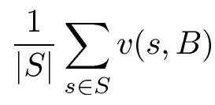
Sample Average Approximation
Algorithms
SAA algorithm samples S scenarios from clearing price distribution model.
Find a set of bids B that maximizes:
  S : a set of sampled clearing prices.
Notes:
Maximizes the expected value across the sampled clearing prices.

Slide 8
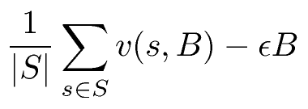
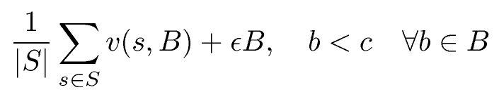
Sample Average Approximation
Algorithms
There are infinitely many solutions!
  e.g. S=1, s=100,
  if B>s, v(s,B)=1000-s, else v(s,B) = 0.
  B can be any number between 100 and 1000.
SAA Bottom: maximize
SAA Top: maximize
Notes:
But, note that
In this thesis, we derived two algorithms, SAA Bottom and SAA Top.
One bids as less as possible
and the other bids as much as possible,
but since it’s too dangerous to bid infinity,
we set a constraint that says the maximum limit of bidding price.

Slide 9
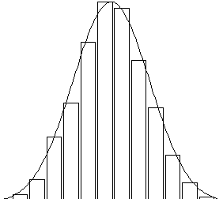
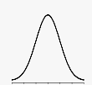
Sample Average Approximation
Algorithms
Defect
  The highest bid SAA Bottom considers submitting may be below clearing price.
  SAA Top may pay more than the highest price it expects.
SAA Bottom
SAA Top
Notes:
SAA is not optimal.
Since the sampled scenarios is not same to the clearing price model, algorithms might get unexpected result.
For example, if the clearing price distribution is the following, and if that’s our samples,
and if we want to get this good by any price,
SAA Bottom will bid here, and SAA Top will bid here.
And if the clearing price is actually within this range, SAA Bottom will fail to win this good.
[ANIMATION]
Also, for SAA Top, if the clearing price is unexpectedly high, he will pay more than it expects.

Slide 10
Marginal Value based Algorithms
Algorithms
Marginal Value of a good: the additional value derived from owning the good relative to the set of goods you can buy.
Characterization Theorem [Greenwald]
  MV(g) > s if g is in all optimal sets.
  MV(g) = s if g is in some optimal sets.
  MV(g) < s if g is not in any optimal sets.
Notes:
There is a nice theorem by Amy,
that, if there is a single clearing price,
marginal value of a good is greater than or equal to the clearing price if it’s in some optimal set of goods,
And it is smaller than the clearing price if it’s not in any optimal set of goods.
Therefore, bidding marginal value on goods in one optimal set will be the optimal solution in single prediction case.

Slide 11
Marginal Value based Algorithms
Algorithms
Use MV based algorithms
which performed well in the TAC:
  TMU/TMU*: RoxyBot 2000
  BE/BE* : RoxyBot 2002
  AMU/SMU : ATTAC

Slide 12
Experiments
Experiments
Decision-Theoretic Setting
  Prediction = Clearing Price (normal dist.)
  Prediction ~ Clearing Price (normal dist.)
Game-Theoretic Setting
  Prediction ~ Clearing Price (CE price)

Slide 13

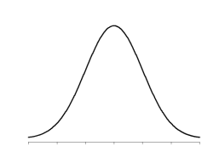
1. Decision-Theoretic (perfect)
Experiments

Slide 14
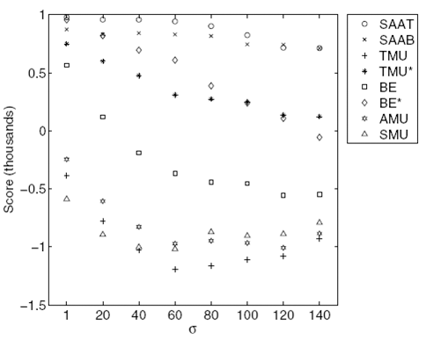
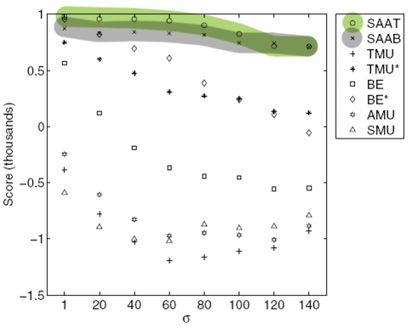
1. Decision-Theoretic (perfect)
Experiments
SAAs are more
tolerant to variance
SAAT ~ SAAB
at a high variance
Variance
Notes:
Some of Marginal Value based algorithms also performs well,
Because with a low variance,
it can be abbreviated to a single prediction problem,
and these algorithms are optimal in that case.

Slide 15
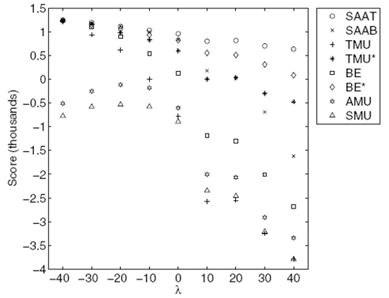
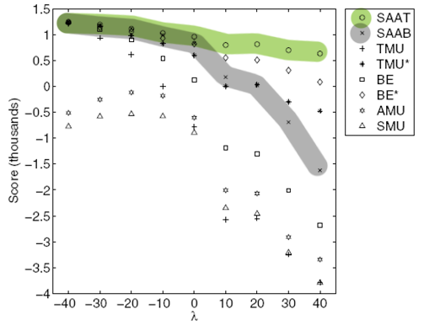
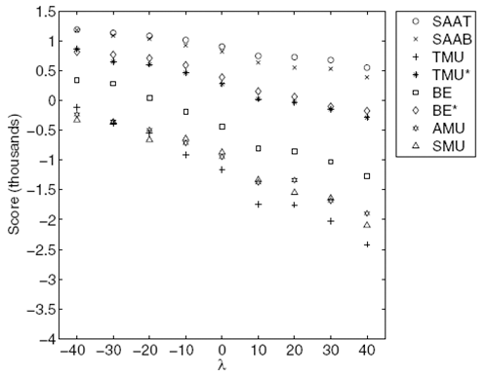
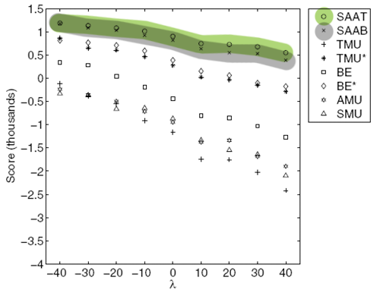
2. Decision-Theoretic (noise)
Experiments
Over-prediction
Under-prediction
Over-prediction
Under-prediction
Low Variance
High Variance
Notes:
We can see SAAB does poorly in low variance, under-prediction.
This happens because SAAB bids not more than
the maximum price in its sampled scenarios,
while most of the clearing prices are greater than its samples.
But, we can see that SAA Bottom also performs good in high variance setting.

Slide 16

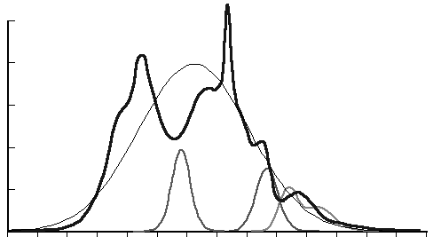
3. Game-Theoretic (CE prices)
Experiments
?
?
Notes:
Now we change to a game-theoretic setting,
so goods are purchased from the auctions.
Since we do not know what the other agents will do,
prediction quality also matters in this setting.

Slide 17
3. Game-Theoretic (CE prices)
Experiments
Competitive Equilibrium [Wellman ’04]
P_{n+1} = P_{n} + MAX(0,αP_{n}(demand - supply))
supply
price
demand
quantity

Slide 18
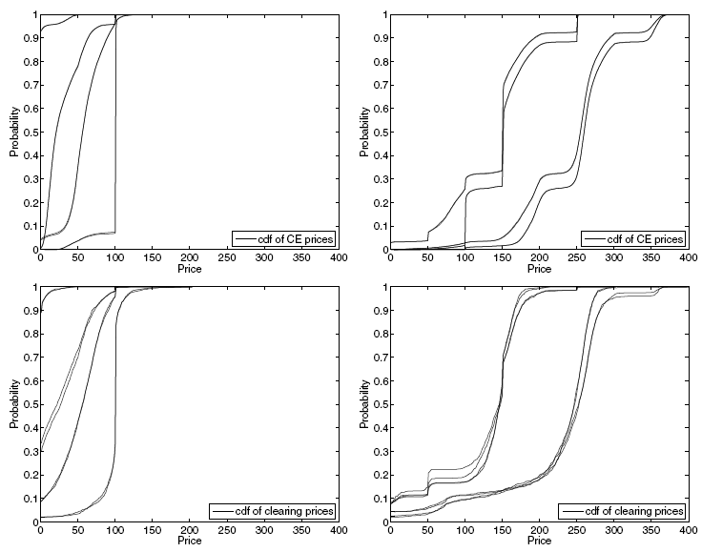
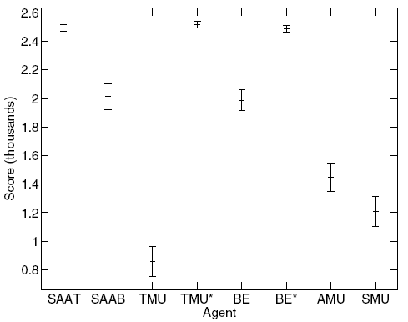
3. Game-Theoretic (CE prices)
Experiments
Cdf of Prediction
Cdf of Clearing Prices
Notes:
So our prediction quality is not that horrible,
actually it’s a little bit of under-prediction with less variance.
But the variance of these prediction is about 20,
which is pretty small,
and we thought this might be the reason that SAA Bottom performs badly.

Slide 19

3. Game-Theoretic (CE prices)
Experiments
?

Slide 20
3. Game-Theoretic (CE prices)
Experiments
Cdf of Prediction
Cdf of Clearing Prices
Low Variance
High Variance
Notes:
Prediction is similar to clearing prices.
Variation increased.

Slide 21
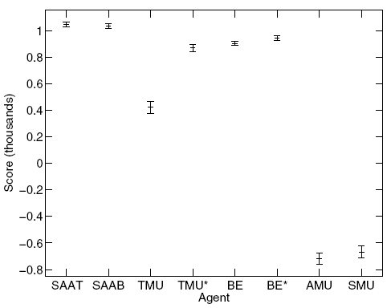
3. Game-Theoretic (CE prices)
Experiments
Low Variance
High Variance
Notes:
SAA Bottom performs as well as SAA Top,
Marginal Value based algorithms perform worse than SAA based algorithms
In high variance.

Slide 22
Conclusion
Sample Average Approximation
  Optimal for decision-theoretic setting,
  with infinite number of scenarios.
  More tolerant to variance.
  More tolerant to noise.
    SAA Top is tolerant to noise in general.
    SAA Bottom is tolerant to noise in high variance.
  Showed a better performance
  even in a game-theoretic setting.

Slide 23
Questions?

Slide 24
Acknowledgements
Andries van Dam
Amy Greenwald
Victor Naroditskiy
Meinolf Sellmann
Notes:
I want to say thank Andy, who has been my advisor for 4 years.
I decided to study computer science after taking his CS15 class,
And I decided to pursue computer graphics after taking his CS123 class.
Also, I really, really thank Amy.
she gave me this research problem two years ago and has been working with me on this topic since then.
Without her, I could not have won at the TAC, have published a paper, or have stood at this place.
She has been a great advisor and mentor to me.
Also thank Victor who has been working with me for two years,
he has always been helping me to become a real researcher.
And, thanks to Meinolf, who willingly agreed to be my thesis committee.
Thank you.

