Slide 1

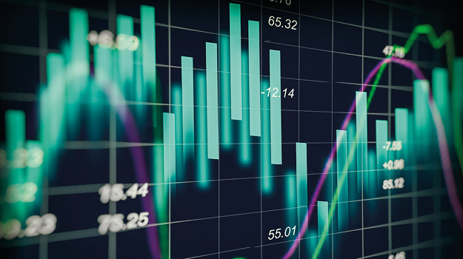
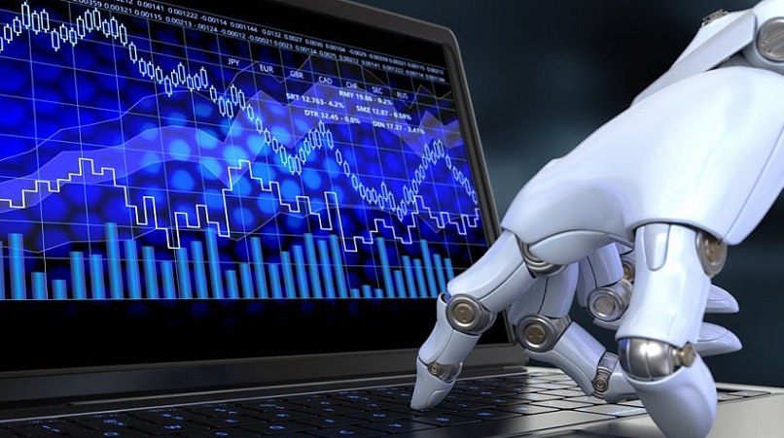
Quant-Investment with AI
Financial strategy
Financial Data Analysis
AI Model
Macro Analysis
Interest rate
Global trends
VIX index
Portfolio Organization
Personal propensity
Strategy
Correlation
Risk Management
Rebalancing
Data Analysis
Pandas Dataframe
Data Visualization
SQL Database
Crawling
Finance News
Domestic/Global Stock
Finance Statement, Value Indicators
Time-series Prediction
Reinforcement Learning
Feature Extractor
RL Environment
RL Agent
Natural Language Processing
Text/keyword tokenize
한국어 임베딩
bilingual word embedding
HuggingFace

