Slide 1
YOLOv3: An Incremental Improvement
M2019170
허성실

Slide 2
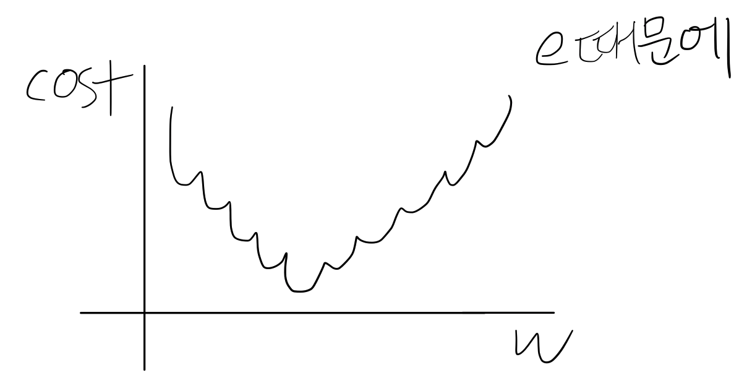
1. Class prediction
Use multi-label classification (ex. woman and person)
-> sum of output may be greater than 1
Softmax function -> independent logistic classifier
Mean square error -> binary cross-entropy loss

Slide 3
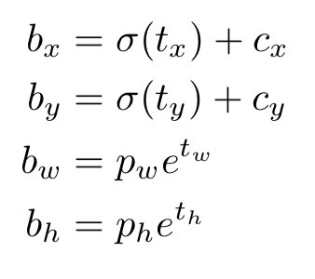
2. Bounding box prediction
Pr(Object) > threshold(default 0.5)인 bounding box만 남김.
각 Ground truth와의 IOU가 가장 큰 bounding box만 objectness score에 1을 줌.
즉, IOU가 가장 큰 bounding box를 제외한 나머지 bounding box에서는 confidence error만 고려. classification error와 localization error를 고려하지 않음.

Slide 4
3. Predictions Across Scales
Similar concept to Feature Pyramid Networks

Slide 5
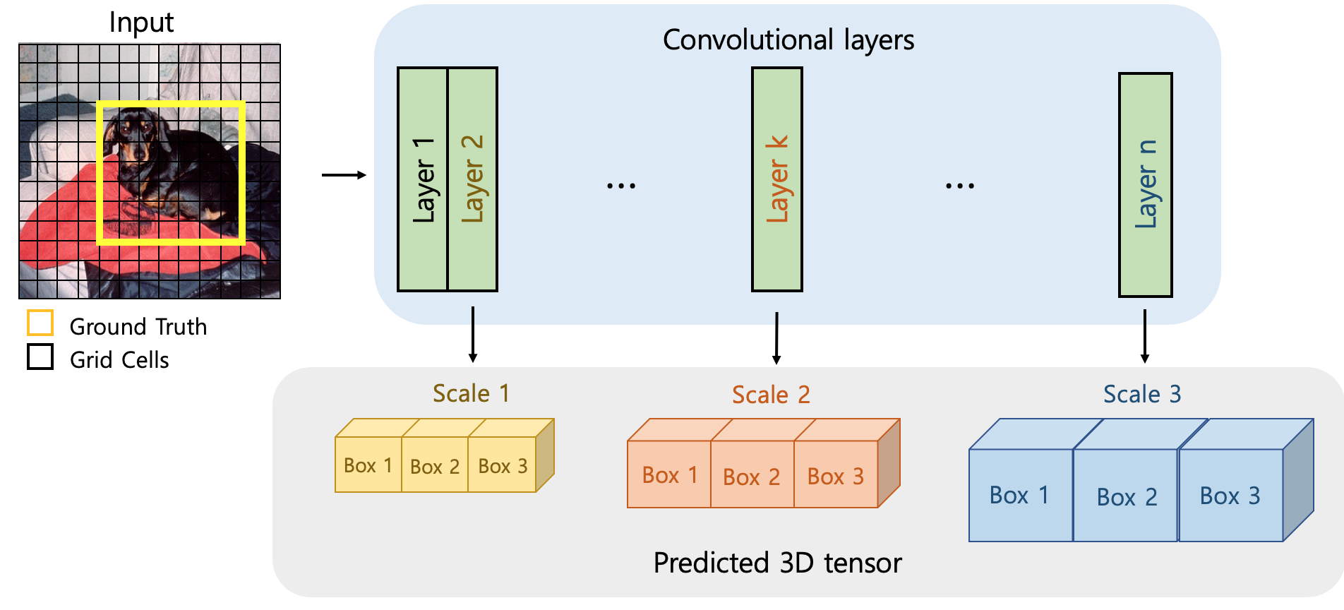
3. Predictions Across Scales
Predicts 3 boxes at 3 different scales.
tensor size : N x N x [3 x 5 + 80]

Slide 6
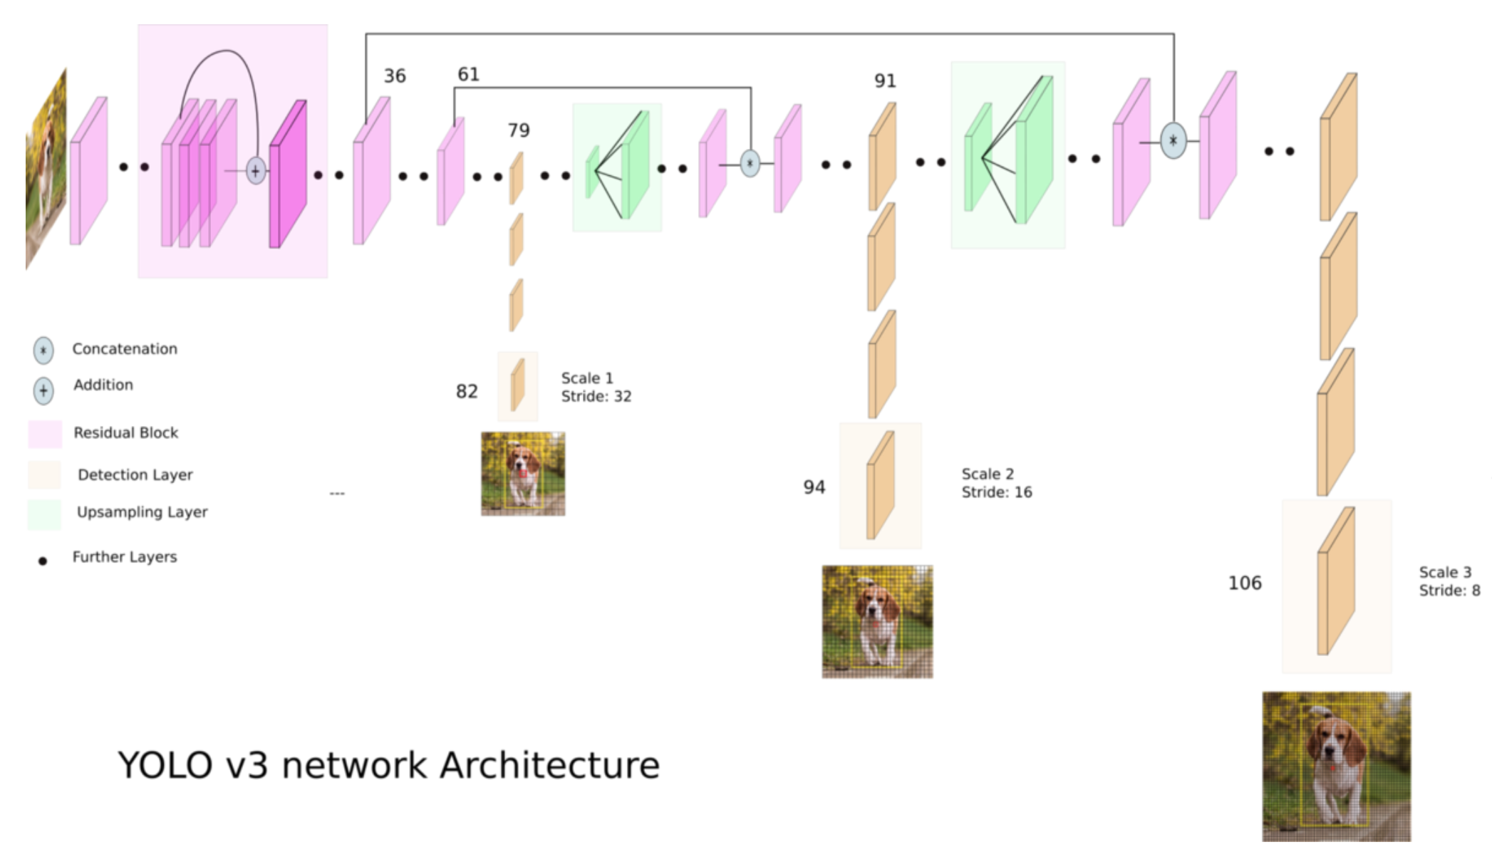
3. Predictions Across Scales
마지막 layer를 x2 upsampling 한 것과, 그전의 레이어와 합친 Feature를 이용해 prediction.
-> upsample한 feature로부터 semantic한 정보, 이전 feature map에서 finer-grained한 정보

Slide 7
3. Predictions Across Scales
Still use k-means clustering to determine bounding box priors.
(10 x 13), (16 x0 3), (33 x 23), (30 x 61), (62 x 45), (59 x 119),
(116 x 90), (156 x 198), (373 x 326),

Slide 8
4. Feature extractor
Darknet-53 아키텍처 사용
Darknet-19에 비해 image classification 성능은 Resnet-101만큼 좋고, 속도도 1.5x 빠름.

Slide 9
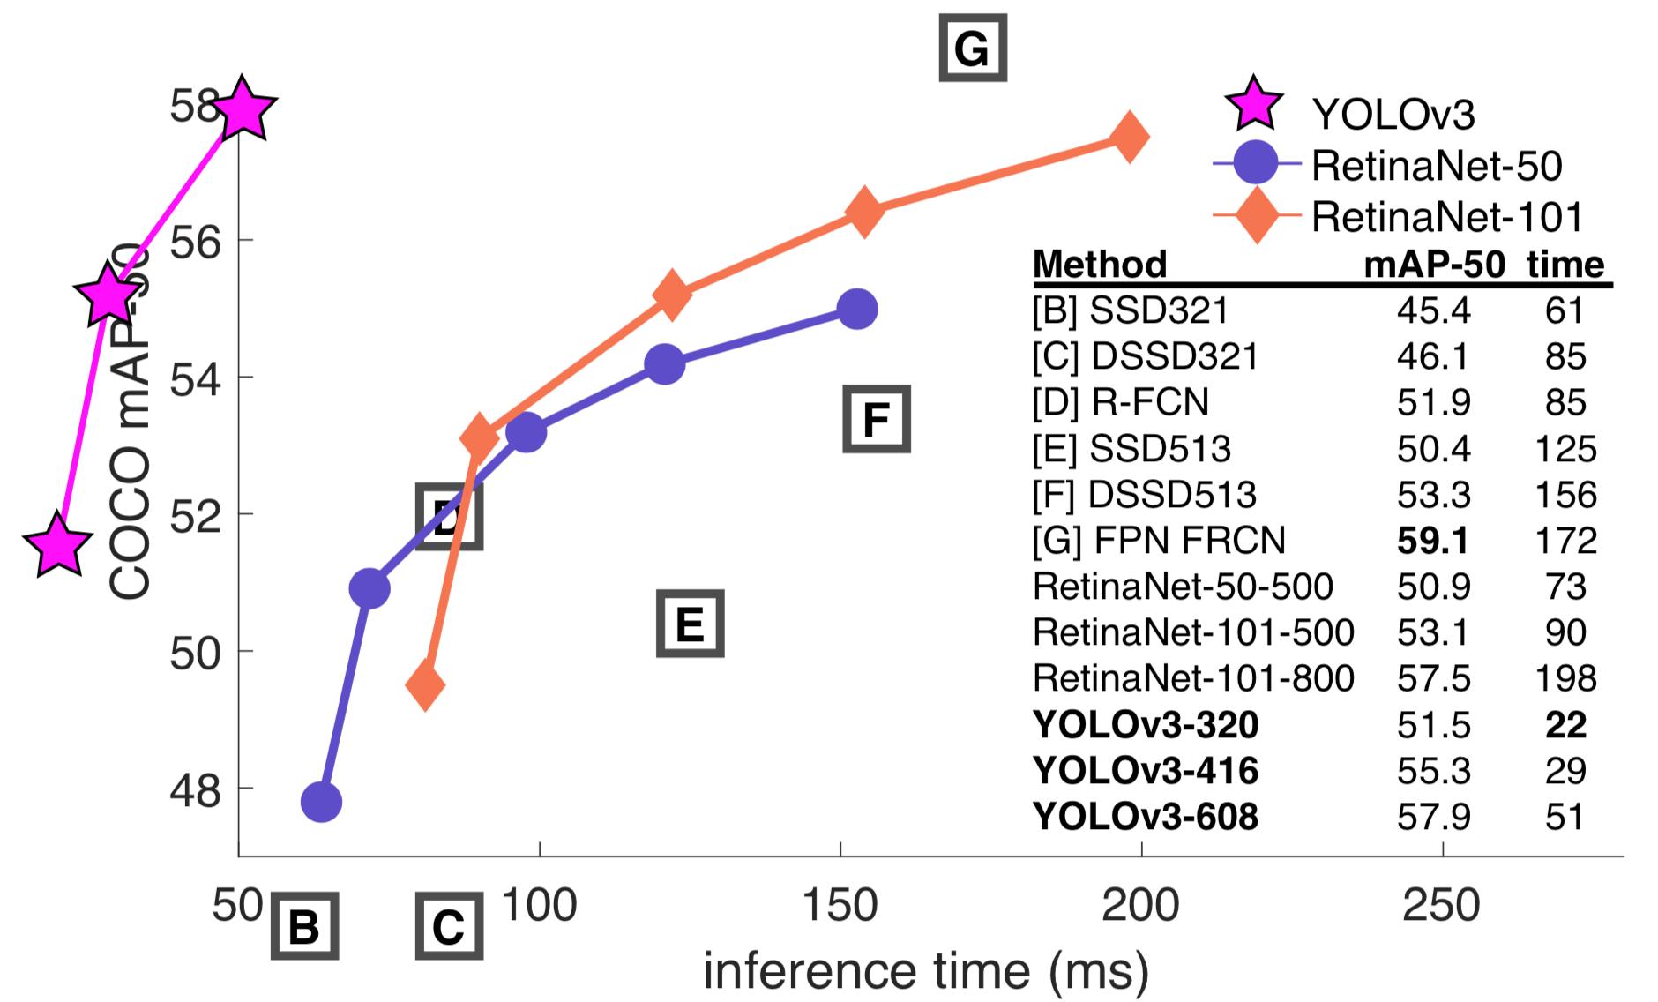
Result

