Slide 1
VGG

Slide 2
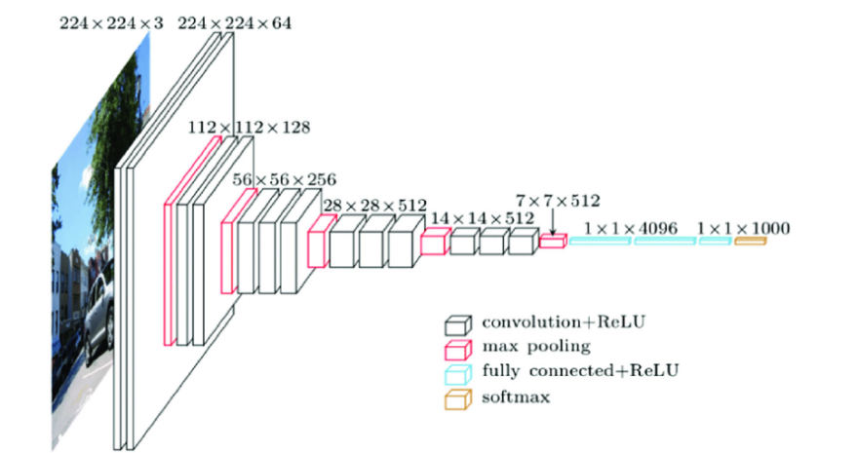
transform = transforms.Compose([
transforms.Resize((224, 224)), # input image size 224 x 224
transforms.ToTensor(),
transforms.Normalize([0.485, 0.456, 0.406],
[0.229, 0.224, 0.225])
# Instead of Preprocessing -> Normalization
])
class VGG16Model(nn.Module): # applying VGG16 model
def __init__(self):
super(VGG16Model, self).__init__()
base_model = models.vgg16(pretrained=True) # load pretrained VGG
self.conv = base_model.features # convolutional layer
self.pool = nn.AdaptiveAvgPool2d((7, 7)) # feature map 7x7
self.fc = nn.Sequential(
nn.Flatten(), # 3D to 1D flattening
nn.Linear(512 * 7 * 7, 128), # output channel 7x7
nn.ReLU(), # activation function
nn.Linear(128, 2) # good or bad paper -> binary classification
)
for param in self.conv.parameters():
param.requires_grad = False # less dataset -> reduce time
def forward(self, x):
x = self.conv(x)
x = self.pool(x)
x = self.fc(x)
return x
Input: 224 x 224 x 3(RGB)
Preprocessing: Subtracting mean RGB value
Activation Function: ReLU
Convolutional Layer: 3 x 3
Pooling: Max Pooling 2 x 2
Stride: 2
Dropout: 50%
Parameter requires gradient = False // to reduce time & overfitting
Output kernel size: 7 x 7

Slide 3
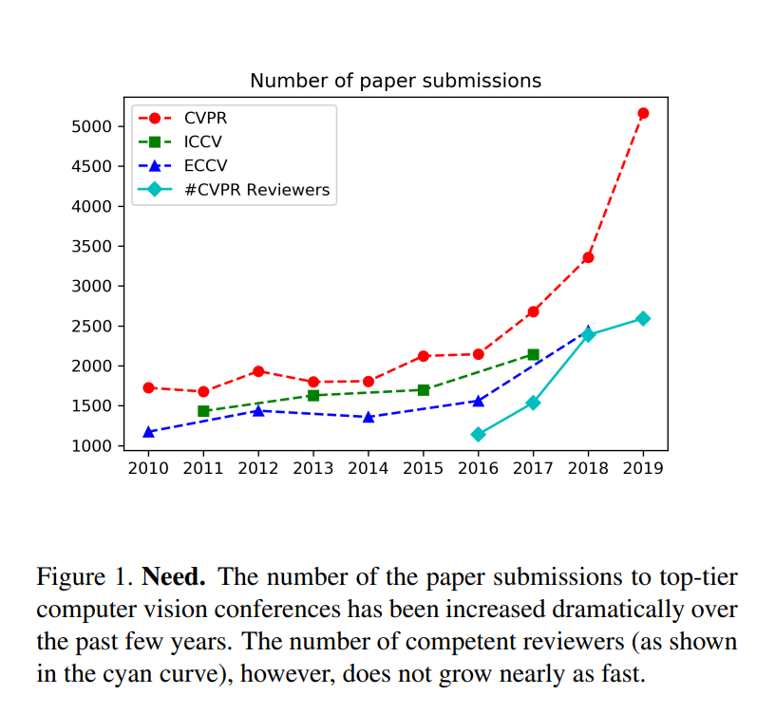

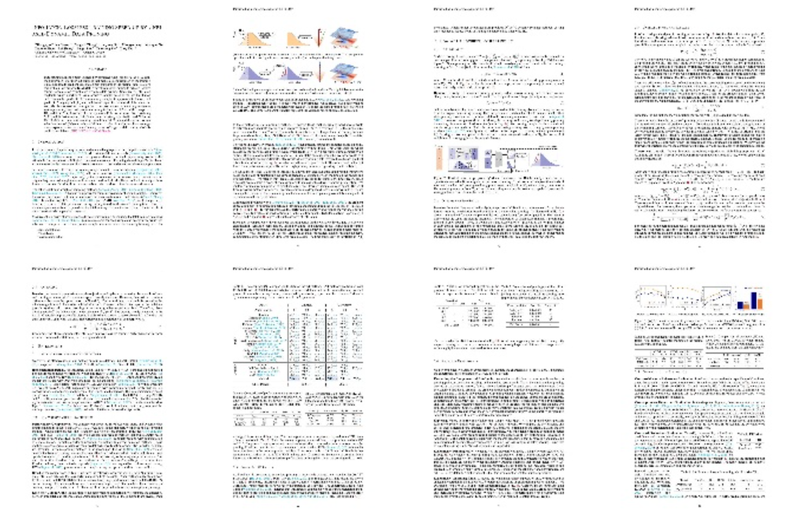
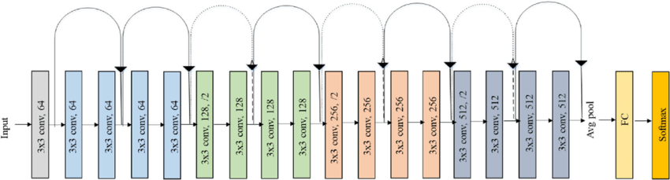
Deep Paper Gestalt: Key Concept and Pipeline
preprocessing
8 Page
CNN(ResNet-18) Model
Accepted
Rejected

Slide 4
Resnet

Slide 5
Resnet-18 Architecture

