Slide 1
Control for Multicycle Approach

Slide 2
Simple Questions
How many cycles will it take to execute this code? lw $t2, 0($t3) lw $t3, 4($t3) beq $t2, $t3, Label #assume not taken add $t5, $t2, $t3 sw $t5, 8($t3) Label: ...
What is going on during the 8th cycle of execution?
In what cycle does the actual addition of $t2 and $t3 takes place?

Slide 3
Implementing the Control
Value of control signals is dependent upon:
what instruction is being executed
which step is being performed
Use the information we’ve accumulated to specify a finite state machine
specify the finite state machine graphically, or
use microprogramming
Implementation can be derived from specification

Slide 4
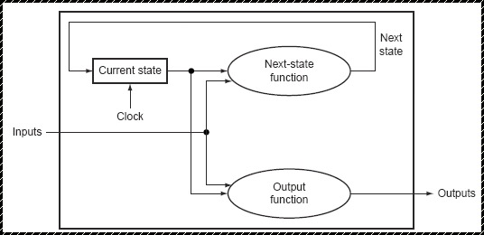
Review: finite state machines
Finite state machines:
sets of states, inputs, outputs and
next state function :
next state = f (current state, input)
output function
output = f (current state, {input})
We’ll use a Moore machine (output based only on current state)

Slide 5
FSM example
Define a Finite State Machine which output 0 if the input is 0, and output 1 if the input is 1.
Set of input = {0,1}
Set of output = {0,1}
Set of state = {0,1,2,….?}
Output f current stats | output 0번 state 1번 state
0 0 0
1 1
C.S in | N.S 1
0 0 0
0 1 1
0 0
1 1 1
0
1

Slide 6
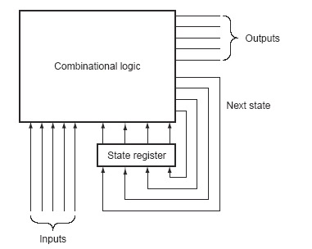
Implementing a FSM

Slide 7
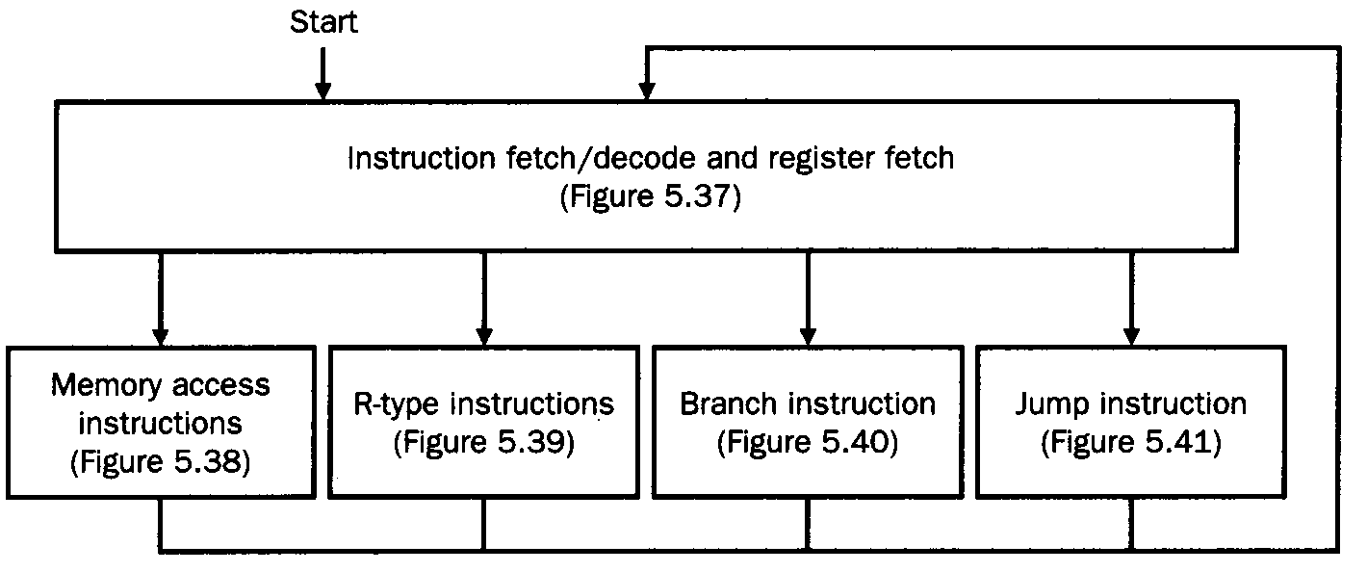
The high level view of the FSM control

Slide 8
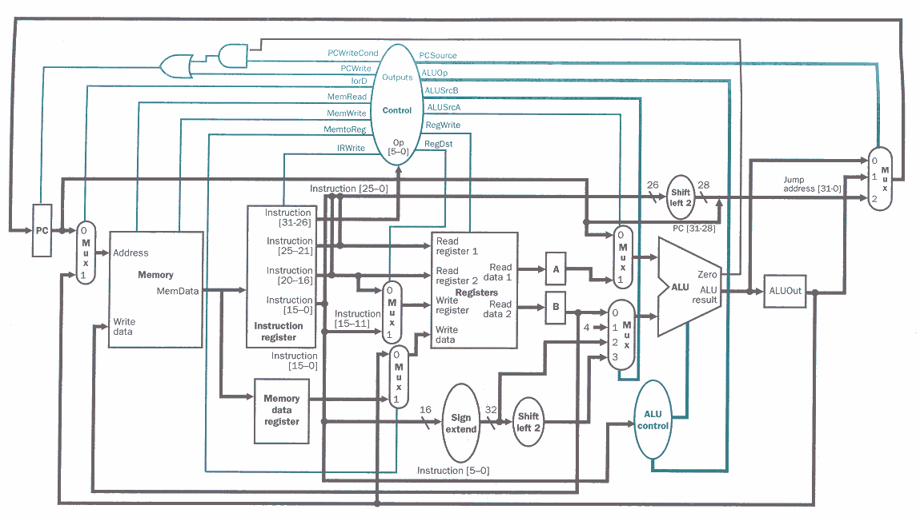
The multicycle datapath

Slide 9
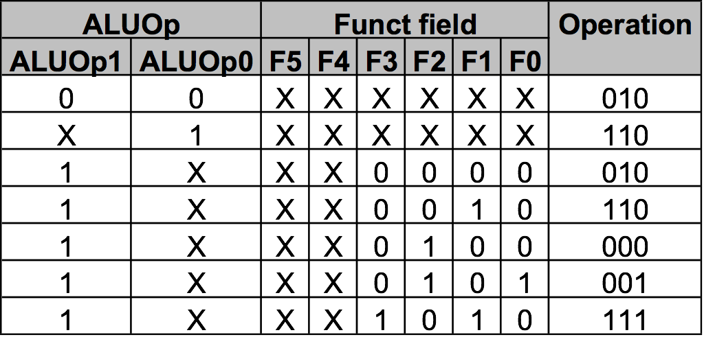
ALU Control
Must describe hardware to compute 3-bit ALU control input
given instruction type 00 = lw, sw 01 = beq, 10 = arithmetic
function code for arithmetic
Describe it using a truth table (can turn into gates):
ALUOp
computed from instruction type

Slide 10
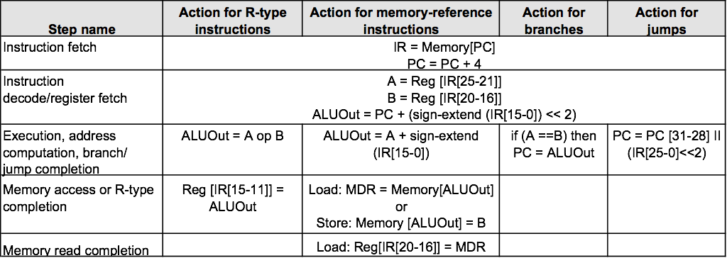
Instruction Execution Steps

Slide 11
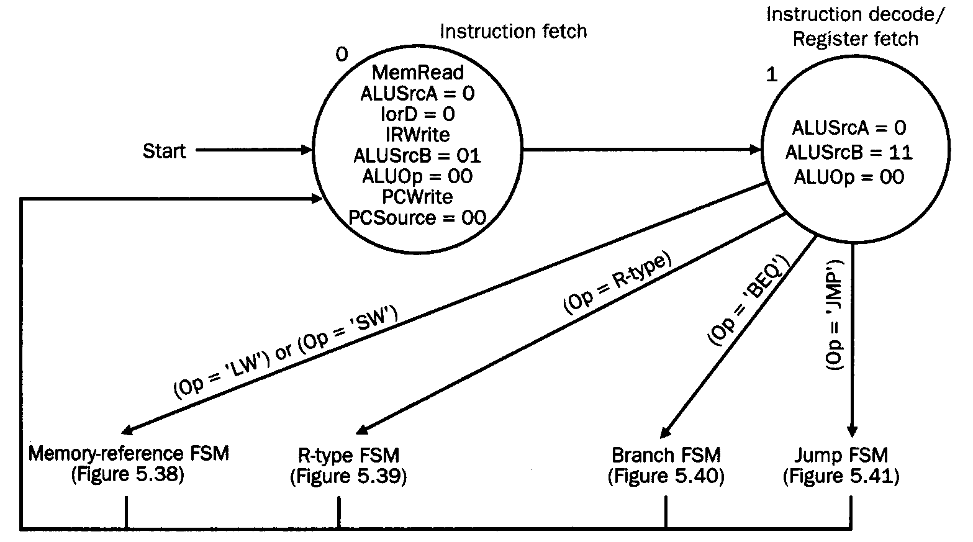
Figure 5.37 IF and ID

Slide 12
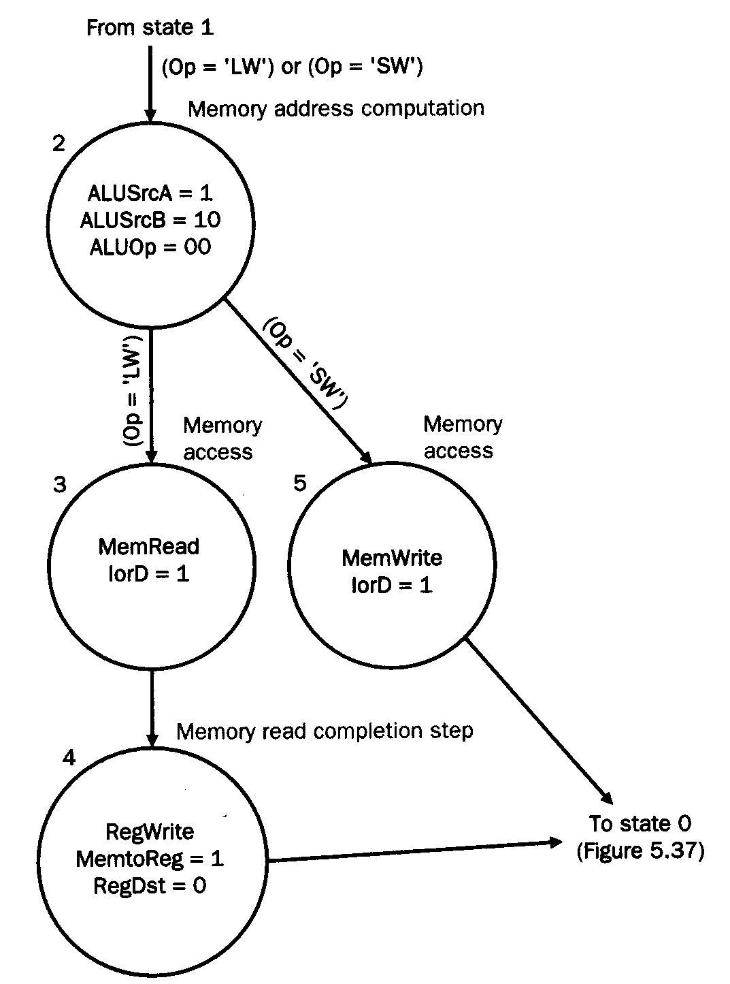
Figure 5.38 Memory-reference instruction

Slide 13
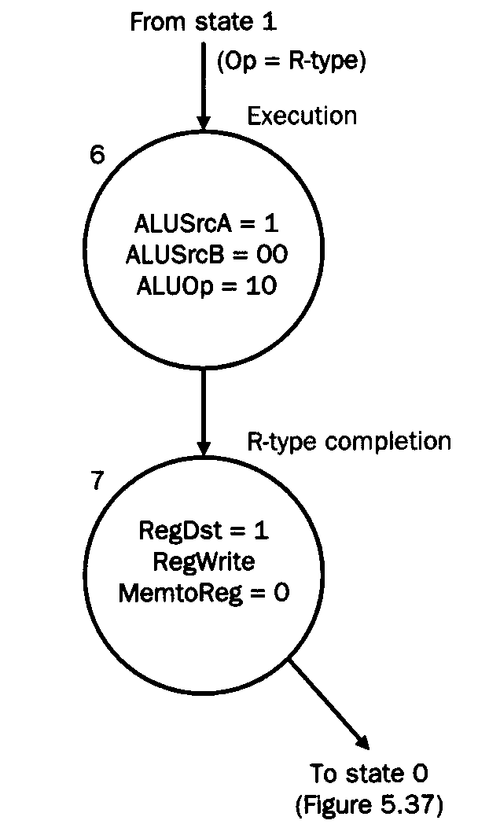
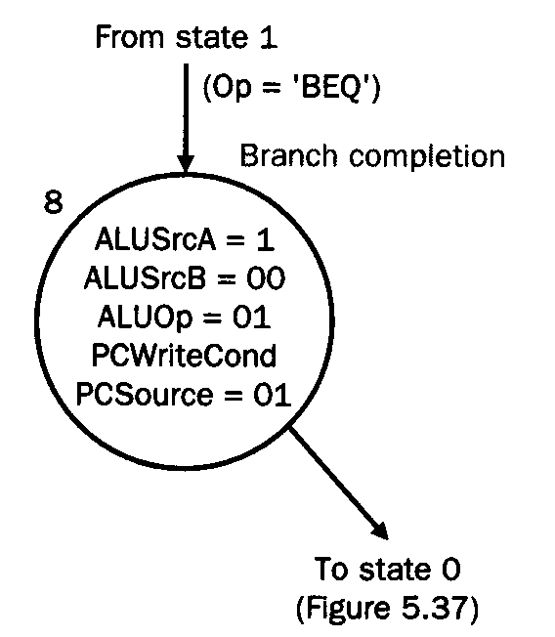
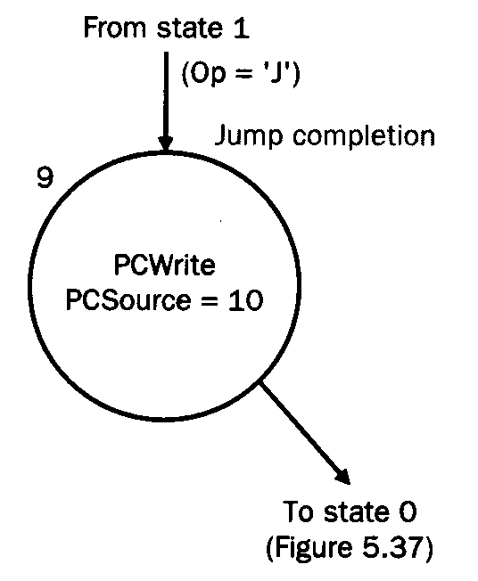
Figure 5.39,40,41 Other Instructions
R-type instructions
Branch instruction
Jump instruction

Slide 14
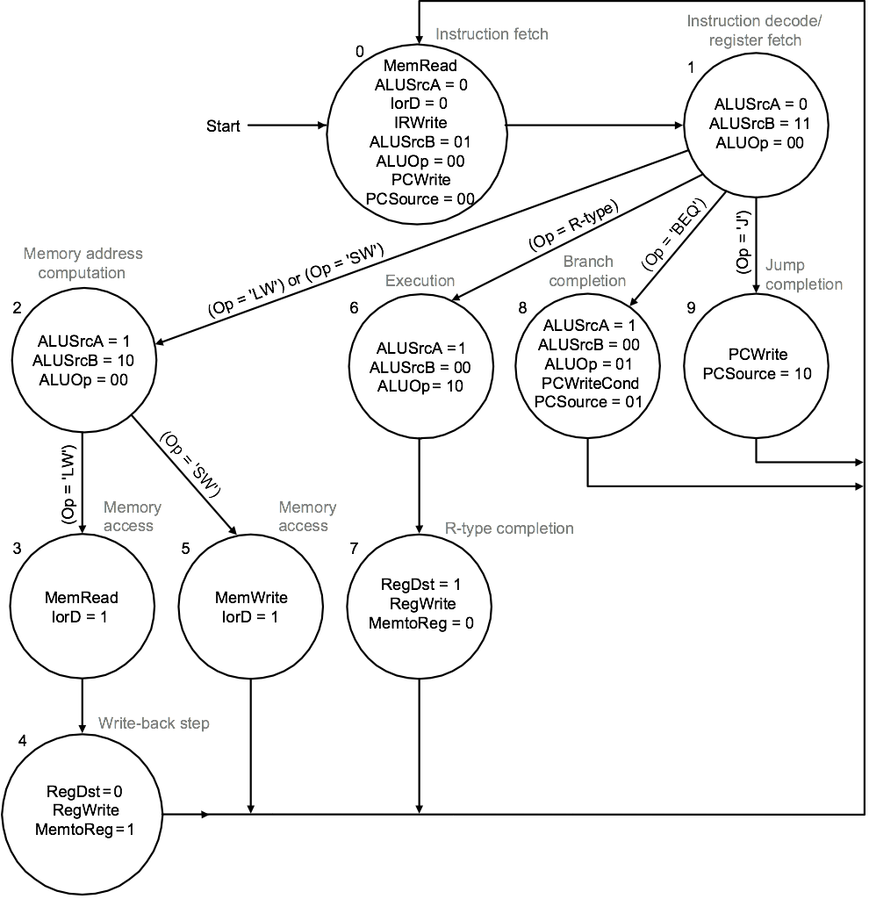
Graphical Specification of FSM

Slide 15
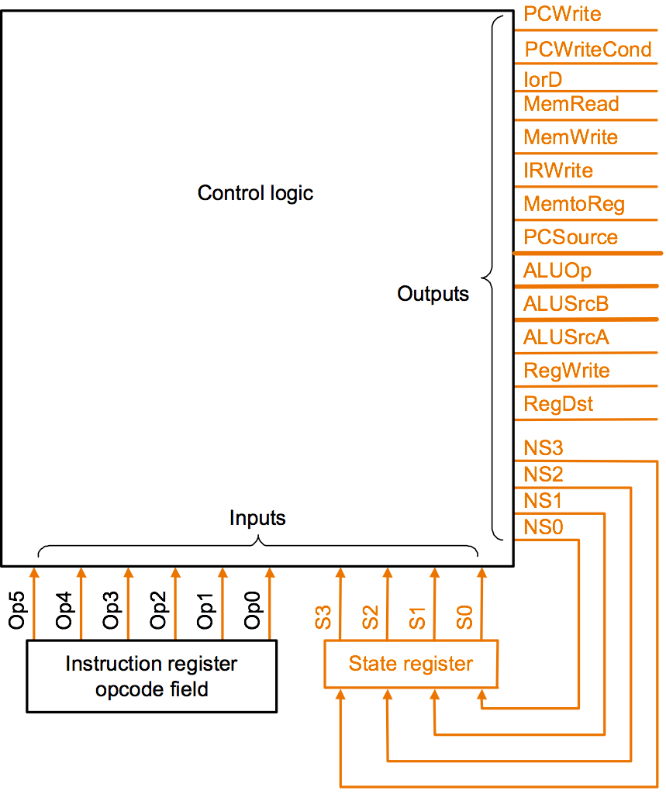
Finite State Machine for Control
Implementation:
Combinational logic

Slide 16
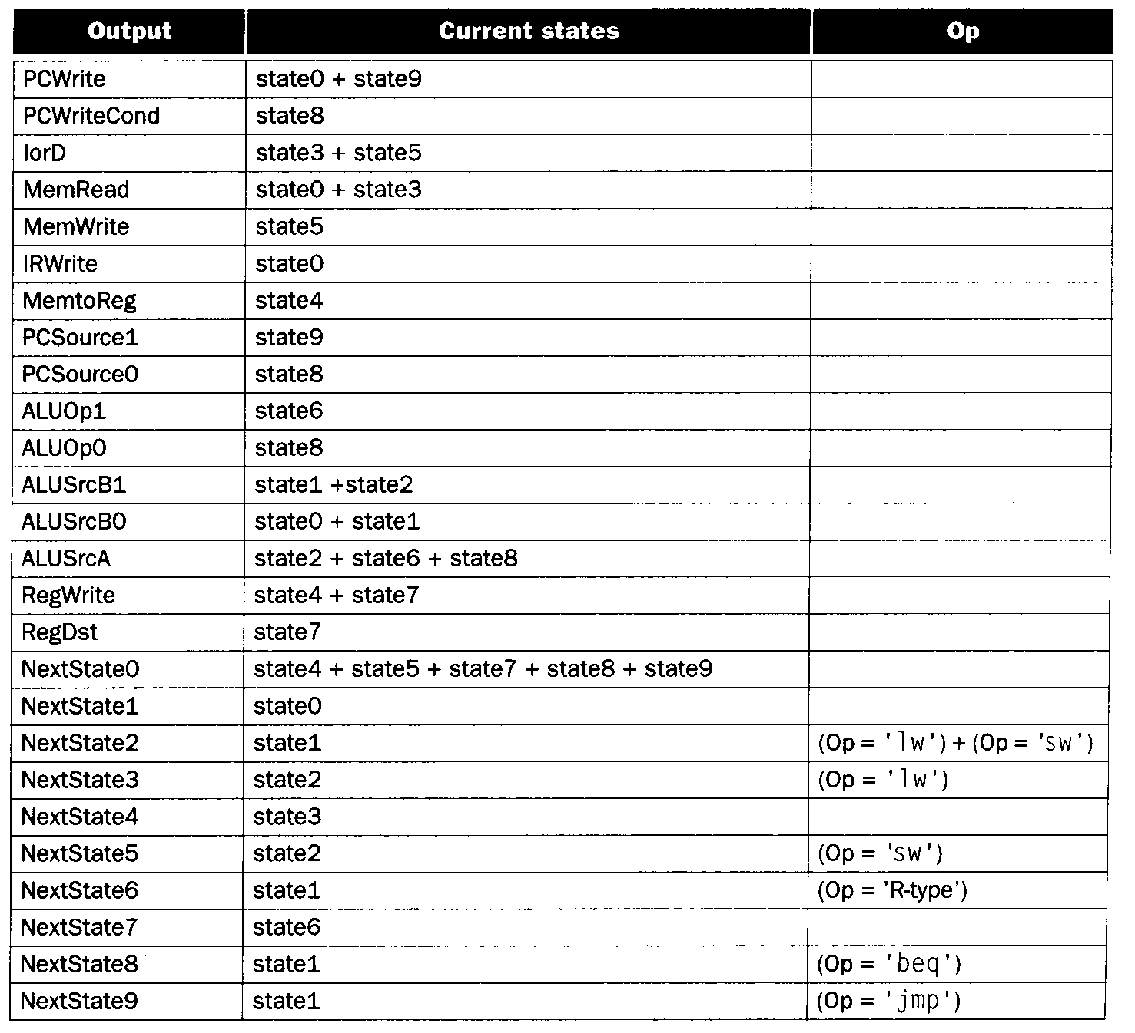
Output Table (next state function + output function)

Slide 17
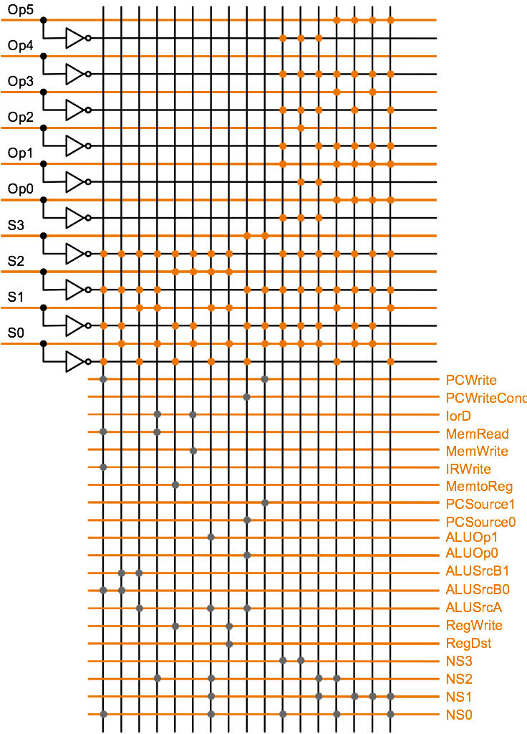
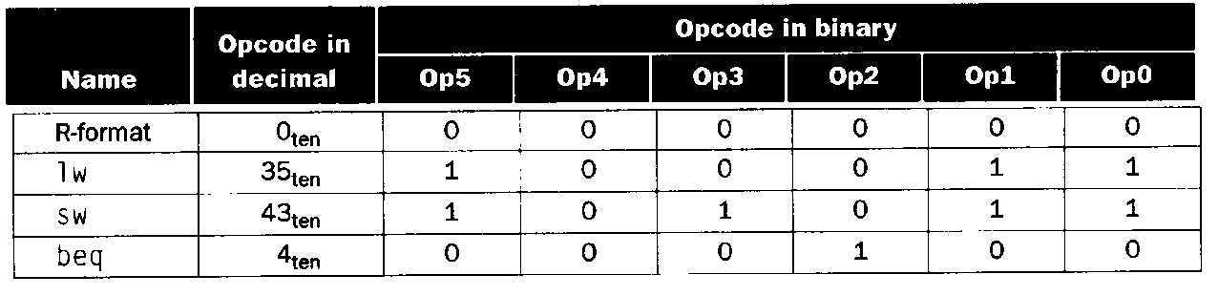
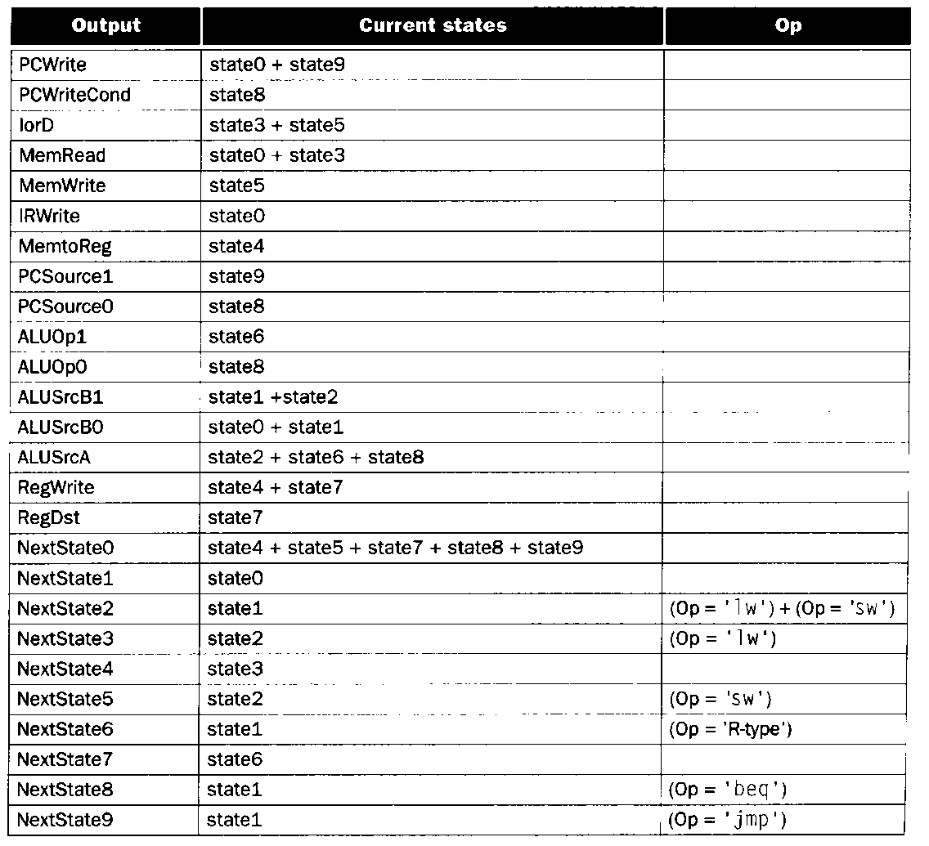
PLA Implementation for control logic

Slide 18
Summary
If we understand the instructions… We can build a simple processor!
If instructions take different amounts of time, multi-cycle is better
Datapath implemented using:
Combinational logic for arithmetic
State holding elements to remember bits
Control implemented using:
Combinational logic for single-cycle implementation
Finite state machine for multi-cycle implementation

