Slide 1
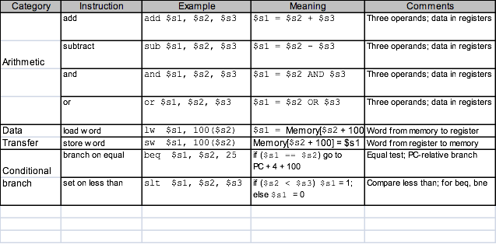
HW4-Design Project 2 (submission due: 11/14)
Using register files & registers, memories, ALUs, adders and multiplexors, design a multicycle datapath of a processor that can perform the following MIPS instructions : add,sub,and,or,slt,beq,lw,sw,j instructions.
2. Draw a (psuedo) truth table for a control logic for datapath designed in problem 1 and design the corresponding logic using a PLA and registers.

Slide 2
For 4~6, combine logics in problem 1 and 2, and make 12 copies of it.
3. In the logic diagram of problem 2, describe each vertical wire in terms of its role.
4. Represent “add $4, $2, $3” instruction in binary number. When this instruction is executed, show the input and output values of control as 0 or 1 on the logic drawn in problems 1 and 2 for each cycle. In addition, highlight the path that data travels as a result of the given control signals. You will need to use 4 copies of the circuit diagram.
5. Repeat problem 3 for an instruction “lw $2, 8($3)”.
You will need to use 5 copies of the circuit diagram.
6. Repeat problem 3 for an instruction “beq $2, $3, 8”.
You will need to use 3 copies of the circuit diagram.

Slide 3
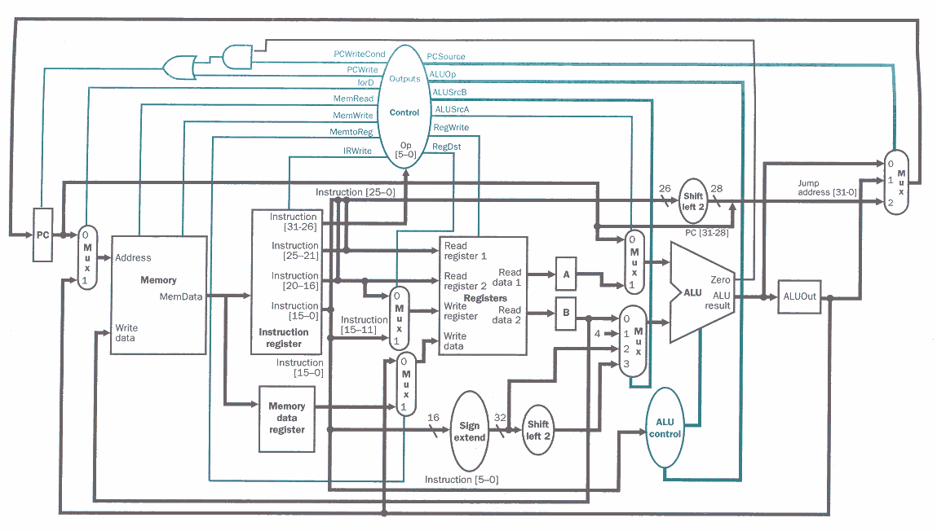
1-1

Slide 4
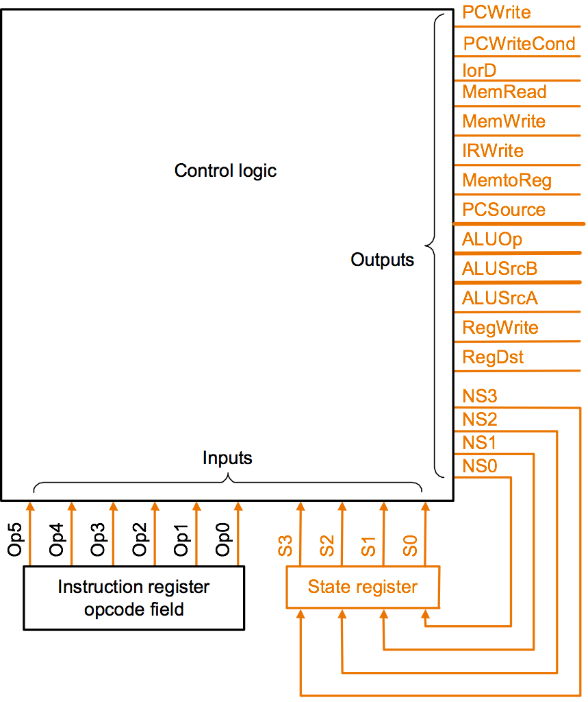
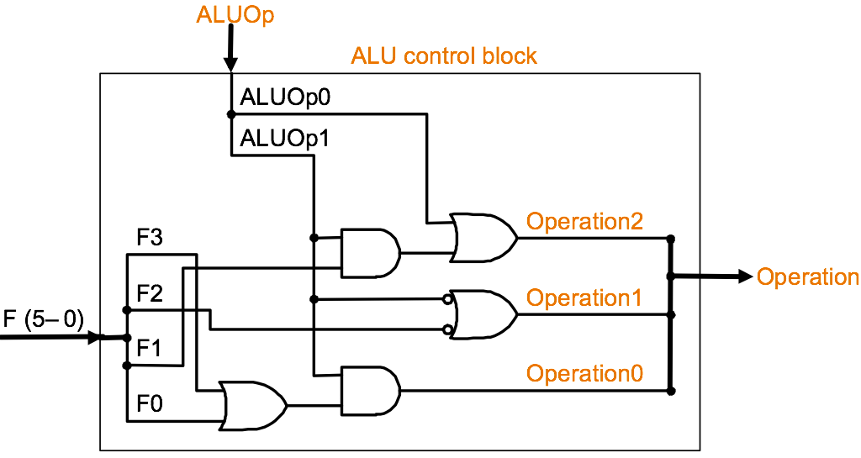
1-2

Slide 5
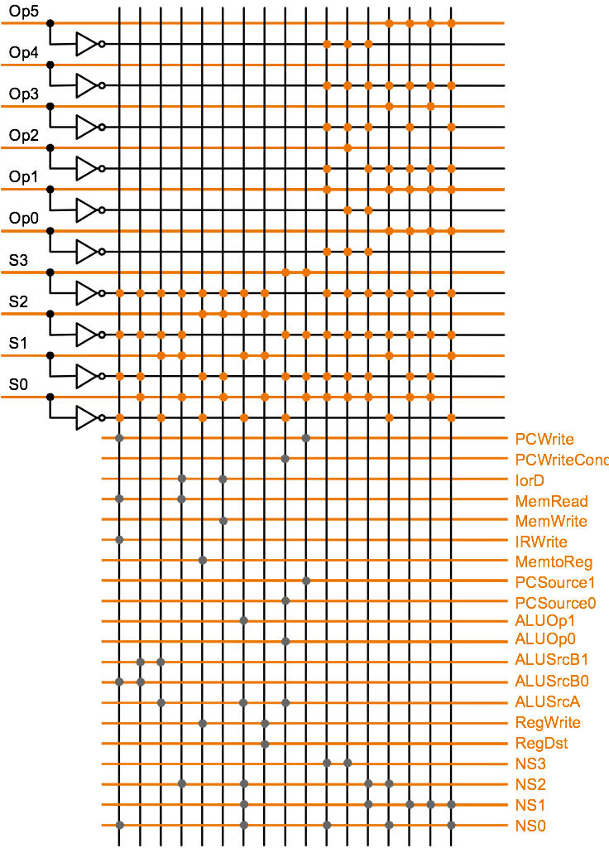
2-1

Slide 6
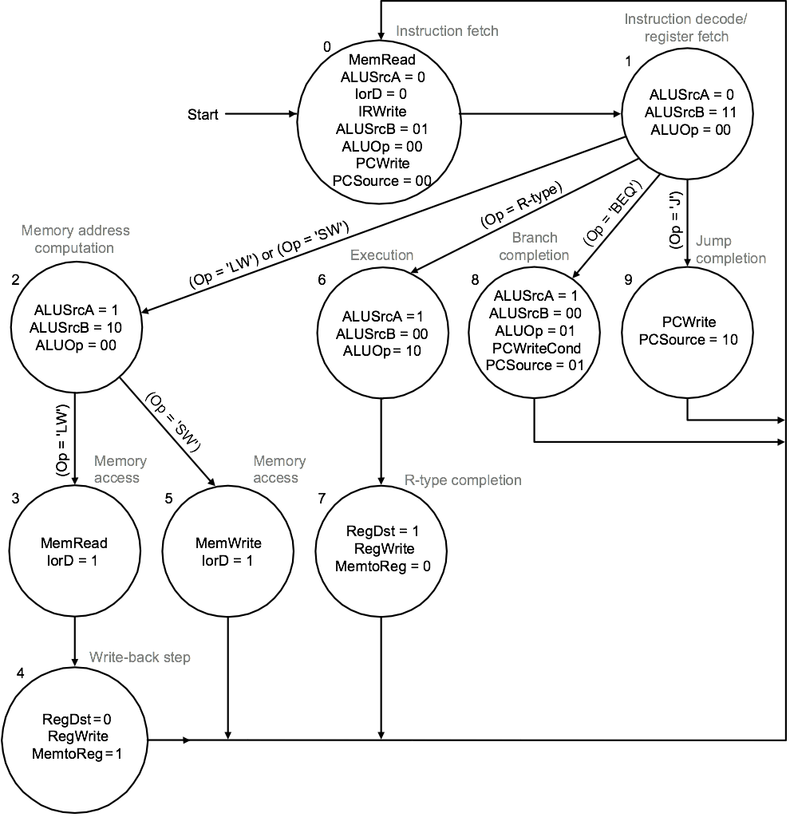
2-2

