Slide 1
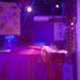
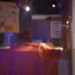


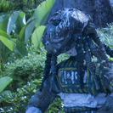
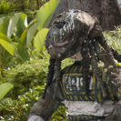


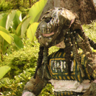
…
128×128×24
…
64×64×48
16×16×192
8×8×192
…
…
16×16×192
8×8×384
8×8×384
32×32×48
16×16×192
16×16×384
Training patches
64×64×24
64×64×48
Encoder
Auto WB
decoder
64×64×48
64×64×96
White-balanced patches
128×128×24
128×128×48
128×128×3
128×128×24
Output of 3×3 convolutional layers with stride 1 and padding 1
…
…
Output of ReLU layers
128×128×24
128×128×24
…
Output of 2×2 max-pooling layers with stride 2
64×64×48
Output of 2×2 transposed convolutional layers with stride 2
16×16×384
16×16×192
8×8×384
…
Output of depth concatenation layers
Output of 1×1 convolutional layer with stride 1 and padding 1
16×16×192
Skip connections*
Shade WB
decoder
64×64×96
64×64×48
Patches with shade WB
*Skip connections for the shade WB decoder not shown to aid visualization.
128×128×48
128×128×3

