Slide 1







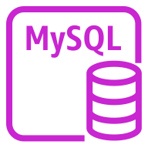
AWS Cloud
Virtual private cloud (VPC)
Internet gateway
ap-northeast-2a
ap-northeast-2c
Public subnet
Public subnet
EC2
Application Load Balancer
ap-northeast-2b
ap-northeast-2d
Private subnet
Private subnet
DB subnet group
MySQL
instance

