Slide 1

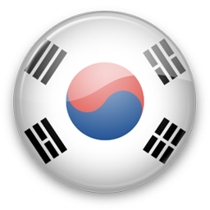

#1분 한국어공부 #1minkorean
The more you learn,
The more you can hear ☺

Slide 2
#1분 한국어공부 #1minkorean
1min Korean
Vocab
And
expressions
Day #
The more you learn,
The more you can hear ☺

Slide 3
#1분 한국어공부 #1minkorean
올림픽
Olympic
The more you learn,
The more you can hear ☺

Slide 4
#1분 한국어공부 #1minkorean
핑퐁으로 알려진 탁구는 천구백팔십팔년 이래 올림픽 종목이었습니다
Table tenis, also known as ping pong, has been an olympic sport since 1988
The more you learn,
The more you can hear ☺

Slide 5

#1분 한국어공부 #1minkorean
Subscribe for
more
Korean
Learning!
And master Korean!
The more you learn,
The more you can hear ☺

