Slide 1

Products – SOFTWARE – Aduino IDE

Slide 2
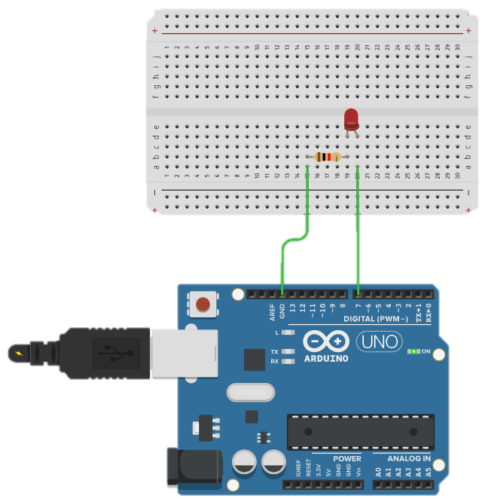
아두이노 LED 제어하기
void setup(){
pinMode(7, OUTPUT);
}
void loop() {
digitalWrite(7, HIGH);
delay(1000);
digitalWrite(7, LOW);
delay(1000);
}

Slide 3
전송 데이터에 따라 LED 켜고 끄기
void setup(){
Serial.begin(9600);
}
void loop() {
Serial.println(“Hello”);
delay(1000);
}
void setup(){
Serial.begin(9600);
pinMode(7, OUTPUT);
}
void loop() {
if( Serial.available() > 0)
{
char sData = Serial.read();
if(sData == 'a')
{
digitalWrite(7, HIGH);
}
else if(sData == 'b')
{
digitalWrite(7, HIGH);
}
}
}

Slide 4
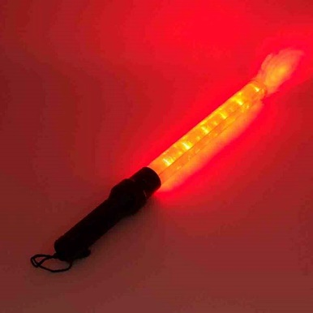
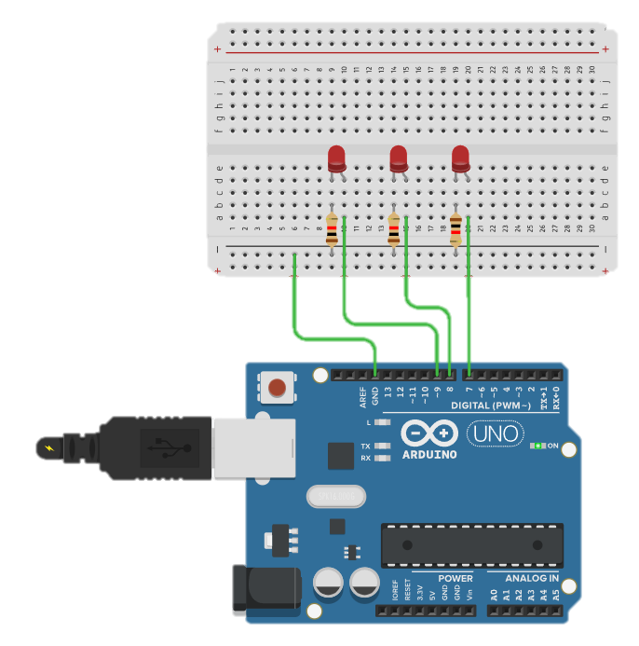
위험을 알리는 경광등 만들기
#define LED1 9
#define LED2 8
#define LED3 7
void setup(){
pinMode(LED1, OUTPUT);
pinMode(LED2, OUTPUT);
pinMode(LED3, OUTPUT);
}
void loop() {
digitalWrite(LED1, HIGH);
digitalWrite(LED2, HIGH);
digitalWrite(LED3, HIGH);
delay(1000);
digitalWrite(LED1, LOW);
digitalWrite(LED2, LOW);
digitalWrite(LED3, LOW);
delay(1000);
}

Slide 5
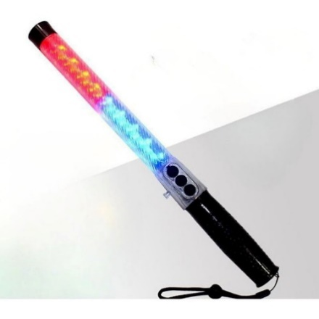
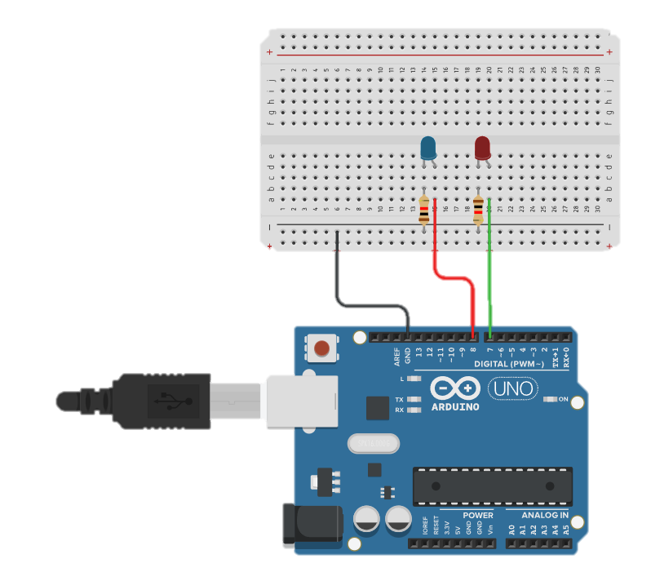
경찰차에 표시하는 경광등 만들기
#define LED_BLUE 8
#define LED_RED 7
#define DELAY_TIME 80
void setup(){
pinMode(LED_BLUE, OUTPUT);
pinMode(LED_RED, OUTPUT);
}
void loop() {
digitalWrite(LED_BLUE, HIGH);
digitalWrite(LED_RED, LOW);
delay(DELAY_TIME);
digitalWrite(LED_RED, HIGH);
digitalWrite(LED_BLUE, LOW);
delay(DELAY_TIME);
}

Slide 6
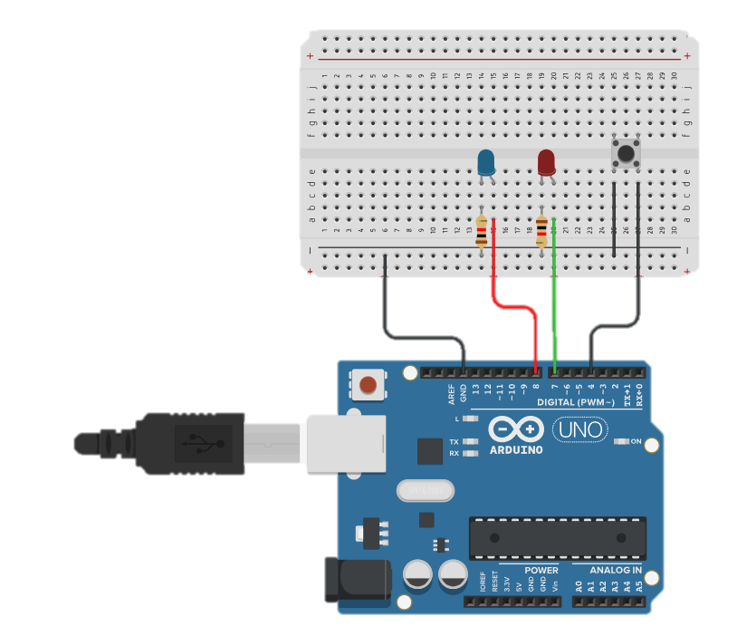
경찰차에 표시하는 경광등 만들기
#define BUTTON 4
void setup() {
Serial.begin(9600);
pinMode(BUTTON, INPUT_PULLUP);
}
void loop() {
int buttonValue=digitalRead(BUTTON);
Serial.println (buttonValue);
delay(100);
}

Slide 7
경찰차에 표시하는 경광등 만들기
#define BUTTON 4
#define LED_BLUE 8
#define LED_RED 7
#define DELAY_TIME 80
int state = 0;
void setup() {
Serial.begin(9600);
pinMode(BUTTON, INPUT_PULLUP);
pinMode(LED_BLUE, OUTPUT);
pinMode(LED_RED, OUTPUT);
}
void loop() {
int buttonValue = !digitalRead(BUTTON);
if(buttonValue == 1) {
state = !state;
delay(500);
}
if(state == 0){
digitalWrite(LED_BLUE, HIGH);
digitalWrite(LED_RED, LOW);
delay(DELAY_TIME);
digitalWrite(LED_RED, HIGH);
digitalWrite(LED_BLUE, LOW);
delay(DELAY_TIME);
}
else if(state == 1) {
digitalWrite(LED_BLUE, LOW);
digitalWrite(LED_RED, LOW);
}
}

Slide 8
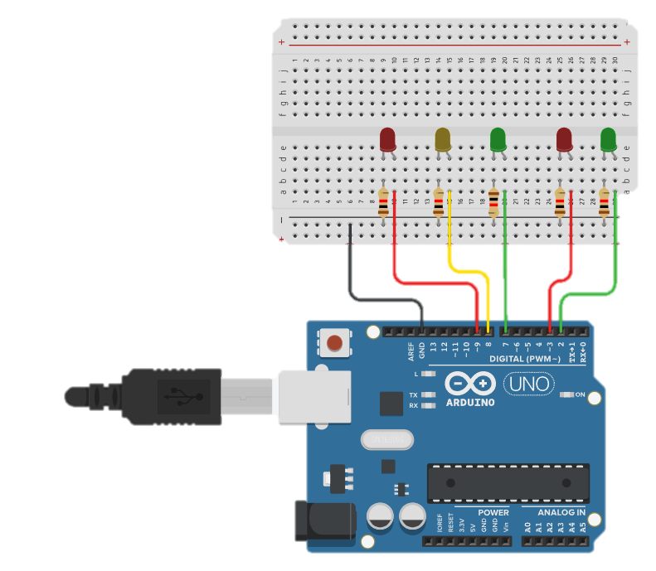
LED를 이용한 신호등 구현
#define CAR_LED_RED 9
#define CAR_LED_YELLOW 8
#define CAR_LED_GREEN 7
#define HUMAN_LED_RED 3
#define HUMAN_LED_GREEN 2
void setup() {
pinMode(CAR_LED_RED, OUTPUT);
pinMode(CAR_LED_YELLOW, OUTPUT);
pinMode(CAR_LED_GREEN, OUTPUT);
pinMode(HUMAN_LED_RED, OUTPUT);
pinMode(HUMAN_LED_GREEN, OUTPUT);
}
void loop() {
digitalWrite(CAR_LED_RED, LOW);
digitalWrite(CAR_LED_YELLOW, LOW);
digitalWrite(CAR_LED_GREEN, HIGH);
digitalWrite(HUMAN_LED_RED, HIGH);
digitalWrite(HUMAN_LED_GREEN, LOW);
delay(5000);
digitalWrite(CAR_LED_RED, LOW);
digitalWrite(CAR_LED_YELLOW, HIGH);
digitalWrite(CAR_LED_GREEN, LOW);
digitalWrite(HUMAN_LED_RED, HIGH);
digitalWrite(HUMAN_LED_GREEN, LOW);
delay(5000);
digitalWrite(CAR_LED_RED, HIGH);
digitalWrite(CAR_LED_YELLOW, LOW);
digitalWrite(CAR_LED_GREEN, LOW);
digitalWrite(HUMAN_LED_RED, LOW);
digitalWrite(HUMAN_LED_GREEN, HIGH);
delay(2000);
digitalWrite(HUMAN_LED_GREEN, LOW);
delay(500);
digitalWrite(HUMAN_LED_GREEN, HIGH);
delay(500);
digitalWrite(HUMAN_LED_GREEN, LOW);
delay(500);
digitalWrite(HUMAN_LED_GREEN, HIGH);
delay(500);
digitalWrite(HUMAN_LED_GREEN, LOW);
delay(500);
digitalWrite(HUMAN_LED_GREEN, HIGH);
delay(500);
}

Slide 9
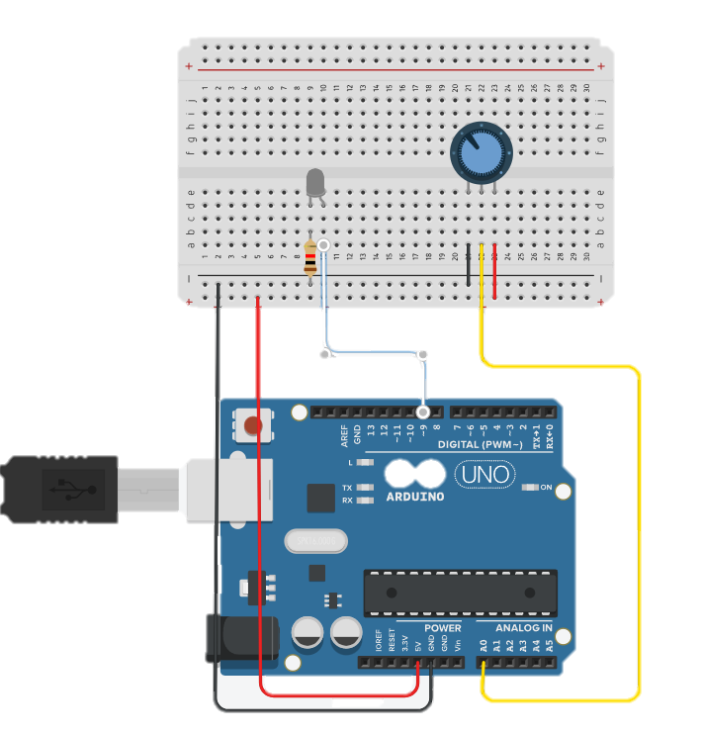
LED 스탠드 만들기 1_가변저항 사용
#define LED 9
#define VR A0
void setup(){
Serial.begin(9600);
}
void loop(){
Serial.println(analogRead(VR));
delay(500);
}
#define LED 9
#define VR A0
void setup(){
Serial.begin(9600);
}
void loop(){
analogWrite(LED, 0);
delay(500);
analogWrite(LED, 50);
delay(500);
analogWrite(LED, 150);
delay(500);
analogWrite(LED, 255);
delay(500);
}
#define LED 9
#define VR A0
void setup(){
Serial.begin(9600);
}
void loop(){
int analogValue = analogRead(VR);
int analogMapping = map(analogValue, 0, 1023, 0, 255);
analogWrite(LED, analogMapping);
}

Slide 10
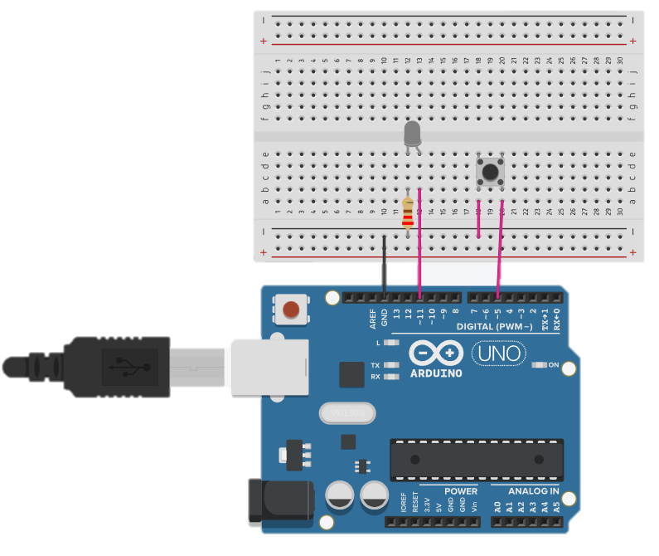
LED 스탠드 만들기 2
#define SW_PIN 5
void setup() {
Serial.begin(9600);
pinMode(SW_PIN, INPUT_PULLUP);
}
void loop() {
int swValue = digitalRead(SW_PIN);
Serial.prntln(swValue);
}
#define SW_PIN 5
#define LED_PIN 11
int newSwValue = 1;
int oldSwValue = 1;
int cnt = 0;
void setup() {
Serial.begin(9600);
pinMode(SW_PIN, INPUT_PULLUP);
}
void loop() {
newSwValue = digitalRead(SW_PIN);
if(newSwValue != oldSwValue) {
oldSwValue = newSwValue;
if(newSwValue == 0) {
cnt++;
if(cnt >= 4) cnt = 0;
Serial.println(newSwValue);
}
delay(200);
}
if(cnt == 0) analogWrite(LED_PIN, 0);
else if(cnt == 1) analogWrite(LED_PIN, 50);
else if(cnt == 2) analogWrite(LED_PIN, 150);
else if(cnt == 3) analogWrite(LED_PIN, 255);
}
#define SW_PIN 5
int newSwValue = 1;
int oldSwValue = 1;
void setup() {
Serial.begin(9600);
pinMode(SW_PIN, INPUT_PULLUP);
}
void loop() {
newSwValue = digitalRead(SW_PIN);
if(newSwValue != oldSwValue) {
oldSwValue = newSwValue;
Serial.println(newSwValue);
}
}

Slide 11
Reference
만들면서 배우는 아두이노와 40개의 작품들. 장문철, 앤써북

