Slide 1

Sensor

Slide 2
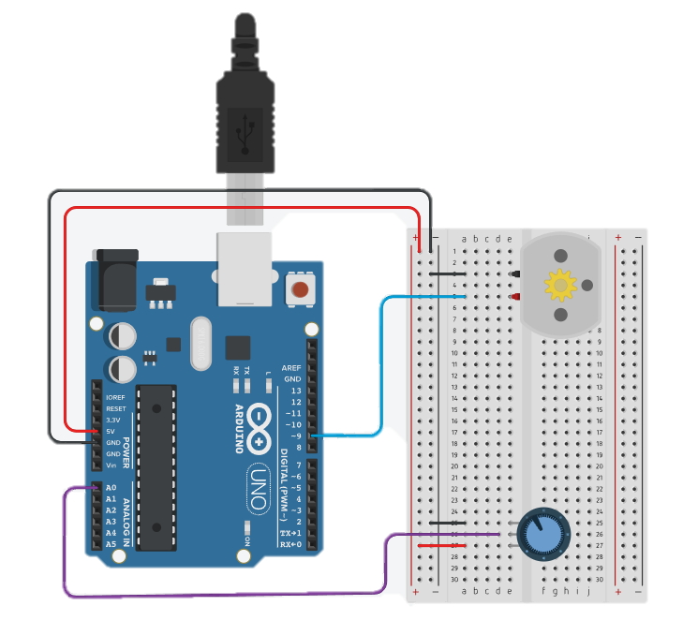
DC Motor
void setup()
{
pinMode(9, OUTPUT);
}
void loop()
{
Serial.begin(9600);
int inputValue = analogRead(A0);
Serial.println(inputValue);
int convertedValue = map(inputValue, 0, 1023, 0, 255);
analogWrite(9, convertedValue);
delay(100);
}

Slide 3
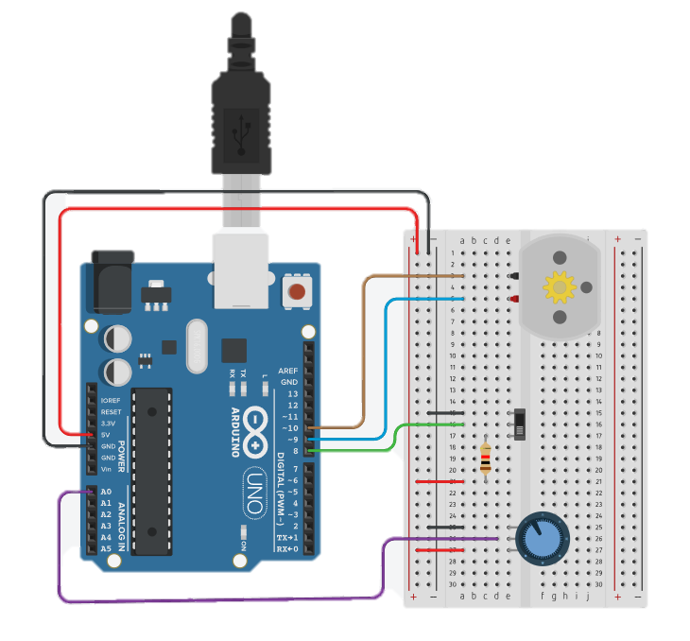
DC Motor
void setup()
{
pinMode(9, OUTPUT);
pinMode(10, OUTPUT);
pinMode(8, INPUT);
}
void loop()
{
int inputValue = analogRead(A0);
Serial.println(inputValue);
int convertedValue = map(inputValue, 0, 1023, 0, 255);
int inputSwitch = digitalRead(8);
if(inputSwitch == LOW) {
analogWrite(9, convertedValue);
analogWrite(10, 0);
}
else {
analogWrite(9, 0);
analogWrite(10, convertedValue);
}
delay(100);
}

Slide 4
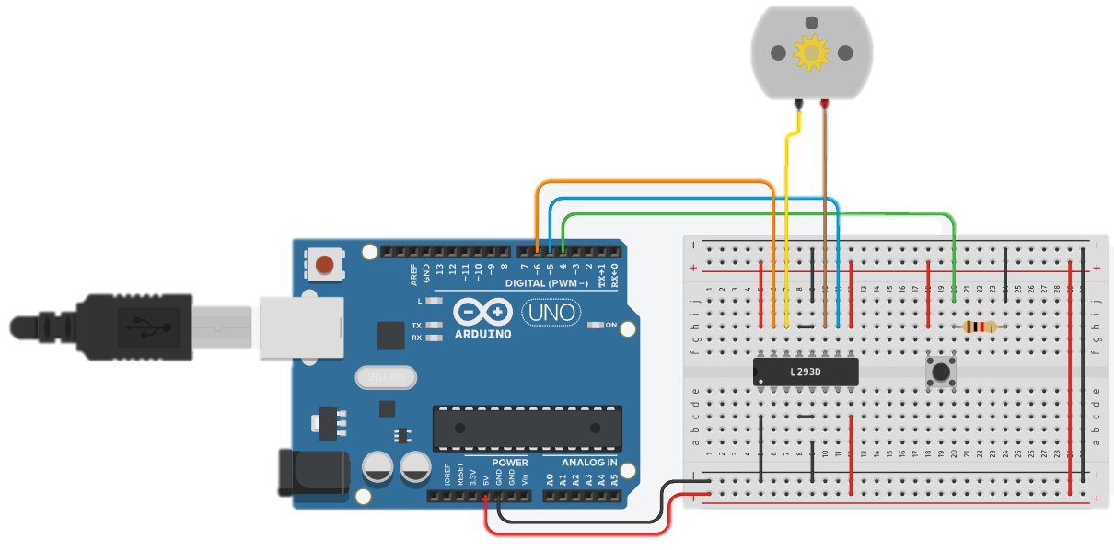
DC Motor
const int MOTOR_PIN_A = 5;
const int MOTOR_PIN_B = 6;
void setup()
{
pinMode(MOTOR_PIN_A, OUTPUT);
pinMode(MOTOR_PIN_B, OUTPUT);
}
void loop()
{
int readValue = digitalRead(4);
if(readValue == LOW) {
analogWrite(MOTOR_PIN_A, 255);
analogWrite(MOTOR_PIN_B, 0);
}
else {
analogWrite(MOTOR_PIN_A, 0);
analogWrite(MOTOR_PIN_B, 255);
}
delay(100);
}

Slide 5
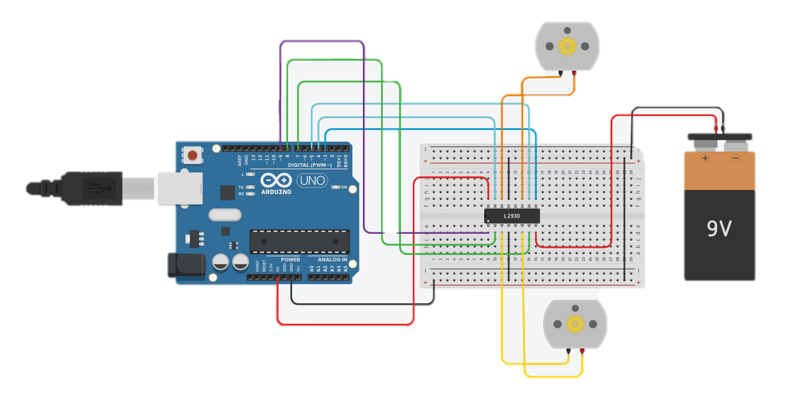
DC Motor

Slide 6
DC Motor
// Motor A connections
int enA = 9;
int in1 = 8;
int in2 = 7;
// Motor B connections
int enB = 3;
int in3 = 5;
int in4 = 4;
void setup() {
// Set all the motor control pins to outputs
pinMode(enA, OUTPUT);
pinMode(enB, OUTPUT);
pinMode(in1, OUTPUT);
pinMode(in2, OUTPUT);
pinMode(in3, OUTPUT);
pinMode(in4, OUTPUT);
// Turn off motors - Initial state
digitalWrite(in1, LOW);
digitalWrite(in2, LOW);
digitalWrite(in3, LOW);
digitalWrite(in4, LOW);
}
void loop() {
directionControl();
delay(1000);
speedControl();
delay(1000);
}
// This function lets you control spinning direction of motors
void directionControl() {
// Set motors to maximum speed
// For PWM maximum possible values are 0 to 255
analogWrite(enA, 255);
analogWrite(enB, 255);
// Turn on motor A & B
digitalWrite(in1, HIGH);
digitalWrite(in2, LOW);
digitalWrite(in3, HIGH);
digitalWrite(in4, LOW);
delay(2000);
// Now change motor directions
digitalWrite(in1, LOW);
digitalWrite(in2, HIGH);
digitalWrite(in3, LOW);
digitalWrite(in4, HIGH);
delay(2000);
// Turn off motors
digitalWrite(in1, LOW);
digitalWrite(in2, LOW);
digitalWrite(in3, LOW);
digitalWrite(in4, LOW);
}
// This function lets you control speed of the motors
void speedControl() {
// Turn on motors
digitalWrite(in1, LOW);
digitalWrite(in2, HIGH);
digitalWrite(in3, LOW);
digitalWrite(in4, HIGH);
// Accelerate from zero to maximum speed
for (int i = 0; i < 256; i++) {
analogWrite(enA, i);
analogWrite(enB, i);
delay(20);
}
// Decelerate from maximum speed to zero
for (int i = 255; i >= 0; --i) {
analogWrite(enA, i);
analogWrite(enB, i);
delay(20);
}
// Now turn off motors
digitalWrite(in1, LOW);
digitalWrite(in2, LOW);
digitalWrite(in3, LOW);
digitalWrite(in4, LOW);
}

Slide 7
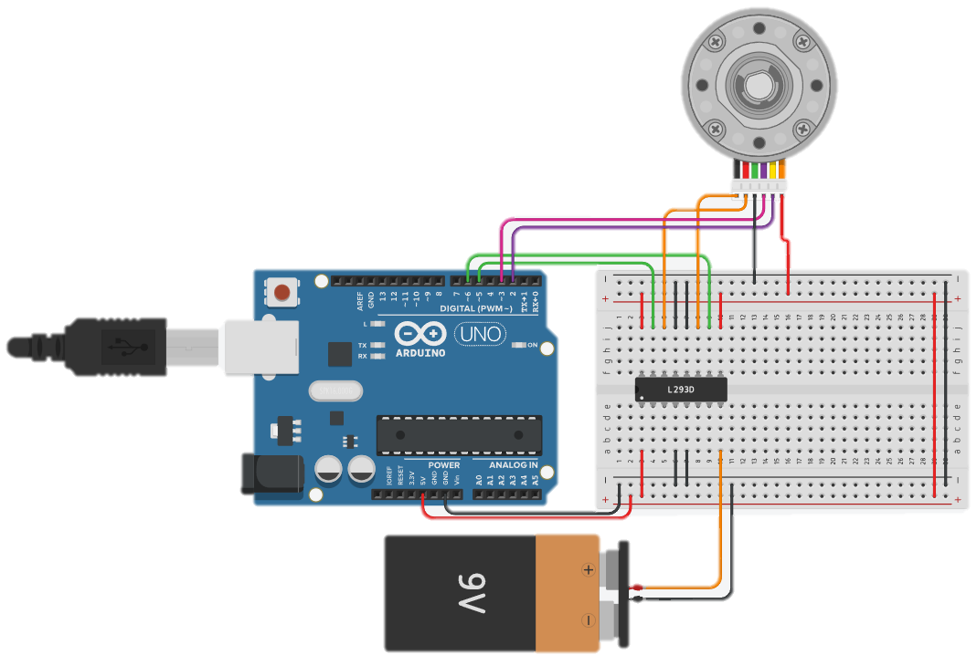
DC Motor With Encoder
#include <Encoder.h>
//use the Encoder library
Encoder encoder(2,3);
//create the encoder (always use pins 2 and 3 on UNO)
long position = 0;
//current motor position (10 steps per revolution)
int rotation = 0;
//current number of revolutions from 0 point
void setup()
{
Serial.begin(9600);
pinMode(5, OUTPUT);
pinMode(6, OUTPUT);
}
void loop()
{
//spin the motor
analogWrite(5, 30);
analogWrite(6,0);
//get the current encoder position
position = encoder.read() / 10;
//calculate the number of complete rotations
rotation = abs(position) / 10;
//print results
Serial.print("pos: ");
Serial.println(position);
Serial.print("rot: ");
Serial.println(rotation);
}

Slide 8
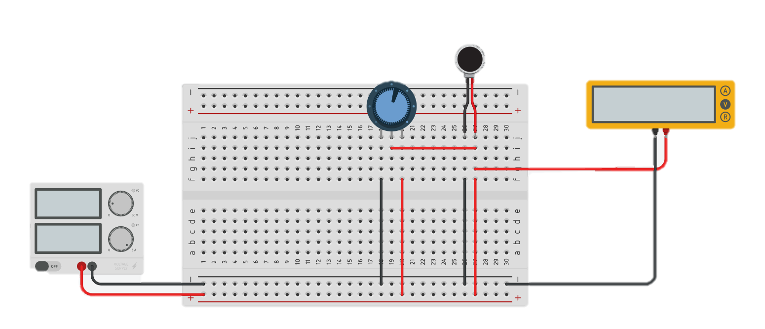
Vibrator Motor

Slide 9
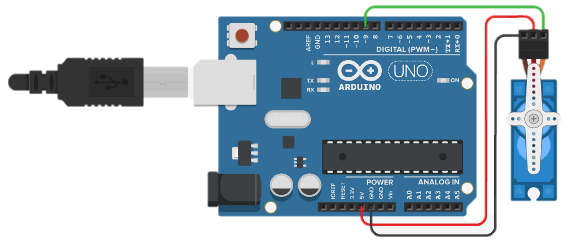
Micro Servo
/*
Sweep
by BARRAGAN <http://barraganstudio.com>
This example code is in the public domain.
modified 8 Nov 2013 by Scott Fitzgerald
http://www.arduino.cc/en/Tutorial/Sweep
*/
#include <Servo.h>
int pos = 0;
Servo servo_9;
void setup()
{
servo_9.attach(9, 500, 2500);
}
void loop()
{
// sweep the servo from 0 to 180 degrees in steps
// of 1 degrees
for (pos = 0; pos <= 180; pos += 1) {
// tell servo to go to position in variable 'pos'
servo_9.write(pos);
// wait 15 ms for servo to reach the position
delay(15); // Wait for 15 millisecond(s)
}
for (pos = 180; pos >= 0; pos -= 1) {
// tell servo to go to position in variable 'pos'
servo_9.write(pos);
// wait 15 ms for servo to reach the position
delay(15); // Wait for 15 millisecond(s)
}
}

Slide 10
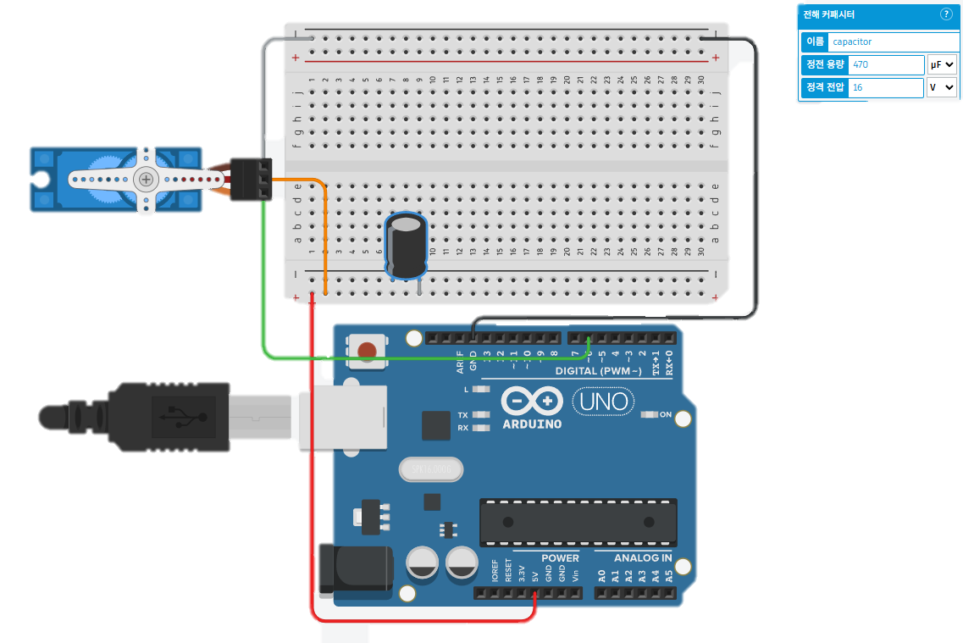
Micro Servo
#include <Servo.h> //use library <Servo.h> (1m)
Servo myservo; //name the pin of servo motor as myservo (1m)
//int angle = 0; //current angle
//int direc = 0; //currrent direction;0=clockwise;1=anti-clockwise
void setup(){
myservo.attach(6); //pwm to D6
}
void loop(){
for(int ang=0; ang<180; ang++){ //clockwise
myservo.write(ang); //rotate pin of servo motor (1m)
delay(50); //for 0.05 second (1m)
}
for(int ang=180; ang>0; ang--){ //anti-clockwise
myservo.write(ang);
delay(50);
}
}

Slide 11
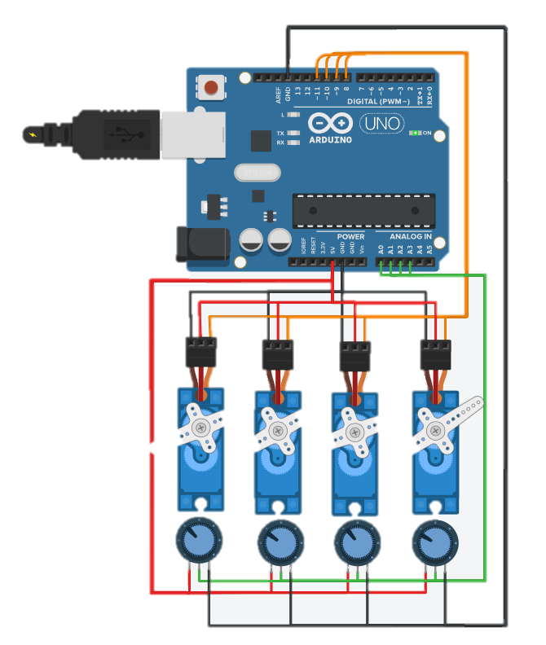
Micro Servo
#include <Servo.h>
Servo servo_5;
Servo servo_4;
Servo servo_3;
Servo servo_2;
void setup()
{
pinMode(A3, INPUT);
servo_5.attach(11);
pinMode(A2, INPUT);
servo_4.attach(10);
pinMode(A1, INPUT);
servo_3.attach(9);
pinMode(A0, INPUT);
servo_2.attach(8);
}
void loop()
{
servo_5.write(map(analogRead(A3), 0, 1023, 0, 180));
servo_4.write(map(analogRead(A2), 0, 1023, 0, 180));
servo_3.write(map(analogRead(A1), 0, 1023, 0, 180));
servo_2.write(map(analogRead(A0), 0, 1023, 0, 180));
delay(10); // Delay a little bit to improve simulation performance
}

Slide 12
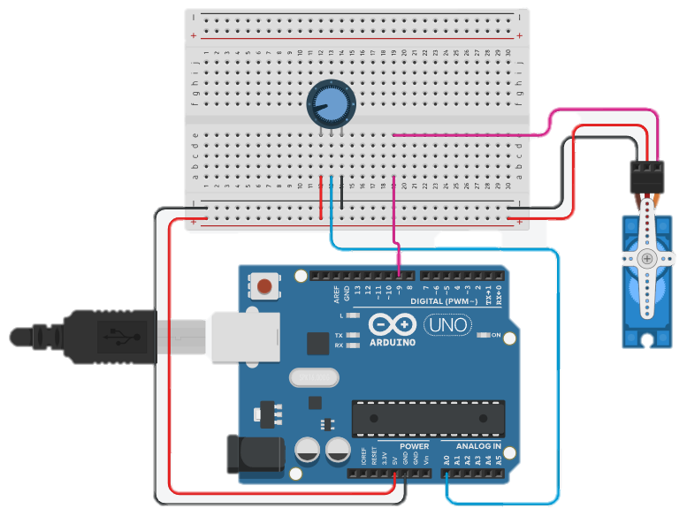
Micro Servo
#include <Servo.h>
Servo servoMotor;
int potPos;
void setup() {
servoMotor.attach(9);
}
void loop () {
potPos = map(analogRead(A0), 0, 1023, 0, 180);
servoMotor.write(potPos);
delay(15);
}

Slide 13
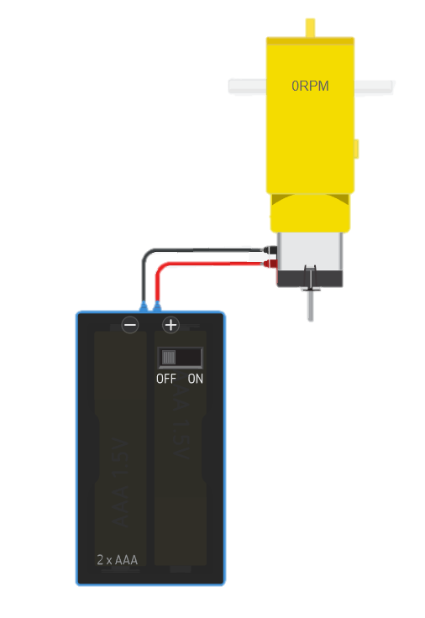
Hobby Gearmotor

Slide 14
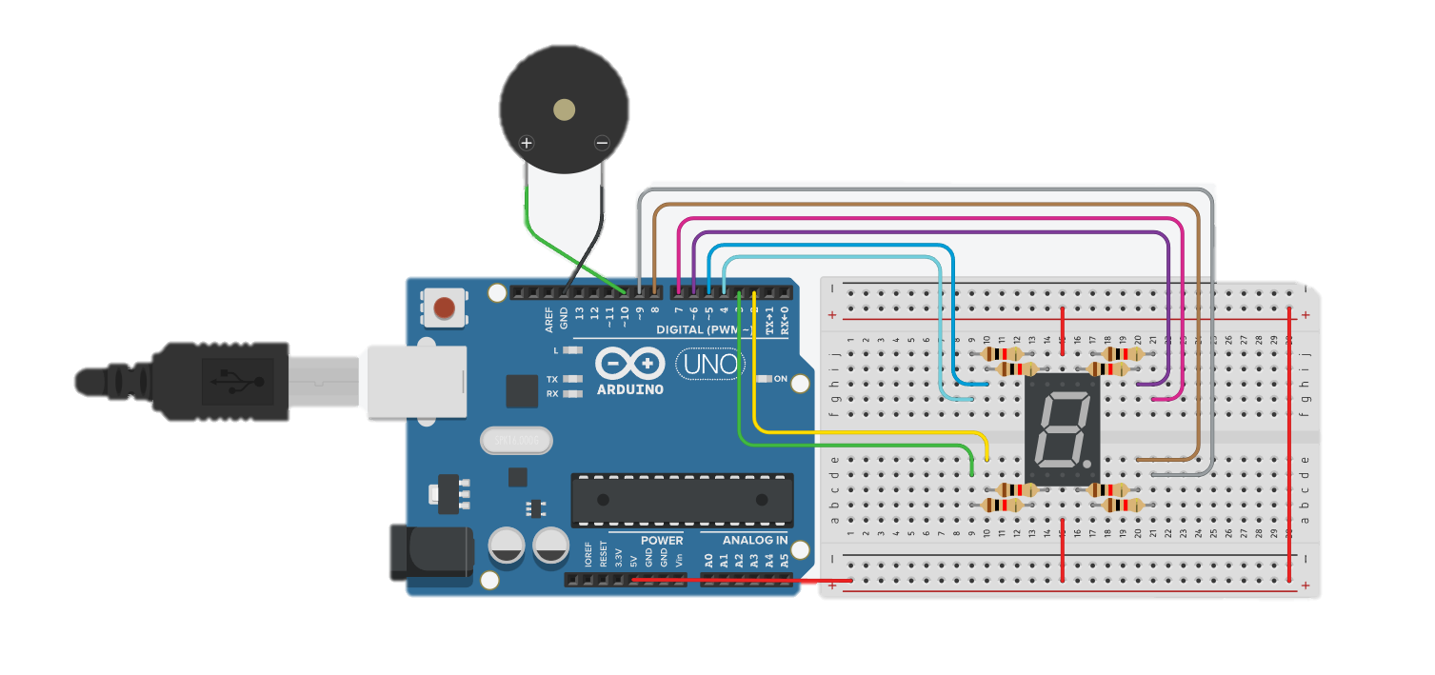
7-segment display(ca): Count Down Alarm

Slide 15
7-segment display(ca): Count Down Alarm
int index = 0;
int counter;
String pattern[]=
{
"00100001",
"11111001",
"00010011",
"01010001",
"11001001",
"01000101",
"00000101",
"11110001",
"00000001",
"01000001",
};
void clear()
{
index = 0;
for (counter = 0; counter < 8; ++counter) {
analogWrite(index+2, 255);
index++;
}
}
void display(int num)
{
clear();
index = 0;
for (counter = 0; counter < 8; ++counter) {
if (pattern[num].substring(index,index+1)=="0"){
analogWrite(index+2, 0);
}
index++;
}
}
void setup()
{
pinMode(2, OUTPUT);
pinMode(3, OUTPUT);
pinMode(4, OUTPUT);
pinMode(5, OUTPUT);
pinMode(6, OUTPUT);
pinMode(7, OUTPUT);
pinMode(8, OUTPUT);
pinMode(9, OUTPUT);
display(9);
delay(1000);
display(8);
delay(1000);
display(7);
delay(1000);
display(6);
delay(1000);
display(5);
delay(1000);
display(4);
delay(1000);
display(3);
delay(1000);
display(2);
delay(1000);
display(1);
delay(1000);
display(0);
tone(10,523,500);
}
void loop()
{
}

Slide 16
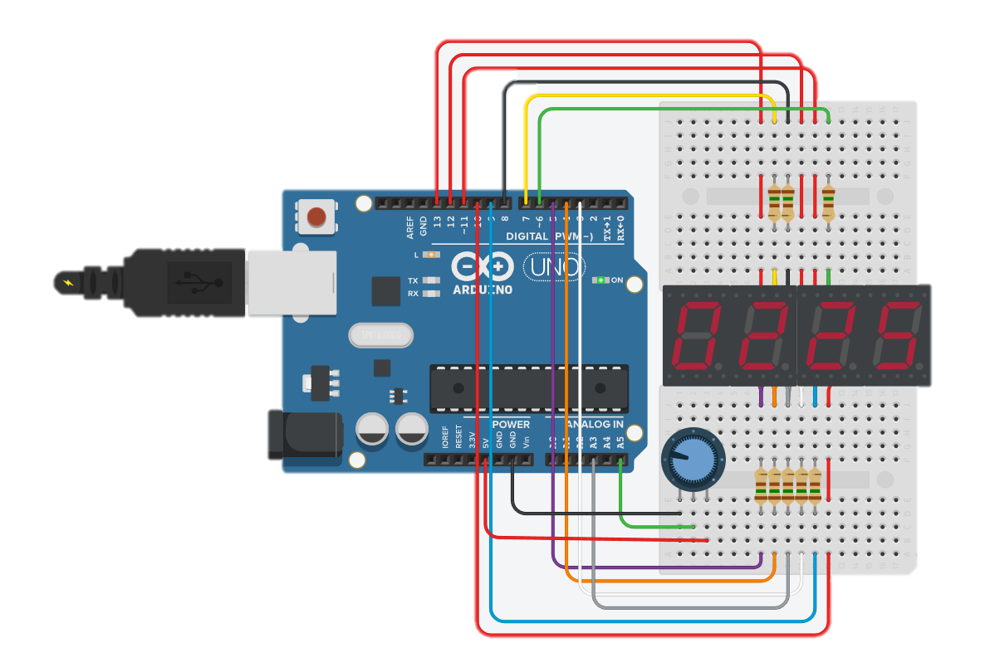
MISA 7-Segment 4-Digit LED Display

Slide 17
MISA 7-Segment 4-Digit LED Display
/* 6-13-2011 Spark Fun Electronics 2011 -- Nathan Seidle */
int digit1 = 13; //PWM Display pin 1
int digit2 = 12; //PWM Display pin 2
int digit3 = 11; //PWM Display pin 6
int digit4 = 10; //PWM Display pin 8
//Pin mapping
int segA = 7; //Display pin 14
int segB = 6; //Display pin 16
int segC = 3; //Display pin 13
int segD = 4; //Display pin 3
int segE = 5; //Display pin 5
int segF = 8; //Display pin 11
int segG = 9; //Display pin 15
int segDP = 2;
void setup() {
pinMode(segA, OUTPUT);
pinMode(segB, OUTPUT);
pinMode(segC, OUTPUT);
pinMode(segD, OUTPUT);
pinMode(segE, OUTPUT);
pinMode(segF, OUTPUT);
pinMode(segG, OUTPUT);
pinMode(digit1, OUTPUT);
pinMode(digit2, OUTPUT);
pinMode(digit3, OUTPUT);
pinMode(digit4, OUTPUT);
pinMode(13, OUTPUT); //Builtin LED
}
void loop()
{
displayNumber( analogRead(5) );
}
void displayNumber(int toDisplay) {
#define DISPLAY_BRIGHTNESS 500
#define DIGIT_ON HIGH
#define DIGIT_OFF LOW
long beginTime = millis();
for(int digit = 4 ; digit > 0 ; digit--) {
//Turn on a digit for a short amount of time
switch(digit) {
case 1:
digitalWrite(digit1, DIGIT_ON);
break;
case 2:
digitalWrite(digit2, DIGIT_ON);
break;
case 3:
digitalWrite(digit3, DIGIT_ON);
break;
case 4:
digitalWrite(digit4, DIGIT_ON);
break;
}
//Turn on the right segments for this digit
lightNumber(toDisplay % 10);
toDisplay /= 10;
delayMicroseconds(DISPLAY_BRIGHTNESS); //Display this digit for a fraction of a second (between 1us and 5000us, 500 is pretty good)
//Turn off all segments
lightNumber(10);
//Turn off all digits
digitalWrite(digit1, DIGIT_OFF);
digitalWrite(digit2, DIGIT_OFF);
digitalWrite(digit3, DIGIT_OFF);
digitalWrite(digit4, DIGIT_OFF);
}
while( (millis() - beginTime) < 10) ; //Wait for 20ms to pass before we paint the display again
}

Slide 18
MISA 7-Segment 4-Digit LED Display
//Given a number, turns on those segments
//If number == 10, then turn off number
void lightNumber(int numberToDisplay) {
#define SEGMENT_ON LOW
#define SEGMENT_OFF HIGH
switch (numberToDisplay){
case 0:
digitalWrite(segA, SEGMENT_ON);
digitalWrite(segB, SEGMENT_ON);
digitalWrite(segC, SEGMENT_ON);
digitalWrite(segD, SEGMENT_ON);
digitalWrite(segE, SEGMENT_ON);
digitalWrite(segF, SEGMENT_ON);
digitalWrite(segG, SEGMENT_OFF);
break;
case 1:
digitalWrite(segA, SEGMENT_OFF);
digitalWrite(segB, SEGMENT_ON);
digitalWrite(segC, SEGMENT_ON);
digitalWrite(segD, SEGMENT_OFF);
digitalWrite(segE, SEGMENT_OFF);
digitalWrite(segF, SEGMENT_OFF);
digitalWrite(segG, SEGMENT_OFF);
break;
case 2:
digitalWrite(segA, SEGMENT_ON);
digitalWrite(segB, SEGMENT_ON);
digitalWrite(segC, SEGMENT_OFF);
digitalWrite(segD, SEGMENT_ON);
digitalWrite(segE, SEGMENT_ON);
digitalWrite(segF, SEGMENT_OFF);
digitalWrite(segG, SEGMENT_ON);
break;
case 3:
digitalWrite(segA, SEGMENT_ON);
digitalWrite(segB, SEGMENT_ON);
digitalWrite(segC, SEGMENT_ON);
digitalWrite(segD, SEGMENT_ON);
digitalWrite(segE, SEGMENT_OFF);
digitalWrite(segF, SEGMENT_OFF);
digitalWrite(segG, SEGMENT_ON);
break;
case 4:
digitalWrite(segA, SEGMENT_OFF);
digitalWrite(segB, SEGMENT_ON);
digitalWrite(segC, SEGMENT_ON);
digitalWrite(segD, SEGMENT_OFF);
digitalWrite(segE, SEGMENT_OFF);
digitalWrite(segF, SEGMENT_ON);
digitalWrite(segG, SEGMENT_ON);
break;
case 5:
digitalWrite(segA, SEGMENT_ON);
digitalWrite(segB, SEGMENT_OFF);
digitalWrite(segC, SEGMENT_ON);
digitalWrite(segD, SEGMENT_ON);
digitalWrite(segE, SEGMENT_OFF);
digitalWrite(segF, SEGMENT_ON);
digitalWrite(segG, SEGMENT_ON);
break;
case 6:
digitalWrite(segA, SEGMENT_ON);
digitalWrite(segB, SEGMENT_OFF);
digitalWrite(segC, SEGMENT_ON);
digitalWrite(segD, SEGMENT_ON);
digitalWrite(segE, SEGMENT_ON);
digitalWrite(segF, SEGMENT_ON);
digitalWrite(segG, SEGMENT_ON);
break;
case 7:
digitalWrite(segA, SEGMENT_ON);
digitalWrite(segB, SEGMENT_ON);
digitalWrite(segC, SEGMENT_ON);
digitalWrite(segD, SEGMENT_OFF);
digitalWrite(segE, SEGMENT_OFF);
digitalWrite(segF, SEGMENT_OFF);
digitalWrite(segG, SEGMENT_OFF);
break;

Slide 19
MISA 7-Segment 4-Digit LED Display
case 8:
digitalWrite(segA, SEGMENT_ON);
digitalWrite(segB, SEGMENT_ON);
digitalWrite(segC, SEGMENT_ON);
digitalWrite(segD, SEGMENT_ON);
digitalWrite(segE, SEGMENT_ON);
digitalWrite(segF, SEGMENT_ON);
digitalWrite(segG, SEGMENT_ON);
break;
case 9:
digitalWrite(segA, SEGMENT_ON);
digitalWrite(segB, SEGMENT_ON);
digitalWrite(segC, SEGMENT_ON);
digitalWrite(segD, SEGMENT_ON);
digitalWrite(segE, SEGMENT_OFF);
digitalWrite(segF, SEGMENT_ON);
digitalWrite(segG, SEGMENT_ON);
break;
case 10:
digitalWrite(segA, SEGMENT_OFF);
digitalWrite(segB, SEGMENT_OFF);
digitalWrite(segC, SEGMENT_OFF);
digitalWrite(segD, SEGMENT_OFF);
digitalWrite(segE, SEGMENT_OFF);
digitalWrite(segF, SEGMENT_OFF);
digitalWrite(segG, SEGMENT_OFF);
break;
}
}

Slide 21
Reference
만들면서 배우는 아두이노와 40개의 작품들. 장문철, 앤써북
스마트폰, 블루투스, 이더넷, WiFi 그리고 아두이노, 조도현 외 4, 북두출판사
https://wikidocs.net/30784

