Slide 1
High-throughput Phenotyping with Temporal Sequences
Hossein Estiri#, Thomas H. McCoy, Jr, Kavishwar B. Wagholikar, Alyssa P. Goodson, Katie Murphy, Shawn N. Murphy

Slide 2
EHRs reflect
﻿clinical processes
patient’s interaction with the system, and
the recording process
contain temporal information about progression of disease, treatment outcomes
Notes:
No 독립적 so to speak, sequence has useful info.

Slide 3
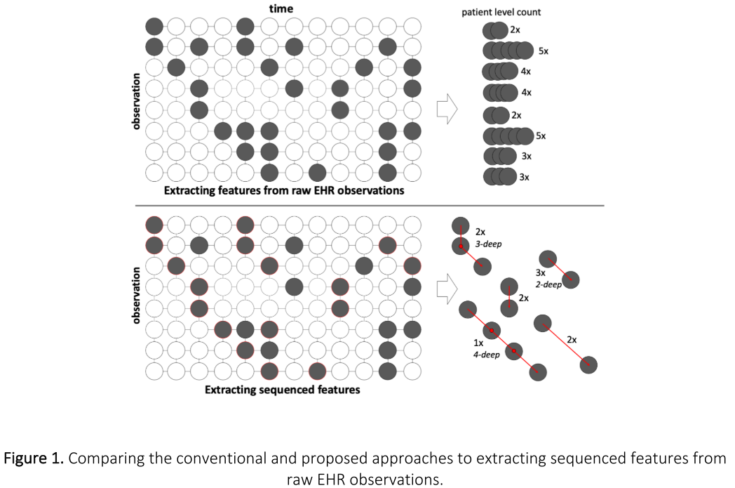
Notes:
﻿(e.g., clinician’s decision making process

Slide 4
﻿(e.g., clinician’s decision making process, disease progression)

Slide 5
Abstract
Phenotyping using temporal sequences ﻿ → predictive and interpretable data representations
﻿sequenced features outperform raw EHR features in CHF
temporal sequencing of EHR improve computational classification or phenotyping
Notes:
No 독립적 so to speak, sequence has useful info.

Slide 6
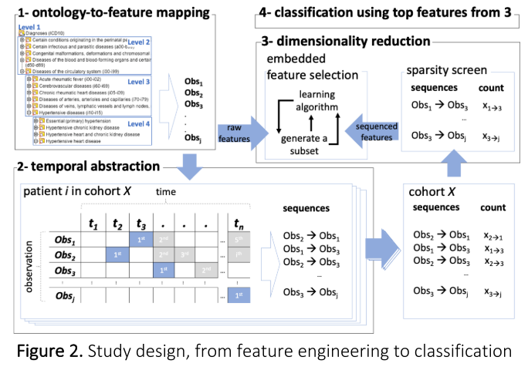

Slide 7
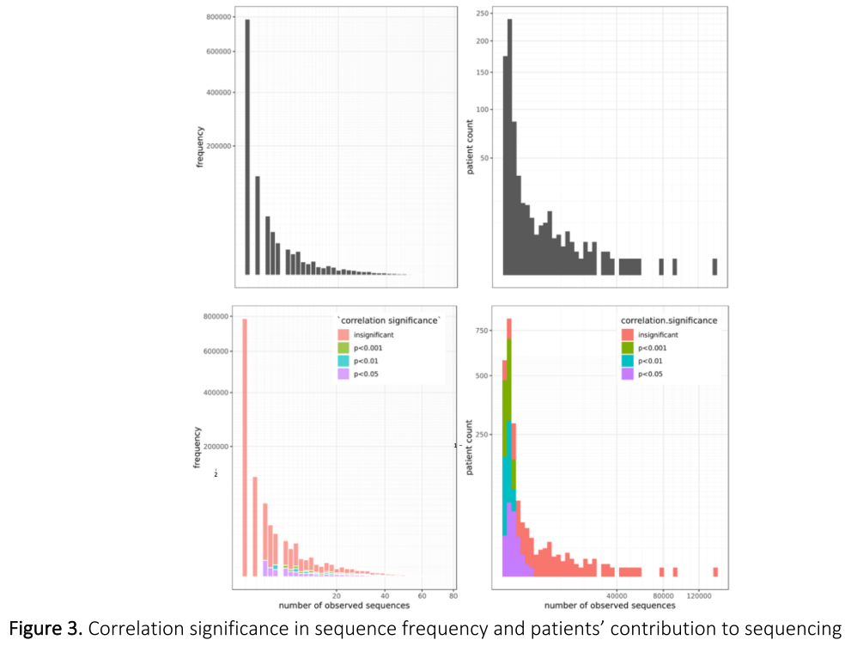
Screening sparsity
Remove low frequencies, 백만 → 20만 (cohort)
Correlation p-value (btw seq & HF)

Slide 8
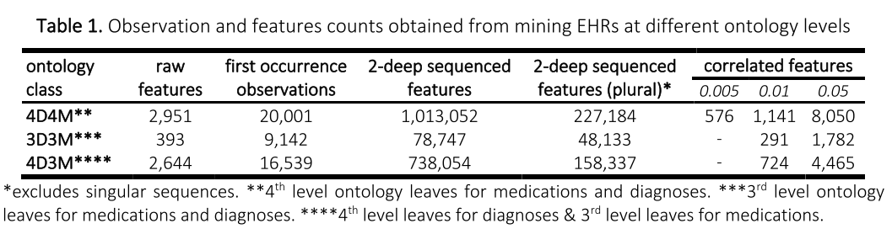

Slide 9
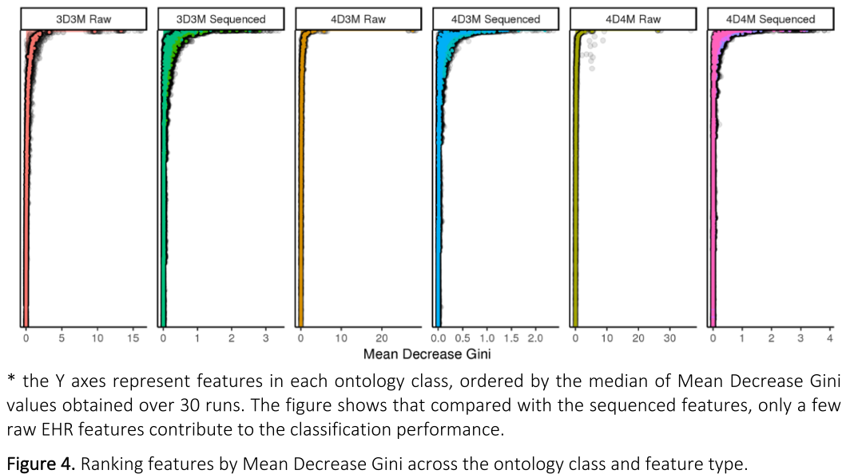
Variable Importance

Slide 10
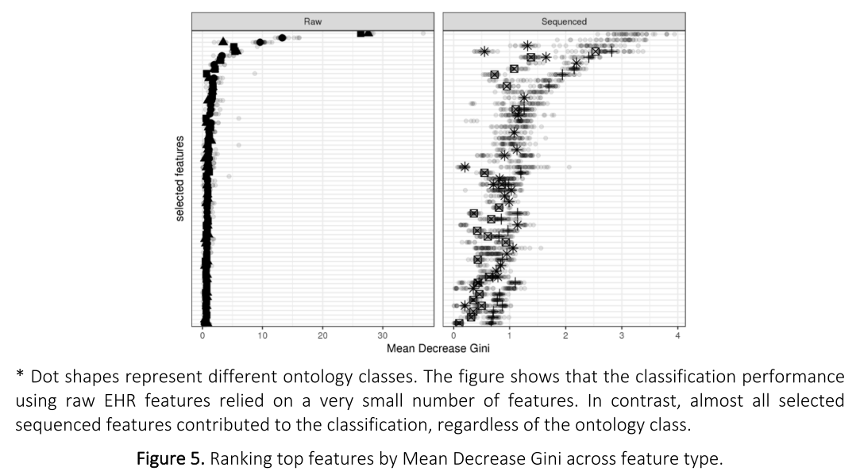

Slide 11
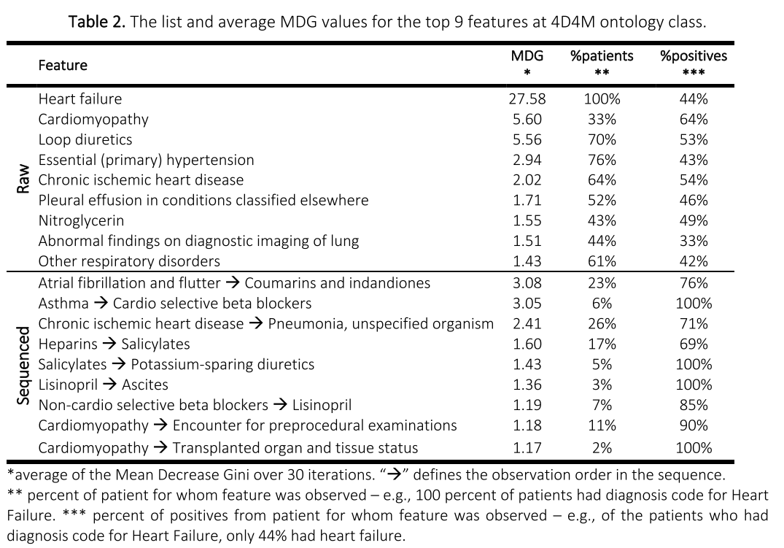

Slide 12
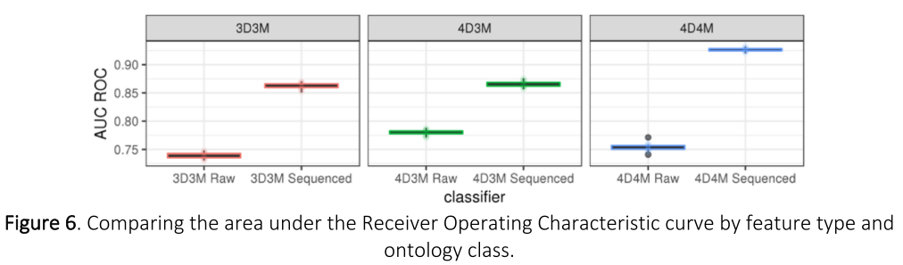

Slide 13
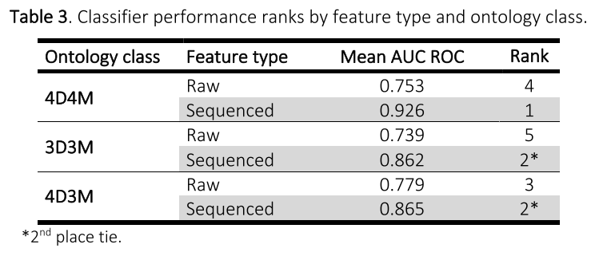

Slide 14
Conclusion
knowledge of disease progression through temporal sequencing can improve computational disease classification (phenotyping) using EHR observations
found new information about clinical processes in sequenced features that are difficult to discern from raw EHR data
\
Notes:
No 독립적 so to speak, sequence has useful info.

