Slide 1

DICOM & NIfTI images of different modalities
HEALTH BIG DATA
GIULIA TOMMASINI
STEVEN MOR
LEONARDO VICENTINI
ANGELO NOTARNICOLA
SEPANTA GANJEI
Prof. Maria Gabriella Signorini
Prof. Pierluigi Reali

Slide 2

Table of Contents
3
4
5-6
Problems
Solution
DICOM & NIfTI
7
8-18
19-27
Proposed Datasets
Data Management
Data Exchange
28-33
34
35
Application & Results
Conclusions
Future Developments

Slide 3
Problems
Medical imaging uses non-interoperable formats (DICOM in clinics, NIfTI in research) different data structures and metadata.
1
Dataset management is complex manual format conversions, multiple tools for visualization/download, and difficulties organizing imaging series.
2
Data access is limited metadata is fragmented or poorly accessible, making large datasets slow to navigate and hard to analyze or share efficiently
3
3

Slide 4
Solution: MedIndex
Unified integration of DICOM and NIfTI data and metadata
Intuitive access to datasets and metadata through a user-friendly interface.
Real-time dataset exploration without full data download.
Metadata standardization using SNOMED CT International vocabulary.
4

Slide 5
DICOM
(Digital Imaging and Communication in Medicine)
International standard for the storage, management, and transmission of medical imaging information.
Metadata (Header) – patient information, imaging modality, acquisition parameters, study and equipment information
Pixel Data – the medical image itself
A DICOM FILE CONTAINS:
DATA HIERARCHY:
Patient
Study
Series
Image
It enables structured storage; each level has a unique identifier
5

Slide 6
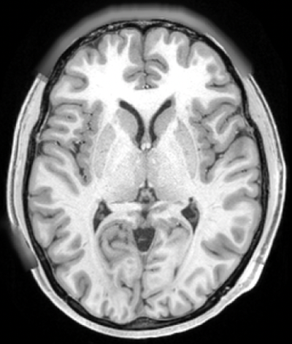
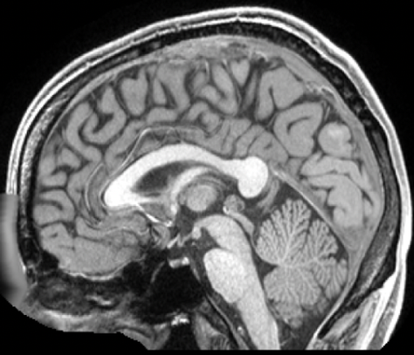
NIfTI
(Neuroimaging Informatic Technology Initiative)
It was developed to simplify the storage and analysis of medical imaging data for research applications.
It represents medical images as complete 3D or 4D volumes, enabling efficient quantitative and temporal analysis.
It includes metadata describing voxel dimensions, spatial orientation, and anatomical positioning.
6

Slide 7
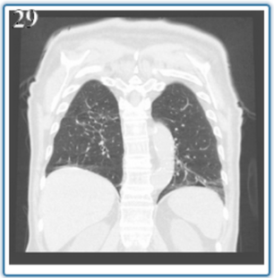
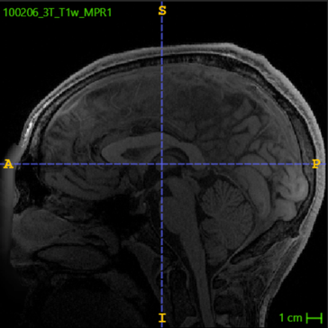
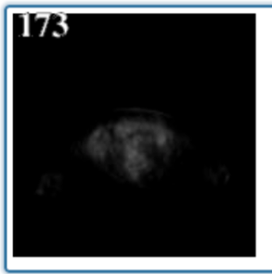
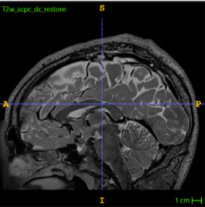
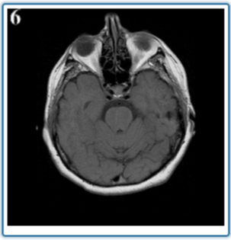
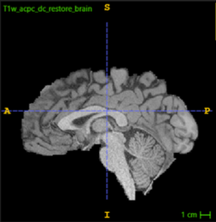
Proposed Datasets
CPTAC-LUAD
BraTS-TCGA-GBM
DICOM files
CT, PET and MRI of various patients diagnosed with Lung Adenocarcinoma
NIfTI files
multiumodal MRI, expert tumour segmentations, and radiomic features for Glioblastoma research
7

Slide 8
Data Management overview
Data sources
Data modeling
Data exploration
Data provisioning
Data access
Data transformation
Data storage
8
Notes:
Data Modeling and Data exploration are not properly part of the data management pipeline, but rather a fundational step and a functionality built on top of it.

Slide 9
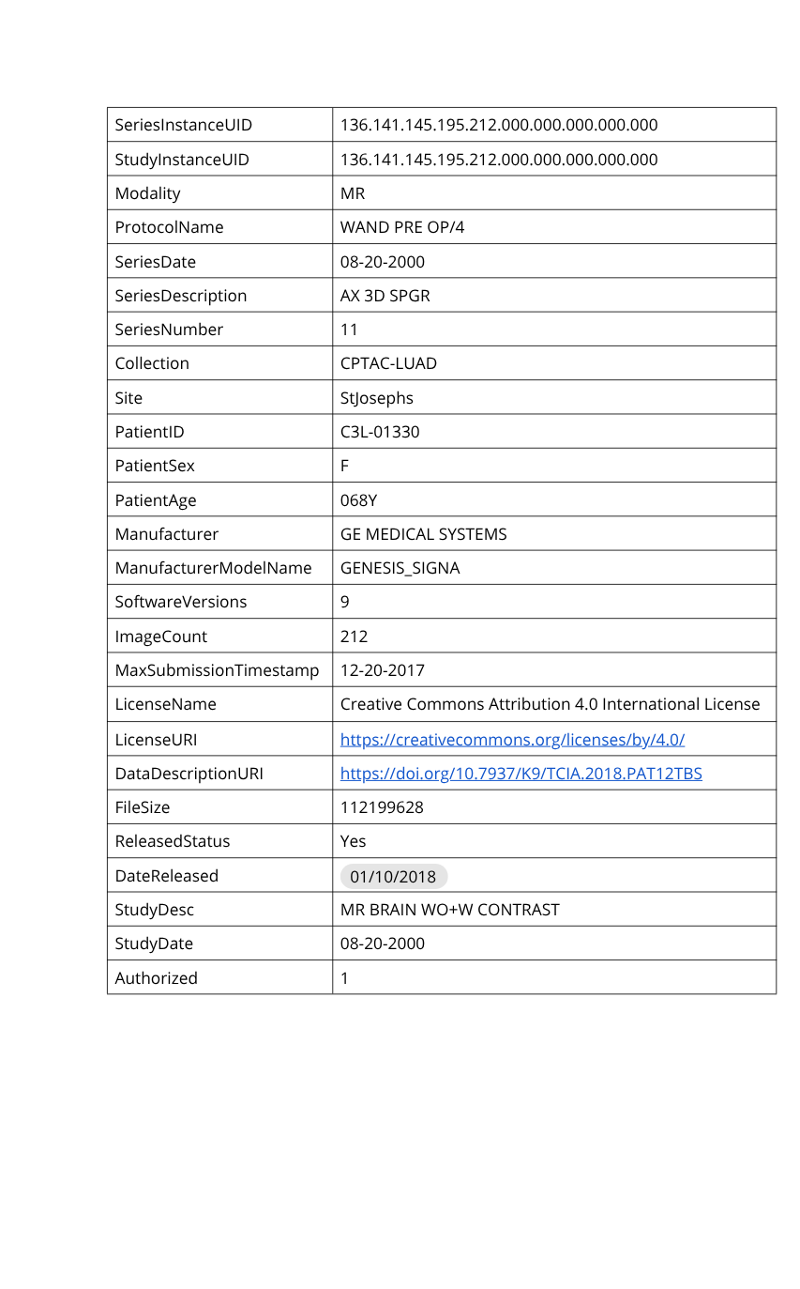
Data sources:
metadata
Remote data sources - TCIA archive
Metadata concerns:
Collections
Studies
Series
Patients
Metadata format: JSON API response
View of one series’ metadata
9

Slide 10
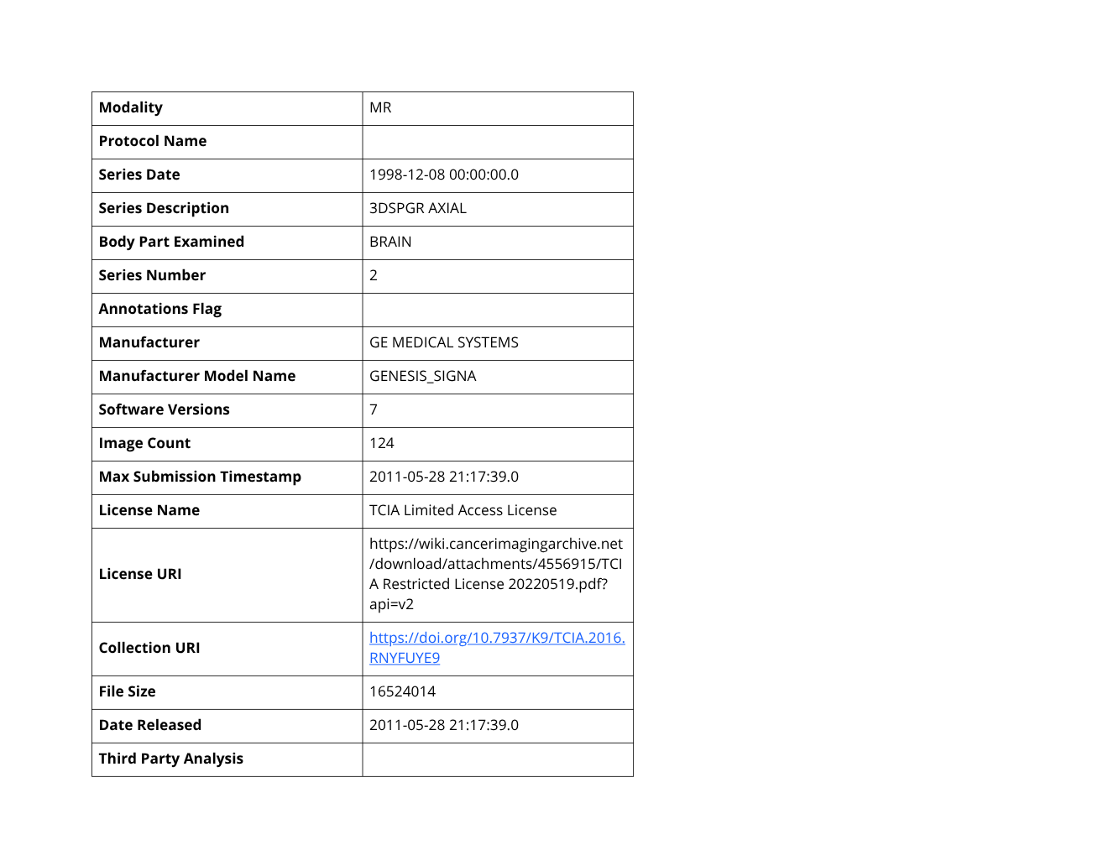
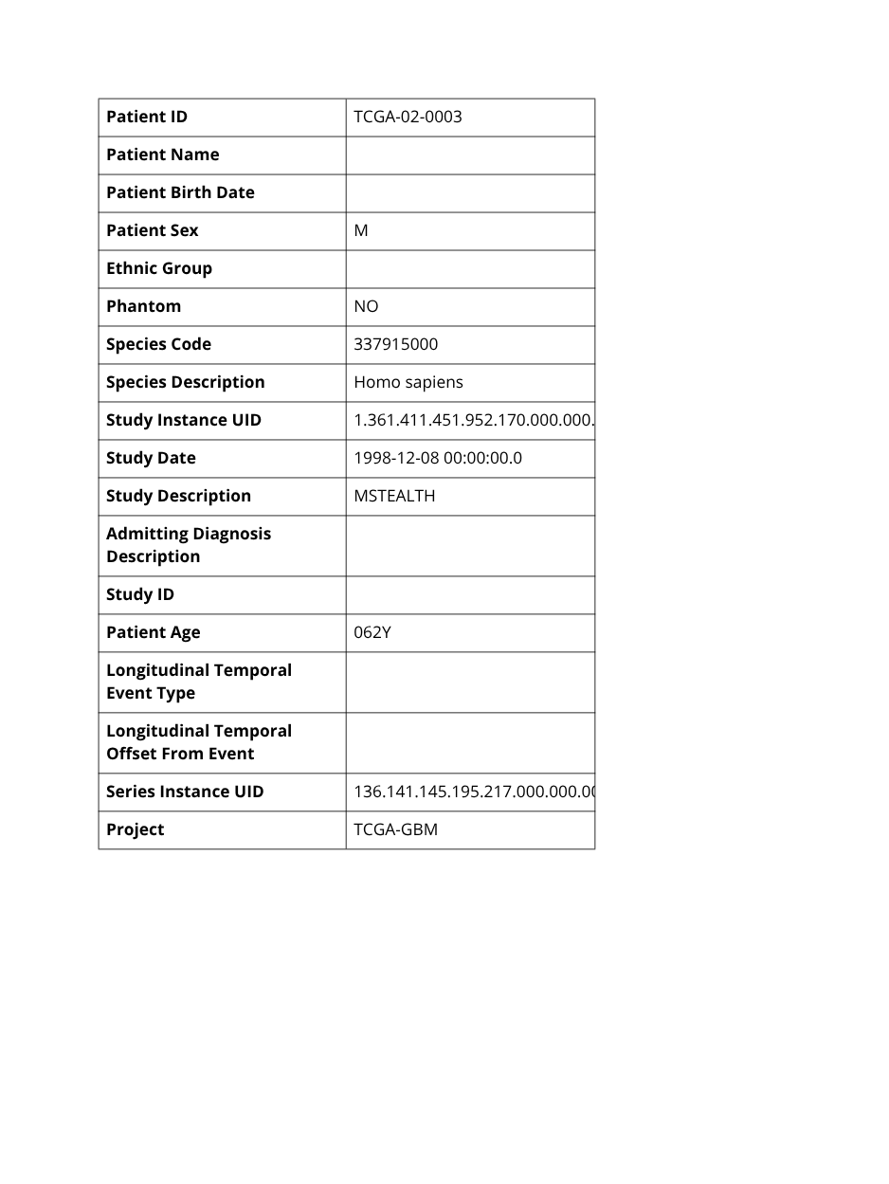
Data sources:
metadata
Local data sources
- Zip files
Metadata concerns:
Collection
Studies
Series
Patients
Metadata format: tabular file
View of one record of the
collection’s metadata
10

Slide 11
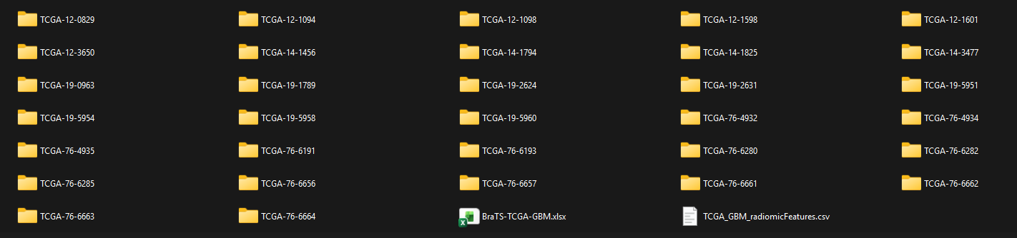
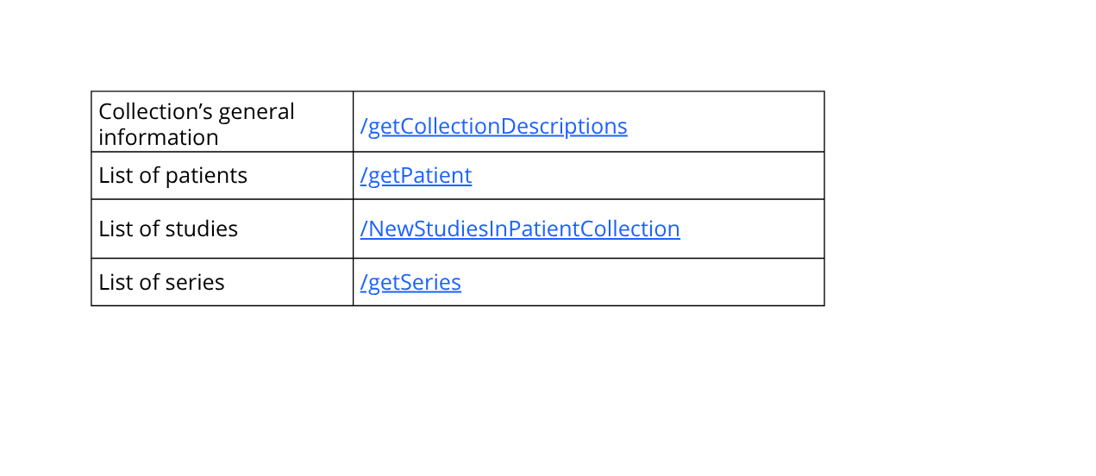
Data access: metadata
Remote data sources - TCIA archive
Local data sources - Zip files
Metadata:
Accessed by opening the file and browsing the table
Metadata is accessed through REST APIs.
Based on the data we are interested in, there are different endpoints to access.
11

Slide 12
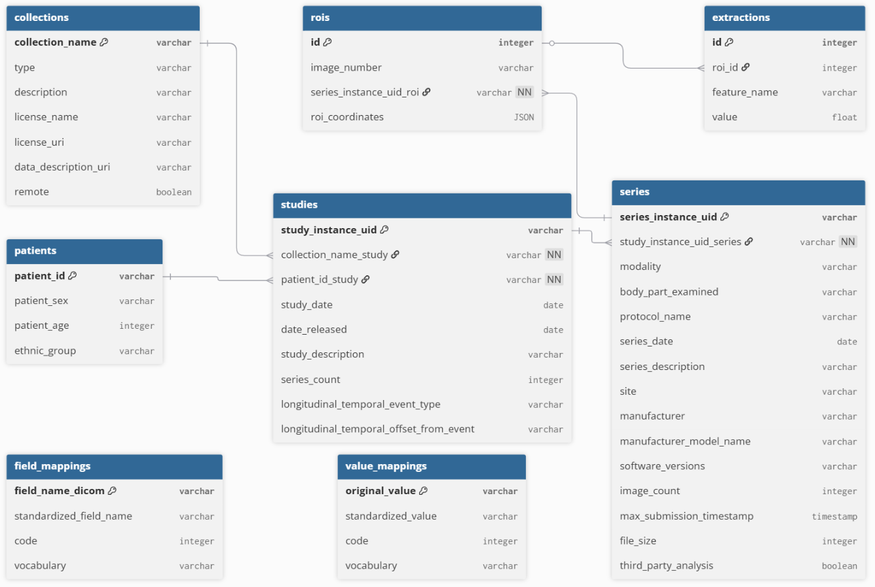
Foundation: data modeling
1) Attribute criteria:
Exploratory: discover the collection and its potential uses.
Analytical: support analysis of imaging data.
2) Independent mapping tables
12

Slide 13
Data transformation: metadata
Data transformation:
Align metadata with our internal data model
Handle missing values
Remote data sources - TCIA archive
Local data sources - Zip files
Fixed naming
Inconsistent attribute naming
Mapping defined a priori
Set of dynamic mapping rules
13
Notes:
For both types of sources, data transformation involves transforming the structure of the source metadata to align with our local data model. This includes mapping source attributes to the corresponding attributes in our entities, constructing entities from the raw data, and handling missing values.

Slide 14
Functionality: data exploration on-demand
Works for remote collections only.
Data Sources
Data Access
Data Transformation
Data Provisioning
Same standardization procedure, but no storage
14
Notes:
For both types of sources, data transformation involves transforming the structure of the source metadata to align with our local data model. This includes mapping source attributes to the corresponding attributes in our entities, constructing entities from the raw data, and handling missing values.

Slide 15
Data storage: metadata
Metadata is mapped to the internal data model; insertion order is enforced to respect foreign key dependencies.
Collection dictionary
Collection object → collections table
List of patient dictionaries
Study objects → studies table
List of study dictionaries
Patient objects → patients table
List of series dictionaries
Series objects → series table
15
Notes:
For both types of sources, data transformation involves transforming the structure of the source metadata to align with our local data model. This includes mapping source attributes to the corresponding attributes in our entities, constructing entities from the raw data, and handling missing values.

Slide 16
Data provisioning: metadata
Data is consumed by the front-end through a set of REST API endpoints, each associated with a specific type of metadata.
Persistent mode
Data Sources
Data Access
Data Transformation
Data Storage
Data Provisioning
On-demand mode
Data Sources
Data Access
Data Transformation
Data Provisioning
Data provisioning:
for both DICOM and NIfTI collections
for both the persistent and on-demand approaches
16

Slide 17
Data ingestion: images
DICOM collections
NIfTI collections
Metadata extracted directly from DICOM headers.
Automatic grouping by:
Collection
Patient
Study
Series
No external metadata required.
Metadata provided in an external file.
Each NIfTI file is matched to a metadata record.
Patient, study and series information derived from the association.
17

Slide 18
Data storage: images
Imaging files stored in an object store following the DICOM hierarchical path generated during ingestion:
Collection / Patient / Study / Series / File name
This allows direct mapping to the metadata model and fast retrieval.
18

Slide 19
Data Exchange
Objectives
Mapping preparation
Advantages
The vocabulary
Mapping procedure
19
Notes:
Data Modeling and Data exploration are not properly part of the data management pipeline, but rather a fundational step and a functionality built on top of it.

Slide 20
Data Exchange: objectives
Easier interpretation: users are more used to a common vocabulary.
1
Consistent representation throughout the platform: users of the platfrom will experience the same vocabulary throughout the platform.
2
3
Better interoperability: the integrated dataset, together with the mapping tables, can be shared between research centers that employ the same vocabulary.
20
Notes:
Data Modeling and Data exploration are not properly part of the data management pipeline, but rather a fundational step and a functionality built on top of it.

Slide 21
Data Exchange: the vocabulary
SNOMED CT (Systematized Nomenclature of Medicine – Clinical Terms)
Pros
Among the most widely adopted clinical terminologies
Rich network of clinical concepts, supporting complex relationships
Cons
No 1-to-1 correspondence between DICOM attributes and SNOMED CT terms
Difficult to map image feature names to SNOMED CT terminology
21
Notes:
Data Modeling and Data exploration are not properly part of the data management pipeline, but rather a fundational step and a functionality built on top of it.

Slide 22
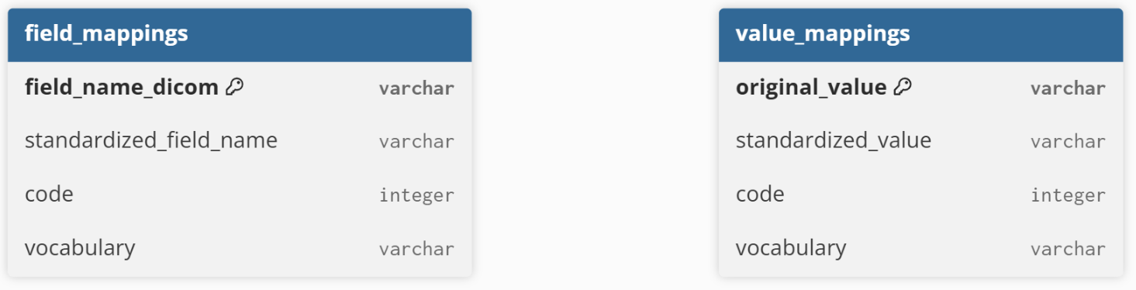
Data Exchange: mapping preparation
In our case manual mapping ensures high accuracy with minimal setup effort.
22
Notes:
Data Modeling and Data exploration are not properly part of the data management pipeline, but rather a fundational step and a functionality built on top of it.

Slide 23
Data Exchange: mapping procedure
Mapping to a common vocabulary.
Attributes
Values
Query the field_mappings table
Filter for the current entity
Output: dictionary {original attribute → standardized attribute}
Query the value_mappings table
Map one value at a time
Output: standardized value (if found)
23
Notes:
Data Modeling and Data exploration are not properly part of the data management pipeline, but rather a fundational step and a functionality built on top of it.

Slide 24
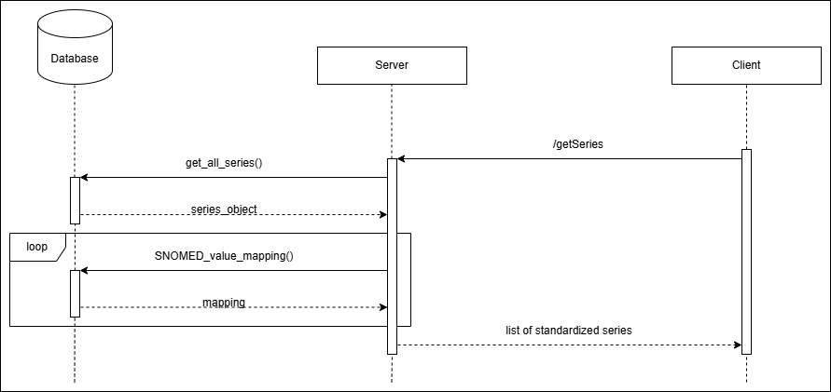
Data Exchange: mapping procedure
Example: mapping procedure for the values of a series
24
Notes:
Data Modeling and Data exploration are not properly part of the data management pipeline, but rather a fundational step and a functionality built on top of it.

Slide 25
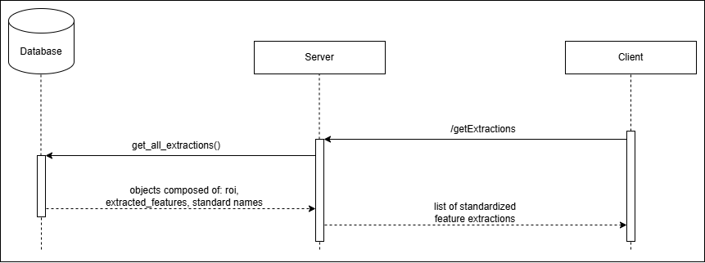
Data Exchange: mapping procedure
Example: mapping procedure for extracted features
25
Notes:
Data Modeling and Data exploration are not properly part of the data management pipeline, but rather a fundational step and a functionality built on top of it.

Slide 26
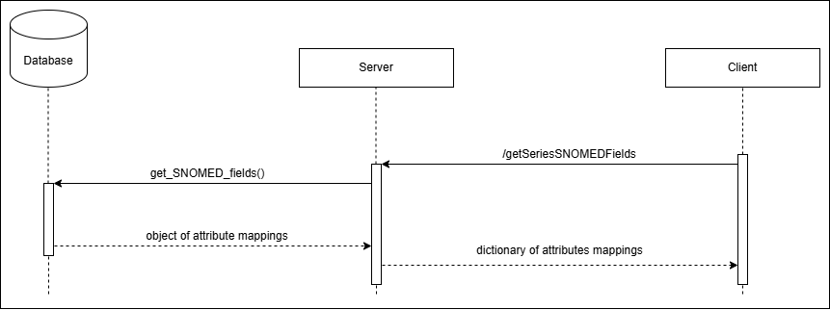
Data Exchange: mapping procedure
Example: mapping procedure for the attribtues of a series
26
Notes:
Data Modeling and Data exploration are not properly part of the data management pipeline, but rather a fundational step and a functionality built on top of it.

Slide 27
Data Exchange: advantages
1
Decoupling of mapping tables from the internal database schema
2
Straightforward update of mappings
3
Traceability of attribute transformations
4
Compact representation of mapping definitions
27
Notes:
Data Modeling and Data exploration are not properly part of the data management pipeline, but rather a fundational step and a functionality built on top of it.

Slide 28
Application and results
Application Architecture
Results
Storage and Infrastructure
28

Slide 29


Application Architecture
Frontend
HTML, CSS and JavaScript
Dataset browsing and visualization
Backend
Python and FastAPI
Metadata and image data management
29

Slide 30

Storage and Infrastructure
Core components
Database: PostgreSQL
Object Storage: MinIO
Frontend Web Server: Nginx
Backend Web Server: Uvicorn
Development environment
Containerized architecture
All services run in Docker containers
Single Docker Compose file for deployment
30

Slide 31
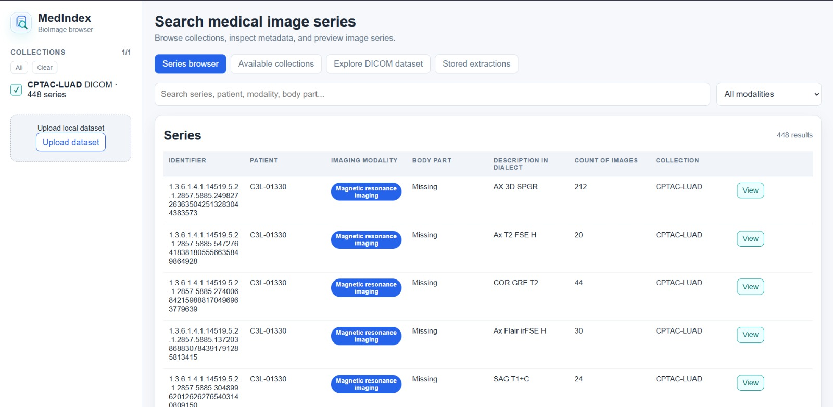
Results
31

Slide 32
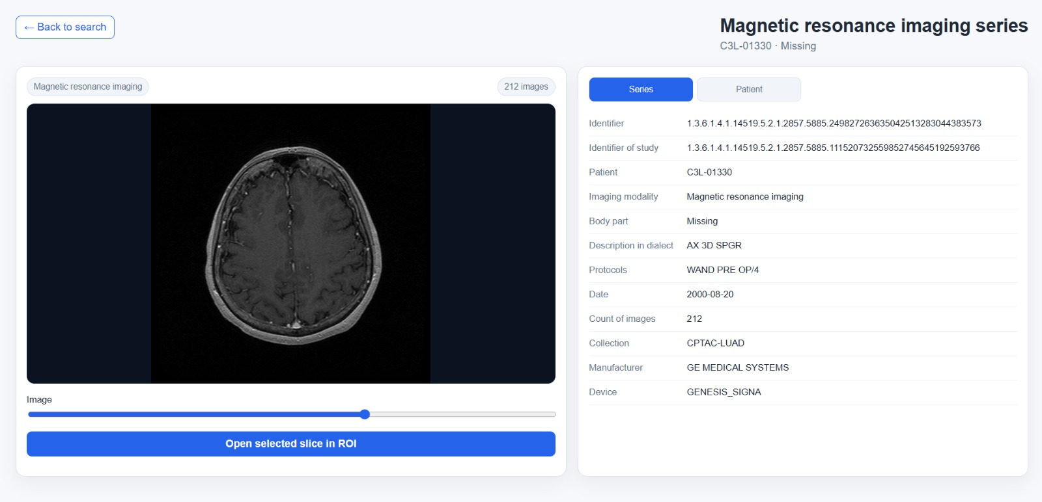
Results
32

Slide 33
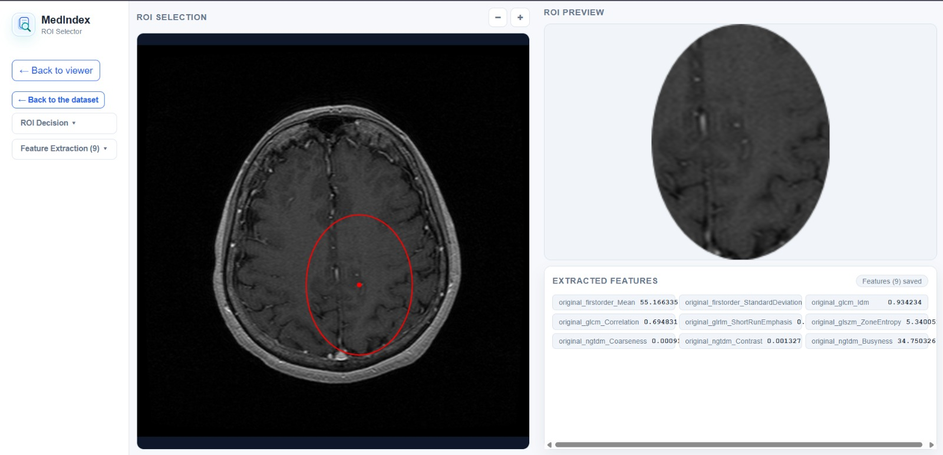
Results
33

Slide 34
Conclusions
Enhanced data interoperability
Well-structured data model
Standardized vocabulary
Single access point for all DICOM and NIfTI collections relevant to the research study
Improved data discoverability
Remote exploration of the TCIA archive
Support for imaging data analysis
Extraction of first-order image features is enabled
34
Notes:
Data Modeling and Data exploration are not properly part of the data management pipeline, but rather a fundational step and a functionality built on top of it.

Slide 35
Future developments: real-time diagnosis
Series is selected
Name | Task | Anatomical region | Model | Size
vit_brain_tumor_multiclass_v2 | Brain tumor classification | Brain (MRI) | Vision Transformer | ∼ 340 MB
lung_nodule_ct_detection | Lung nodule detection | Lung (CT) | RetinaNet 3D | ∼ 16 GB VRAM
AI model is chosen based on the body part
Diagnosis is performed
35
Notes:
Data Modeling and Data exploration are not properly part of the data management pipeline, but rather a fundational step and a functionality built on top of it.

Slide 36
The End
THANK YOU FOR LISTENING

