Slide 1
Making Housing investment the smart way
Atte Kokko
Tarmo Lindfors

Slide 2
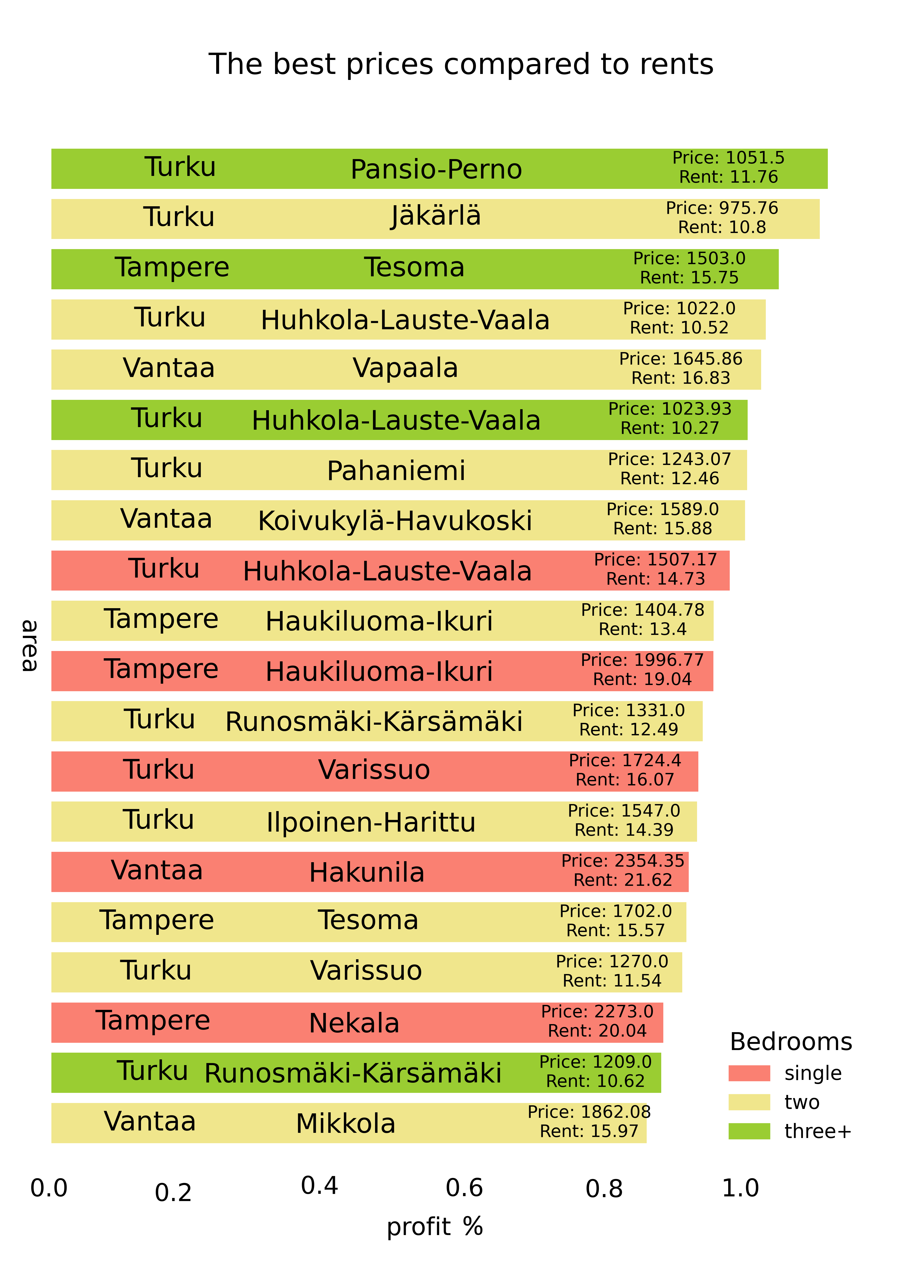
Best areas easily accessible
Surprise areas popping up
Differently priced areas give the same profit

Slide 3
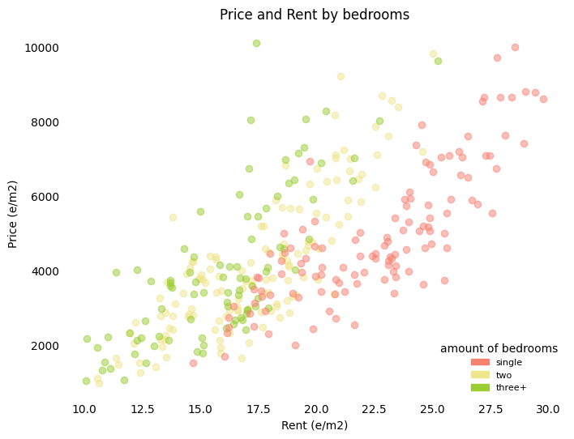
Compare different housing types
Aim for the ones with high rents
Avoid the overpriced ones!

Slide 4
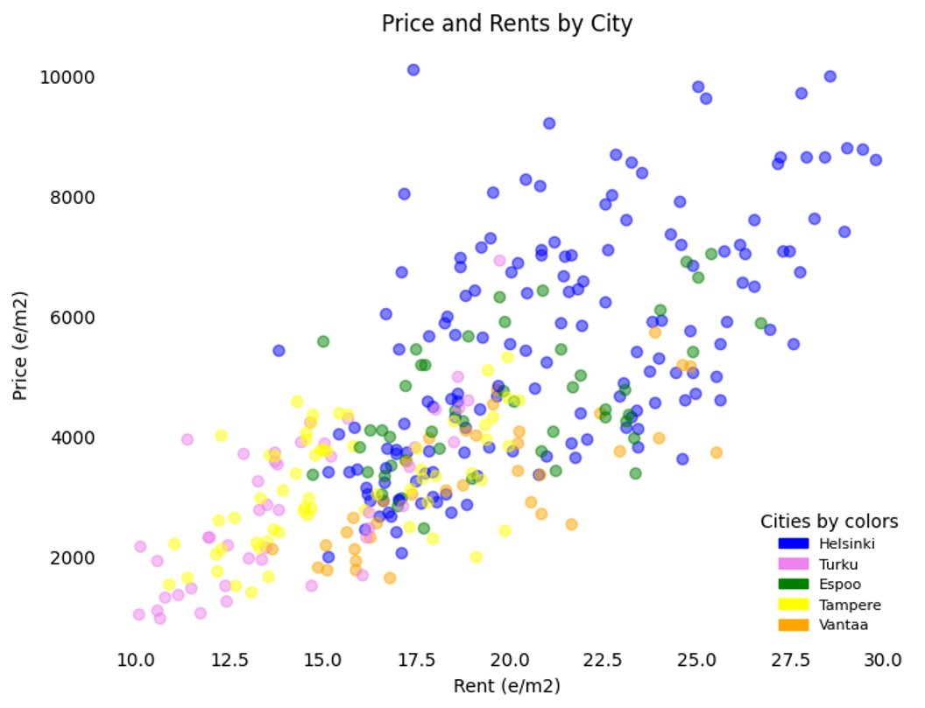
Compare cities
Helsinki is way overpriced!

