Slide 1

A case study
by
Sepehr Sadighpour

Slide 2

What gets measured, gets optimized.
The number of weigh-ins is consistently the most likely extrinsic factor to support weight loss, according to linear regression models.
Furthermore, each weigh-in, on average accounts for 0.3% weight loss, which beats the other likely factor: meals tracked (0.2%).
Therefore, improvements to the online weight tracker is likely the best option for improving outcomes.

Slide 3
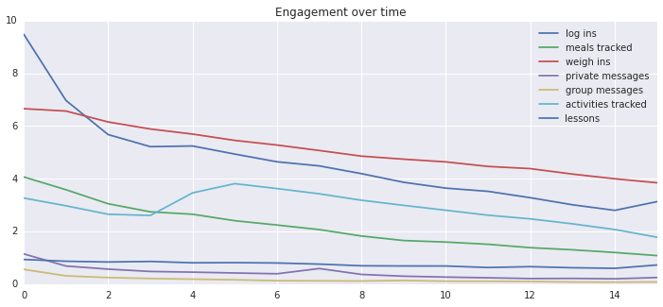
While most engagement metrics decrease during the program, weigh-ins remain the most popular.
Program Week

Slide 4
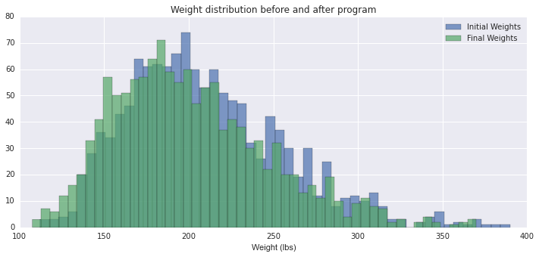
Prevent’s Effectiveness, in a chart!

