Slide 1
Computer Networks
Assignment 4: Internet Measurement

Slide 2
Overview
You will be analyzing public data to observe patterns and properties of the internet.
You can use any programming language to analyze the data given to you for this assignment.
Data comes from routers managing traffic for locations and monitoring BGP, stored in CSV files.
Will be answering questions on the metrics, graphs, and patterns your asked to generate or find and will compile your solutions in a PDF.

Slide 3
Why Measure The Internet?
Understand performance of protocols, topology
Maintenance and repairs
Billing

Slide 4
Traffic Measurement
Data collected using Netflow in routers.
Allows routers to examine traffic as it comes in.
Does so by aggregating packets into flows.
Data about the flows can be saved which can be used to profile traffic and measure things like congestion

Slide 5
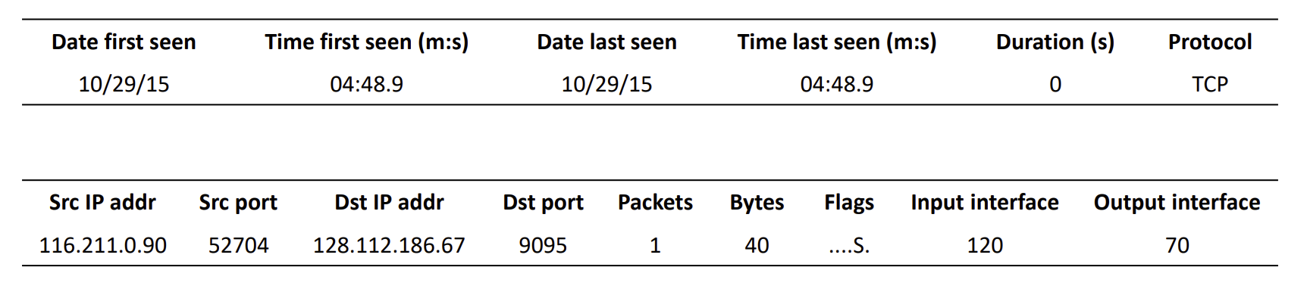
Understanding Netflow Data

Slide 6
Example
Get the number of flows for each source IP address, only considering its 16-bit prefix (for example: the IP addresses 255.255.0.1 and 255.255.0.2 are counted as there being two 255.255 addresses). What are the top ten IP address prefixes, and what percentage of all the flows recorded are they involved in? (No need to report the percentage per source IP address, just report the aggregate percentage for top ten source IP addresses.)

Slide 7
BGP Measurement
Data is collected using monitoring routers
These routers only monitor changes in BGP across the internet (relative to them), do not participate in handling traffic
RouteViews is a project that monitors BGP updates amongst different ISPs, and all their sessions’ data is publicly archived on their site
Will be analyzing both a snapshot of BGP Routing Information Base (RIBS, stores routes for destinations IPs) and a series of BGP update messages leading to that snapshot.

Slide 8
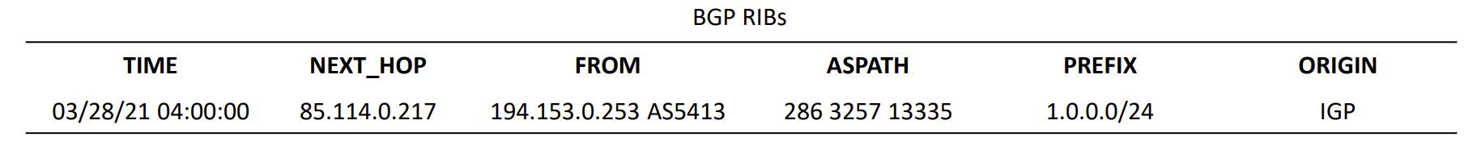
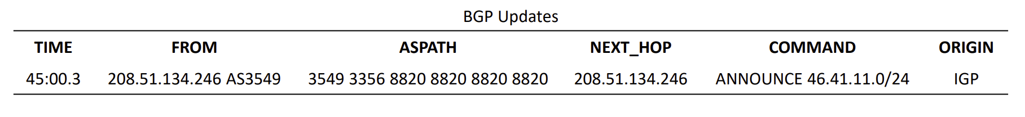
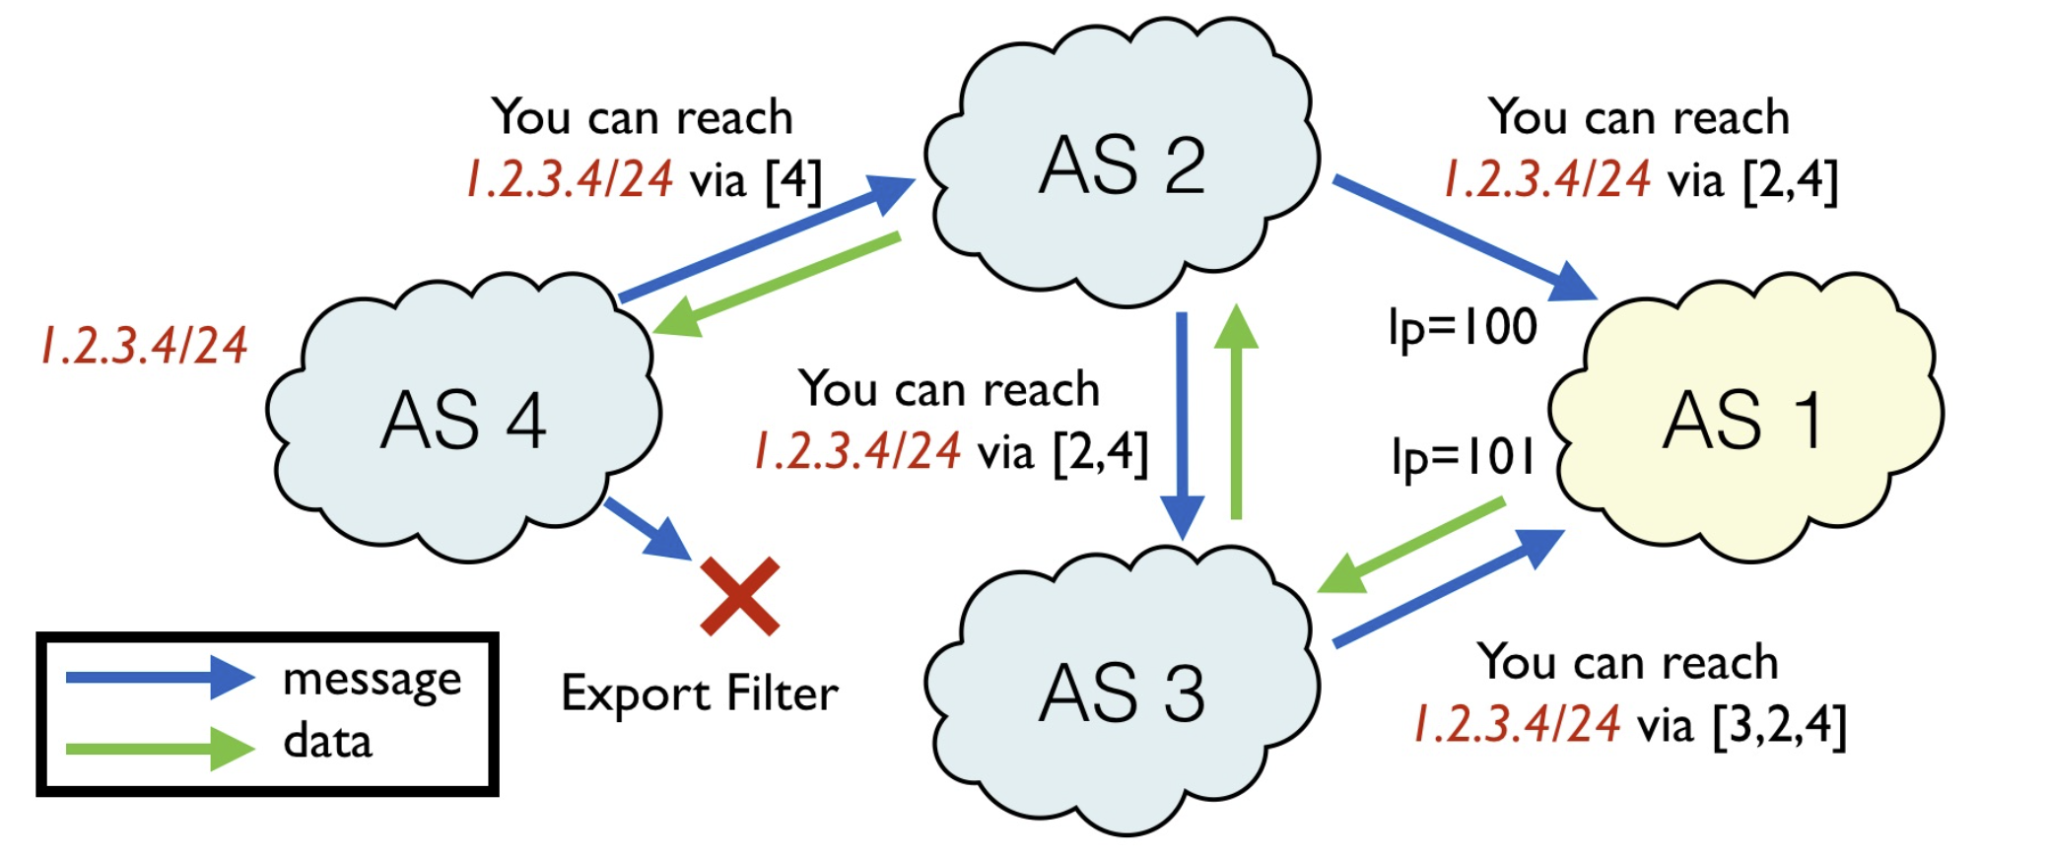
Understanding RouteViews Data

Slide 9
Example
What are the 10 most frequent ASes in all the BGP paths?

Slide 10
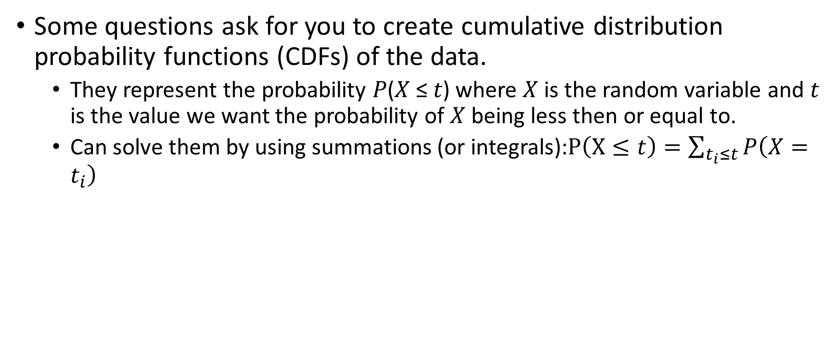
CDFs
Some questions ask for you to create cumulative distribution probability functions (CDFs) of the data.
They represent the probability 𝑃(𝑋 ≤ 𝑡) where 𝑋 is the random variable and 𝑡 is the value we want the probability of 𝑋 being less then or equal to.
Can solve them by using summations (or integrals):$P\left(X≤t\right)=\sum_{t_{i}≤t}{P\left(X=t_{i}\right)}$

Slide 11
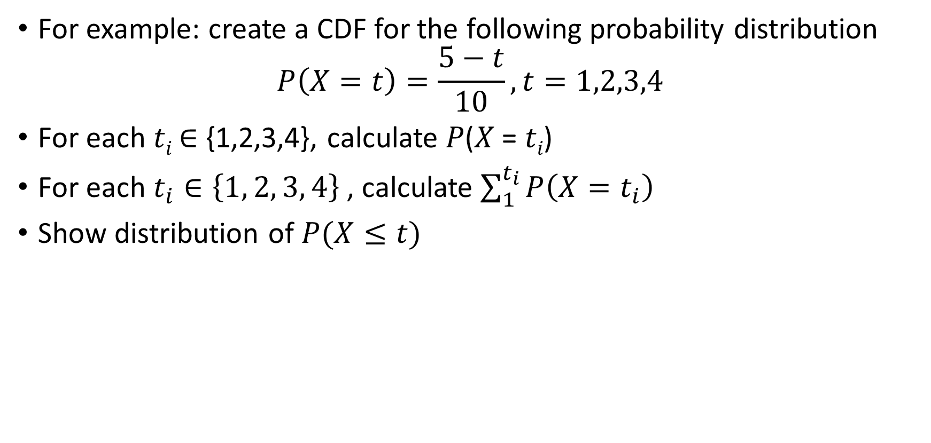
CDFs (cont’d)
For example: create a CDF for the following probability distribution
$$P\left(X=t\right)=\frac{5−t}{10}, t=1,2,3,4$$
For each 𝑡_{𝑖} ∈ {1,2,3,4}, calculate 𝑃(𝑋 = 𝑡_{𝑖})
For each $t_{i}∈\left\{1, 2, 3, 4\right\}$, calculate $\sum_{1}^{t_{i}}{P\left(X=t_{i}\right)}$
Show distribution of $P(X≤t)$

Slide 12
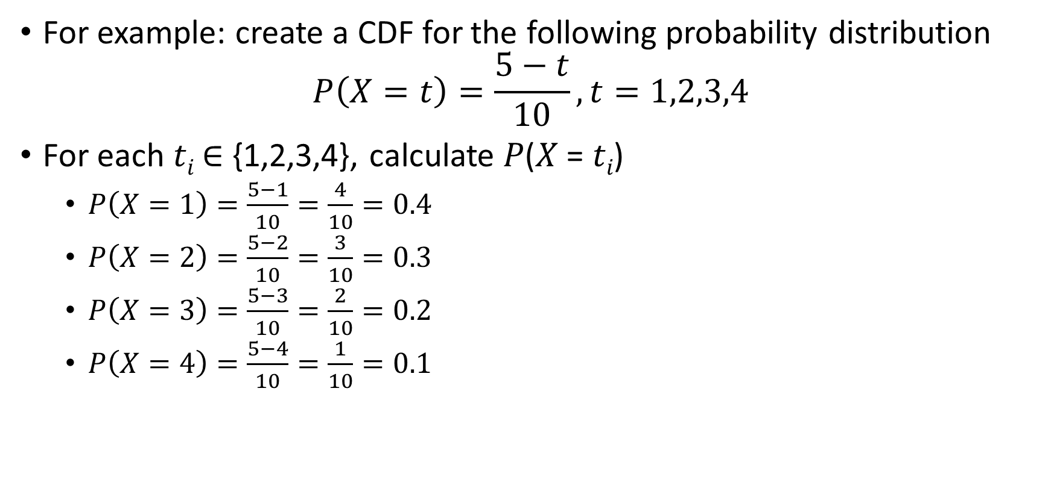
CDFs (cont’d)
For example: create a CDF for the following probability distribution
$$P\left(X=t\right)=\frac{5−t}{10}, t=1,2,3,4$$
For each 𝑡_{𝑖} ∈ {1,2,3,4}, calculate 𝑃(𝑋 = 𝑡_{𝑖})
$P\left(X=1\right)=\frac{5−1}{10}=\frac{4}{10}=0.4$
$P\left(X=2\right)=\frac{5−2}{10}=\frac{3}{10}=0.3$
$P\left(X=3\right)=\frac{5−3}{10}=\frac{2}{10}=0.2$
$P\left(X=4\right)=\frac{5−4}{10}=\frac{1}{10}=0.1$

Slide 13
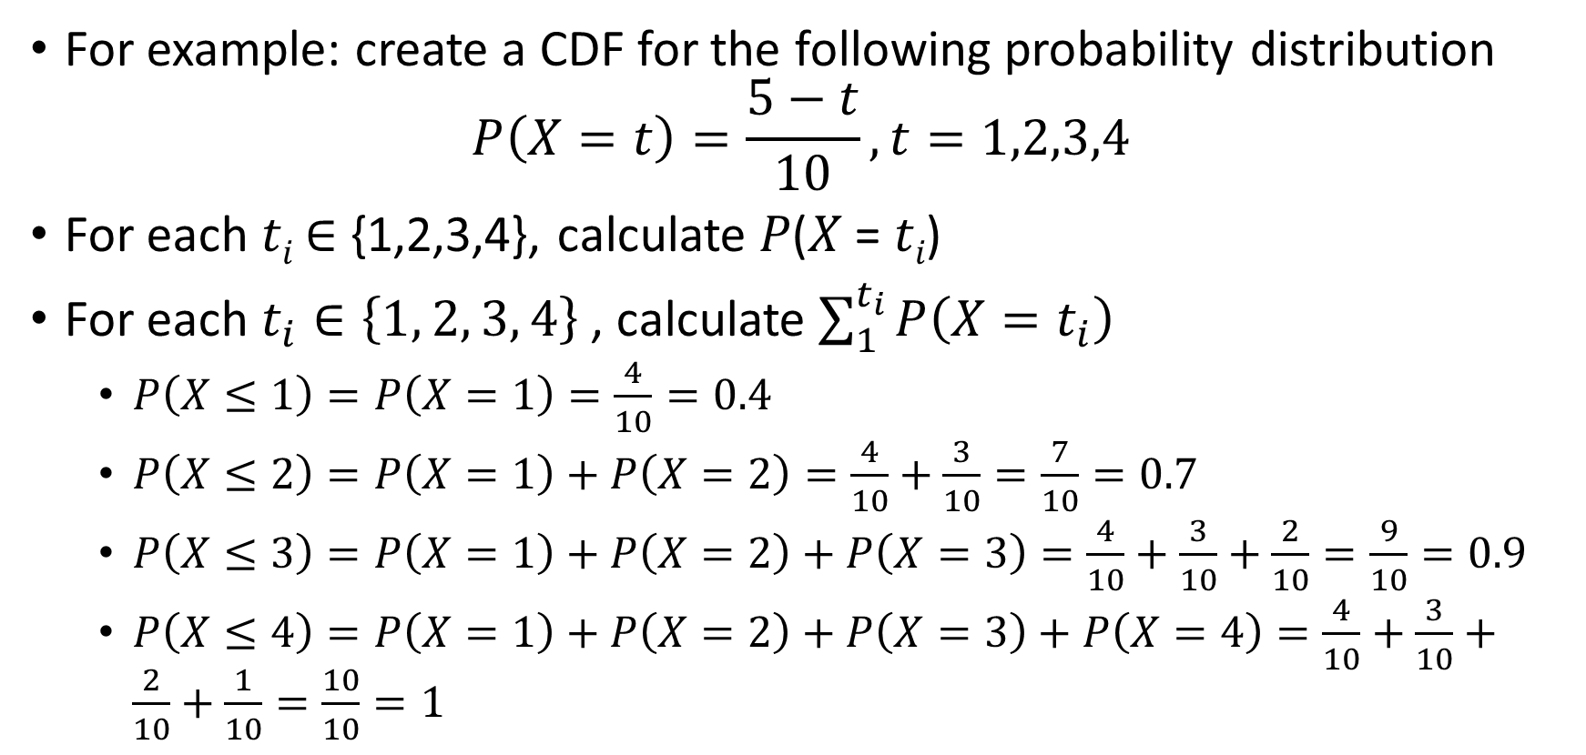
CDFs (cont’d)
For example: create a CDF for the following probability distribution
$$P\left(X=t\right)=\frac{5−t}{10}, t=1,2,3,4$$
For each 𝑡_{𝑖} ∈ {1,2,3,4}, calculate 𝑃(𝑋 = 𝑡_{𝑖})
For each $t_{i}∈\left\{1, 2, 3, 4\right\}$, calculate $\sum_{1}^{t_{i}}{P\left(X=t_{i}\right)}$
$P\left(X≤1\right)=P\left(X=1\right)=\frac{4}{10}=0.4$
$P\left(X≤2\right)=P\left(X=1\right)+P\left(X=2\right)=\frac{4}{10}+\frac{3}{10}=\frac{7}{10}=0.7$
$P\left(X≤3\right)=P\left(X=1\right)+P\left(X=2\right)+P\left(X=3\right)=\frac{4}{10}+\frac{3}{10}+\frac{2}{10}=\frac{9}{10}=0.9$
$P\left(X≤4\right)=P\left(X=1\right)+P\left(X=2\right)+P\left(X=3\right)+P\left(X=4\right)=\frac{4}{10}+\frac{3}{10}+\frac{2}{10}+\frac{1}{10}=\frac{10}{10}=1$

Slide 14
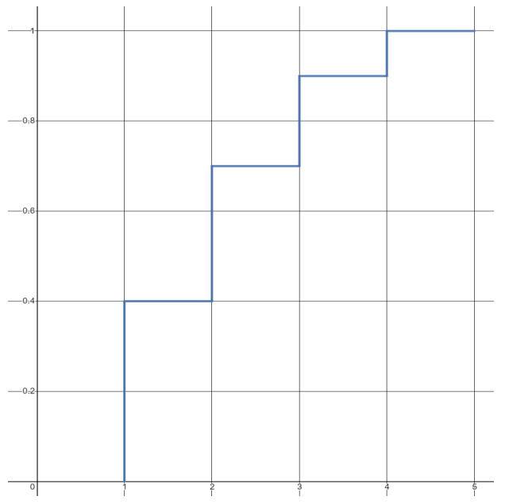
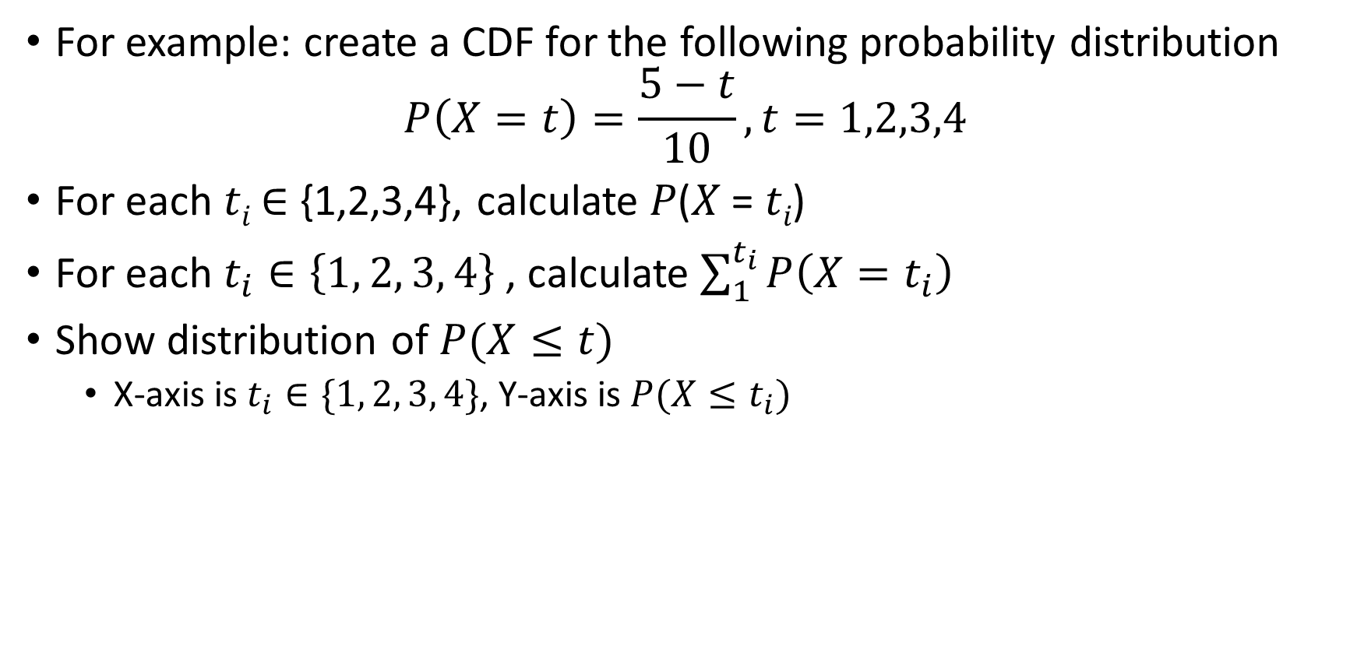
CDFs (cont’d)
For example: create a CDF for the following probability distribution
$$P\left(X=t\right)=\frac{5−t}{10}, t=1,2,3,4$$
For each 𝑡_{𝑖} ∈ {1,2,3,4}, calculate 𝑃(𝑋 = 𝑡_{𝑖})
For each $t_{i}∈\left\{1, 2, 3, 4\right\}$, calculate $\sum_{1}^{t_{i}}{P\left(X=t_{i}\right)}$
Show distribution of $P(X≤t)$
X-axis is $t_{i}∈\{1, 2, 3, 4\}$, Y-axis is $P(X≤t_{i})$

Slide 15
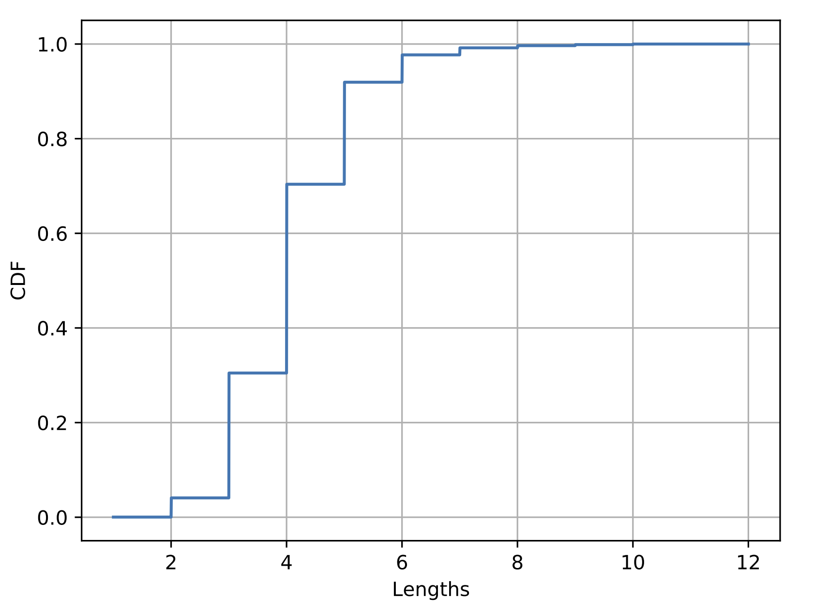
Example
Plot a cumulative distribution function (CDF) where the x-axis is the length of a BGP path and y-axis is the proportion of the paths with that length or less. The length is the number of unique ASes in an entry’s “ASPATH”.

Slide 16
What About The PDF?
Every question should be answered in this document (no credit for answers not here).
Have a section explaining how your code works, what platform you coded it on, and what are some interesting methods you are using to calculate your solutions (basically a README).
Answers and observations should be full sentences, written well, clearly answering the question being asked.
PDF should be formatted nicely.

Slide 17
Suggestions
Recommend using a programming language that makes manipulation of data, generating graphs painless.
Python have a lot of libraries that make these kind of things easy (Pandas, Numpy, Matplotlib).
Make sure visuals are well-labeled and are easy to understand.

Slide 18
Any Questions?

