Slide 1

HTTP

Slide 2
Outline
HTTP overview
Proxies

Slide 3
Application Layer Protocols
Variable Headers vs. Fixed Headers
  App headers handled by program rather than hardware
  Variable headers allow for incrementally adding features
Human Readable
  Easy for programmers to reason about
  Parsed by humans / programs rather than hardware
More later on, but useful for understanding HTTP’s design
Notes:
Incremental because you just add a new header label and those that support it will use it

Slide 4
HTTP Basics (Overview)
HTTP layered over bidirectional byte stream
  Almost always TCP
Interaction
  Client looks up host (DNS)
  Client sends request to server
  Server responds with data or error
  Requests/responses are encoded in text
Stateless
  Server maintains no info about past client requests
Notes:
Why TCP?
- don’t want to have holes in our web page – won’t render correctly
Encoded in text would be “human readable”
Stateless – simplifies the server, reduces resources / client

Slide 5

HTTP Request
“cr” is \r “lf” is \n
sp is “ “
Notes:
sp = space
cr = \r
lf = \n
Body only fills in for POST requests, not GET requests

Slide 6
HTTP Request
Request line
  Method
    GET – return URI
    HEAD – return headers only of GET response
    POST – send data to the server (forms, etc.)
  URL (relative)
    E.g., /index.html
  HTTP version
Notes:
Why is it relative?
Rest of URL is implied by what you connect to
Can use Host: header if different

Slide 7
HTTP Request (cont.)
Request headers
  Variable length, human-readable
  Uses:
    Authorization – authentication info
    Acceptable document types/encodings
    From – user email
    If-Modified-Since
    Referrer – what caused this page to be requested
    User-Agent – client software
Blank-line
Body

Slide 8
HTTP Request Example
GET /index.html HTTP/1.1
Host: www.example.com
Notes:
Simple example with only the Host as the header
Grabbing index.html from that site, using HTTP 1.1

Slide 9
HTTP Request Example
GET /index.html HTTP/1.1
Host: www.example.com
Accept-Language: en-us
Accept-Encoding: gzip, deflate
User-Agent: Mozilla/4.0 (compatible; MSIE 5.5; Windows NT 5.0)
Connection: Keep-Alive
Notes:
Can add more headers easily. Each on their own line

Slide 10
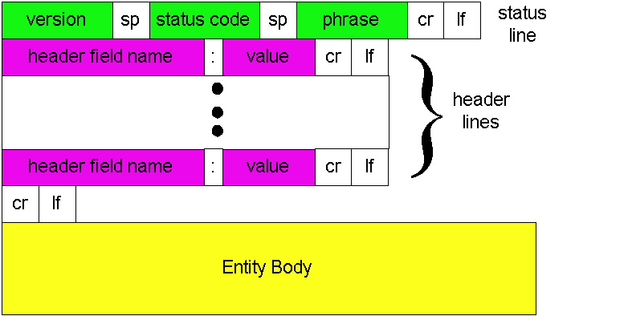
HTTP Response
Notes:
Entity Body for 200 is typically the HTML or data for img/js/etc

Slide 11
HTTP Response
Status-line
  HTTP version
  3 digit response code
    1XX – informational
    2XX – success
      200 OK
    3XX – redirection
      301 Moved Permanently
      303 Moved Temporarily
      304 Not Modified
    4XX – client error
      404 Not Found
    5XX – server error
      505 HTTP Version Not Supported
  Reason phrase

Slide 12
HTTP Response (cont.)
Headers
  Variable length, human-readable
  Uses:
    Location – for redirection
    Server – server software
    WWW-Authenticate – request for authentication
    Allow – list of methods supported (get, head, etc)
    Content-Encoding – E.g x-gzip
    Content-Length
    Content-Type
    Expires (caching)
    Last-Modified (caching)
Blank-line
Body
Notes:
The body contains all the HTML and/or data for images, etc

Slide 13
HTTP Response Example
HTTP/1.1 200 OK
Date: Tue, 27 Mar 2001 03:49:38 GMT
Server: Apache/1.3.14 (Unix) (Red-Hat/Linux) mod_ssl/2.7.1 OpenSSL/0.9.5a DAV/1.0.2 PHP/4.0.1pl2 mod_perl/1.24
Last-Modified: Mon, 29 Jan 2001 17:54:18 GMT
Accept-Ranges: bytes
Content-Length: 4333
Keep-Alive: timeout=15, max=100
Connection: Keep-Alive
Content-Type: text/html
…..

Slide 14
How to Mark End of Message?
Content-Length
  Must know size of transfer in advance
Close connection
  Only server can do this
Implied length
  E.g., 304 never have body content
Transfer-Encoding: chunked (HTTP/1.1)
  After headers, each chunk is content length in hex, CRLF, then body. Final chunk is length 0.
Notes:
Server either explicitly tells us the content length with header field
Server implicitly tells us by closing the connection
304 and other errors / directives have implied lengths of nothing
Chunked encoding, using for dynamic

Slide 15
Outline
HTTP overview
Proxies

Slide 16
Proxies
End host that acts a broker between client and server
  Speaks to server on client’s behalf
Why?
  Privacy
  Content filtering
  Can use caching (not in this assignment)
Notes:
Privacy – server doesn’t know the actual originating addr, just proxy’s
Content filtering – can selectively block requests and instead server up other pages
Caching – Multiple people want the same thing, cache it on proxy and save a request to server

Slide 17

Proxies (Cont.)
Accept requests from multiple clients
Takes request and reissues it to server
Takes response and forwards to client
origin
server
Proxy
server
HTTP request
HTTP request
client
HTTP response
HTTP response
HTTP request
HTTP response
client
origin
server

Slide 18
Assignment 1
Non-caching, HTTP 1.0 proxy
  Support only GET requests
Multi-process
  Use fork()
Simple binary that takes a port number
  ./proxy 12345 (proxy listens on port 12345)
Work in Firefox & Chrome
  Use settings to point browser to your proxy
Notes:
Don’t need to worry about POST and others
When using it with your browser, sites like Facebook / etc WILL NOT WORK as well

Slide 19
Assignment 1 (Cont.)
What you need from a client request: host, port, and URI path
  GET http://www.jhu.edu:80/ HTTP/1.0
What you send to a remote server:
  GET / HTTP/1.0
  Host: www.jhu.edu:80 Connection: close
Check request line and header format
Forward the response to the client
Notes:
Turn explicit request into implicit one

Slide 20
Assignment 1 (Cont.)
Non-GET request?
  return “Not Implemented” (code 501)
Unparseable request?
  return “Bad Request” (code 400)
Use provided parsing library
Postel’s law
  Be liberal in what you accept, and conservative in what you send
  convert HTTP 1.1 request to HTTP 1.0
  convert \r to \r\n
  etc
Notes:
Try to fix small errors when it’s obvious what the user wants to do, but make sure your responses are “by the book”

Slide 21
Advice
Networking is hard
  Hard to know what’s going on in network layers
  Start out simple, test often
Build in steps
  Incrementally add pieces
  Make sure they work
  Will help reduce the effect of “incomplete” information
Notes:
Don’t try to code up everything at once and then wonder where it goes wrong

Slide 22
Assignment 1 – Getting Started
Modify Assn 0 to have server respond
  Simple echo of what client sent
Modify Assn 0 to handle concurrent clients
  Use fork()
Create “proxy” server
  Simply “repeats” client msg to a server, and “repeats” server msg back
Client sends HTTP requests, proxy parses

Slide 23
Summary
HTTP: Simple text-based file exchange protocol
  Support for status/error responses, authentication, client-side state maintenance, cache maintenance

