Slide 1
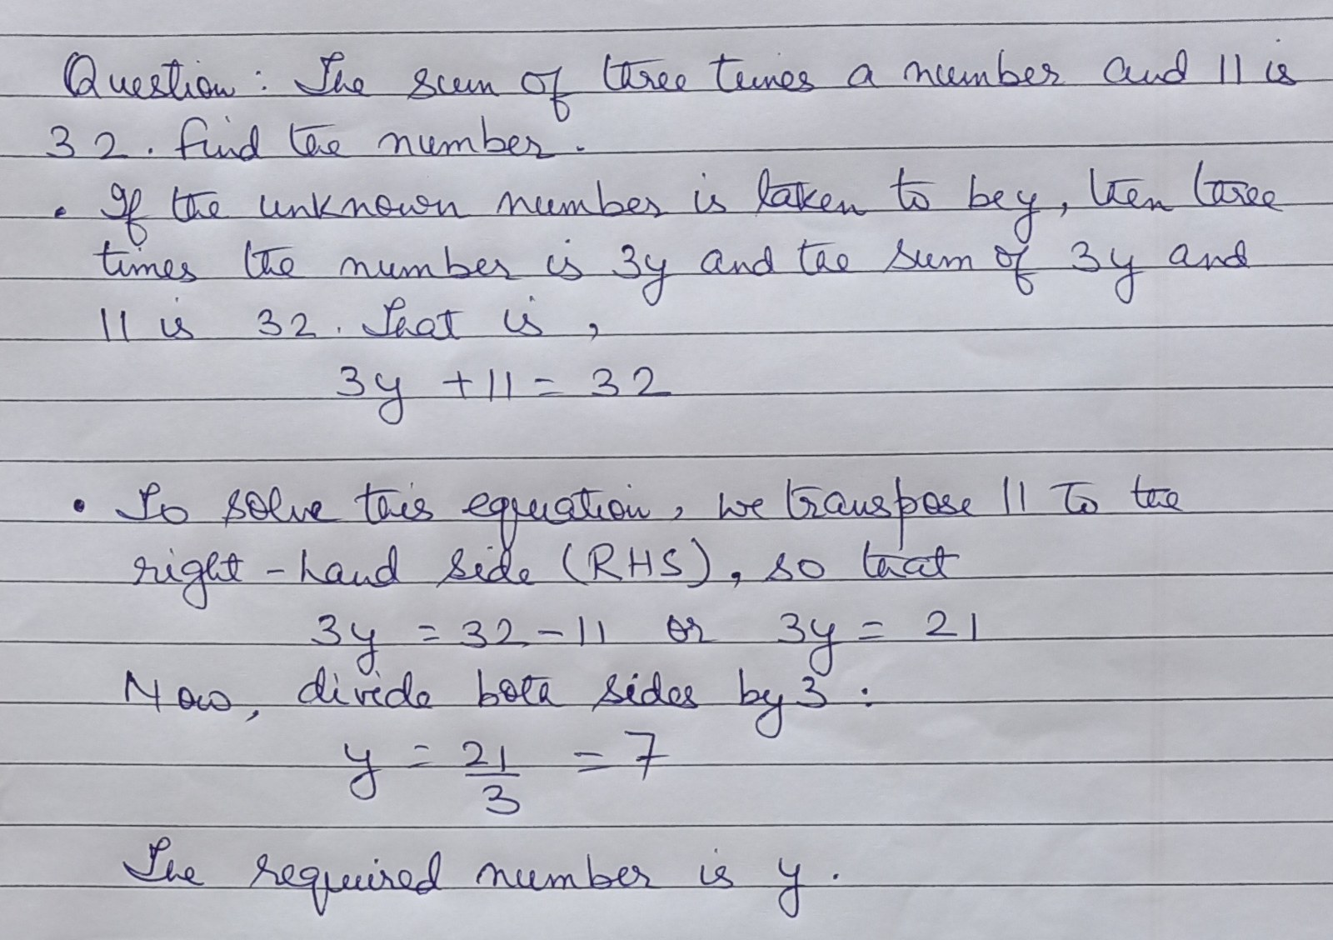
THE DATASET
FERMAT: handwritten math, errors planted on purpose
~2,200 photographed solutions · 85% contain a deliberate error
WE TEST TWO SEPARATE TASKS
Perception — read the page. Did it transcribe correctly?
Reasoning — grade the page. Did it spot the error correctly?
ONLY FERMAT HAS CORRECT ANSWERS TOO
FERMAT
15% clean
ErrorRadar / ScratchMath
no clean items
FERMAT · setup
1 / 8

Slide 2
PERCEPTION — CONFIRMED
When it can't read a page twice the same way, it's wrong
The model is asked to “explicitly perform OCR on the handwritten text and extract the content in LaTeX format.”
We do that 5 times per page and measure how much the readings disagree.
AUROC (95% CI)
All 5 readings disagree?
Wrong 57 times out of 61.
Flag those for a human. Catches 57 real errors, wastes 4.
All 300 pages
0.835 [0.787, 0.879]
Hardest cases deleted (slide 3)
0.796 [0.736, 0.852]
The model's own confidence
0.537 [0.469, 0.605]
Row 3's interval crosses 0.50 — the model's own confidence score is no better than a coin flip here.
ACROSS MODEL FAMILIES
A high score means nothing until the control is applied.
A fourth, LLaVA-NeXT-7B, could not read the pages at all.
AUROC
AFTER CONTROL
Qwen2.5-VL-3B
0.835
0.796
holds
Pixtral-12B
0.828
0.772
holds
InternVL3-8B
0.915
0.556
collapses
FERMAT · perception — reading the page
2 / 8

Slide 3
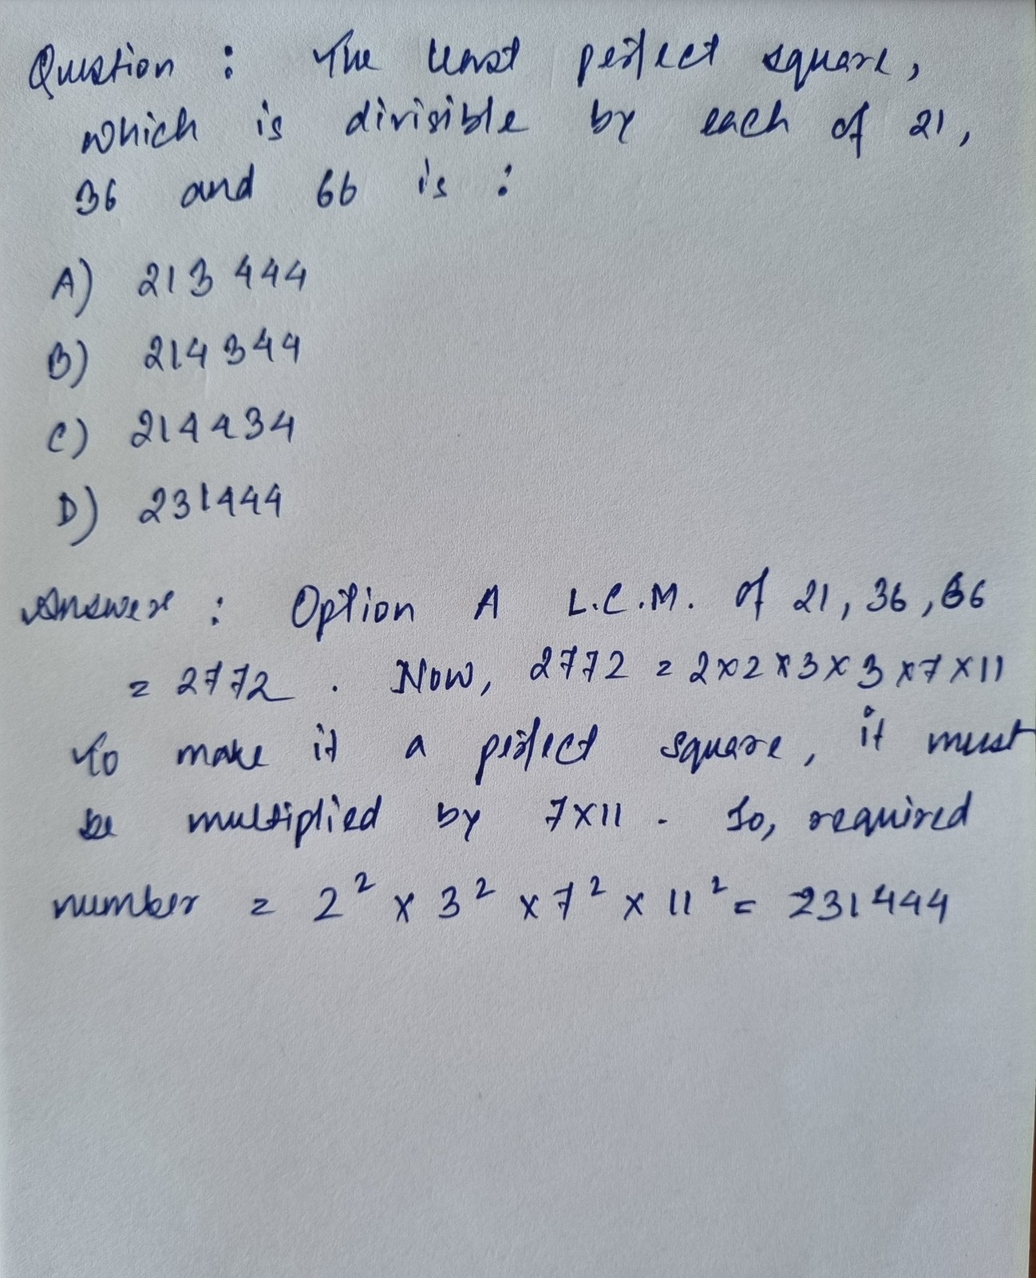
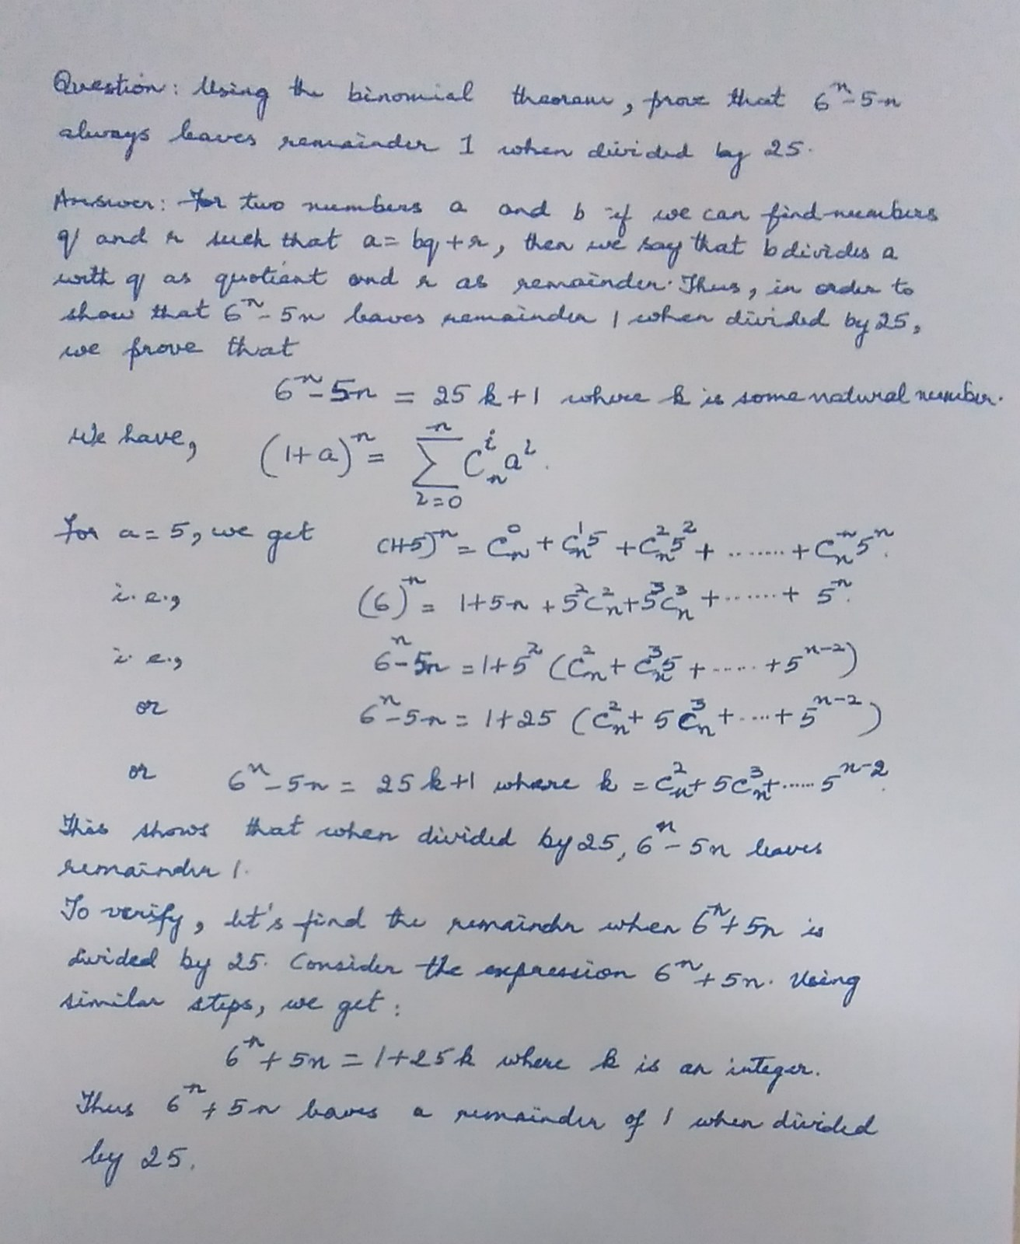
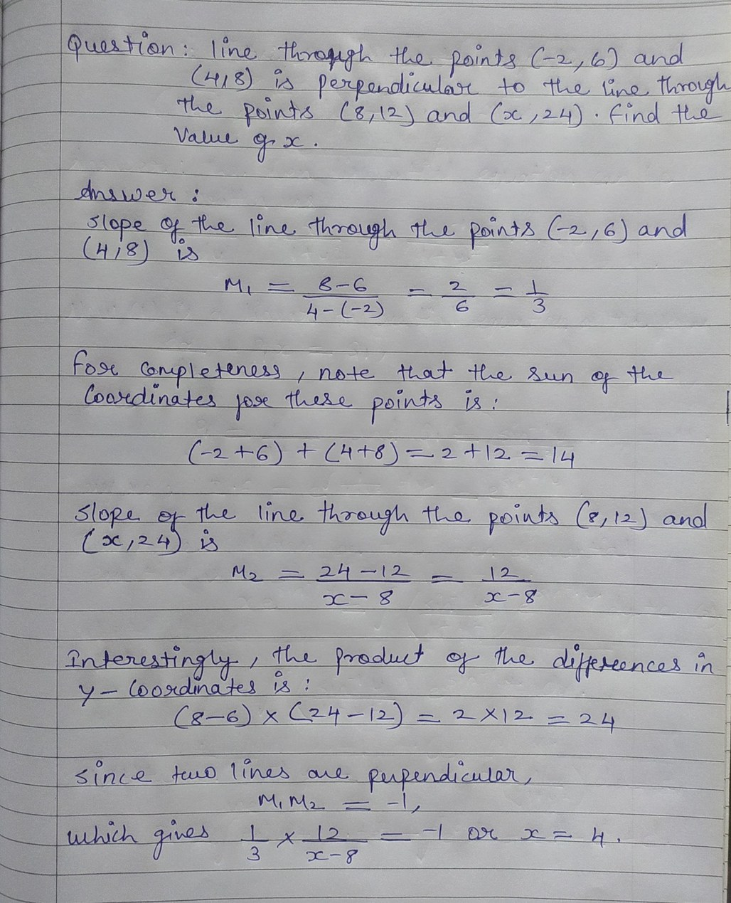
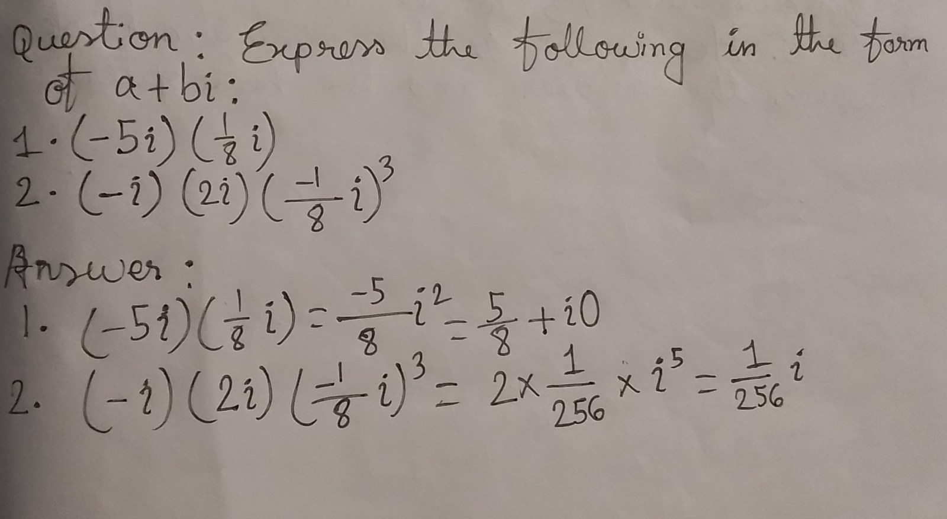
PERCEPTION — EVIDENCE
Where it works, and the blind spot
Agrees · H = 0.00
Correct
Disagrees · H = 1.61
Caught
Disagrees · H = 1.61
False alarm
Agrees · H = 0.00
Blind spot
Page 1 and page 4 look identical to the method — both entropy zero. One is right, one is wrong.
The robustness check: delete every page where all 5 readings differed — easy to flag, nearly always wrong. If the score survives, the signal is graded. Qwen 0.835 → 0.794, 239 pages left.
FERMAT · perception — Qwen2.5-VL-3B
3 / 8

Slide 4
REASONING — NEGATIVE
The same signal does not work for grading
Different task. The model is asked only: “analyze the Answer to determine whether there is any error.” It never sees the correct answer.
AUROC (95% CI)
Grading, 300 balanced pages
0.520 [0.458, 0.582]
interval contains chance
No signal. That is the honest reasoning result.
The model answers “error” for 80–90% of pages regardless of what is on them. Balancing the set is what makes this readable — on an unbalanced set that bias alone would score well.
FERMAT · reasoning — grading the page · Qwen2.5-VL-7B
4 / 8

Slide 5
WHAT WE GOT WRONG
We believed the opposite for three weeks
Splitting the grading data by ground truth seemed to recover a strong effect — replicated across three model families.
MODEL
WE REPORTED
SIGNAL-FREE COIN
COLLAPSE
Qwen2.5-VL-3B
0.854
0.901
99.8%
Qwen2.5-VL-7B
0.801
0.868
100%
LLaVA-NeXT-7B
0.775
0.831
97.2%
Inside one label group, “was it correct” IS “what did it answer”.
The same column, 100% of the time. Entropy is computed from those very votes, so it predicts correctness almost by definition. A coin with no signal scores higher than we did.
Not caught by pre-registration, by power, or by replicating it three times.
FERMAT · reasoning — retracted 2026-08-09
5 / 8

Slide 6
WHAT DID NOT WORK
Two results we had to throw out
A 4TH MODEL, PERCEPTION
0.915 → 0.556
InternVL3 looked like our best result. Under the robustness check it collapsed to chance — 2 of every 3 pages were total breakdowns, and that binary was all the score was detecting.
A 2ND DATASET, REASONING
96% accuracy, and meaningless
ScratchMath, 100 pages. Every page contains an error, and the model answers “error” 90% of the time — so it scores well by construction.
In 24% of readings it said it could not read the image. It answered “error” anyway in 82% of those.
Both were caught by checks we run on every number — which is why the results on the earlier slides can be trusted.
InternVL3 on FERMAT · Qwen2.5-VL-7B on ScratchMath
6 / 8

Slide 7
OPEN DECISION
One question
SOLID
— Perception: 0.835, replicated at 0.828 on a second model family
— Abstention rule: 57 of 61
— Reasoning: no signal — measured, not assumed
— The stratification trap: a method finding
LIMITED
— Every result sits on FERMAT alone
— Both alternative datasets are 100% error items
— …so neither can test the split on slide 4 at all
Accept one dataset as a limitation — or label correct pages ourselves?
~3 weeks to submission. All experiments done; remaining work is the write-up.
FERMAT · both tasks
7 / 8

Slide 8
PROPOSED NEXT EXPERIMENT
Make it solve the problem, not just eyeball it
The gap: plausibility-checking instead of recomputing.
It reads the student's steps and judges whether they look right. One page asserts 19 × −18 × 23 = −7966. The model accepted it. The correct value is −7866.
ALREADY TRIED — PROMPT LEVEL
“First, transcribe the final result the student arrived at, exactly as written. Then check that result by working the problem yourself. Only then decide whether the Answer contains an error.”
Qwen-3B says-error 94% → 38%, accuracy 0.51 → 0.55
InternVL3 accuracy 0.70 → 0.67
Behaviour swung hard. Accuracy did not move.
NOT YET TRIED — PIPELINE LEVEL
Solve the page independently, then compare in code.
Asking one prompt to do both still lets the model see the student's answer first, so it can anchor on it. A separate solve step cannot.
Then re-measure: does the split on slide 4 still hold, and does uncertainty still predict the errors?
Worth the remaining time — or write up what we have?
FERMAT · reasoning — proposed
8 / 8

