Slide 1
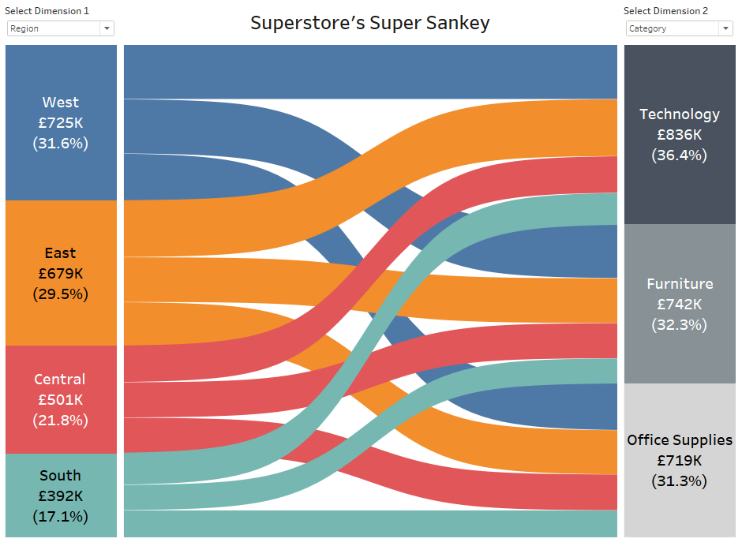
Hidden stats: Education, Status, Wealth, Outlawness
Health, Energy, Joy, Freetime
H+2
F-2
E-2
T-2
Cable TV
1 BR Apt
300€/m
Ratty car
snakey diagram
Shared apt
150€/m
Newspaper delivery job
Work overtime
New phone
Vegetables
Meat
Nice car

