Slide 1

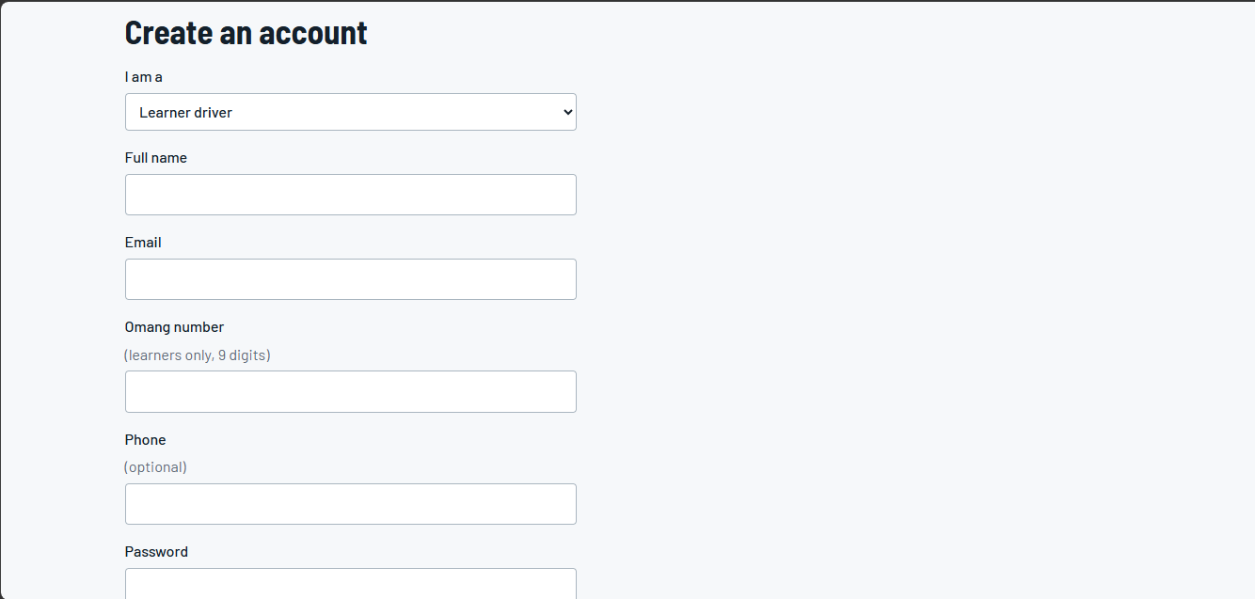
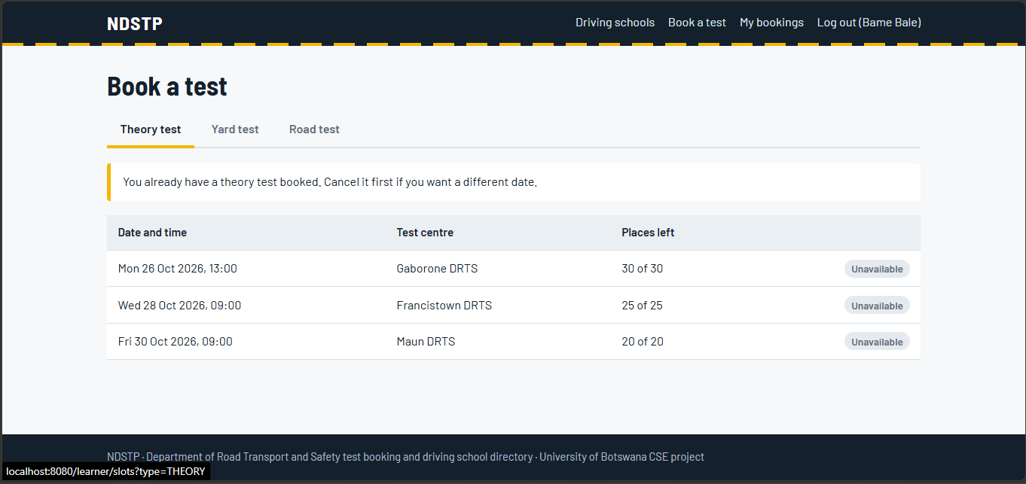
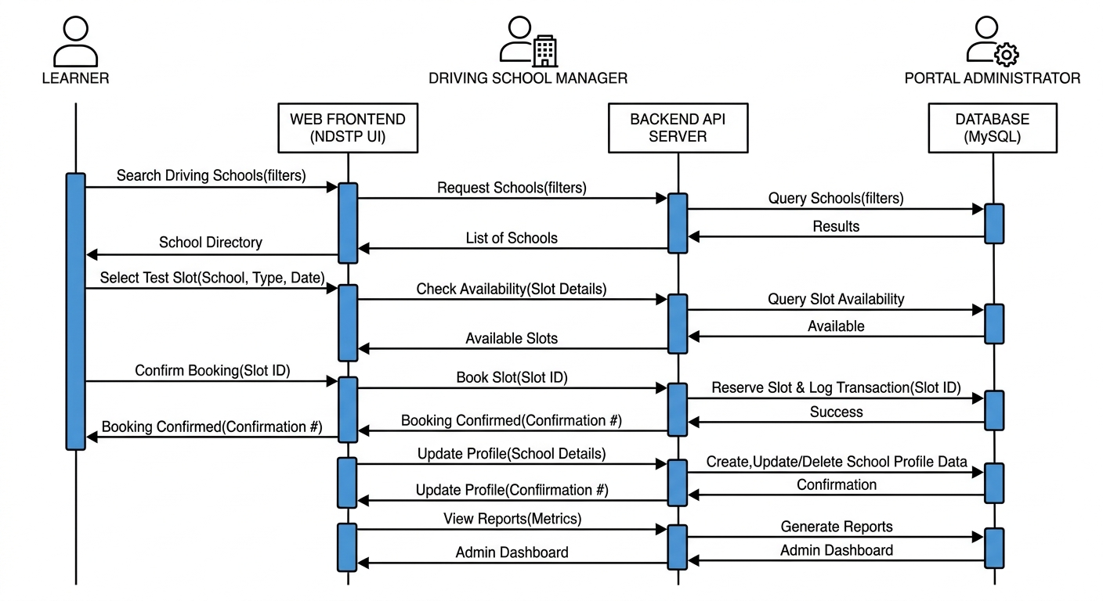


BSBS • RESEARCH AND INNOVATION PROJECT
TECH STACK
NDSTP
National Driving School & Testing Portal (NDSTP)
HTML5, CSS3, JS, Node.js, MySQL
DURATION
A centralized web application for DRTS license examination bookings and an accredited driving school directory
14 weeks
Group Members: Itumeleng Sepepe |Rrapula Phemelo Semele |Bame Bale |Kago Tlotlo Kelefe
METHOD
Institution Name [BOTSWANA SCHOOL OF BUSINESS SCIENCES] • BSc (Hons) Computer Systems Engineering [2024-2028]
Agile sprints
1
INTRODUCTION & PROBLEM STATEMENT
2
LITERATURE REVIEW
Background
Licensing needs three sequential modules: Theory, Yard and Road.
DRTS bookings are manual: long queues, low date visibility.
Problem Statement
Paper logs cause double-booking, idle examiner time and no-shows.
No national school directory: drivers face information asymmetry.
Solution: real-time slot locking plus a verified school marketplace.
TAM: adoption depends on Perceived Usefulness and Ease of Use (Davis, 1989).
Dynamic scheduling: transactional locking removes double-bookings (Silberschatz et al., 2020).
Two-sided platforms: aggregation cuts search costs and lifts small-firm visibility (Rochet & Tirole, 2003).
Gap: no approach pairs real-time slot locking with verified school listings.
Existing work | Strength | Limitation
Manual DRTS | Physical audit trail | Queues, double-booking
Social media | Broad reach | Unverified, no slot sync
NDSTP Portal | Real-time locks, RBAC and a verified school directory; needs web connection
3
SYSTEM DESIGN
Agile sprints over 14 weeks.
Multi-tier decoupled web model with RBAC.
Learner: slot search, real-time booking, school lookup.
Manager: service packages, lead tracking.
Admin: examiner allocation, accreditation audits.
Node.js / Express API with MySQL / PostgreSQL.
Technology Acceptance Model
Usefulness and ease of use drive adoption
NDSTP
Real-time slot locking
RBAC security
Verified school directory
Outcome
Less physical congestion
No double-booking
Reduced market asymmetry
Dynamic scheduling
Transactional locking prevents collisions
Users &
Roles
Client UI
HTML5 / CSS3 / JS
REST API
Node.js / Express
Relational DB
MySQL / PostgreSQL
Two-sided platforms
Marketplace cuts search costs
Figure 2. High-level multi-tier design: users, client UI, REST API, relational database.
Figure 1. Conceptual framework: three theories inform the design of NDSTP.
Learner
Exam slot search
Real-time booking
School lookup
Manager
Service packages
Lead tracking
Admin
Examiner allocation
Accreditation audits
4
RESULTS & DISCUSSION
Prototype verified by automated tests, concurrency load simulation and UAT.
All three criteria passed: 100% tests, SUS 84.5, 420 ms with zero collisions.
Transactional locks prevented double-booking under simulated concurrent slot selection.
Client UI • HTML5 / CSS3 / JS
Role-Based Access Control (RBAC)
REST API Engine
Node.js / Express
Relational Database
MySQL / PostgreSQL
Figure 3. Role-based architecture: each role reaches shared services through the REST API.
Figure 5. Evaluation highlights from the functional prototype.
Evaluation criterion | Method | Target | Result
Functionality | Automated tests (Auth, Slot CRUD) | 100% pass | PASSED: 100%
Usability | UAT with SUS survey | Score > 80 | PASSED: 84.5
Performance | Concurrency load simulation | < 2.0 s, 0 collisions | PASSED: 420 ms, 0 broken locks
Figure 4. Sequence diagram: learner, school manager and administrator interactions with the web frontend, backend API and MySQL database.
5
CONCLUSION
6
RECOMMENDATIONS & FUTURE WORK
NDSTP replaces paper-based, queue-heavy DRTS operations with a self-service portal.
TAM, dynamic slot scheduling and RBAC together resolve congestion and market asymmetry.
All evaluation targets were met, including zero double-bookings.
Pilot NDSTP at DRTS in Gaborone and Francistown.
Integrate Orange Money and MyZaka for instant fee settlement.
Add SMS and email reminders and a Flutter mobile app.
REFERENCES
Davis, F. D. (1989). Perceived usefulness and acceptance of IT. MISQ, 13(3), 319–340. • Government of Botswana. (2020). Road Transport and Safety Strategy Report. Gaborone. • Leong, C., et al. (2021). Smart appointment systems. J. Inf. Tech., 36(2), 145–162. • Mpofu, R., & Ohei, K. N. (2022). Directory platforms & market visibility. AJIS, 14(1). • Rochet, J.-C., & Tirole, J. (2003). Platform competition in two-sided markets. • Silberschatz, A., et al. (2020). Database system concepts.

