Slide 1
P2P Messaging + Location Sharing

Slide 2
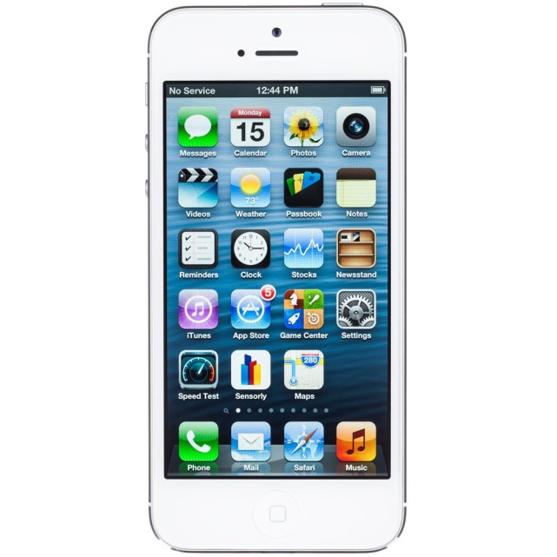

Login
Update IP

Slide 3

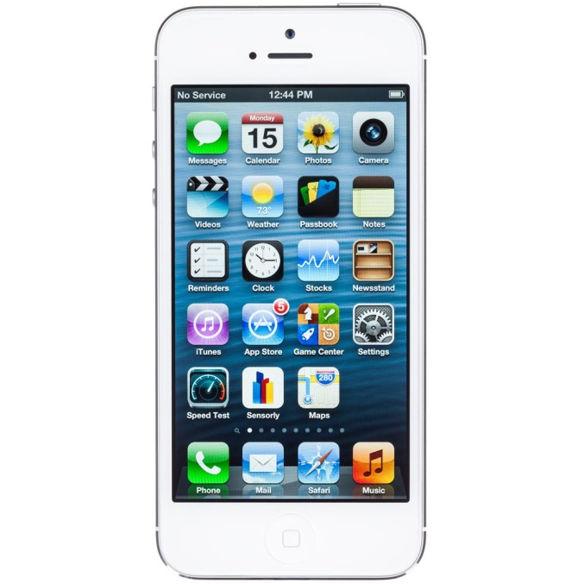

Create Chat
Request recipients IP
IP stored from last login
Receive IP

Slide 4

Send Message
Message

Slide 5
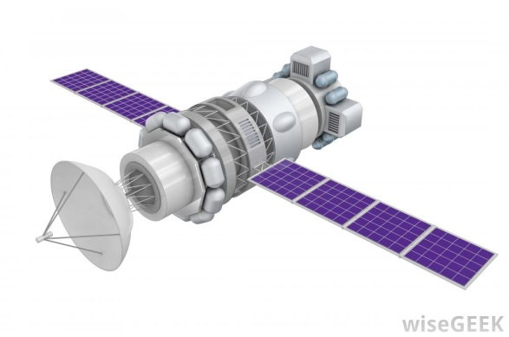


Send Map Location
GPS Request
GPS Location
GPS Message

Slide 6
Packet
Sending Clients Username
Sending Clients IP Address
Map Coordinates
Message

