Slide 1

Analysis of NYPD Shooting Incidents
Sepideh Forouzi
https://github.com/sepidfs/DTSA5301

Slide 2
Introduction & Motivation
📌 Dataset
NYPD Shooting Incident Records
Event details: location, time, demographics, outcome
📊 Research Questions
Where and when are shootings most lethal?
What features predict murder vs. non-lethal incidents?
How do race, sex, and age influence predictions?
⚖️ Ethical Focus
Use demographic data with caution
Reflect on fairness, not amplify bias
Interpretive modeling, not punitive

Slide 3
NYPD Shooting Dataset Overview
🗂 Data Source & Scope
Dataset: NYPD Shooting Incident Data (Historic)
Records: 28,562 unique firearm incidents
Time Range: Multiple years; day-level granularity via OCCUR_DATE
Geographic Coverage:
Manhattan
Brooklyn
Bronx
Queens
Staten Island
📌 Why This Dataset Matters
Supports granular study of firearm violence
Enables spatial-temporal pattern recognition
Critical for criminology, sociology, and public health

Slide 4
Structured Variables in the Dataset
📊 Selected Key Variables
Column | Description | Type
INCIDENT_KEY | Unique identifier | Integer
OCCUR_DATE / TIME | Date and time of incident | DateTime
BORO | Borough (e.g., Brooklyn) | Categorical
PRECINCT | Police precinct code | Integer
STATISTICAL_MURDER_FLAG | 1 if lethal, 0 otherwise | Boolean
VIC_AGE_GROUP | Victim age group | Categorical
VIC_SEX | Victim sex (M, F, U) | Categorical
VIC_RACE | Victim race/ethnicity | Categorical
LATITUDE / LONGITUDE | Geographic coordinates | Float

Slide 5
Preprocessing & Class Imbalance
🧼 Preprocessing Steps
Parsed OCCUR_TIME → OCCUR_HOUR (0–23)
Imputed missing coordinates (<1%)
Encoded 'U' / NULL as valid categories
Label-encoded categorical variables (e.g., VIC_RACE, VIC_AGE_GROUP)
📉 Class Imbalance
Non-lethal incidents: 80.4%
Lethal incidents: 19.6% ⚠️ Standard models may ignore rare class → risk of false negatives
✅ Remedy:
Applied random undersampling of the majority class
Maintains interpretability while improving class parity

Slide 6
Demographic Features & Ethical Modeling Constraints
🧠 Use of Demographics
Race, sex, and age included in models only for diagnostic purposes
Not used for predictive enforcement
Aim: assess exposure disparities, not individual culpability
⚖️ Ethical Commitments
Demographics ≠ proxies for criminality
Feature audits planned to assess disparate impact
Maintain transparency about variable influence in model decisions

Slide 7
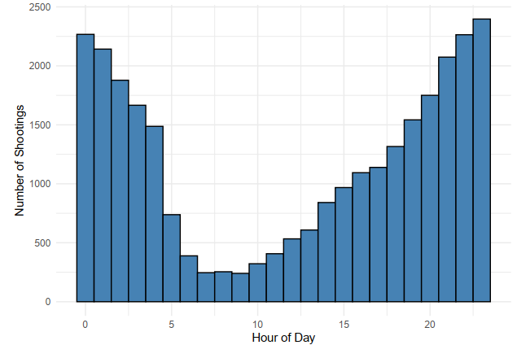
When Do Shootings Happen?

Slide 8
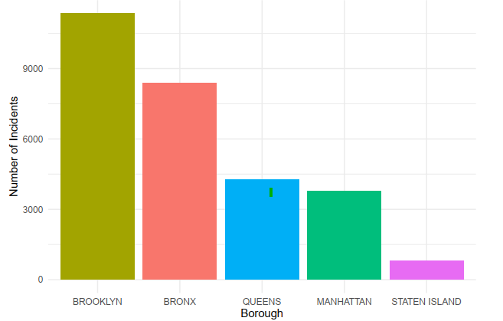
Where Do Shootings Happen?

Slide 9
Predicting Shooting Lethality
🎯 Goal
Predict whether a shooting leads to murder (1) or non-murder (0)
Use information available at the time of incident
🧮 Model Used
Logistic Regression (easy to interpret, good baseline)
Feature | Type
Borough | Categorical
Hour of Day | Numeric
Victim Age Group | Categorical
Victim Sex | Categorical
Victim Race | Categorical

Slide 10

How Logistic Regression Works
🧮 What It Predicts
Estimates the probability that a shooting leads to murder
Output is a number between 0 and 1
Uses a logit function to link features to probability
📝 Model Formula
Let:
$y_{i} ∈\{0,1\}$: outcome for incident i
$x_{i} ∈ ℝ^{d}$: feature vector
$\hat{p_{i}}=P(y_{i}=1|x_{i})$: predicted probability
$$\log\left(\frac{\hat{p_{i}}}{1−\hat{p_{i}}}\right)=b_{0}+\sum_{j=1}^{d}{b_{j}x_{ij}} \text{​}$$

Slide 11
Baseline Model
Class | Precision | Recall | F1-Score
Non-Murder | 0.81 | 1.00 | 0.89
Murder | 0.00 | 0.00 | 0.00
🚨 Problem:
Model predicted everything as non-lethal
Totally missed actual murder cases
This is called the accuracy paradox
🛠 Next Step:
Apply undersampling to fix class imbalance (19.6% lethal)

Slide 12
Why and How We Used Undersampling
⚠️ The Problem
Only ~20% of shootings are murders
Model learns to predict "non-murder" for everything
High accuracy, but no real value
🔁 The Solution: Undersampling
Keep all murder cases
Randomly select a smaller number of non-murder cases
Balance the dataset so both classes are equal
📊 Result:
Model sees murders and non-murders equally

Slide 13
Confusion Matrix
 | Predicted Non-Murder | Predicted Murder
Actual Non-Murder | 694 | 423
Actual Murder | 656 | 438

Slide 14
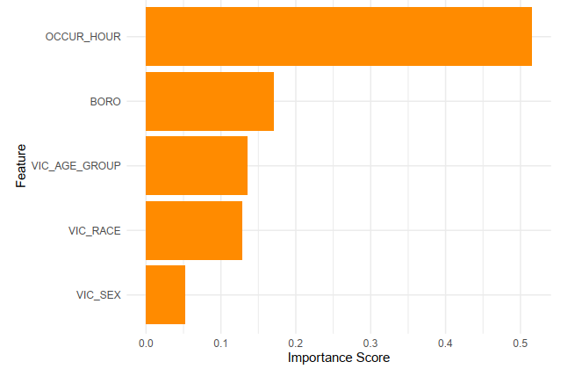
Top Factors Influencing Lethality
📊 Most Important Features
Time of Day (OCCUR_HOUR) → Late-night (12–2 AM) = higher lethality
Borough (BORO) → Staten Island = fewer but deadlier incidents
Victim Age (VIC_AGE_GROUP) → Young adults (18–44) = higher fatality risk
Victim Race (VIC_RACE) → Reflects exposure, not causation
Victim Sex (VIC_SEX) → Least useful — most victims are male

Slide 15
Conclusion
We examined the top predictors:
Time of day was most important — shootings after midnight were more often deadly.
Borough played a role — Staten Island stood out.
Victim age mattered — fatalities were higher among 18–44 year-olds.
In conclusion, this project combined statistical modeling with ethical insight to study gun violence in NYC. It shows how data science can responsibly support public safety.

Slide 16
Thank you

