Slide 1
Progress ITS Project 18/11/2022
Silke Van Poeyer, Lare De Vlieger, Seppe Vilain

Slide 2
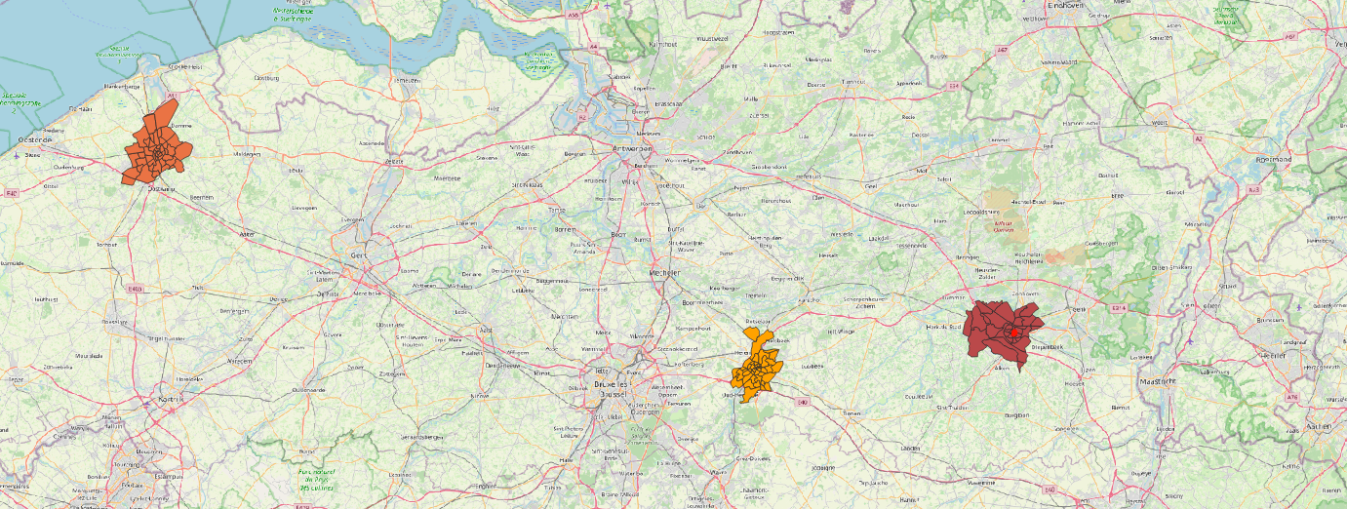
Training data
3 zones
Brugge
Hasselt
Leuven

Slide 3
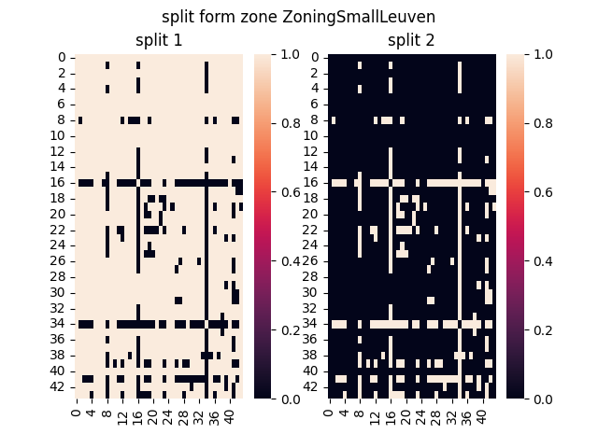
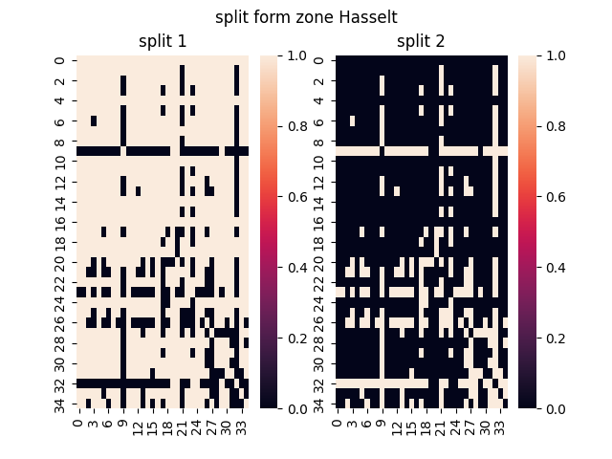
Split tomtom od matrix
Use average od as split value

Slide 4
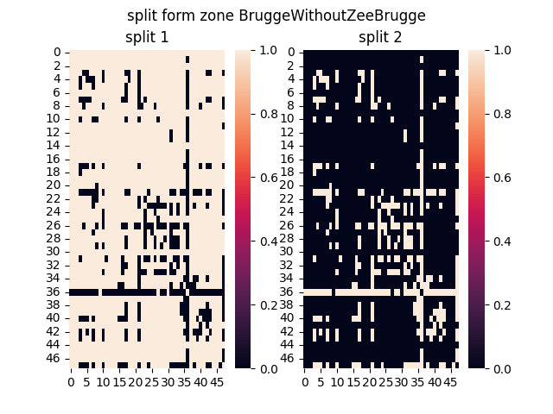
Split tomtom od matrix
Split 1 contains most of the od pairs
Split 2 contains the outliers
Makes te analysis more robust

Slide 5
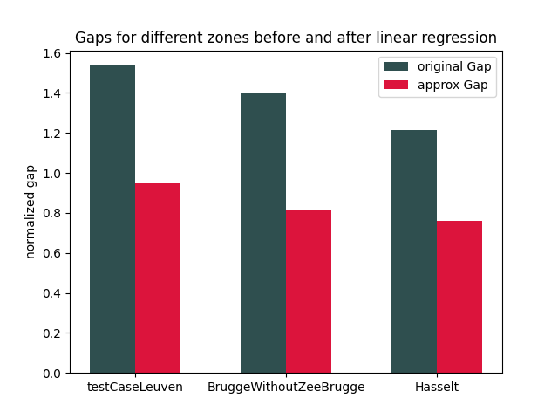
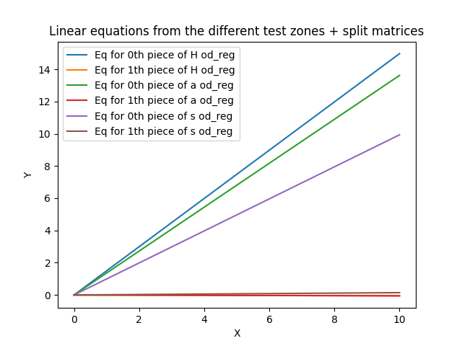
Linear regression for each zone
Gap after the combined linear regression
The data is normalized before the regression
~ -40%
~ -40%
~ -35%

Slide 6
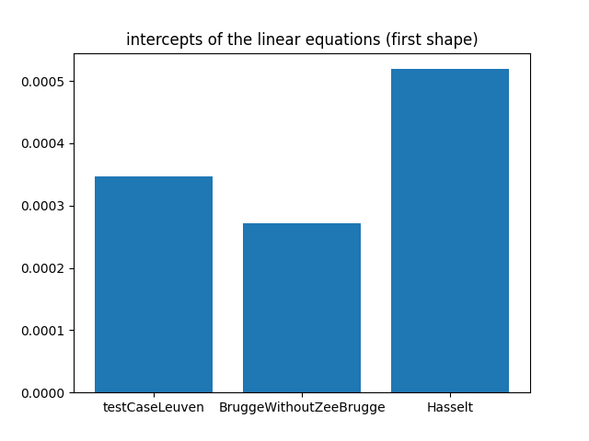
Linear regression for each zone
Equations:
Leuven:
Y = 1.4966297004652385 * X + 0.00034647180094710085
Brugge:
Y = 1.3616455511669245 * X + 0.0002723014846428652
Hasselt:
Y = 0.9933224965627021 * X + 0.0005190897335068025
Small change in intercept, more change in slope

Slide 7
Analysis
Analysis done to find correlation between the slopes and other properties of the zones.
For now limited to TomTom provieded properties:
Zone | Area [km²] | Road Coverage [km]
Leuven | 57.52 | 997.67
Brugge | 95.36 | 1069.56
Hasselt | 102.53 | 1487.82

Slide 8
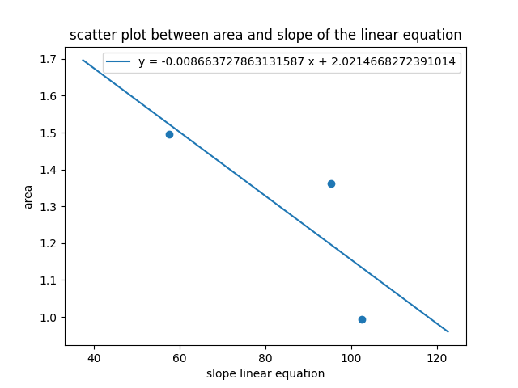
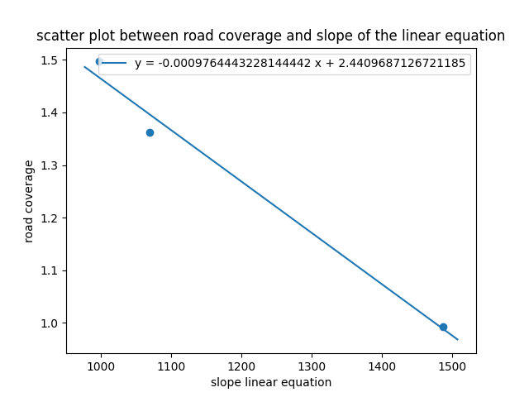
Analysis
Area
Road coverage

Slide 9
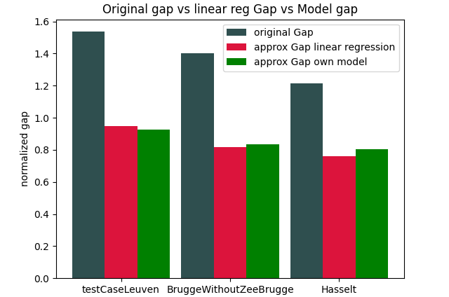
First Model
OD_matrix =[(-0.0009764443228144442 * RC + 2.4409687126721185) *OD + 0.00037928767303225624] * NT
Only done for first ‘split’ part
Linear equation with ‘variable’ road coverage for slope
Intercept = average of 3 found intercepts
For comparing purpose second ‘split’ used from the linear regressions
Future work to make a model for this aswel
RC = Road Coverage
OD = TomTom OD table
NT = Number of Trips

Slide 10
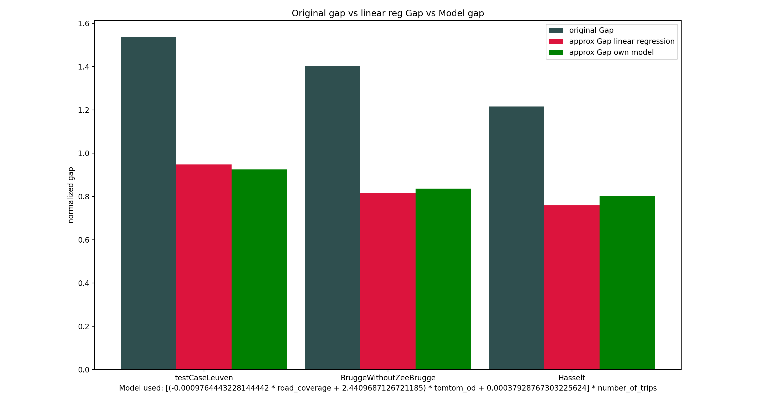
First Model
OD_matrix ={[(-0.0009764443228144442 * RC) + 2.4409687126721185] *OD
+ 0.00037928767303225624} * NT

Slide 11
Future Work
Extend the trainings data (zones)
Find more zone properties
Non TomTom related (OSM?)
Apply same steps on the 2nd ‘split’
Define some validation data (zones)
…

