Slide 1
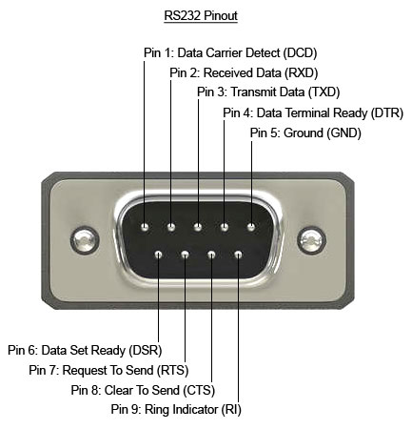
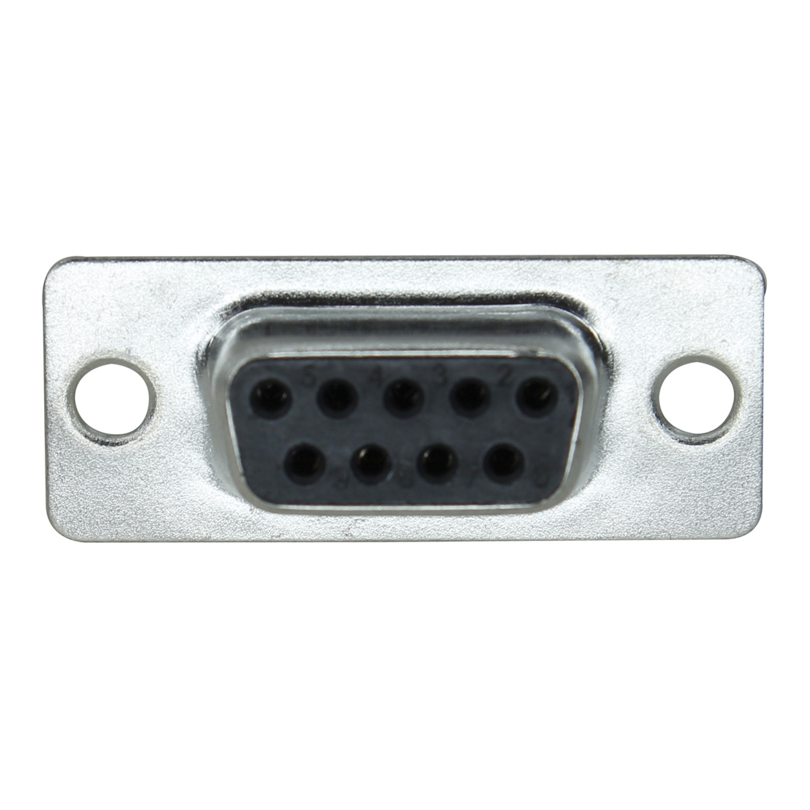
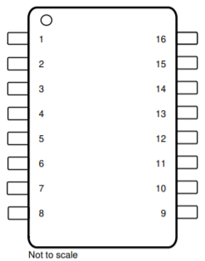


RIN1
Pin 13
DOUT1
Pin 14
SCALE OUT
GND
SCALE GND
VCC
GND
SCALE OUT
RXD
To uC
TXD
R1OUT on MAX3232 chip – Connect to uC RX line

Slide 2
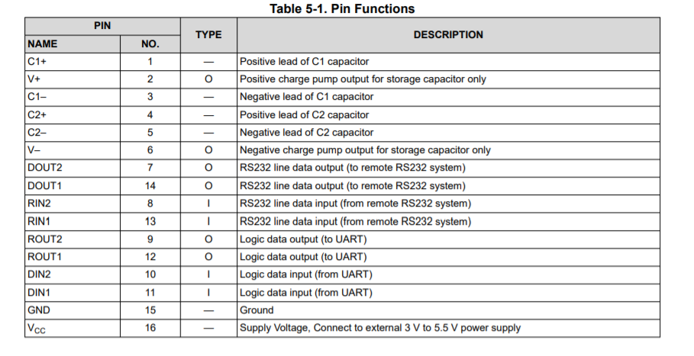

Slide 3
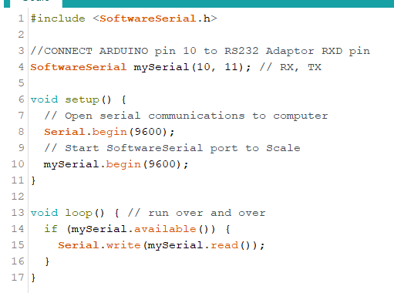

Slide 4
This is the output from Arduino Pin 11 (TX) sending “A” using software serial.

Slide 5
This is the max3232 output (DB9 pin ??) when the max3232 is powered with Arduino 3.3V. Blue is the Arduino input to the Max3232. Yellow is the output of the Max3232. Note that the yellow is inverted with respect to the input, AND swings between about -6 and 6V.

Slide 6
Same as the previous slide, but now powered by the 5V pin on the Arduino. Note that the yellow now swings between -8.5V and 8.5V.

Slide 7
Still powered at 5V… now looping backing the DB9 pins… the yellow is now the RXD pin of the Max3232 board. Note that the “high” level to the Arduino is only 2V!!!! That’s probably why nothing is being recognized by the Software Serial… voltage for HIGH is too low??? But the Max3232 has “reinverted” the output so matches the input.

Slide 8
1528-1876-ND x2
3M5480-ND x1
ATMEGA328P-PU-ND x1
Barrel connector
https://www.michaels.com/12x5.5-clear-pine-craft-wood-by-artminds/10212989.html

Slide 9
https://www.adafruit.com/product/1270

