Slide 1


Slide 2
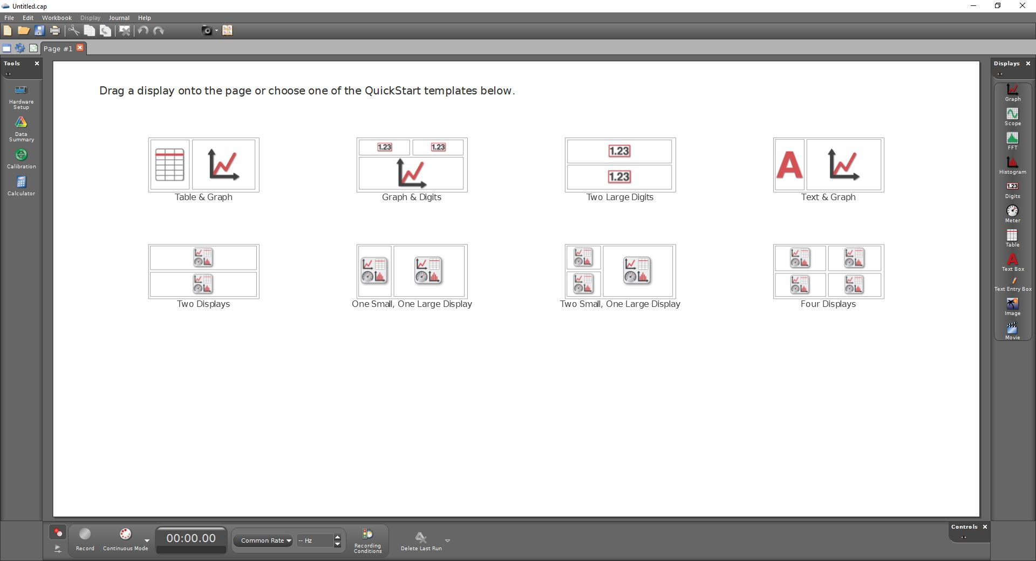
Menu
Most Common Workspaces
Tools Palette
Display Palette
Control Palette

Slide 3
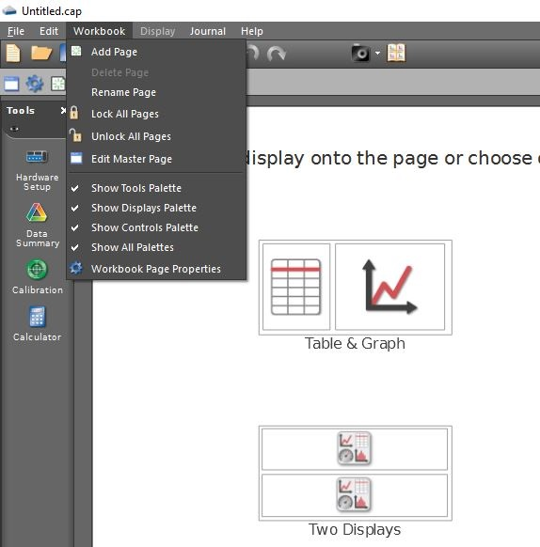
1. If you don’t see a palette, click [Workbook] in the menu
2. Click to display or remove whichever palette you like.
3. When you are ready to take and display data, select [Table & Graph]

Slide 4
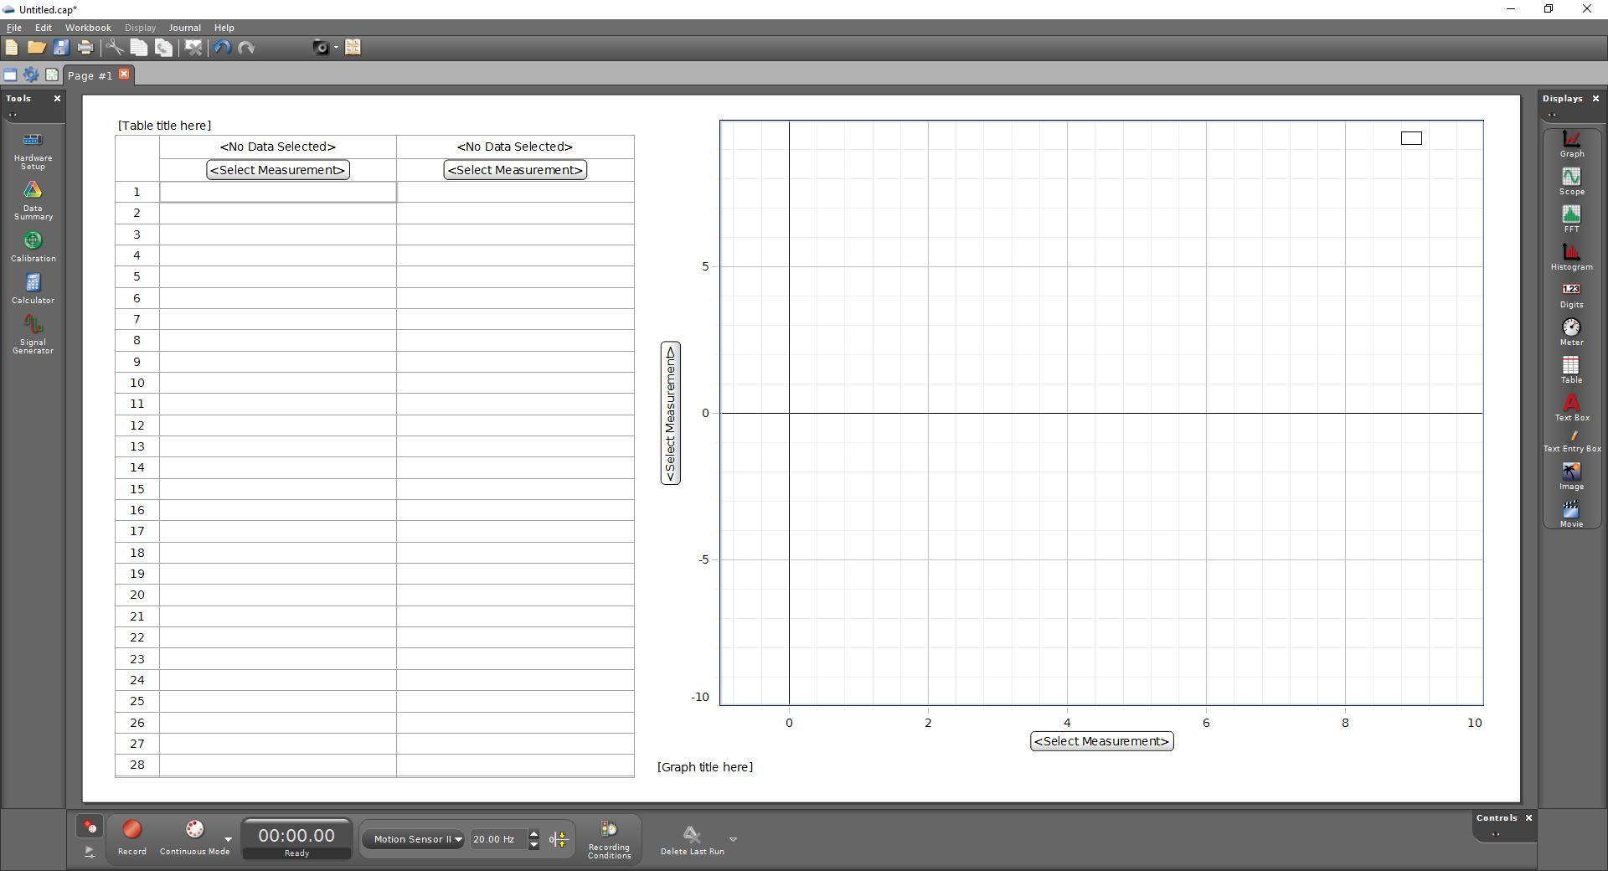
1. Hardware setup
2. Labelling graphs & tables
3. Recording data

Slide 5
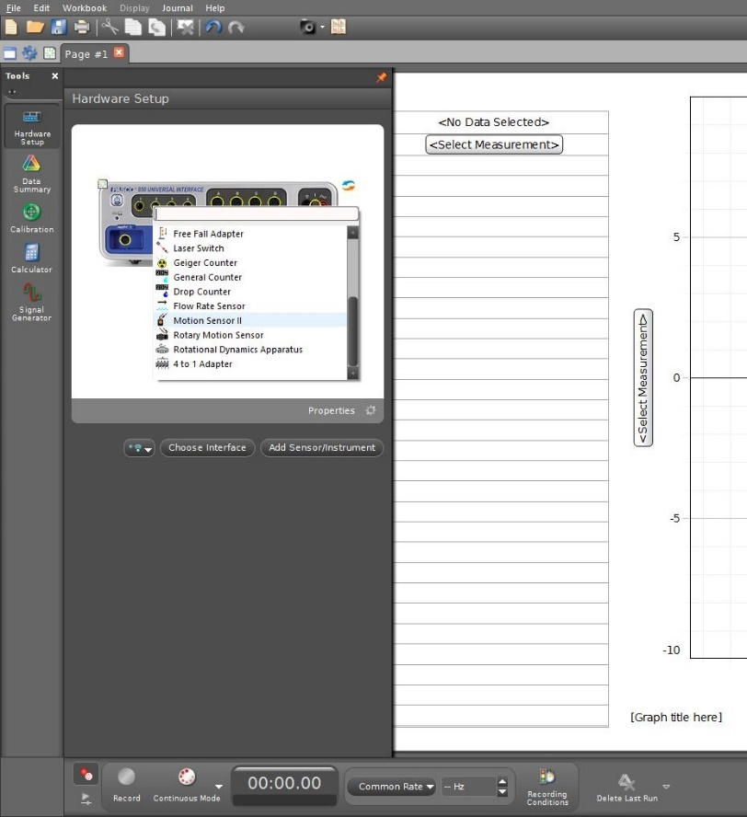
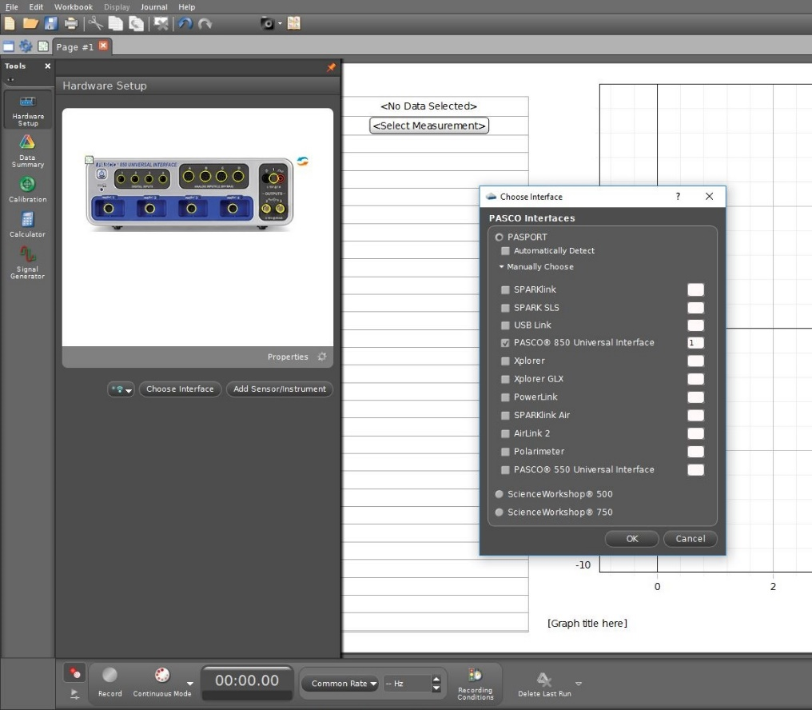
Clicking [Hardware Setup] should give an image of the
PASCO 850 Universal Interface.
If not, click [Choose Interface].
You might need to open the [Manually Choose], then check PASCO 850 Universal Interface.
The PASCO Interface will allow different measuring devices. To plug in the motion sensor, right-click on the left-most digital input, then
scroll down and select the [Motion Sensor II].
The motion sensor has two plugs.
The yellow plug should be in digital-input 1.
The black plug should be in digital-input 2.
Remember to turn on the PASCO Interface.
(The actual equipment.)

Slide 6
Clicking [Hardware Setup] should give an image of the
PASCO 850 Universal Interface.
Remember to turn on the PASCO Interface.
(The actual equipment.)

Slide 7
Clicking [Hardware Setup] should give an image of the
PASCO 850 Universal Interface.
If not, click [Choose Interface].
You might need to open the [Manually Choose], then check PASCO 850 Universal Interface.

Slide 8
The PASCO Interface will allow different measuring devices. To plug in the motion sensor, right-click on the left-most digital input, then
scroll down and select the [Motion Sensor II].
The motion sensor has two plugs.
The yellow plug should be in digital-input 1.
The black plug should be in digital-input 2.

Slide 9
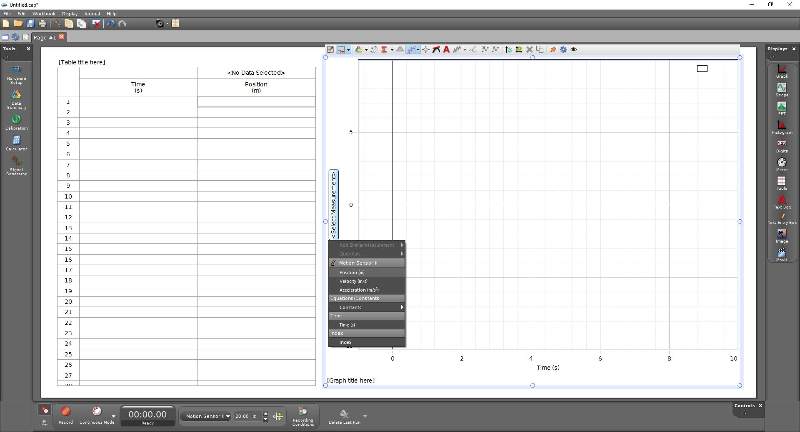
Click each <Select Measurement>
In the pop-up menu, select the appropriate variable.

Slide 10
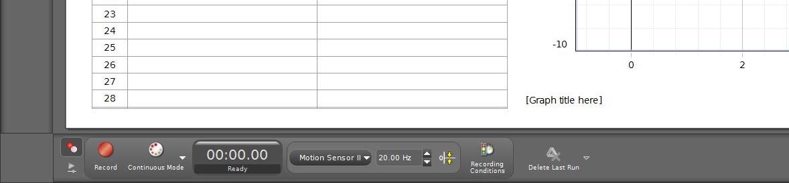
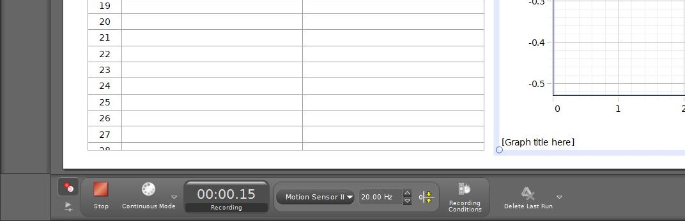
When you are ready, click [Record] to begin collecting data.
The [Record] button will become a [Stop] button while the data is being collected.
The graphs and table should fill with data as it is collected.
When you are done, click [Stop] to end the data collection.

Slide 11
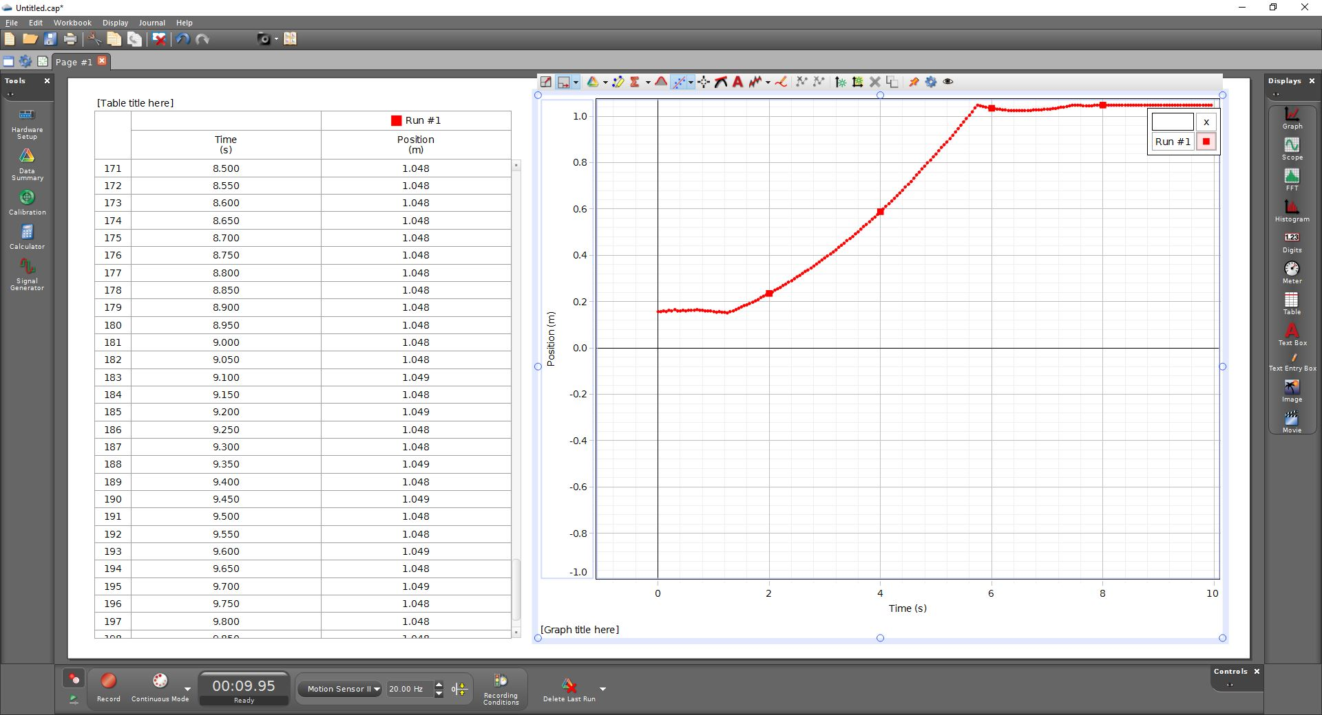
You can resize the graph here.
You can decide which data set to display here.
You can add more pages of graphs or tables here
You can create a “best fit” curve here.
You can add a graph to this page here.
These are similar, but different
You can add a graph to this page here.
You can record additional data sets here.
You can delete specific data sets here.

Slide 12
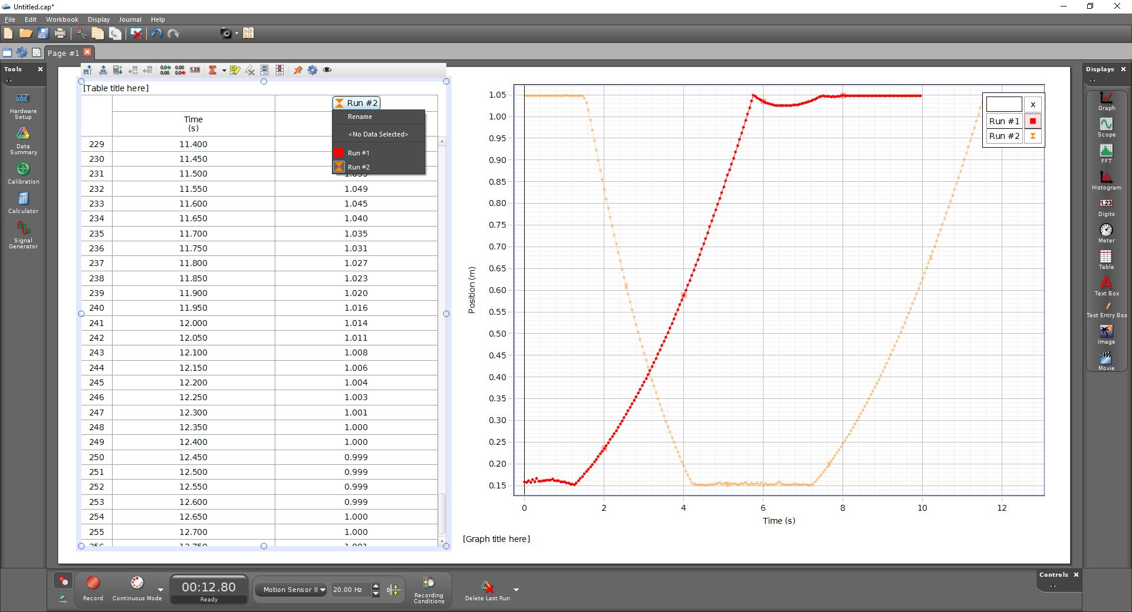
After collecting multiple data sets, you can choose which to display in your table
This button allows you to remove a column from your table
This button allows you to add a new column to your table

Slide 13
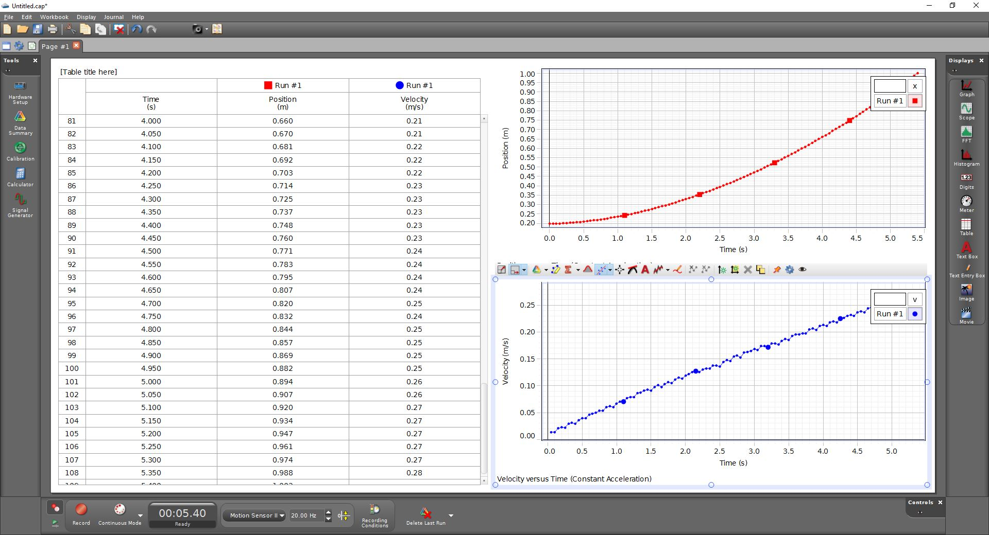
This shows one data set, but with multiple variables (position and velocity). Note that both are labelled as “Run #1” in both the table and the graph.
I had to insert a new column into the table to allow the velocity data to be included.
I created the second graph using the Display-Palette on the far right, which means that the velocity graph has its own menu and can be re-sized independently of the position graph.

Slide 14
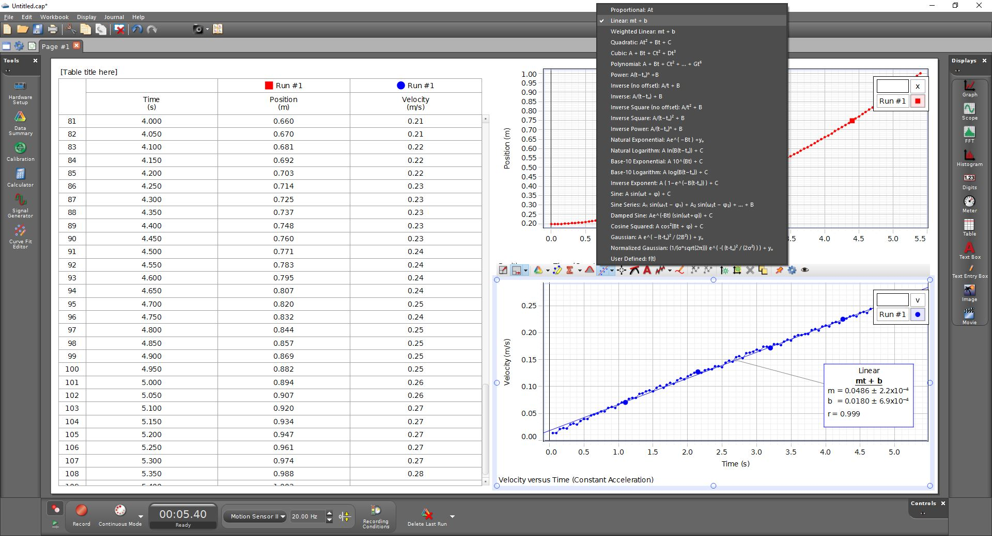
When you click here to create a best-fit, you get a menu to select the type of curve to fit the data with.
You will usually want either linear or quadratic fit.

Slide 15
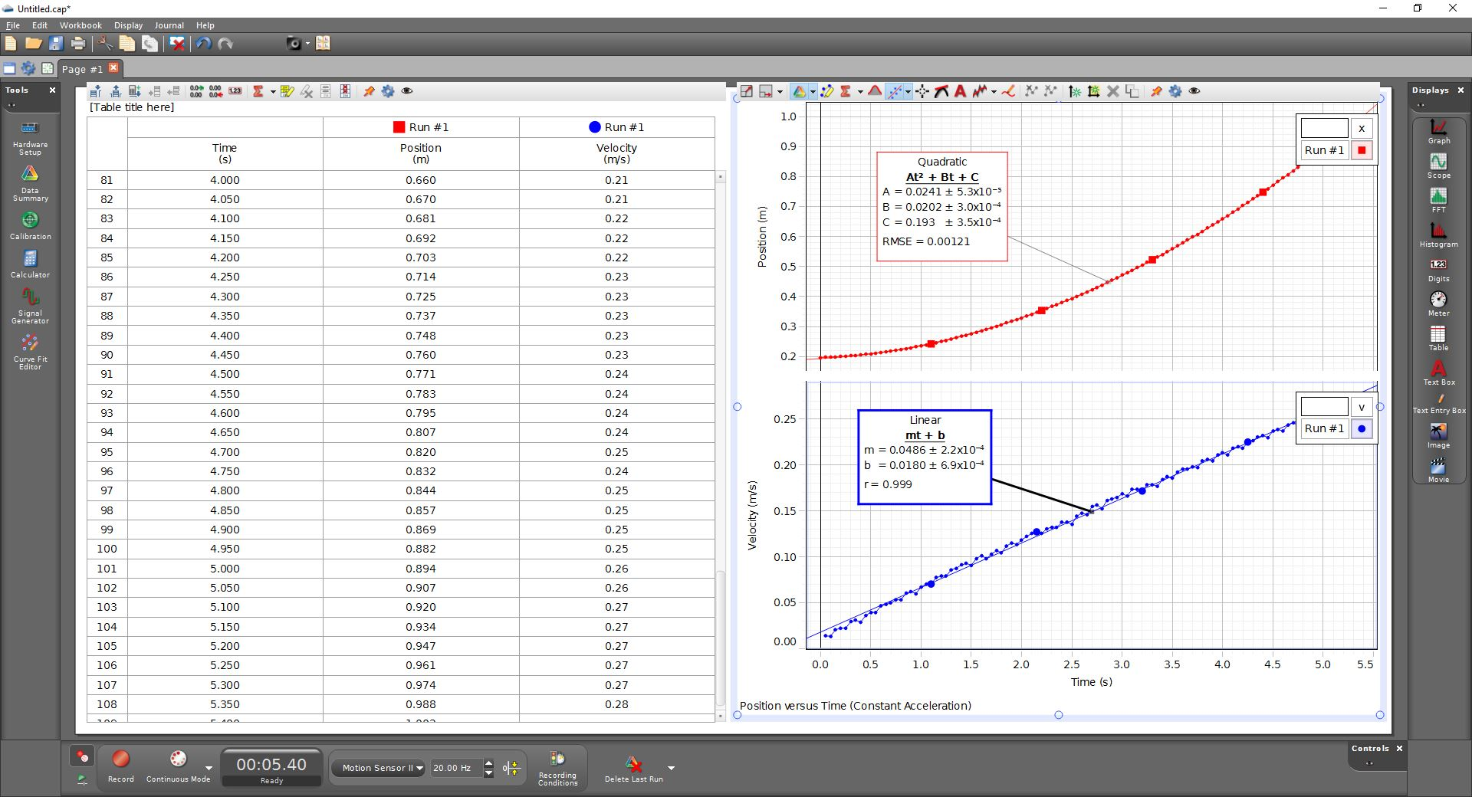
This shows one data set, but with multiple variables (position and velocity). Note that both are labelled as “Run #1” in both the table and the graph.
I had to insert a new column into the table to allow the velocity data to be included.
I created the second graph using the insert graph menu option, which means that both graphs are controlled by the same menu and will be scaled together.

