Slide 1
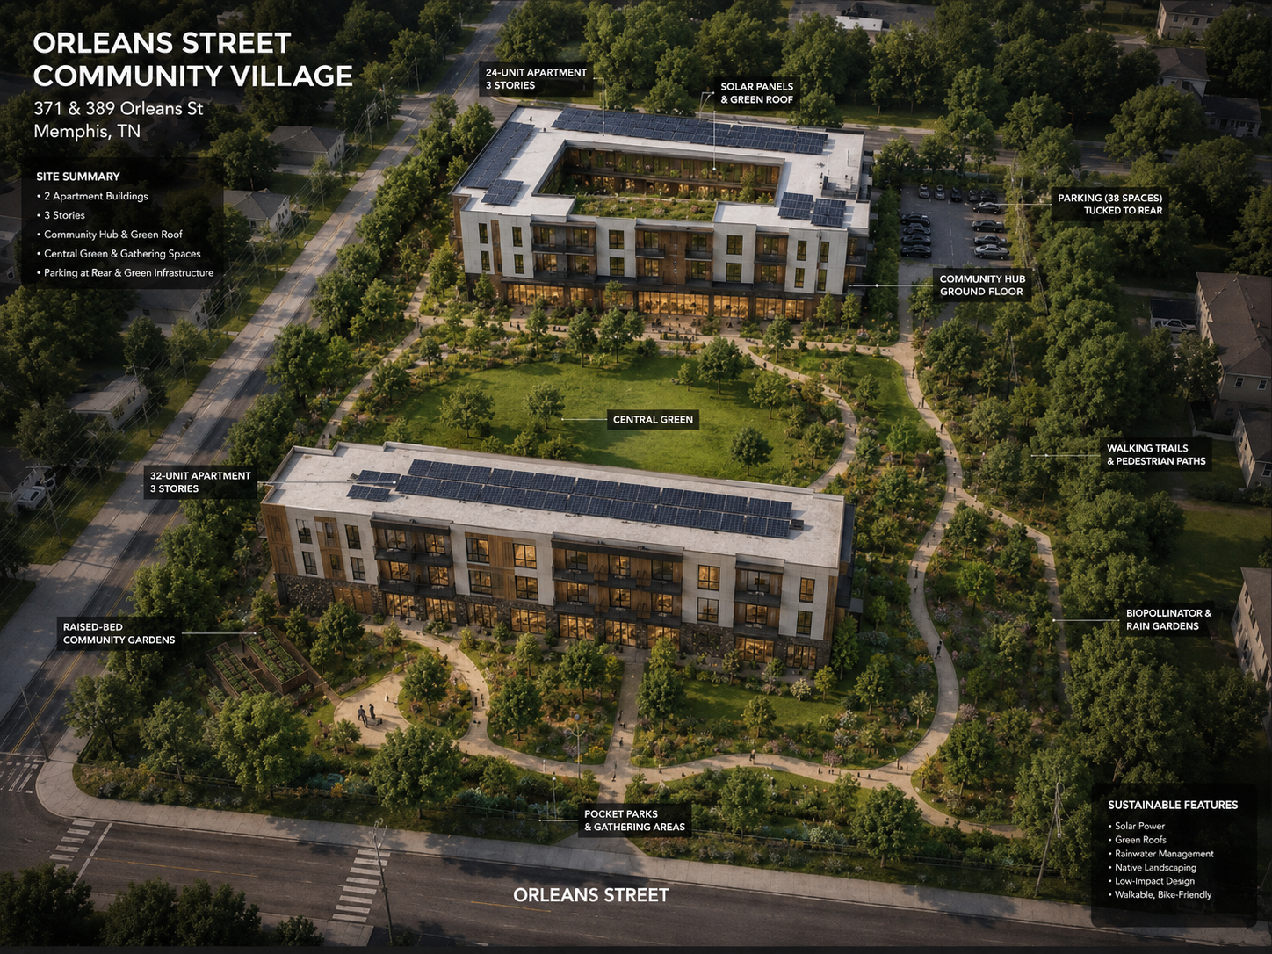
WILLIAM HURLEY ASSOCIATES LLC
Re-imagining the Senior Experience
Memphis-based senior community concept focused on wellness-centered independent living, connection, creativity, mobility, and dignity.
Informational discussion material only. Not an offer to sell securities or solicitation of investment.

Slide 2
William Hurley Associates LLC
The Problem
Many independent seniors need more than basic apartments, but less than institutional care.
• Standard senior apartments often solve shelter but not isolation, mobility, creativity, or purpose.
• Assisted living, skilled nursing, and memory care are not the Version 1 product.
• The gap: attainable senior housing plus programming, wellness, community, and dignity.

Slide 3
William Hurley Associates LLC
The Concept
A wellness-centered senior rental community with a real community hub.
• Adults 62.5+ who can live independently or with light non-medical support.
• Community hub, wellness programming, creative spaces, gardens, walking paths, and intergenerational partnerships.
• Orleans Street canonical rendering: two apartment buildings, no tiny homes.
• Cottage-style homes may be evaluated for another site.

Slide 4
ORLEANS STREET SCENARIO
Canonical Rendering
Two apartment buildings shown for concept discussion only; final site plan, unit mix, and program remain subject to feasibility, financing, and approvals.

Slide 5
William Hurley Associates LLC
Construction Strategy
The economic thesis depends on disciplined delivery, not expensive senior-housing defaults.
• Value-engineered alternative construction methods, including modular/prefab.
• Targeting sub-$40K per door as a pressure-test assumption, not a guarantee.
• Phase 1 capital requirement target: sub-$1M, subject to site control, design, civil, pricing, financing, and approvals.
• Stevon Hammond, Lead Developer / General Contractor, brings 20+ years commercial construction experience.

Slide 6
William Hurley Associates LLC
Financial Mechanics to Pressure-Test
The model needs blended affordability, not one magical funding source.
• Mission resident income profile: approx. $25K-$30K/year.
• 30% affordability benchmark implies approx. $625-$750/month supported rent.
• Working model: approx. $800/month mission-resident rent and approx. $1,350/month market-rate rent.
• Potential cross-subsidy plus grants, sponsorships, public/private funding, and proposed nonprofit/foundation support.

Slide 7
William Hurley Associates LLC
Community Hub + Partnerships
The moat is the operating model around the housing.
• University and student engagement, social-work student engagement, and health-science programming.
• Physical therapy / mobility support, mental wellness, nutrition education, and walking/movement programming.
• Creative and cultural programming, oral history, reading programs, gardens, and plant workshops.
• Partnership conversations are exploratory; programming is not a guaranteed operating commitment yet.

Slide 8
William Hurley Associates LLC
Capital + Grant Strategy
Disciplined blended-capital path.
• For-profit LLC for development, ownership, financing, operations, and asset management.
• Proposed future foundation/nonprofit arm for grants, resident enrichment, sponsorships, and social-impact reporting.
• 501(c)(3) options: direct Form 1023 filing and/or interim fiscal sponsorship through an existing 501(c)(3).
• Private capital, debt, affordable-housing/tax-credit, city/local, federal/grant, and sponsorship lanes to review.

Slide 9
William Hurley Associates LLC
Founder Edge
Healthcare insight plus construction-aware execution.
• Shirley Brown Hammond, Founder & CEO: 30+ years healthcare experience, including geriatric psychiatric and long-term care experience.
• RN, psychiatric nurse practitioner, and Ed.D. in leadership.
• Stevon Hammond, Lead Developer / General Contractor: 20+ years commercial construction experience.
• The team is seeking advisor/investor feedback before a formal capital raise.

Slide 10
William Hurley Associates LLC
Current Ask
Pressure-test before hardening the plan.
• Phase 1 feasibility and site capacity.
• Capital stack, rent/income assumptions, mixed-income structure, and investor fit.
• Grant/public-funding fit and 501(c)(3)/fiscal sponsorship path.
• Alternative construction strategy and development timeline.

Slide 11
IMPORTANT NOTICE
Informational Discussion Material Only
This deck is for informational and discussion purposes only. It does not constitute an offer to sell securities, a solicitation of investment, legal advice, financial advice, medical advice, healthcare advice, or a commitment to develop any specific site. Project details, site assumptions, unit counts, rents, funding structure, construction costs, nonprofit/foundation strategy, and timelines are preliminary and subject to diligence, feasibility review, legal review, financing, and approvals. Generated/concept renderings should not be represented as documentary photography, evidence of site control, final architectural plans, or completed improvements.

