Slide 1
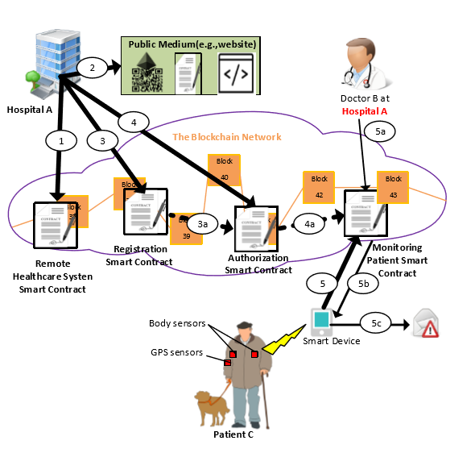
Source: Pham, Hoai Luan, Thi Hong Tran, and Yasuhiko Nakashima. "A secure remote healthcare system for hospital using blockchain smart contract." 2018 IEEE Globecom Workshops (GC Wkshps). IEEE, 2018.

