Slide 1
PYTHON’S STRING MANIPULATION
CMPE 103
OBJECT-ORIENTED PROGRAMMING
Module 1

Slide 2
STRINGS
Like many other popular programming languages, strings in Python are arrays of bytes representing Unicode characters. However, Python does not have a character data type, a single character is simply a string with a length of 1. Square brackets can be used to access elements of the string.

Slide 3
How to change or delete a string?
Strings are immutable. This means that elements of a string cannot be changed once it has been assigned. We can simply reassign different strings to the same name.
>>> my_strin = ‘CPE’
>>> my_strin[5] = 'a'
TypeError: 'str' object does not support item assignment.

Slide 4
How to create a string in Python?
How to create a string in Python? Strings can be created by enclosing characters inside a single quote or double quotes. Even triple quotes can be used in Python but generally used to represent multiline strings and docstrings.

Slide 5
REPRESENTATION OF STRING
>>> s = “Hello Python” This is how Python would index the string:
Backward Indexing
-12 | -11 | -10 | -9 | -8 | -7 | -6 | -5 | -4 | -3 | -2 | -1
H | e | l | l | o |  | P | y | t | h | o | n
0 | 1 | 2 | 3 | 4 | 5 | 6 | 7 | 8 | 9 | 10 | 11
Forward Indexing

Slide 6
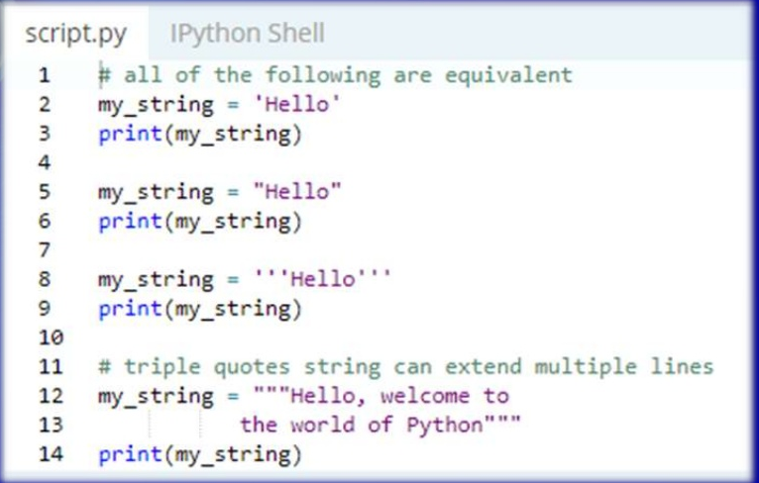
Programming Example

Slide 7
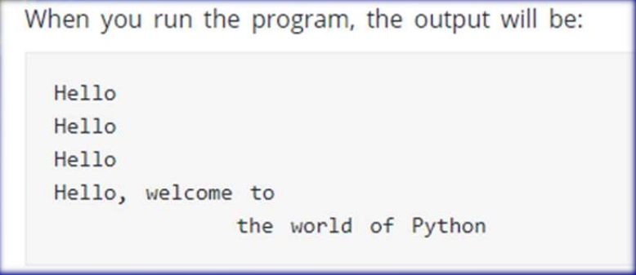
Output:

Slide 8
HOW to access characters in string
We can access individual characters using indexing and a range of characters using slicing. Index starts from 0. Trying to access a character out of index range will raise an IndexError. The index must be an integer. We can't use float or other types, this will result into TypeError.
Python allows negative indexing for its sequences. The index of -1 refers to the last item, -2 to the second last item and so on. We can access a range of items in a string by using the slicing operator (colon).

Slide 9
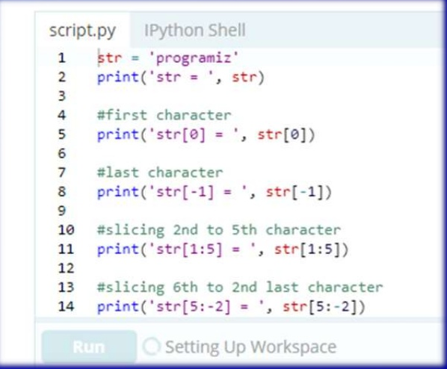

Slide 10
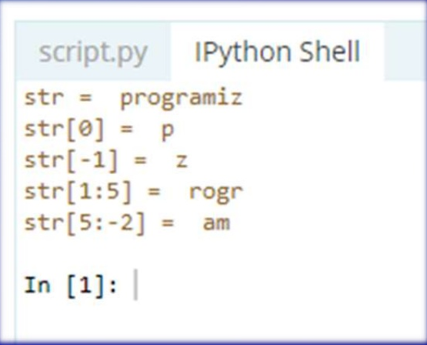

Slide 11
SLICING STRINGS EXAMPLES
For example:
>>>“Program”[3:5] will result in: ‘gr ’ >>>“Program”[3:6] will yield: ‘gra’
>>>p = “Program”
>>>p [:4] ‘Prog’
>>>p = “Program”
>>>p [4:] ‘ram’
>>>p = “Program”
>>>p [3:6] ‘gra’

Slide 12
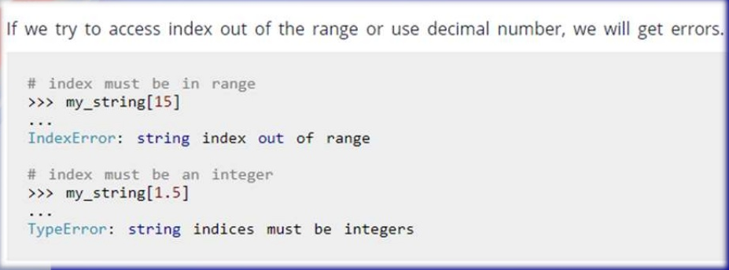
STRINGS –Index error

Slide 13
More Functionality of String
Finding Length of string
>>> len(“Computer Engineering”)
String Concatenation
>>>print(“CMPE” + “103”)
String Repeat
>>>print(“A” * 4 ) AAAA
Substring Tests
>>>”p” in “Computer” True
>>>”pr” in “computer” False
>>>”pr” not in “computer” True

Slide 14
More Functionality of String
>>> name1="computer"
>>> name2=name1[3:5]
>>>name2
pu

Slide 15
String Methods
String Methods In Python, a method is a function that is defined with respect to a particular object.
Syntax: object.method(arguments)
For Example: >>>name=“Classic” >>>name.find(“s”) = 3
the first position where “s” appears
Method Argument
String object
String Method

Slide 16
1. capitalize() Method
Capitalizes first letter of string
>>>name=“computer”
>>>name.capitalize()
‘Computer’

Slide 17
2. lstrip() & 3. rstrip() Methods
lstrip() method is used to remove left padded spaces in a given string
>>>name1=“ a “
>>>name1.lstrip()
‘a ‘
rstrip() method is used to remove right padded spaces in a given string
>>>name1.rstrip()
‘ a’
Removing left spaces Removing right spaces

Slide 18
4. strip() Method
strip() method is used to remove left and right padded spaces in a given string
>>>name1=“ a “
>>>name1.strip()
‘a‘
Removing left and right spaces for a given string

Slide 19
5. lower() Method
lower() method is used to convert given string in to lower case.
>>>name1=“ COMPUTER“
>>>name1.lower()
computer

Slide 20
6. UPPER() Method
upper() method is used to convert given string in to upper case.
>>>name1=“ computer“
>>>name1.upper()
COMPUTER

Slide 21
7. TITLE() Method
title() method is used to convert given string in to title case. Every first character of word of a given string is converted to title case. >>>name1=“ cpe python syllabus“ >>>name1.title()
Cpe Python Syllabus

Slide 22
8. swapcase() Method
swapcase() method is toggle the case. Meaining upper to lower and lower to upper case. >>>name1=“ Computer “ >>>name1.swapcase()
cOMPUTER
Every character case is changed

Slide 23
9. ljust() Method
ljust() method is used to add spaces to the left side of the given string
>>>name1=“anand “
>>>name1.ljust(15)
‘anand ’
Left side padded with spaces
Note: string length is 5 and 10 spaces added to the left side of string

Slide 24
10. rjust() Method
rjust() method is used to add spaces to the left side of the given string
>>>name1=“anand “
>>>name1.rjust(15)
‘ anand’
Left side padded with spaces
Note: string length is 5 and 10 spaces added to the left side of string

Slide 25
11. center(width, fillchar) Method
The method center() returns centered in a string of length width. Padding is done using the specified fillchar. Default filler is a space. Centered string
>>>name=“Anand”
>>>name.center(36,”a”)
aaaaaaaaaaaaaaaAnandaaaaaaaaaaaaaaaa
>>>name.center(20,”*”)
*******Anand********

Slide 26
12. zfill() Method
zfill() method is used to fill the zero to a given string
>>>name1=‘ 123’
>>>name1.zfill(15)
’00000000000 123’
Filling Zeros

Slide 27
13. find() Method
find() method is used to find a perticular character or string in a given string.
>>> name1=“Internet"
>>> name1.find("e")
3
e is present at 3rd location (first appearance) in a given string

Slide 28
14. count() Method
count() method is used to the number of times character or string appears in a given string. >>>name1=“Internet “
>>>name1.count(“n”)
2
2 times n appears in a given string

Slide 29
15. stratswith() Method
startswith() method is used check string start with particular string or not
>>>name1=“Delhi“
>>>name1.startswith(“a”)
False
Given string not starting with “a”

Slide 30
16. endswith() Method
endswith() method is used check string ends with particular string or not
>>>name1=“Dairy“
>>>name1.endswith(“ry”)
True
Given string ends with “en”

Slide 31
17. isdigit() Method
isdigit() method is used check string is digit (number) or not and returns Boolean value true or false.
>>>name2=“123”
>>>name2.isdigit()
True
>>name1=“123keyboard“
>>name1.isdigit()
False
Given string not number so false

Slide 32
18. isnumeric() Method
isnumeric() is similar to isdigit() method and is used check string is digit (number) or not and returns Boolean value true or false. >>>name2=“123”
>>>name2.isnumeric()
True
>>name1=“123keyboard“ >>name1.isnumeric()
False
Given string not number so false

Slide 33
19. isdecimal() Method
isnumeric(),isdigit() and isdecimal() methods are used to check string is digit (number) or not and returns Boolean value true or false. >>>name2=“123”
>>>name2.decimal()
True
>>name1=“123keyboard“
>>name1.isnumeric()
False
Given string not number so false

Slide 34
20. isalpha() Method
isalpha() method is used check string is digit or not and returns Boolean value true or false.
>>>name2=“123”
>>>name2.isalpha()
False (Given string does not contain string )
>>name1=“123computer“
>>name1.isalpha()
False (Given string is not a string it contains digits)
>>>name3=“Keynoard”
>>>Name3.isalpha()
True (It’s a string )

Slide 35
21. isalnum() Method
isalnum() method is used check string is alpha numeric string or not.
>>>name2=“123”
>>>name2.isalnum()
True (True Given string is alpha numeric)
>>>name1=“123computer“
>>>name1.isalnum()
True (True Given string is alpha numeric )
>>>name3=“Praveen”
>>>name3.isalnum()
True (Given string is alpha numeric )

Slide 36
22. islower() Method
islower() method is used check string contains all lower case letters or not, it returns true or false result.
>>>name2=“Anand”
>>>name2.islower()
False (Given string is not lower case string)
>>>name1=“anand“
>>>name1.islower()
True (Given string is lower case string )

Slide 37
23. isupper() Method
isupper() method is used check string contains all letters upper case or not, it returns true or false result.
>>>name2=“Anand”
>>>name2.isupper()
False (Given string is not upper case string)
>>>name1=“ANAND”
>>>name1.isupper()
True (Given string is upper case string )

Slide 38
24. isspace() Method
isspace() method is used check string contains space only or not.
>>>name2=“ ”
>>>name2.isspace()
True (Given string contains space only )
>>>name1=“Anandalaya Anand “ >>>name1.isspace()
False (Given string not containing space only)

Slide 39
25. find() Methods
find() method is used to find a particular string (substring) in a given string. >>>name=“Classic”
>>>name.find(“s”)
3
the first position where “s” appears in the string.

Slide 40
26. str() Method
str() method is used convert non string data into string type.
>>>str(576)
‘576’ (576 is number converted to string)

Slide 41
27 len() Method
len() method is used get a length of string.
>>>len(“Naveen”)
6 ( Gives the string length)

Slide 42
28 max() Method
max() method is used get a max alphabet of string.
>>>max(“Praveen”)
v ( Gives max character )

Slide 43
29 min() Method
min() method is used get a max alphabet of string.
>>>min(“Anand”)
A ( Gives min character A because it has ASCII Value 65 )

Slide 44
30 split() Method
split() method is used split a string.
>>>name=“Anandalaya NDDB Campus Anand”
>>>name.split()
[“Anandalaya”,“NDDB”,“ Campus”,“Anand”]
Split in to several words or substrings

Slide 45
30 split() Method
split() method is used split a string according to delimiter.
>>>name=“Anandalaya NDDB Campus Anand”
>>>name.split(“Ca”)
[“Anandalaya NDDB”,“ mpus Anand”]
Split in to several words or substrings acording to delimiter.

Slide 46
31. index() Method
Same as find(), but raises an exception if str not found.
>>> name="Sainik“
>>> name.index("a",3,5)
ValueError: substring not found
>>> name.index("a",1,5)
1 (Character found, returning the position )

Slide 47
32. ord Method
ord() method is used get a ASCII value for a character.
>>ord(“a”)
97
(97 is the ASCII value for character ‘a’ )

Slide 48
33. chr() Method
chr() method is used get a character for an ASCII value.
>>chr(97)
‘a’
( ‘a’ ASCII value is 97)

Slide 49
34. Replace() Method
replace(old,new)
>>> name="Sainik”
>>> name.replace(“i",”e”)
output: “Saenek”

