Slide 1
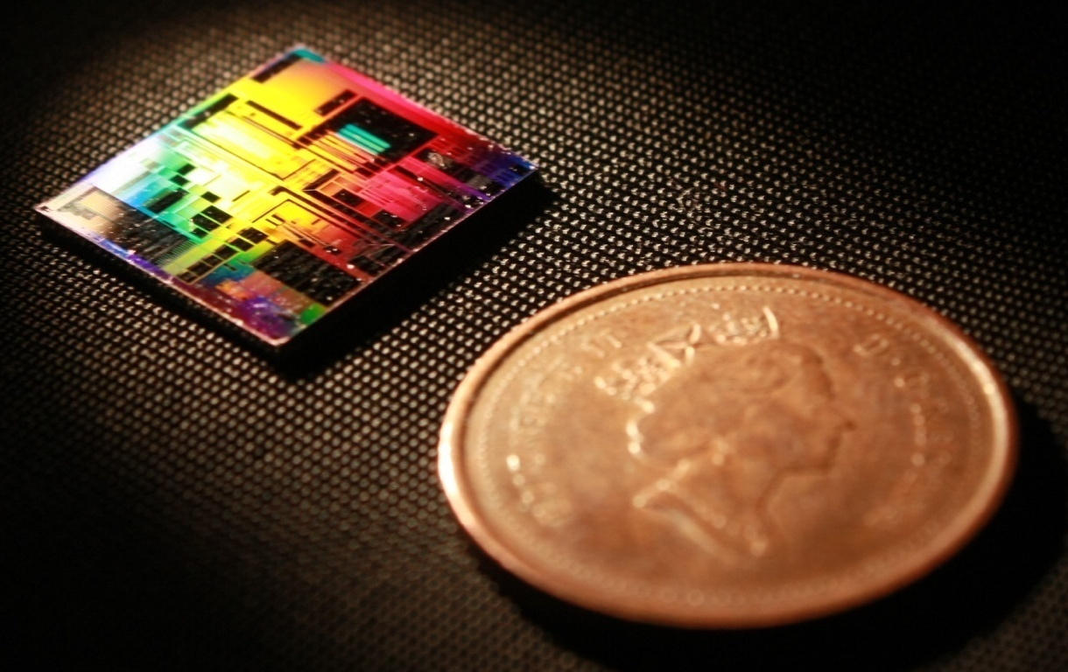
Klayout: Layout Scripting 2019 SiEPIC Passive Silicon Photonics Workshop, Vancouver, Canada
Mustafa Hammood,
The University of British Columbia, Vancouver, Canada

Slide 2
Outline
What is a parameterized cell?
How to setup and start creating scripts
Define components library
Make your first parameterized cell

