Slide 1
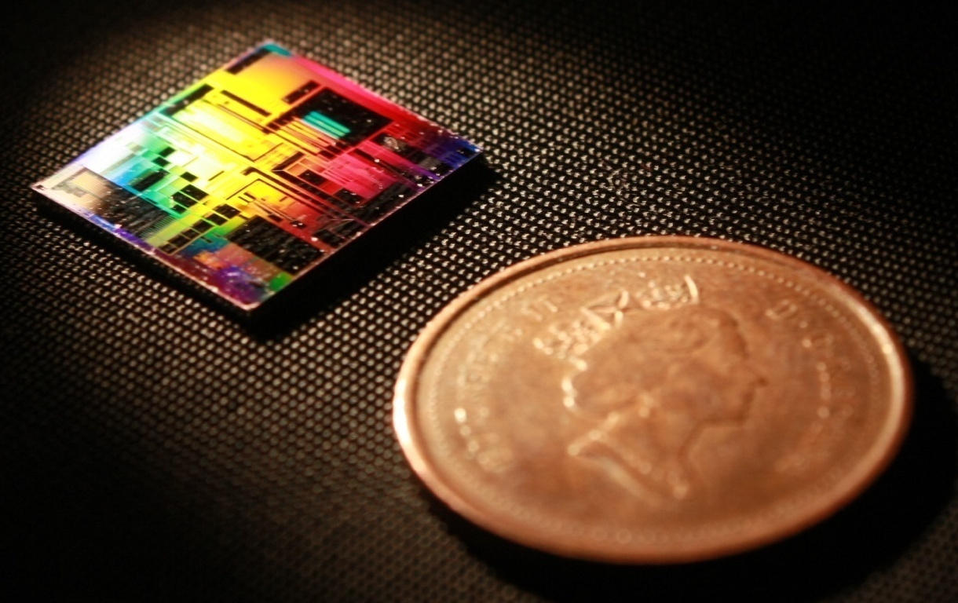
SiEPIC-TOOLS: Process Control Monitors Structures
Mustafa Hammood
The University of British Columbia

Slide 2
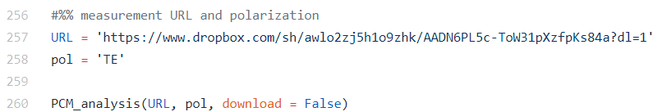
Automated report generation
Load the URL with all data of automated measurements
Load the polarization of automated measurements
Run the automated PCM analysis script

Slide 3
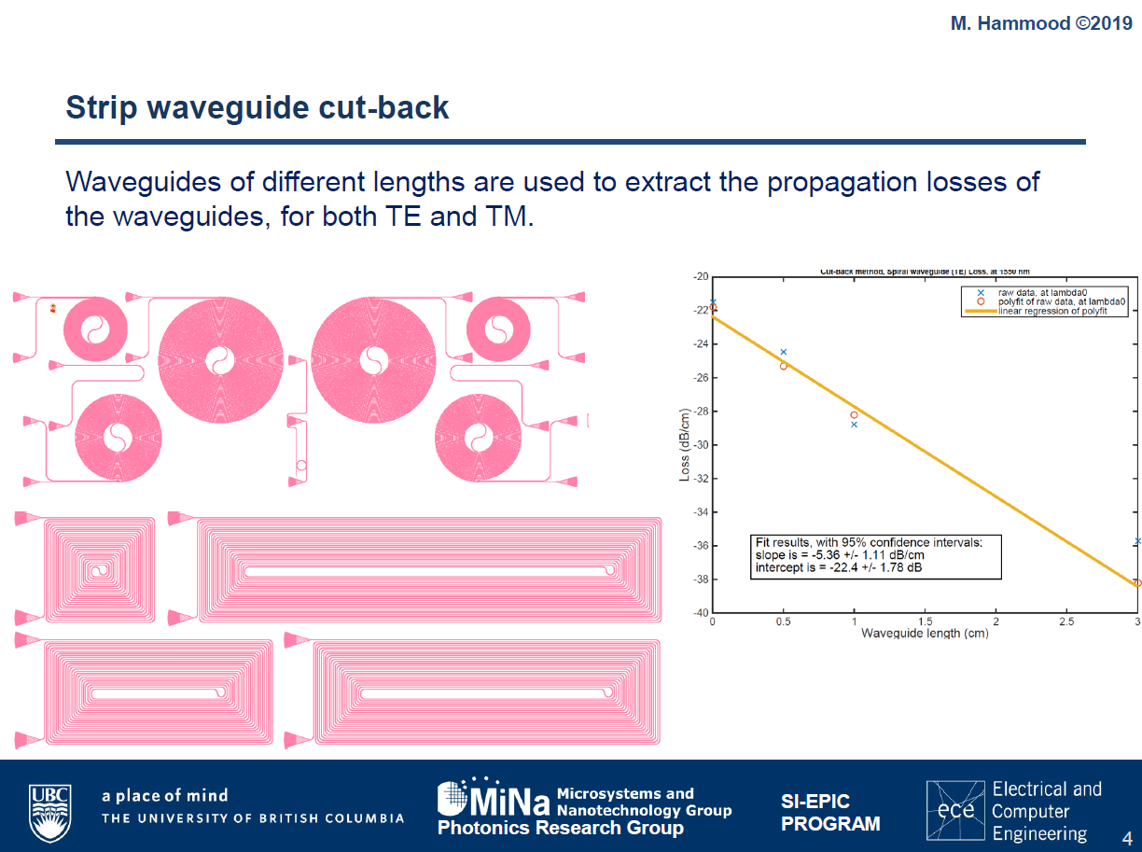

Slide 4
Objectives
Assess propagation losses of waveguides (TE+TM)
Straight waveguides
Spiral waveguides
Sub-wavelength waveguide
Assess side-wall roughness
Assess performance of different devices:
Bragg waveguides
dW vs bandwidth- what’s the real conclusion here? reproducibility?
Contra-DCs
Analyze the spectrum – watch for self-reflection
Proximity effects + writing jitter
Assess insertion losses of contra-DCs
Cut-back structures
PRBGs for sidewall angle?

Slide 5
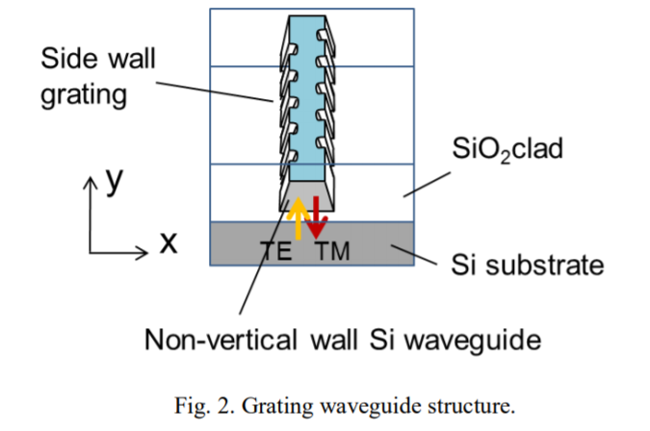
Polarization rotating Bragg gratings
“Polarization rotation Bragg grating using Si wire waveguide with non-vertical sidewall” Hideaki Okayama et al.

Slide 6
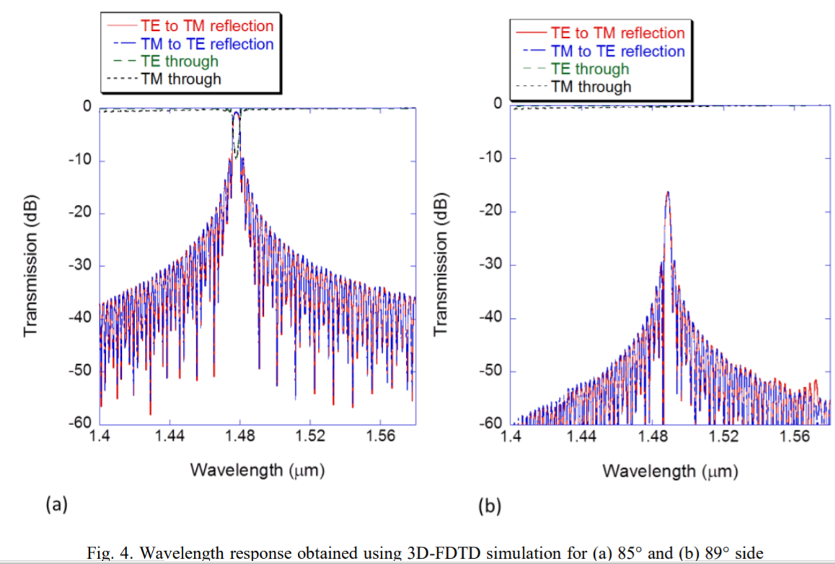
Polarization rotating Bragg gratings

Slide 7
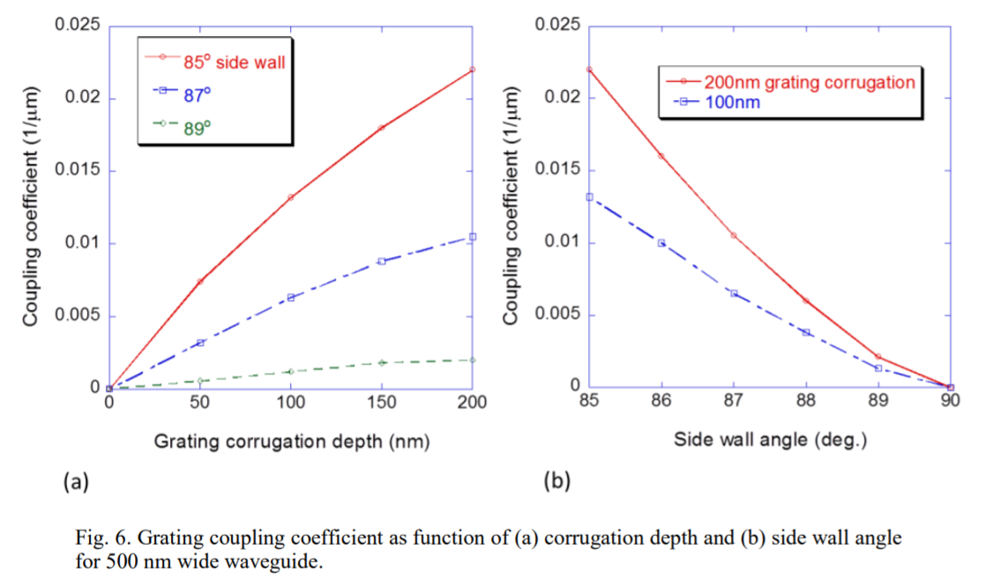
Polarization rotating Bragg gratings

