Slide 1
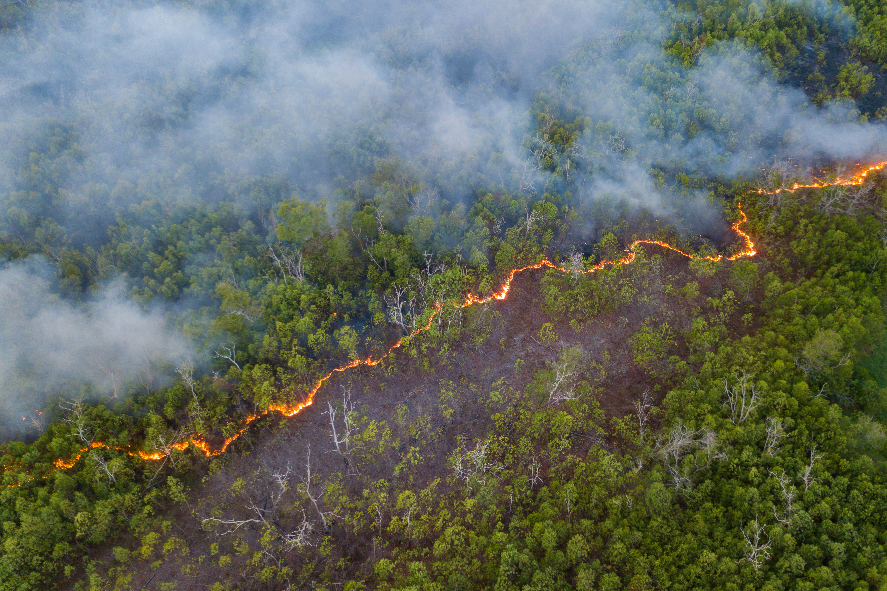
Towards A Statistical Analysis of Wildland and Prescribed Fires in the Changing California Climate
Sequoia Andrade, Dr. Alexandra Piryatinska
San Francisco State University

Slide 2
Motivation
Climate change-driven large, destructive wildfires becoming more frequent, especially in California
Prescribed burns are known to be effective in reducing wildfire intensity in some scenarios, yet:
  Environmental trends indicate the window for prescribed burns is shrinking
  Limited implementation due to controversy on risk, cost, and environmental impact
Much of the existing body of research was performed in the previous century and did for climate change’s impact on prescribed burn efficacy
Statistical analysis can be used to identify effective or ineffective prevention strategies, such as prescribed burns, but the data needed to study this question is fragmented and complex

Slide 3
Research Questions
Are prescribed burns effective at reducing the size of wildfires?
Are prescribed burns effective at reducing the size of wildfires while controlling for climate-relevant variables
How do these relationships change at different spatio-temporal scales?
We Investigate these questions with:
Monthly Time Series Analysis – Correlation and Cross-Correlation
Inferential Statistics - Mann-Whitney U-test
Regression Analysis – Ordinary Least Squares Linear Regression

Slide 4
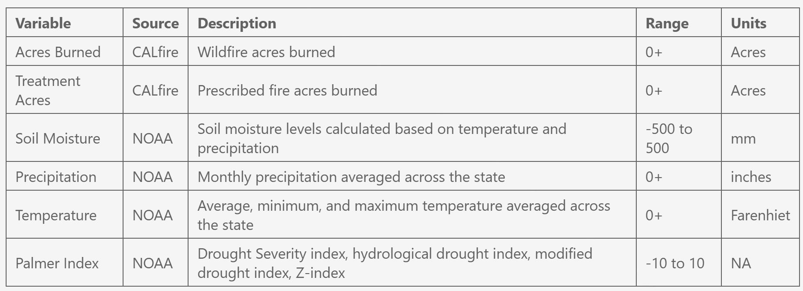
Data
Table 1: Variables in the dataset, including descriptions, sources, and units

Slide 5
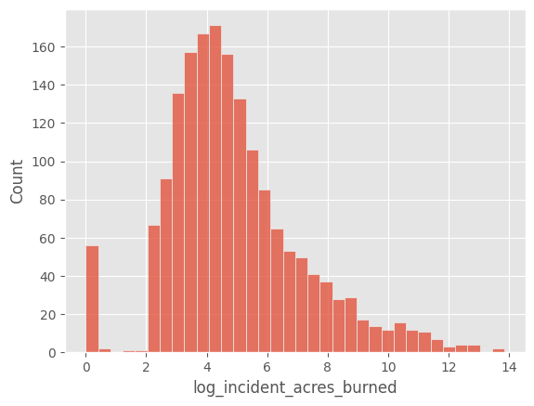
Dataset Creation
Data from 1734 wildfires from 1/2016 – 12/2022
Columns:
  wildfire acres burned, previous month precipitation, avg temp, max temp, min temp, drought index, soil moisture
  for each 3/6/12/24/36 month time frame, 5/10/25/50/100 km distance, total prescribed fire acres burned
Monthly dataset: sums total acres per month
Figure 1: Distribution of wildfire size
Notes:
Mention challenge of the data: spatial and time component

Slide 6

Data Overview
Figure 2: Visualization of prescribed fires for each year and wildfires in following years

Slide 7
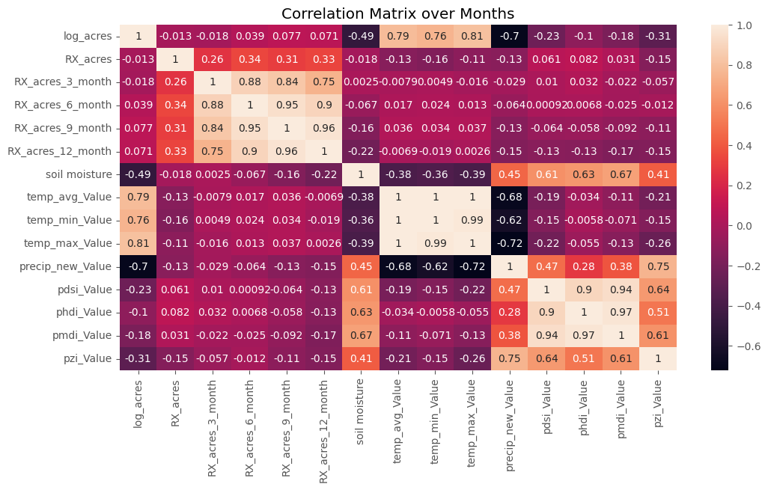
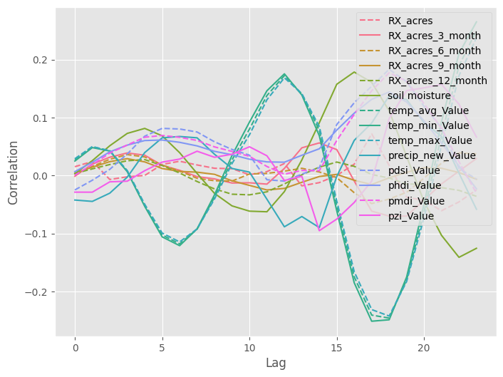
Time Series Analysis: Monthly
Wildfire acres burned have the strongest correlation with climate variables
Figure 3: Correlation matrix for predictors and wildfire size
Figure 4: Cross-correlations for predictors and wildfire size

Slide 8
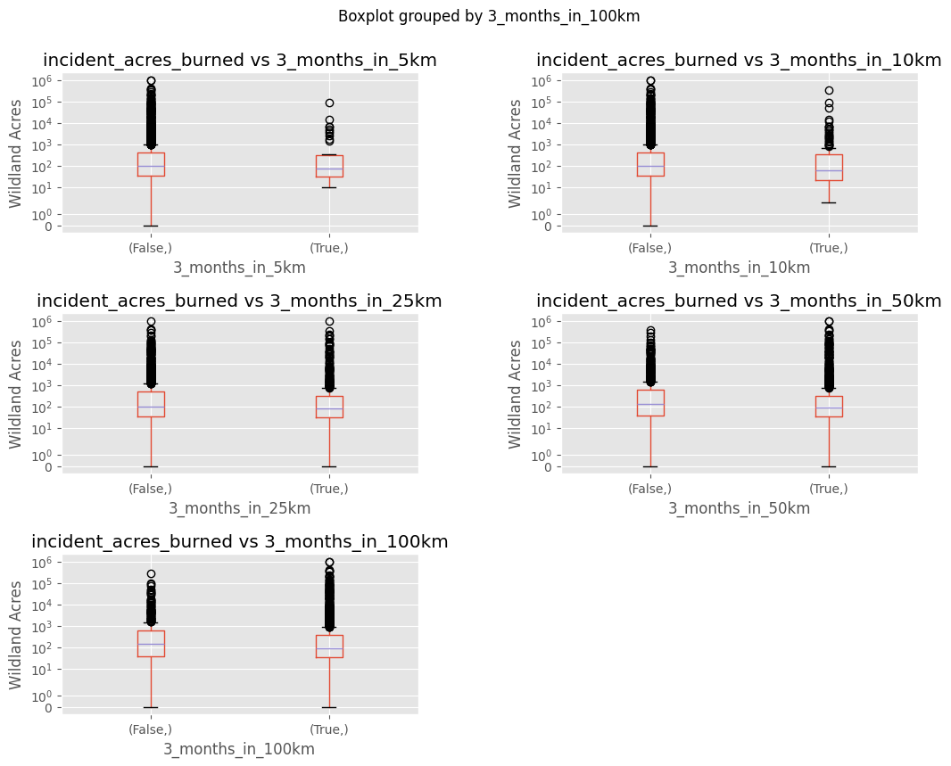
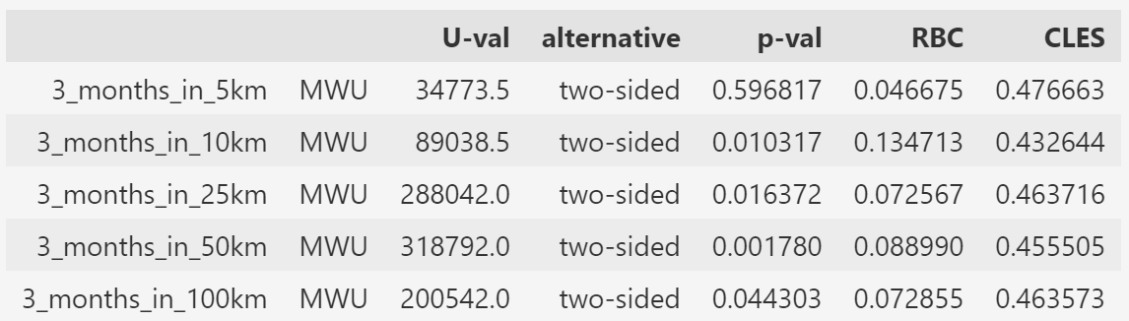
Inferential Analysis: Treatment Data
Figure 5: Box plot of wildfire size between groups with and without prescribed burns within the specified distance
Table 2: Mann-Whitney U-test results, including rank biserial correlation (RBC) and common language effect size (CLES)
Prescribed burn treatment is associated with fewer acres burned at 10 km, 25 km, 50 km, and 100km distance when completed 3 months before a fire

Slide 9
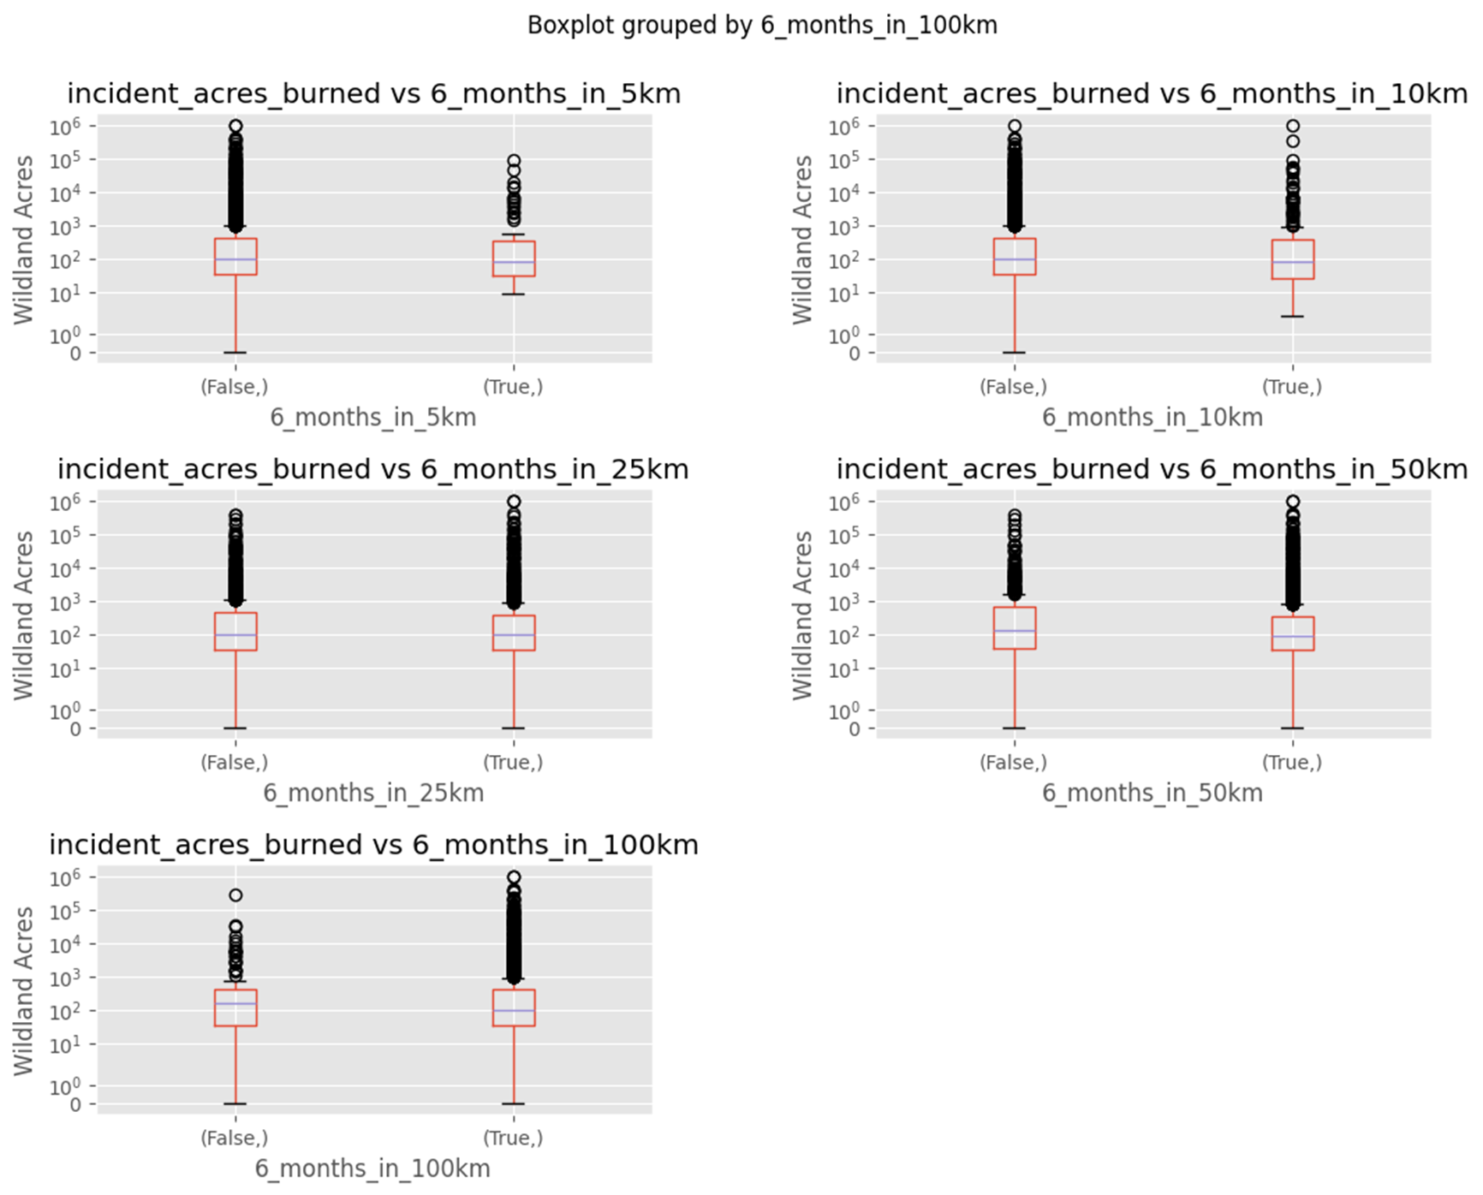
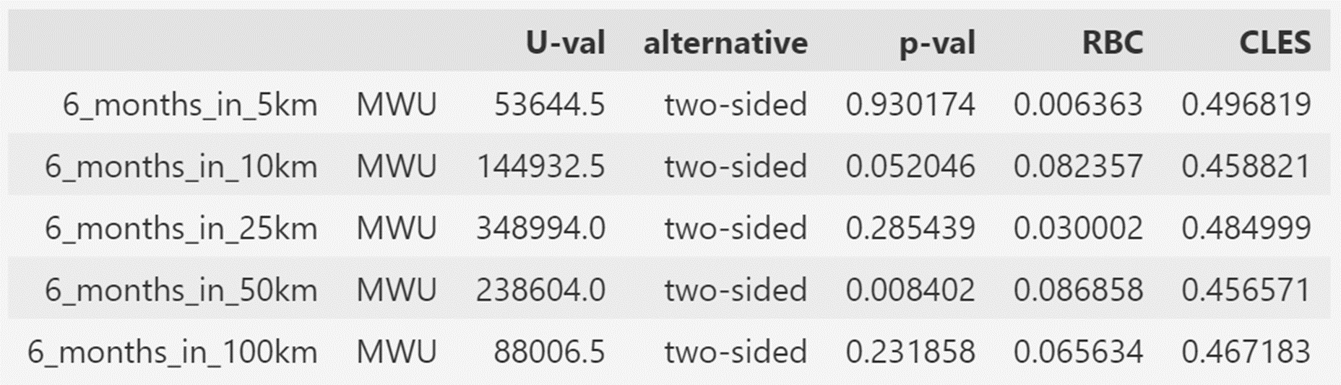
Inferential Analysis: Treatment Data
Figure 6: Box plot of wildfire size between groups with and without prescribed burns within the specified distance
Table 3: Mann-Whitney U-test results, including rank biserial correlation (RBC) and common language effect size (CLES)
Prescribed burn treatment is associated with fewer acres burned at 10 km and 50 km distance when completed 6 months before a fire

Slide 10
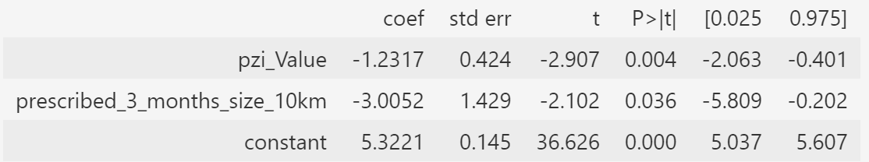
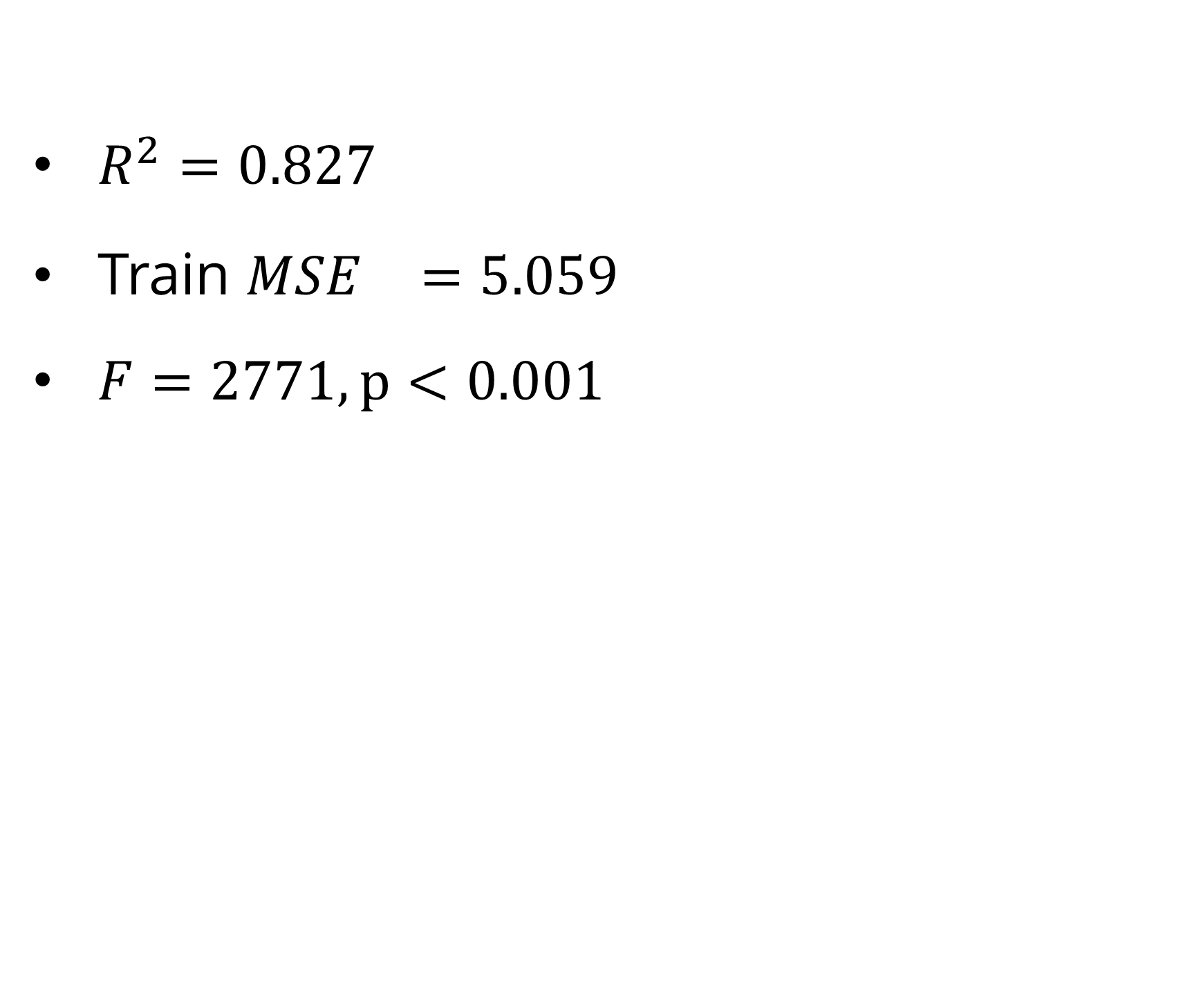
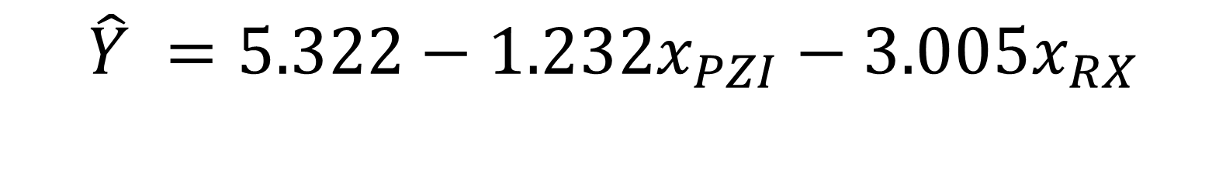
Regression Analysis: Treatment
Y: Wildfire acres burned
X: PZI drought index, 3 months prescribed fire in 10km (RX)
$R^{2}=0.827$
Train ${MSE}^{}=5.059$
$F=2771, p<0.001$
$$\hat{Y} =5.322−1.232x_{PZI}−3.005x_{RX}$$
Prescribed burns are related to decreases in wildfire size
Increased drought severity is related to increases in wildfire size
Prescribed burns have a slightly greater effect on wildfire size than drought
Table 4: Regression coefficient results
Notes:
Preprocessing:
- standardized scaling, VIF to remove correlated predictors
Predictor selection:
- ANOVA to test for significant difference between models with and without interaction term
Results:
- log predictor, e^5 ~ 157 acres

Slide 11
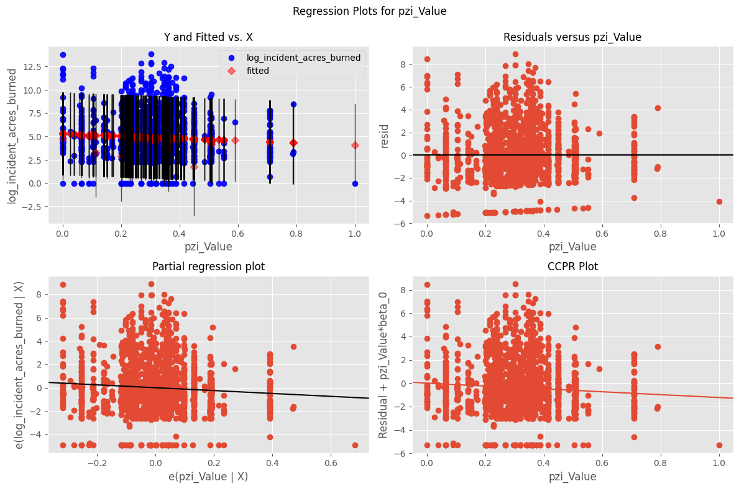
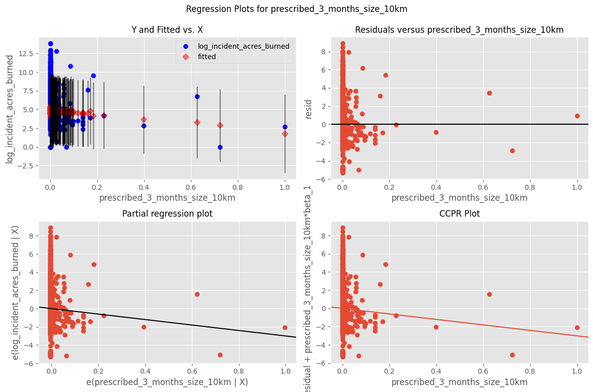
Regression Analysis: Treatment
Figure 7: Residuals and partial regression for PZI
Figure 8: Residuals and partial regression for prescribed burns
Notes:
Residuals, Partial regression

Slide 12
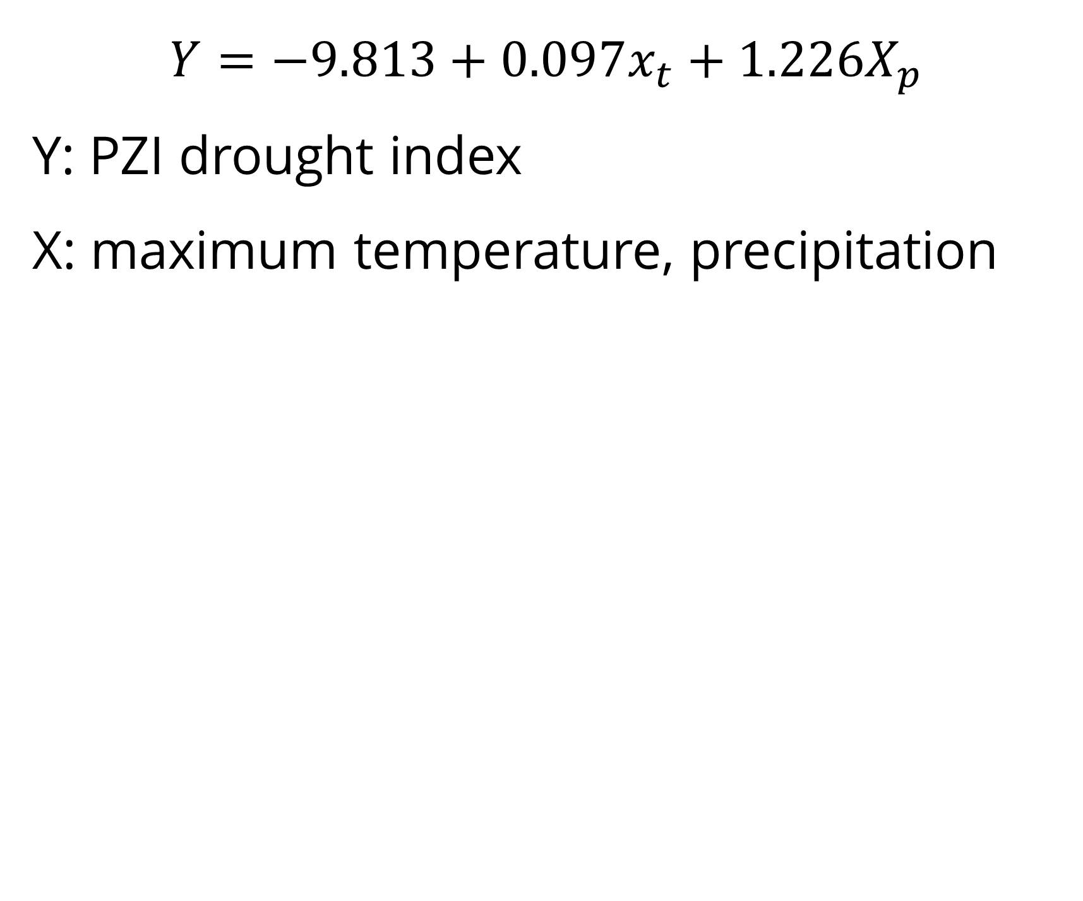
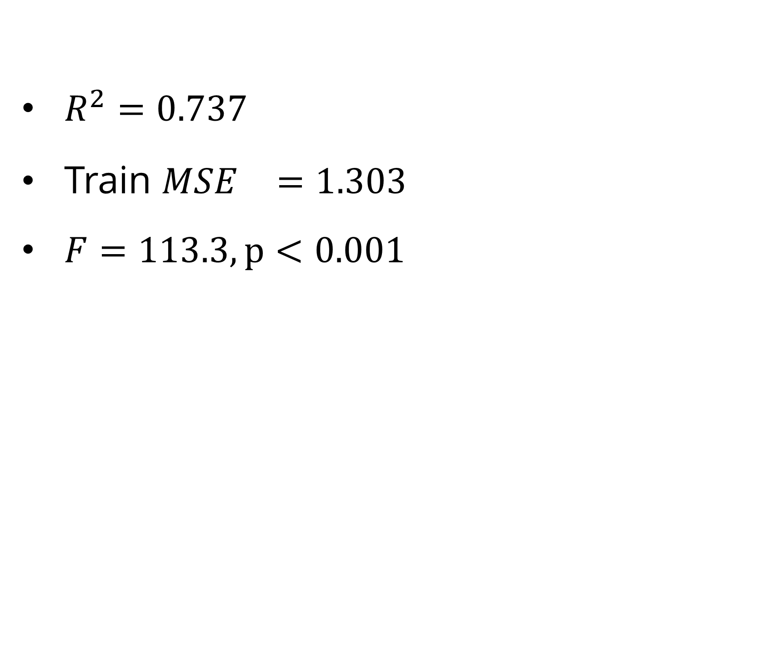
Regression Analysis: Drought Index
$$Y=−9.813+0.097x_{t}+1.226X_{p}$$
Y: PZI drought index
X: maximum temperature, precipitation
$R^{2}=0.737$
Train ${MSE}^{}=1.303$
$F=113.3, p<0.001$
Precipitation decreases are related to increased drought severity
Precipitation has the greatest impact on drought index
Temperature has very minimal effect on drought index
Table 5: Regression coefficient results
Notes:
Do anova model, remove precipitation or drought

Slide 13
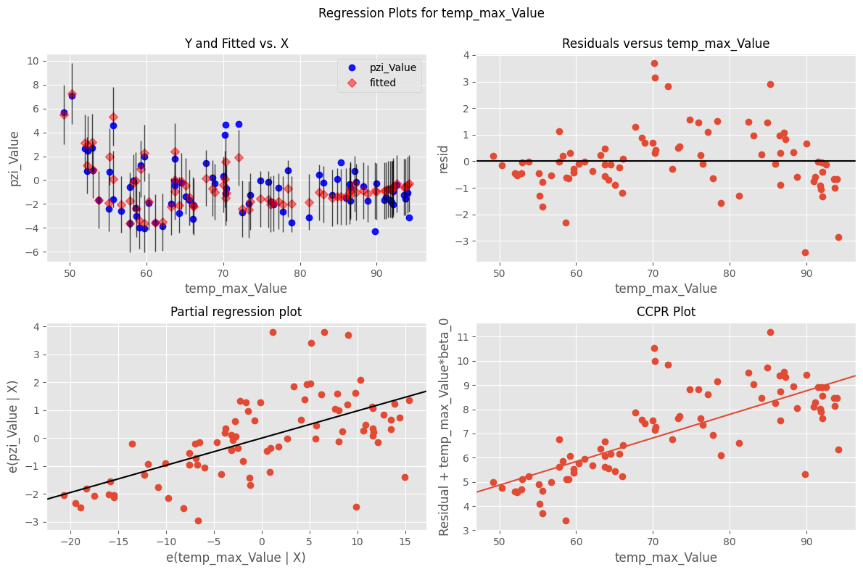
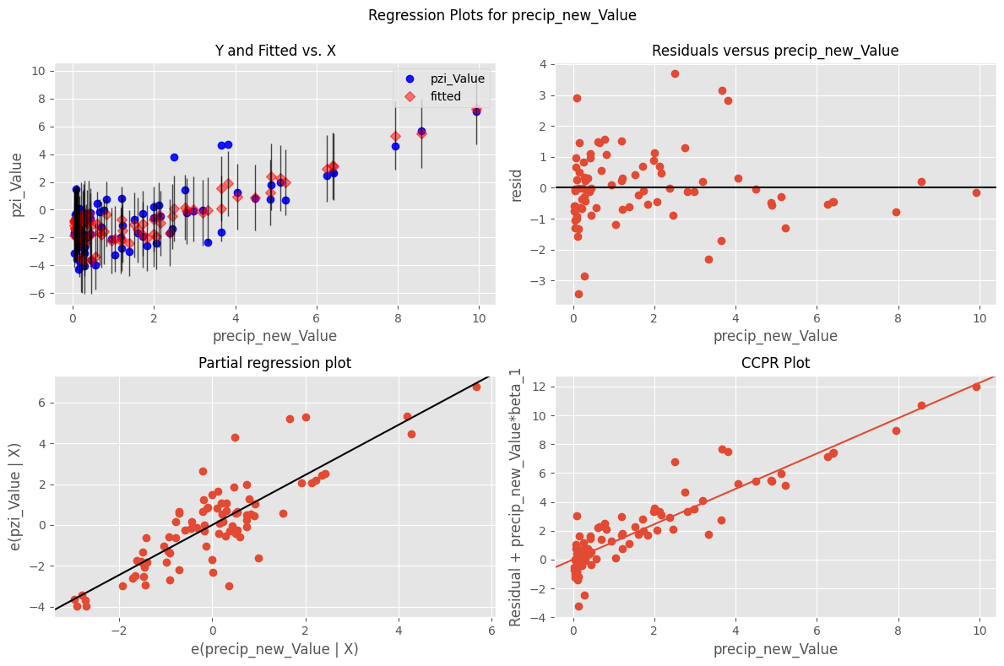
Regression Analysis: Drought Index
Figure 9: Residuals and partial regression for temperature
Figure 10: Residuals and partial regression for precipitation
Notes:
Residuals, Partial regression

Slide 14
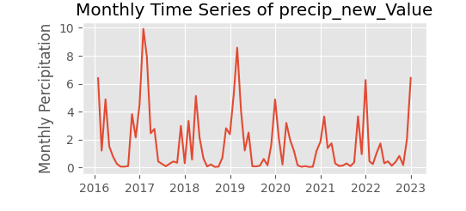
Discussion
Prescribed burns are associated with decreased wildfire size and have a greater effect than drought index
When chaining the models, precipitation has the largest impact on wildfire size
Limitations:
Treatment climate variables are for the whole of California, instead of the region the fire occurs in
Vegetation type is not considered in this model
Models use binning for handing spatial and temporal differences – an integrated model could be better
Figure 11: Precipitation time series

Slide 15
Recall: Research Questions
Are prescribed burns effective at reducing the size of wildfires?
Are prescribed burns effective at reducing the size of wildfires while controlling for climate-relevant variables
How do these relationships change at different spatio-temporal scales?

Slide 16
Conclusion and Future Work
Increased prescribed burn acreage is related to decreased wildfire size under certain circumstances
When controlling for drought index, prescribed burns are still a significant predictor of wildfire size
Prescribed burns have the greatest impact when performed within 3 months and 10 km of wildfires.
Future analysis will explore other methods for incorporating spatio-temporal information, such as coregionalization modeling and mixed effects modeling
Notes:
Are prescribed burns effective at reducing the size of wildfires?
Are prescribed burns effective at reducing the size of wildfires while controlling for climate-relevant variables
How do these relationships change at different spatio-temporal scales?

Slide 17
San Francisco State University

Slide 18
Methods
Dataset creation:
  Monthly Dataset
  Treatment Dataset
Inferential analysis:
  Wilcoxson Signed Rank test / Mann-Whitney U-test
Time series Analysis
  Cross correlation
  Correlation Matrix
Regression Analysis
  PZI drought index
  Acres burned per wildfire incident

