Slide 1
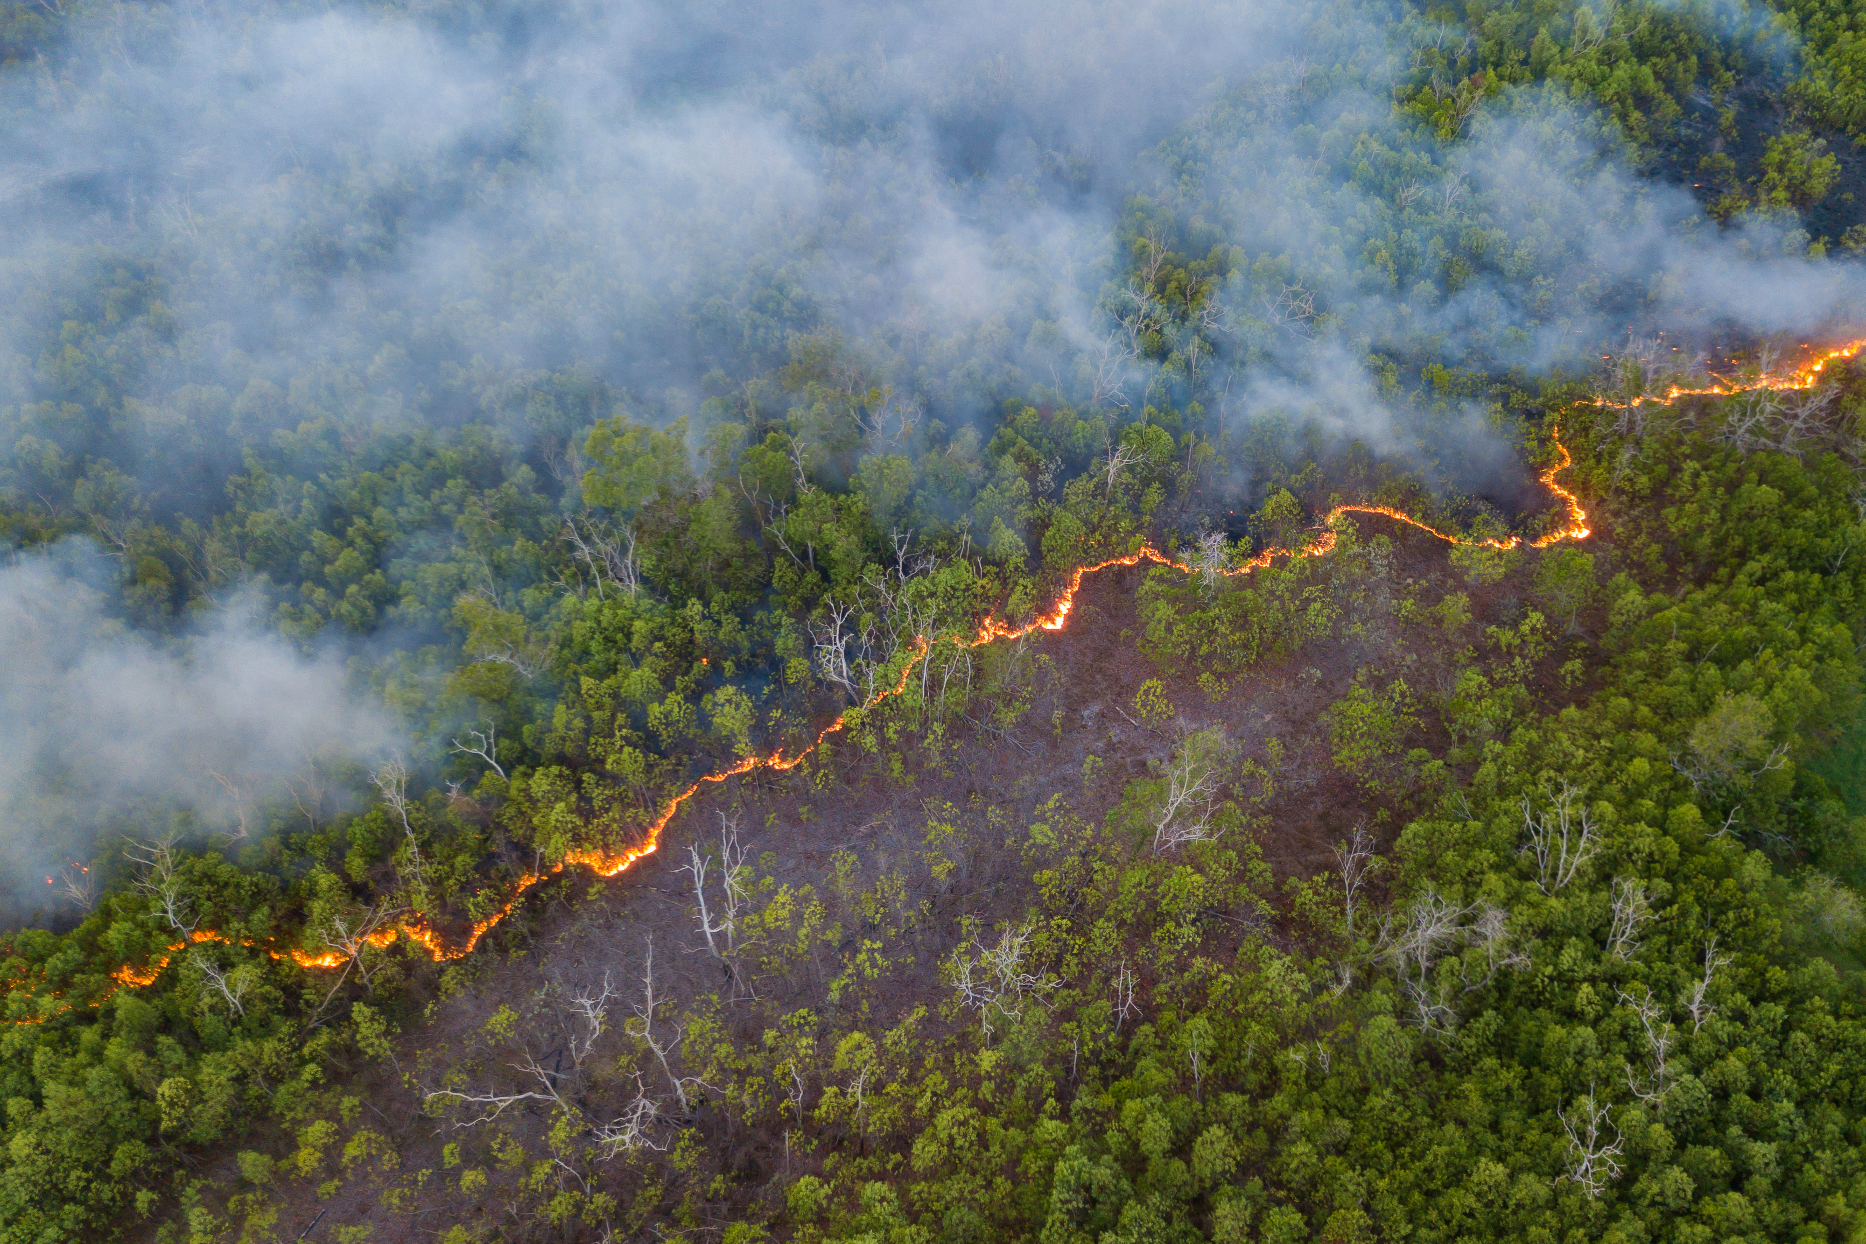
A Statistical Analysis of Wildland and Prescribed Fires in the Changing California Climate
Sequoia Andrade, Dr. Alexandra Piryatinska
San Francisco State University

Slide 2
Motivation
Climate change-driven large, destructive wildfires becoming more frequent, especially in California
Prescribed burns are known to be effective in reducing wildfire intensity in some scenarios, yet:
  Environmental trends indicate the window for prescribed burns is shrinking
  Limited implementation due to controversy on risk, cost, and environmental impact
Much of the existing body of research was performed in the previous century and did not account for climate change’s impact on prescribed burn efficacy
Statistical analysis can be used to identify effective or ineffective prevention strategies, such as prescribed burns, but the data needed to study this question is fragmented and complex

Slide 3
Research Questions
Are prescribed burns effective at reducing the size of wildfires?
Are prescribed burns effective at reducing the size of wildfires while controlling for climate-relevant variables
How do these relationships change at different spatio-temporal scales?
We Investigate these questions with:
Monthly Time Series Analysis – Correlation and Cross-Correlation
Inferential Statistics - Mann-Whitney U-test
Regression Analysis – Ordinary Least Squares Linear Regression

Slide 4
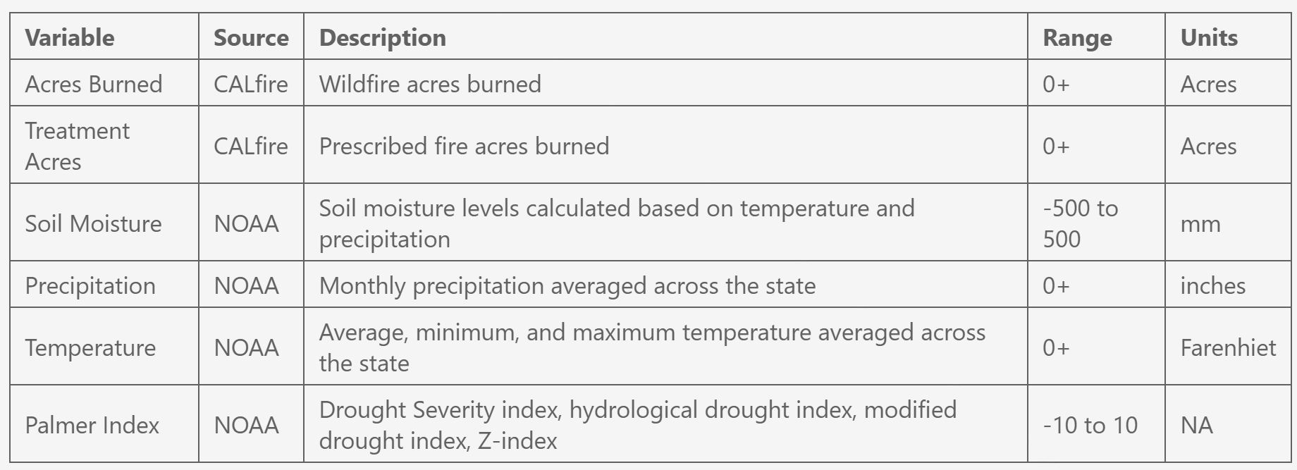
Data
Table 1: Variables in the dataset, including descriptions, sources, and units

Slide 5
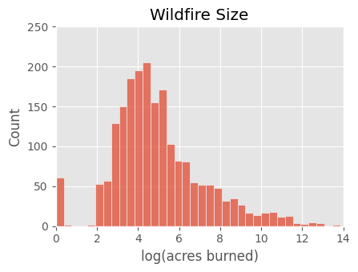
Dataset Creation
Data from 2041 wildfires from 1/2013 – 12/2022
Columns:
  wildfire acres burned, previous month precipitation, avg temp, max temp, min temp, drought index
  for each 3/6/9/12/24/36 month time frame, 5/10/25/50/100 km distance, total prescribed fire acres burned
Monthly dataset: sum of total acres burned per month
Figure 1: Distribution wildfire size

Slide 6
Methods
Time series analysis:
  Correlation to identify which predictors are associated with acres burned
  Cross-correlation to identify at what time lags predictors are associated with acres burned
Inferential analysis:
  Difference of median test to examine if wildfires are smaller when there is a prescribed fire nearby
Regression Analysis:
  Predict acres burned per wildfire incident from prescribed fires and climate variables

Slide 7
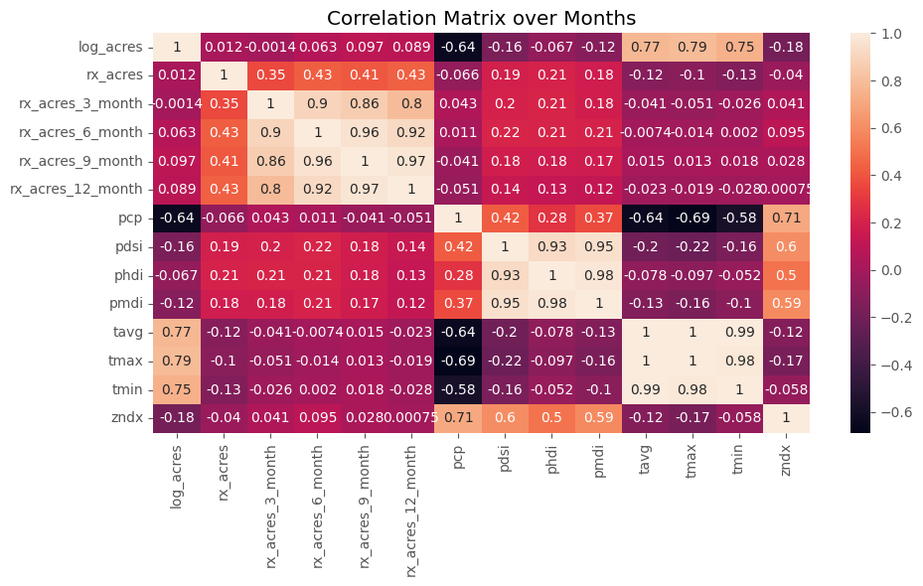
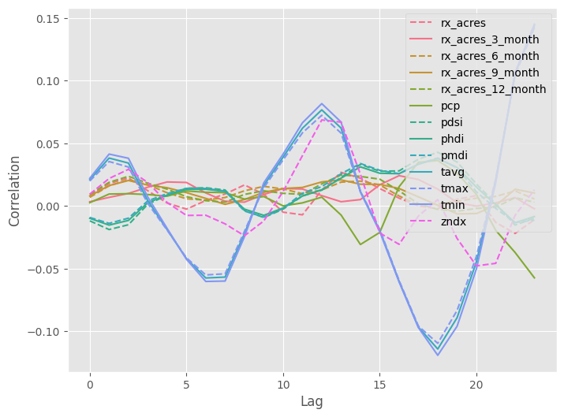
Time Series Analysis: Monthly
Wildfire acres burned have the strongest correlation with climate variables
Figure 2: Correlation matrix for predictors and wildfire size
Figure 3: Cross-correlations for predictors and wildfire size

Slide 8
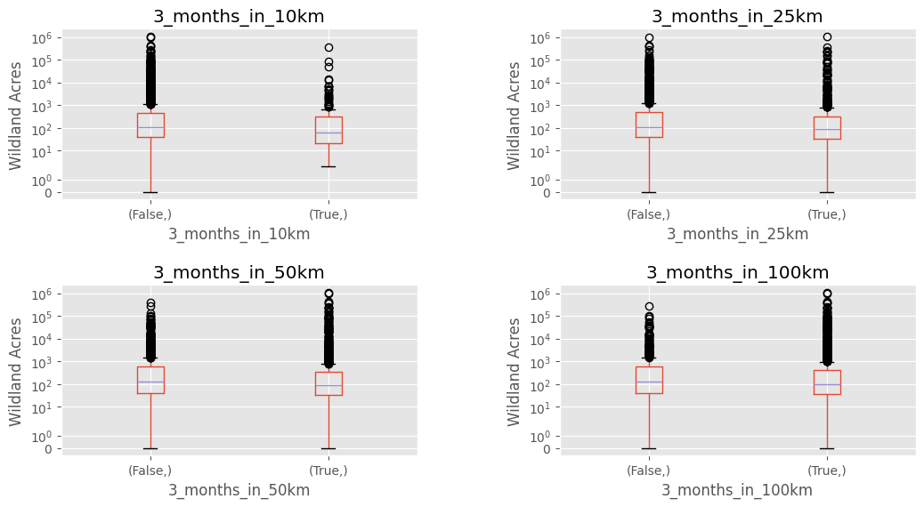
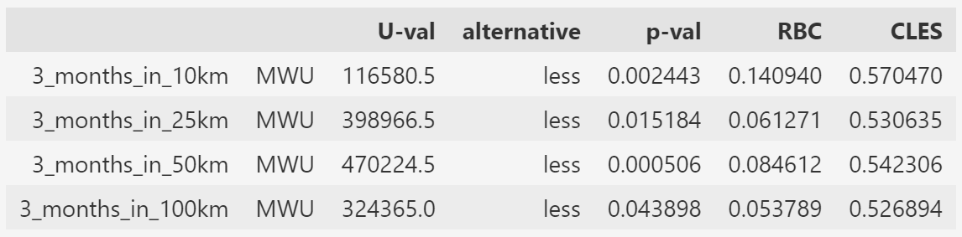
Inferential Analysis: Treatment Data
Figure 4: Box plot of wildfire size between groups with and without prescribed burns within the specified distance
Table 2: Mann-Whitney U-test results, including rank biserial correlation (RBC) and common language effect size (CLES)
Prescribed burn treatment is associated with fewer acres burned at 10 km, 25 km, 50 km, and 100km distance when completed 3 months before a fire

Slide 9
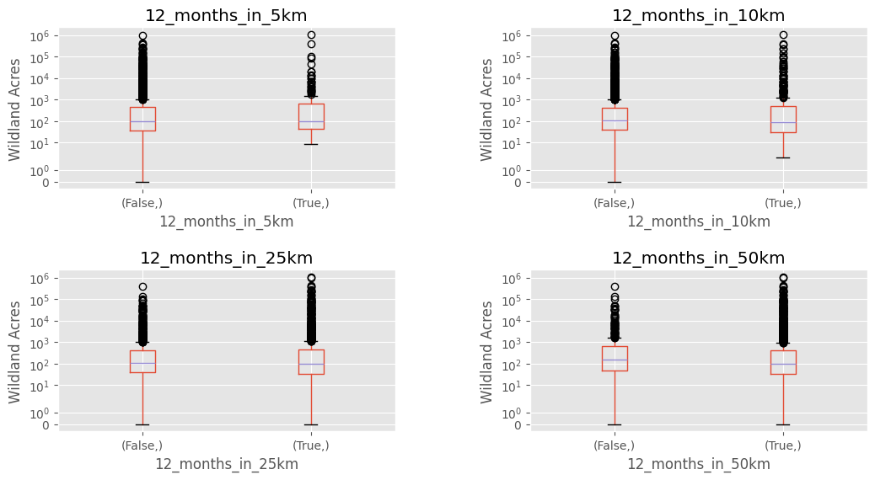
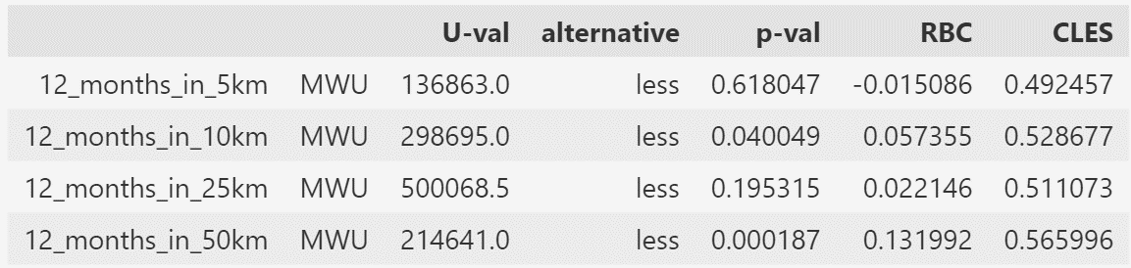
Inferential Analysis: Treatment Data
Figure 5: Box plot of wildfire size between groups with and without prescribed burns within the specified distance
Table 3: Mann-Whitney U-test results, including rank biserial correlation (RBC) and common language effect size (CLES)
Prescribed burn treatment is associated with fewer acres burned at 10 km 50 km distances when completed 12 months before a fire

Slide 10
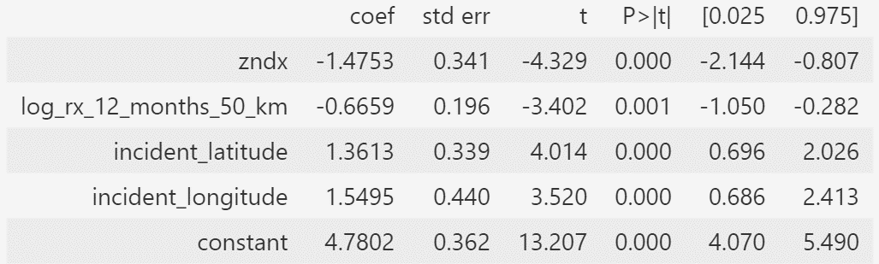
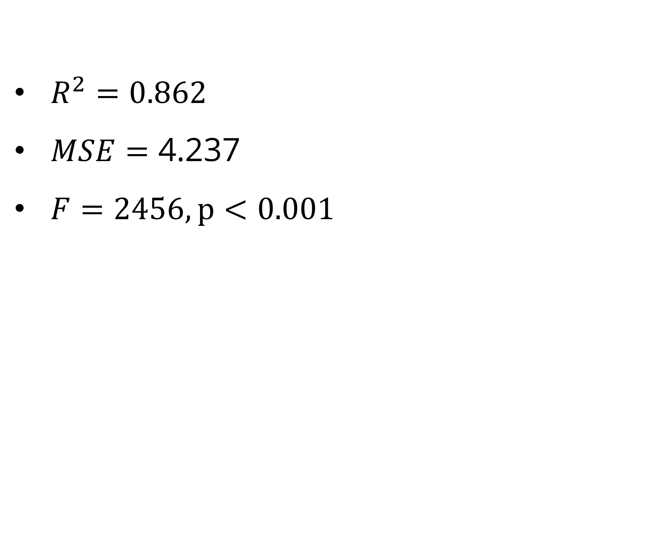
Regression Analysis: Treatment Data
$$Y =4.780−1.475x_{PZI}−0.666x_{RX}+1.361x_{lat}+1.550x_{lon}$$
Y: log(Wildfire acres burned)
X: PZI drought index,
log(12 months prescribed fire in 50km), latitude, longitude
$R^{2}=0.862$
$MSE=\text{4.237}$
$F=2456, p<0.001$
Prescribed burns are related to decreases in wildfire size
Increased drought severity is related to increases in wildfire size
Table 4: Regression coefficient results
Notes:
Preprocessing:
- standardized scaling, VIF to remove correlated predictors
Predictor selection:
- ANOVA to test for significant difference between models with and without interaction term
Results:
- log predictor, e^5 ~ 157 acres

Slide 11
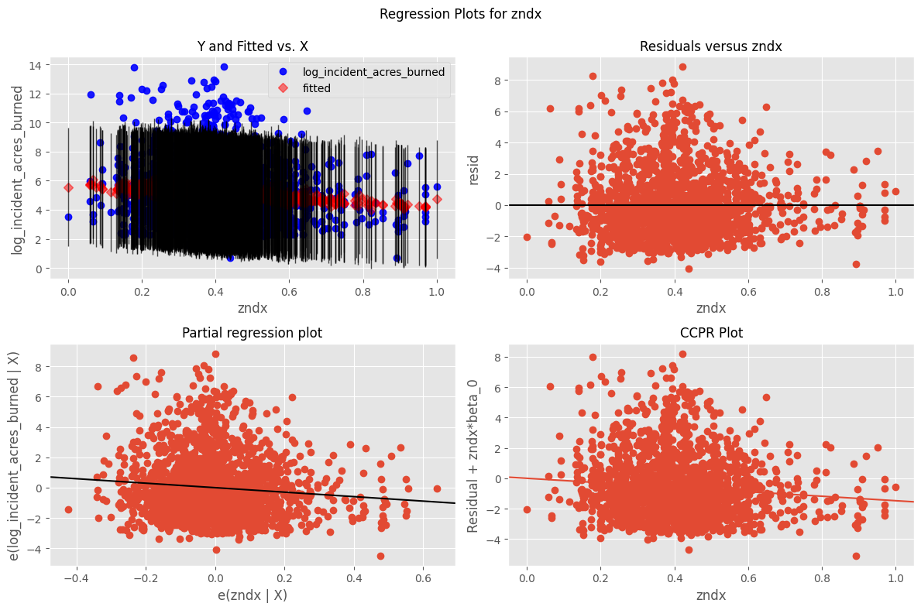
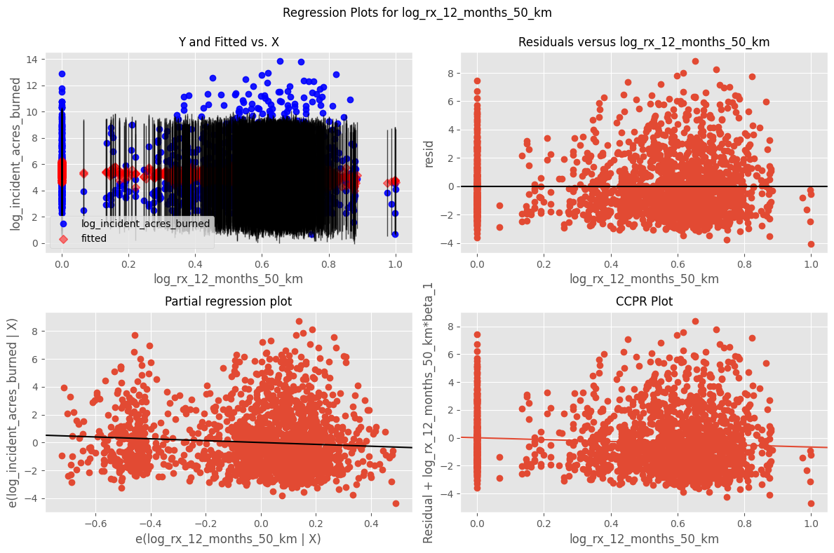
Regression Analysis: Treatment
Figure 6: Residuals and partial regression for PZI
Figure 7: Residuals and partial regression for prescribed burns
Notes:
Residuals, Partial regression

Slide 12
Discussion
Prescribed burns are associated with decreased wildfire size
Severe drought is associated with larger wildfire size
Latitude and longitude are significant predictors, indicating spatial location is important
Limitations:
Vegetation type is not considered in this model
Models use binning for handing spatial and temporal differences – an integrated model could be better

Slide 13
Recall: Research Questions
Are prescribed burns effective at reducing the size of wildfires?
Are prescribed burns effective at reducing the size of wildfires while controlling for climate-relevant variables
How do these relationships change at different spatio-temporal scales?

Slide 14
Conclusion and Future Work
Increased prescribed burn acreage is related to decreased wildfire size under certain circumstances
When controlling for drought index, prescribed burns are still a significant predictor of wildfire size
Prescribed burns have the greatest impact when performed within 12 months and 50 km of wildfires when controlling for drought
Future analysis will explore other methods for incorporating spatio-temporal information, such as coregionalization modeling and mixed effects modeling
Notes:
Are prescribed burns effective at reducing the size of wildfires?
Are prescribed burns effective at reducing the size of wildfires while controlling for climate-relevant variables
How do these relationships change at different spatio-temporal scales?

Slide 15
San Francisco State University

Slide 16

Data Overview
Figure 2: Visualization of prescribed fires for each year and wildfires in following years

Slide 17
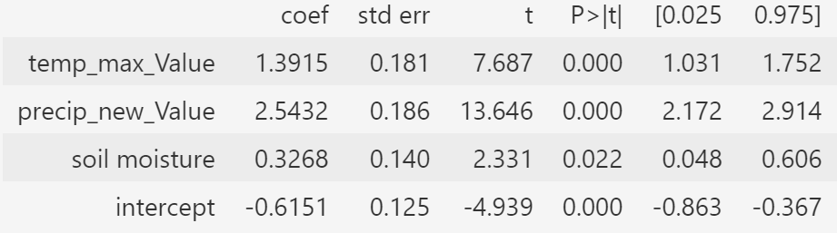
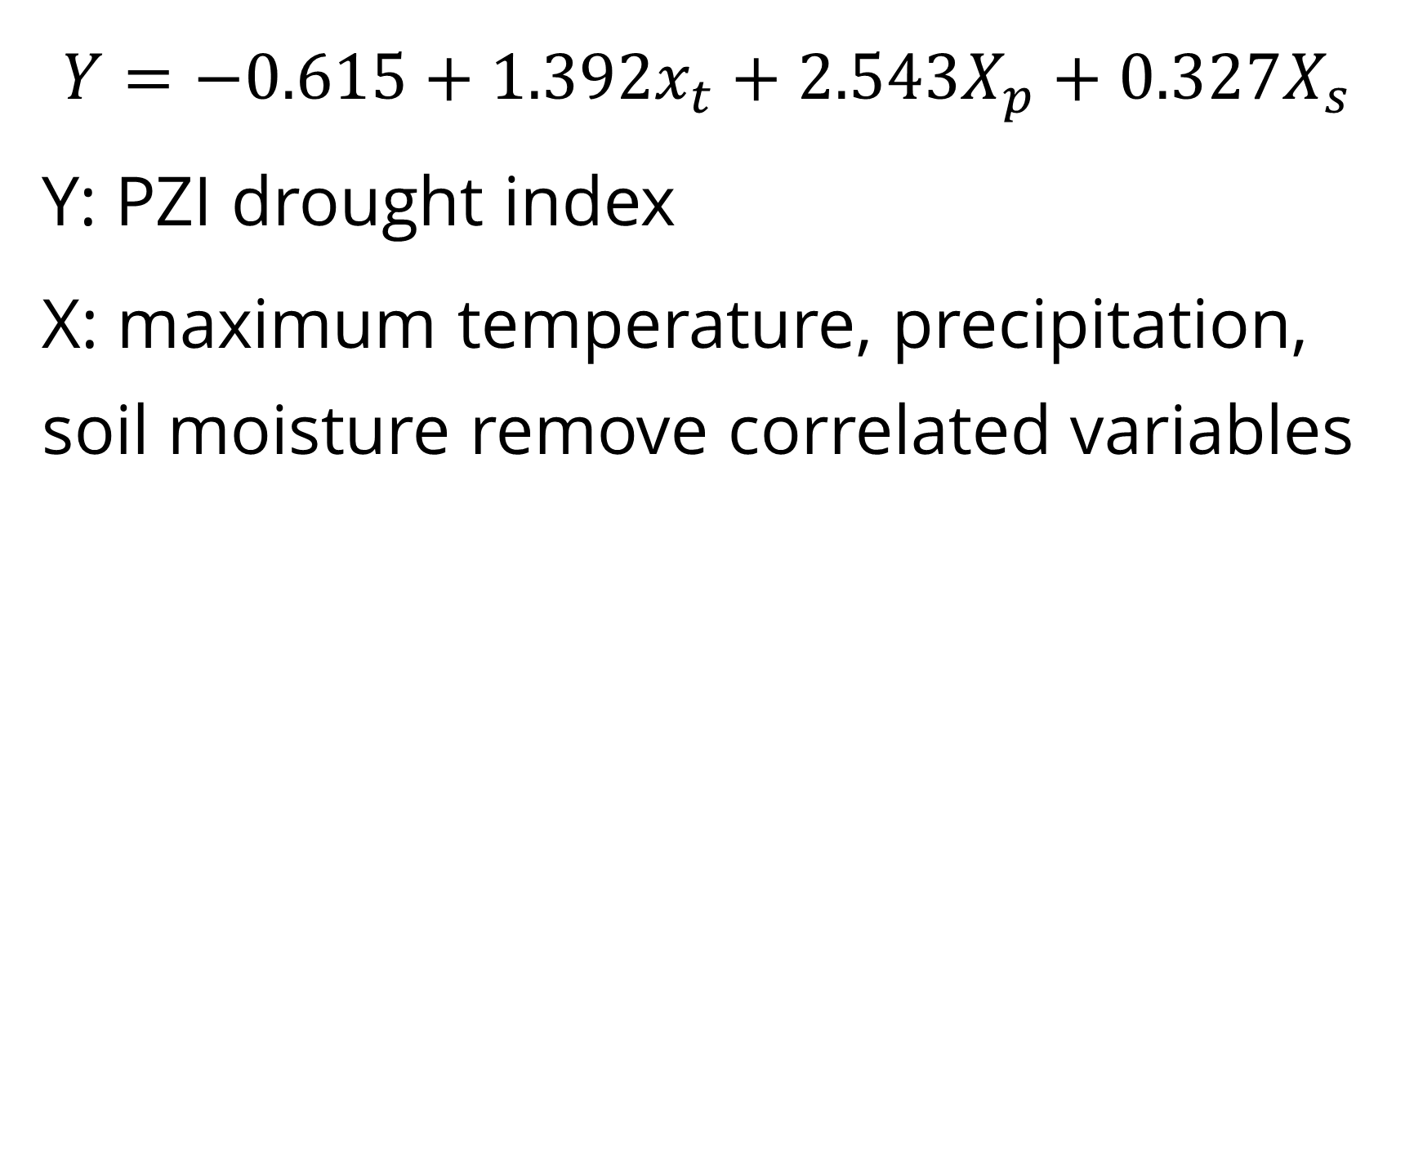
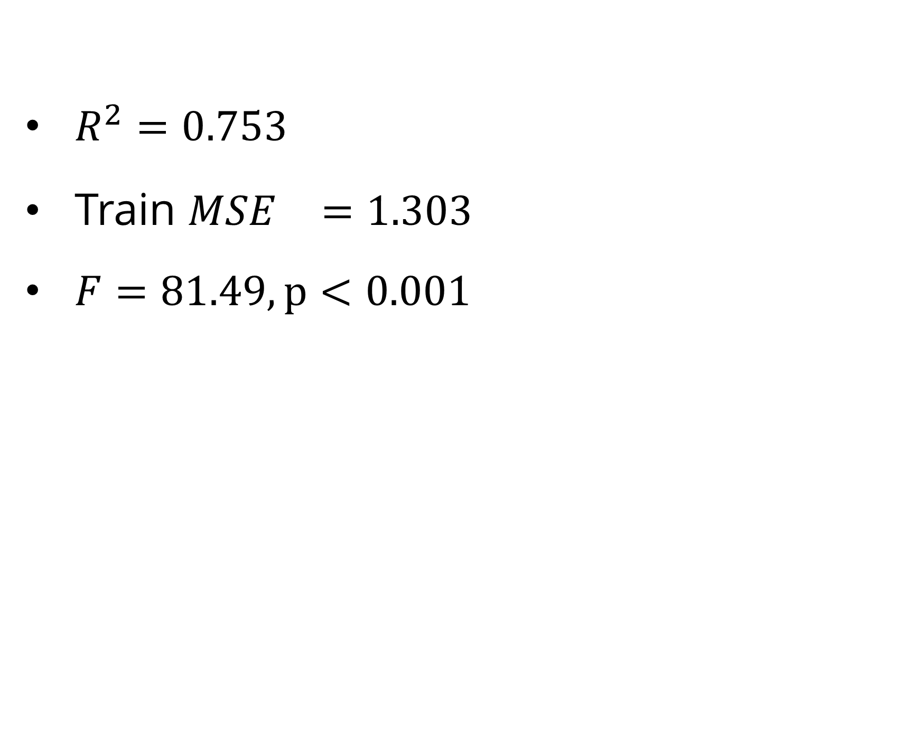
Regression Analysis: Drought Index
$$Y=−0.615+1.392x_{t}+2.543X_{p}+0.327X_{s}$$
Y: PZI drought index
X: maximum temperature, precipitation, soil moisture remove correlated variables
$R^{2}=0.753$
Train ${MSE}^{}=1.303$
$F=81.49, p<0.001$
Temperature increases are related to increased drought severity
Precipitation and soil moisture decreases are related to increased drought severity
Precipitation has the greatest impact on drought index
Table 5: Regression coefficient results

Slide 18
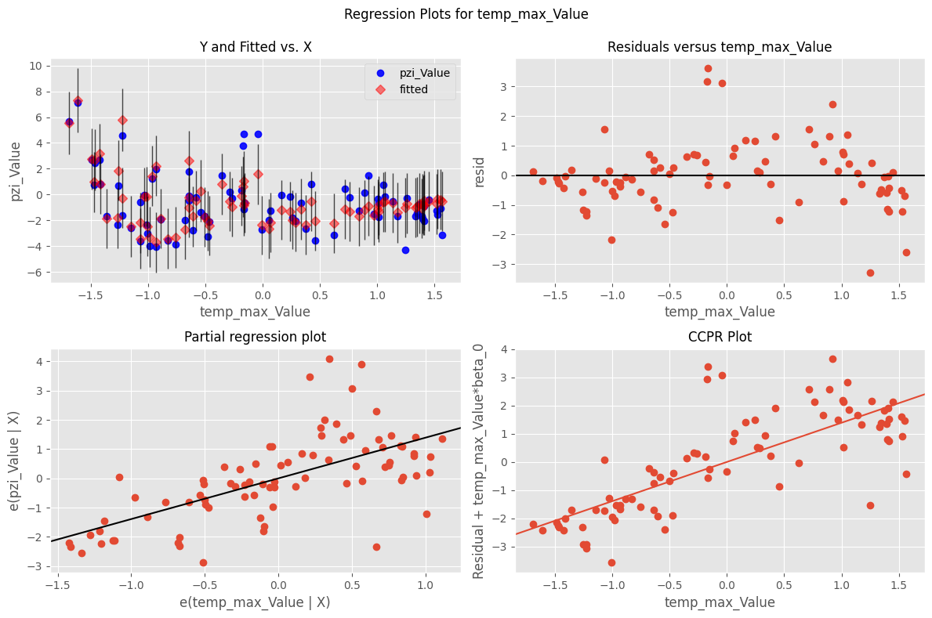
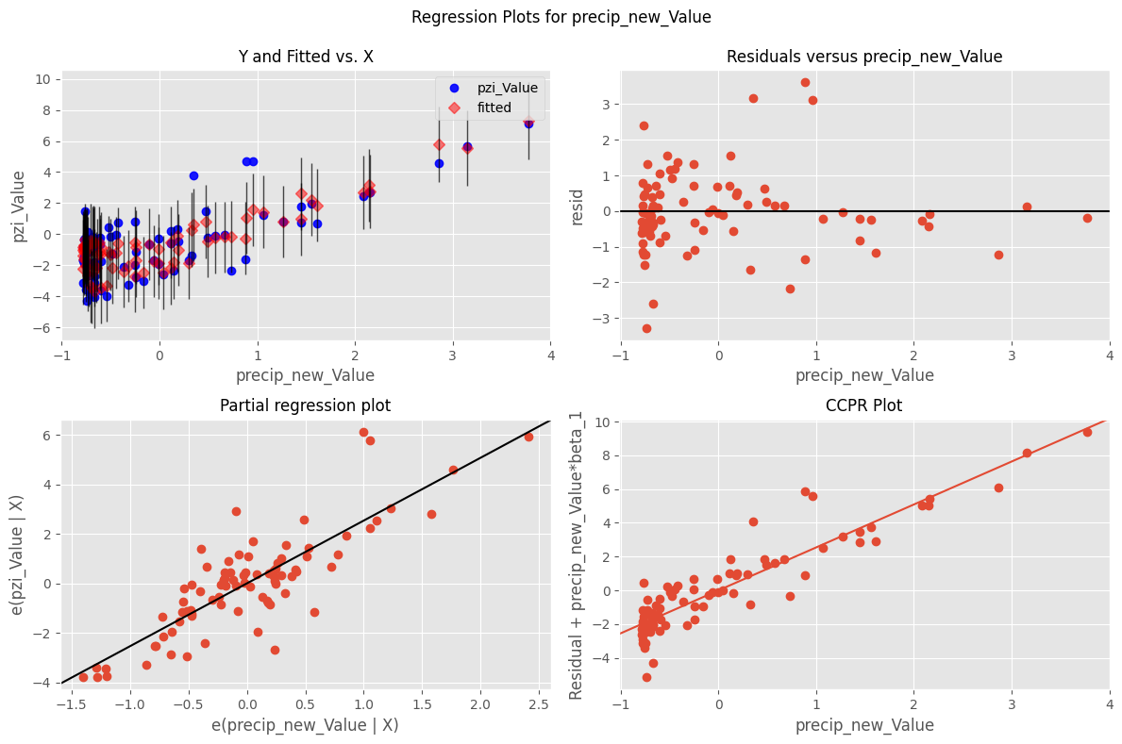
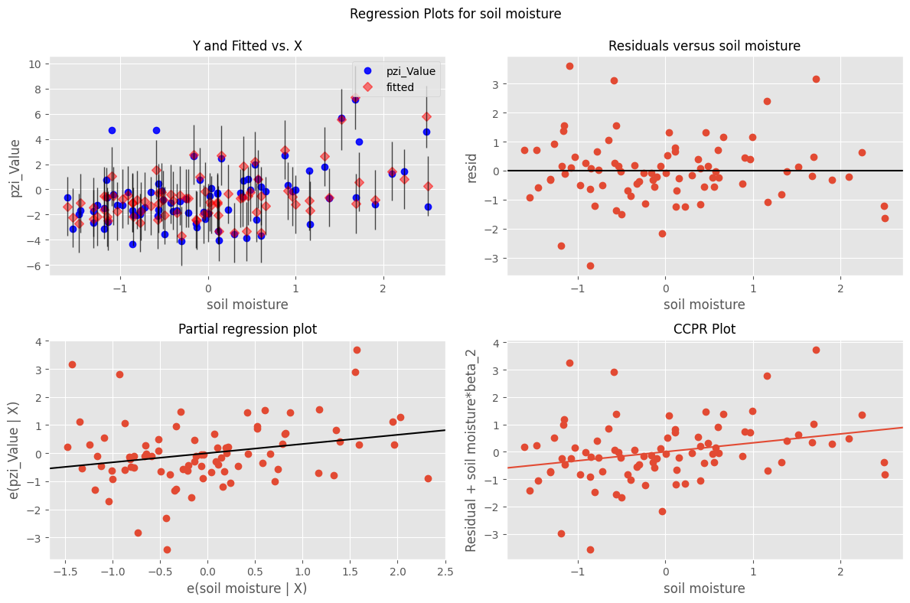
Regression Analysis: Drought Index
Figure 9: Residuals and partial regression for temperature
Figure 10: Residuals and partial regression for precipitation
Figure 11: Residuals and partial regression for soil moisture
Notes:
Residuals, Partial regression

Slide 19
Regression Analysis: Monthly
Y: Wildfire acres burned
X:
Variance Inflation Factor (VIF) is used to remove correlated variables

