Slide 1
San Francisco State University

Slide 2
Towards A Statistical Analysis of Wildland and Prescribed Fires in the Changing California Climate
Sequoia Andrade
10/13/2023

Slide 3
Motivation
Climate change-driven large, destructive wildfires becoming more frequent, especially in California
Data can be used to identify effective or ineffective prevention strategies, such as prescribed burns
Much of the existing body of research was performed in the previous century and did for climate change’s impact on prescribed burn efficacy
The data needed to study this question is fragmented and complex

Slide 4
Background
Consensus on prescribed burns as effective in certain scenarios
Environmental trends indicate the window for prescribed burns is shrinking
Limited implementation due to controversy on:
  Potential harmful negative effects to the ecosystem, including soil and water
  Impact on air quality
  Risk and cost
Previous work:
  Cross correlation showed strong relationship between humidity, precipitation, and wildfire
  Drough impacts larger fires while wind impacts smaller
  GLM, mixed models, proportion tests, chi-squared

Slide 5
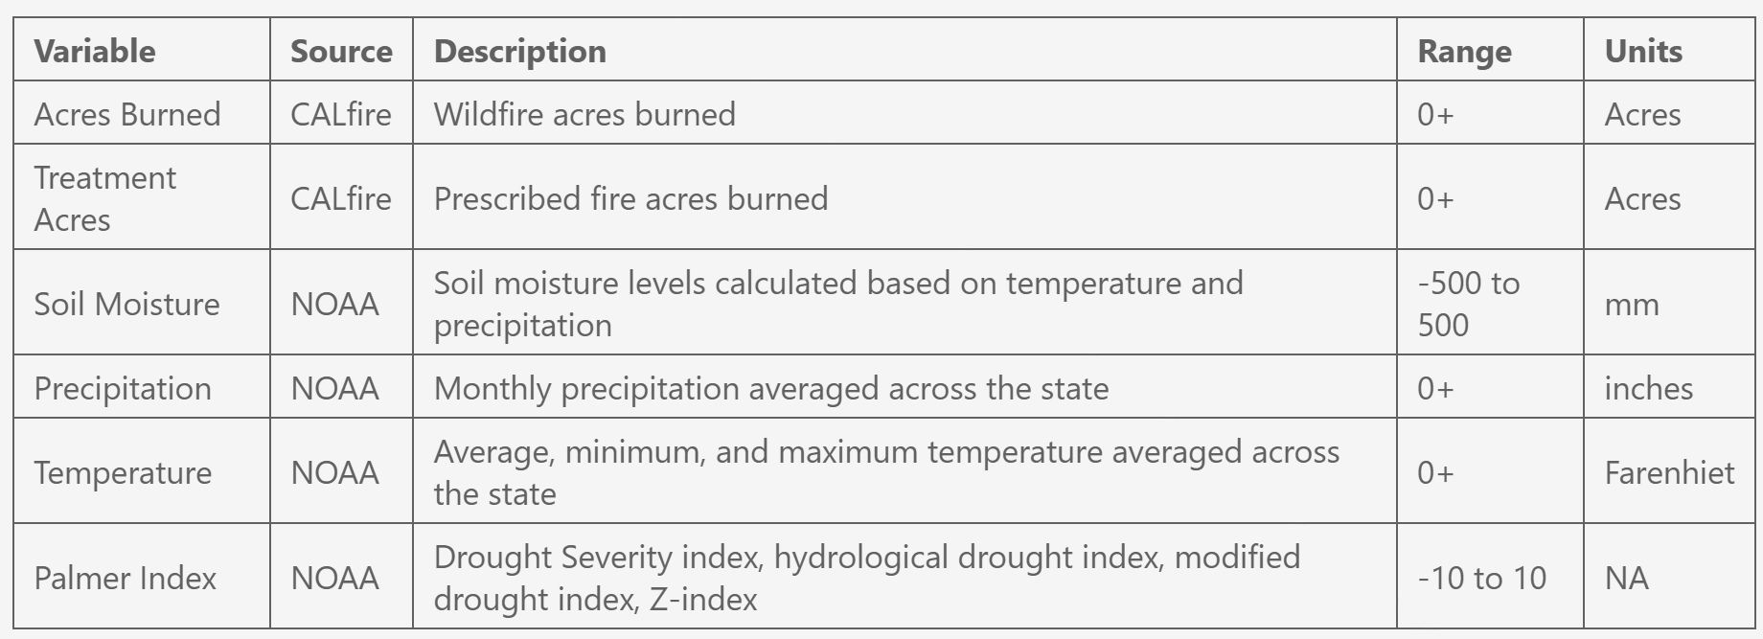
Data

Slide 6
Dataset Creation
Monthly dataset
  Rows are months
  Columns are wildfire acres burned, prescribed fire acres burned, precipitation, avg temp, max temp, min temp, drought index, soil moisture
Treatment dataset
  Rows are wildfire incidents
  Columns are acres burned, for each 3/6/12/24/36 month time frame Boolean true/false if prescribed fire in 5/10/25/50/100 km, acres burned in prescribed fire within 5/10/25/50/100 km
  Will add in climate data from month before the fire

Slide 7
Methods
Descriptive analysis:
  Summary statistics
Inferential analysis:
  WSR test / MWU
Time series Analysis
  Cross correlation
  Correlation Matrix
Regression Analysis

Slide 8

Overview

Slide 9
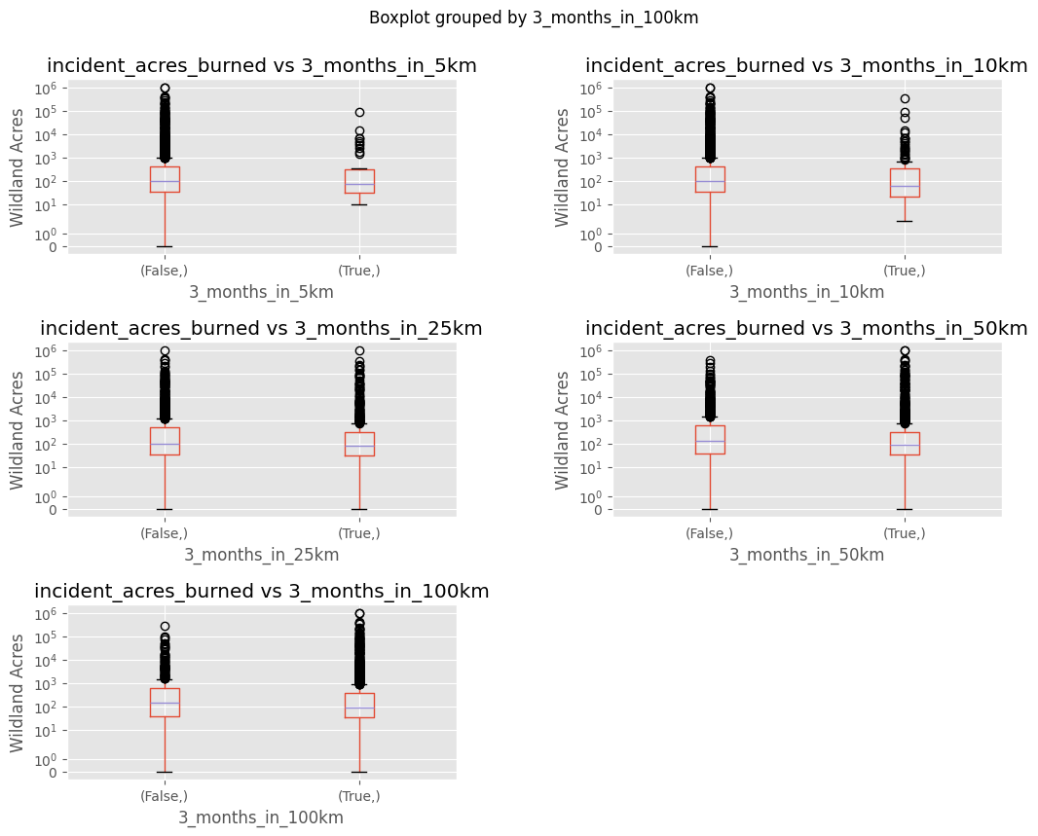
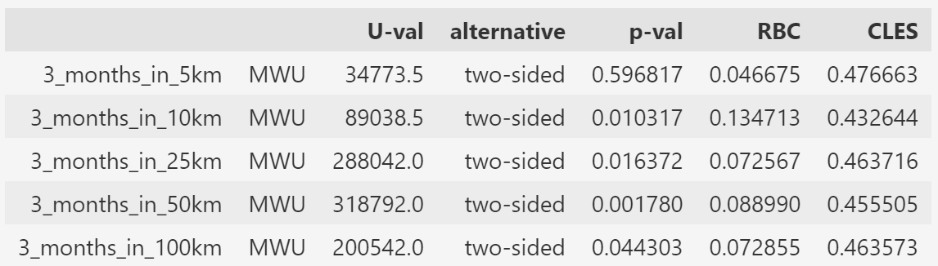
Inferential Analysis: Treatment Data

Slide 10
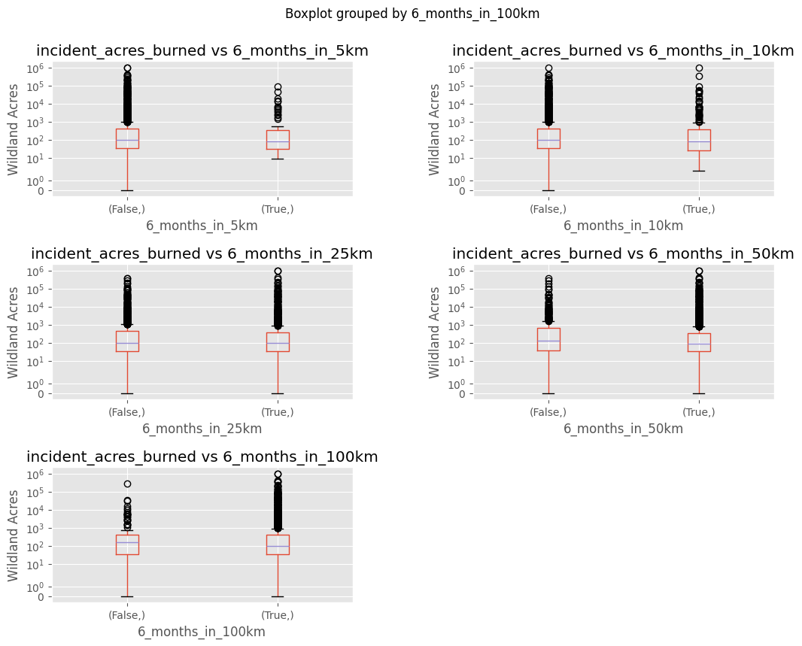
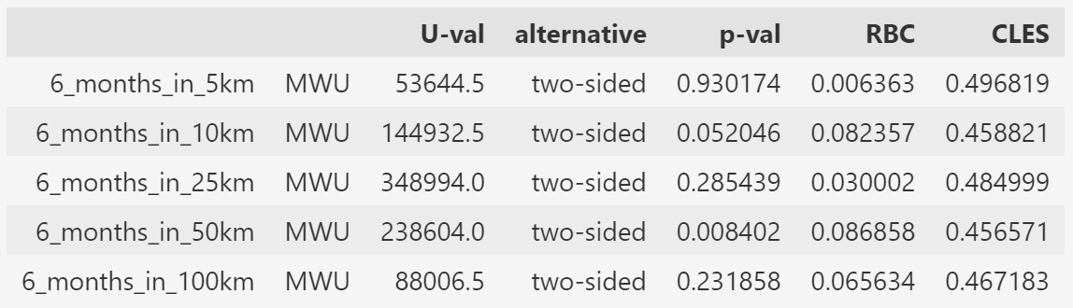
Inferential Analysis: Treatment Data

Slide 11
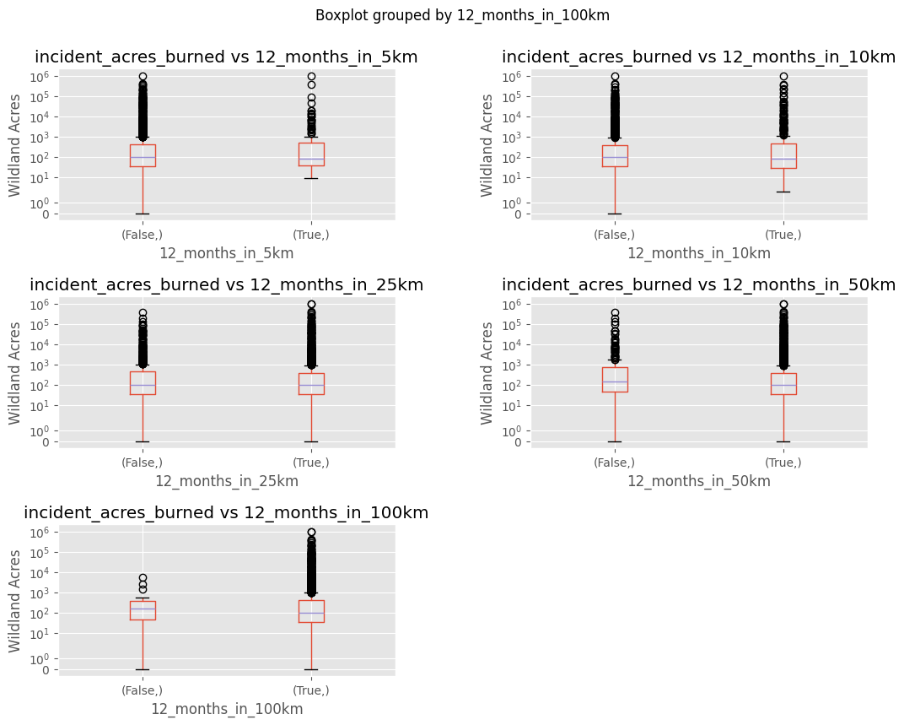
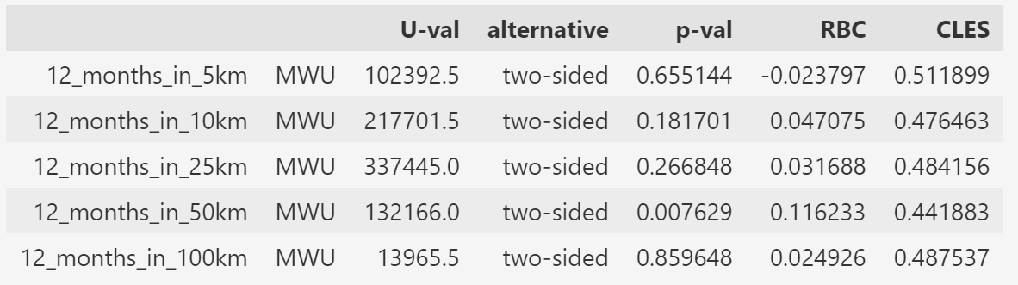
Inferential Analysis: Treatment Data

Slide 12
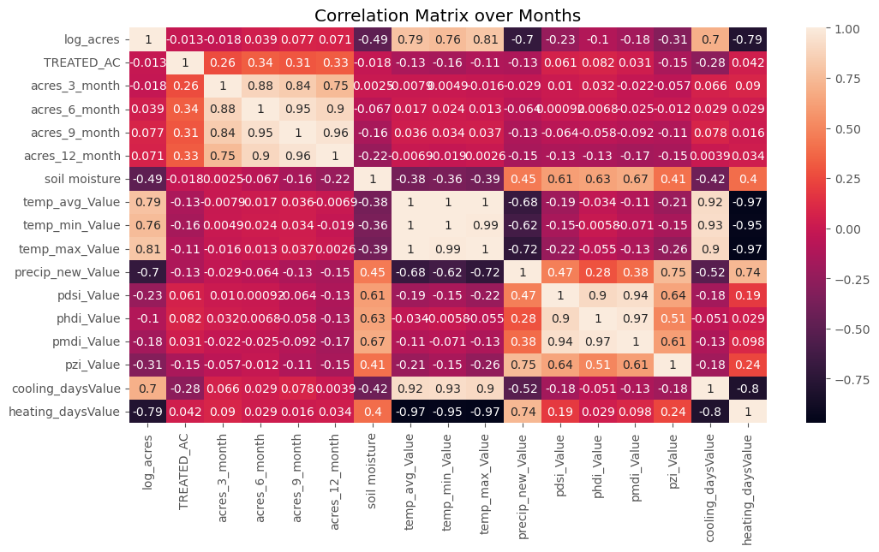
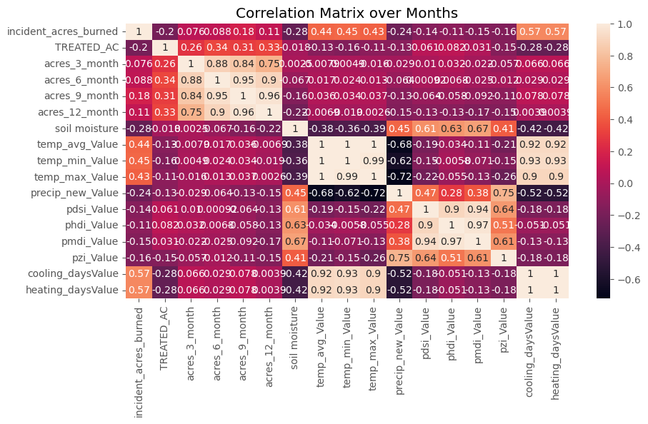
Time Series Analysis

Slide 13
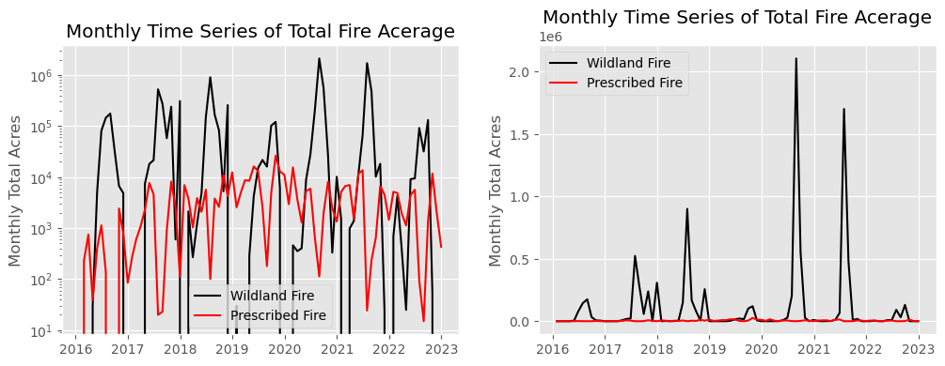
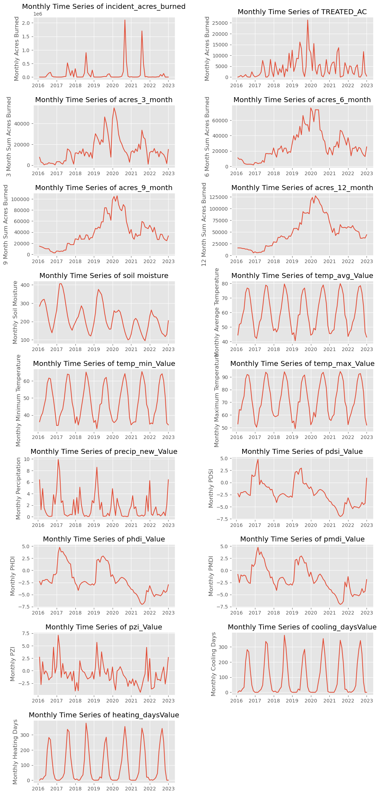
Time Series Analysis

Slide 14
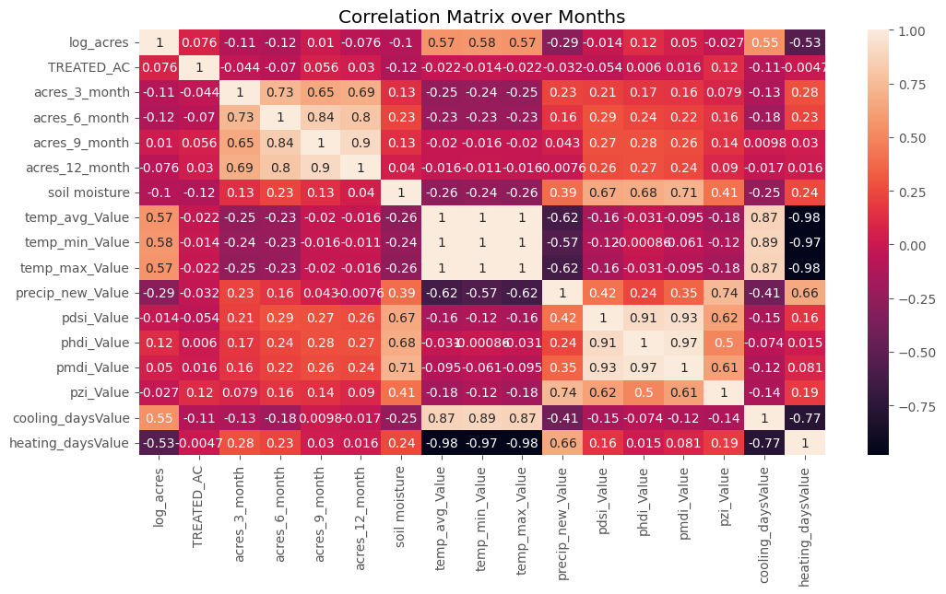
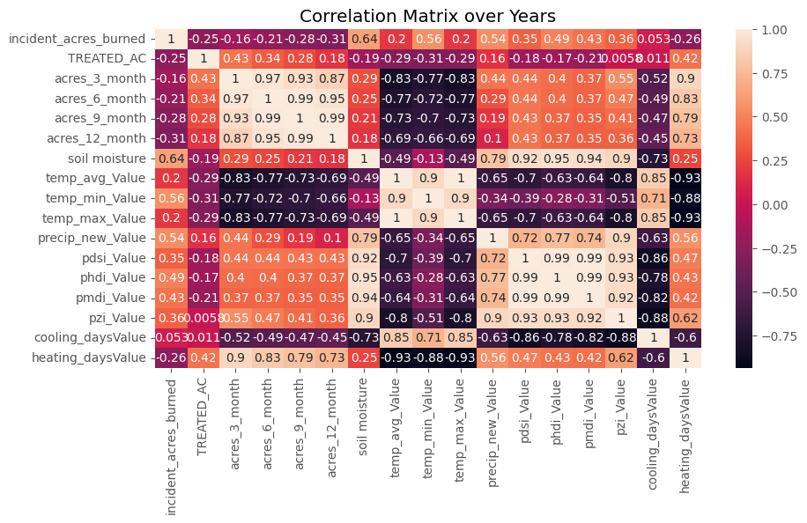
Time Series Analysis: Tulare

Slide 15
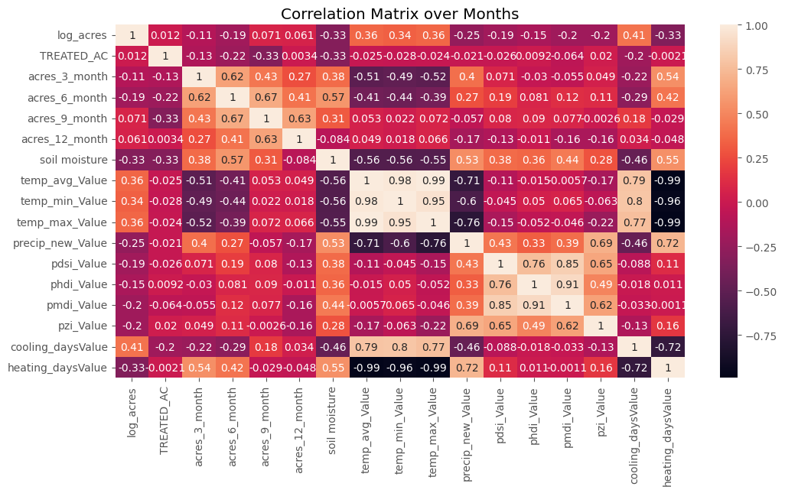
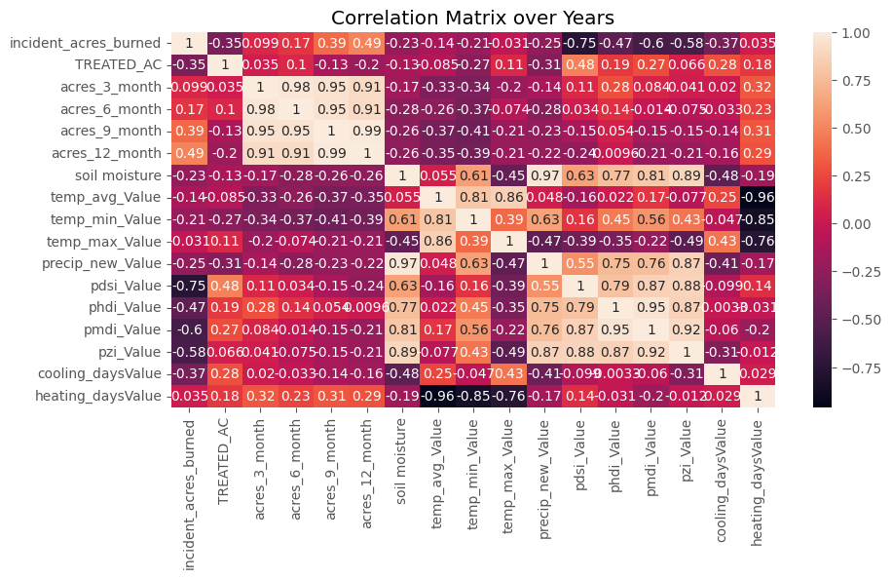
Time Series Analysis: Humboldt

Slide 16
Summary
3 and 6 month prescribed burn increments have significant effect
5 km not significant - could be too small of a distance
Increased soli moisture associated with decreased acres burned, lower drought index associated with increased acres burned, higher temperature associated with increased acres burned
Prescribed burn acres are correlated with the log of wildfire acres
Effect varies based on county
prescribed burns might be more effective in Humboldt County
There are a lot of variables to consider, confounding variables, and different directions of causality – very complex problem

Slide 17
Future Work
Regression analysis – predict wildfire size from prescribed burn characteristics, climate – should add in the lat lon, look at interaction
Spatial analysis – incorporate location more - how to best do this?
Possible Markov Chain analysis – transition between fire states?

Slide 19
Contact Me
College or Department
Office Phone
(832) 123.4567
Email / Website
blank@sfsu.edu
blank.com

Slide 20
Section Heading

Slide 21
Section Title
Text
1
2
Text
3
Text
Notes:
Angie

Slide 22
Title
Notes:
Heidi

Slide 23
Title
Text
Text
Notes:
Heidi

Slide 24

Section Title
Text
Text
Notes:
Heidi – finish out by mentioning that they can ask their colleagues for more info at the end

