Slide 1
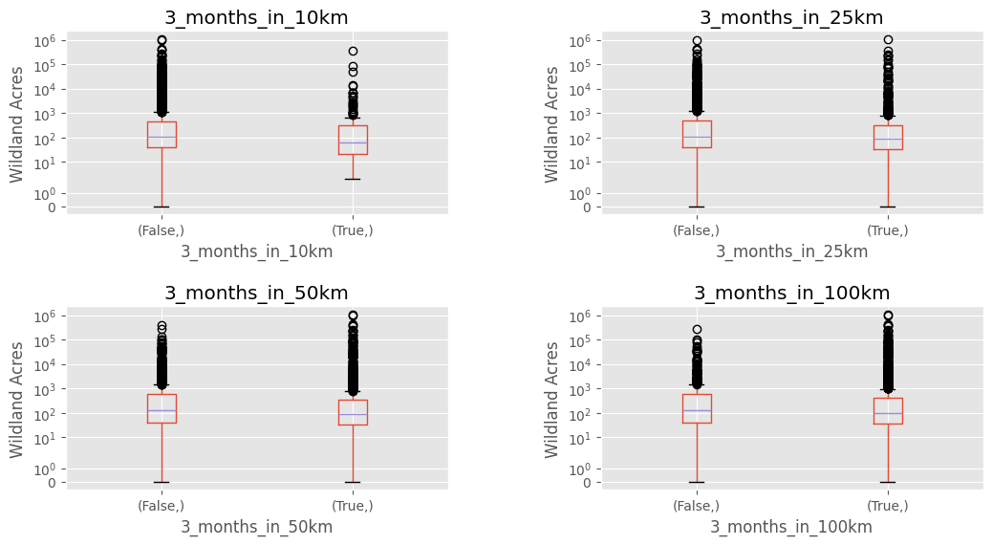
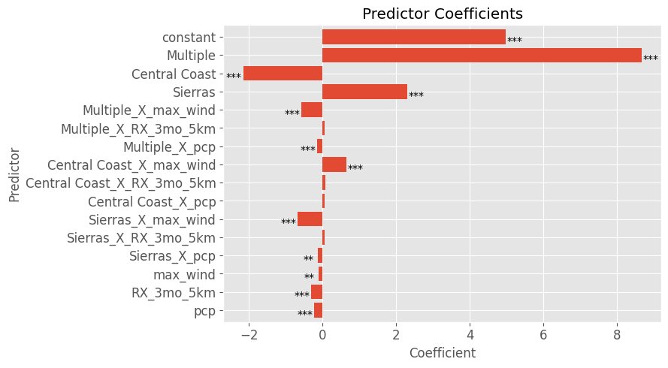
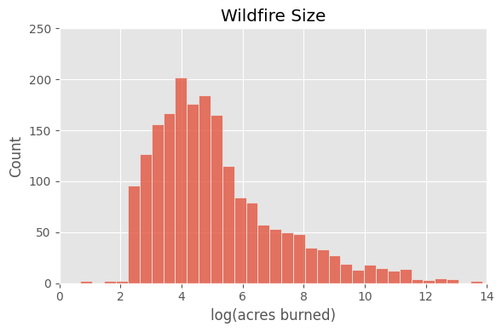

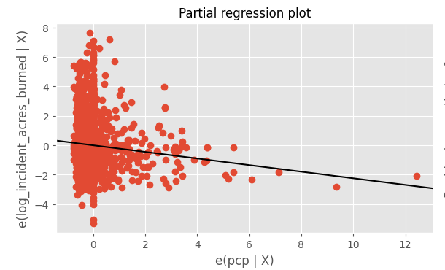
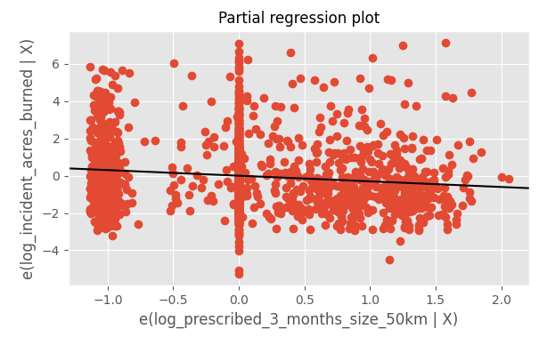
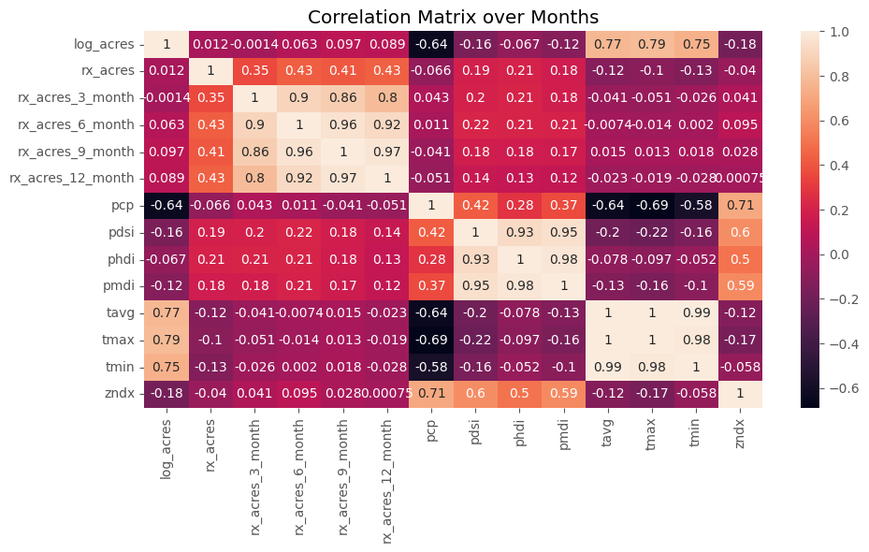
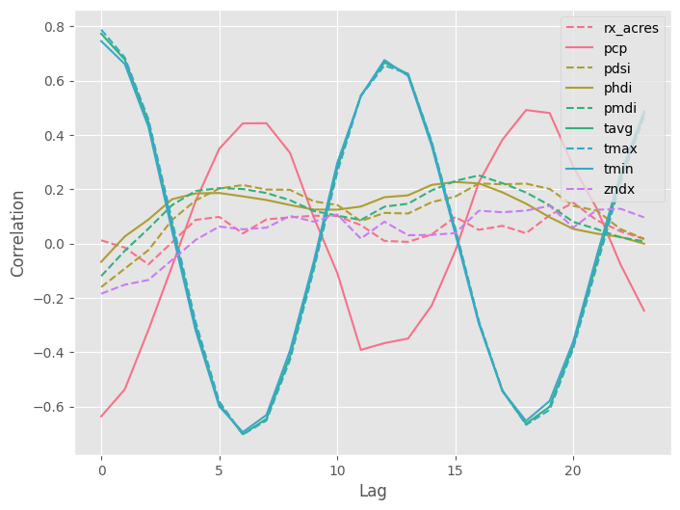

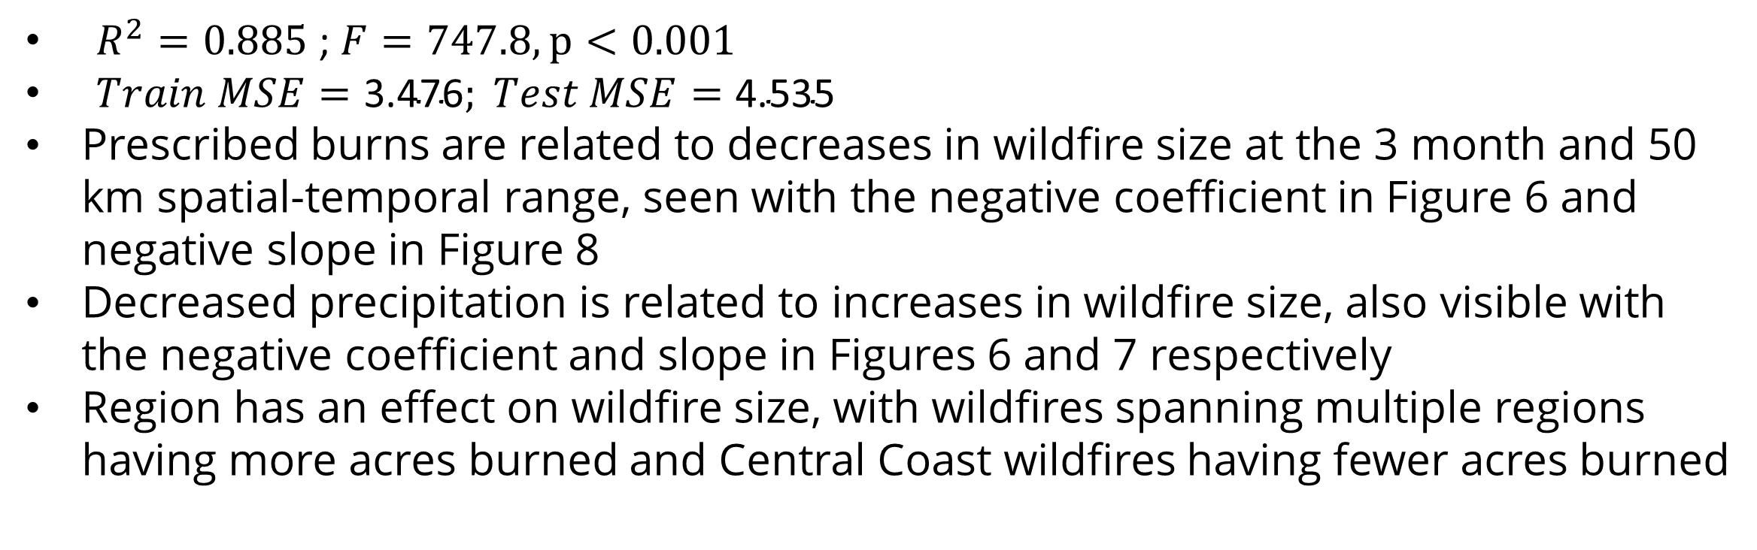
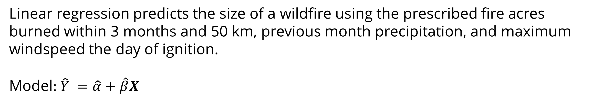
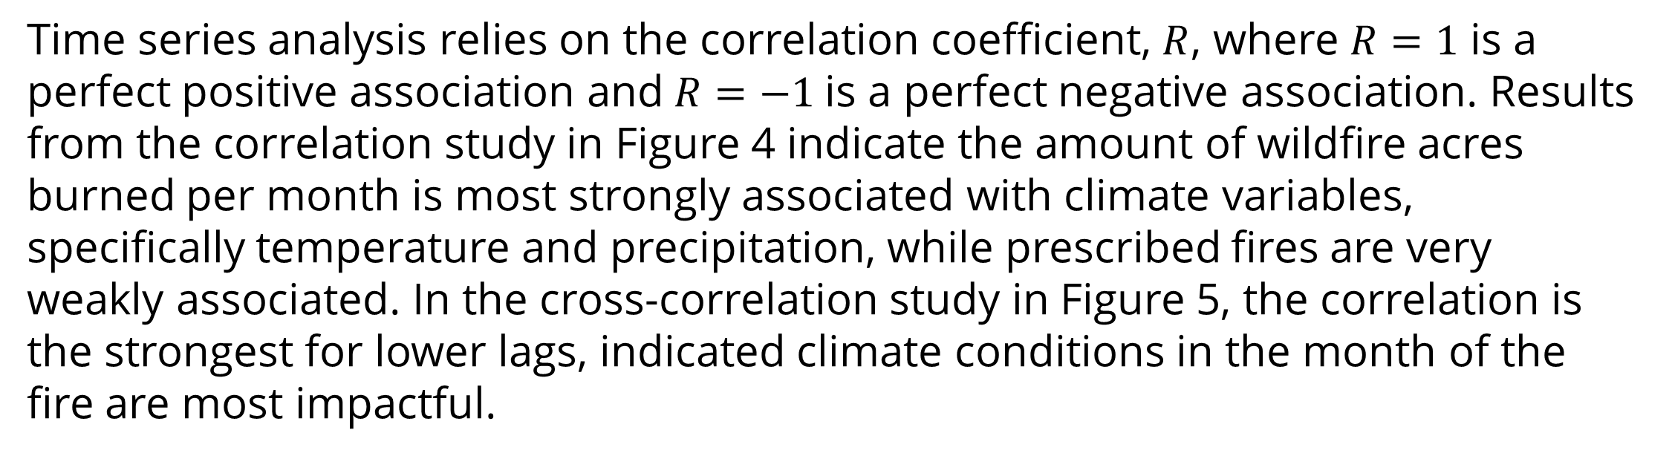
A Statistical Analysis of Wildland and Prescribed Fires in the Changing California Climate
Presented by Sequoia Andrade
San Francisco State University
Mathematics Department – M.S. Statistical Data Science
Motivation
Inferential Analysis
Regression Analysis
Climate change-driven large, destructive wildfires becoming more frequent, especially in California [1,2]
Prescribed burns are known to be effective in reducing wildfire intensity[3], yet much of the existing body of research was performed in the previous century and did not account for climate change’s impact on prescribed burn efficacy
Statistical analysis can be used to identify effective or ineffective prevention strategies, such as prescribed burns, but the data needed to study this question is fragmented and complex
Linear regression predicts the size of a wildfire using the prescribed fire acres burned within 3 months and 50 km, previous month precipitation, and maximum windspeed the day of ignition.
Model: $\hat{Y} =\hat{α}+\hat{β}X$
Research Questions
Are prescribed burns effective at reducing the size of wildfires?
Are prescribed burns effective at reducing the size of wildfires while controlling for climate-relevant variables
How do these relationships change at different spatio-temporal scales?
Data
The data set used in this research was created by combining NOAA climate data and CALFire fire history data. This data consists of 2041 wildfires spanning January 2013 to December 2022, where each row is a wildfire and columns include:
Wildfire acres burned, precipitation, temperature, wind speed, drought index
For each 3-36 month time frame, prescribed fire acres burned in 5 - 100 km distance radius
Figure 3: Box plot of wildfire size between groups with and without prescribed burns within the specified distance
Table 2: Mann-Whitney U-test results, including rank biserial correlation (RBC) and common language effect size (CLES)
Figure 6: Linear Regression coefficients, with significant predictors notated with “*”
Month | Spatial Radius | U-value | Tail | P-val | CLES
3 | 10km | 116580.5 | Less | 0.002 | 0.57
 | 25km | 398966.5 | Less | 0.015 | 0.531
 | 50km | 47.0224.5 | Less | 0.0005 | 0.542
 | 100km | 324365 | Less | 0.054 | 0.527
$R^{2}=0.885$ ; $F=747.8, p<0.001$
$Train MSE=\text{3.47}\text{6}; Test MSE=\text{4.}\text{535}$
Prescribed burns are related to decreases in wildfire size at the 3 month and 50 km spatial-temporal range, seen with the negative coefficient in Figure 6 and negative slope in Figure 8
Decreased precipitation is related to increases in wildfire size, also visible with the negative coefficient and slope in Figures 6 and 7 respectively
Region has an effect on wildfire size, with wildfires spanning multiple regions having more acres burned and Central Coast wildfires having fewer acres burned
Mann-Whitney U-test uses ranking to determine if wildfires with prescribed fires near by are smaller on average than wildfires without prescribed fires. The test results in Table 2 yield significant differences, showing prescribed burn treatment is associated with fewer acres burned at 10 km, 25 km, 50 km, and 100km distance when completed 3 months before a fire. The difference can be visually seen in Figure 3, where the median (blue line) is slightly lower for cases with prescribed burns.
Figure 7: Partial regression for precipitation
Figure 8: Partial regression for prescribed burns
Figure 1: Distribution of wildfire size
Table 1: Variables in the dataset
Figure 2: Location and size of fires at scale
Time Series Analysis
Variable | Source | Description | Range | Units | Symbol
Acres Burned | CALfire[4] | Wildfire acres burned | 0+ | Log(Acres) | log_acres
Treatment Acres | CALfire[5] | Prescribed fire acres burned | 0+ | Acres | rx_acres
Precipitation | NOAA[6] | Monthly Precipitation averaged across the county | 0+ | Inches | pcp
Temperature | NOAA[6] | Average, minimum, and maximum temperature averaged across the county | 0+ | Fahrenheit | temp
Palmer Index | NOAA[6] | Drought severity indices | [-10, 10] | N/A | zndx, pdsi, phdi, pmdi
Windspeed | OpenMeteo [7] | Maximum windspeed on fire start date | 0+ | Km/h | max_wind
Time series analysis relies on the correlation coefficient, $R$, where $R=1$ is a perfect positive association and$R=−1$is a perfect negative association. Results from the correlation study in Figure 4 indicate the amount of wildfire acres burned per month is most strongly associated with climate variables, specifically temperature and precipitation, while prescribed fires are very weakly associated. In the cross-correlation study in Figure 5, the correlation is the strongest for lower lags, indicated climate conditions in the month of the fire are most impactful.
Conclusion
Increased prescribed burns are associated with decreased wildfire size for certain cases
When controlling for climate variables, such as precipitation, prescribed burns are still a significant predictor of wildfire size
Prescribed burns have the greatest impact when performed within 12 months and 50 km of wildfires when controlling for drought
Figure 4: Correlation between wildfire acres burned and predictors
Figure 5: Cross-correlation between wildfire acres burned and predictors
Methods
References
Inferential analysis:
Difference of median test to examine if wildfires are smaller when there is a prescribed fire nearby
Time series analysis:
Correlation to identify which predictors are associated with acres burned
Cross-correlation to identify at what time lags predictors are associated with acres burned
Regression Analysis:
Predict acres burned per wildfire incident from prescribed fires and climate variables
[1] CALFire. Top 20 Most Destructive California Wildfires. Accessed on 2023-01-05. url: https://www.fire.ca.gov/our-impact/statistics
[2] CALFire. Top 20 Largest California Wildfires. Accessed on 2023-01-05. url: https://www.fire.ca.gov/our-impact/statistics.
[3] Molly E Hunter and Marcos D Robles. “Tamm review: The effects of prescribed fire on wildfire regimes and impacts: A framework for comparison”. In: Forest Ecology and Management 475 (2020), p. 118435
[4] CALFire. Incident Data. 2023. url: https://www.fire.ca.gov/incidents/
[5] CALFIRE. Prescribed Burns. 2022. url: https://data.ca.gov/dataset/prescribed-burns1
[6] NOAA National Centers for Environmental information. Climate at a Glance:Statewide Time Series. 2023. url: https://www.ncei.noaa.gov/access/monitoring/climate-at-a-glance/statewide/time-series
[7] Zippenfenig, P. Open Meteo Historic Weather API. 2024. doi: https : / /
zenodo.org/records/7973572. url: https://open-meteo.com/en/docs/historical-weather-api

