Slide 1

A different kind of Carpentry
Software Carpentry, Data Carpentry, and giving researchers the skills they need to tackle large data and computing challenges
Feel free to tweet or post slide photos from this talk

Slide 2




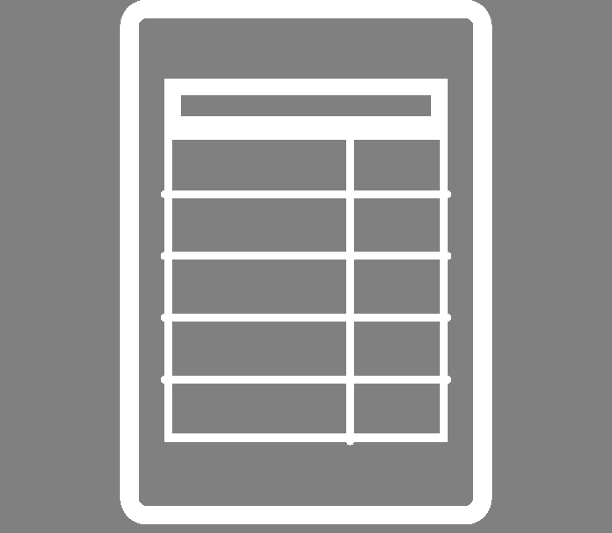
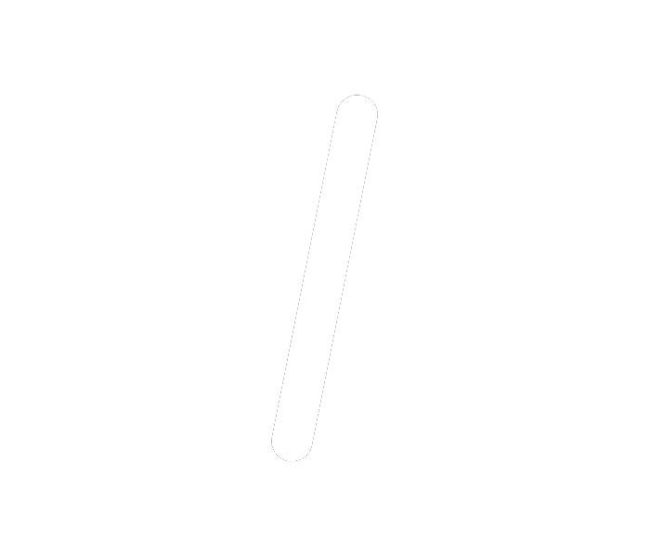



What are Software and Data Carpentry?
Two formal organizations* + international community of volunteers
that develop lessons, train instructors + organize workshops
in data management and software development
best practices
For and by researchers across disciplines
* soon to be restructured into a combined organization

Slide 3
Filling the Gaps
Identified needs
Researchers writing programs without any training in useful “industry-standard” best practices
Researchers struggling with quantity of data and how to organize, analyze, and otherwise manage it
Solution
2-day, peer-led workshops
collaboratively developed lesson modules
leveraging the volunteer efforts of community members
emphasis on best practices

Slide 4
Carpentries Philosophy: Content
Software and Data Carpentry teach skills:
version control, basic programming, command line
data organization, cleaning, analysis and visualization
Founded on best practices
building modular code, using data structures, reproducibility
For a research audience
Emphasis is not advanced, enterprise workflows or tools, but basic “toolbox” skills for everyday use

Slide 5
Carpentries Philosophy: Method
Interactive exercises
Real time feedback
Sticky Notes
Research-based pedagogy
Helpers
Hands-on
Live Coding
Inclusive
Peer-led
Code of conduct

Slide 6
Carpentries: “Broader Impacts”
Build local community around computing and data skills
Provide researchers with transferable skills in programming, data analysis, and teaching
Meet others in similar roles
Build local community of well-trained instructors
Adapt lesson materials for courses or trainings; jump start course creation
Promote open,
reproducible, research
Make oneself more attractive job (faculty) candidate
Discover job opportunities

Slide 7
The Current Carpentries
International community with many ways to engage
Hosting workshops, teaching, helping, developing lessons, mentoring others, sharing expertise
Two major lesson stacks + more coming
Instructor training on how to teach more effectively
Can get help organizing or self-organize workshops
In the past 5 years, more than 1,100 workshops of 28,000+ learners in over 40 countries

Slide 8
How could “the carpentries” help you at your institution?

Slide 9




Next Steps: Learn More
Look at lessons
Follow
Join
email lists
https://twitter.com/swcarpentry
https://software-carpentry.org/blog/
https://twitter.com/datacarpentry
http://www.datacarpentry.org/blog/
https://software-carpentry.org/lessons
http://www.datacarpentry.org/lessons/
http://eepurl.com/cfODMH
http://lists.software-carpentry.org/listinfo/discuss

Slide 10


Next Steps: Get Involved
Host a workshop
Become an instructor
Become a partner
https://software-carpentry.org/membership/
http://www.datacarpentry.org/partnerships/
https://software-carpentry.org/workshops/request/
http://www.datacarpentry.org/workshops-host/
http://swcarpentry.github.io/instructor-training/
https://amy.software-carpentry.org/forms/request_training/

Slide 11
Next Steps: HPCarpentry?
What about large-scale computing? Can “Carpentry” principles be applied to create lessons in using high throughput / high performance / large memory systems?
Unique challenges for this lesson: how to handle a variety of systems, schedulers, and use cases
Lots of interest and initial outlines here:
https://github.com/swcarpentry/hpc-novice/
If interested, join mailing list:
https://groups.google.com/a/carpentries.org/forum/#!forum/hpc-discuss

Slide 12
Questions?
For further inquires, email ckoch5 (at) wisc (dot) edu
Slides available at https://speakerdeck.com/christinalk/

Slide 13
Icon credits
https://thenounproject.com/
Book by Pumpkin Juice from the Noun Project
Mail by Kidiladon from the Noun Project
Newspaper by unlimicon from the Noun Project
audience by Gan Khoon Lay from the Noun Project
Institution by amy morgan from the Noun Project
Erlenmeyer Flask by Rockicon from the Noun Project
house plant by Arthur Shlain from the Noun Project
atom by Awesome from the Noun Project
Table by www.mindgraphy.com from the Noun Project
code by Ananth from the Noun Project
people by Anastasia Latysheva from the Noun Project

