Slide 1
How to Connect to CSPRO
[CSE4070]
Instructors
Prof. Youngjae Kim and Prof. Sungyong Park
Teaching Assistants
Hyeongu Kang
Suyeon Lee
Fall 2020

Slide 2
Terminals
You need to use terminal to connect to CSPRO9 or CSPRO10 server
There are many terminals you can use
I will introduce representative terminals for each OS

Slide 3
Windows
You can use 'PuTTY' as a terminal to connect
Download it from https://www.chiark.greenend.org.uk/~sgtatham/putty/latest.html

Slide 4
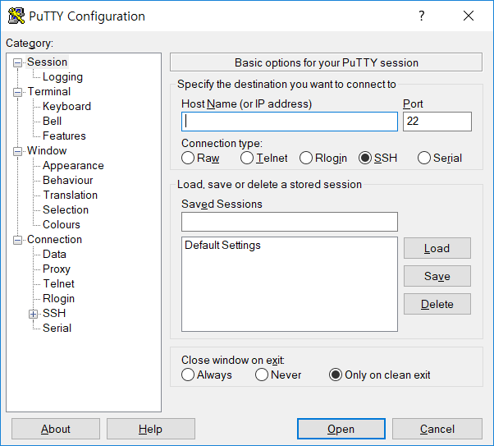
Windows
If you launch PuTTY, you can see this screen

Slide 5
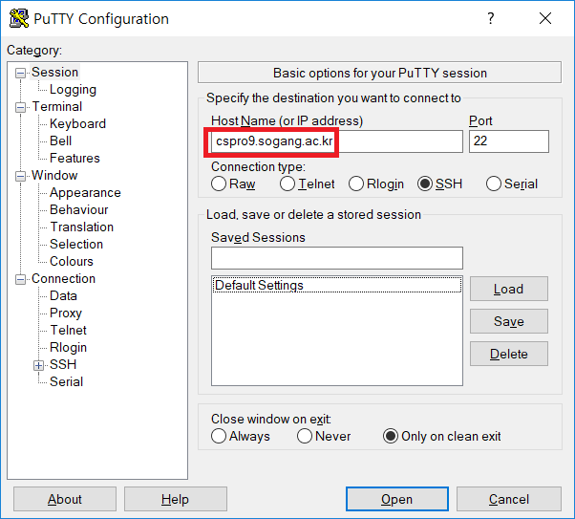
Windows
Enter the server address (cspro9.sogang.ac.kr) in Host Name

Slide 6
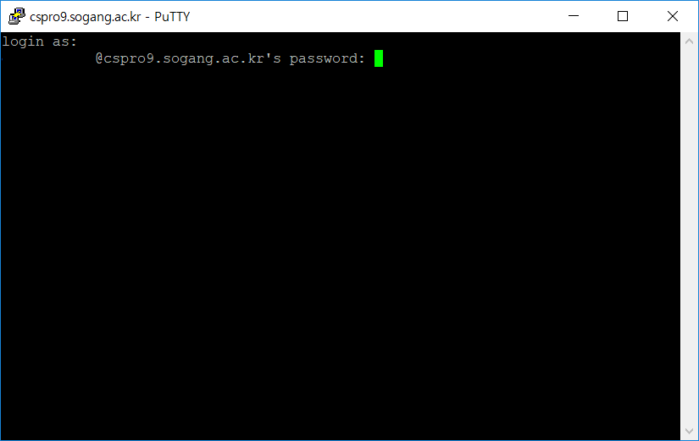
Windows
Enter your ID and PW

Slide 7
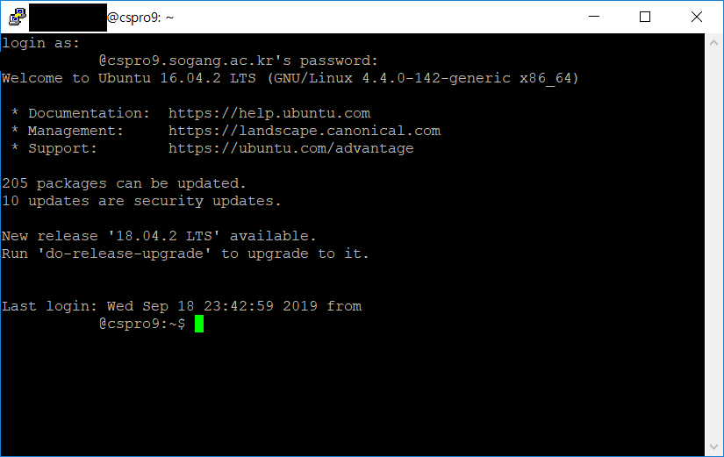
Windows
If you succeed to login, you can see the screen like below
Now you can do your work in the CSPRO server

Slide 8
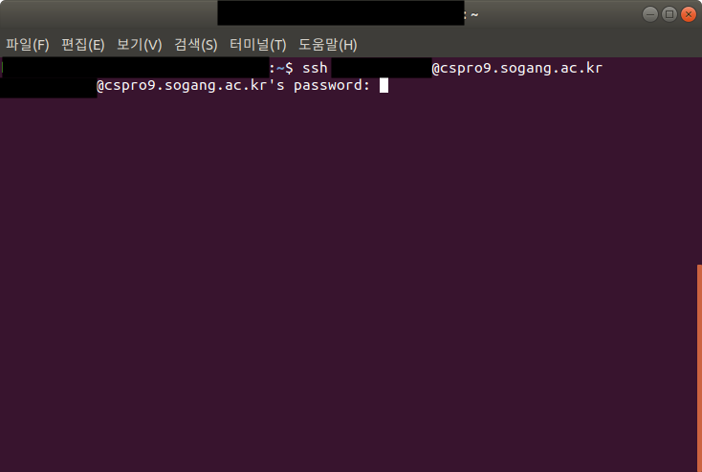
Linux (Ubuntu)
You can use built-in 'Terminal' application in Ubuntu
Launch Terminal and enter 'ssh [Your ID]@cspro9.sogang.ac.kr' and your PW

Slide 9
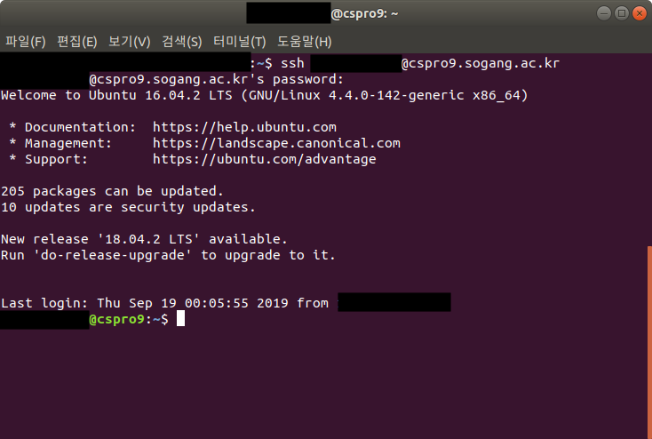
Linux (Ubuntu)
If you succeed to login, you can see the screen like below
Now you can do your work in the CSPRO server

Slide 10
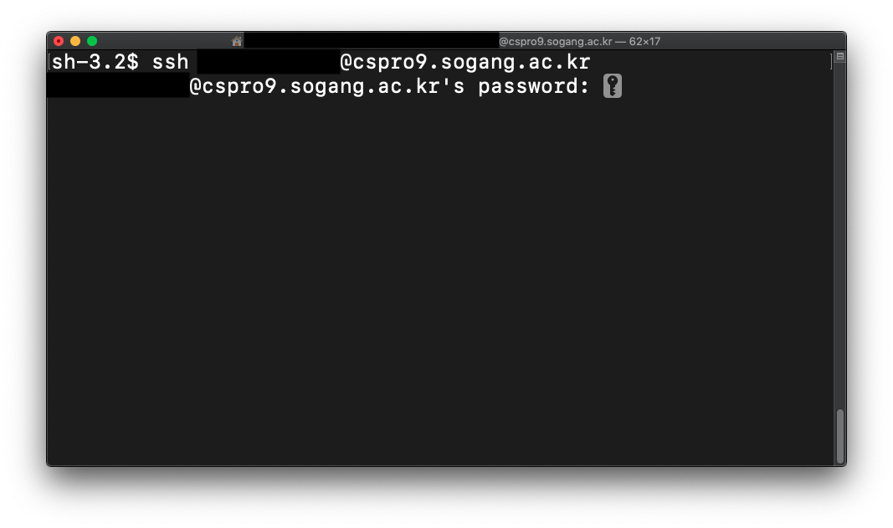
macOS
You can use built-in 'Terminal' application in macOS
Launch Terminal and enter 'ssh [Your ID]@cspro9.sogang.ac.kr' and your PW

Slide 11
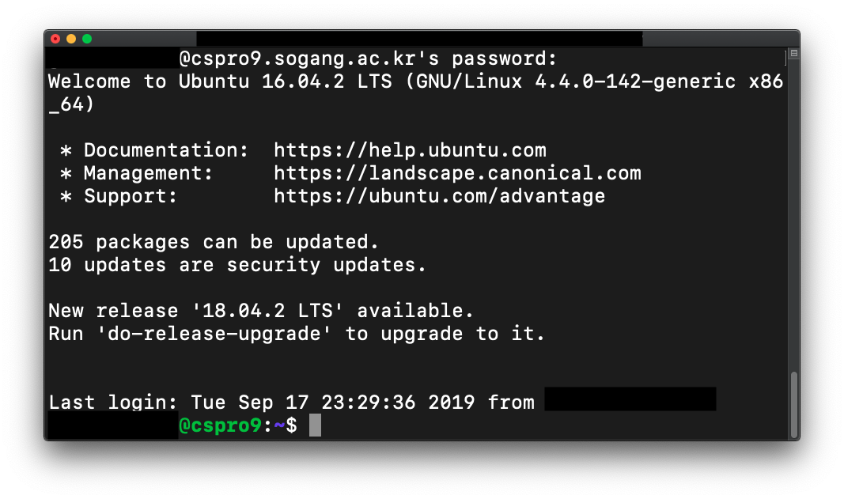
macOS
If you succeed to login, you can see the screen like below
Now you can do your work in the CSPRO server

