Slide 1
Pintos Introduction
[CSE4070]
Instructors
Prof. Youngjae Kim and Prof. Sungyong Park
Teaching Assistants
Hyeongu Kang
Suyeon Lee
Fall 2020

Slide 2
Contents
Operating Systems
What is Pintos?
Virtual Machine
Structures of Pintos
From Booting to Power Off
Project Schedule

Slide 3
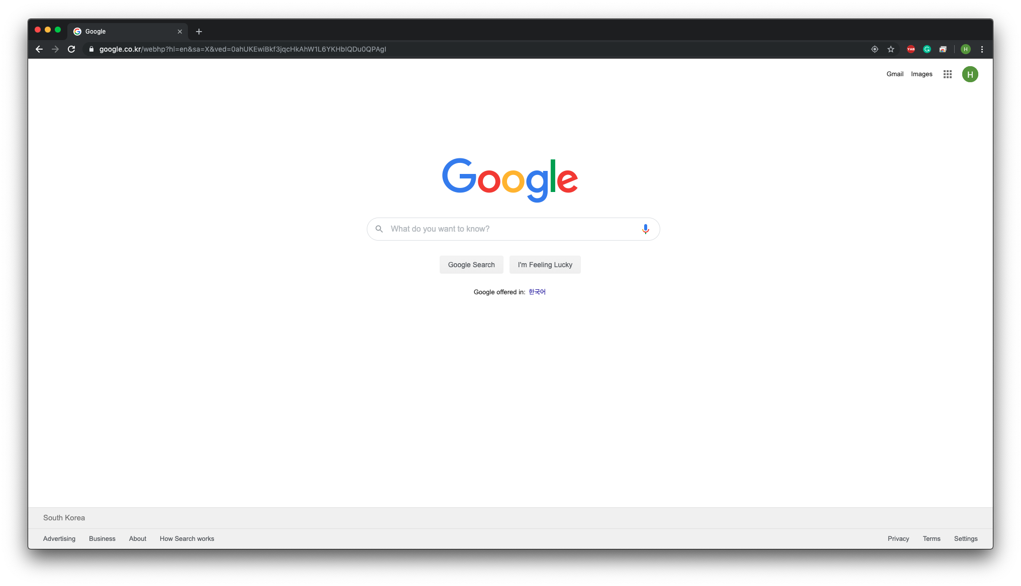
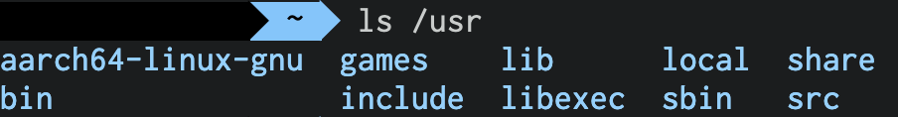
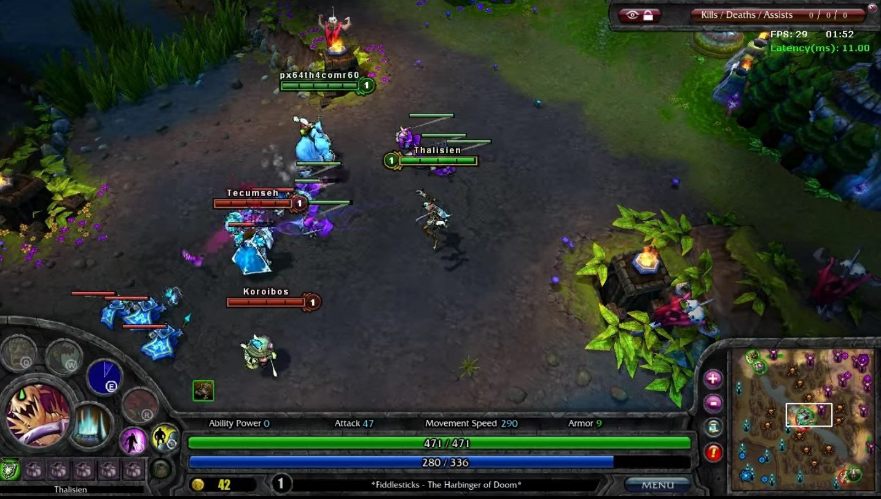
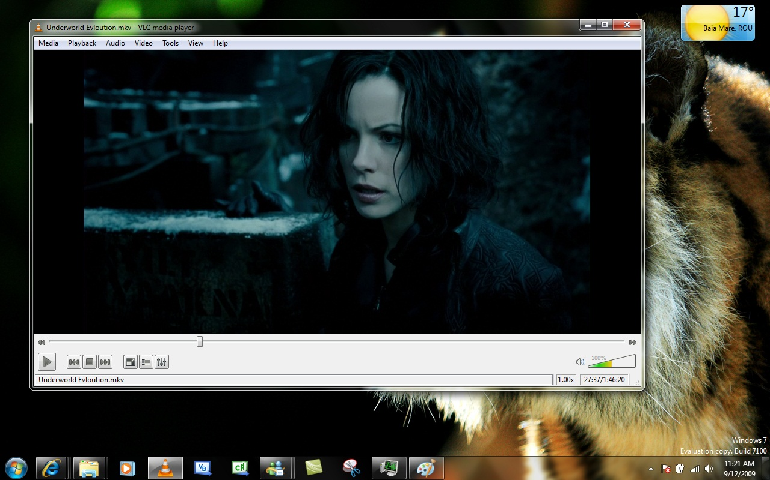
Operating Systems
We usually double click icon to launch applications on Windows or type commands on Linux and use the applications or see the result.
But, how is it possible?

Slide 4
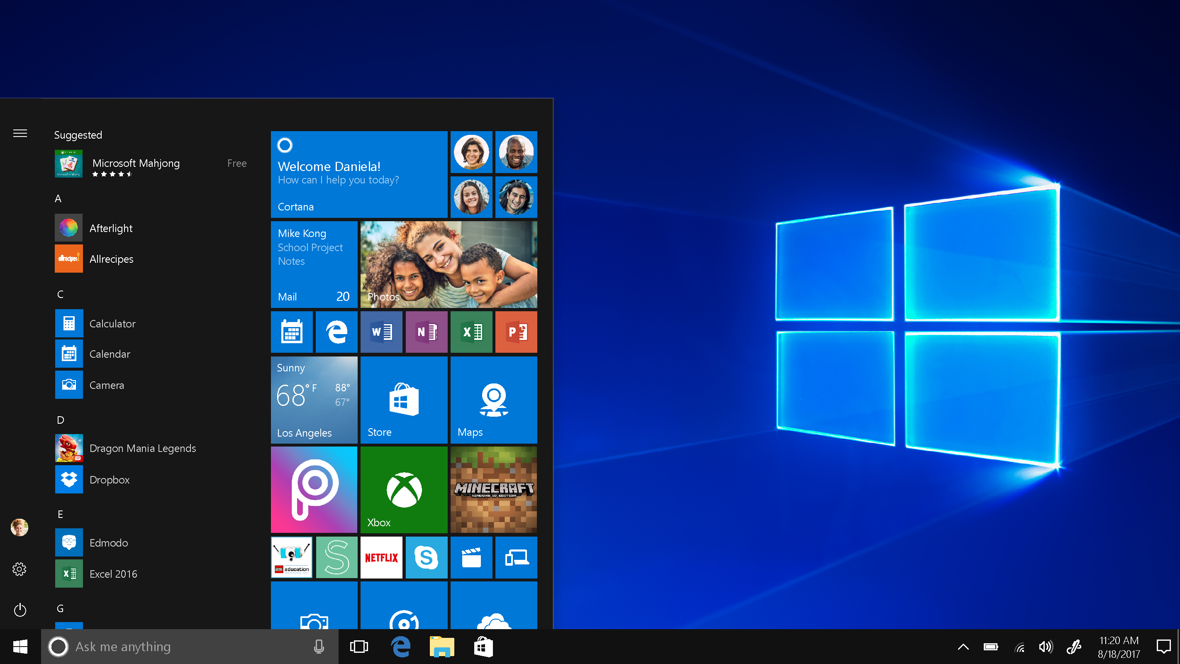
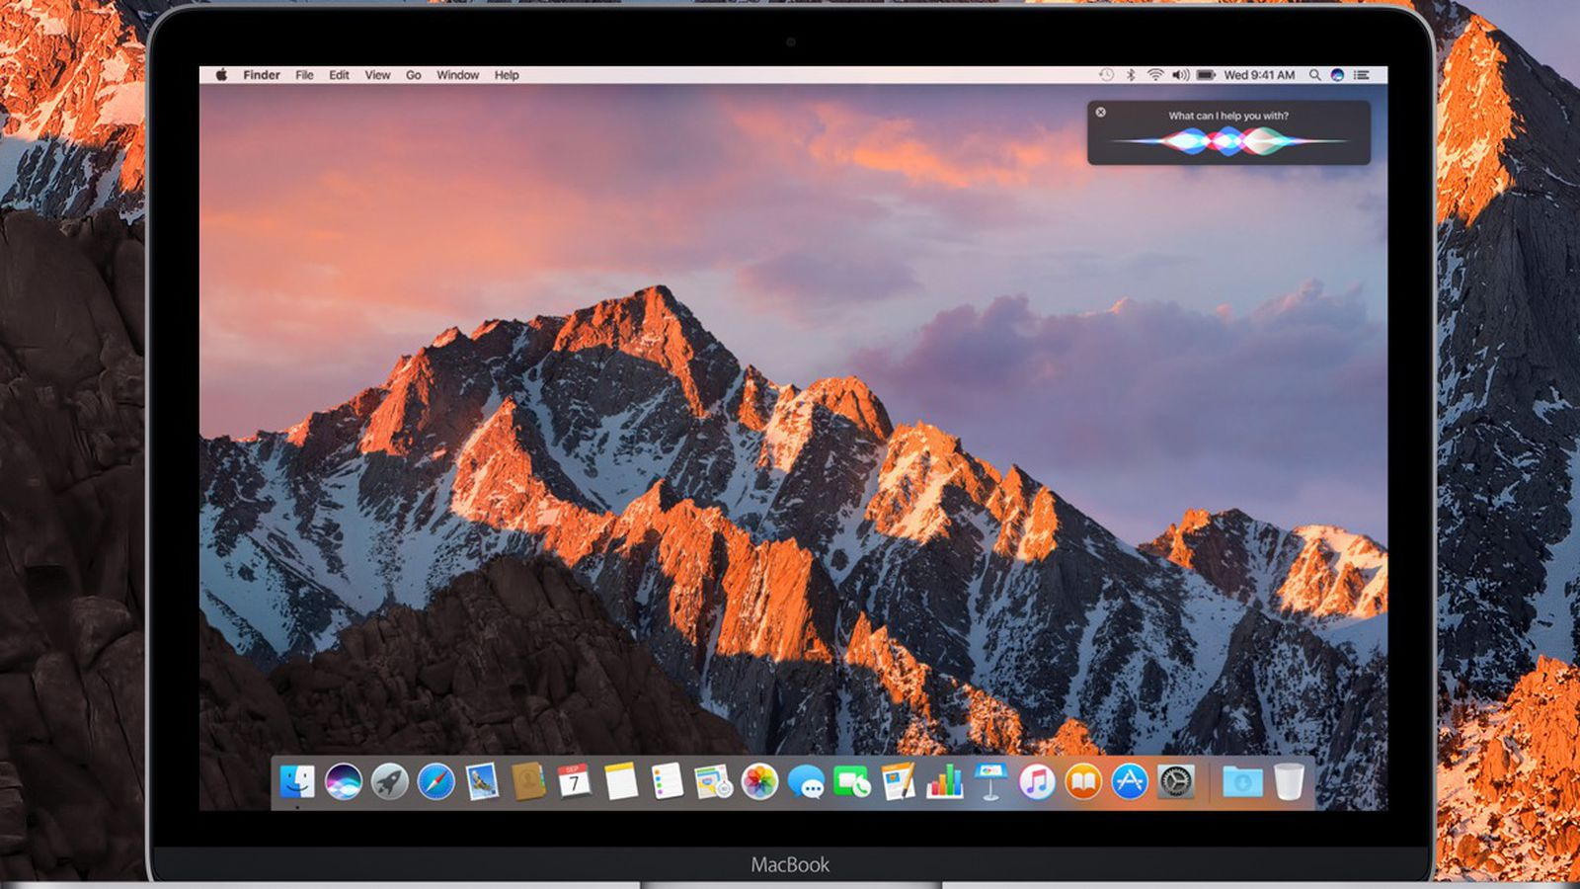
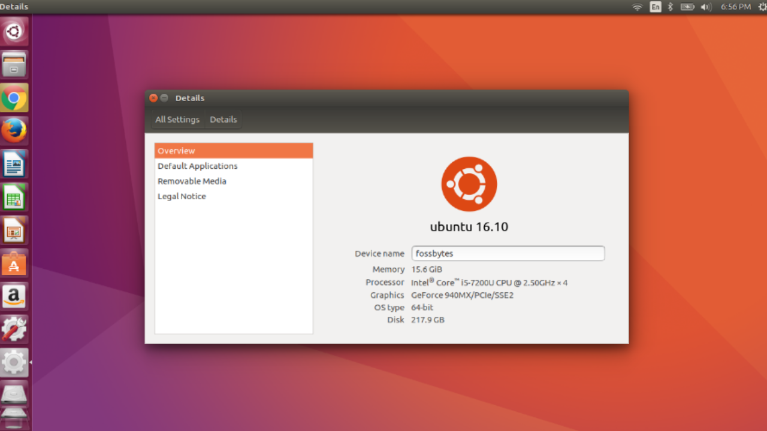
Operating Systems
What do we need to run applications?
We need some intermediary between hardware and applications.
It is operating system.
In this class, we will do Pintos projects to understand principles of operating systems
Windows
macOS
Linux

Slide 5
What is Pintos?
Though existing OSes have rich functionalities, Pintos doesn't.
Pintos is a simple operating system framework for the 80x86 architecture.
It only supports basic functionalities and provides us some skeletons.
Kernel threads
Loading and running user programs
Simple file system
Simple memory management
We will develop Pintos to be more complicated operating system.

Slide 6
What is Pintos?
Pintos is the operating system like Windows, macOS and Linux.
Thus we can install the Pintos on real machine which has 80x86 architecture.
It means we need the machine that can interpret Intel's ISA. (Instruction Set Architecture)
If you don't have 80x86 architecture machine, you should buy one.
Even if we already have it, Pintos is simple so that we can not do many things by using Pintos.
It means that it is not comfortable to develop Pintos in the machine where Pintos is installed.
We will use virtual machine for Pintos projects.

Slide 7


Virtual Machine (VM)
Virtual machine is an emulation of a computer system.
We can think of it literally as virtually constructed machine.
We can install and run operating systems or applications on virtual machine.
We will run Pintos on virtual machine.
Pintos supports two softwares for virtual machine, Bochs and QEMU.
We use QEMU as Pintos emulator.

Slide 8
Structures of Pintos
Pintos can boot, power off and run only one application at once but you can not check the result of execution.
The basic functionalities which Pintos provides.
We will do User Programs (1), (2) and Threads projects.
User Programs
Functionalities | Projects
Load and run user program | User Programs (1), (2)
Kernel threads | Threads
Simple file system | File Systems
Memory management | Virtual Memory
Pintos
✓
✓
QEMU
APPs
Linux (Ubuntu)
H/W

Slide 9
From Booting to Power Off
BIOS loads the loader into memory, which is stored in the first sector of the first disk.
Loader finds the kernel image by reading the partition table on each disk.
When the loader finds a bootable kernel partition, it reads the kernel into memory.
Loader's final job is to extract the entry point from the kernel image and transfer control to it.
Loader
1
Kernel
3
2
MBR
(Loader)
Partition Table
Kernel
Disk
Memory

Slide 10
From Booting to Power Off
Kernel's entry point is start() in 'threads/starts.S'
It obtains the machine's memory size, by asking the BIOS for the PC's memory size.
Basic page table is created, which maps virtual address 3GB ~ 3GB + 64MB to physical address 0MB ~ 64MB.
Call main() in 'threads/init.c'
In main(), each kernel system is initialized such as thread, memory and interrupt system.
If '-q' was specified on the kernel command line, shutdown_power_off() in 'devices/shutdown.c' is called and Pintos is terminated.
3 GB + 64 MB
3 GB
Page Pool
64 MB
Kernel
Loader
0 MB
Virtual Memory
Physical Memory

