Slide 1



Assistant of Business Analytics and Content Provider for Improvement
Presented By,
Seralathan S (811722104136)
Uma Maheswari M (811722104171)
Vasan S (811722104177)
Guided By,
Ms. V .Sowmiya, M.E.,
11/06/2025

Slide 2

ABSTRACT
BIA revolutionizes business intelligence by enabling natural language-driven data analysis, eliminating the need for technical expertise. Leveraging AI technologies like Retrieval-Augmented Generation (RAG), Hugging Face LLMs, and FAISS vector databases, the system transforms raw datasets into actionable insights through intuitive conversations. Users upload CSV files to a streamlined interface, where automated preprocessing handles column detection, missing values, and statistical summaries (e.g., sales trends, product rankings). Natural language queries (e.g., “Top products in Q3”) trigger semantic searches to retrieve relevant metadata, synthesized by LLMs into structured responses with summaries, metrics, and recommendations. A one-click visualization module generates charts (line, bar) without coding, while dynamic column mapping ensures adaptability to diverse datasets.
By democratizing data analytics, BIA empowers non-technical users to generate reports, identify trends, and drive decisions independently, accelerating organizational agility and reducing reliance on specialized teams. This framework showcases AI’s potential to make data-driven cultures inclusive and actionable.
11/06/2025

Slide 3
OBJECTIVE
To enable non-technical users to analyze data using natural language queries.
To eliminate the need for SQL, data modeling, or analytics tool expertise.
To automatically detect key columns and generate statistical summaries.
To streamline workflows for faster insight generation from complex datasets.
To use Retrieval-Augmented Generation (RAG) for accurate, context-aware responses.
To provide standardized, easy-to-understand outputs and visualizations.
To support modular, scalable design for easy deployment in any environment.
To promote data literacy and informed decision-making across all user levels.
11/06/2025

Slide 4
LITERATURE SURVEY
S.No. | Paper Title | Year | Remark
1 | Hybrid LLM/Rule-based Approaches to Business Insights Generation from Structured Data, Aliaksei Vertsel and Mikhali Rumiantsau | 2024 | Combines deterministic rule-based preprocessing with LLMs for interpretation and insight generation from structured data. System integration is complex and performance depends heavily on the quality and diversity of input datasets.
2 | Harnessing Business and Media Insights With Large Language Models, Yujia Bao and Ankit Parag Shah | 2024 | Domain-specific LLM trained on curated Fortune Media datasets for business and media insights, using time-aware reasoning and task decomposition. Limited generalizability outside the business/media domain; model requires extensive resources and curated data to maintain accuracy.
3 | AI Business Model Innovation, Philip Jorzik and Sascha P | 2024 | Systematic review identifying four AI-driven business model innovation typologies using a strategic and managerial lens. The study is primarily conceptual and lacks real-time data validation and empirical case studies.
11/06/2025

Slide 5
LITERATURE SURVEY
S.No. | Paper Title | Year | Remark
4 | Structure-Aware Language Model Pretraining Improves Dense Retrieval on Structured Data, Xinze Li and Zhenghao Liu | 2023 | Introduces pretraining tasks (Structured Data Alignment, Masked Entity Prediction) to improve semantic understanding in LLMs. Requires domain-specific alignment data and has high computational demands during pretraining.
5 | Business Analytics in Industry 4.0: Systematic Review, Antonio Joao Silva and Paulo Carlos | 2021 | Literature-based review using Gartner’s analytics maturity model to classify 169 studies in business analytics. Over-representation of manufacturing domain, lacks post-2020 developments, and excludes non-English publications.
6 | Artificial Intigelence in Business: From Research and Innovation to Market Deployment, Neha Soni and Amita Kapoor | 2020 | Analytical study of AI evolution and adoption using startup trends, funding data, and sector-wise deployment analysis. Data limited to pre-2020 trends; lacks discussion on post-2020 AI advancements and ethical concerns such as bias and transparency.
11/06/2025

Slide 6
LITERATURE SURVEY
S.No. | Paper Title | Year | Remark
7 | Time Series Data Prediction using IoT and Machine Learning Technique, Pardeep Kumar and Yugal Kumar | 2020 | Integration of IoT sensor data with regression models (e.g., ARIMA, LSTM) to predict air quality trends. Small dataset, simplified architecture, and limited deployment context restrict scalability and real-world applicability.
8 | Walmart’s Sales Data Analysis - A Big Data Analytics Perspective, Manpreet Singh and Aesaan Mohammed | 2017 | Applied data mining and visualization techniques on Walmart’s historical sales data to uncover patterns and trends. Narrow focus on internal sales data without external influencers (e.g., promotions, economic shifts); lacks advanced modeling techniques.
9 | Industrial Big Data Analysis in Smart Factory: Current Status and Research Strategies, Xiaoya Xu and Qingsong Hua | 2017 | Review of predictive analytics strategies and smart factory architectures using deep learning and CPS (Cyber-Physical Systems). Theoretical framework with minimal real-world deployment validation; compatibility with legacy systems remains unresolved.
11/06/2025

Slide 7
EXISTING SYSTEM
The existing business intelligence systems rely heavily on fragmented and manual data collection methods, such as periodic spreadsheets, manual logs, and isolated SQL databases. These approaches lead to significant delays in data availability and hinder real-time decision-making. Data inconsistencies often arise due to different naming conventions for similar parameters across systems. Maintenance strategies are largely reactive, with rule-based alerts triggered only after failures occur. Additionally, the lack of integration between machines, inventory, and supply chains creates operational silos, requiring manual intervention and diagnostics. Visualization is limited to static, infrequent reports, offering little support for dynamic analysis or actionable insights.
11/06/2025

Slide 8
PROPOSED SYSTEM
The proposed system introduces BIAssistant, an AI-powered business intelligence platform designed to simplify data analysis for non-technical users. It allows users to interact with business data using natural language queries, eliminating the need for SQL or programming knowledge. Upon uploading a CSV file, the system automatically performs preprocessing tasks such as column detection, missing value handling, and data preview. It generates statistical summaries and stores them as embeddings in a FAISS vector database, enabling semantic search. By leveraging Retrieval-Augmented Generation (RAG) and Large Language Models (LLMs), the assistant delivers accurate, context-aware responses. Additionally, users can generate dynamic visualizations through a streamlined Gradio-based interface, making data-driven decision-making more accessible and efficient.
11/06/2025

Slide 9
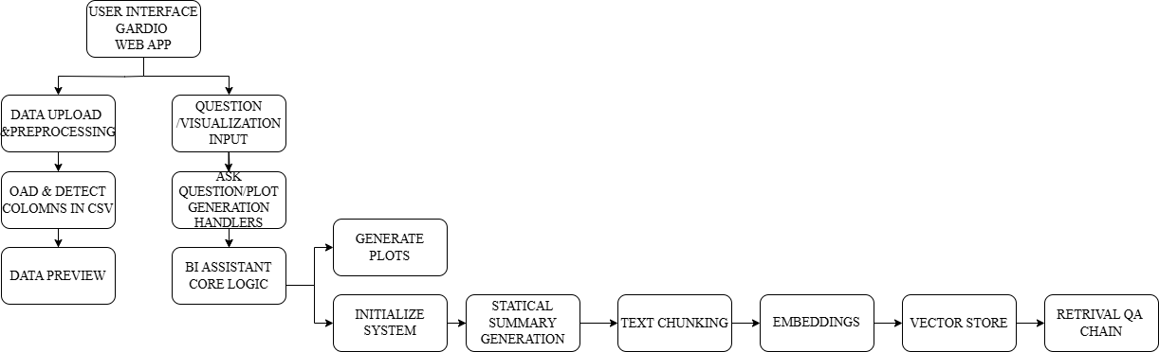
SYSTEM ARCHITECTURE
11/06/2025

Slide 10
MODULE 1 : Data Collection and Preparation
Collects POS retail data in CSV format (fields like Date, Product, Sales, Region,
Customer Age).
Validates structure, converts date formats, handles missing values.
Generates HTML previews for user verification.
Provides error feedback for invalid files.
Can be extended with outlier detection, real-time anomaly alerts, and GDPR compliance.
11/06/2025

Slide 11
MODULE 2 : Column Mapping
Automatically detects and maps dataset columns to business terms
(e.g., date, product, sales).
Does not depend on exact column names (e.g., maps both "order_date"
and "sale_date" to "date").
Uses lowercase conversion and keyword matching.
Built using pandas and Python regex for flexibility across datasets.
11/06/2025

Slide 12
MODULE 3 : Statistical Summary Generation
Analyzes data for key metrics: product performance, trends, outliers, and missing data.
Produces summaries for user understanding and later LLM-based insights.
Built using libraries like pandas ,numpy and scipy
11/06/2025

Slide 13
MODULE 4 : Embedding and Vector Store Creation
Converts textual summaries into searchable vector embeddings.
Uses Sentence Transformers (e.g., all-mpnet-base-v2) for embedding.
Stores in FAISS vector database for fast semantic search.
Tools used: sentence-transformers, FAISS, NLTK, spaCy
11/06/2025

Slide 14
MODULE 5 : Dashboard Development
Creates an intuitive, multi-tab dashboard for data upload, query input,
and visualization.
Displays status updates, formatted outputs, and allows interactive data analysis.
Tools used: Gradio, Dash, pandas.
11/06/2025

Slide 15
MODULE 6 : Language Model Initialization
Loads pre-trained GPT-2 model with a tokenizer for text generation.
Initializes pipeline for efficient and consistent natural language responses.
Supports GPU acceleration.
Tools used: transformers, torch.
11/06/2025

Slide 16
MODULE 7 : Question Answering
Handles natural language queries using RAG (Retrieval-Augmented Generation).
Retrieves relevant data chunks and generates structured answers.
Provides summaries, top products, key metrics, and recommendations.
Tools used: transformers, FAISS, sentence-transformers.
11/06/2025

Slide 17
MODULE 8 : Data Visualization
Generates dynamic, auto-formatted charts (bar, line, pie) based on user input.
Adapts visualization to dataset structure with consistent styling.
Tools used: Matplotlib, Seaborn, Plotly.
11/06/2025

Slide 18
MODULE 9 : User Interface (Gradio)
Provides a web-based UI with separate tabs for each function.
Enables file upload, question input, and visualization selection.
Includes responsive event handling and real-time feedback.
Built entirely using the Gradio Python library.
11/06/2025

Slide 19
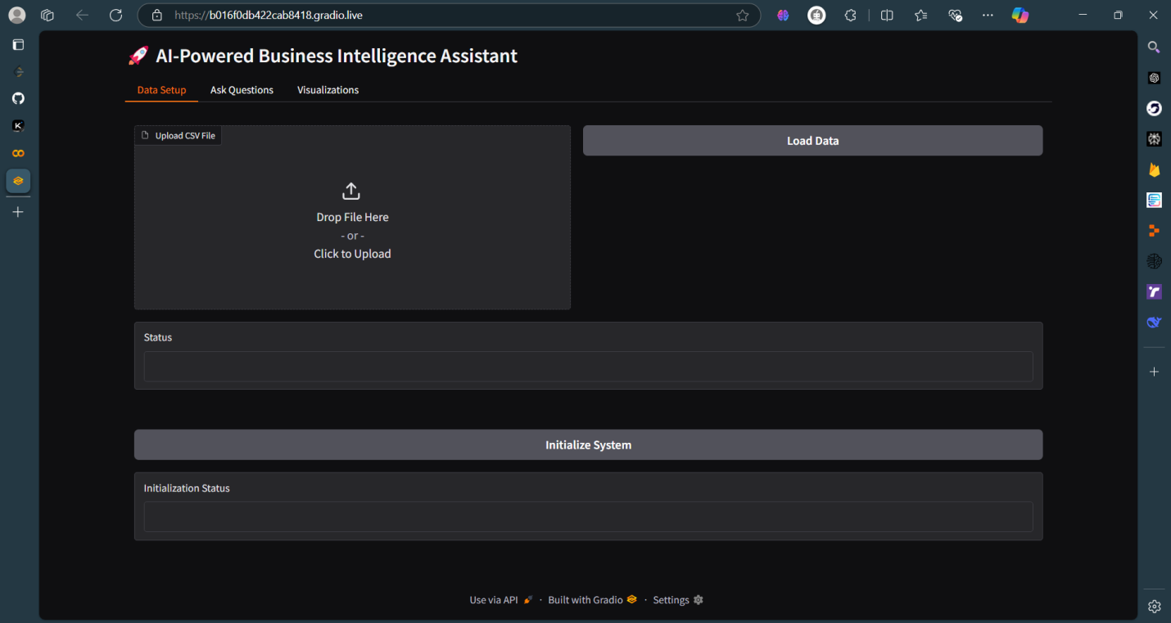
OUTPUT
11/06/2025

Slide 20
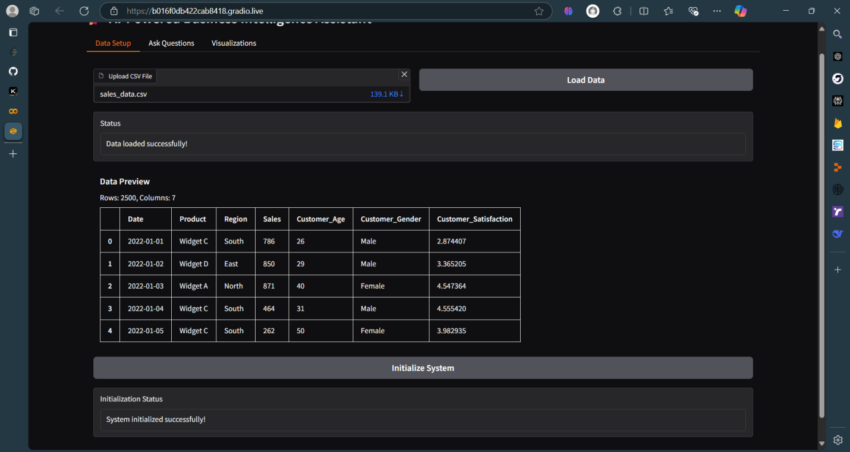
OUTPUT
11/06/2025

Slide 21
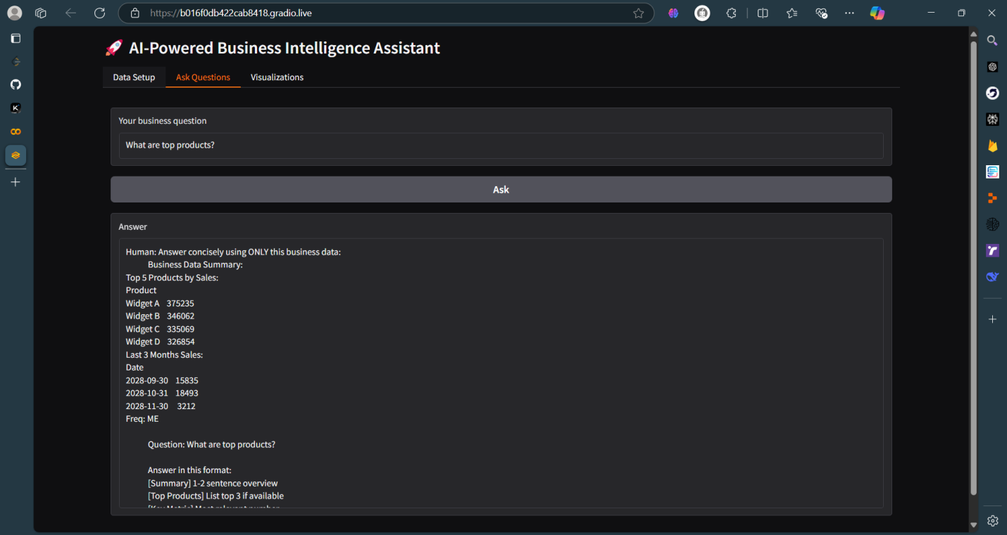
OUTPUT
11/06/2025

Slide 22
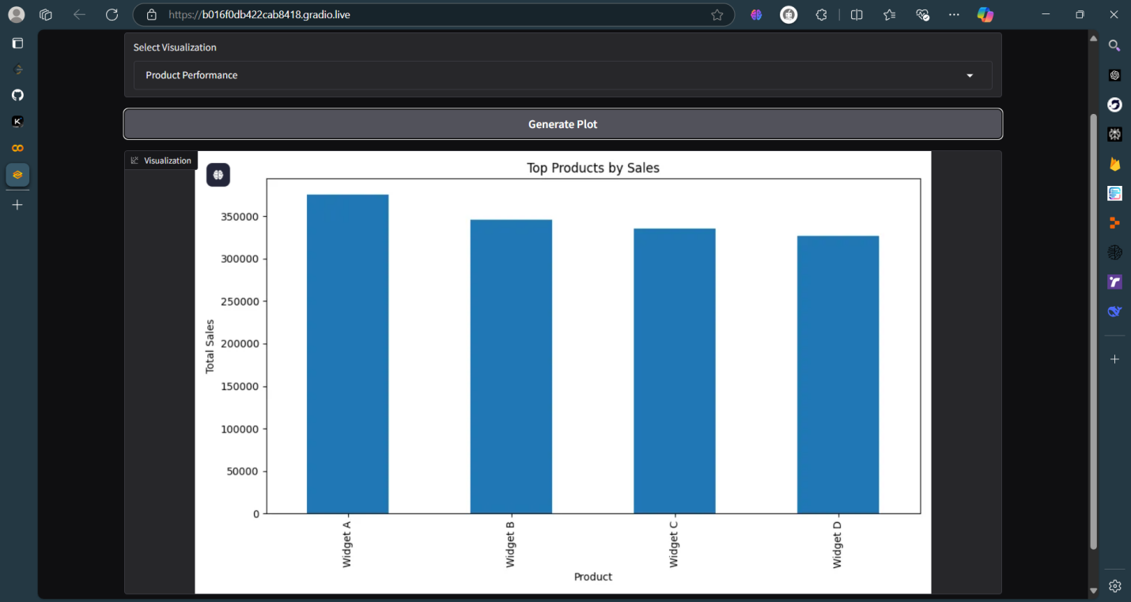
OUTPUT
11/06/2025

Slide 23
CONCLUSION & FUTURE ENHANCEMENT
Conclusion:
The Business Intelligence Assistant (BIA) system presents a transformative approach to data analysis by enabling users to interact with business data using natural language, without requiring technical expertise. By integrating advanced AI technologies such as Large Language Models, Retrieval-Augmented Generation, semantic embeddings, and vector databases, the system simplifies complex analytics into a seamless and intuitive experience. Users can effortlessly upload datasets, ask business-related questions, and receive insightful responses along with dynamic visualizations. This democratization of data analysis not only accelerates decision-making but also fosters a data-driven culture across all levels of an organization, ultimately transforming raw data into strategic value.
11/06/2025

Slide 24
CONCLUSION & FUTURE ENHANCEMENT
Future Enhancement:
Expand support to Excel, APIs, SQL.
Add real-time streaming, domain-specific tuning.
Develop mobile, voice, and multilingual interfaces.
Enable collaboration, shared dashboards, and adaptive learning
11/06/2025

Slide 25
REFERENCES
Hybrid LLM/Rule-based Approaches to Business Insights Generation from Structured Data, Aliaksei Vertsel and Mikhail Rumiantsau – 2024
Harnessing Business and Media Insights with Large Language Models, Yujia Bao, Ankit Parag Shah, Neeru Narang, Jonathan Rivers, Rajeev Maksey, Lan Guan, and colleagues from Accenture and Fortune Media – 2024
AI Business Model Innovation, Philip Jorzik, Sascha P. Klein, Sascha Kraus – 2024
Structure-Aware Language Model Pretraining Improves Dense Retrieval on Structured Data, Xinze Li, Zhenghao Liu, Chenyan Xiong, Shi Yu, Yu Gu, Zhiyuan Liu, Ge Yu - 2023
Business Analytics in Industry 4.0: A Systematic Review, António João Silva, Paulo Cortez, Carlos Pereira, André Pilastri – 2021
11/06/2025

Slide 26

DD/MM/YYYY

