Slide 2
Go Mobile with C#, Visual Studio, and Xamarin
Sergio Andrés Vargas
Developer Evangelist, Xamarin

Slide 3
Xamarin – Your Complete Mobile Solution
DESIGN – DEVELOP - INTEGRATE
TEST
MONITOR
LEARN

Slide 4
Xamarin’s Unique Approach
iOS C# UI
Android C# UI
Windows C# UI
Azure
Linux/Mono
CoreCLR
Shared C# Mobile
C# Server
Shared C# Client/Server
Shared C# codebase • 100% native API access • High performance

Slide 5
Using Xamarin.Forms things are simpler!
Shared C# Mobile
C# Server
Shared C# Client/Server
Shared C# codebase • 100% native API access • High performance

Slide 6
Xamarin’s Unique Approach
iOS F# UI
Android F# UI
Windows F# UI
Azure
Linux/Mono
CoreCLR
Shared F# Mobile
F# Server
Shared F# Client/Server
Shared C# or F# codebase • 100% native API access • High performance

Slide 7
Windows APIs
Microsoft.Phone
Microsoft.Networking
Windows.Storage
Windows.Foundation
Microsoft.Devices
System.Net
System
System.IO
System.Linq
System.Xml
System.Data
System.Windows
System.Numerics
System.Core
System.ServiceModel

Slide 8
iOS – 100% API Coverage
MapKit
UIKit
iBeacon
CoreGraphics
CoreMotion
System.Net
System
System.IO
System.Linq
System.Xml
System.Data
System.Windows
System.Numerics
System.Core
System.ServiceModel

Slide 9
Android – 100% API Coverage
Text-to-speech
ActionBar
Printing Framework
Renderscript
NFC
System.Net
System
System.IO
System.Linq
System.Xml
System.Data
System.Windows
System.Numerics
System.Core
System.ServiceModel

Slide 10
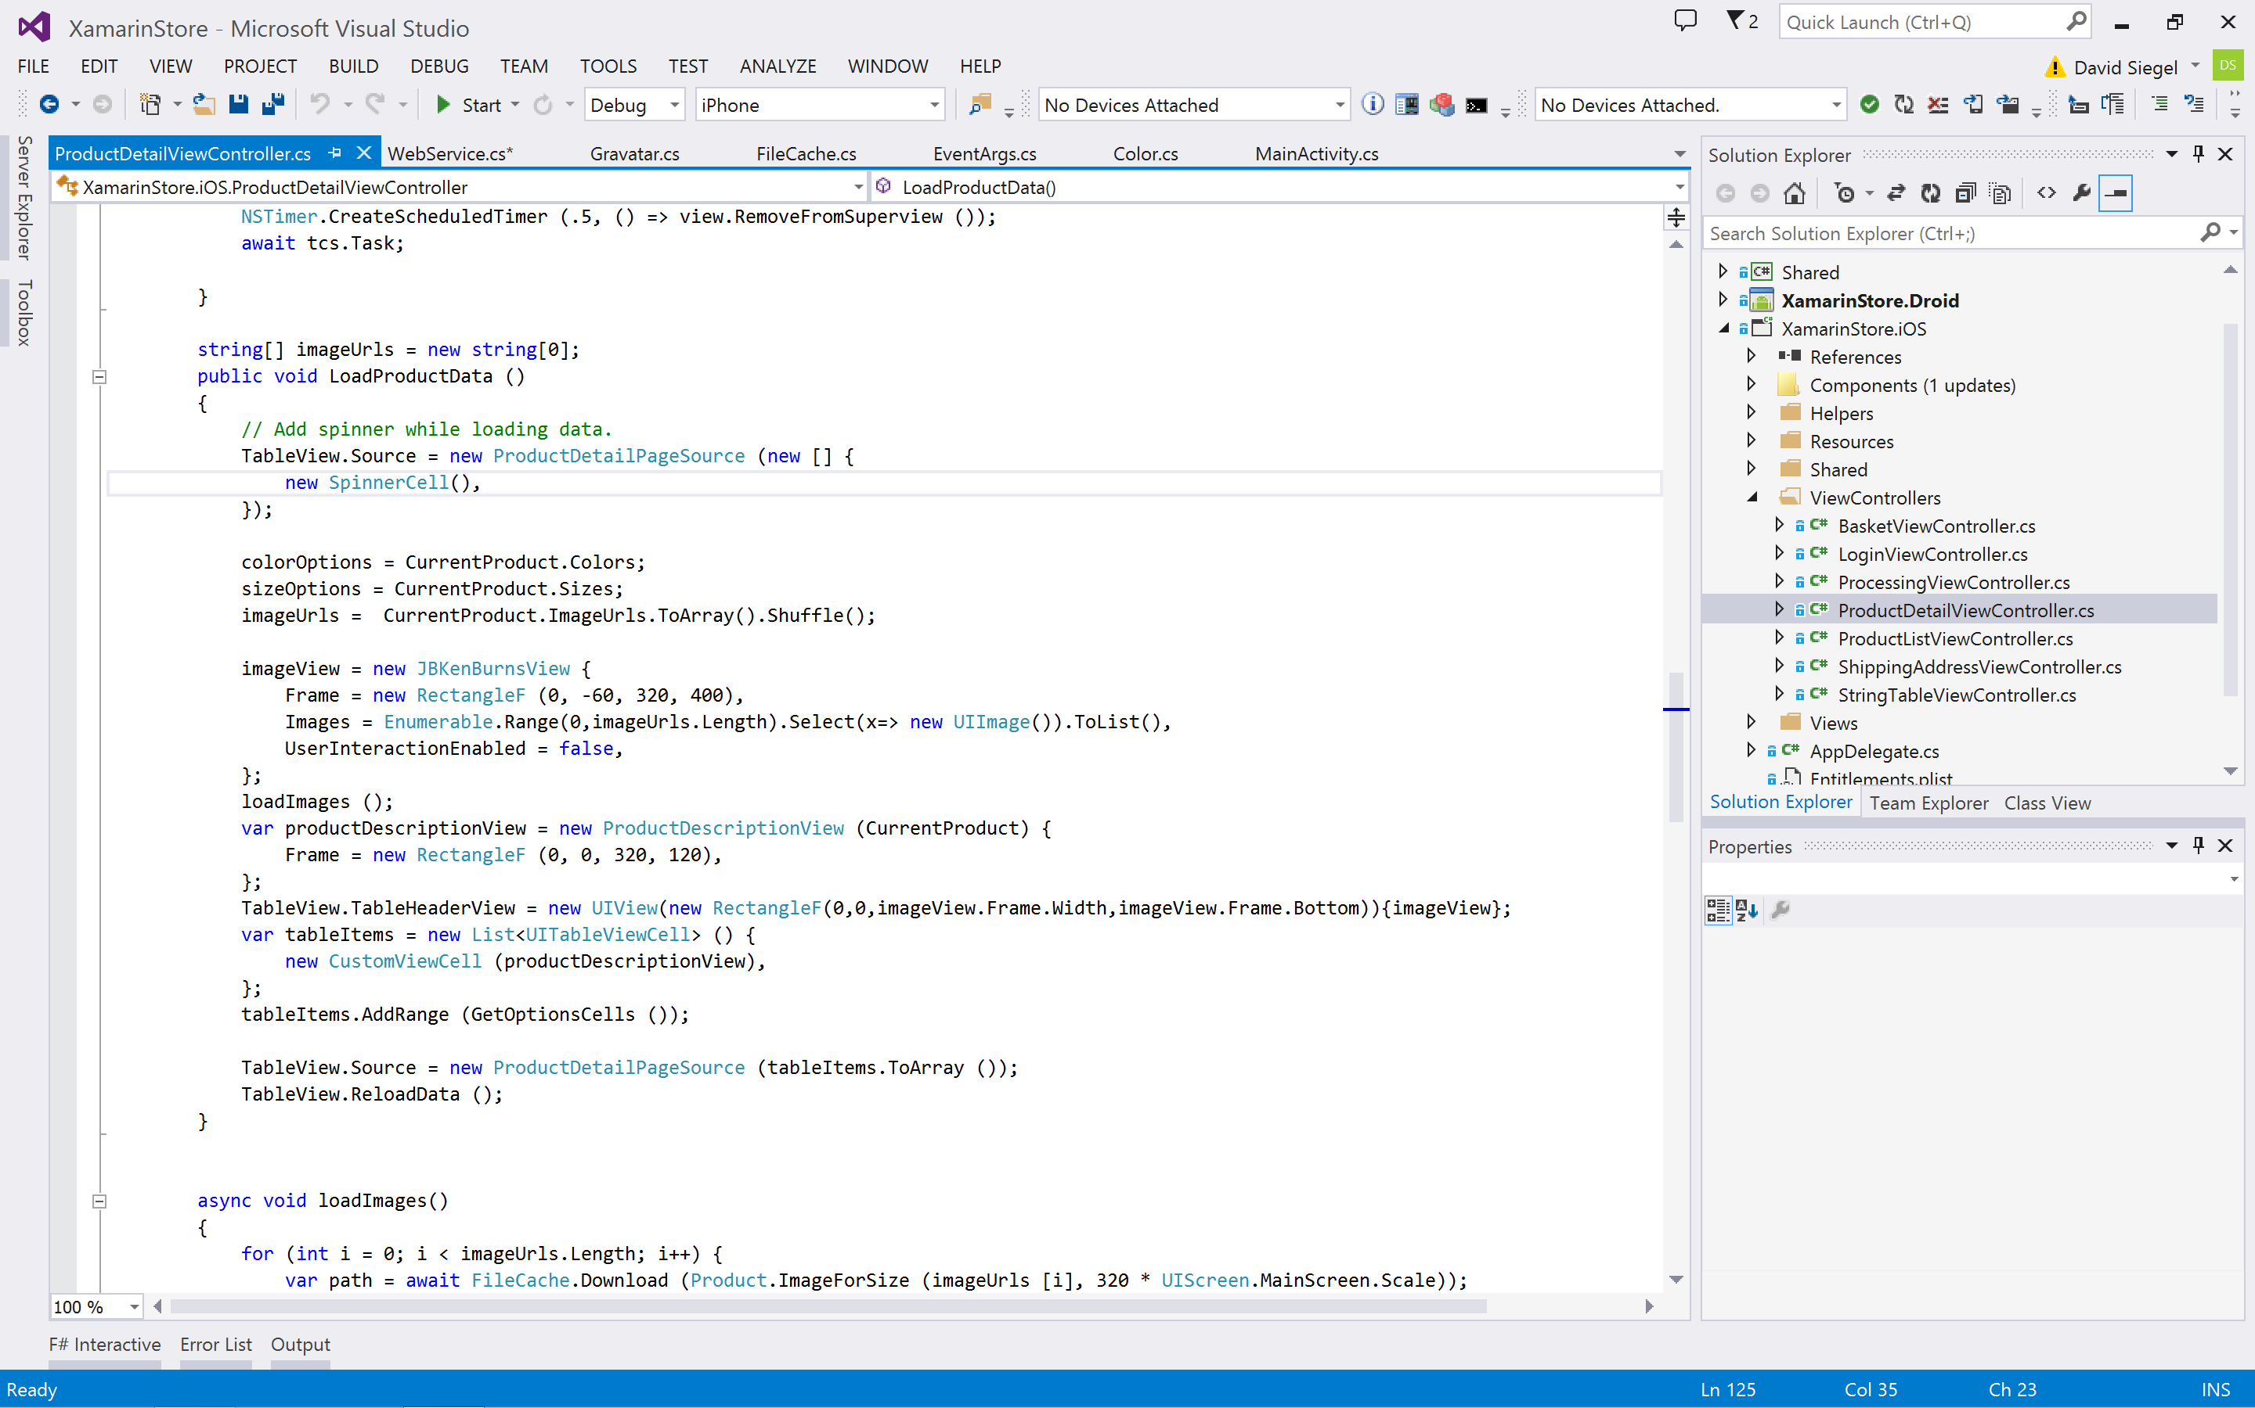
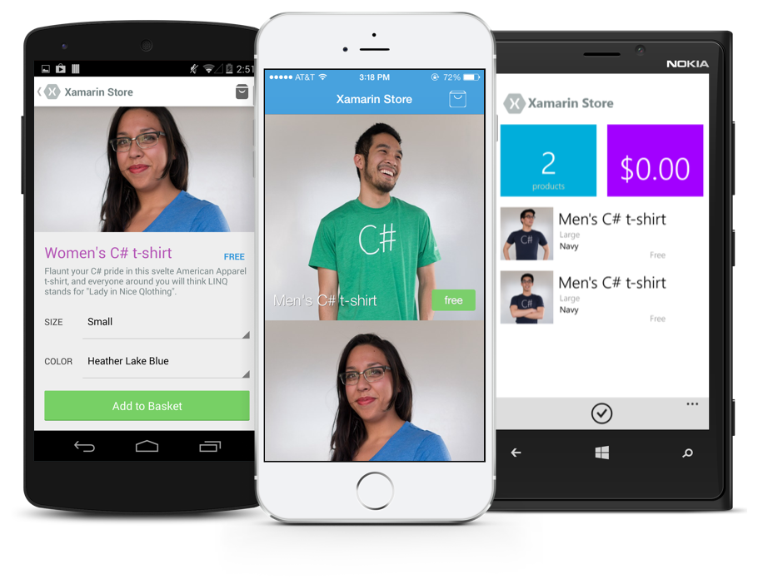
Anything you can do in Objective-C, Swift, or Java can be done in C# and Visual Studio with Xamarin.

Slide 11
Anything you can do in Objective-C, Swift, or Java can be done in C# and Visual Studio with Xamarin.
C# Shirt: http://xamarin.com/shirt F# Shirt: http://xamarin.com/f-sharp-shirt

Slide 13









Crowded space

Slide 14
Sillicon Valley 101

Slide 15
Silicon Valley 101: Find Larger Market

Slide 16
Silicon Valley 101: Find Larger Market
78 million children in America
1.9 billion children in the world
and countless concerned parents

Slide 17
Silicon Valley 101: Find a differentiator

Slide 18
Silicon Valley 101: Find a differentiator
Family focused

Slide 19
Silicon Valley 101: Find Product/Market Fit

Slide 20
Silicon Valley 101: Find Product/Market Fit
Leverage Helicopter Parenting

Slide 21
Silicon Valley 101: Grow Your Market

Slide 22
Silicon Valley 101: Grow Your Market
Use Best Industry Practices:
Gamify Parenting
Points
Badges
Leaderboards

Slide 23

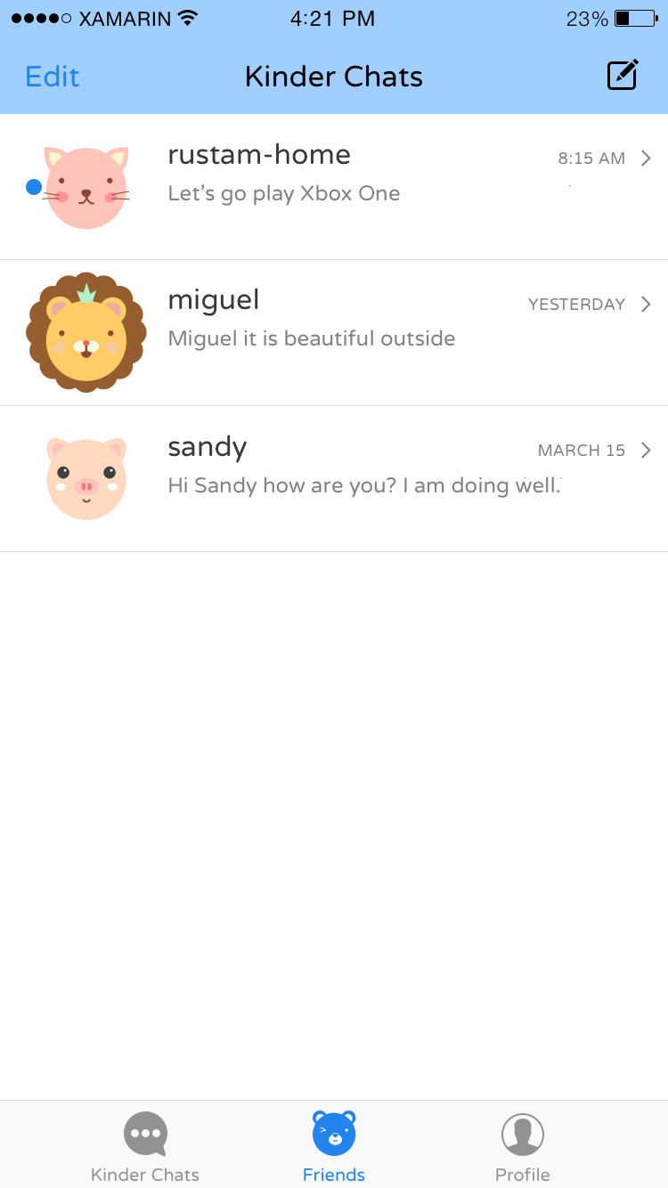
Introducing Kinder Chat

Slide 24
Solution Walkthrough

Slide 25
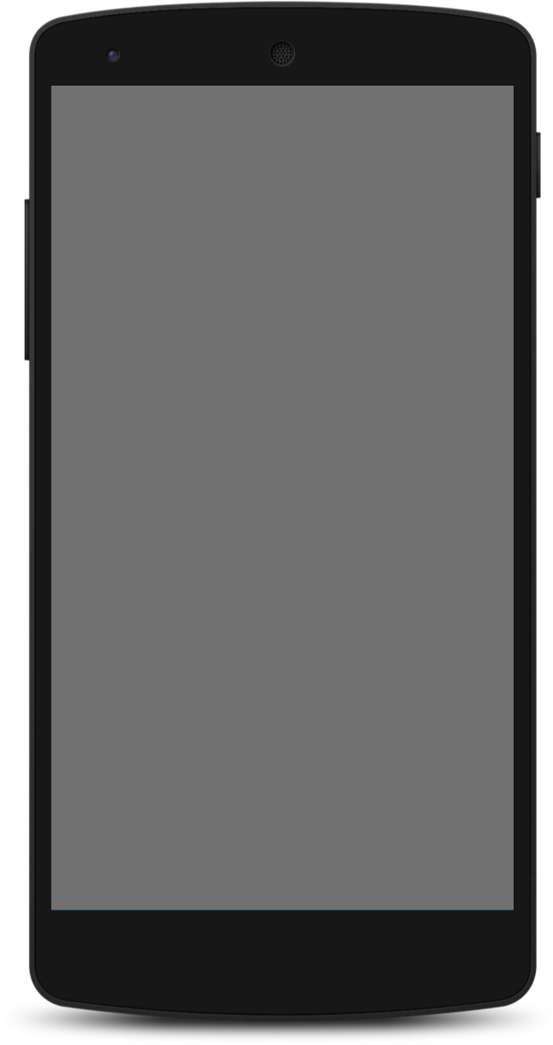
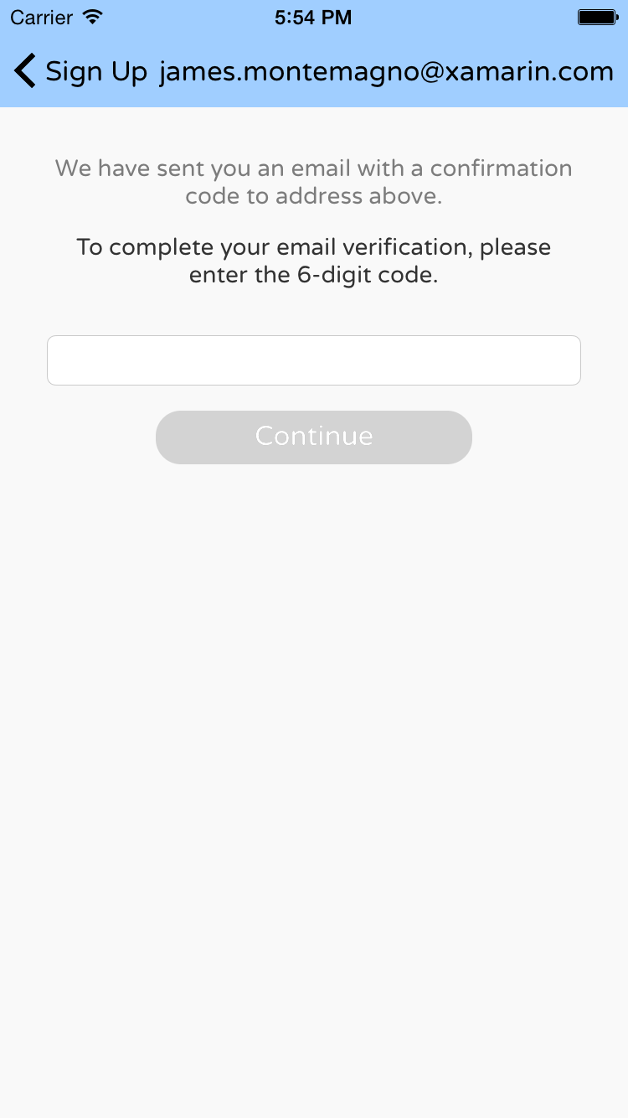
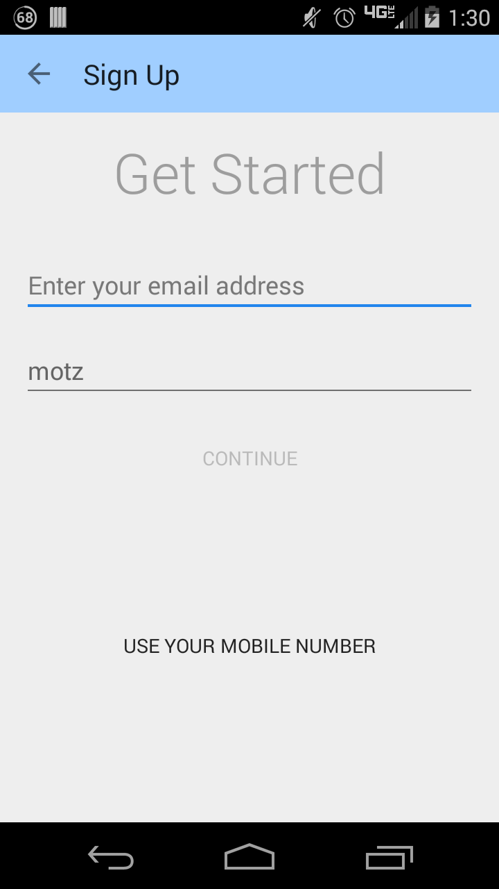
✓ Easy Onboarding

Slide 26
Onboarding Demo

Slide 27
Encouraging App Use

Slide 28
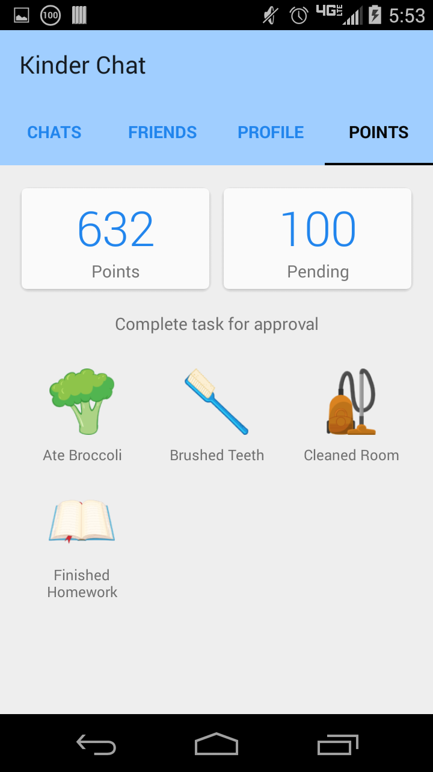
Gamification
✓ Kinder-chievements
✓ Points Hub
✓ Point Exchange

Slide 29
Xamarin Inspector

Slide 30
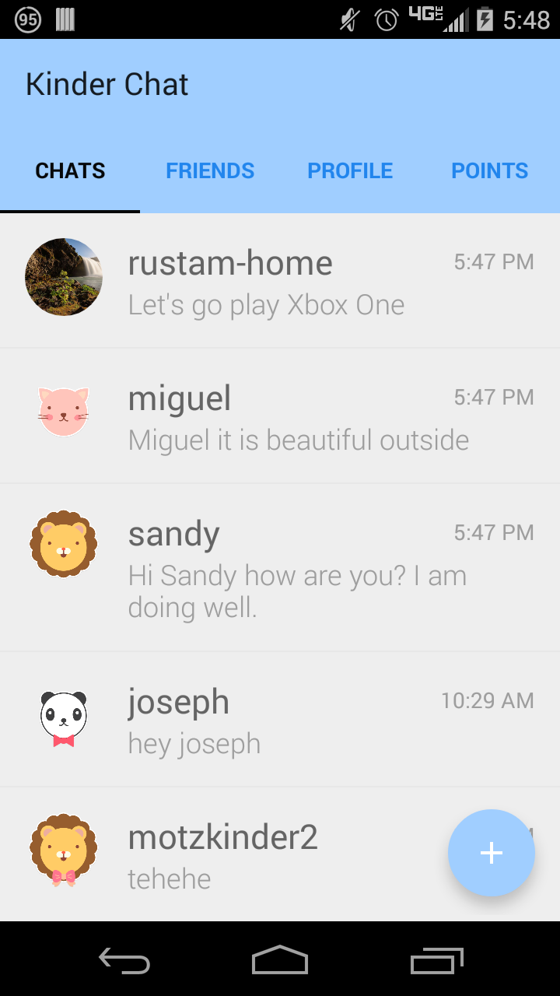
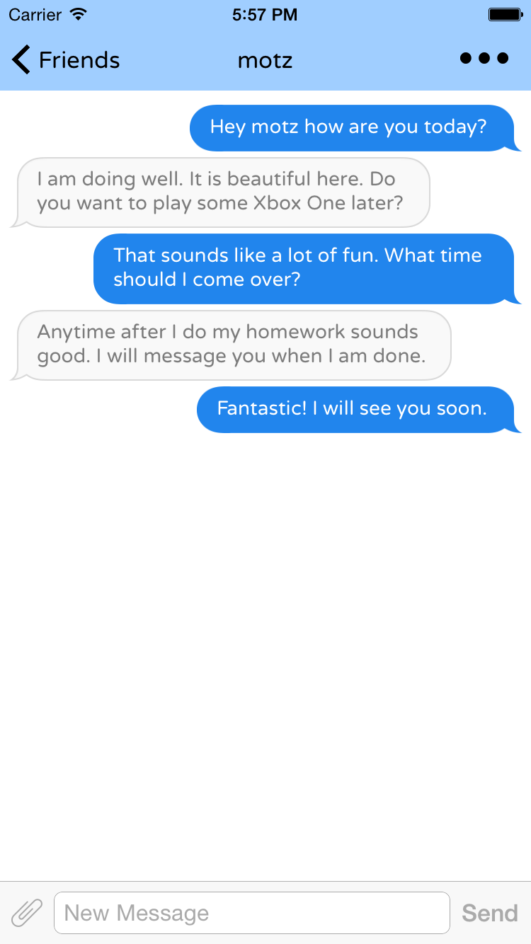
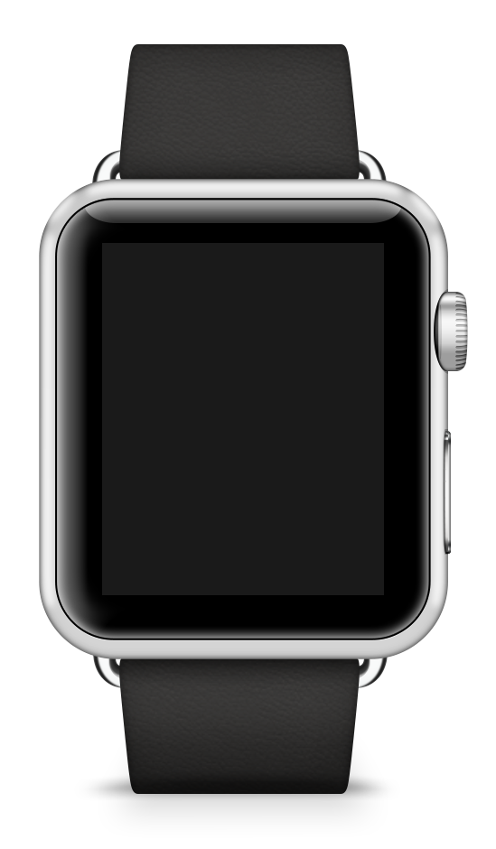
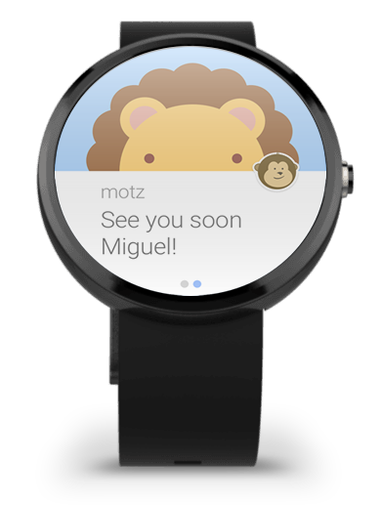

Ensuring a great experience – everywhere

Slide 31
Android Market
Adoption
46.8%
1%
40.7%
6.4%
5.7%
0.4%
2.2
Froyo
2.3.3 – 2.3.7
Gingerbread
4
Ice Cream Sandwich
4.1 – 4.3
Jelly Bean
4.4+
KitKat+
5.0
Lollipop
Parents
Kids

Slide 32
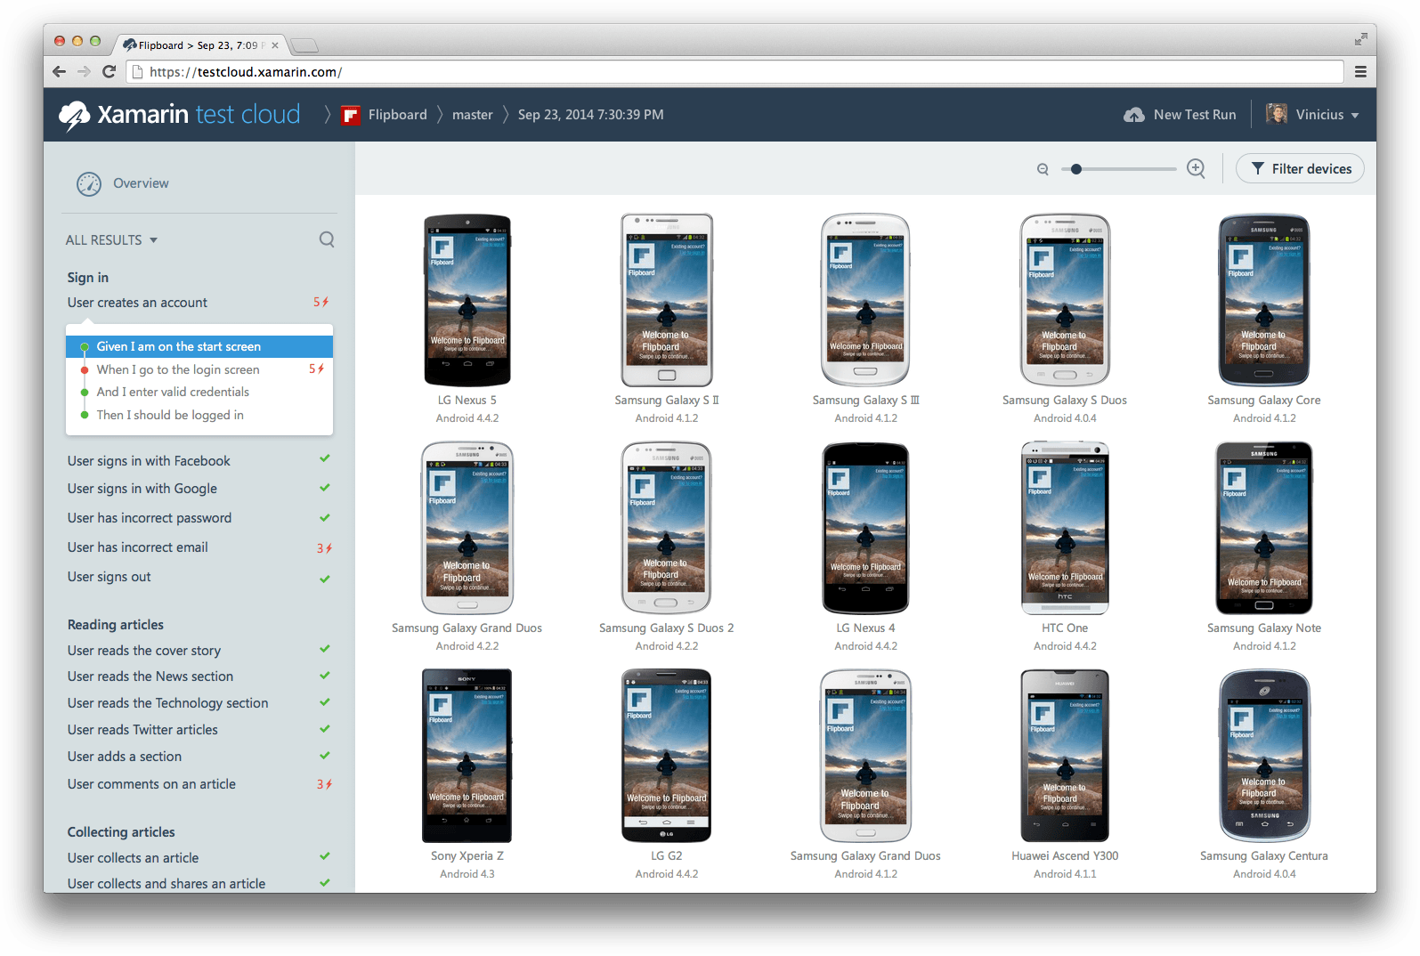
xamarin.com/testcloud

Slide 33
Kinder Chat code sharing
70%
50%
20%
iOS
Android
Client / Server

Slide 34
Xamarin + Xamarin.Forms
iOS C# UI
Android C# UI
Windows C# UI
Shared UI Code
Shared C# Backend
Shared C# Backend
Traditional Xamarin Approach
With Xamarin.Forms:
More code-sharing, all native

Slide 35
Unrivaled Mobile Development Training
Live unlimited mobile development training from mobile experts, in your time-zone, on your schedule, and as often as you'd like.
xamarin.com/university

Slide 36

Thank you.
Miguel de Icaza
CTO and Co-founder, Xamarin
James Montemagno
Developer Evangelist, Xamarin
miguel@xamarin.com
@migueldeicaza
james@xamarin.com
@JamesMontemagno

