Slide 1
ISA5577 Applied Quantitative Methods for Human-Computer Interaction
人機互動量化研究方法
September 14, 2017
Hao-Chuan Wang

Slide 2
Basic Information
Time & Location:
  Thursday 15:30 – 18:20 pm (please confirm your availability)
  Delta 632 (台達館 632, if number of participants <20), starting next week
Language:
Lectures will be *mainly* delivered in Chinese (but there can be some exceptions when translation is difficult). You’re required to work on the assignments in English (if you’re an HCI-specialized student).
Course website:
NTHU Learning Management System
http://lms.nthu.edu.tw

Slide 3
What This Course Is and Isn’t ?
This course is designed for HCI-focused students currently working on HCI research
  We expect you to have an HCI research topic at hand
  Assignment 1 requires you to submit a 3-page English description (around 800-1000 words) of your project (due Oct 5)
If you never learned about HCI to get a basic sense, this is not the right course for you.
  Please consider taking ISA5579 Interaction Design available this semester.
  Talk to me if you think your case is special

Slide 4
What is Research Method?
Source: Scott MacKenize http://www.yorku.ca/mack/CourseNotes.pdf

Slide 5
What is Research?
Research is …
Careful or diligent search
Studious inquiry or examination; especially: investigation or experimentation aimed at the discovery and interpretation of facts, revision of accepted theories or laws in the light of new facts, or practical application of such new or revised theories or laws
The collecting of information about a particular subject
In HCI, add “relevant to phenomena surrounding humans interacting with computers”

Slide 6
What is Empirical?
“Empirical Research”
Empirical is …
Originating in or based on observation or experience
Relying on experience or observation alone often without regard for system and theory
Capable of being verified or disproved by observation or experiment

Slide 7
How do we do Empirical Research?
We conduct empirical research through …
  A program of inquiry conforming to the scientific method
The scientific method is …
  (basically) The principles and procedures for the systematic pursuit of knowledge involving the recognition and formulation of a problem, the collection of data through observation and experiment, and the formulation and testing of hypotheses

Slide 8
Why do Empirical Research
We conduct empirical research to …
  Answer (and raise!) questions about new or existing HCI designs or interaction techniques
  Transform baseless opinions into informed opinions supported by evidence
  Develop or explore models that describe or predict behavior (of humans interacting with computers)

Slide 9
Course Topics
Quantitative method
  Experimental Design, Data Collection
  Interpretations of results
Statistical analysis
  Frequentist, behaviorist approach
  Statistical comparison and inference
  Effect size, simple regression analysis
Applied Machine Learning
  Overview and use of machine learning
  Software practice
Qualitative method
  Complementing what quan. method cannot do well.

Slide 10
Instructional Methods
Student-centered, learning by doing
  We expect you to actively engage in reading, discussion, and individual assignments
  In principle, there’s no group work. Every assignment is individual, developed around the individual project that you propose in Assignment 1.
  There’ll be a mid-term, focusing on experimental design and basic statistics
  Talk to me for special cases and needs.

Slide 11
Instructional Methods
Reading and paper commenting
  Similar to ISA5578 Social Computing
  Read papers of your own choice. Post your comments on specific papers by the beginning of the class of each week.
  1% per paper comment. Students may receive up to 15% of the final grade of the semester through paper commenting.

Slide 12
Instructional Methods
Talking
  I’m hoping to maximize the amount of time that students talk, rather than the teacher talks.
  Reason is simple- normally you don’t think and remember that much when you’re just listening.
  As mentioned, you’ll discuss about required and optional readings in the class.
  You will also have time to talk about your own research and assignments and get feedback from other students.

Slide 13
Ultimate Goal
You can really use what you learn from this course and other places in your current and future research
  Crucial to research methods: There’s no “ISO standard” about how methods are taught. But there tends to be community norm about what methods are considered legitimate given a specific research topic and context.
  Doing, reading, and talking/discussing, as I see, is likely to be the best way to learn this type of implicit, procedural knowledge.
  Capable of learning (and developing) new methods on your own.

Slide 14
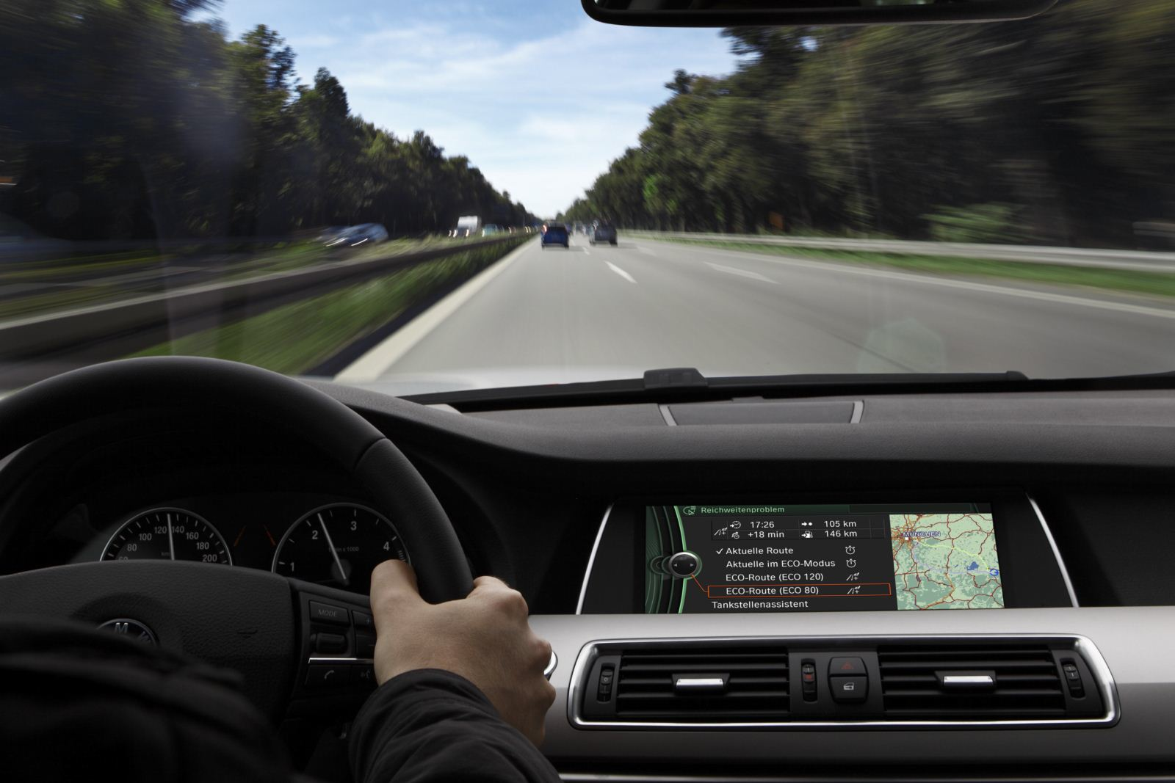
Think about Driving
We don’t learn that much from listening to driving lectures.
We mostly learn from doing (driving) it on our own.

Slide 15

Main Textbook
MacKenzie, I. S. (2013). Human-Computer Interaction: An Empirical Research Perspective. Morgan Kaufmann .
Under the term of fair use,
selected chapters will
be posted on LMS as weekly readings.
  You’re *strongly encouraged* to buy this book.

Slide 16
Statistical Software
However, you’re *strongly encouraged* to purchase at least a 6-month academic license for SAS JMP
  Get a 30-day trial at http://www.jmp.com/landing/jmp_trial.shtml
  Purchase 6-month academic license at
  http://www.onthehub.com/jmp/
When we talk about statistical analyses, you will need to use JMP (or SPSS, R) to complete your assignments.

