Slide 1
ISA5577 Applied Quantitative Methods for Human-Computer Interaction
人機互動量化研究方法
September 21, 2017
Hao-Chuan Wang

Slide 2
Today’s Agenda
Data collection
HCI Research questions
Source: Scott MacKenize http://www.yorku.ca/mack/CourseNotes.pdf

Slide 3
Observe and Measure
Observations are gathered…
  Manually (human observers)
  Automatically (computers, software, cameras, sensors, etc.)
A measurement is a recorded observation
When you cannot measure, your knowledge is of a meager and unsatisfactory kind.
  William Thomson, 1883
  (father of thermodynamics)

Slide 4
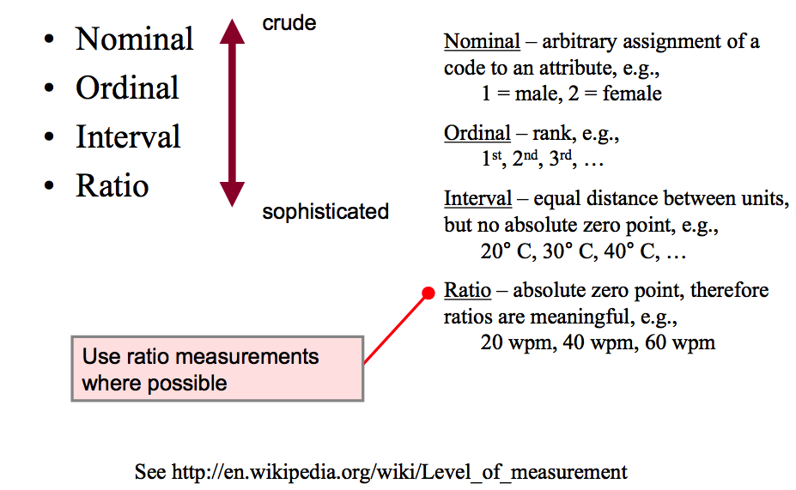
Types of Measurement

Slide 5
Nominal Data
Nominal data (aka categorical data) are arbitrary codes assigned to attributes; e.g.,
  1=male, 2=female
  1=mouse, 2=touchpad, 3=pointing stick
The code is so arbitrary, it needn’t be a number; i.e.,
  M=male, F=female
Obviously, the statistical mean cannot be computed on nominal data
Usually it is the count that is important
  “Are females or males more likely to …”
  “Do left handers or right handers have more difficulty with …”

Slide 6
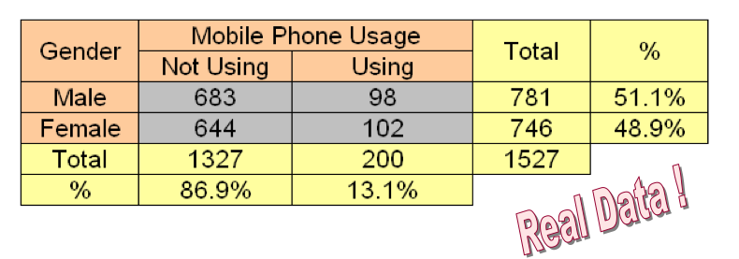
Example of Nominal Data in HCI
Observe students “on the move” on university campus
Code and count students by …
  Gender (male, female)
  Mobile phone usage (not using, using)

Slide 7
Think of Another Example for Nominal Data
Arbitrarily form two-person group
Discuss for five minutes
Share your example

Slide 8
Ordinal Data
Ordinal data associate an order or rank to an attribute
The attribute is any characteristic or circumstance of interest; e.g.,
  Users try three different GPS systems for a period of time, then rank them: 1st, 2nd, 3rd choice
More sophisticated than nominal data
  Comparisons of “greater than” or “less than” possible
  Questionnaire example (see next slide)

Slide 9
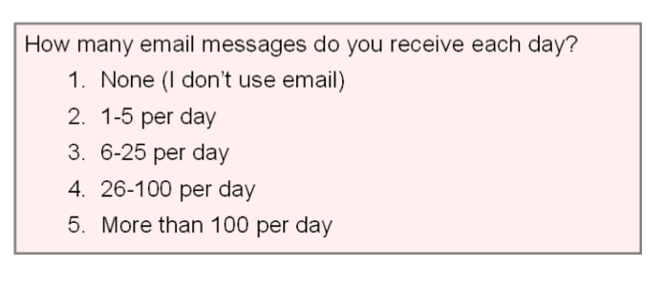
Example of Ordinal Data in HCI

Slide 10
Interval Data
Equal distances between adjacent values
But, no absolute zero
Classical example: temperature on the Fahrenheit or Celsius scale
Statistical mean possible
  E.g., the mean midday temperature during July
Ratios not possible
  Cannot say 10°C is twice 5°C

Slide 11
Example of Interval Data in HCI
Questionnaires solicit a level of agreement to a statement (e.g., “strongly agree”, “strongly disagree”)
Responses on a Likert scale
Likert scale characteristics:
  Responses are symmetric about a neutral middle value
  Gradations between responses are equal (more-or-less)
Assuming “equal gradations”, the statistical mean is valid (and related statistical tests are possible)

Slide 12
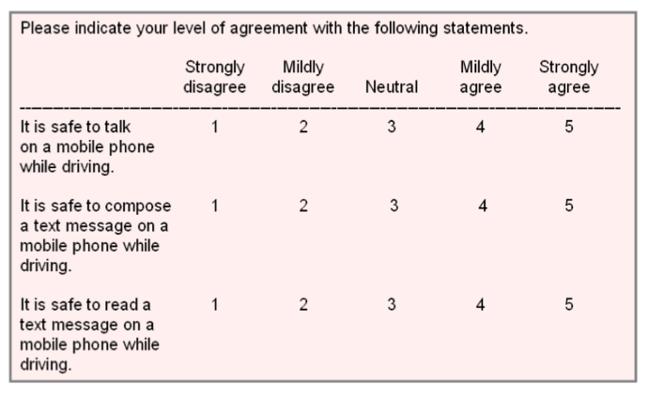
Example of Interval Data in HCI

Slide 13
Ratio Data
Most sophisticated of the four types of measurement
Preferred type of measurement
Absolute zero, therefore many calculations possible
Summaries and comparisons are strengthened
A “count” is a ratio-scale measurement
  E.g, “time” (the number of seconds or minutes)
Enhance counts by adding further ratios where possible
  Facilitates comparisons
  Example- a 10-word phrase was entered in 30 seconds
    Bad: t=30 seconds
    Good: Entry rate = 10/0.5 = 20 wpm

Slide 14
Think of Examples for Interval Data and Ratio Data
Arbitrarily form two-person group
Discuss what’s the same and different between interval data and ratio data
Give examples to illustrate your point

Slide 15
HCI Research?
Conceptual issue: What’s considered “research”?
What “research”, “design” and “engineering” refer to each?
Discuss for five minutes
Share your thought

Slide 16
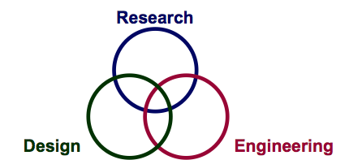
Research vs. Design vs. Engineering
(Note: This is Scott MacKenzie’s view)
Design is not research
  Design is the process of creating artifacts, considering ...
    Form <-> Function
Engineering is not research
  Engineering is the process of creating artifacts, considering …
    Form <-> Function

Slide 17
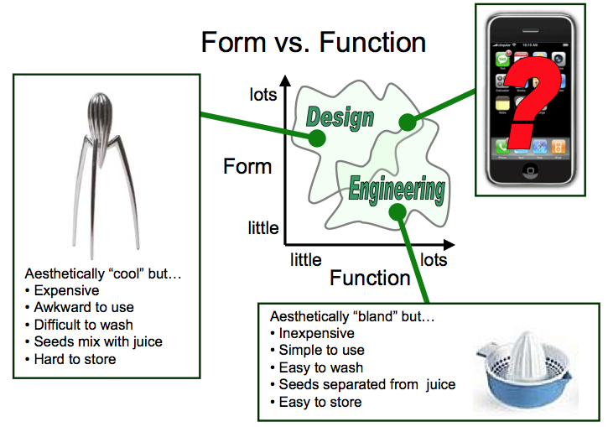
Form vs. Function

Slide 18
Research Questions
We conduct empirical research to answer (and raise) questions about new or existing UI designs or interaction techniques.
Consider the following questions
  Is it viable (workable)?
  Is it as good as or better than current practice?
  Which of several design alternatives is best?
  What are its performance limits and capabilities?
  What are its strengths and weakness?
  Does it work well for novices, for experts?
  How much practice is required to become proficient?

Slide 19
Testable Research Questions
Previous questions, while unquestionably relevant, not all of them are testable
Try to re-cast as testable questions (… even though the new question may appear less important)
Scenario
  You have invented a new text entry techniques for mobile phones, and you think it’s pretty good. In fact, you think it is better than the commonly use multi-tap technique. You decide to undertake a program of empirical inquiry to evaluate your invention. What are your research questions?

Slide 20
Research Questions (2)
Very weak
  Is the new technique any good?
Weak
  Is the new technique better than multi-tap?
Better
  Is the new technique faster than multi-tap?
Better still
  Is the new technique faster than multi-tap within one hour of use?
Even better
  If error rates are kept under 2%, is the new technique faster than multi-tap within one hour of use?

Slide 21
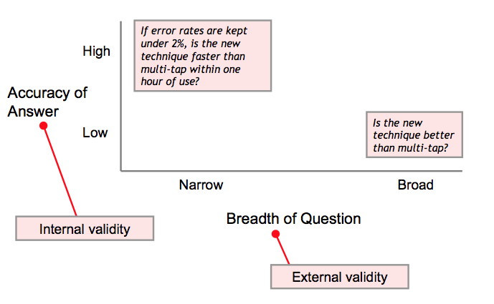
A Tradeoff

Slide 22
Internal Validity
Definition: The extent to which the effects observed are due to the test conditions (e.g., multitap vs. new)
Statistically ..
  Differences (in the means) are due to inherent properties of the test conditions
  Variances are due to participant, individual differences (“pre-dispositions”)
  Other potential sources of variance are controlled or exist equally and randomly across the test conditions.

Slide 23
External Validity
Definition: The extent to which results are generalizable to other people and other situations
Statistically …
People
  The participants are representative of the broader intended population of users
  Situations
    Test environment and experimental procedures are representative of real world situations where the interface or technique will be used.

Slide 24
Discussion Time
1.
Reflect papers you read this week.
What is an “HCI Idea”? How to ask questions around HCI ideas? Share your thoughts?
2.
Talk about your individual research project
Generate at least two research questions and share them
Listen to other people’s research questions. Help them revise the questions or suggest other research questions.

