Slide 1
ISA5577 Applied Quantitative Methods for Human-Computer Interaction
人機互動量化研究方法
October 19, 2017
Hao-Chuan Wang

Slide 2
Today’s Agenda
More advanced experimental design issues
Within- and between-subject design
Counterbalancing technique
Strategic planning for upcoming assignments
Sources: Scott MacKenize http://www.yorku.ca/mack/CourseNotes.ppt
Scott Klemmer. CS147 http://hci.stanford.edu/courses/cs147/2012/

Slide 3


Slide 4
Key consideration:
Should every participant use every alternative?

Slide 5


Example
Which vacuum cleaner is more effective?

Slide 6
What are the measures?
Faster?
Cleaner?
Fatigue?
Ergonomics?
Environmental impact?
Portability?
Ease of use?
Fewer errors?

Slide 7
Manipulation: Vacuum type
Measure: Speed, cleanliness

Slide 8
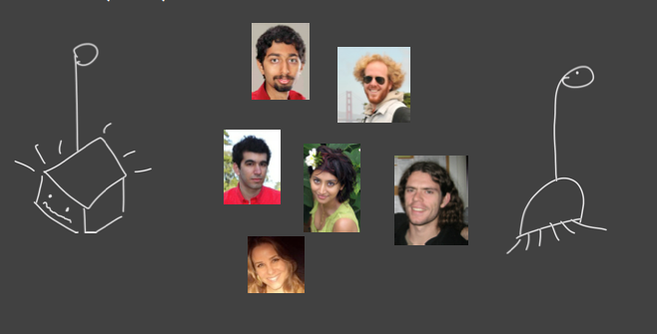
Between subjects design
Half the participants use one interface. The other half use the other.

Slide 9
Between subjects design
Participants assigned to use Vacuum A | Time (in seconds) | Participants assigned to use Vacuum B | Time (in seconds)
Mike | 11.7 | Don | 15.7
Bob | 18.2 | Hector | 13.4
Homer | 12.2 | Ron | 18.0
George | 15.4 | Tom | 12.8
Harry | 15.8 | Steve | 13.6
Gordon | 13.2 | Dale | 19.0
John | 13.7 | Pete | 16.2
Bill | 19.1 | Juan | 11.9
Randy | 12.9 | Dan | 14.6
Tim | 16.0 | Paul | 18.0

Slide 10
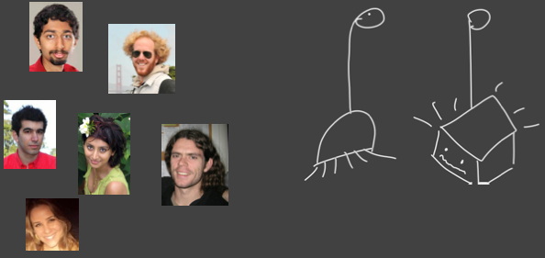
Within subjects design
Everyone uses both interfaces.

Slide 11
Within subjects design
Participants | Time when using Vacuum A (in seconds) | Time when using Vacuum B (in seconds)
Mike | 11.7 | 15.7
Bob | 18.2 | 13.4
Homer | 12.2 | 18.0
George | 15.4 | 12.8
Harry | 15.8 | 13.6
Gordon | 13.2 | 19.0
John | 13.7 | 16.2
Bill | 19.1 | 11.9
Randy | 12.9 | 14.6
Tim | 16.0 | 18.0

Slide 12
Between vs. within subjects
Within subjects
  All participants try all conditions
    + Can isolate effect of individual differences
    + Requires fewer participants
    - Ordering (learning, carry-over etc.) and fatigue effects
Between subjects
  Each participant tries one condition
    + No ordering effects, less fatigue.
    - Cannot isolate effects due to individual differences.
    - Need more participants

Slide 13
Ordering effects
Ordering of conditions is a variable that can confound the results
  Randomization
  Counterbalancing
  Latin square (partial counterbalancing)
“The day should come then when no reputable psychologist will use a within-subject design… without combining it with a separate groups [between subjects] design.” - Poulton 1973

Slide 14
Within vs. Between Subjects
Question: Is it best to assign a factor within subjects or between subjects?
Answer: It depends!
Sometimes a factor must be between subjects (e.g., gender, age)
Sometimes a factor must be within subjects (e.g., session, block)
Sometimes there is a choice. In this case, there is a tradeoff
Within subjects advantage: the variance due to participants’ pre-dispositions (i.e., individual differences) should be the same across test conditions.
Between subjects advantage: avoids interference effects (e.g., typing on two different layouts of keyboards)

Slide 15
Counterbalancing
For within subjects designs, participants’ performance may improve with practice as they progress from one test condition to the next. Thus, participants may perform better on the second condition simply because they benefited from practice on the first. This is bad news.
To compensate, the order of presenting conditions is counterbalanced
Participants are divided into groups, and a different order of administration is used for each group
Group, then, is a between subjects factor (Was there an effect for group? Hopefully not!)
The order can be governed by a Latin Square when there’re too many conditions to test.

Slide 16
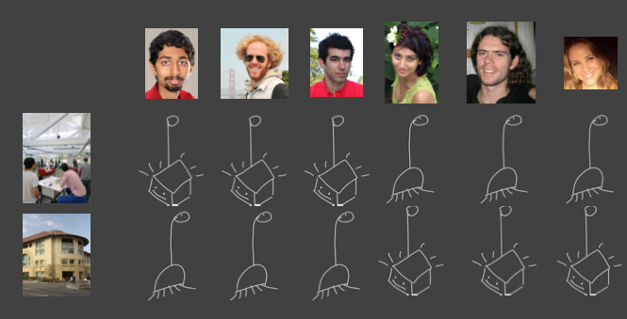
Addressing ordering effects with counterbalancing
From Scott Klemmer’s course note

Slide 17
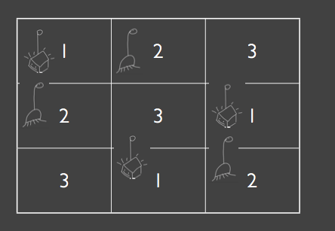
What about three or more alternative conditions?
Latin square
From Scott Klemmer’s course note

Slide 18
Latin Square
The defining characteristic of a Latin Square is that each condition occurs only once in each row and column
Examples:
Google “latin square” and “latin square generator”.
3 X 3 Latin Square
4 x 4 Latin Square
4 x 4 Balanced Latin Square
A B C
B C A
C A B
A B C D
B C D A
C D A B
D A B C
A B C D
B D A C
D C B A
C A D B
A row is a
test group
Note: In a balanced Latin Square each condition both precedes and follows each other condition an equal number of times

Slide 19
Random Order
Counterbalancing using a Latin Square requires m participants, where m % n = 0 (n is the number of test conditions)
Sometimes this is not practical or possible (e.g., number of participants is unknown)
Alternatively, learning effects may be minimized by
  Randomizing the order of presentation
  Using “all possible orders”; e.g., n = 3 →
ABC
ACB
BAC
BCA
CAB
CBA

Slide 20
Succinct Statement of Design
“3 x 2 repeated-measures design” refers to an experiment with two factors, having three levels on the first, and two levels on the second. There are six test conditions in total. Both factors are repeated measures, meaning all participants were tested on all test conditions
Note: A mixed design is also possible
  In this case, the levels for one factor are administered to all participants (within subjects) while the levels for another factor are administered to separate groups of participants (between subjects).
  An example of a mixed design: http://www.yorku.ca/mack/uist01.html

Slide 21
Assignment 2
Assignment 2- Experimental design and initial data collection based on your own research questions (due November 9). (think this as a pilot study)
  Collect a small set of data on your own for your topic

Slide 22
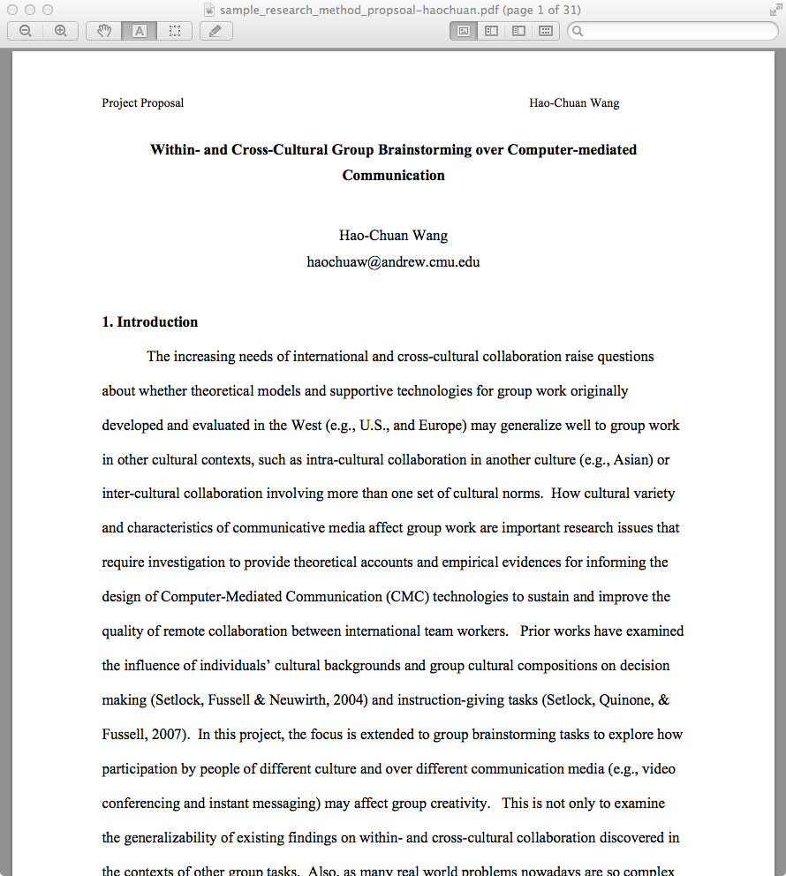

Sample Research Method Course Project
Prof. Sara Kiesler
Applied Research Method course at CMU

