Slide 1
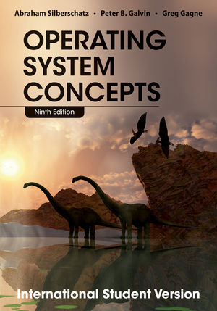
Operating System Course
Jia-Shung Wang
Department of Computer Science
National Tsing Hua University
http://lms.nthu.edu.tw/course/33022/
Textbooks: (A. Silberschatz, P. Galvin and G. Gagne)
Operating System Concepts, 9th Edition (International Student), John Wiley & Sons, Inc., 2013.
Operating System Concepts, 10th Edition, John Wiley & Sons, Inc., February, 2018.

Slide 2

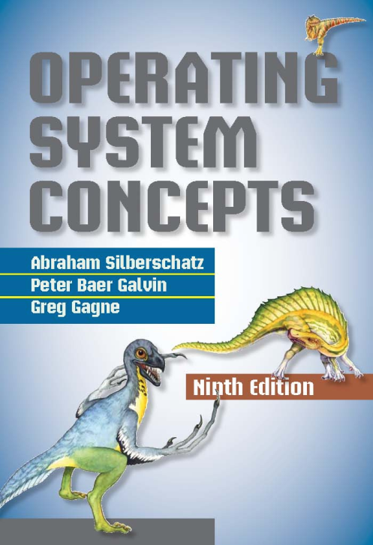
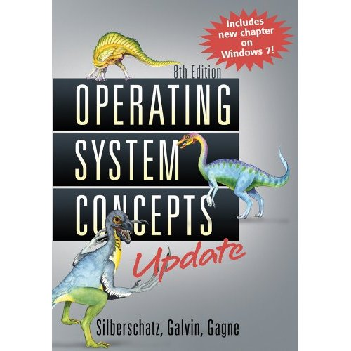
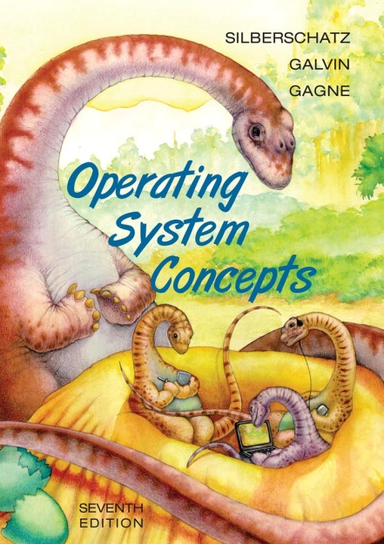
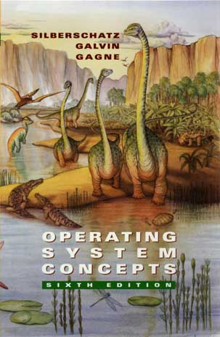


Slide 3
Scoring
  Midterm Exam (32%) 17 April, 2018
  Quiz (12%) 3 May, 2018
  Final Exam (36%) 12 June, 2018
  Exercises and Term Projects (20%)
Office Hour
  Friday 11:00~12:00

Slide 4
Book Information
http://codex.cs.yale.edu/avi/os-book/
  A brief history of the textbooks (21 chapters and 4 appendices)
  Important OS papers
  Linux Virtual Machine
  Solutions to Practice Exercises
  Source codes
  Study Guide to Accompany Operating Systems Concepts, By Andrew DeNicola

Slide 5
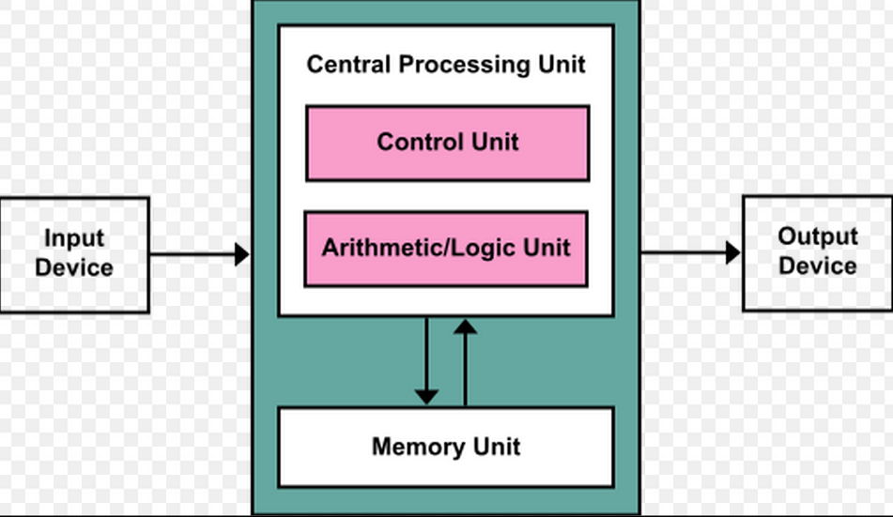
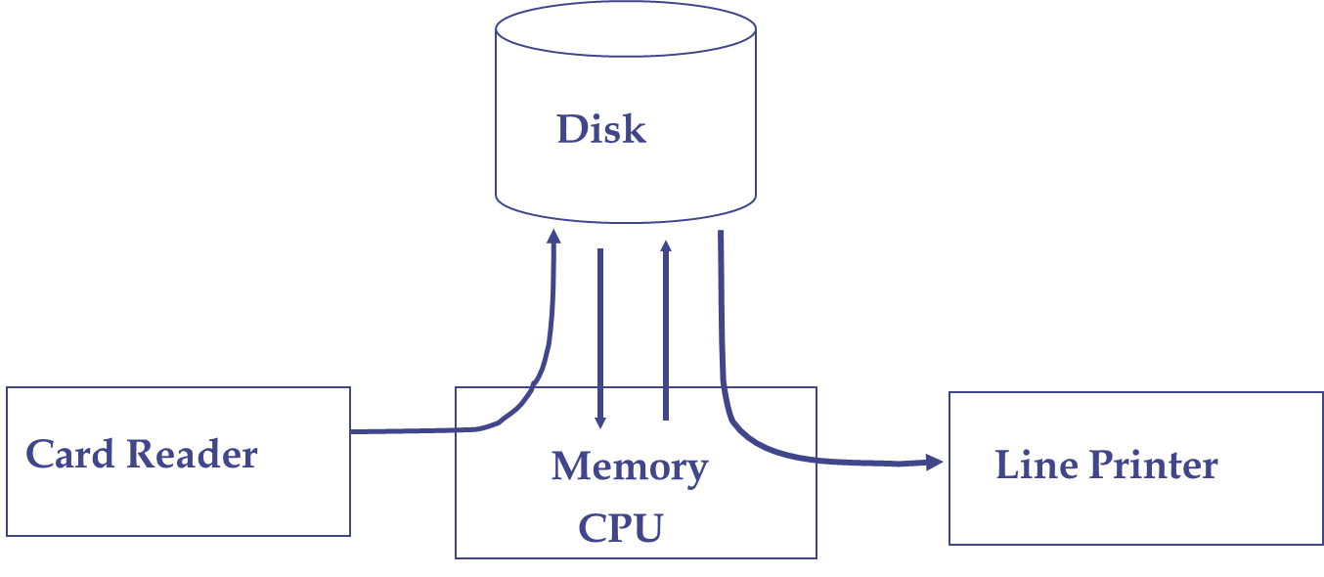
Early Stage: Von Neumann Machine, Batch OS, …

Slide 6
1970s: Original UNIX System
The users
shells and commands
compilers and interpreters
system
programs
system libraries
(2)
system-call interface to the kernel
signals file system CPU scheduling
terminal swapping page replacement
Handling
(1)
kernel
char I/O block I/O demand paging
terminal disk and tape virtual
drivers drivers memory
kernel interface to the hardware
hardware
terminal controllers
device controllers
memory controllers
terminals devices and tapes physical memory

Slide 7
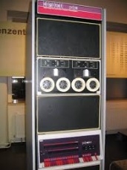
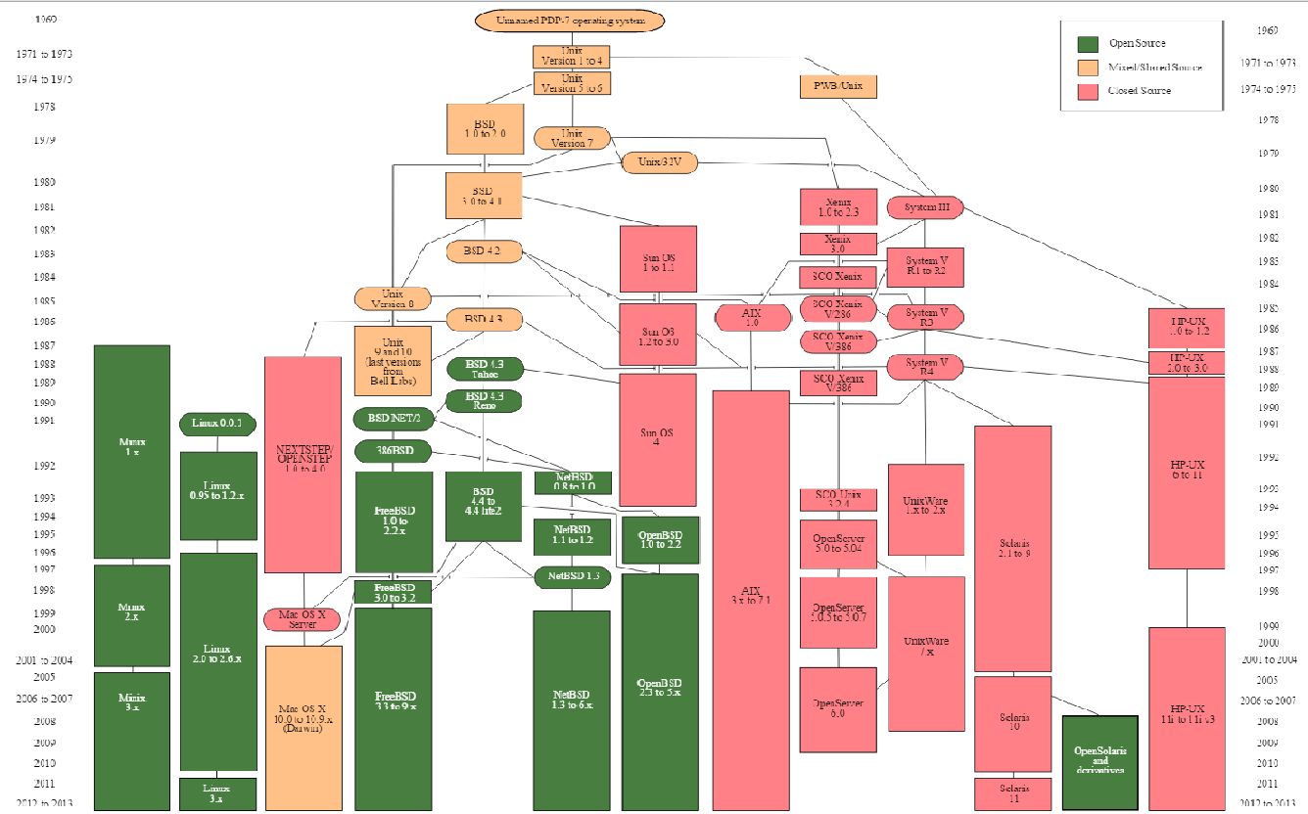
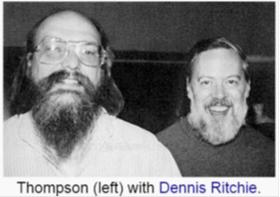
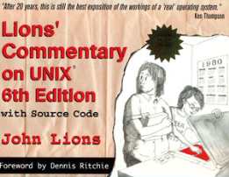


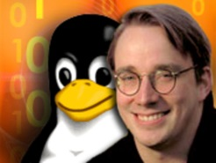




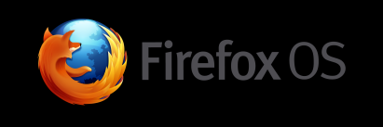

Evolution of Unix and Unix-like systems

Slide 8
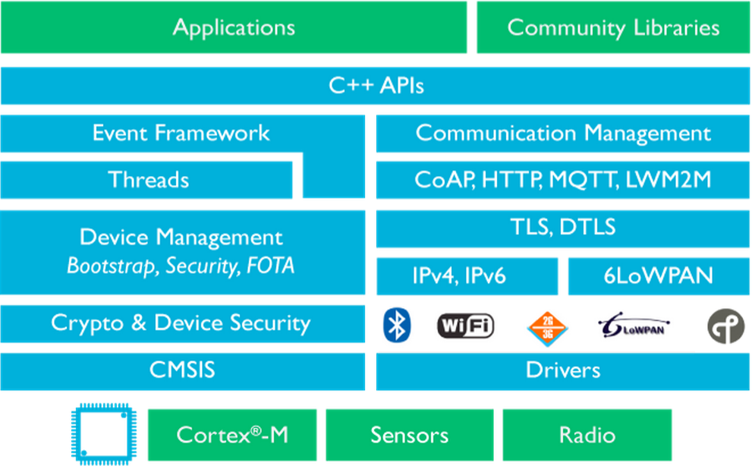
Lately: ARM mbed, IoT Solution,
https://os.mbed.com/

Slide 9
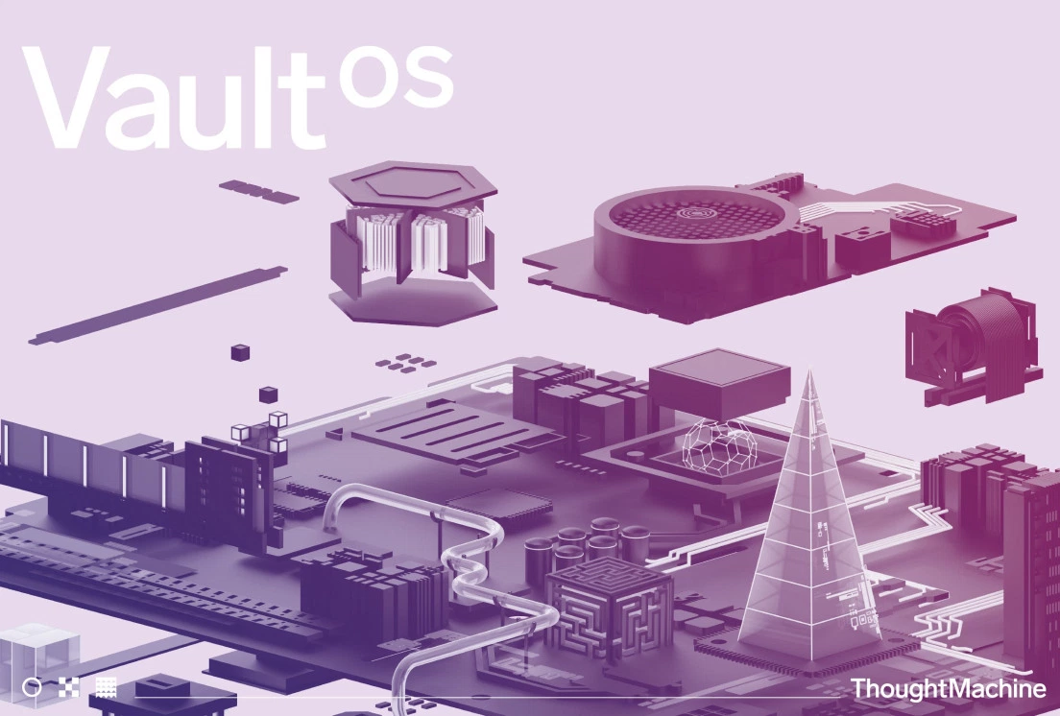
Lately: Vault OS, Blockchain-Based System for Banks https://www.thoughtmachine.net/
ex-Google engineer Paul Taylor

Slide 10
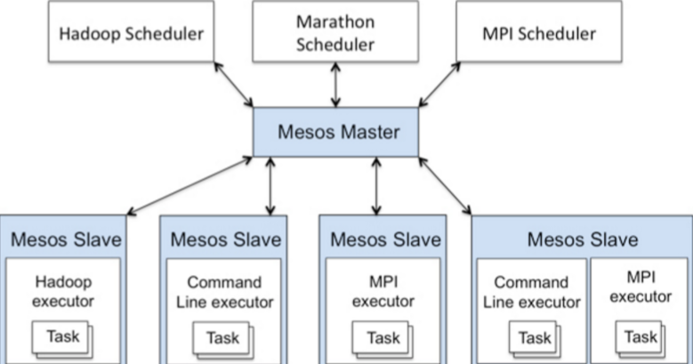

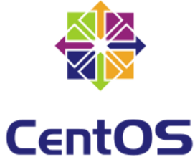
Lately:, MesOS, CentOS
Since being developed at UC Berkeley, it has been adopted by several large software companies, including Twitter, Airbnb and Apple. At least 50 organizations currently use Mesos.
Community Enterprise Operating System(CentOS)
  forked from RHEL version 2.1AS.
  7.4-1708

Slide 11



Lately: Fuchsia OS, Google
Fuchsia (pronounced "fyoo-shuh") can run on just about any kind of device? Pixelbook, …
Magenta kernel (Chrome OS, Android: Linux kernel)
Google's Dart programming language

Slide 12
Overview (1)
Operating systems are an essential part of any computer system.
Similarly, a course on operating systems is an essential part of any computer-science education.
This field is undergoing change at a rapid rate, as computers are now prevalent in virtually every application, from games for children through the most sophisticated planning tools for governments and multinational firms.
Prerequisites: we assume that the reader is familiar with basic data structures, computer organization, and a high-level language, such as C, POXIS, Java.

Slide 13
Overview (2)
Concepts are presented using intuitive descriptions.
Important theoretical results are covered, but formal proofs are omitted.
The bibliographical notes contain pointers to research papers in which results were first presented and proved, as well as references to material for further reading.
In place of proofs, figures and examples are used to suggest why we should expect the result in question to be true.

Slide 14
Overview (3)
The fundamental concepts and algorithms covered in the book are often based on those used in existing commercial operating systems.
Our aim is to present these concepts and algorithms in a general setting that is not tied to one particular operating system.
The content of the text corresponds to the suggestions from Computing Curricula 2001 for teaching operating systems, published by the Joint Task Force of the IEEE Computing Society and the Association for Computing Machinery (ACM).

Slide 15
Programming Environments (1)
POSIX: POSIX (Portable Operating System Interface) represents a set of standards implemented primarily for UNIX-based operating systems. POSIX-compliant systems must implement the POSIX core standard (POSIX .1)--Linux, Solaris, and Mac OS X. POSIX also defines several extensions to the standards, including real-time extensions (POSIX 1.b) and an extension for a threads library (POSIX 1.c, better known as Pthreads)
Several programming examples written in C and tested on Linux 2.6, and 3.2 systems, Mac OS X 10.7, and Solaris 10.
Windows systems: Windows API, which provides a comprehensive set of functions for managing processes, threads, memory, and peripheral devices.

Slide 16
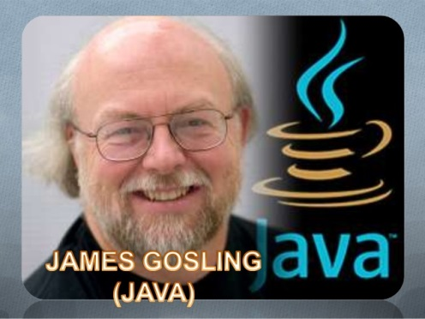
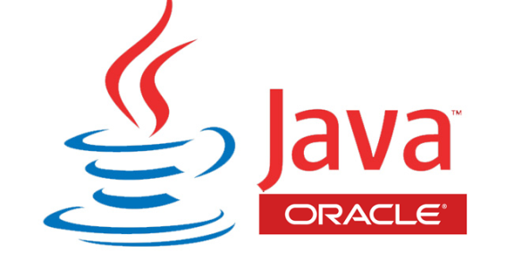
Programming Environments (2)
Java: Java is a widely used programming language with a rich API and built-in language Java programs run on any OS supporting a Java virtual machine (or JVM).

Slide 17
Linux Virtual Machine
This virtual machine also includes a gcc development environment with compilers and editors.
Most of the programming assignments in the book can be completed on this virtual machine.
Provide three programming assignments that modify the Linux kernel through kernel modules:
  Adding a basic kernel module to the Linux kernel.
  Adding a kernel module that uses various kernel data structures.
  Adding a kernel module that iterates over tasks in a running Linux system.

Slide 18
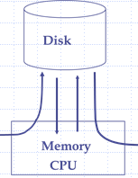
Startup
Booting – starting a computer by loading the kernel.
Bootstrap program – code stored in ROM that is able to locate the kernel, load it into memory, and start its execution.

Slide 19
Startup
Process Creation: Parent process create children processes, which, in turn create other processes, forming a tree of processes.

Slide 20
Startup
file name
Application Programs
write(data_file, item)
Given a symbolic file name,
use directory to provide
values needed by FOM
Logical File System
information
of data_file
Transform logical address to
physical block address
File-Organization Module
2144th block
Basic File System
Numeric disk address
driver 1, cylinder 73,
surface 2, sector 10
I/O Control
Driver: hardware instructions
Devices

Slide 21
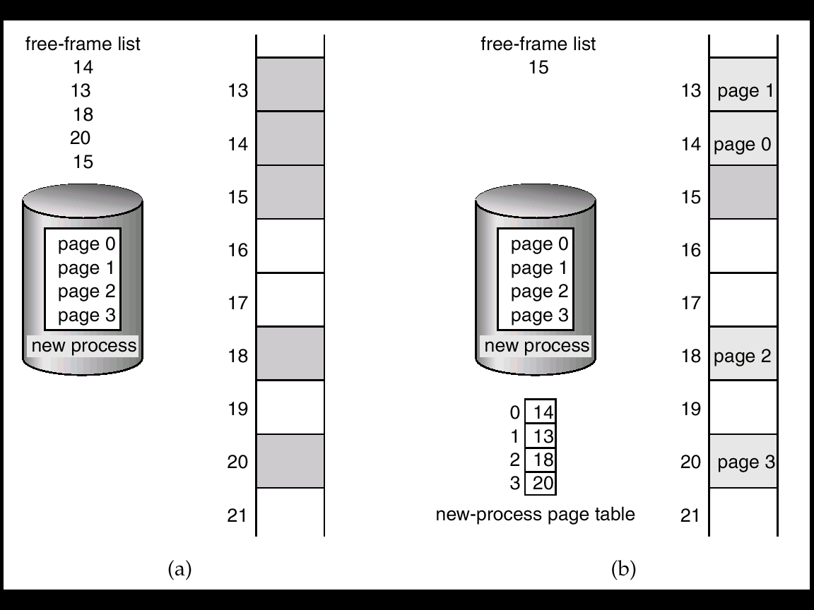
Startup
Long-term Scheduler (Job Scheduler): selecting processes from the job pool and loads them into memory for execution.
Paging: dividing logical memory into blocks of same size, set up a page table to translate logical to physical addresses.

Slide 22
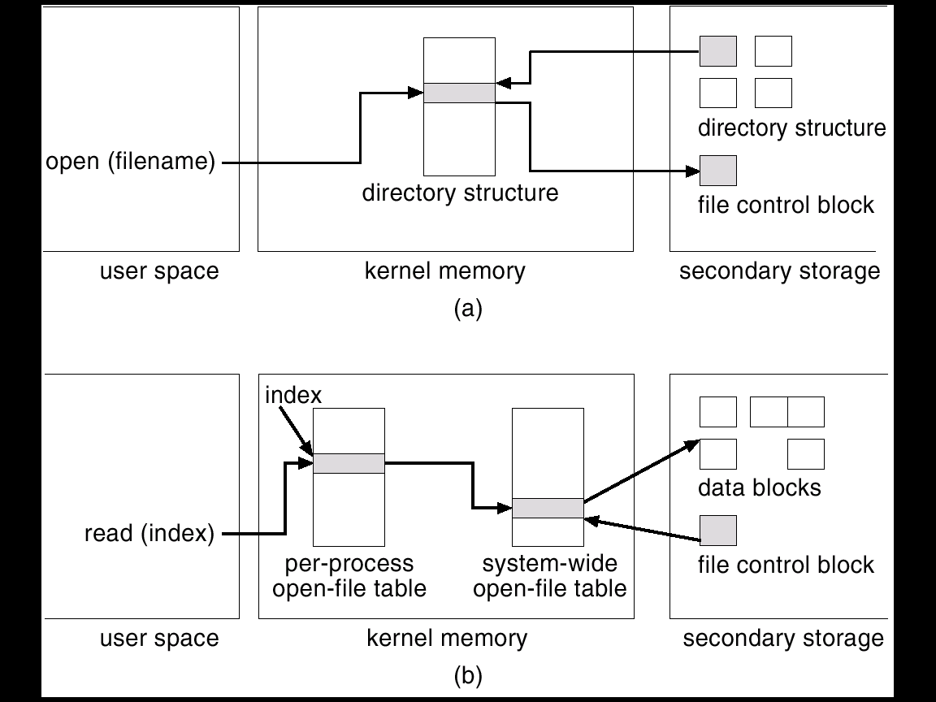
In-Memory File System Structures

Slide 23
Contents (9th ed.)
PART ONE OVERVIEW
Chapter 1 Introduction
Chapter 2 Operating-System Structures
PART TWO PROCESS MANAGEMENT
Chapter 3 Processes
Chapter 4 Threads
Chapter 5 Process Synchronization
Chapter 6 CPU Scheduling
Chapter 7 Deadlocks
PART THREE STORAGE MANAGEMENT
Chapter 8 Memory Management

Slide 24
Chapter 9 Virtual Memory
PART FOUR STORAGE MANAGEMENT
Chapter 10 Mass-Storage Structure
Chapter 11 File-System Interface
Chapter 12 File-System Implementation
Chapter 13 I/O Systems
PART FIVE PROTECTION AND SECURITY
Chapter 14 Protection
Chapter 15 Security
PART SIX ADVANCED TOPICS
Chapter 16 Virtual Machines

Slide 25
Chapter 17 Distributed Systems
PART SEVEN CASE STUDIES
Chapter 18 The Linux System
Chapter 19 Windows 7
Chapter 20 Influential Operating Systems
Appendix A BSD Unix
Appendix B The Mach System
Appendix The Nachos System

Slide 26
Tenth Edition
Sustained growth in four fundamental areas that affect operating systems: Mobile OSs, Multicore, Virtualization, Nonvolatile memory secondary storage
Major Changes
  Chapter 1: updated coverage of multicore systems, as well as new coverage of NUMA systems and Hadoop clusters.
  Chapter 2: GRUB (system boot) for Linux systems, linkers and loaders, BCC debugging toolset.

Slide 27
Major Changes, cont’d
  Chapter 3: Android process hierarchy, Mach message passing, and Android RPCs.
  Chapter 4: fork-join framework in Java, Intel thread building blocks.
  Chapter 5 (scheduling): NUMA-aware scheduling issues throughout, including how this scheduling affects load balancing.
  Chapter 6 (Synchronization Tools): Lockfree algorithms using compare-and-swap instructions; new coverage of memory models, memory barriers, and liveness issues.

Slide 28
Major Changes, cont’d
  Chapter 7: Synchronization Examples (previously part of Chapter 5, Process Synchronization) POSIX named and unnamed semaphores, and condition variables; Java synchronization is included.
  Chapter 8: livelock and liveness hazard.
  Chapter 9: ARMv8 64-bit architecture, eliminated coverage of segmentation.
  Chapter 10: compressed memory, major/minor page faults, and memory management in Linux and Windows 10.

Slide 29
Major Changes, cont’d
  Chapter 11: cloud storage, updated RAID coverage, object storage.
  Chapter 12 (I/O): vectored I/O, power management for mobile OS.
  Chapter 13 (File-System Interface)
  Chapter 14 (File-System Implementation): TRIM and the Apple File System.
  Chapter 15 (File System Internals) is new and contains updated information from the previous Chapters 11 and 12.

Slide 30
The 9th Edition (1)
1: updated coverage of multiprocessor and multicore systems, as well as a new section on kernel data structures.
1: computing environments: includes mobile systems, cloud computing and an overview of real-time systems.
2: user interfaces for mobile devices, including discussions of iOS and Android.
3(Processes): multitasking in mobile OSs, multiprocess model in Google’s Chrome, and zombie and orphan processes in UNIX.
4(Threads): parallelism and Amdahl’s law; a new section on implicit threading, including OpenMP and Apple’s Grand Central Dispatch.

Slide 31
The 9th Edition (2)
5(Process Synchronization): mutex locks, synchronization using OpenMP, … .
6(CPU Scheduling): Linux CFS scheduler and Windows user-mode scheduling.
8 (Main Memory): swapping on mobile systems and Intel 32- and 64-bit architectures. A new section for ARM architecture.
9 (Virtual Memory): Linux SLUB and SLOB memory allocators.
10 (Mass-Storage Structure): solid-state disks.

Slide 32
Historical Perspective
Mainframe: Batch
Mainframe: Multiprogramming
Mainframe: Time-Sharing
Computer-system Architecture
  Single-processor Systems
    PCs
  Multiprocessor Systems
    Parallel Systems or Tightly Coupled Systems
  Cluster Systems

Slide 33
Mainframe: Batch Systems
Main job of early OS: automatically transfer control from one job to the next. (resident in memory)
To speed up processing, jobs with similar needs were batched together and were running through the computer as a group.
A batch operating system
  Programmers submit jobs (program, data, control cards)
  Operator sort jobs into batches with similar requirements (Fortran, Cobol)
  OS transfers control from one job the the next.

Slide 34
$END
$RUN
$LOAD
$FNT
$JOB
data for the program
program to be compiled

Slide 35
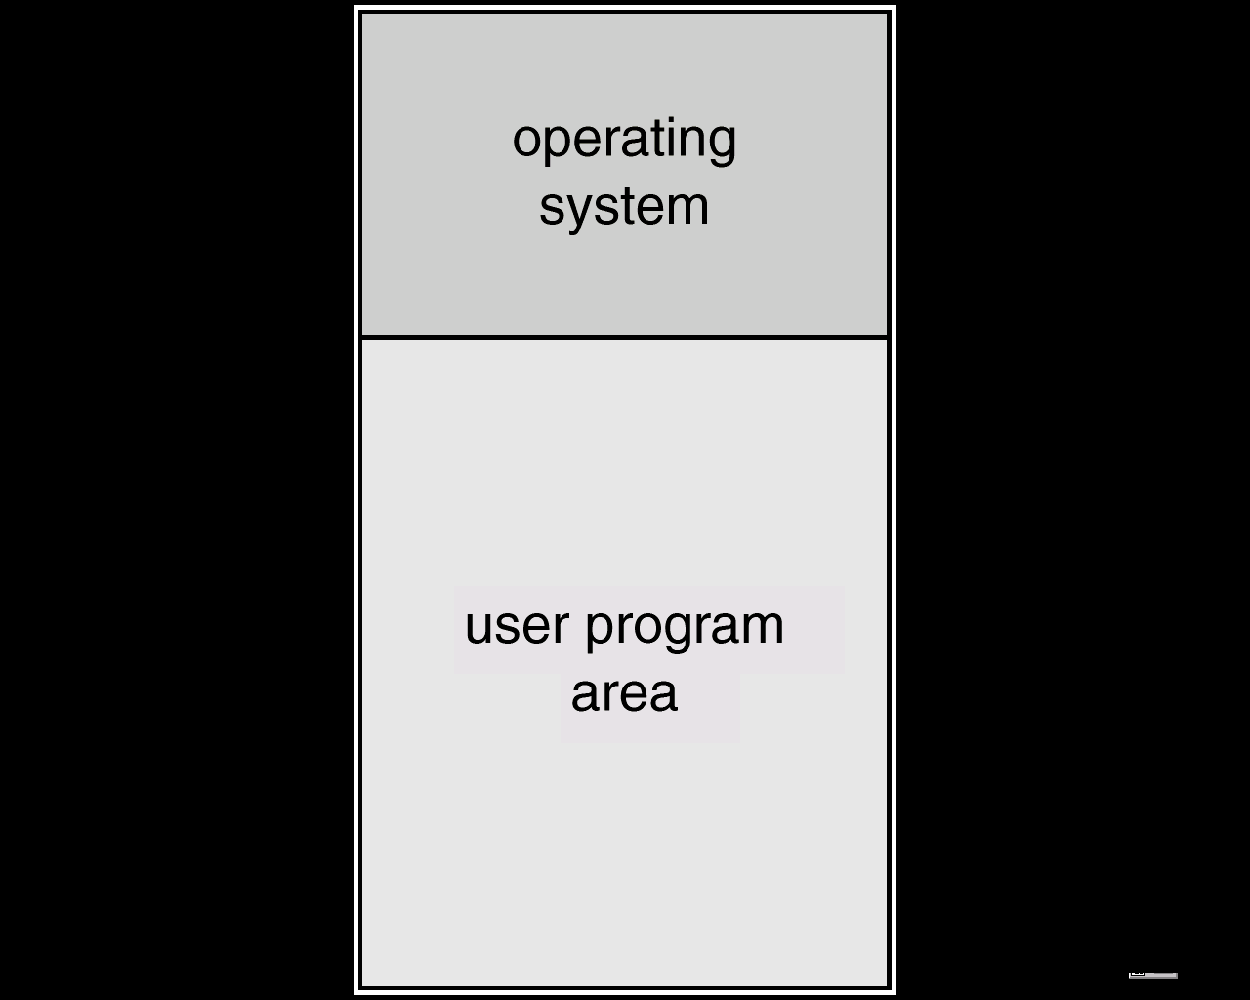
Memory Layout for a Simple Batch System

Slide 36
Lack of interaction between the user and the job while that job is executing.
CPU is often idle
  I/O devices: card reader/printer
  I/O speed << CPU speed (at least 1:1000)
Introduction of Disk technology
  Spooling (Simultaneous Peripheral Operation On-Line)
  I/O is done with no CPU intervention
  CPU just needs to be notified when I/O is done

Slide 37
Disk
Card Reader
Memory
Line Printer
CPU
Spooling

Slide 38
Spooling overlaps the I/O of one job with the computation of other jobs.
  The spooler may be reading the input of one job while printing the output of a different job.
☺By overlaps, spooling keeps both the CPU and the I/O devices working at much higher rates.

Slide 39
Mainframe: Multiprogramming Batched Systems
Spooling provides an important data structure: a job pool, which contains jobs waiting on disk, ready to run.
Job scheduling becomes possible: OS can select which job to run next, to increase CPU utilization.
The most important aspect of job scheduling is the ability to multiprogram : OS keeps several jobs in memory at a time.
☺ Multiprogramming organizes jobs such that CPU always has one to execute. (When one job is waiting for I/O, CPU switches to another.)

Slide 40
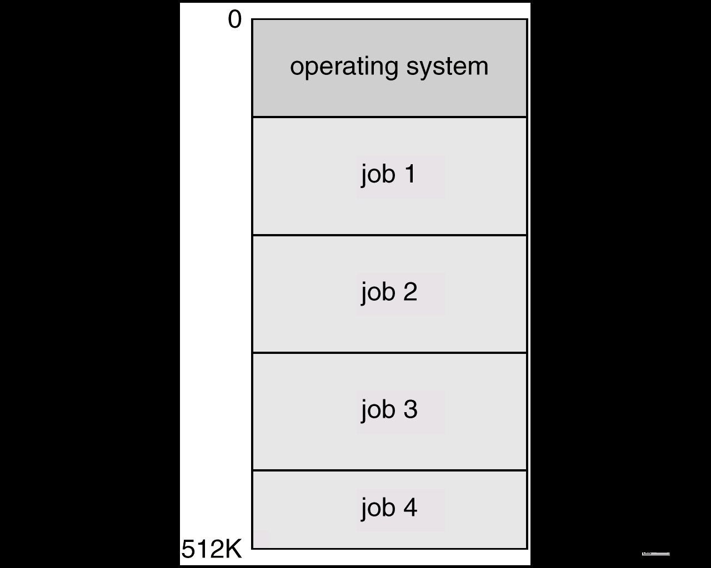
Multiprogramming Systems
Several jobs are kept in main memory at the same time, and the CPU is multiplexed among them.

Slide 41
OS Features Needed for Multiprogramming
I/O routine supplied by the system.
Memory management – the system must allocate the memory to several jobs.
CPU scheduling – the system must choose among several jobs ready to run.
Allocation of devices.

Slide 42
Job Scheduling
Operating System
CPU Scheduling
Job 1
CPU
Job 2
Job 3
Job pool
Job 4

Slide 43
Mainframe: Time-Sharing Systems
☹ Disadvantages of a multiprogrammed batched systems
  No interaction with users: users must set up control cards for all possible outcomes.
  Statically debugging: long turnaround time inhibits experimentation. (But, it instills good discipline of writing/testing)
An interactive (or hand-on) system: allows on-line communication between users and the system. (Usually, keyboard/screen are used. Users can see results immediately.)

Slide 44
Time-sharing (or multi-tasking): an extension of multiprogramming.
  CPU switches among jobs frequently such that users may interact with programs.
  Switch job when
    finish
    waiting I/O
    a short period of time
Early OS: single user, interactive
Batch: good CPU utilization, no interaction
Time-sharing: interaction, reasonable cost
Combine: Batch + Time sharing (IBM OS/360)

Slide 45
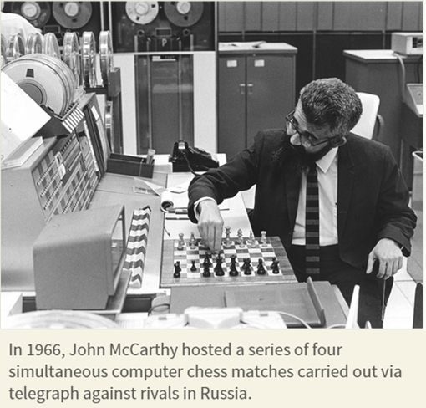
Time-sharing System
CPU Scheduling and multiprogramming provide each user with a small portion of a time-shared computer.
CPU-bound and I/O-bound process
Memory management and Protection
Virtual memory
File system, Disk management
Concurrent execution
Process synchronization and Deadlock

Slide 46
The Movement of OS
MULTICS (1965-1970 MIT) for GE 645
UNIX (Ken Thompson, 1970 Bell Lab) for DEC PDP-11, C-language
UNIX-like OS: System V, XENIX, BSD, Solaris, Linux, Cloud OS
Workstation: Solaris, RS/6000, NT
PC: Windows, Unix, Linux, OS/2, MacOS, …
Hand-held: Palm, Windows CE, Linux, Symbian, iOS, Android, …
Embedded Systems: Linux, Wind River, …

Slide 47
1970s: Original UNIX System
The users
shells and commands
compilers and interpreters
system
programs
system libraries
(2)
system-call interface to the kernel
signals file system CPU scheduling
terminal swapping page replacement
Handling
(1)
kernel
char I/O block I/O demand paging
terminal disk and tape virtual
drivers drivers memory
kernel interface to the hardware
hardware
terminal controllers
device controllers
memory controllers
terminals devices and tapes physical memory

Slide 48
Computer-system Architecture
Single-processor Systems
  PCs
Multiprocessor Systems
  Parallel Systems or Tightly Coupled Systems

Slide 49
Desktop Systems
Personal computers (PC) – computer system dedicated to a single user.
I/O devices – keyboards, mice, display screens, small printers.
User convenience and responsiveness.
Can adopt technology developed for larger operating system, often individuals have sole use of computer and do not need advanced CPU utilization of protection features.
May run several different types of operating systems (Windows, MacOS, UNIX, Linux)

Slide 50
Personal-Computer Systems
PCs: appeared in the 1970s, instead of maximizing CPU and peripheral utilization, the systems opt for maximizing user convenience and responsiveness.
MS-DOS, OS/2, MacOS, Windows, Linux, Android, …
GUI
Lack of file protection at first: destroy data, system or even worldwide networks via virus mechanisms.
LAN, Internet, browser, Social Networks, …

Slide 51
Parallel Systems (1)
Multiprocessor systems with more than one CPU in close communication.
Tightly coupled system – processors share memory and a clock; communication usually takes place through the shared memory.
Advantages of parallel systems:
  Increased throughput
  Economical
  Increased reliability
    graceful degradation

Slide 52
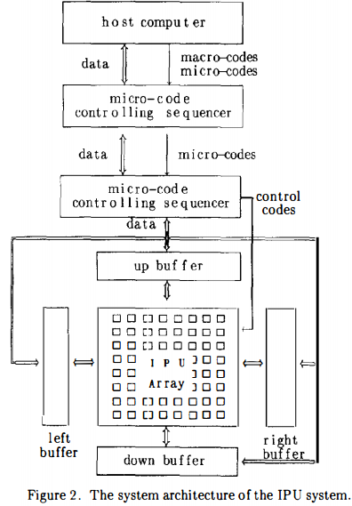
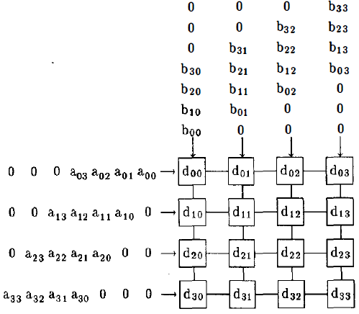
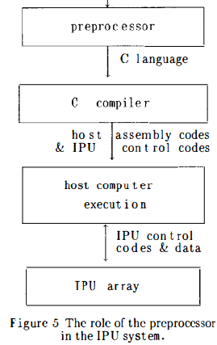
Parallel Systems (2)
Symmetric multiprocessing (SMP)
  Each processor runs an identical copy of the operating system.
  Many processes can run at once without performance deterioration.
  Most modern operating systems support SMP, Solaris 2, …
Asymmetric multiprocessing
  Each processor is assigned a specific task; master processor schedules and allocated work to slave processors.
  More common in extremely large systems
  Grid computing

Slide 53
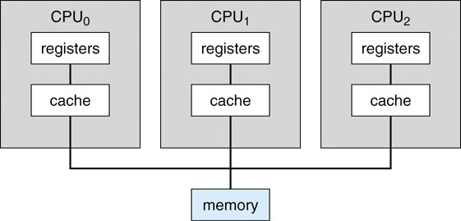
Symmetric Multiprocessing Architecture
All processors are peer; no master-slave relationship exists between processors.
Shared dynamically
Among PEs

Slide 54
Uniform Memory Access VS.
Non-Uniform Memory Access (NUMA)
Uniform Memory Access (UMA)
  Access to any RAM from any CPU (or Core) takes the same amount of time.
Non-Uniform Memory Access (NUMA)
  Some part of memory may take longer access than other parts, creating a performance penalty. (Section 9.5.4)

Slide 55
Multi-Core
On-chip communication is faster than between-chip communication
Power Consumption
  One chip with multiple cores uses significantly less power than multiple single-core chips.
  Multicore systems are well suited for server systems such as database and Web servers.

Slide 56
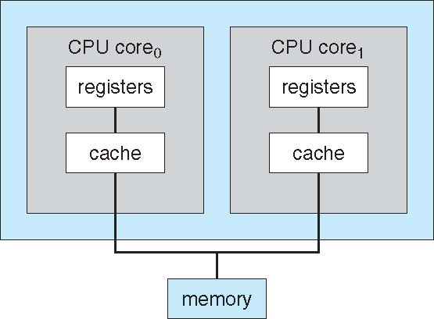
A Dual-Core Design
other designs:
A combination of
local and shared caches
blade servers:
Each blade–processor board
boots independently and
run its own OS.

Slide 57
Clustered Systems
Definition: Cluster computers share storage and are closely linked via a local area network (LAN) or a faster interconnect, such as InfiniBand.
Provides high reliability
Asymmetric clustering: one server runs the application while other servers standby.
Symmetric clustering: two or more hosts are running application and are monitoring each other.

Slide 58
Parallelization and
Distributed Lock Management
Parallelization: divide a program in several components and run in parallel
Parallel clusters
Distributed Lock Management (DLM): To provide the shared access to data, the system must also supply access control and locking to ensure that no conflicting operations occur.

Slide 59
Operating System Components
Timesharing (multitasking) is logical extension in which CPU switches jobs so frequently that users can interact with each job while it is running, creating interactive computing
  Response time should be < 1 second
  Each user has at least one program executing in memory process
  If several jobs ready to run at the same time  CPU scheduling
  If processes don’t fit in memory, swapping moves them in and out to run
  Virtual memory allows execution of processes not completely in memory

Slide 60
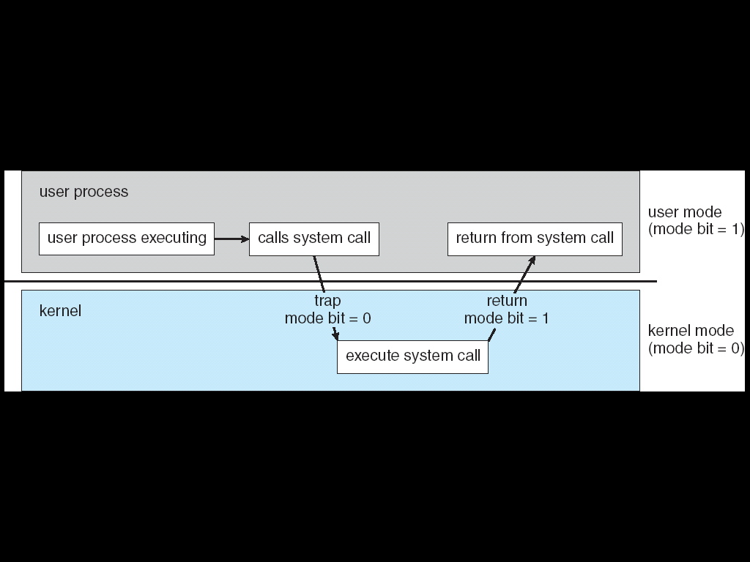
Dual-mode
Dual-mode operation allows OS to protect itself and other system components
  User mode and kernel mode
  Mode bit provided by hardware
    Provides ability to distinguish when system is running user code or kernel code
    Some instructions designated as privileged, only executable in kernel mode
    System call changes mode to kernel, return from call resets it to user

Slide 61
System Structures designer point of view
Simple structure: DOS
Layered approach
Microkernels

Slide 62
MS-DOS Layer Structure
application program
resident system program
MS-DOS
device drivers
ROM BIOS device drivers

Slide 63
System Implementation
Traditionally written in assembly language, operating systems can now be written in higher-level languages.
Code written in a high-level language:
  can be written faster
  is more compact
  is easier to understand and debug
An operating system is far easier to port (move to some other hardware) if it is written in a high-level language.

Slide 64
System Generation (SYSGEN)
Operating systems are designed to run on any of a class of machines; the system must be configured for each specific computer site.
SYSGEN program obtains information concerning the specific configuration of the hardware system.
  CPU type, memory size, devices, OS options, OS parameters, etc.
Booting – starting a computer by loading the kernel.
Bootstrap program – code stored in ROM that is able to locate the kernel, load it into memory, and start its execution.

