Slide 1
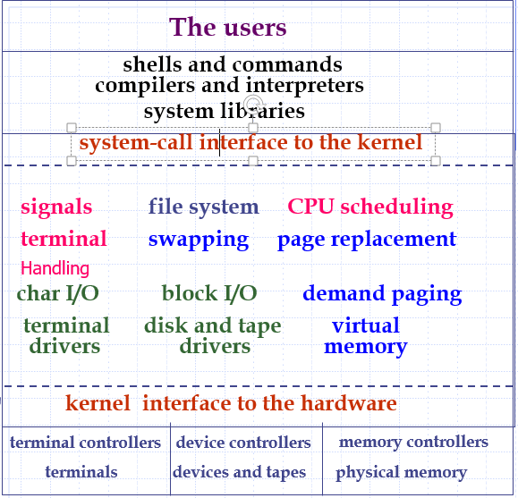
Chapter 1
Introduction

Slide 2
Introduction
What is an Operating System?
Computer-System Organization
Computer-System Architecture (OS0-2018)
Operating-System Operations
Process, Memory, Storage Management
Protection and Security
Kernel Data Structures
Computing Environments
Open-Source Operating Systems

Slide 3
What is an Operating System?
A program that acts as an intermediary between a user of a computer and the computer hardware.
Operating system goals:
  Execute user programs and make solving user problems easier.
  Make the computer system convenient to use.
Use the computer hardware in an efficient manner.

Slide 4
Computer System Structures
1. Hardware – provides basic computing resources (CPU, memory, I/O devices).
2. Operating system – controls and coordinates the use of the hardware among the various application programs for the various users.
3. Applications programs – define the ways in which the system resources are used to solve the computing problems of the users (compilers, database systems, video games, business programs).
4. Users (people, machines, other computers).

Slide 5
Four components of a computer system
User
1
User
2
User
3
User
n
Compiler Assember Text Editor Browser
Application Programs
Operating System
Computer
Hardware

Slide 6
Operating System Definitions
Resource allocator – manages and allocates resources.
Control program – controls the execution of user programs and operations of I/O devices .
No universally accepted definition
Kernel – the one program running at all times (all else being system programs or application programs).

Slide 7
Goals of OS
Primary-- convenience
  make the computer system convenient to use
Secondary-- efficiency
  use the computer hardware in an efficient manner
The two goals are contradictory sometimes
In the past, the secondary goal is more important.

Slide 8
Computer
Original goal: Computing
Problem Solving
Next: Reasoning and Proving, AI
Following: Storage and retrieval, Database
Following: Communication, Networking
Following: Multimedia, Consumer
Following: Internet(WWW), Sharing & Searching
Following: Social Networks (Relationship), Cloud Computing (Utility), AI(Deep Learning), Internet of Things

Slide 9
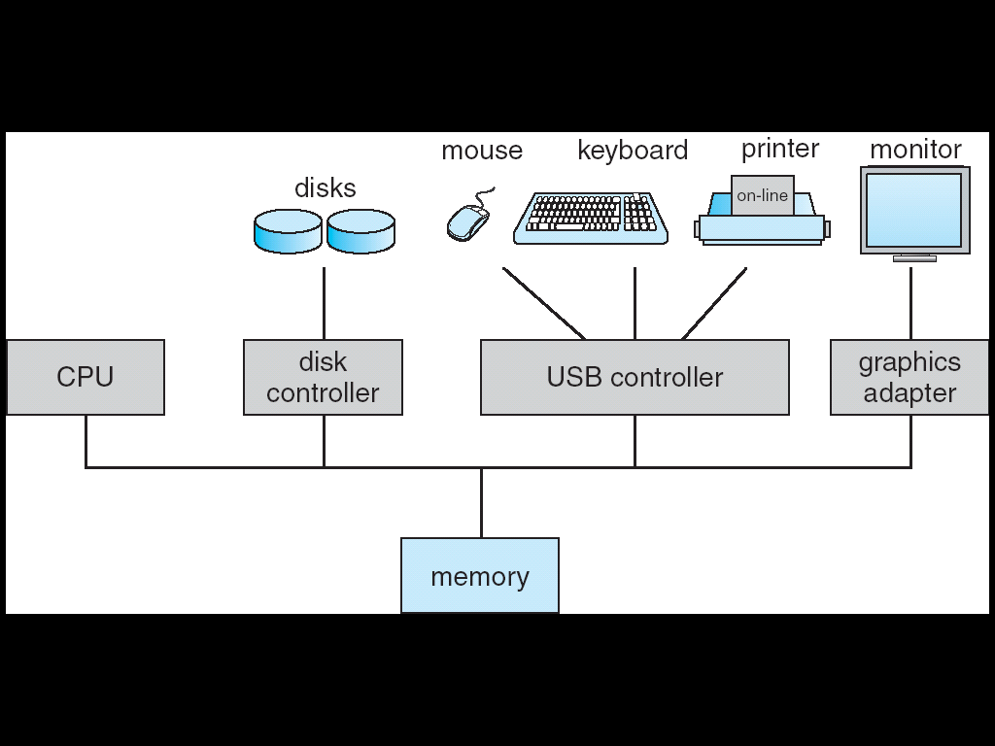
Computer-System Organization
Computer-system operation
  One or more CPUs, device controllers connect through common bus providing access to shared memory
  Concurrent execution of CPUs and devices competing for memory cycles

Slide 10
Computer-System Operation
I/O devices and the CPU can execute concurrently.
Each device controller is in charge of a particular device type.
Each device controller has a local buffer.
CPU moves data from/to main memory to/from local buffers
I/O is from the device to local buffer of controller.
Device controller informs CPU that it has finished its operation by causing an interrupt.

Slide 11
Common Functions of Interrupts
Interrupt transfers control to the interrupt service routine generally, through the interrupt vector, which contains the addresses of all the service routines.
Interrupt architecture must save the address of the interrupted instruction.
Incoming interrupts are disabled while another interrupt is being processed to prevent a lost interrupt.
Nested interrupts 
A trap is a software-generated interrupt caused either by an error or a user request.

Slide 12
resident monitor
1
interrupt
vector
2
i
2
perform the service
routine for device i
service routine
for device i
1
3
return to
user
an interrupt
from device i
occurs
a:=b+c
d:=3*c
user program

Slide 13
resident monitor
case n
1
read
2
perform
I/O
trap to
monitor
system call n
3
return to
user
d:=3*c
user program

Slide 14
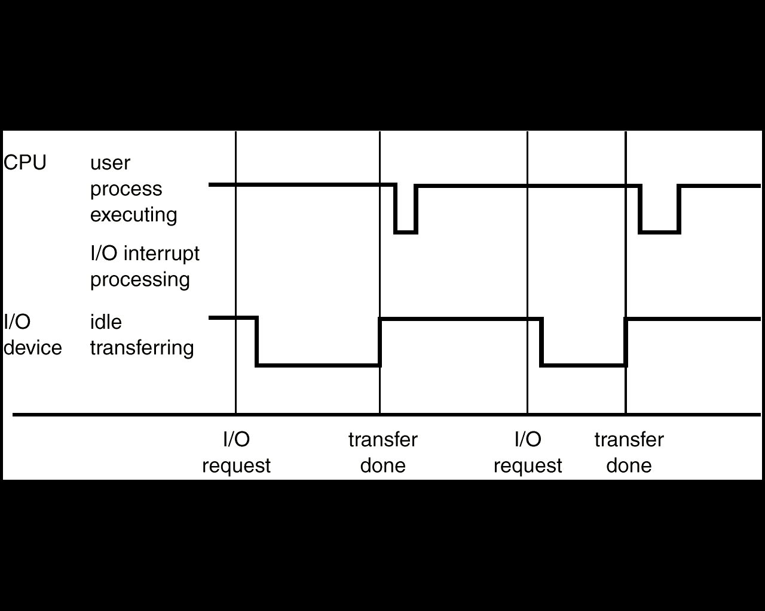
Interrupt Time Line For a Single Process Doing Output

Slide 15
I/O Structure
After I/O starts, control returns to user program only upon I/O completion.
  Wait instruction idles the CPU until the next interrupt
  Wait loop (Loop: jmp Loop)
  At most one I/O request is outstanding at a time, no simultaneous I/O processing.

Slide 16
I/O Structure
After I/O starts, control returns to user program without waiting for I/O completion.
  System call – request to the operating system to allow user to wait for I/O completion.
  Device-status table contains entry for each I/O device indicating its type, address, and state.
  Operating system indexes into I/O device table to determine device status and to modify table entry to include interrupt.

Slide 17
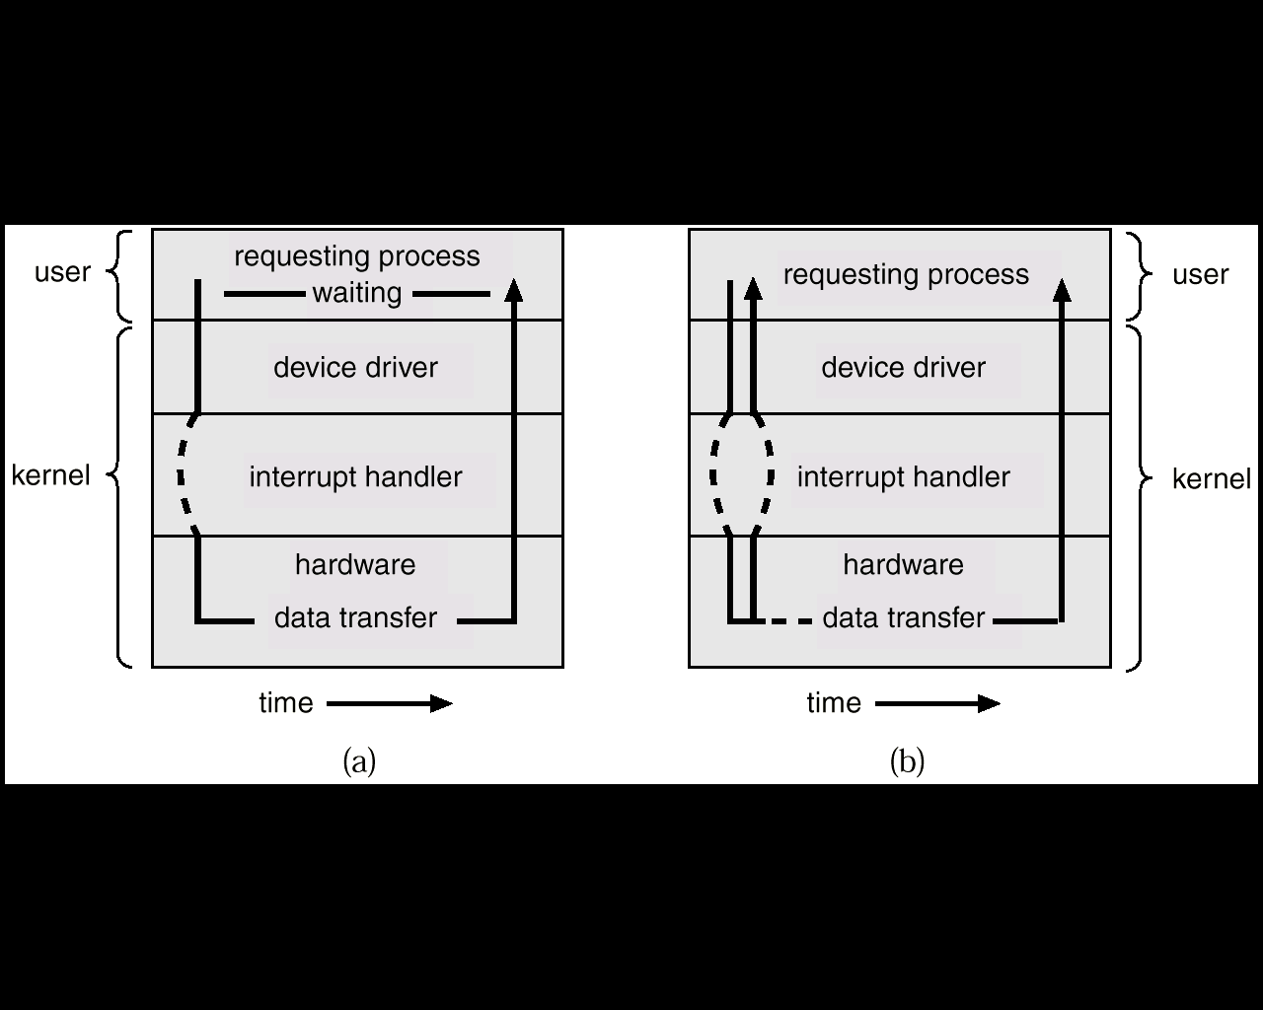
Two I/O Methods
Synchronous
Asynchronous

Slide 18
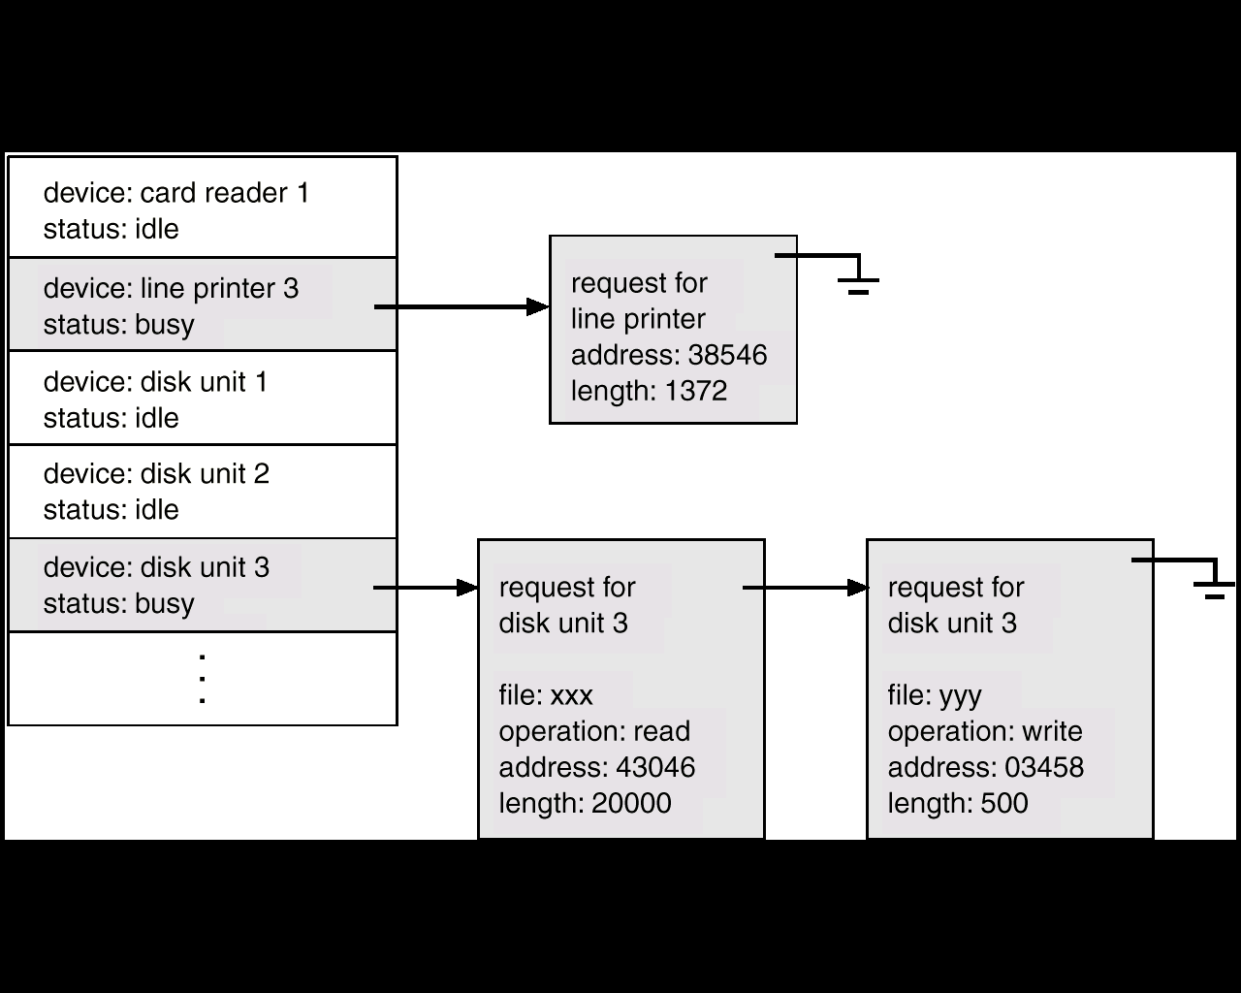
Device-Status Table

Slide 19
Direct Memory Access Structure
Used for high-speed I/O devices able to transmit information at close to memory speeds.
Device controller transfers blocks of data❶ from buffer storage❷ directly to main memory without CPU intervention❸.
Only one interrupt is generated per block, rather than the one interrupt per byte.
Cycle Stealing

Slide 20
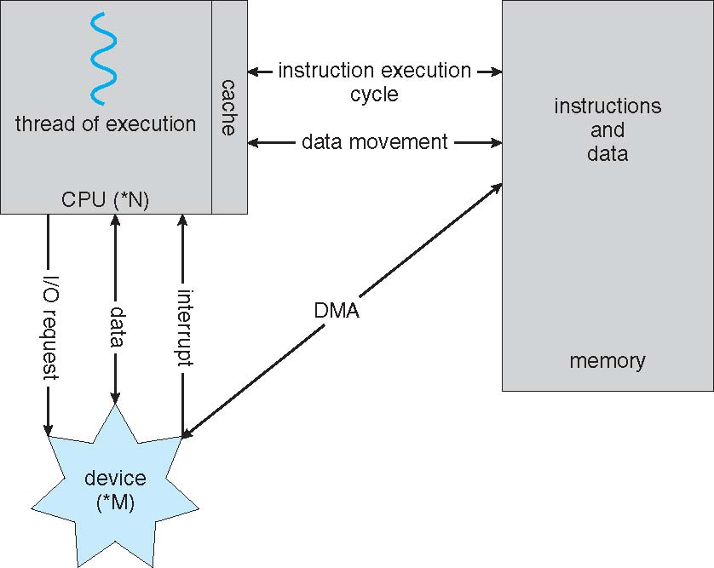
How a Modern Computer Works

Slide 21
Storage Structure
Main memory – only large storage media that the CPU can access directly.
Secondary storage – extension of main memory that provides large nonvolatile storage capacity.
Magnetic disks – rigid metal or glass platters covered with magnetic recording material
  Disk surface is logically divided into tracks, which are subdivided into sectors.
  The disk controller determines the logical interaction between the device and the computer.

Slide 22
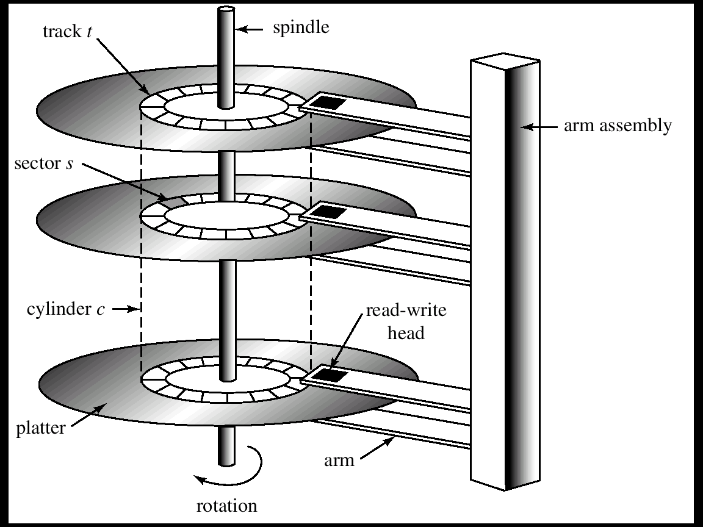
Moving-Head Disk Mechanism

Slide 23
Storage Hierarchy
Storage systems organized in hierarchy.
  Speed
  Cost
  Volatility
Speed of magnetic disk
  transfer rate * size
  positioning time (random access time)
    seek time + rotational latency
Caching – copying information into faster storage system; main memory can be viewed as a last cache for secondary storage.

Slide 24
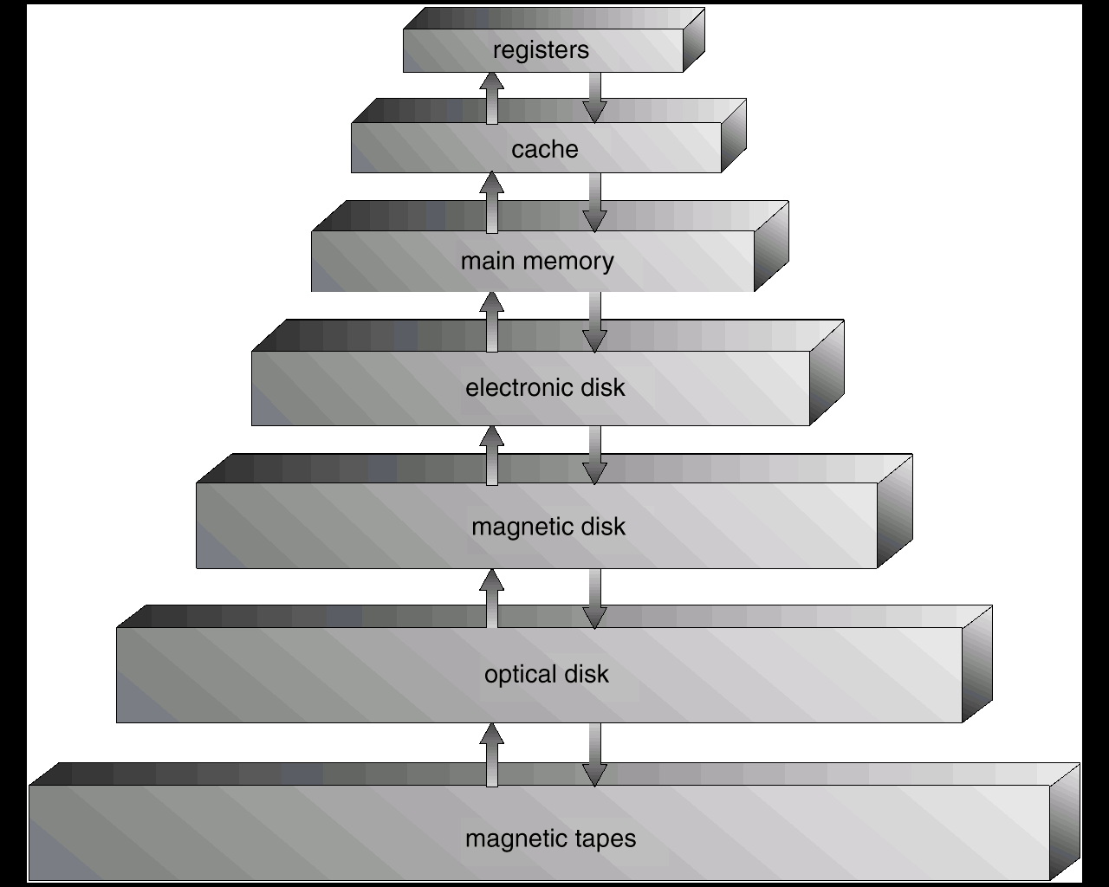
Storage-Device Hierarchy

Slide 25
Caching (1)
Important principle, performed at many levels in a computer (in hardware, operating system, software)
Information in use copied from slower to faster storage temporarily
Faster storage (cache) checked first to determine if information is there
  If it is, information used directly from the cache (fast)
  If not, data copied to cache and used there
Smaller than storage being cached
  Cache management
  Cache size and replacement policy

Slide 26
Caching (2)
Use of high-speed memory to hold recently-accessed data.
Caching introduces another level in storage hierarchy. This requires data that is simultaneously stored in more than one level to be consistent.

Slide 27
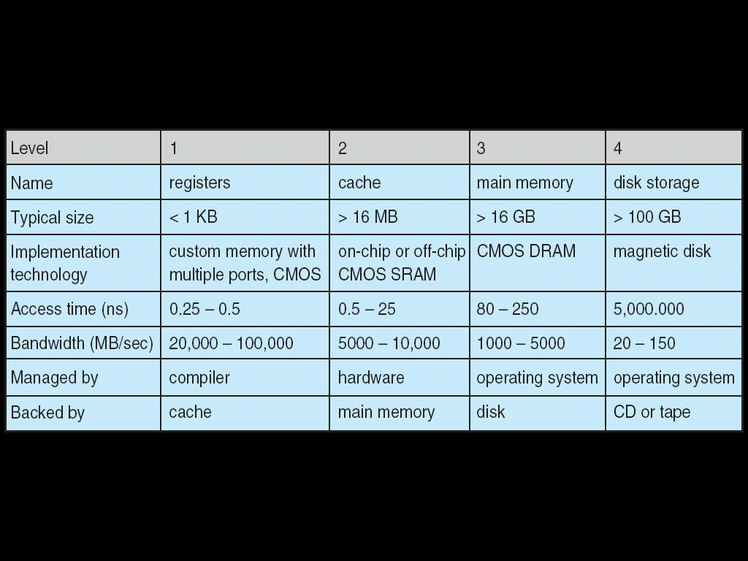
Performance of Various Levels of Storage

Slide 28
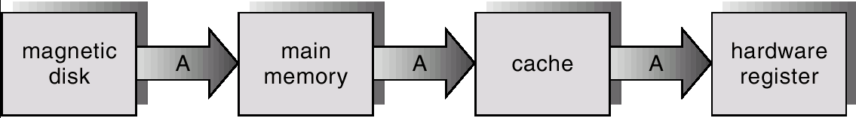
Migration of Integer A from Disk to Register
Multitasking environments must be careful to use most recent value, not matter where it is stored in the storage hierarchy
Multiprocessor environment must provide cache coherency in hardware such that all CPUs have the most recent value in their cache
Distributed environment situation even more complex
  Several copies of a datum can exist
  Various solutions covered in Chapter 16

Slide 29
Coherency and Consistency
In a hierarchical storage system, the same data may appear in different levels.
  Change the copy in register make it inconsistent with other copies
  No problem for single task accessing (Highest level is used)
Multi-task accessing: need to ensure each access obtain the most recent value

Slide 30
Multiprocessor environment
  Each CPU has a local cache.
  Cache coherency problem: make sure that an update to a copy in one cache is immediately reflected in all copies of other caches.
Distributed environment
  Several copies of the same file can be kept on different computers
Cache Coherency Protocols

Slide 31
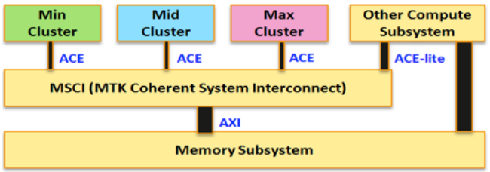
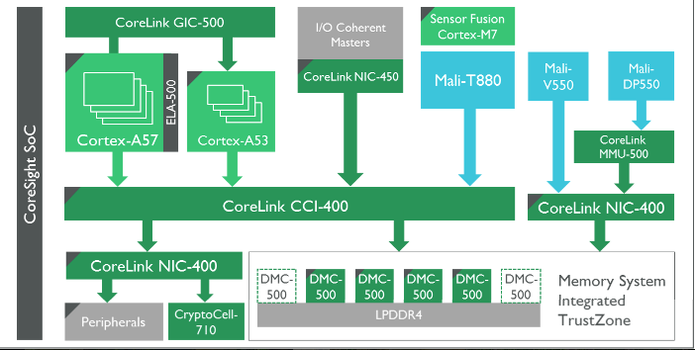
Cache Coherency Protocols

Slide 32
Operating System Components
Timesharing (multitasking) is logical extension in which CPU switches jobs so frequently that users can interact with each job while it is running, creating interactive computing
  Response time should be < 1 second
  Each user has at least one program executing in memory process
  If several jobs ready to run at the same time  CPU scheduling
  If processes don’t fit in memory, swapping moves them in and out to run
  Virtual memory allows execution of processes not completely in memory

Slide 33
Process Management
A process is a program in execution. It is a unit of work within the system. Program is a passive entity, process is an active entity.
Process needs resources to accomplish its task
  CPU, memory, I/O, files
  Initialization data
Single-threaded process has one program counter specifying location of next instruction to execute
  Process executes instructions sequentially, one at a time, until completion
Multi-threaded process has one program counter per thread
Typically system has many processes, some user, some operating system running concurrently on one or more CPUs
  Concurrency by multiplexing the CPUs among the processes / threads

Slide 34
Process Management Activities
The operating system is responsible for the following activities in connection with process management:
  Creating and deleting both user and system processes
  Suspending and resuming processes
  Providing mechanisms for process synchronization
  Providing mechanisms for process communication
  Providing mechanisms for deadlock handling

Slide 35
Memory Management
Memory management determines what is in memory when
  Optimizing CPU utilization and computer response to users
Memory management activities
  Keeping track of which parts of memory are currently being used and by whom
  Deciding which processes (or parts thereof) and data to move into and out of memory
  Allocating and deallocating memory space as needed

Slide 36
Storage Management
OS provides uniform, logical view of information storage
  Abstracts physical properties to logical storage unit - file
  Each medium is controlled by device (i.e., disk drive, tape drive)
    Varying properties include access speed, capacity, data-transfer rate, access method (sequential or random)
File-System management
  Files usually organized into directories
  Access control on most systems to determine who can access what
  OS activities include
    Creating and deleting files and directories
    Primitives to manipulate files and dirs
    Mapping files onto secondary storage
    Backup files onto stable (non-volatile) storage media

Slide 37
Mass-Storage Management
Entire speed of computer operation hinges on disk subsystem and its algorithms
OS activities
  Free-space management
  Storage allocation
  Disk scheduling
Some storage need not be fast
  Tertiary storage includes optical storage, magnetic tape
  Varies between WORM (write-once, read-many-times) and RW (read-write)

Slide 38
I/O Subsystem
One purpose of OS is to hide peculiarities of hardware devices from the user
I/O subsystem responsible for
  Memory management of I/O including
    buffering (storing data temporarily while it is being transferred),
    caching (storing parts of data in faster storage for performance),
    spooling (the overlapping of output of one job with input of other jobs)
  General device-driver interface
  Drivers for specific hardware devices

Slide 39
Protection and Security
Protection – the mechanism for controlling access
Security – the defense of the system against internal and external attacks
Systems generally first distinguish among users, to determine who can do what
  User identities (user IDs, security IDs) include name and associated number, one per user
  User ID then associated with all files, processes of that user to determine access control
  Group identifier (group ID) allows set of users to be defined and controls managed, then also associated with each process, file
  Privilege escalation allows user to change to effective ID with more rights, such as setuid

Slide 40
Kernel Data Structures
Many similar to standard programming data structures
Singly linked list
Doubly linked list
Circular linked list

Slide 41
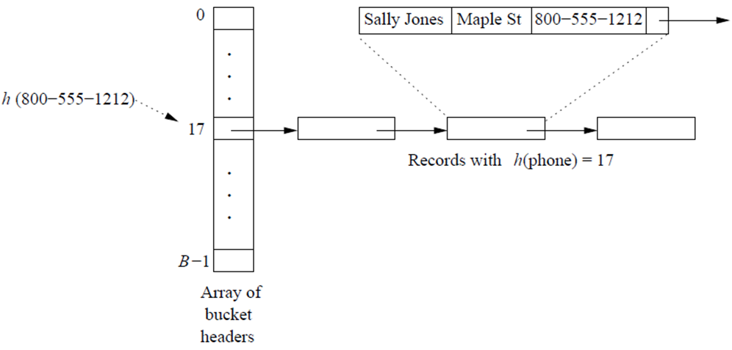
Kernel Data Structures
Balanced binary search tree: O(lg n)
  Linux uses a balanced binary search tree as part its CPU-scheduling algorithm
Hash function: takes data as its input, performs a numeric operation on this data, and returns a numeric value.
  This numeric value can then be used as an index into a table (typically an array) to quickly retrieve the data.
  hash collision: a linked list at that table location that contains all of the items with the same hash value.

Slide 42
Kernel Data Structures
  hash map: associates (or maps) [key: value] pairs using a hash function. Once the mapping is established, we can apply the hash function to the key to obtain the value from the hash map.
  For example, [user name: password]
Bitmaps
  For example, disk blocks. A bitmap can be used to indicate the availability of each disk block.

Slide 43
Computing Environments
Traditional Computing
Mobile Computing
Distributed Systems
Client-Server Computing
Peer-to-Peer Computing
Virtualization
Cloud Computing
Real-Time Embedded Systems

Slide 44
Traditional Computing
Office environment
  Web-based computing: network computers (or thin clients) are used in place of traditional workstations where more security or easier maintenance is desired.
  Mobile computers can synchronize with PCs to allow very portable use of company information.
Home networks
  Networking becoming ubiquitous - even home systems use firewalls to protect home computers from Internet attacks.
Time-sharing systems
Bring your own device (BYOD)

Slide 45
Mobile Computing
Handheld smartphones, tablets, etc.
  Extra feature - more OS features (GPS, gyroscope)
  Allows new types of apps like augmented reality, which overlay information on a display of the current environment.
Use IEEE 802.11 wireless, or cellular data networks (4G, 5G?) for connectivity
Leaders are Apple iOS and Google Android

Slide 46
Distributed Systems
Distributed computing
  Collection of separate, possibly heterogeneous, systems networked together with TCP/IP, FTP, NFS, etc.
  Local Area Network (LAN), Wide Area Network (WAN), Metropolitan Area Network (MAN), Personal Area Network (PAN)
Network Operating System provides features between systems across network
  file sharing across the network, communication scheme that allows different processes on different computers to exchange messages
  Illusion of a single system

Slide 47
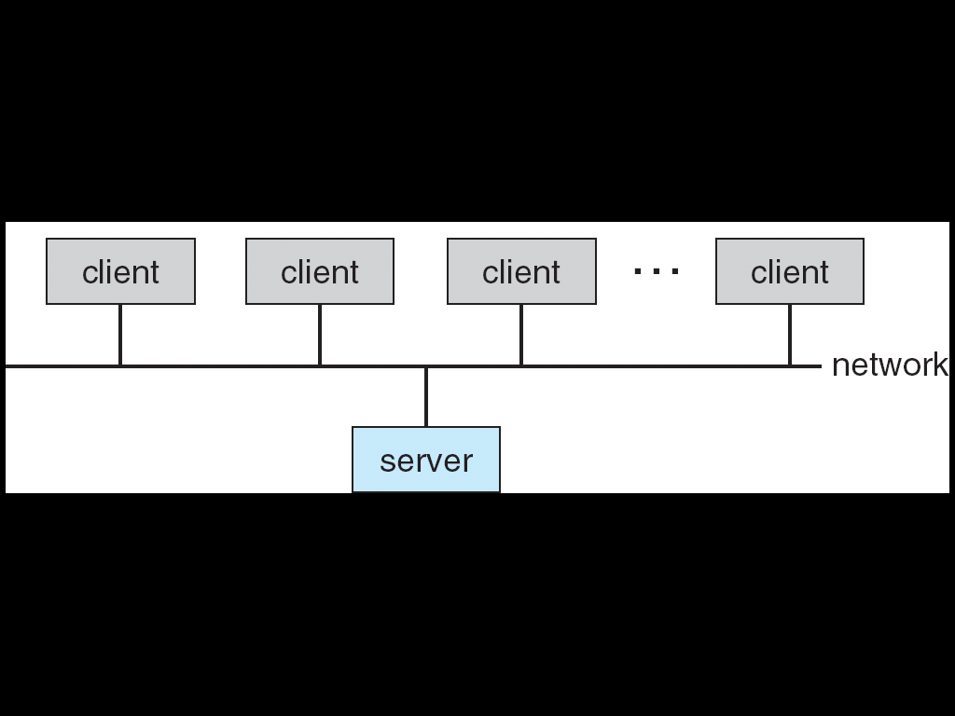
Client-Server Computing
Many systems now servers, responding to requests generated by clients
  Compute-server provides an interface to client to request services
  File-server provides interface for clients to store and retrieve files

Slide 48
Peer-to-Peer Computing
Another model of distributed systems
P2P does not distinguish clients and servers
  Instead all nodes are considered peers, may each act as client, server or both
  Node must join P2P networks
    Registers its service with central lookup service on network, or
    Broadcast request for service and respond to requests for service via discovery protocol
  Napster and Gnutella. Skype is another example.

Slide 49
Virtualization
Virtualization is a technology that allows operating systems to run as applications within other operating systems.
  one member of a class of software that includes emulation. Emulation is used when the source CPU type is different from the target CPU type.
  For example, when Apple switched from the IBM Power CPU to the Intel x86, it included an emulation facility called “Rosetta,” which allowed applications compiled for the IBM CPU to run on the Intel CPU.

Slide 50
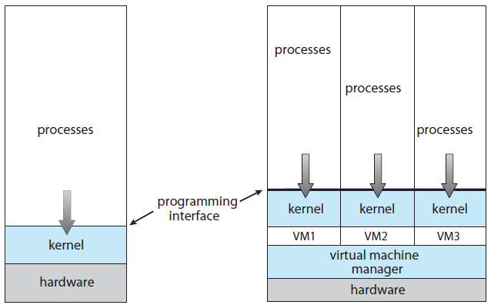
Virtualization
Virtualization first came about on IBM mainframes as a method for multiple users to run tasks concurrently.
Later, in response to problems with running multiple Microsoft Windows XP applications on the Intel x86 CPU, VMware created a new virtualization technology in the form of an application that ran on XP.
  That application ran one or more guest copies of Windows or other native x86 operating systems, each running its own applications.

Slide 51
Cloud Computing
A type of computing that delivers computing, storage, even apps as a service across a network.
Uses virtualization as the base for it functionality.
  E.g., Amazon Elastic Compute Cloud (EC2)
Public cloud – available via Internet to anyone willing to pay
Private cloud – run by a company for the company's own use
Hybrid cloud – includes both public and private cloud components
Software as a Service (SaaS) – one or more applications available via the Internet (i.e., word processor)
Platform as a Service (PaaS) – software stack ready for application use via the Internet (i.e., a database server)
Infrastructure as a Service (IaaS) – servers or storage available over Internet (i.e., storage available for backup use)

Slide 52
Cloud Computing
Cloud computing environments composed of traditional OS + VMMs + Cloud management tools (e.g., Vware vCloud Director, Eucalyptus)
  Internet connectivity requires security like firewalls
  Load balancers spread traffic across multiple applications

Slide 53
Software Stack for Cloud OS
Cloud Application Management Tool
Hypervisor (VMM)
Xen, Cambridge 2003
Virtual Cluster Provisioning
Network/System
Management
Physical
Cluster
Deployment
Tool
Physical Compute Servers
Security
Distributed Main/Secondary Storage
All-layer-2 Network
Intra-Virtual-Cluster
Load Balancing
Power
Management
Virtual Machine Management

Slide 54


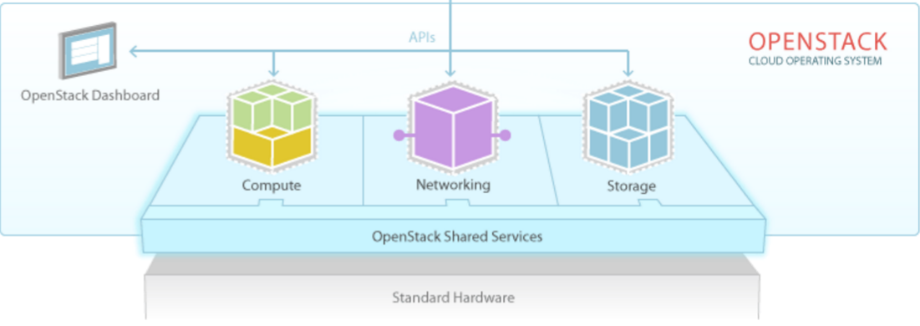
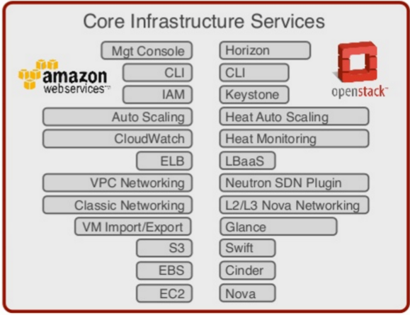
OpenStack

Slide 55
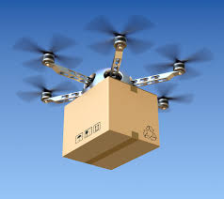
Real-Time Embedded Systems
Embedded computers are the most prevalent form of computers in existence. These devices are found everywhere, from car engines and manufacturing robots to Unmanned aerial vehicle (UAV, Drone) and microwave ovens.
Embedded systems almost always run real-time operating systems.
A real-time system is used when rigid time requirements have been placed on the operation of a processor or the flow of data; thus, it is often used as a control device in a dedicated application.

Slide 56
Real-Time Embedded Systems
Sensors bring data to the computer. The computer must analyze the data and possibly adjust controls to modify the sensor inputs.
A real-time system has well-defined, fixed time constraints. Processing must be done within the defined constraints, or the system will fail.
Real-time systems may be either hard or soft real-time.

Slide 57
Real-Time Embedded Systems
Hard real-time
  Guarantees that the critical tasks complete on time.
  Secondary storage limited or absent, data stored in short term memory, or read-only memory (ROM)
  Conflicts with time-sharing systems, not supported by general-purpose operating systems.
Soft real-time
  A critical real-time task gets priority over other tasks, and retains that priority until it completes.
  Kernel delays need to be bounded; Limited utility in industrial control of robotics.

Slide 58
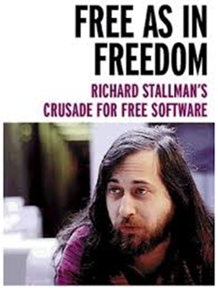

Open-Source Operating Systems
available in source-code rather than just binary closed-source
Learning OS by examining the actual source code, rather than reading summaries of that code, can be extremely useful. (modify → compile → run)
Benefits: community of interested programmers contribute to the code: debug, analyze, support, and suggest changes.
  More secure than closed-source codes (?)
  Version control and services: Red Hat, etc.
  Low cost

Slide 59
Open-Source Operating Systems
Counter to the copy protection and Digital Rights Management (DRM) movement
Free Software Foundation (FSF), which has ″copyleft″ GNU Public License (GPL)
Examples: GNU/Linux, BSD UNIX (including core of Mac OS X), and Sun Solaris
Can use VMM like VMware Player (Free on Windows), Virtualbox (open source and free on many platforms - http://www.virtualbox.com)

Slide 60

GitHub
The largest open source community in the world, https://github.com/
Git: version control system that is used for software development
  created by Linus Torvalds in 2005 for development of the Linux kernel.

Slide 61
EX 1.6
Which of the following instructions should be privileged?
  a. Set value of timer.
  b. Read the clock.
  c. Clear memory.
  d. Issue a trap instruction.
  e. Turn off interrupts.
  f. Modify entries in device-status table.
  g. Switch from user to kernel mode.
  h. Access I/O device.

Slide 62
EX 18.2
In Linux, threads are implemented within the kernel by a clone mechanism that creates a new process within the same virtual address space as the parent process. Unlike some kernel-based thread packages, the Linux kernel does not make any distinction between threads and processes: a thread is simply a process that did not create a new virtual address space when it was initialized.
The main advantage of implementing threads in the kernel rather than in a user-mode library are that:
  kernel-threaded systems can take advantage of multiple processors if they are available; and
  if one thread blocks in a kernel service routine (for example, a system call or page fault), other threads are still able to run.

Slide 63
EX 18.4
Discuss advantages of dynamic (shared) linkage of libraries compared with static linkage.
Reduce the memory and disk space used by a system
Enhance maintainability: upgrading (either to add new functionality or to fix bugs) can be done simply by replacing that shared library. There is no need to recompile or relink any applications.

