Slide 1
Chapter 2
Operating-System Structures

Slide 2
Outlines
Operating System Services
User Operating System Interface
System Calls
System Programs
Operating System Design and Implementation
Operating System Structure
Virtual Machines
Hardware Protection

Slide 3
Objectives
To describe the services an operating system provides to users, processes, and other systems
To discuss the various ways of structuring an operating system
To explain how operating systems are installed and customized and how they boot (OS0-2016)

Slide 4
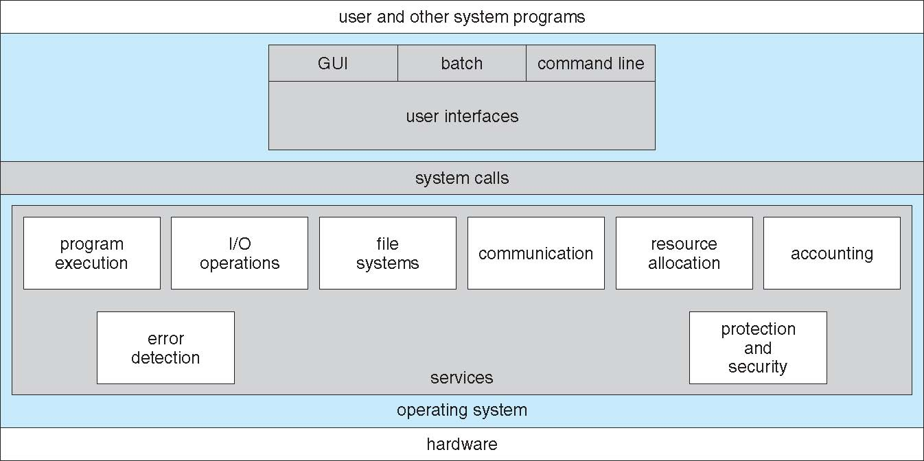
Operating System Services (1)

Slide 5
Operating System Services (2)
User interface - Almost all operating systems have a user interface (UI)
  Varies between Command-Line (CLI), Graphics User Interface (GUI), Batch
Program execution – system capability to load a program into memory and to run it, end execution, either normally or abnormally (indicating error).
I/O operations – since user programs cannot execute I/O operations directly, the operating system must provide some means to perform I/O.
File-system manipulation –programs need to read and write files and directories, create and delete them, search them, list file Information, permission management.

Slide 6
Operating System Services (3)
Communications – exchange of information between processes executing either on the same computer or on different systems tied together by a network. Communications via shared memory or message passing.
Error detection – OS needs to be constantly aware of possible errors
  May occur in the CPU and memory hardware, in I/O devices, in user program
  For each type of error, OS should take the appropriate action to ensure correct and consistent computing
  Debugging facilities can greatly enhance the user’s and programmer’s abilities to efficiently use the system

Slide 7
Additional Operating System Functions
Another set of OS functions exists for ensuring the efficient operation of the system itself via resource sharing
  Resource allocation – When multiple users or multiple jobs running concurrently, resources must be allocated to each of them
  Accounting – keep track of and record which users use how much and what kinds of computer resources for account billing or for accumulating usage statistics.
  Protection and Security
    Protection – ensuring that all access to system resources is controlled.
    Security of the system from outsiders requires user authentication, extends to defending external I/O devices from invalid access attempts

Slide 8
User OS Interface – CLI (1)
CLI allows direct command entry
Sometimes implemented in kernel, sometimes by systems program
Sometimes multiple flavors implemented – shells
Fetches a command from user and executes it
  Sometimes commands built-in,
  sometimes just names of programs
    - adding new features doesn’t require shell modification

Slide 9
User OS Interface – GUI (2)
User-friendly desktop metaphor interface
  Usually mouse, keyboard, and monitor
  Icons represent files, programs, actions, etc
  Various mouse buttons over objects in the interface cause various actions (provide information, options, execute function, open directory (known as a folder)
  Invented at Xerox PARC

Slide 10
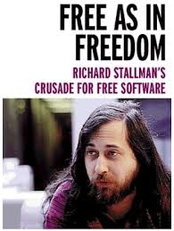
User OS Interface – GUI (3)
Many systems now include both CLI and GUI interfaces
  Microsoft Windows is GUI with CLI “command” shell
  Apple Mac OS X as “Aqua” GUI interface with UNIX kernel underneath and shells available.
  Unix and Linux have CLI with optional GUI interfaces CDE, LDE, GNOME (GNU Network Object Model Environment)
Touch Panel, Multi-finger, Voice and Gesture controls, Force Touch, …
2018/3/5
10
Notes:
10

Slide 11
Touchscreen and Voice
Touch screen devices require new interfaces
  Mouse not possible or not desired
  Actions and selection based on gestures
  Virtual keyboard for text entry
  Force touch: pressure sensitive multi-touch
Voice secretary
  Apple Siri, Microsoft Cortana, Google Now, Amazon Alexa, Facebook M, …
2018/3/5
11
Notes:
11

Slide 12
System Calls
System calls provide the interface between a running program and the operating system
  Available as assembly-language instructions initially
  Languages defined to replace assembly language for systems programming allow system calls to be made directly (e.g., C, C++)
  Mostly accessed by programs via a high-level Application Programming Interface (API) rather than direct system call use.
  Win32 , POSIX, Java

Slide 13
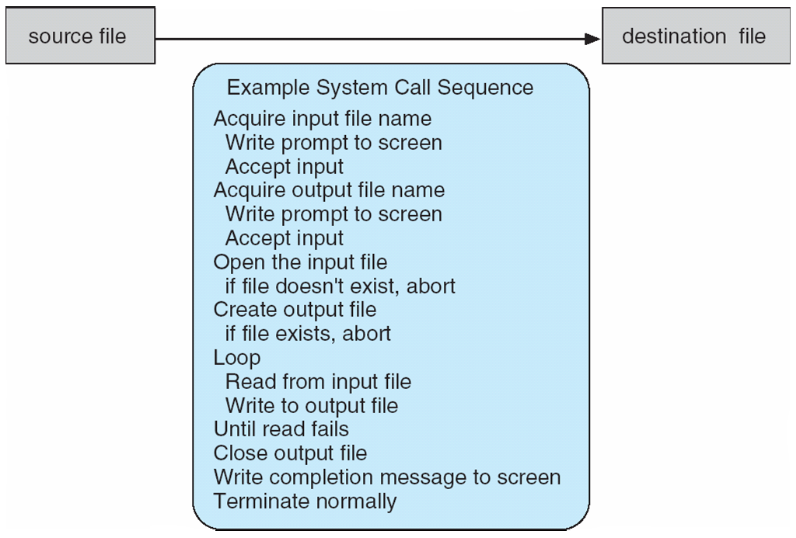
An Example of System Calls
Copy the contents of one file to another file

Slide 14
System Call Implementation
Typically, a number associated with each system call
  System-call interface maintains a table indexed according to these numbers
The interface invokes the intended system call and returns status and any return values
The caller need know nothing about how the system call is implemented
  Most details of OS interface hidden from programmer by API
  Managed by run-time support library
2018/3/5
14
Notes:
14

Slide 15
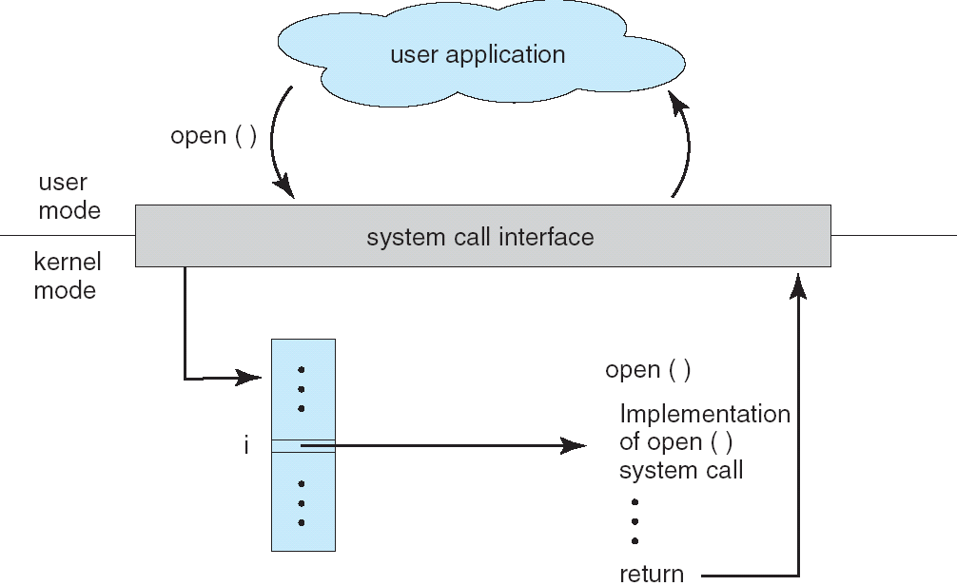
API – System Call – OS Relationship

Slide 16
System Calls – Parameter Passing
Three general methods are used to pass parameters between a running program and the operating system.
  Pass parameters in registers
  Store the parameters in a block, or table in memory, and the table address is passed as a parameter in a register
  Push (store) the parameters onto the stack by the program, and pop off the stack by operating system
  Block and stack methods do not limit the number or length of parameters being passed
2018/3/5
16
Notes:
16

Slide 17
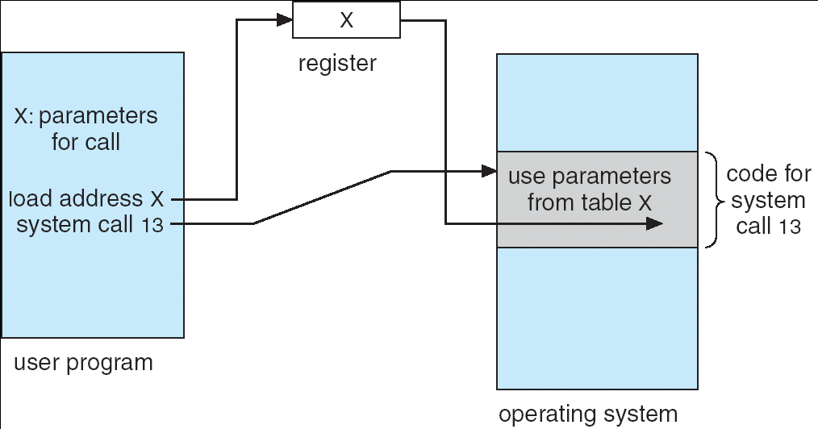
Parameter Passing via Table

Slide 18
Types of System Calls
Process control
File management
Device management
Information maintenance
Communications
Protection

Slide 19
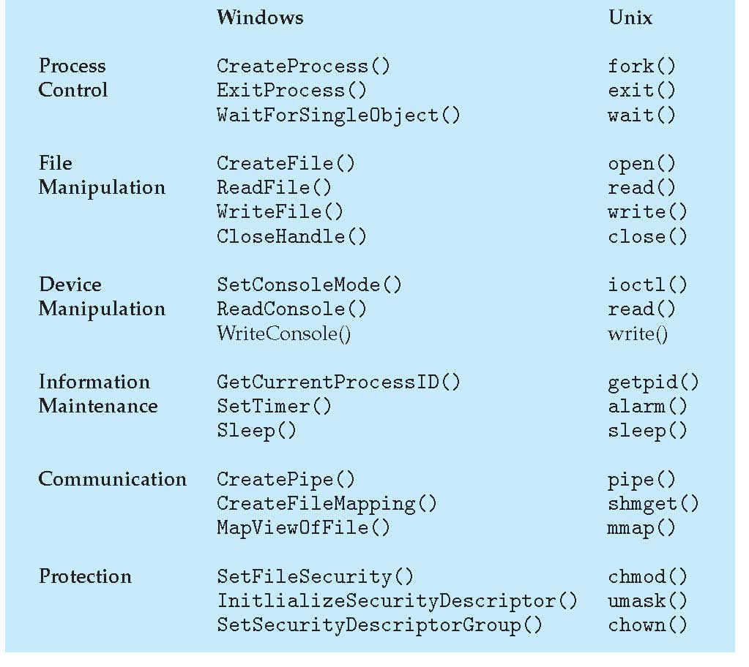
Examples: Windows and Unix System Calls

Slide 20
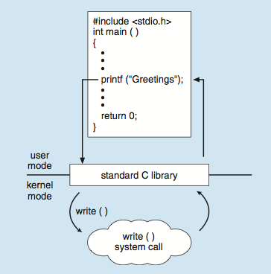
Standard C Library Example
C program invoking printf() library call, which calls write() system call
2018/3/5
20

Slide 21
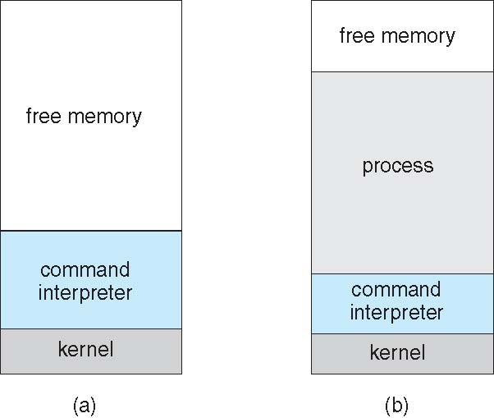
Example: MS-DOS
Single-tasking
Shell invoked when system booted
Simple method to run program
  No process created
Single memory space
Loads program into memory, overwriting all but the kernel
Program exit -> shell reloaded
system startup running a program
2018/3/5
21

Slide 22
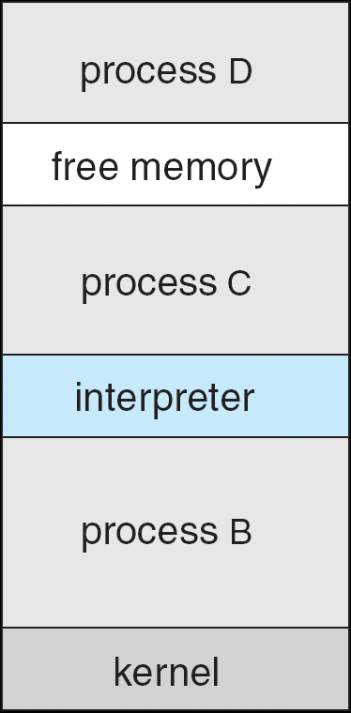
Example: FreeBSD
Unix variant
Multitasking
User login -> invoke user′s choice of shell
Shell executes fork() system call to create process
  Executes exec() to load program into process
  Shell waits for process to terminate or continues with user commands
Process exits with:
  code = 0 – no error
  code > 0 – error code
2018/3/5
22

Slide 23
Status information
  Some ask the system for info - date, time, amount of available memory, disk space, number of users
  Others provide detailed performance, logging, and debugging information
  Typically, these programs format and print the output to the terminal or other output devices
  Some systems implement a registry - used to store and retrieve configuration information

Slide 24
Background Services
  Launch at boot time
    Some for system startup, then terminate
    Some from system boot to shutdown
  Provide facilities like disk checking, process scheduling, error logging, printing
  Run in user context not kernel context
  Known as services, subsystems, daemons

Slide 25
System Programs
File modification
  Text editors to create and modify files
  Special commands to search contents of files or perform transformations of the text
Programming-language support - Compilers, assemblers, debuggers and interpreters sometimes provided
Program loading and execution- Absolute loaders, relocatable loaders, linkage editors, and overlay-loaders, debugging systems for higher-level and machine language

Slide 26
System Programs
Communications - Provide the mechanism for creating virtual connections among processes, users, and computer systems
  Allow users to send messages to one another’s screens, browse web pages, send electronic-mail messages, log in remotely, transfer files from one machine to another

Slide 27
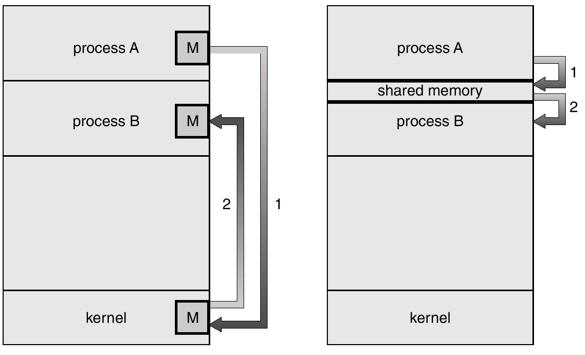
Communication Models
Communication may take place using either message passing or shared memory.
Msg Passing
Shared Memory

Slide 28
Design
Design and Implementation of OS not “solvable”, but some approaches have proven successful
Internal structure of different Operating Systems can vary widely
Start by defining goals and specifications
Affected by choice of hardware, type of system

Slide 29
Design
User goals and System goals
  User goals – operating system should be convenient to use, easy to learn, reliable, safe, and fast
  System goals – operating system should be easy to design, implement, and maintain, as well as flexible, reliable, error-free, and efficient
2018/3/5
29
Notes:
29

Slide 30
Mechanisms and Policies
Mechanism: determine how to do something, e.g., protect CPU using timer.
Policy: decide what will be done, e.g., CPU should be protected or not?
The separation of policy from mechanism is a very important principle, it allows maximum flexibility if policy decisions are to be changed later.
Specifying and designing an OS is highly creative task of software engineering

Slide 31
Operating System Structure
General-purpose OS is very large program
Various ways to structure ones
  Simple structure – MS-DOS
  More complex - UNIX
  Layered - an abstraction
  Microkernel - Mach

Slide 32
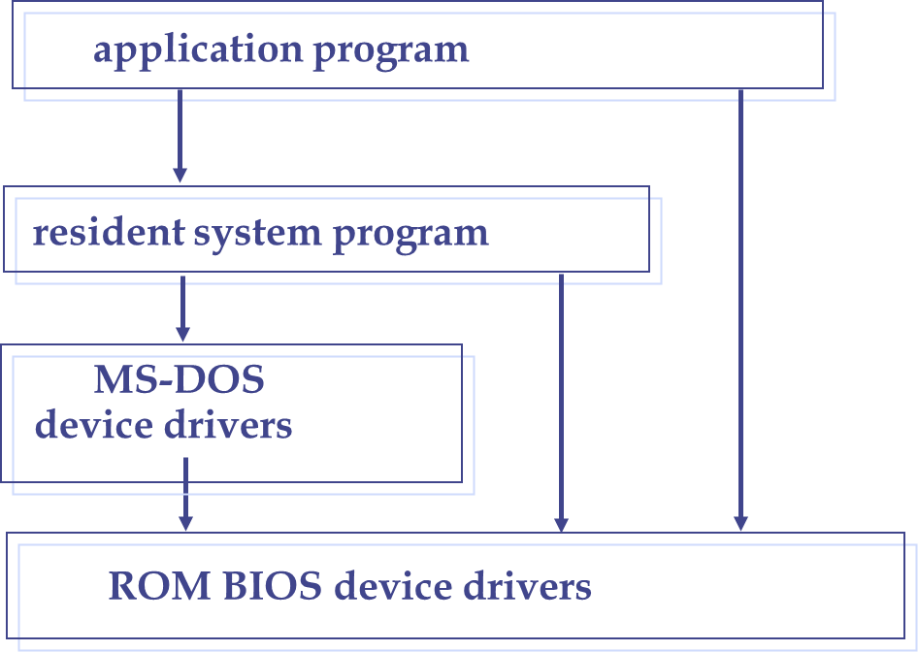
Simple Structure -- MS-DOS
MS-DOS – written to provide the most functionality in the least space
  Not divided into modules
  Although MS-DOS has some structure, its interfaces and levels of functionality are not well separated

Slide 33
Non Simple Structure -- UNIX
Limited by hardware functionality, the original UNIX operating system had limited structuring. The UNIX OS consists of two separable parts
  Systems programs
  The kernel
  Consists of everything below the system-call interface and above the physical hardware
  Provides the file system, CPU scheduling, memory management, and other operating-system functions; a large number of functions for one level

Slide 34
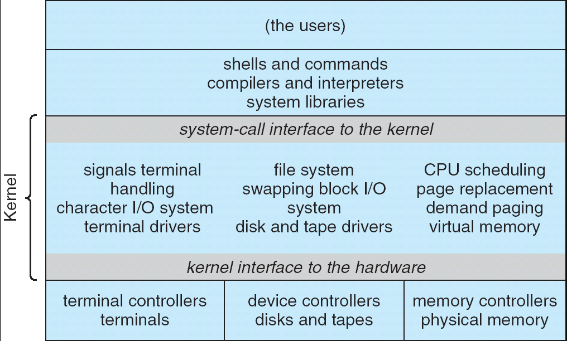
UNIX System Structure

Slide 35
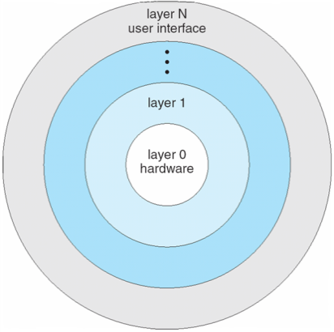
Layered Approach
The operating system is divided into a number of layers (levels), each built on top of lower layers. The bottom layer (layer 0), is the hardware; the highest (layer N) is the user interface.
With modularity, layers are selected such that each uses functions (operations) and services of only lower-level layers.
If an error is found during the debugging of a particular layer, the error must be on that layer, because the layers below it are already debugged.
Problems: definition of the layers, less efficient

Slide 36
Microkernel System Structure
Moves as much from the kernel into user space
Communication takes place between user modules using message passing
Benefits
  Easier to extend a microkernel
  Easier to port the operating system to new architectures
  More reliable (less code is running in kernel mode)
  More secure
Detriments
  Performance overhead of user space to kernel space communication

Slide 37
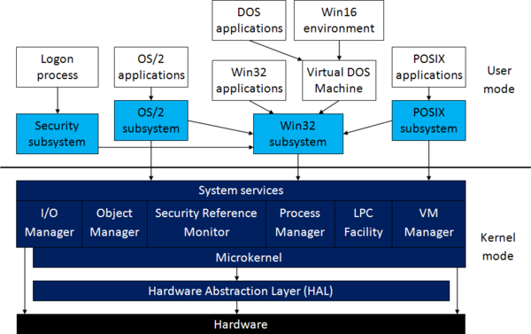
Microkernel System Structure
The performance of the original version was low compared with that of Windows 95 (monolithic).

Slide 38
Modules
Most modern operating systems implement kernel modules
  Uses object-oriented approach
  Each core component is separate
  Each talks to the others over known interfaces
  Each is loadable as needed within the kernel
Overall, similar to layers but with more flexible
  Linux, Solaris, etc

Slide 39
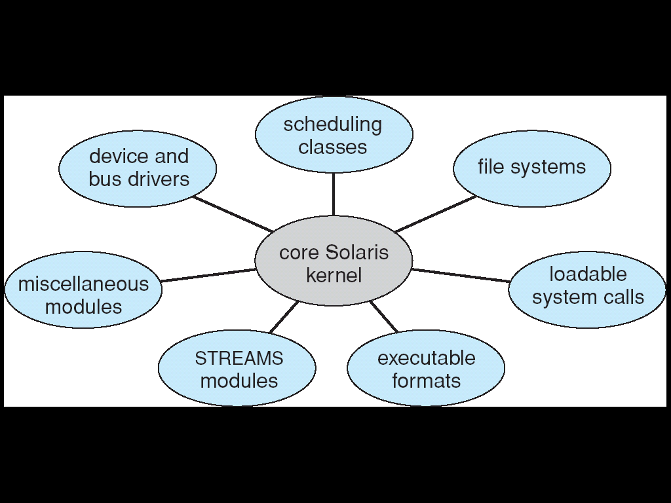
Solaris Modular Approach

Slide 40
Hybrid Systems
Not one pure model
  Hybrid combines multiple approaches to address performance, security, usability needs
  Linux and Solaris kernels in kernel address space, so monolithic, plus modular for dynamic loading of functionality
  Windows mostly monolithic, plus microkernel for different subsystem personalities
Apple Mac OS X hybrid, layered, Aqua UI + Cocoa programming environment

Slide 41
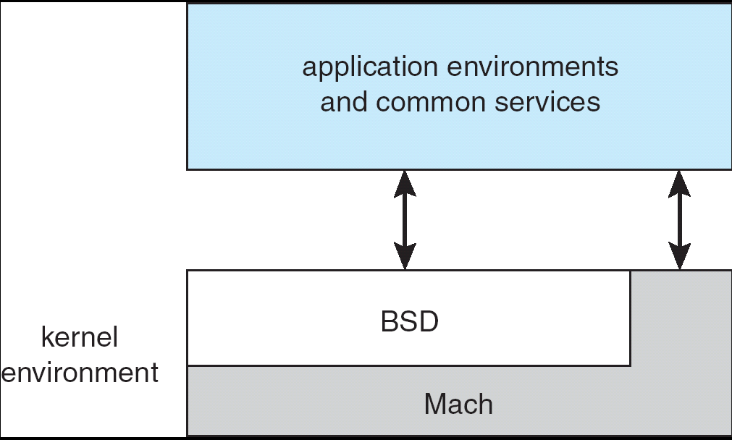
Mac OS X Structure, hybrid structured
I/O kit for device drivers
Dynamically loadable modules
BSD CLI, networking,
file systems,
POSIX APIs
MM, RPCs, IPC,
thread scheduling
Message passing
Mach microkernel + BSD Unix parts + I/O kit + dynamically loadable modules (called kernel extensions)

Slide 42
iOS
Apple mobile OS for iPhone, iPad
  Structured on Mac OS X, added functionality
  Does not run OS X applications natively (directly)
    Also runs on different CPU architecture (ARM vs. Intel)
  Cocoa Touch Objective-C API for developing apps
  Media services layer for graphics, audio, video
  Core services provides cloud computing, databases
  Core operating system, based on Mac OS X kernel

Slide 43

Android
Open Source: Developed by Open Handset Alliance (mostly Google)
Similar stack to IOS
Based on Linux kernel but modified
  Provides process, memory, device-driver management
  Adds power management
Runtime environment includes core set of libraries and Dalvik virtual machine
  Apps developed in Java, running in Dalvik VM
Libraries: web browser (webkit), database (SQLite), multimedia, smaller libc

Slide 44
Android Architecture

Slide 45
Operating-System Debugging
OS generates log files containing error information
Failure of an application can generate core dump file capturing memory of the process
Operating system failure can generate crash dump file containing kernel memory
Beyond crashes, performance tuning can optimize system performance
  Sometimes using trace listings of activities, recorded for analysis
  Profiling is periodic sampling of instruction pointer to look for statistical trends
Kernighan’s Law: Debugging is twice as hard as writing the code in the first place. Therefore, if you write the code as cleverly as possible, you are, by definition, not smart enough to debug it.
2018/3/5
45

Slide 46
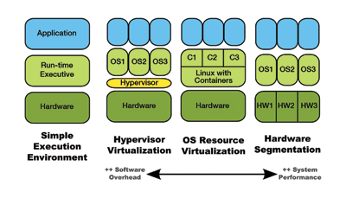
Simulation and Virtualization
Simulation: the host system has one system architecture and the guest system was complied for a different architecture.
  The programs (such as important programs that were compiled for the old system) could be run in an emulator that translates each of the outdated system’s instructions into the current instruction set. (disadv.: 10 times slow usually)
Virtualization
2018/3/5
46
Notes:
46

Slide 47
Virtual Machines
A virtual machine takes the layered approach to its logical conclusion
  It treats hardware and the operating system kernel as though they were all hardware
A virtual machine provides an interface identical to the underlying bare hardware
The operating system creates the illusion of multiple processes, each executing on its own processor with its own (virtual) memory

Slide 48
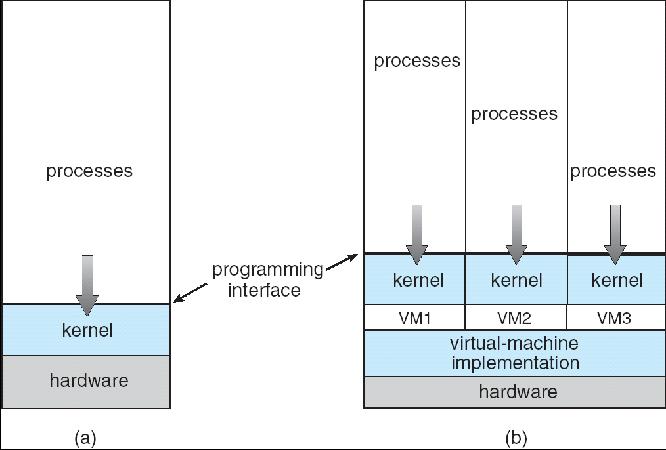
Virtual Machines
Non-virtual Machine
Virtual Machine

Slide 49
Virtual Machines
CPU scheduling, Virtual memory, Virtual Disk, …
The resources of the physical computer are shared to create the virtual machines.
  CPU scheduling can create the appearance that users have their own processor
  Spooling and a file system can provide virtual card readers and virtual line printers
  A normal user time-sharing terminal serves as the virtual machine operator’s console

Slide 50
Hypervisor, Type I and II
Hypervisor (virtual machine manager, VMM): is one of many hardware virtualization techniques that allow multiple operating systems (guests) to run concurrently on a host computer. It was first used in 1965 (IBM 360).
Classification
  Type I: run directly on the host's hardware to control the hardware and to manage guest operating systems.
  Type II: run within a conventional operating system environment. With the hypervisor layer as a distinct second software level, guest operating systems run at the third level above the hardware.
2018/3/5
50
Notes:
50

Slide 51
Advantages/Disadvantages of VM
The virtual-machine concept provides complete protection of system resources since each virtual machine is isolated from all other virtual machines. This isolation, however, permits no direct sharing of resources
A virtual-machine system is a perfect vehicle for operating-systems research and development. System development is done on the virtual machine, instead of on a physical machine and so does not disrupt normal system operation
The virtual machine concept is difficult to implement due to the effort required to provide an exact duplicate to the underlying machine
2018/3/5
51
Notes:
51

Slide 52
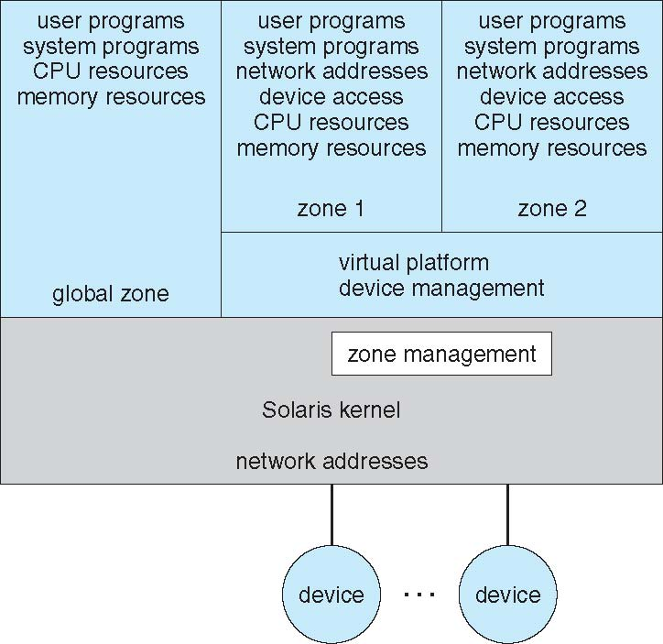
Para-virtualization
Presents guest with system similar but not identical to the guest’s preferred systems. Guest must be modified to run on para-virtualized hardware.
Solaris 10: creates a virtual layer between OS and the applications.
In this system, only one kernel is installed, and the hardware is not virtualized, rather, OS and its devices are virtualized, providing processes within a containers (zones) with the impression that they are the only processes on this system.
Xen (Cambridge 2003): a hypervisor using a microkernel design, under Linux runs on x86. Open source -> Citrix.
Hardware-assisted virtualization: offers new instructions to support direct calls by a paravirtualized guest into the hypervisor by hypercalls.
2018/3/5
Kernel-based Virtual Machine (KVM), Linux 2.6.2
Intel VT, AMD-V
Ubuntu, Redhat, …
52

Slide 53
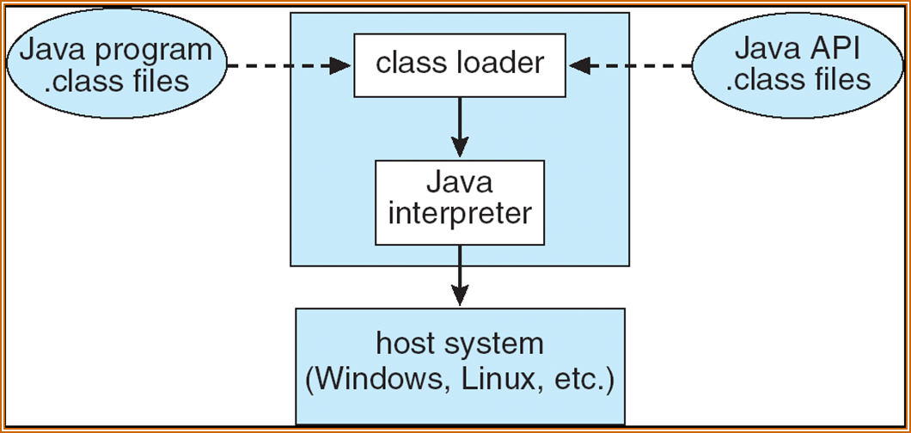
Java Virtual Machine
Compiled Java programs are platform-neutral bytecodes executed by a Java Virtual Machine (JVM)
JVM consists of
- class loader
- class verifier
- runtime interpreter
Just-In-Time (JIT) compilers increase performance

Slide 54
Hardware Protection
Dual-Mode Operation
I/O Protection
Memory Protection
CPU Protection

Slide 55
Dual-Mode Operation
Sharing system resources requires OS to ensure that an incorrect program cannot cause other programs to execute incorrectly
Provide hardware support to differentiate between at least two modes of operations
  1. User mode – execution done on behalf of a user
  2. Monitor mode (also kernel mode or system mode) – execution done on behalf of operating system

Slide 56
I/O Protection
All I/O instructions are privileged instructions
Must ensure that a user program could never gain control of the computer in monitor mode (i.e., a user program that, as part of its execution, stores a new address in the interrupt vector)
User code

Slide 57
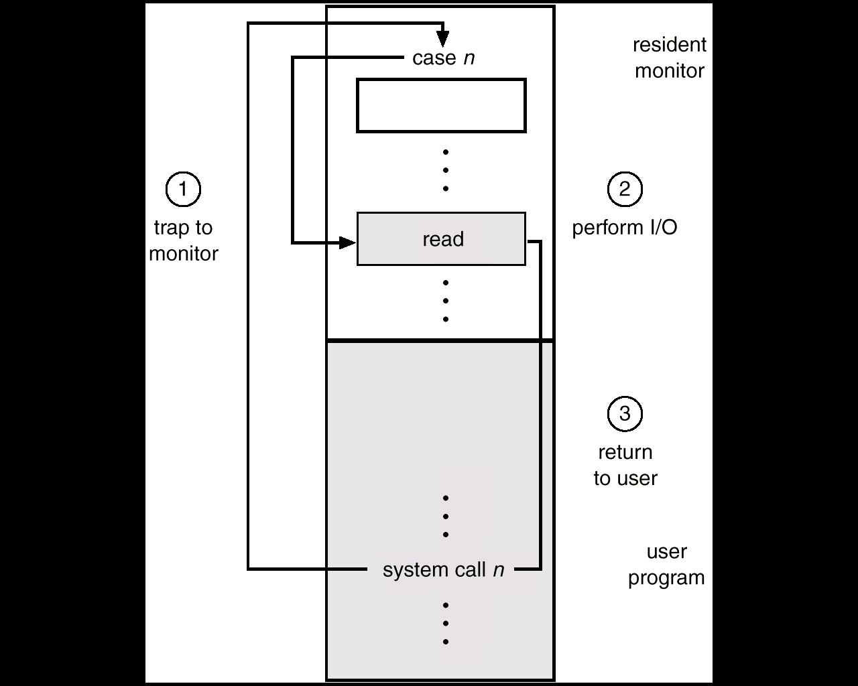
Use of A System Call to Perform I/O

Slide 58
Memory Protection
Must provide memory protection at least for the interrupt vector and the interrupt service routines
In order to have memory protection, add two registers that determine the range of legal addresses a program may access:
  Base register – holds the smallest legal physical memory address
  Limit register – contains the size of the range
Memory outside the defined range is protected

Slide 59
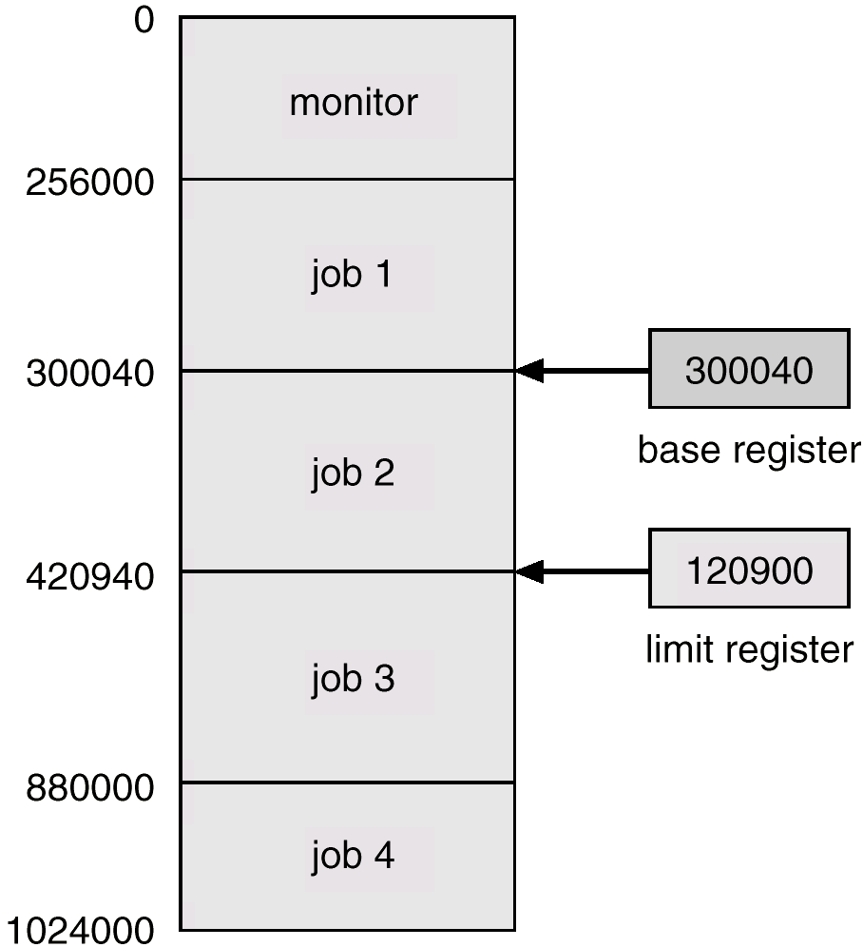
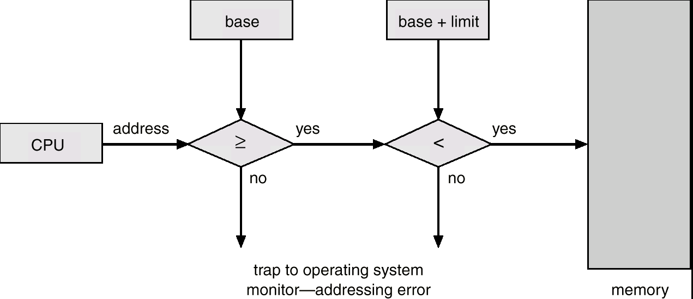
Hardware Address Protection

Slide 60
Hardware Protection
When executing in monitor mode, the operating system has unrestricted access to both monitor and user’s memory.
The load instructions for the base and limit registers are privileged instructions.

Slide 61
CPU Protection
Timer – interrupts computer after specified period to ensure operating system maintains control
  Timer is decremented every clock tick
  When timer reaches the value 0, an interrupt occurs
Timer commonly used to implement time sharing
Timer also used to compute the current time.
Load-timer is a privileged instruction

Slide 62
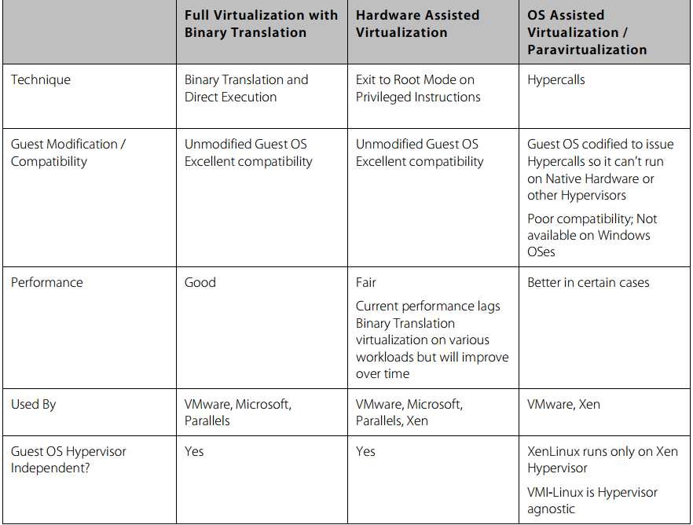
Virtualization: VMWare
Xen
VMWare
KVM

Slide 63
Containers: OS Level Virtualization

Slide 64
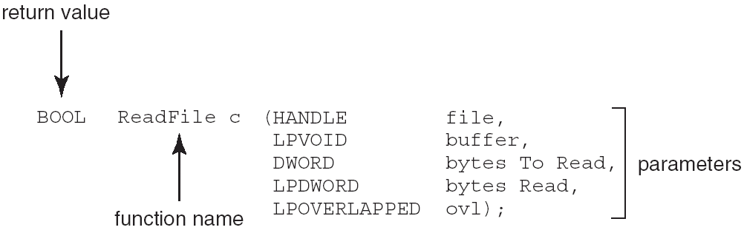
An Example of Standard API
Consider the ReadFile() function in the Win32 API—a function for reading from a file
A description of the parameters passed to ReadFile()
  HANDLE file—the file to be read
  LPVOID buffer—a buffer where the data will be read into and written from
  DWORD bytesToRead—the number of bytes to be read into the buffer
  LPDWORD bytesRead—the number of bytes read during the last read
  LPOVERLAPPED ovl—indicates if overlapped I/O is being used

Slide 65
System Programs
System programs provide a convenient environment for program development and execution. The can be divided into:
  File manipulation
  Status information stored in a File modification
  Programming language support
  Program loading and execution
  Communications
  Background services
  Application programs
Most users’ view of the operation system is defined by system programs, not the actual system calls

Slide 66
Implementation
Many variations
  Early OS in assembly language
  Then system programming languages like Algol, PL/1
  Now C, C++
Actually usually a mix of languages
  Lowest levels in assembly
  Main body in C
  Systems programs in C, C++, scripting languages like PERL, Python, shell scripts
More high-level language easier to port to other hardware
  But slower
Emulation can allow an OS to run on non-native hardware

Slide 67
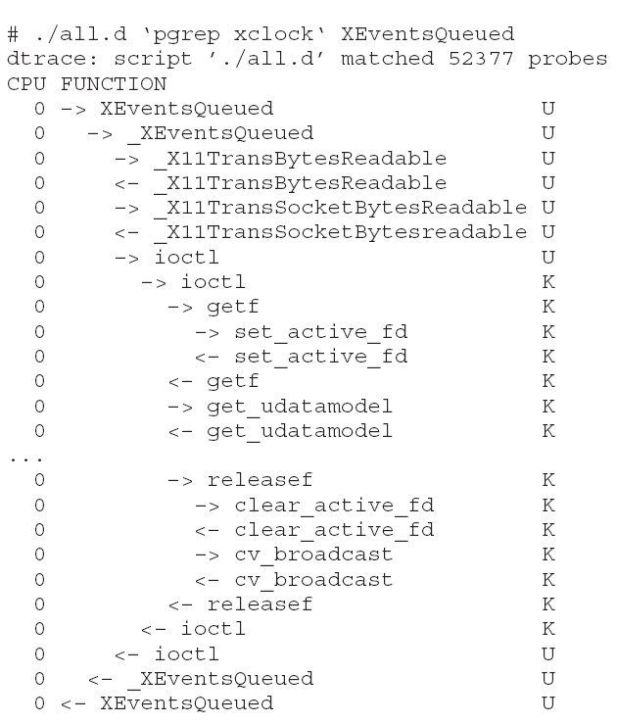
DTrace Tool
DTrace tool in Solaris, FreeBSD, Mac OS X allows live instrumentation on production systems
Probes fire when code is executed within a provider, capturing state data and sending it to consumers of those probes
Example of following XEventsQueued system call move from libc library to kernel and back
2018/3/5
67

Slide 68
How does Linux kernel compare to microkernel architectures? Rahul Bhadana
Monolithic kernel is much older than Microkernel. It’s used in Unix. while Idea of microkernel appeared at the end of the 1980's.
the example of os having the Monolithic kernels are UNIX, LINUX while the os having Microkernel are QNX, L4, HURD, initially Mach (not mac os x) later it will converted into hybrid kernel, even MINIX is not pure kernel because device driver are compiled as part of the kernel.
Monolithic kernel are faster than microkernel. while The first microkernel Mach is 50% slower than Monolithic kernel while later version like L4 only 2% or 4% slower than the Monolithic kernel.
Monolithic kernel generally are bulky. while Pure monolithic kernel has to be small in size even fit in s into processor first level cache (first generation microkernel).

Slide 69
How does Linux kernel compare to microkernel architectures? Rahul Bhadana
In the Monolithic kernel device driver reside in the kernel space. while in the Microkernel device driver reside in the user space.
Since the device driver reside in the kernel space it make monolithic kernel less secure than microkernel. (Failure in the driver may lead to crash) while Microkernels are more secure than the monolithic kernel hence used in some military devices.
Monolithic kernels use signals and sockets to ensure IPC while microkernel approach uses message queues. 1 gen of microkernel poorly implemented IPC so were slow on context switches.
adding new feature to a monolithic system means recompiling the whole kernel while you can add new feature or patches without recompiling.

Slide 70
How does Linux kernel compare to microkernel architectures? Schily
The terms monolithic kernel and microkernel cannot be seriously compared as they describe different aspects of kernel design (structure vs. size).
A typical monolithic kernel was the SunOS-4.x kernel and Linux is still similar, as you manually configure the content of the basic kernel.
The Solaris kernel (starting with 2.1 on 1992) cannot be called monolithic anymore as all drivers are loaded automatically on demand and only a tiny part is loaded during the initial boot.
SunOS-4.x and Solaris (SunOS-5.x) and Linux are all single context implementations. Their entire code runs in a single MMU context.

Slide 71
How does Linux kernel compare to microkernel architectures? Schily
Mac OS X is based on Mach and runs as a multi context implementation with several processes separated by MMU contexts. In this concept, drivers are in separate processes and separate MMU contexts.
Many people call Mac OS X a "microkernel system", but it may be that the basic kernel is not smaller than the basic kernel from Solaris.
So it seems that it would be better to talk about single context kernels vs. multi context kernels.

