Slide 1
Chapter 3
Processes

Slide 2
Outline
Process Concept
Process Scheduling
Operations on Processes
Cooperating Processes
Interprocess Communication
Communication in Client-Server Systems

Slide 3
Process Concept (1)
Process (job): a program in execution (informally)
  the unit of work in most systems
  A system consists of a collection of processes (system processes and user processes) executing concurrently, with CPU multiplexed among them
A process is more than the program code (known as the text section). It also includes: (more formal definition)
  current activity (program counter, content of registers)
  stack containing temporary data (e.g., parameters)
  heap containing memory dynamically allocated
  data section containing global variables
  a set of associated resources

Slide 4
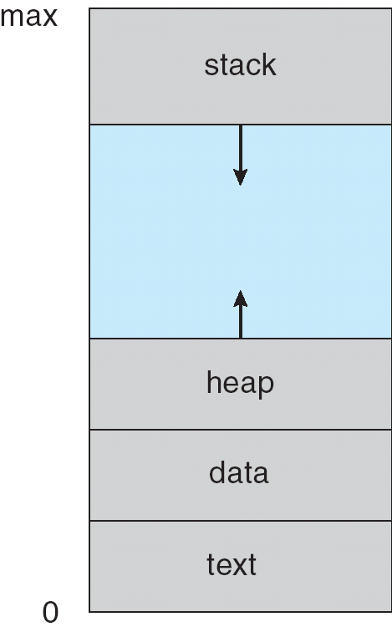
Process in Memory

Slide 5
Process Concept (2)
program counter: next instruction to be executed
A program is a passive entity but a process is an active entity
Two processes may be associated with the same program, they are considered as separate execution sequences
  They have the same text section, but their data section will vary
    e.g., several users may running the copies of the mail/editor program
A process may spawn many processes as it runs

Slide 6
Process State
Process state
  new: the process is being created
  running: instructions are being executed
  waiting: the process is waiting for some event to occur (such as an I/O completion or reception of a signal)
  ready: The process is waiting to be assigned to a processor
  terminated: The process has finished execution
Only one process is running on any processor at any instant. However, many processes may be ready or waiting

Slide 7
Diagram of Process State
admitted
interrupt
terminated
new
exit
ready
running
I/O or
event completion
scheduler dispatch
I/O or event wait
waiting

Slide 8
Process Control Block (PCB)
Each process control block (task control block) represents a process. It includes
  process state (N, R, T, W, Run)
  program counter
  CPU registers
  CPU scheduling information (e.g., priority)
  memory-management information
  (e.g., base/limit register)
  accounting information
  I/O status information
to next PCB
process
pointer
state
process number
program counter
registers
memory limits
list of open files
.
.
.

Slide 9
CPU Switching
process P0 operating system process P1
interrupt or system call
executing
.
.
.
.
save state into PCB0
.
.
.
.
.
.
.
.
.
.
.
.
idle
.
.
.
.
.
reload state from PCB1
.
.
.
executing
.
idle
interrupt or system call
.
.
.
.
.
.
.
save state into PCB1
.
.
.
.
.
.
.
idle
.
.
.
executing
reload state from PCB0

Slide 10
Threads
Sometimes is called a lightweight process: is a basic unit of CPU utilization; it comprises a thread ID, a program counter, a register set, and a stack
It shares with other threads belonging to the same process its code section, data section, and other OS resources, such as open files and signals
  A web browser might have one thread display images or text while another thread retrieves data from the network
Modern OS has extend the process concept to allow a process to have multiple threads of execution

Slide 11
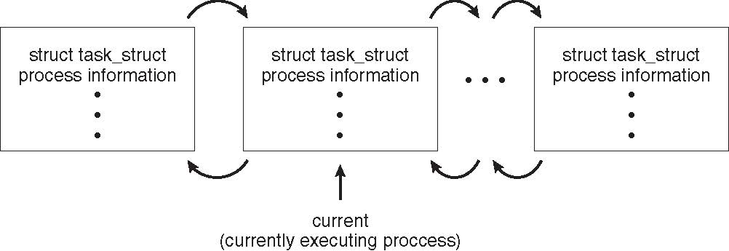
Process Representation in Linux
Represented by the C structure task_struct
pid t_pid; /* process identifier */
long state; /* state of the process */
unsigned int time_slice /* scheduling information */
struct task_struct *parent; /* this process’s parent */
struct list_head children; /* this process’s children */
struct files_struct *files; /* list of open files */
struct mm_struct *mm; /* address space of this process */

Slide 12
Process Scheduling
Objective of multiprogramming: CPU runs process at all times to maximize CPU utilization
Objective of time sharing: switch CPU frequently such that users can interact with each program while it is running
For a uni-processor system, there is only one running process. The rest should wait until CPU free and is rescheduled

Slide 13
Scheduling Queues
Scheduling queues
  job queue: containing all processes
  ready queue
    usually, stored as a linked list
  device queues: each containing processes waiting for it
Queuing diagram: a common representation for process scheduling
  rectangle: queue
  circle: server for a queue
  arrow: flow

Slide 14
PCB7
PCB2
ready
head
queue
tail
registers
registers
mag tape
head
unit 1
tail
PCB3
PCB14
PCB8
disk
head
unit 0
tail
registers
registers
registers
PCB6
terminal
head
unit 0
tail
registers
Ready queue and various I/O device queues

Slide 15
Queuing-diagram Representation of Process Scheduling
ready queue
CPU
I/O
I/O queue
I/O request
time slice expired
Child
terminates
Child
executes
fork a child
Interrupt
occurs
wait for an INT

Slide 16
Schedulers (1)
Long-term Scheduler (job Scheduler): selecting processes from the job pool and loads them into memory for execution
  Execute less frequently (e.g., once several minutes)
  Control the degree of multiprogramming
  Select a good process mix of I/O-bound processes and CPU-bound processes
  Some systems, such as time-sharing system, do not have. Their multiprogramming degree are controlled by hardware limitation (e.g., # of terminals) or on the self-adjusting nature of users

Slide 17
Schedulers (2): Short-term scheduler (CPU scheduler)
selecting one of the ready processes, and allocates the CPU to it.
  Execute quite frequently (e.g., once per 100ms)
  must be very fast
    e.g., if it takes 10 ms, then 10/(100+10) percent of CPU is wasted.
long-term
short-term
ready queue
CPU
I/O
I/O queue(s)

Slide 18
Schedulers (3): Medium-term Scheduler (Swapping)
swap out: removing processes from memory to reduce the degree of multiprogramming.
swap in: reintroducing swap-out processes into memory
medium-term
swap in
swap out
partially executed
swapped-out processes
ready queue
CPU
I/O
I/O waiting

Slide 19
Schedulers (4)
context switch: saving the state of the old process and loading the saved state of the new process
  This is a pure overhead
  switch time (about 1~1000 ms) depends on
    memory speed
    number of registers
    existence of special instructions
      e.g., a single instruction to save/load all registers
    hardware support
      e.g., multiple sets of registers

Slide 20
Schedulers (5)
Short-term scheduler is invoked very frequently (milliseconds) ⇒ (must be fast)
Long-term scheduler is invoked very infrequently (seconds, minutes) ⇒ (may be slow)
The long-term scheduler controls the degree of multiprogramming
Processes can be described as either:
  I/O-bound process – spends more time doing I/O than computations, many short CPU bursts
  CPU-bound process – spends more time doing computations; few very long CPU bursts

Slide 21
Multitasking in Mobile Systems
Some mobile systems (e.g., early version of iOS) allow only one process to run, others suspended
Beginning with iOS 4, provides a limited form of multitasking for user applications
  Single foreground process- controlled via user interface
  Multiple background processes– in memory, running, but not occupy the display screen, and with limited number of application types, including applications:
  Limits include single, short task, receiving notification of events, specific long-running tasks like audio playback
due to battery life and memory use concerns

Slide 22
Multitasking in Mobile Systems
Android does not place such constraints on the types of applications that can run in the background.
If an application requires processing while in the background, the application must use a service, a separate application component that runs on behalf of the background process
  Background process uses a service to perform tasks
  Service can keep running even if background process is suspended
  Service has no user interface, small memory use (footprint).
Consider a streaming audio application: if the application moves to the background, the service continues to send audio files to the audio device driver on behalf of the background application.

Slide 23
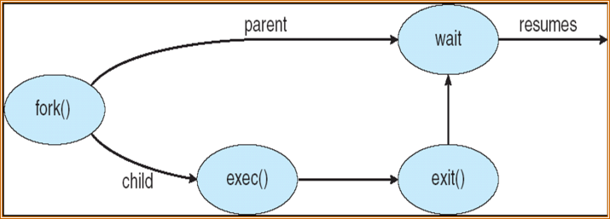
Process Creation (1)
Parent process create children processes, which, in turn create other processes, forming a tree of processes
Resource sharing
  Parent and children share all resources
  Children share subset of parent’s resources
  Parent and child share no resources, the child ask new one from OS
Two possibilities of execution
  Parent and children execute concurrently
  Parent waits until children terminate

Slide 24
Process Creation (2)
Two possibilities of address space
  Child duplicate of parent, communication via sharing variables
  Child has a program loaded into it, communication via message passing
UNIX examples
  fork system call creates new process
  exec system call used after a fork to replace the process’ memory space with a new program

Slide 25
Forking Separate Process
int main()
{
Pid_t pid;
/* fork another process */
pid = fork();
if (pid < 0) { /* error occurred */
fprintf(stderr, "Fork Failed");
exit(-1);
}
else if (pid == 0) { /* child process */
execlp("/bin/ls", "ls", NULL);
}
else { /* parent process */
/* parent will wait for the child to complete */
wait (NULL);
printf ("Child Complete");
exit(0);
}
}

Slide 26
A Tree of Processes in Linux

Slide 27
Process Termination
Process executes last statement and asks the operating system to delete it (exit)
  Output data from child to parent (via wait)
  Process’ resources are deallocated by operating system
Parent may terminate execution of children processes (abort)
  Child has exceeded allocated resources
  Task assigned to child is no longer required
  If parent is exiting
    Some operating system does not allow child to continue if its parent terminates
    All children terminated - cascading termination

Slide 28
Process Termination
The parent process may wait for termination of a child process by using the wait()system call. The call returns status information and the pid of the terminated process
pid = wait(&status);
If no parent waiting (did not invoke wait()) process is a zombie
If parent terminated without invoking wait, process is an orphan

Slide 29
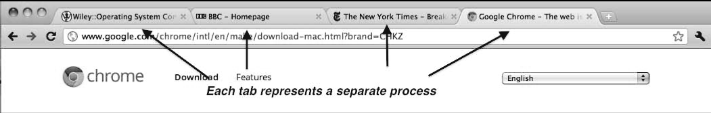
Multiprocess Architecture – Chrome Browser
Many web browsers ran as single process (some still do)
  If one web site causes trouble, entire browser can hang or crash
Google Chrome Browser is multiprocess with 3 different types of processes:
  Browser process manages user interface, disk and network I/O
  Renderer process renders web pages, deals with HTML, Javascript. A new renderer created for each website opened
    Runs in sandbox restricting disk and network I/O, minimizing effect of security exploits
  Plug-in process for each type of plug-in

Slide 30
Multiprocess Architecture – Chrome Browser
Advantage: websites run in isolation from one another. If one website crashes, only its renderer process is affected; all other processes remain unharmed.
Furthermore, renderer processes run in a sandbox, which means that access to disk and network I/O is restricted, minimizing the effects of any security exploits.

Slide 31
Cooperating Processes
Independent process cannot affect or be affected by the execution of another process
Cooperating process can affect or be affected by the execution of another process
Advantages of process cooperation
  Information sharing
  Computation speed-up
  Modularity
  Convenience, e.g., A user can performs several tasks at one time (editing, printing, compiling))

Slide 32
Interprocess Communication (IPC)
Shared Memory, Producer-Consumer Problem
Paradigm for cooperating processes, producer process produces information that is consumed by a consumer process.
  unbounded-buffer places no practical limit on the size of the buffer
    producer: no wait
    consumer: wait when buffer is empty
  bounded-buffer assumes that there is a fixed buffer size
    producer: wait when buffer is full
    consumer: wait when buffer is empty

Slide 33
Bounded-Buffer – Shared-Memory Solution
Buffer as a circular array
      var buffer: array[0..B-1] of item;
        in, out: 0.. B-1; (initialized to 0)
      next free: in
      first available: out
      empty: in = out
      full: (in+1) % B = out
Solution is correct, but can only use BUFFER_SIZE-1 elements
out
in

Slide 34
Bounded-Buffer – Producer Process
item nextProduced;
while (1) {
while (((in + 1) % BUFFER_SIZE) == out)
; /* do nothing */
buffer[in] = nextProduced;
in = (in + 1) % BUFFER_SIZE;
}

Slide 35
Bounded-Buffer – Consumer Process
item nextConsumed;
while (1) {
while (in == out)
; /* do nothing */
nextConsumed = buffer[out];
out = (out + 1) % BUFFER_SIZE;
}

Slide 36
Interprocess Communication (IPC)
Message Passing (1)
Mechanism for processes to communicate and to synchronize their actions
Message system – processes communicate with each other without resorting to shared variables
IPC facility provides two operations:
  send(message) – message size fixed or variable
  receive(message)
Web services: RESTful, SOAP, XML-RPC, …

Slide 37
Interprocess Communication (IPC)
Message Passing (2)
If P and Q wish to communicate, they need to:
  establish a communication link between them
  exchange messages via send/receive
Implementation of communication link
  physical (e.g., shared memory, hardware bus)
  logical (e.g., logical properties)

Slide 38
Implementation Questions
How are links established?
Can a link be associated with more than two processes?
How many links can there be between every pair of communicating processes?
What is the capacity of a link?
Is the size of a message that the link can accommodate fixed or variable?
Is a link unidirectional or bi-directional?

Slide 39
Several methods for logically implementing a link and the send/receive operations:
  Direct or indirect communication
  Symmetric or asymmetric communication
  Automatic or explicit buffering
  Send by copy or send by reference
  Fixed-sized or variable-sized messages
Naming
Buffering

Slide 40
Direct Communication
Processes must name each other explicitly:
  send (P, message) – send a message to process P
  receive(Q, message) – receive a message from process Q
Properties of communication link
  Links are established automatically
  A link is associated with exactly one pair of communicating processes
  Between each pair there exists exactly one link.
  The link may be unidirectional, but is usually bi-directional

Slide 41
Example: a solution to the producer-consumer problem
L limited modularity: if the name of a process is changed, all old names should be found. It is not easy for separate compilation
Producer process
Consumer process
repeat
...
produce an item in nextp
...
send(consumer, nextp);
until false;
repeat
receive(producer, nextc);
...
consume the item in nextc
...
until false;

Slide 42
Indirect Communication (1)
Messages are directed and received from mailboxes (also referred to as ports)
  Each mailbox has a unique id
  Processes can communicate only if they share a mailbox
Properties of communication link
  Link established only if processes share a common mailbox
  A link may be associated with many processes
  Each pair of processes may share several communication links
  Link may be unidirectional or bi-directional

Slide 43
Indirect Communication (2)
Operations
  create a new mailbox
  send and receive messages through mailbox
  destroy a mailbox
Primitives are defined as:
send(A, message) – send a message to mailbox A
receive(A, message) – receive a message from mailbox A

Slide 44
Indirect Communication (3)
Mailbox sharing
  P₁, P₂, and P₃ share mailbox A
  P₁ sends; P₂ and P₃ receive
    Who gets the message?
Solutions
  Allow a link to be associated with at most two processes
  Allow only one process at a time to execute a receive operation
  Allow the system to select arbitrarily the receiver (not both). Sender is notified who the receiver was

Slide 45
Synchronization
Message passing may be either blocking or non-blocking
  Blocking send: SP is blocked until the message is received by RP or by the mailbox
  Nonblocking send: SP sends the message and resumes operation
  Blocking receive: RP is blocked until the message is available
  Nonblocking receive: RP receives a valid message or a null

Slide 46
Buffering (1)
Queue of messages attached to the link; implemented in one of three ways
  1. Zero capacity – 0 messages
  Sender must wait for receiver (rendezvous)
  2. Bounded capacity – finite length of n messages
  Sender must wait if link full
  3. Unbounded capacity – infinite length
  Sender never waits
No buffering
Automatic buffering
Automatic buffering

Slide 47
Buffering (2)
In nonzero-capacity cases, two processes communicate asynchronously
For asynchronous communication, one way to make sure (or to wait) that the receiver has received the sent message is as follows
  process P (sender)
    send(Q, message)
    receive (Q, message)
  process Q (receiver)
receive(P, message)
send(P, acknowledgement")

Slide 48
An Example: Mach
Developed at Carnegie Mellon University
Most communications are carried out by messages. Message are sent to and received from mailboxes, called ports
Even system calls are made by messages. When each task is created, two special mailboxes – the Kernel mailbox and the Notify mailbox – are also created
  The Kernel mailbox is used by the kernel to communication with the task. The kernel sends notification of event occurrences to the Notify port

Slide 49
Three system calls using message transfer
  msg_send: sends a message to a mailbox
  msg_receive
  msg_rpc: Remote Procedure Calls (PRCs)
port_allocate: creates a new mailbox and allocates space for its queue of messages. The task that creates the mailbox is that mailbox’s owner
Messages are copied into mailbox. Multiple messages from the same sender are queued in FIFO order
If the mailbox is full, the sending thread has 4 options:
  Wait indefinitely until there is a room in the mailbox
  Wait at most n milliseconds
  Do not wait at all, but rather return immediately
  Temporarily cache a message

Slide 50
The receive operation must specify from which mailbox or mailbox set to receive a message
port_status: returns # of messages in a given mailbox
If no message is waiting to be received, the receiving thread may wait, wait at most n milliseconds, or not wait
The Mach message system attempts to avoid double copy operations by using virtual-memory management techniques.
  Mach maps the address space containing the sender’s message into the receiver’s address space

Slide 51
An Example: POSIX
POSIX: Support both shared memory and message passing
POSIX Shared Memory
  Process first creates shared memory segment
  segment id = shmget(IPC PRIVATE, size, S IRUSR | S IWUSR);
    IPC PRIVATE: a new shared-memory segment is created.
    mode (S IRUSR | S IWUSR): Owner may read or write
    segment id: return value, integer id for the shared-memory segment
  Process wanting access to that shared memory must attach to it
  shared memory = (char *) shmat(id, NULL, 0);
  Now the process could write to the shared memory
  sprintf(shared memory, "Writing to shared memory");
  When done a process can detach the shared memory from its address space
  shmdt(shared memory);

Slide 52
An Example: Windows XP
Message-passing centric via local procedure call (LPC) facility
  Only works between processes on the same machine
  Uses ports (like mailboxes) to establish and maintain communication channels
  Communication works as follows:
    The client opens a handle to the subsystem’s connection port object
    The client sends a connection request
    The server creates two private communication ports and returns the handle to one of them to the client
    The client and server use the corresponding port handle to send messages or callbacks and to listen for replies

Slide 53
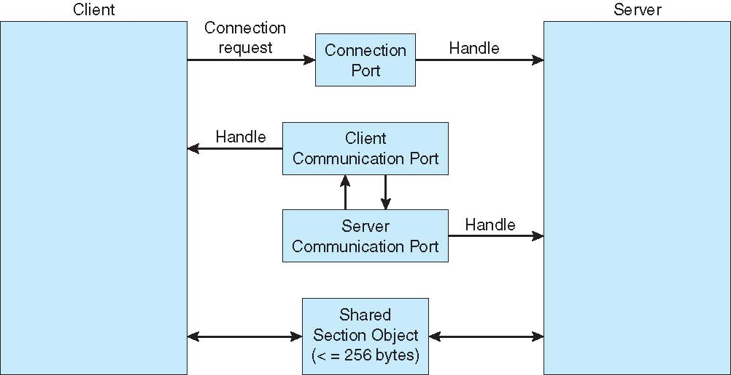
Local procedure calls in windows XP

Slide 54
Client-Server Communication
Sockets
Remote Procedure Calls
Remote Method Invocation (Java)

Slide 55
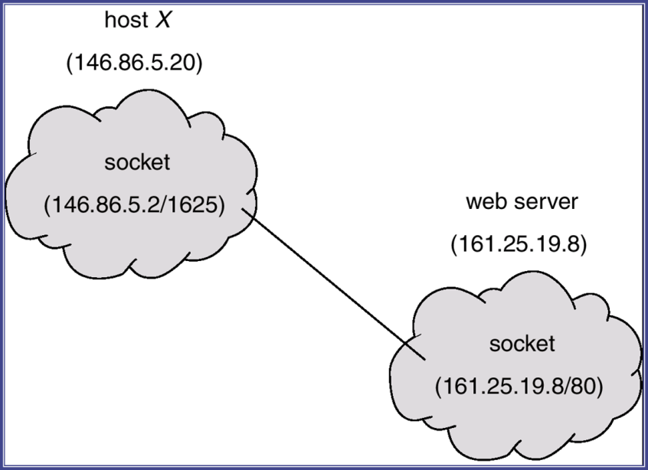
Sockets
A socket is defined as an endpoint for communication
Concatenation of IP address and port
  The socket 161.25.19.8:1625 refers to port 1625 on host 161.25.19.8
Communication consists between a pair of sockets

Slide 56
Remote Procedure Calls (1)
Remote procedure call (RPC) abstracts procedure calls between processes on networked systems
Stubs – client-side proxy for the actual procedure on the server
The client-side stub locates the server and marshalls the parameters
The server-side stub receives this message, unpacks the marshalled parameters, and performs the procedure on the server
Issues and solutions: external data representation (XDR), timestamp, matchmaker
On Windows, stub code compile from specification written in Microsoft Interface Definition Language (MIDL)

Slide 57
Remote Procedure Calls (2)
Semantics of a call: RPCs may fail, or be duplicated and execute more than once, as a result of common network errors.
exact once vs. at most once semantics
at most once: implemented by attaching a timestamp to each message. The server must keep a history large enough to ensure that repeated messages are detected.
exact once : remove the risk that the server will never receive the request.
  The server must acknowledge to the client that the RPC call was received and executed.
  The client must resend each RPC call periodically until it receives the ACK.

Slide 58
Execution of RPC
32-bit integers: Some systems,
big-endian store the most significant byte
first, while
little-endian store the least significant
byte first.
To resolve differences: external data representation (XDR).

Slide 59
Representational State Transfer (REST)
In computing, representational state transfer (REST) is an architectural style of application programming interfaces consisting of a coordinated set of components, connectors, and data elements.
RESTful systems: communicate over HTTP with the same HTTP verbs (GET, POST, PUT, DELETE, etc.) that web browsers use to retrieve web pages and to send data to remote servers.
REST constraints: Client–server, Stateless, Cacheable, Layered system, Code on demand (optional), Uniform interface, Identification of resources (URI), …
REST vs. RPC(SOAP, XML-RPC)
  REST is an architectural style, while SOAP is a protocol
  REST is more predictable than RPC as it relies on the shared semantic of HTTP verbs.

Slide 60
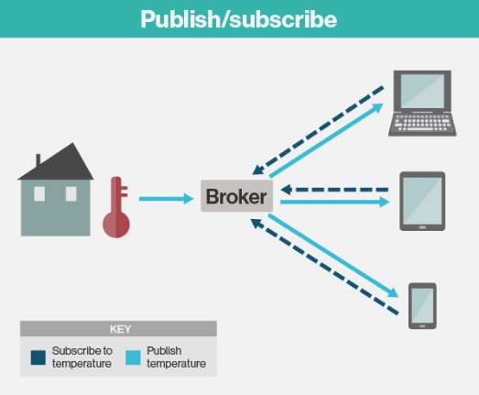
Message Queuing Telemetry Transport,
MQTT
Lightweight messaging protocol that provides resource-constrained network clients with a simple way to distribute telemetry information.
used for machine-to-machine (M2M) communication and plays an important role in the Internet of Things (IoT).
created by Dr. Andy Standford-Clark of IBM and Arlen Nipper of Arcom (now Eurotech) in 1999 as a cost-effective, reliable way to connect monitoring devices used in the oil and gas industries with remote enterprise servers.

Slide 61
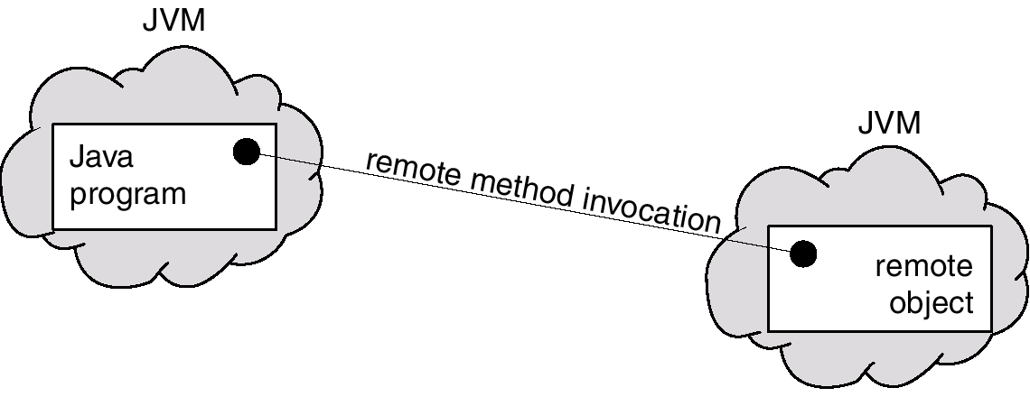
Remote Method Invocation
Remote Method Invocation (RMI) is a Java mechanism similar to RPCs, but
  RMI supports invoking a methods on remote objects directly
  The parameters to remote procedures are ordinary data structures

Slide 62
Marshalling Parameters

Slide 63
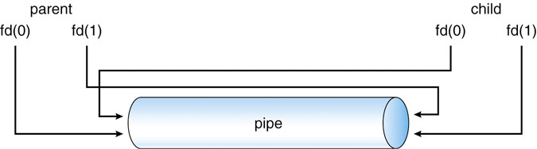
Pipes
One of the 1st IPC mechanism in early UNIX systems
4 issues in implementing
  uni- or bi-directional?
  half or full duplex? (travel in both directions simultaneously)
  Must a relationship (parent – child) exist?
  Over a network, or reside on the same machine?
Ordinary Pipes: unidirectional
  An example: Figures 3.23, 3.24 (Unix); Figures 3.25, 3.26 (Windows)
write-end
Read-end
write-end

Slide 64
Named Pipes
bi-directional
no parent-child relationship is required
Several processes can use it for communications. It may have several writers.
Continue to exist after communicating processes have finished.
Windows: full-duplex is allowed

