Slide 1
Chapter 4
Threads

Slide 2
Outline
Overview
Multicore Programming
Multithreading Models
Thread Libraries
Implicit Threading
Threading Issues
Operating System Examples

Slide 3
OBJECTIVES
To introduce the notion of a thread—a fundamental unit of CPU utilization that forms the basis of multithreaded computer systems.
To discuss the APIs for the Pthreads, Windows, and Java thread libraries.
To explore several strategies that provide implicit threading.
To examine issues related to multithreaded programming.
To cover operating system support for threads in Windows and Linux.

Slide 4
Overview
Sometimes is called a lightweight process: is a basic unit of CPU utilization; it comprises a thread ID, a program counter, a register set, and a stack.
A traditional, or heavyweight, process has a single thread of control.
It shares with other threads belonging to the same process its code section, data section, and other OS resources, such as open files and signals.
In busy WWW server: The server creates a separate thread that would listen for clients requests, when a request was made, creates a thread to service the request.

Slide 5
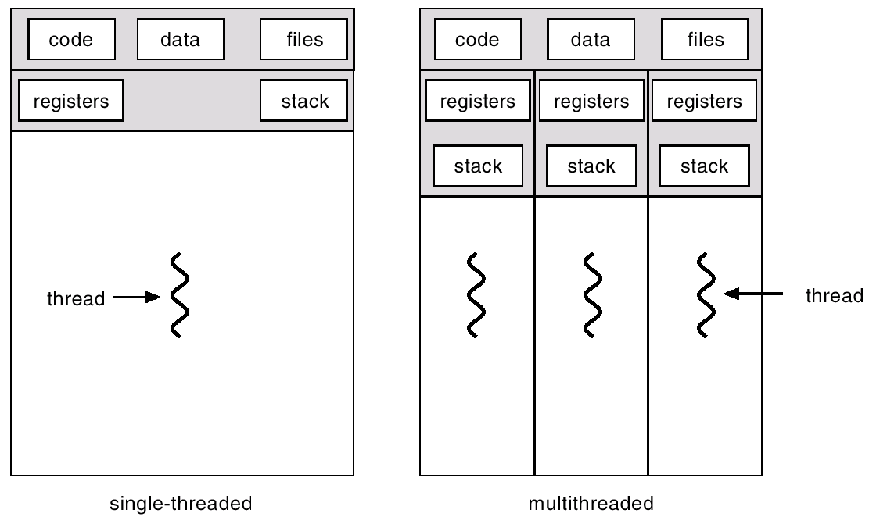
Single and Multithreaded Processes

Slide 6
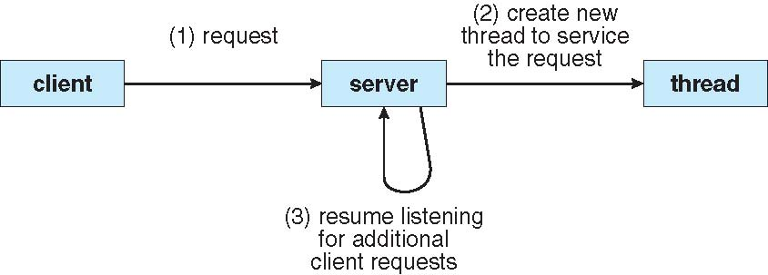
Multithreaded Server Architecture
A separate thread listens for client request.
When a request is issued, creates (or notifies) a thread
to serve the request.

Slide 7
Benefits (1)
Responsiveness: Allow a program to continue running even if part of it is blocked or is performing a lengthy operation.
Resource sharing: several different threads of activity all within the same address space.
Economy: Allocating memory and resources for process creation is costly. In Solaris, creating a process is about 30 times slower than is creating a thread, and context switching is about five times slower. A register set switch is still required, but no memory-management related work is needed.
Remark: Using threads, context switches take less time.

Slide 8
Benefits (2)
Utilization of multiprocessor architecture (Scalability): Several thread may be running in parallel on different processors.
  ☹Of course, multithreading a process may introduce concurrency control problem that requires the use of critical sections or locks.
This is similar to the case where a fork system call is invoked with a new program counter executing within the same address space (sharing memory space).

Slide 9
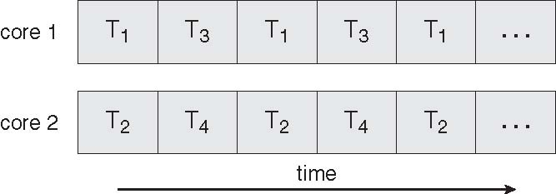
Multicore Programming
Multithreaded programming provides a mechanism for more efficient use of multiple cores and improved concurrency (threads can run in parallel)
Multicore systems putting pressure on system designers and application programmers
  OS designers: scheduling algorithms use cores to allow the parallel execution

Slide 10
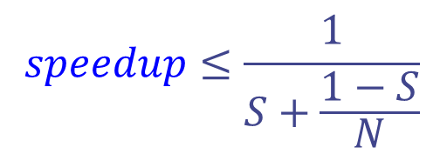
AMDAHL’S LAW
Identifies potential performance gains from adding additional computing cores to an application that has both serial(nonparallel) and parallel components.
  If S is the portion of the application that must be performed serially on a system with N processing cores, the formula:
  an application (75 percent parallel and 25 percent serial running with two processing cores: speedup of 1.6 times.
  If we add two additional cores (for a total of four), the speedup is 2.28 times.

Slide 11
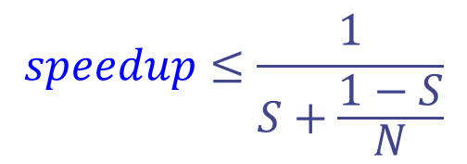
AMDAHL’S LAW
N approaches infinity, the speedup converges to 1/S.
  If 40% of an application is performed serially, the maximum speedup is 2.5 times, regardless of the number of processing cores we add.
Amdahl′s Law: the serial portion of an application can have a disproportionate effect on the performance we gain by adding additional computing cores.

Slide 12
Challenges in Multicore Programming
Dividing activities (Identifying tasks): separate, concurrent tasks and run in parallel
Balance
Data splitting: data accessed and manipulated
Data dependency: synchronized to accommodate the data dependency
Testing and debugging

Slide 13
User Threads
Thread management done by user-level threads library.
  Fast: All thread creating and scheduling are done in user space without the need for kernel intervention.
Any user-level thread performing a blocking system call will cause the entire process to block, even if there are other threads available to run within the applications, if the kernel is single-thread.
Examples
-POSIX Pthreads
- Mach C-threads
- Win32 threads
- Solaris threads, Solaris 2 VI-threads

Slide 14
Kernel Threads
Supported by the Kernel
Examples
- Windows XP/2000
- Solaris
- Tru64 UNIX
- Linux
- Mac OS X

Slide 15
Multithreading Models (1)
Multi-Thread vs. Multi-process
Multiple process
  Each is independent and has it own program counter, stack, register, and address space. This is useful for unrelated jobs.
  Multiple processes can perform the same task as well. (e.g., provide data to remote machines in a network file system). Each executes the same code but has it own memory and file resources.
Multi-thread process
  It is more efficient to have one process containing multiple threads serve the same task.
Most systems support for both user and kernel threads

Slide 16
Multithreading Models (2)
uses fewer resources, including memory, open files and CPU scheduling.
Threads are not independent to each other. This structure does not provide protection.
  However, it is not necessary. Only a single user can own an individual task with multiple threads. The threads should be designed to assist one another.
Threads can create child threads. If one thread is blocked, another thread can run.
Threads provide a mechanism that allows sequential processes to make blocking system calls while also achieving parallelism.

Slide 17
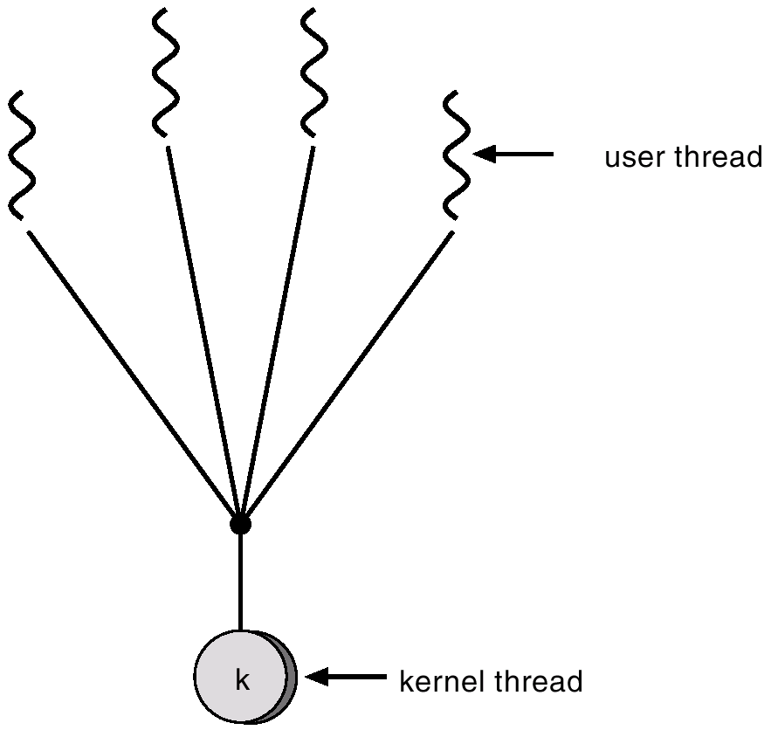
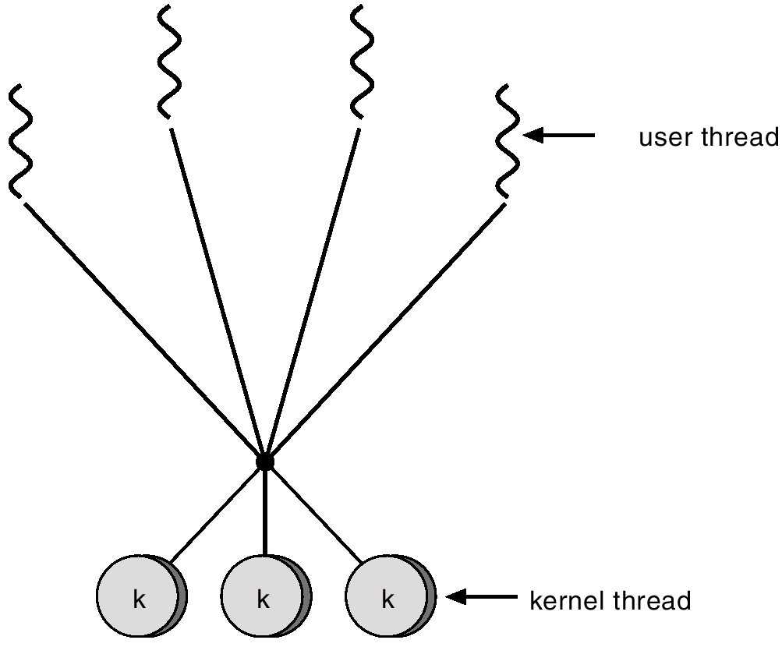
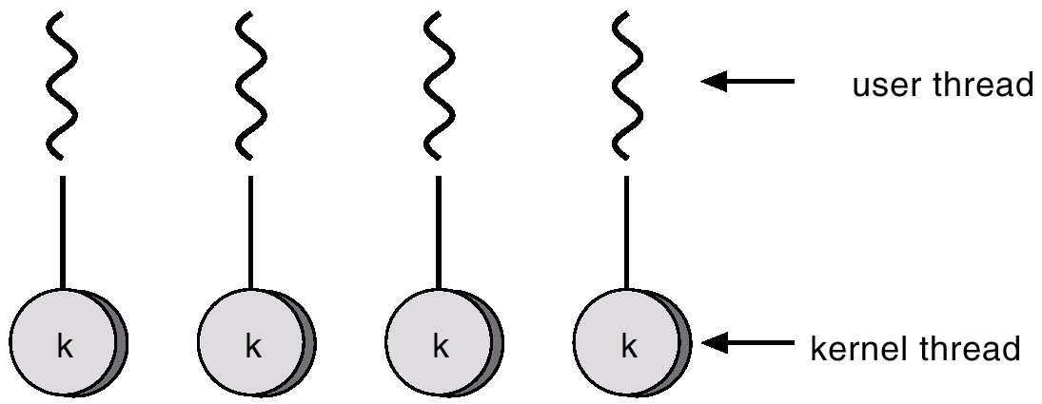
Multithreading Models (3)
The kernel is unaware of the existence of the user- level threads. # of threads in a process
Many-to-One
One-to-One
Many-to-Many
Kernel-level threads are scheduled by the OS, and each thread can be granted its own timeslices by the scheduler.

Slide 18
Many-to-One
Scheduling on processes
If kernel services are relatively less often
Many user-level threads mapped to single kernel thread.
Used on systems that do not support kernel threads.
Thread management is done in user space, so it is efficient.
The entire process will block if a thread makes a blocking system call.
Only one thread can access the kernel at a time, multiple threads are unable to run in parallel on multiprocessors.
  Solaris Green Threads, GNU Portable Threads
The kernel is not going to be able to distribute the other threads on other CPUs.

Slide 19
One-to-One
Each user-level thread maps to kernel thread.
☺More concurrency
☹Overhead: Creating a thread requires creating the corresponding kernel thread.
Examples
- Windows XP/NT/2000
- Linux
- Solaris 9 and later

Slide 20
Many-to-Many
Multiplexes many user-level threads to a smaller or equal number of kernel threads
Allows the developer to create as many user threads as wished.
☺The corresponding kernel threads can run in parallel on a multiprocessor.
☺When a thread performs a blocking call, the kernel can schedule another thread for execution.
Solaris 2, IRIX, Digital UNIX
Windows NT/2000 with the ThreadFiber package

Slide 21
Two-level Model
Popular Variation on Many-to-Many
Similar to Many-to-Many, except that it allows a user thread to be bound to kernel thread
Examples
  IRIX
  HP-UX
  Tru64 UNIX
  Solaris 8 and earlier

Slide 22
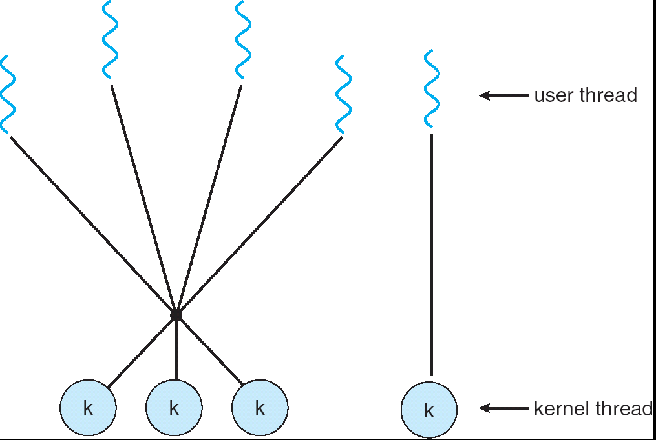
Two-level Model

Slide 23
Pthreads
A POSIX standard (IEEE 1003.1c) API for thread creation and synchronization
  This is a specification for thread behavior, not an implementation.
API specifies behavior of the thread library, implementation is up to development of the library
Common in UNIX operating systems(Solaris, Linux, Mac OS X)

Slide 24
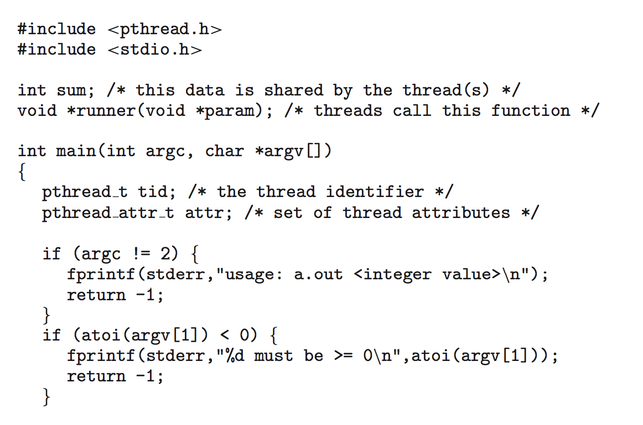
Pthreads Example
header file
identifier
stack size and scheduling information

Slide 25
Pthreads Example (Cont.)
default
A separate thread is created
name of the function
calculates the summation of a nonnegative integer

Slide 26
Java Threads
Support for threads is provided either by OS or by a threads library package. For example, the Win32 library provides a set of APIs for multithreading native Windows applications.
Java is unique in that it provides support at the language level for creation and management of threads.
Java threads may be created by:
  Extending Thread class
  Implementing the Runnable interface
Java threads are managed by the JVM
  It’s difficult to classify Java threads as either user or kernel level.

Slide 27
Java Thread States (1)
Four possible states:
  New
  Runnable: Calling the start() method allocates memory and calls the run() method for the thread object.
  Note: Java does not distinguish between a thread that is eligible to run and a thread that is currently running by the JVM.
  Blocked
  Dead

Slide 28
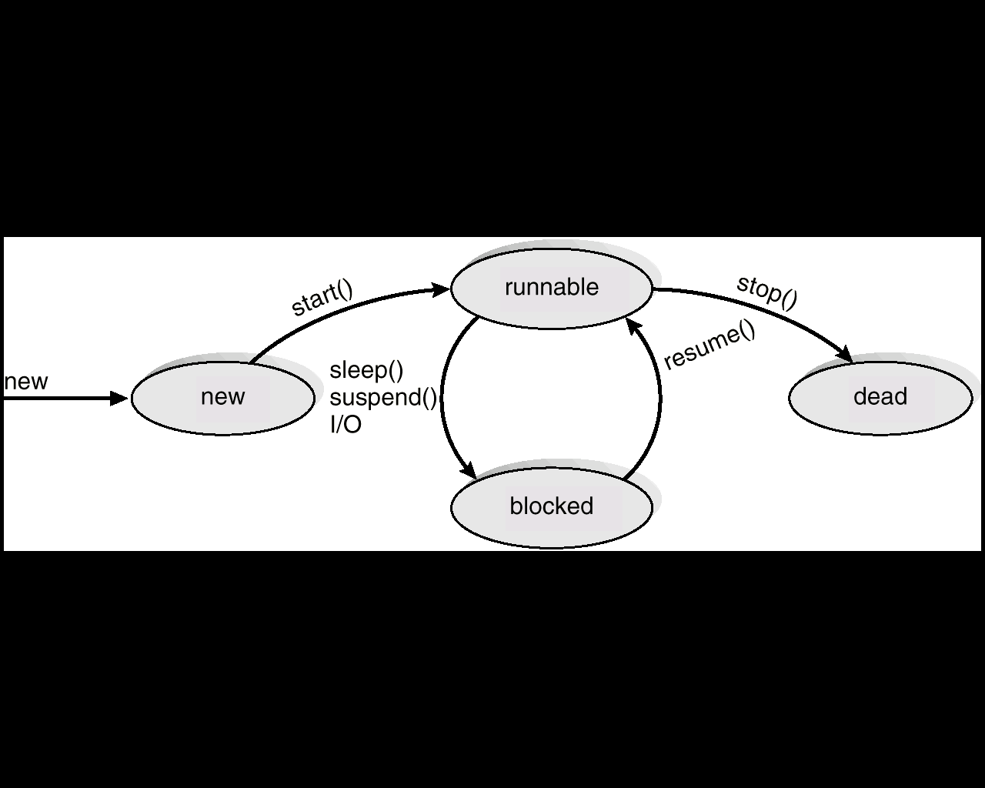
Java Thread States (2)

Slide 29
Java Thread and the JVM
Threads of control
The garbage collector thread: It evaluates objects with the JVM to see whether they are still in use. If they are not, it returns the memory to the system.
Threads of handling timer events
Threads of handling events from graphics controls
Threads of updating the screen
A typical Java application contains several different threads of control in the JVM. Certain threads are explicitly by the program; the other threads are system-level tasks running on behalf of the JVM.

Slide 30
The JVM and Host OS
The typical implementation of the JVM is on top of a host OS. This specification for the JVM does not indicate how Java threads are to be mapped to underlying OS, instead leaving that decision to the particular implementation of the JVM.
Typically, a Java thread is considered a user-level thread, and the JVM is responsible for thread management.

Slide 31
Implicit Threading
Growing in popularity as numbers of threads increase, program correctness more difficult with explicit threads
Implicit Threading: Creation and management of threads done by compilers and run-time libraries rather than programmers
Three methods explored
  Thread Pools
  OpenMP
  Grand Central Dispatch

Slide 32
Thread Pools
time for creating
resources overuse
Create a number of threads in a pool where they await work
Advantages:
  Usually slightly faster to service a request with an existing thread than create a new thread
  Allows the number of threads in the application(s) to be bound to the size of the pool
  Separating task to be performed from mechanics of creating task allows different strategies for running task, i.e. tasks could be scheduled to run periodically
# of threads: # of CPUs, expected # of requests, amount of physical memory

Slide 33
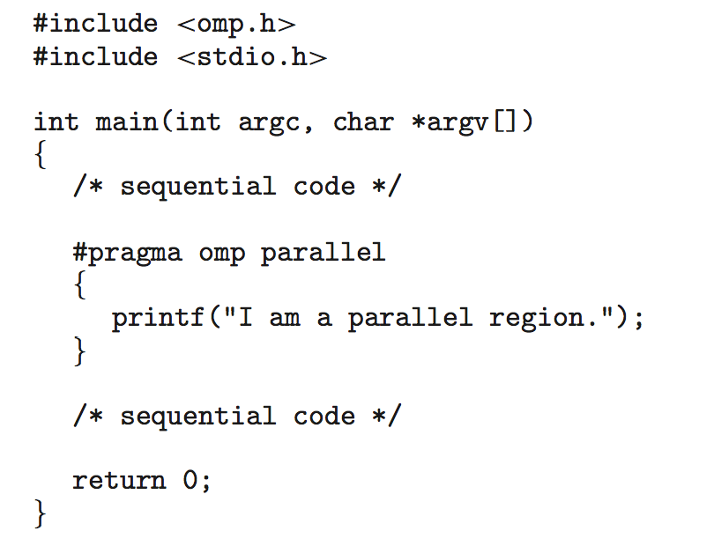
OpenMP
Set of compiler directives and an API for C, C++, FORTRAN
Provides support for parallel programming in shared-memory environments
Identifies parallel regions – blocks of code that can run in parallel
Application developers insert compiler directives into their code at parallel regions, and these directives instruct the OpenMP run-time library to execute the region in parallel.

Slide 34
OpenMP
When OpenMP encounters the directive #pragma omp parallel, it creates as many threads are there are processing cores in the system, i.e., for a quad-core system, four are created.
All the threads then simultaneously execute the parallel region. As each thread exits the parallel region, it is terminated.
OpenMP allows developers to choose among several levels of parallelism:
  can set the number of threads manually.
  allows developers to identify whether data are shared between threads or are private to a thread.
OpenMP is available for Linux, Windows, and Mac OS X systems.

Slide 35
Grand Central Dispatch - Apple
for Mac OS X and iOS: Extensions to C, C++ languages, API, and run-time library
Allows identification of parallel sections. Like OpenMP, manages most of the details of threading
GCD identifies extensions to the C and C++ languages known as blocks. A block is simply a self-contained unit of work.
GCD schedules blocks for run-time execution by placing them on a dispatch queue.
  When it removes a block from a queue, assigns the block to available thread in thread pool.

Slide 36
Grand Central Dispatch - Apple
Two types of dispatch queues:
  Serial – blocks removed in FIFO order. Once a block has been removed from the queue, it must complete execution before another block is removed.
    Each process has its own serial queue (main queue).
    Developers can create additional serial queues that are local to particular processes.
    Serial queues are useful for ensuring the sequential execution of several tasks.

Slide 37
Grand Central Dispatch - Apple
  Concurrent – removed in FIFO order but several may be removed at a time, thus allowing multiple blocks to execute in parallel.
  Three system-wide concurrent dispatch queues, and they are distinguished according to priority: low, default, and high.
  Priorities represent an approximation of the relative importance of blocks.
  Quite simply, blocks with a higher priority should be placed on the high-priority dispatch queue.

Slide 38
Threading Issues
Semantics of fork() and exec() system calls. Duplicate all the threads or not?
Signal handling: Where then should a signal be delivered?
Thread cancellation: Asynchronous or deferred
Thread-local storage: Each thread might need its own copy of certain data
Scheduler activations

Slide 39
Semantics of fork() and exec()
Does fork() duplicate only the calling thread or all threads?
  Two versions of fork()
  If exec() is called immediately after forking, then duplicating all threads is unnecessary.
fork-join strategy: the parent thread creates one or more children and then must wait for all of its children to terminate before it resumes

Slide 40
Signal Handling
Signals (synchronous or asynchronous) are used in UNIX systems to notify a process that a particular event has occurred
A signal handler is used to process signals
  Signal is generated by particular event
  Signal is delivered to a process
  Signal is handled by one of two signal handlers: default and user-defined.
    User-defined signal handler can override default

Slide 41
Signal Handling
Where should a signal be delivered for multi-threaded?
  Deliver the signal to the thread to which the signal applies
  Deliver the signal to every thread in the process
  Deliver the signal to certain threads in the process
  Assign a specific thread to receive all signals for the process

Slide 42
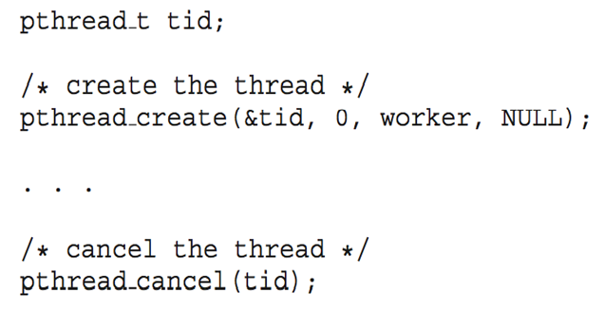
Thread Cancellation
Terminating a thread before it has completed.
Two general approaches:
  Asynchronous cancellation terminates the target thread immediately
  Deferred cancellation The target thread periodically checks whether it should be terminated, allowing it an opportunity to terminate itself in an orderly fashion (canceled safely).

Slide 43
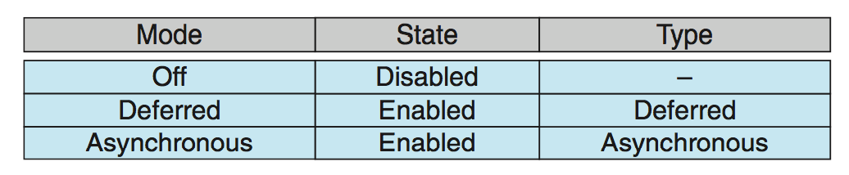
Thread Cancellation
Actual cancellation depends on thread state
If thread has cancellation disabled, cancellation remains pending until thread enables it
Default type is deferred
  Cancellation only occurs when thread reaches cancellation point, then cleanup handler is invoked
On Linux systems, thread cancellation is handled through signals

Slide 44
Thread-Local Storage
Thread-local storage (TLS) allows each thread to have its own copy of data
Useful when you do not have control over the thread creation process (i.e., when using a thread pool)
Different from local variables (may confuse TLS with local variables.)
  Local variables visible only during single function invocation
  TLS visible across function invocations.

Slide 45

Scheduler Activations
Both M:M and Two-level models require communication to maintain the appropriate number of kernel threads allocated to the application
Scheduler activations provide upcalls - a communication mechanism from the kernel to the thread library
This communication allows an application to maintain the correct number kernel threads
blocked
Informing that a thread is about to block, then schedules another thread that is eligible to run on the new virtual processor.

Slide 46
Windows Threads
Implements the one-to-one mapping
Each thread contains
  A thread id
  Register set
  Separate user and kernel stacks
  Private data storage area
The register set, stacks, and private storage area are known as the context of the threads
The primary data structures of a thread include:
  ETHREAD (executive thread block)
  KTHREAD (kernel thread block)
  TEB (thread environment block)

Slide 47
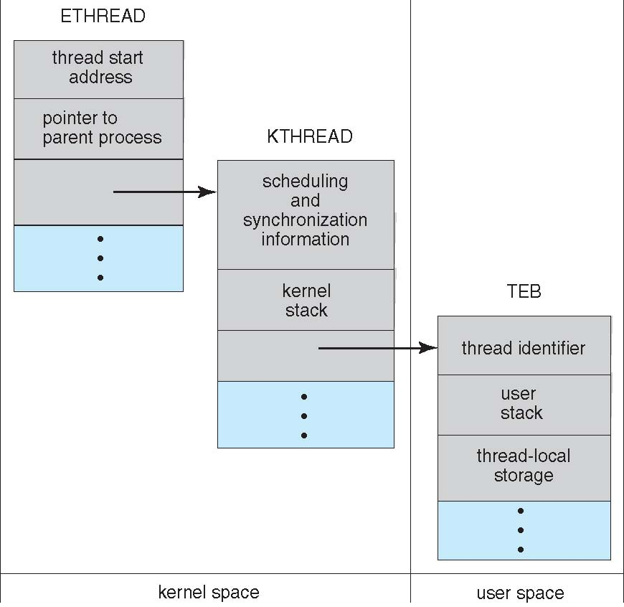
Windows Threads

Slide 48
Linux Threads
Linux refers to them as tasks rather than threads.
Thread creation is done through clone() system call
Clone() allows a child task to share the address space of the parent task (process)
  behaves much like a separate thread
  Linux does not support multithreading, but various Pthreads implementation are available for user-level
or fork ()
A set of flags
NPTL: Native POSIX Thread Library

Slide 49
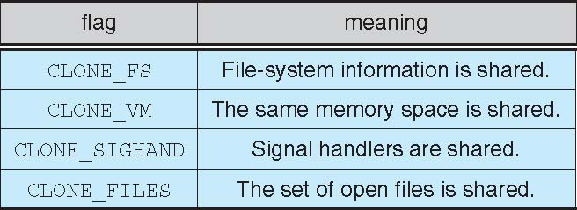
Linux Threads

Slide 50
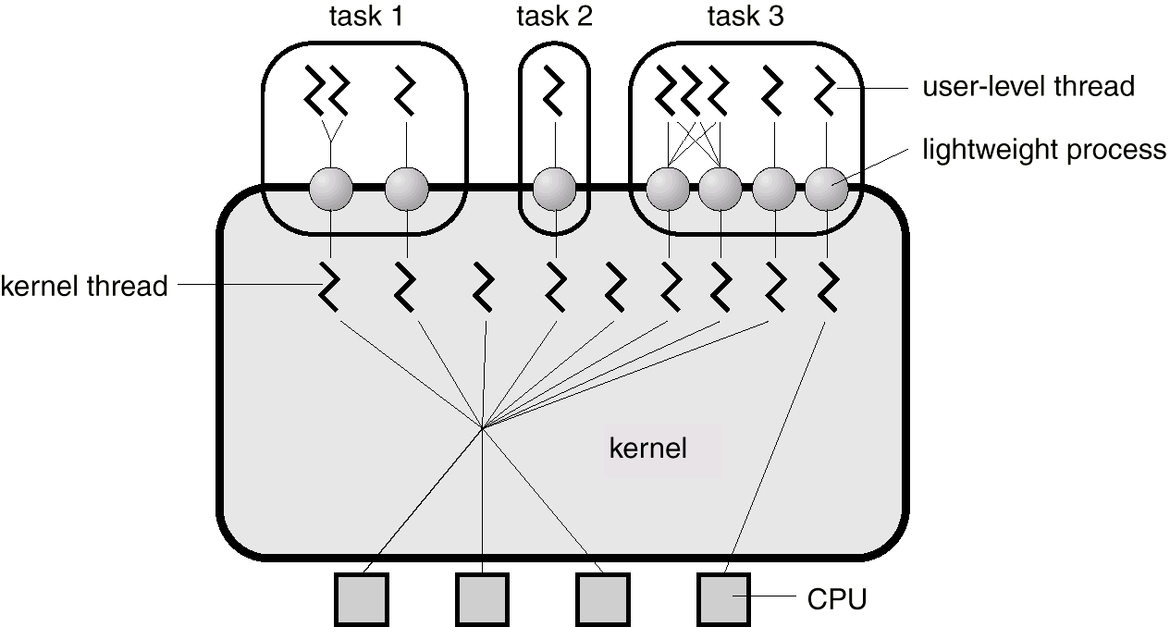
Solaris 2 Threads (1)

Slide 51
Solaris 2 Threads (2)
Support threads at the kernel and user levels, symmetric multiprocessing (SMP), and real-time scheduling.
Supports user-level threads with a library containing APIs for thread creation and management.

Slide 52
Solaris 2 Threads (3)
Intermediate level threads: between user-level threads and kernel-level threads, Solaris 2 defines an intermediate level, the lightweight processes (LWP).
Each task contains at least one LWP.
The user-level threads are multiplexed on the LWPs of the process, and only user-level threads currently connected to LWPs accomplish work. The rest are either blocked or waiting for an LWP on which they can run.
There is a kernel-level thread for each LWP, and there are some kernel-level threads have no associated LWP (for instance, a thread to service disk request).

Slide 53
Kernel-level threads are the only objects scheduled within the system. Solaris implements the many-to-many model.
Bound user-level thread: permanently attached to a LWP. Binding a thread is useful in situations that require quick response time, such as real-time applications.
Unbound user-level thread: All unbound threads in an application are multiplexed onto the pool of available LWPs for the application.

Slide 54
Kernel-level threads are multiplexed on the processors. By request, a thread can also be pinned to a processor.
Each LWP is connected exactly one kernel-level thread, whereas each user-level thread is independent of the kernel.
There may be many LWPs in a task, but they are needed only when threads need to communicate with the kernel.

Slide 55
The threads library dynamically adjusts the number of LWPs in the pool to ensure that the best performance for the application.
  If all the LWPs in a process are blocked and there are other threads that are able to run, the threads library automatically creates another LWP to be assigned to a waiting thread.
With Solaris 2, a task no longer must block while waiting for I/O to complete. The task may have multiple LWPs. If one block, the other may continue to run.

Slide 56
Data structures for threads on Solaris 2
A kernel thread has only a small data structure and a stack. Switching between kernel threads does not require changing memory access information, and thus is relative fast.
An LWP contains a PCB with register data (user level), accounting and memory information. (kernel data structure)
A user-level thread contains a thread ID, register set (a program counter and stack pointer), stack, and priority. No kernel resources are required. Switching between user-level threads is fast.

Slide 57
Multiple-choice Questions
A device driver is: (a) a type of system call; (b) a feature of a hardware device that helps it interact with the OS; (c) a peripheral hardware component of a computer system; (d) a software routine that interfaces with a hardware device.
Which of the following would lead you to believe that a given system is an SMP-type system? (a) Each processor is assigned a specific task; (b) There is a master–slave relationship between the processors; (c) Each processor performs all tasks within the operating system. (d) None of the above.
The two separate modes of operating in a system are: (a) supervisor mode and system mode; (b) user mode and kernel mode; (c) physical mode and logical mode; (d) kernel mode and privileged mode.
When a process creates a new process using the fork() operation, which of the following states is shared between the parent process and the child process? (a) stack; (b) heap; (c) shared memory segments; (d) all of the above.

Slide 58
True or False
The operating system kernel consists of all system and application programs in a computer.
There is no universally accepted definition of an operating system.
Microkernels use shared memory for communication.
One important principle is the separation of policy from mechanism. Policies determine how to do something; mechanisms determine what will be done.
The POSIX provides a portion of the system call interface for UNIX and Linux. Standard C library
Mac OS X is a hybrid system consisting of both the Mach microkernel and BSD UNIX.
The exec() system call creates a new process.

