Slide 1
Chapter 6
CPU Scheduling

Slide 2
Outline
Basic Concepts
Scheduling Criteria
Scheduling Algorithms
Thread Scheduling
Multiple-Processor Scheduling
Real-Time Scheduling
Operating Systems Examples
Algorithm Evaluation
Java Thread Scheduling

Slide 3
Objectives
To introduce CPU scheduling, which is the basis for multiprogrammed operating systems
To describe various CPU-scheduling algorithms
To discuss evaluation criteria for selecting a CPU-scheduling algorithm for a particular system
To examine the scheduling algorithms of several operating systems

Slide 4
Basic Concepts
The idea of multiprogramming:
  Keep several processes in memory. Every time one process has to wait, another process takes over the use of the CPU
CPU-I/O burst cycle: Process execution consists of a cycle of CPU execution and I/O wait (i.e., CPU burst and I/O burst).
  Generally, there is a large number of short CPU bursts, and a small number of long CPU bursts.
  A I/O-bound program would typically has many very short CPU bursts.
  A CPU-bound program might have a few long CPU bursts

Slide 5
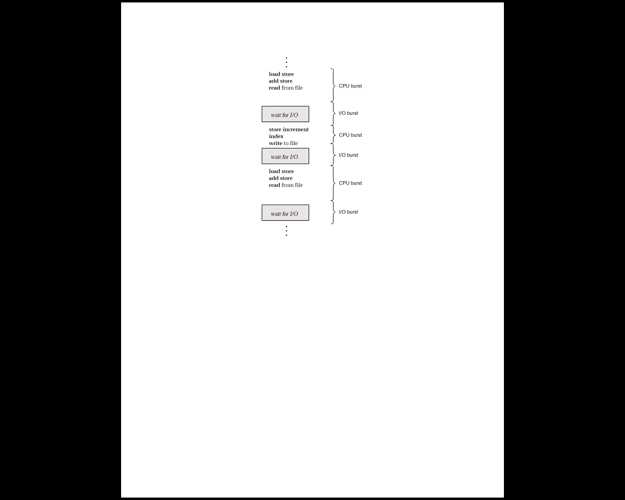
Alternating Sequence of CPU and I/O Bursts

Slide 6

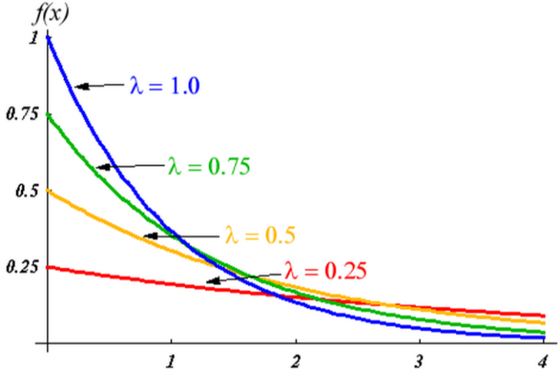
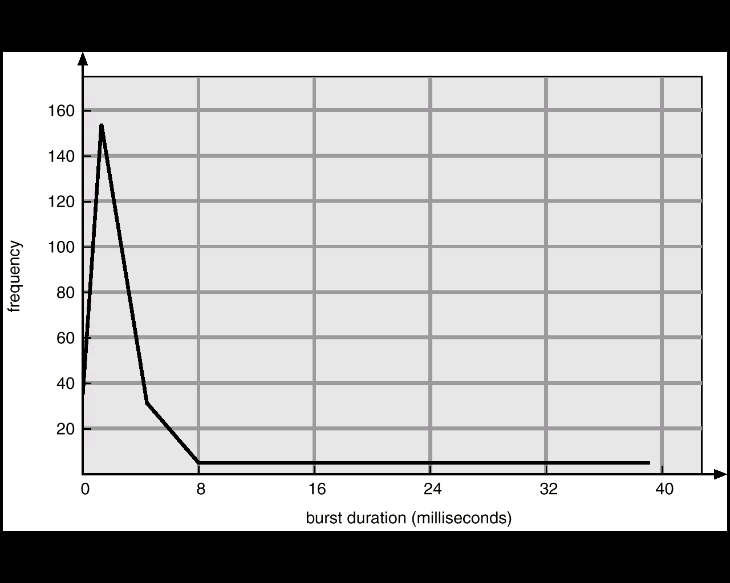
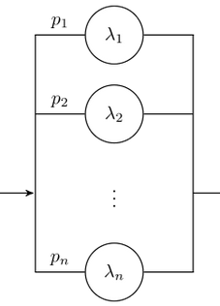
Histogram of CPU-burst Times
exponential or
hyper-exponential

Slide 7
CPU Scheduler
Selects from among the processes in memory that are ready to execute, and allocates the CPU to one of them
CPU scheduling decisions may take place when a process:
  1. Switches from running to waiting state
  2. Switches from running to ready state
  3. Switches from waiting to ready
  4. Terminates
Scheduling under 1 and 4 (no choice in terms of scheduling) is nonpreemptive
All other scheduling is preemptive

Slide 8
Diagram of Process State
admitted
interrupt
terminated
new
exit
ready
running
I/O or
event completion
scheduler dispatch
I/O or event wait
waiting

Slide 9
Preemptive Issues
Inconsistent cases may occur: preemptive scheduling incurs a cost associated with access to shared data
Affect the design of OS kernel: What happens if the process is preempted in the middle of critical changes (for instance, I/O queues) and the kernel (or the device driver) needs to read or modify the same structure?
  Unix solution: waiting either for a system call to complete or for an I/O block to take place before doing a context switch
  However, weak in supporting real-time computing and multiprocessing
Windows 95 and subsequent versions, Mac OS X

Slide 10
Dispatcher
Dispatcher module gives control of the CPU to the process selected by the short-term scheduler; this involves:
  switching context
  switching to user mode
  jumping to the proper location in the user program to restart that program
Dispatch latency – time it takes for the dispatcher to stop one process and start another running

Slide 11
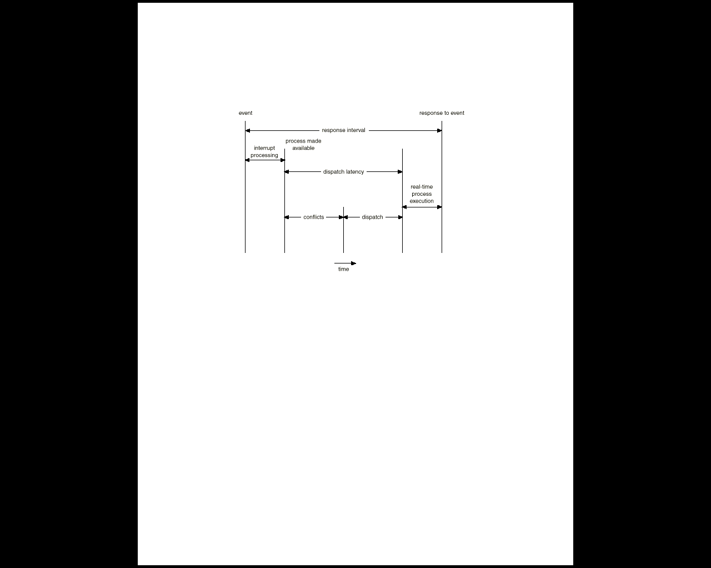
Dispatch Latency

Slide 12
Scheduling Criteria
CPU utilization
  theoretically: 0%~100%
  real systems: 40% (light)~90% (heavy)
Throughput
  number of completed processes per time unit
Turnaround time (of a process)
  submission ~ completion
Waiting time (of a process)
  total waiting time in the ready queue
Response time (of a request)
  submission ~ the first response is produced
max
min

Slide 13
Scheduling Algorithms
first-come, first-served (FCFS) scheduling
shortest-job-first (SJF) scheduling
priority scheduling
round-robin scheduling
multilevel queue scheduling
multilevel feedback queue scheduling

Slide 14
First-Come, First-Served Scheduling (1)
Simplest, non-preemptive, often having a long average waiting time
Example:
Process Burst Time
P1 24
P2 3
P3 3
P1
P2
P3
AWT = (0+24+27)/3
= 17
0 24 27 30
P2
P3
P1
AWT = (6+0+3)/3
= 3
0 3 6 30

Slide 15
First-Come, First-Served Scheduling (2)
Convoy effect: short process behind long process
  P1: a CPU bound process
  others: I/O bound
    P1 uses CPU, all others wait for CPU
        I/O devices idle
    P1 uses I/O, all others use CPU and then soon wait for I/O
        CPU idle
    P1 uses CPU, all others uses I/O and then soon wait for CPU
  lower CPU and I/O utilization

Slide 16
Shortest-Job First (SJF) Scheduling (1)
The smallest next CPU burst is selected
Provide the minimum average waiting time (optimal)
difficulty: no way to know length of the next CPU burst. Thus, it cannot be implemented in short-term scheduler
Process Burst Time
P1 6
P2 8
P3 7
P4 3
AWT = (3+16+9+0)/4
= 7
P4
P1
P3
P2
0 3 9 16 24

Slide 17
Frequently used in long-term scheduling
  A user is asked to estimate the job length. A lower value means faster response. Too low a value will cause timeout (resubmission).
Approximate SJF: the next burst can be predicted as an exponential average of the measured length of previous CPU bursts
history
new one

Slide 18
Exponential predication of next CPU burst
burst length
12
10
8
6
4
2
time
CPU burst t_{n} t₀=6 4 6 4 13 13 13 ...
guess τ_{n} τ₀=10
8
6
6
5
9
11
12
Diff. 4 4 0 2 -8 -4 -2 ...

Slide 19
Shortest-Job First (SJF) Scheduling (2)
Two schemes
  nonpreemptive – once CPU given to the process it cannot be preempted until completes its CPU burst
  preemptive – if a new process arrives with CPU burst length less than remaining time of current executing process, preempt. This scheme is know as the
  Shortest-Remaining-Time-First (SRTF)

Slide 20
Example of Non-Preemptive SJF
Process Arrival Time Burst Time
P₁ 0.0 7
P₂ 2.0 4
P₃ 4.0 1
P₄ 5.0 4
SJF (non-preemptive)
Average waiting time = [0 + (8-2) + 3 + 7]/4 = 4
P₁
P₃
P₂
P₄
0
3
7
8
12
16

Slide 21
Example of Preemptive SJF
Process Arrival Time Burst Time
P₁ 0.0 7
P₂ 2.0 4
P₃ 4.0 1
P₄ 5.0 4
SJF (preemptive)
Average waiting time = [(16-7) + 1 + 0 +2]/4 = 3
P₁
P₂
P₃
P₂
P₄
P₁
0
2
4
5
7
11
16

Slide 22
Priority Scheduling
A priority number (integer) is associated with each process
The CPU is allocated to the process with the highest priority (smallest integer ≡ highest priority)
  Preemptive
  nonpreemptive
SJF is a priority scheduling where priority is the predicted next CPU burst time
Problem ≡ Starvation – low priority processes may never execute. (At MIT, there was a job submitted in 1967 that had not be run in 1973.)
Solution ≡ Aging – as time progresses increase the priority of the process

Slide 23
An Example
Process Burst Time Priority
P1 10 3
P2 1 1
P3 2 4
P4 1 5
P5 5 2
P2
P5
P1
P3
P4
0 1 6 16 18 19
AWT = (6+0+16+18+1)/5=8.2

Slide 24
Round Robin (RR)
Each process gets a small unit of CPU time (time quantum), usually 10-100 milliseconds. After this time has elapsed, the process is preempted and added to the end of the ready queue.
If there are n processes in the ready queue and the time quantum is q, then each process gets 1/n of the CPU time in chunks of at most q time units at once. No process waits more than (n-1)q time units.
Performance
  q large ⇒ FIFO
  q small ⇒ q must be large with respect to context switch, otherwise overhead is too high

Slide 25
Example of RR with Time Quantum = 20
Process Burst Time
P₁ 53
P₂ 17
P₃ 68
P₄ 24
The Gantt chart is:
Typically, higher average turnaround than SJF, but better response
P₁
P₂
P₃
P₄
P₁
P₃
P₄
P₁
P₃
P₃
0
20
37
57
77
97
117
121
134
154
162

Slide 26
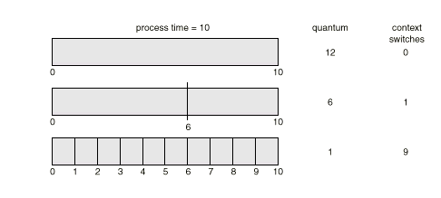
Time Quantum and Context Switch Time

Slide 27
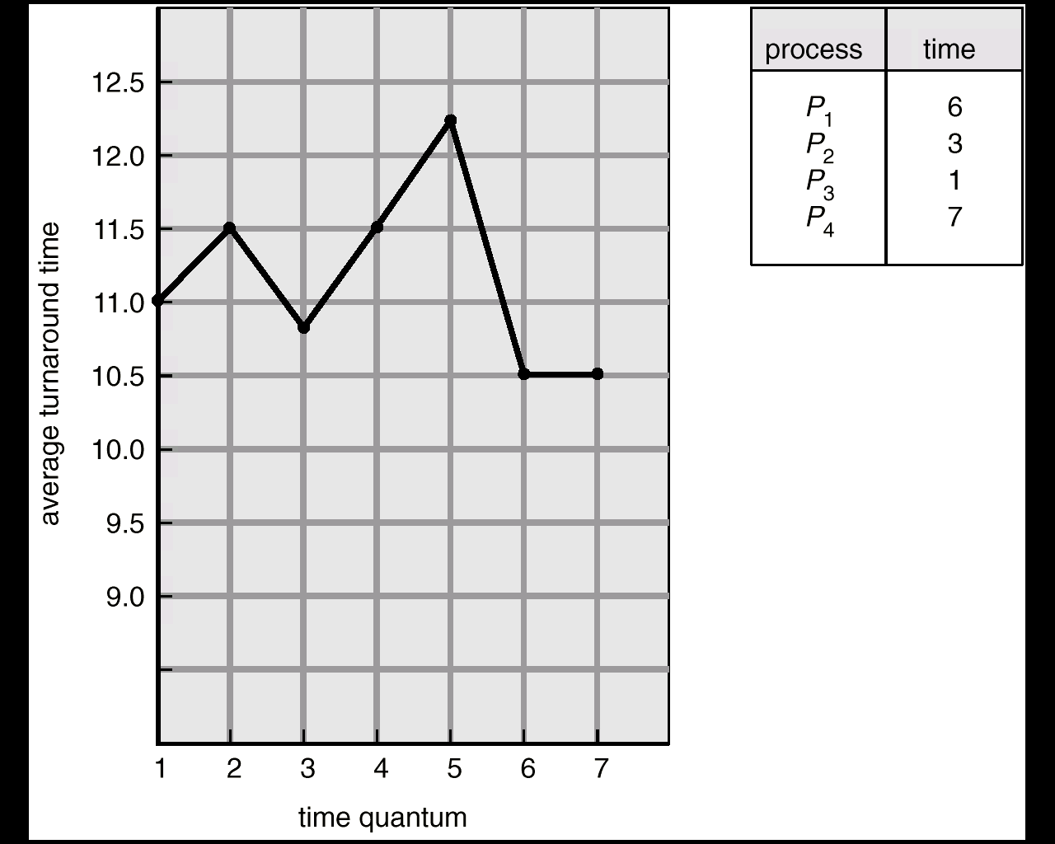
Turnaround Time Varies With The Time Quantum
5 3 1 5 1 2
15+
8+
9+
17 = 49
49/4 = 12.25

Slide 28
Multilevel Queue
Ready queue is partitioned into separate queues:
foreground (interactive)
background (batch)
Each queue has its own scheduling algorithm,
foreground – RR
background – FCFS
Scheduling must be done between the queues.
  Fixed priority scheduling; (i.e., serve all from foreground then from background). Possibility of starvation.
  Time slice – each queue gets a certain amount of CPU time which it can schedule amongst its processes; i.e.,
    80% to foreground in RR
    20% to background in FCFS

Slide 29
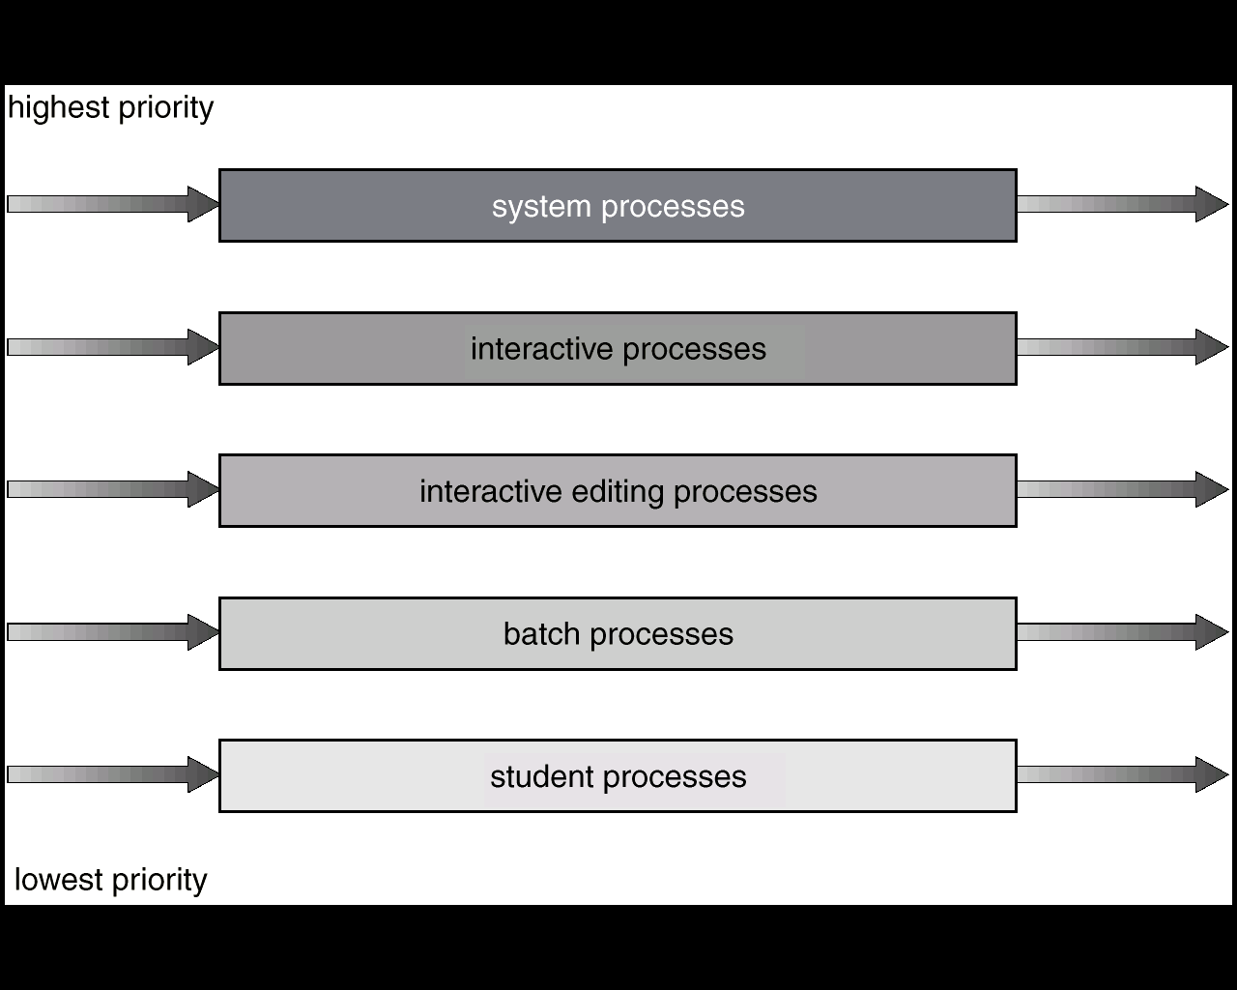
Multilevel Queue Scheduling

Slide 30
Multilevel Feedback Queue
A process can move between the various queues; aging can be implemented this way
Multilevel-feedback-queue scheduler defined by the following parameters:
  number of queues
  scheduling algorithms for each queue
  method used to determine when to upgrade a process
  method used to determine when to demote a process
  method used to determine which queue a process will enter when that process needs service

Slide 31
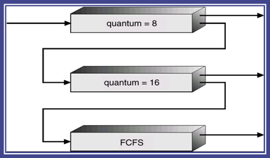
Example of Multilevel Feedback Queue
Three queues:
  Q₀ – time quantum 8 milliseconds
  Q₁ – time quantum 16 milliseconds
  Q₂ – FCFS
Scheduling
  A new job enters queue Q₀ which is served FCFS. When it gains CPU, job receives 8 milliseconds. If it does not finish in 8 milliseconds, job is moved to queue Q₁.
  At Q₁ job is again served FCFS and receives 16 additional milliseconds. If it still does not complete, it is preempted and moved to queue Q₂.

Slide 32
Thread Scheduling
User-level threads are managed by a thread library, and the kernel is unaware of them. To run on a CPU, user-level threads are ultimately mapped to an associated kernel-level thread, or LWP.
  Process local scheduling (process-contention scope): Thread scheduling is done local to the application. The threads library schedules user-level threads to run on an available LWP
  How different threads library locally schedule threads is beyond this course. We omit the discussion here.
  System global scheduling (system-contention scope): The kernel decides which kernel thread to schedule (competition among all threads in system)
competition between threads
of the same process

Slide 33
Pthread Scheduling API
#include <pthread.h>
#include <stdio.h>
#define NUM_THREADS 5
int main(int argc, char *argv[])
{
int i;
pthread_t tid[NUM_THREADS];
pthread_attr_t attr;
/* get the default attributes */
pthread_attr_init(&attr);
/* set the scheduling algorithm to PROCESS or SYSTEM */
pthread_attr_setscope(&attr, PTHREAD_SCOPE_SYSTEM);
/* set the scheduling policy - FIFO, RT, or OTHER */
pthread_attr_setschedpolicy(&attr, SCHED_OTHER);
/* create the threads */
for (i = 0; i < NUM_THREADS; i++)
pthread_create(&tid[i],&attr,runner,NULL);
  PTHREAD SCOPE PROCESS schedules threads using PCS scheduling
  PTHREAD SCOPE SYSTEM schedules threads using SCS scheduling.
limited by OS: Linux and Mac OS X only allow PTHREAD_SCOPE_SYSTEM

Slide 34
Pthread Scheduling API
/* now join on each thread */
for (i = 0; i < NUM THREADS; i++)
pthread_join(tid[i], NULL);
}
/* Each thread will begin control in this function */
void *runner(void *param)
{
printf("I am a thread\n");
pthread_exit(0);
}

Slide 35
Multiple-Processor Scheduling (1)
Only homogeneous systems are discussed here
Scheduling
  1. Each processor has a separate queue
  2. All processes use a common ready queue
  a. Each processor is self-scheduling
  b. Appoint a processor as scheduler for the
  other processes (the master-slave structure)
load balance, NUMA: processor affinity
cache miss (memory stall), instruction pipeline: LP
SMP
processing element (PE) ≡ physical processors (PP)
logical processors (LP) ≡ hardware thread (w. machine-state registers)
SMT(HTT)

Slide 36
Multiple-Processor Scheduling (2)
Asymmetric multiprocessing: all system activities are handled by a processor (alleviating the need for data sharing), the others only execute user code (allocated by the master), which is far simple than SMP
Symmetric multiprocessing (SMP) – each processor is self-scheduling, all processes in common ready queue, or each has its own private queue of ready processes
  SMT (Hyperthreading): one CPU, multi-logical processors
Processor affinity: a process has an affinity for the processor on which it is currently running
  soft affinity: possible to migrate between PEs
  hard affinity : not to migrate to other PEs
Cache memory
validating
Keep running on the same processor

Slide 37
SMT: Symmetric Multithreading
❶ cache miss
memory stall
Hyper-threading technology (HTT), intel©
  providing useful work for execution units that would otherwise be idle, for example during a cache miss, or branch misprediction.
SMP: Allow several threads to run concurrently by providing multiple physical processors (PPs).
SMT: … providing multiple logical processors (LPs).
Each LP has its own architecture state, including general-purpose and machine-state registers.
  LP is responsible for its own interrupt handling
SMT is a feature provided by H/W (state, interrupt handling), not S/W.
  Certain performance gain are possible if OS is aware that.
  e.g., Consider a system with two PPs, both are idle. The scheduler should first try scheduling separate threads on each PP rather than on separate LPs on the same PP.

Slide 38
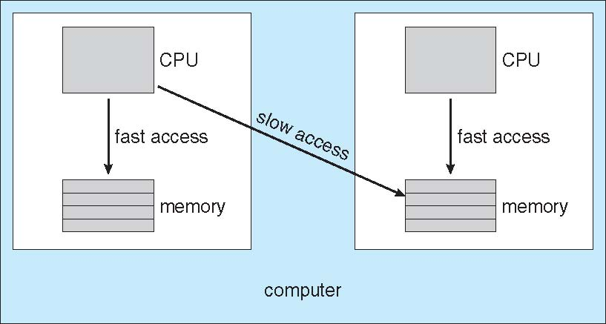
NUMA and CPU Scheduling
❷ scheduler
and memory
placement
NUMA (non-uniform memory access):
  occurs in systems containing combined CPU and memory boards.
  (CPU scheduler and memory-placement works together) A process (assigned affinity to a CPU) can be allocated memory on the board where that CPU resides.
SoC
SiP: system in package

Slide 39
Load Balancing
❸ load balancing
Keep the workload evenly distributed across all PEs (Processing Elements).
  Only necessary on systems where each PE has its own private queue of eligible processes to execute.
Two strategies: Push migration, Pull migration
  Push: move (push) processes from overloaded to idle or less-busy
  Pull: idle PE pulls a waiting task from a busy PE
  Often implemented in parallel
Load balancing often counteracts the benefits of processor affinity.

Slide 40
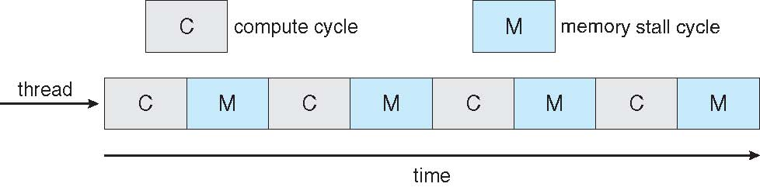
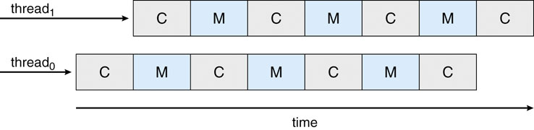
Multicore Processors (1)
Faster and consume less power
memory stall: When access memory, it spends a significant amount of time waiting for the data become available. (e.g. cache miss)
Multi-threaded multicore systems: two (or more) hardware threads are assigned to each core
Takes advantage of memory stall to make progress on another thread while memory retrieve happens.

Slide 41
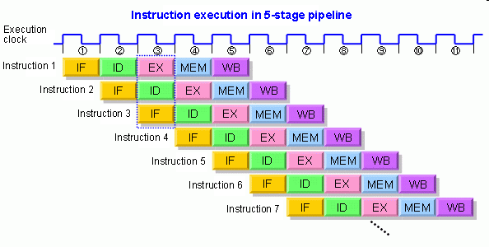
Multicore Processors(2)
❹ multithread PEs
  UltraSPARC T1: 8 cores per chip and 4 hardware threads per core, from the perspective of the OS, 32 logical processors.
Two ways to multithread a PE: coarse-grained and fine-grained
  coarse-grained: switch to another thread when a memory stall occurs. The cost is high as the instruction pipeline must be flushed.
  fine-grained (interleaved): switch between threads at the boundary of an instruction cycle. The architecture design includes logic for thread switching – cost is low.
OS View: Hardware thread = Logical processor

Slide 42
Multicore Processors (3)
Scheduling for Multi-threaded multicore systems
  1st level: Choose which software thread to run on each hardware thread (logical processor).
  2nd level: How each core decides which hardware thread to run.
UltraSPARC T1: a simple round-robin algorithm to schedule the 4 hardware threads to each core.
Intel Itanium (dual-core processor with two hardware-managed threads per core):
  Assign each hardware thread with a dynamic urgency (0~7)
  Identify 5 events that may trigger a thread switch. Compare the urgency of 2 threads and selects the highest one when switch.

Slide 43
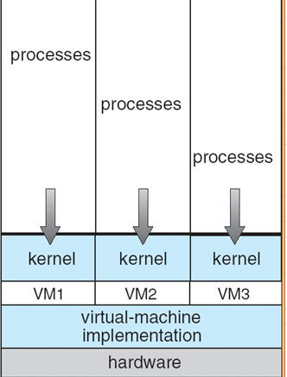
Virtualization and Scheduling
Even a single-CPU system, frequently acts like a multiprocessor system. The virtualization software presents one or more virtual CPUs to each of the VM running on the system and then schedules the use of the physical CPUs among VMs.
Overcommitment: the guests are configured for more CPUs than exist in the system.
  The VMM (overhead) itself needs some CPU cycles for guest management and I/O.
Fairness: if there are 6 hardware CPUs and 12 guest-allocated CPUs, the VMM could allocate CPU resources proportionally, giving each guest half of the CPU resources it believes it has.

Slide 44
Virtualization and Scheduling
Difficult to summarize the effect of virtualization on scheduling
  A given 100ms time slice may take much more than 100ms of virtual CPU time. Depending on how busy the system (host OS) is, the time slice may take a second or more.
  The time-of-day clocks in virtual machine are incorrect because timers take longer to trigger.
To correct for this, a VMM will have an application available for each OS. This application corrects clock drift and others.
How do VMMs schedule CPU use when guest OSs believe they have dedicated CPUs?
How can MM work when many guests require large amounts of memory?

Slide 45
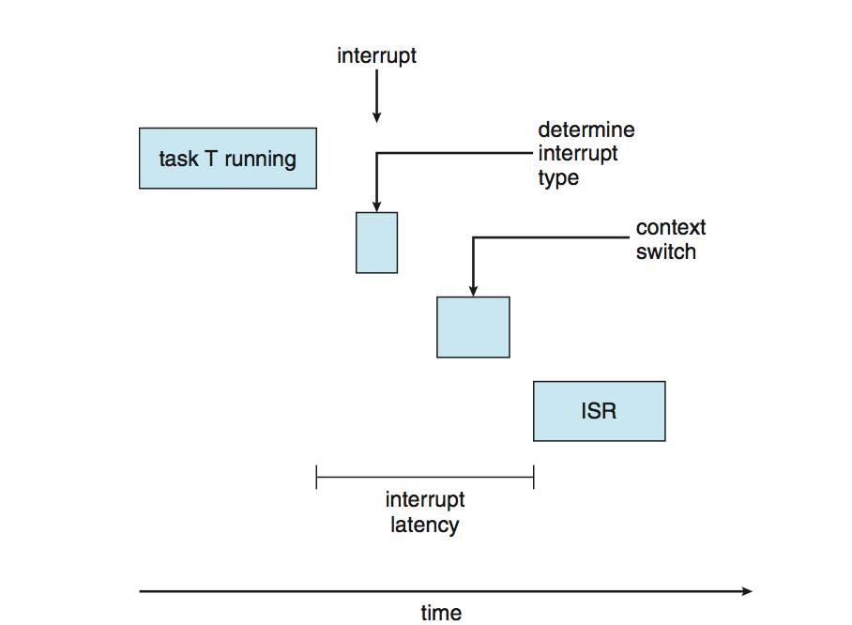
Real-Time Scheduling (1)
Hard real-time systems – required to complete a critical task within a guaranteed amount of time
  Resource reservation is needed
  special purpose software on dedicated HW
Soft real-time computing – requires that critical processes receive priority over less fortunate ones
interrupt service routine

Slide 46
Real-Time Scheduling (2)
Scheduler for soft real-time system
Priority scheduling (real-time process must have the highest priority). Easy!
The dispatch latency must be small
  Problem: Most OS waits a system call to complete (or I/O block to take place) before doing context switch
Solution: system calls should be pre-emptible
  Insert preemption points in long-duration system calls (The latency is still long, there are a few preemption points.)
  Make the entire kernel preemptible

Slide 47
Real-Time Scheduling (3)
Make the entire kernel preemptible
  All kernel data structure used by lower-priority must be protected from modification by high-priority process.
  Problem: priority inversion (A higher-priority process is waiting for a lower-priority one to finish and release some resources)
  Solution: priority inheritance protocol (all lower-priority processes inherit the high priority until they are done with the resource in question.)

Slide 48
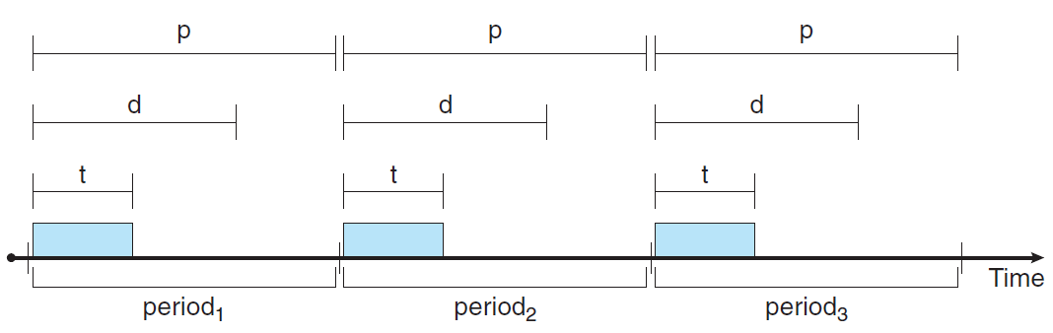
Scheduling Algorithms for Hard Real-time
Periodic process: Once acquired the CPU, it has a fixed processing time t, a deadline d by which it must be serviced by the CPU, and a period p, where 0 ≤ t ≤ d ≤ p.
  The rate of a periodic task is 1/p.

Slide 49
Scheduling Algorithms for Hard Real-time
Schedulers assign priorities according to a process’s deadline or rate requirements.
admission-control: the scheduler does one of two things.
  It either admits the process, guaranteeing that the process will complete on time, or
  rejects the request as impossible if it cannot guarantee that the task will be serviced by its deadline.

Slide 50
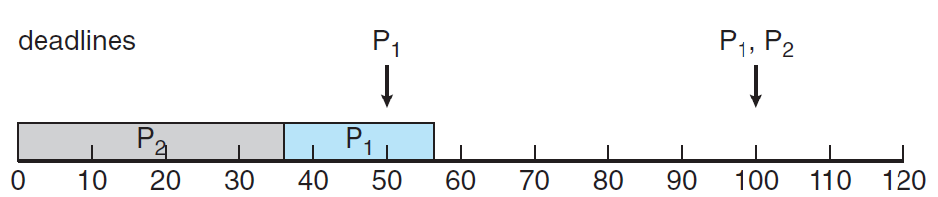
Scheduling Algorithms for Hard Real-time
Static priority policy with preemption
Priority: inverse of its period. Assign a higher priority that requires the CPU more often.
If p₁ = 50 and p₂ = 100; t₁ = 20 and t₂ = 35 (execution time). deadline: complete its CPU burst by the start of its next period.
  t₁/p₁= 20/50 = 0.40, t₂/p₂= 35/100 = 0.35
  If assign P₂ a higher priority than P_{1,} caused P₁ to miss its deadline
CPU utilization

Slide 51
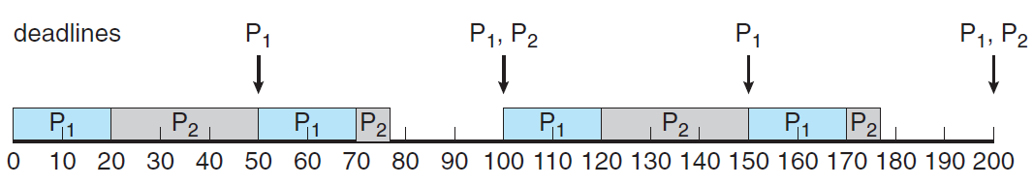
Rate Montonic Scheduling
Liu and Layland 1973
Rate-monotonic scheduling: assign P₁ a higher priority than P₂ because p₁(50) < p₂(100).
  At time 50: P₂ is preempted by P₁. Resumes P₂ at 70 with 5 ms remaining.
  The system is idle until time 100.
RM is optimal: if a set of processes cannot be scheduled by this algorithm, it cannot be scheduled by any other algorithm that assigns static priorities.
CPU utilization = 75 percent

Slide 52
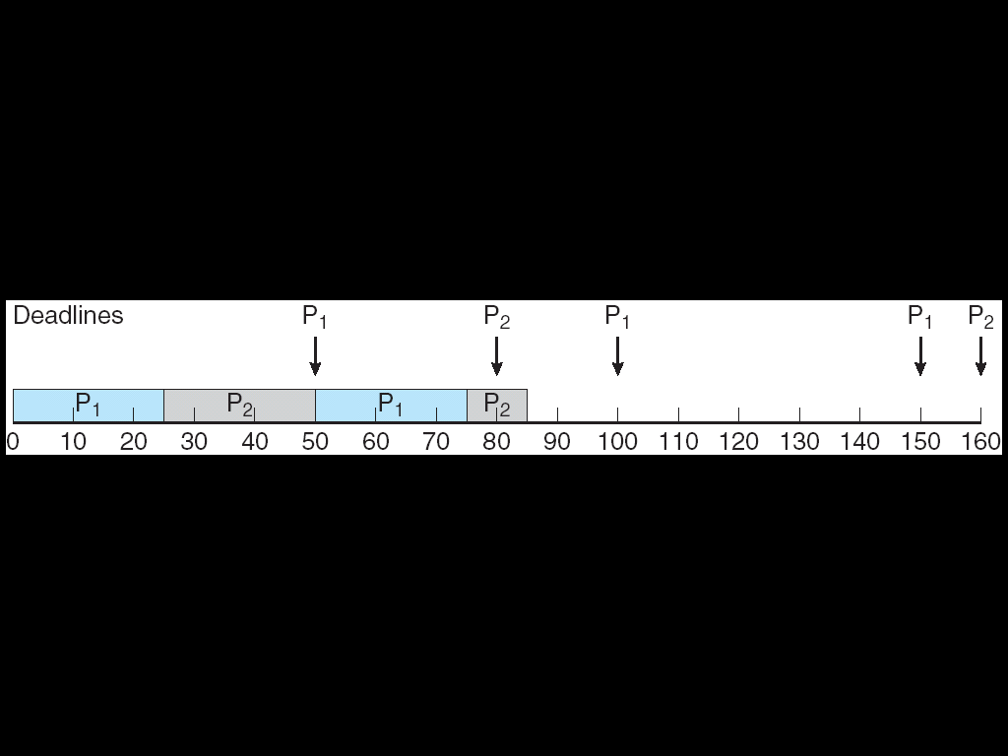
Rate Montonic Scheduling
An example that cannot be scheduled using RM:
  P₁: p₁ = 50 and t₁ = 25. P₂: p₂ = 80 and t₂ = 35.
  RM scheduling would assign process P₁ a higher priority, as it has the shorter period.
  P₂ misses the deadline for completion of its CPU burst at time 80.
CPU utilization = 94 percent ((25/50)+(35/80))

Slide 53
Rate Montonic Scheduling
Despite being optimal, RM has a limitation:
  CPU utilization is bounded, and it is not always possible fully to maximize CPU resources.
  The worst-case CPU utilization for scheduling N processes is N(2^{1/N} − 1).
  With one process in the system, CPU utilization is 100 percent, but it falls to approximately 69 percent as the number of processes approaches infinity.
ln2 = 0.6931…

Slide 54
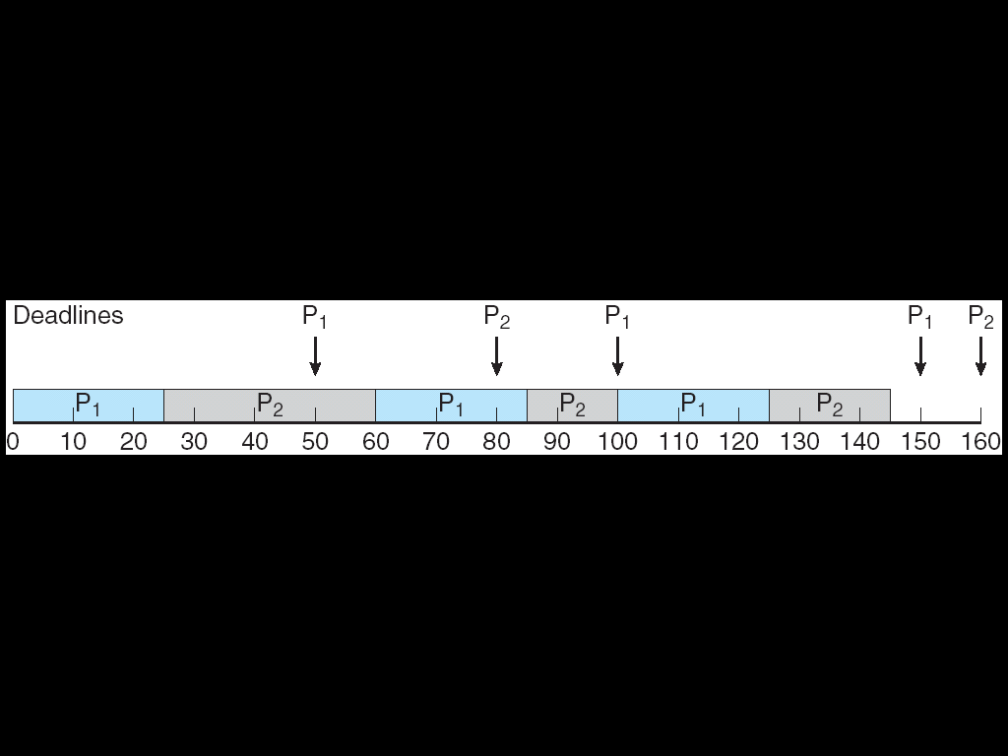
Earliest Deadline First Scheduling (EDF)
Liu and Layland 1973
EDF scheduling dynamically assigns priorities according to deadline. The earlier the deadline, the higher the priority; the later the deadline, the lower the priority.
  must announce its deadline requirements to the system.
  P₁: p₁ = 50 and t₁ = 25. P₂: p₂ = 80 and t₂ = 35.
  Process P₁ has the earliest deadline initially.

Slide 55
Earliest Deadline First Scheduling (EDF)
  RM scheduling allows P₁ to preempt P₂ at time 50, EDF scheduling allows process P₂ to continue running.
  P₂ now has a higher priority than P₁ because its next deadline (at time 80) is earlier than that of P₁ (at time 100). Thus, both P1 and P2 meet their first deadlines.
  Process P₁ again begins running (60-85), also meeting the deadline 100.
  P₂ begins running, only to be preempted by P₁ at the start of its next period at time 100.
P₁ starts after 100
preempted by P₁
idle until 150

Slide 56
EDF vs. RM
Unlike RM, EDF does not require that processes be periodic, nor must a process require a constant amount of CPU time per burst.
The only requirement is that a process announce its deadline to the scheduler when it becomes runnable.
The appeal of EDF scheduling is that it is theoretically optimal—theoretically, it can schedule processes so that each process can meet its deadline requirements and CPU utilization will be 100 percent.
In practice, however, it is impossible to achieve this level of CPU utilization due to the cost of context switching between processes and interrupt handling.

Slide 57
Proportional Share Scheduling
Proportional share schedulers operate by allocating T shares among all applications.
  An application can receive N shares of time, thus ensuring that the application will have N/T of the total processor time.
PS must work in conjunction with an admission-control policy to guarantee that an application receives its allocated shares of time.
T = 100 shares, A:50, B:15, C:20 shares.
Ensures that A (50%), B (15%), and C (20%).

Slide 58
POSIX Real-Time Scheduling
The POSIX.1b standard
Two scheduling classes for real-time threads:
  SCHED_FIFO - threads are scheduled using a FCFS strategy with a FIFO queue. There is no time-slicing for threads of equal priority
  SCHED_RR - similar to SCHED_FIFO except time-slicing occurs for threads of equal priority
Getting and setting scheduling policy:
  pthread_attr_getsched_policy(pthread_attr_t *attr, int *policy)
  pthread_attr_setsched_policy(pthread_attr_t *attr, int policy)

Slide 59
Operating System Examples
Linux scheduling
Windows scheduling
Solaris scheduling
Java scheduling

Slide 60
Linux Scheduling – preemptive & priority
Version 2.5: support SMP, Load balancing & Processor affinity
  Constant order O(1) scheduling time
  Preemptive, priority based. Two priority ranges: time-sharing and real-time, Time-sharing (100-140) and Real-time (0-99)
  Higher priority with longer time quanta
  Map into global priority with numerically lower values indicating higher priority
  Prioritized credit-based – process with most credits is scheduled next
  Credit subtracted when timer interrupt occurs
  When credit = 0, another process chosen
excellent performance
but poor response time

Slide 61
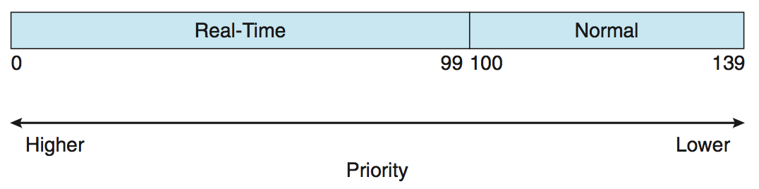
Linux Scheduling – preemptive & priority
  When all processes have credit = 0, recrediting occurs
    Based on factors including priority and history
Worked well, but poor response times for interactive processes
Real-time
  Soft real-time (assigned static priorities)
  Posix.1b compliant – two classes
    FCFS and RR
nice value –20
nice value 19

Slide 62
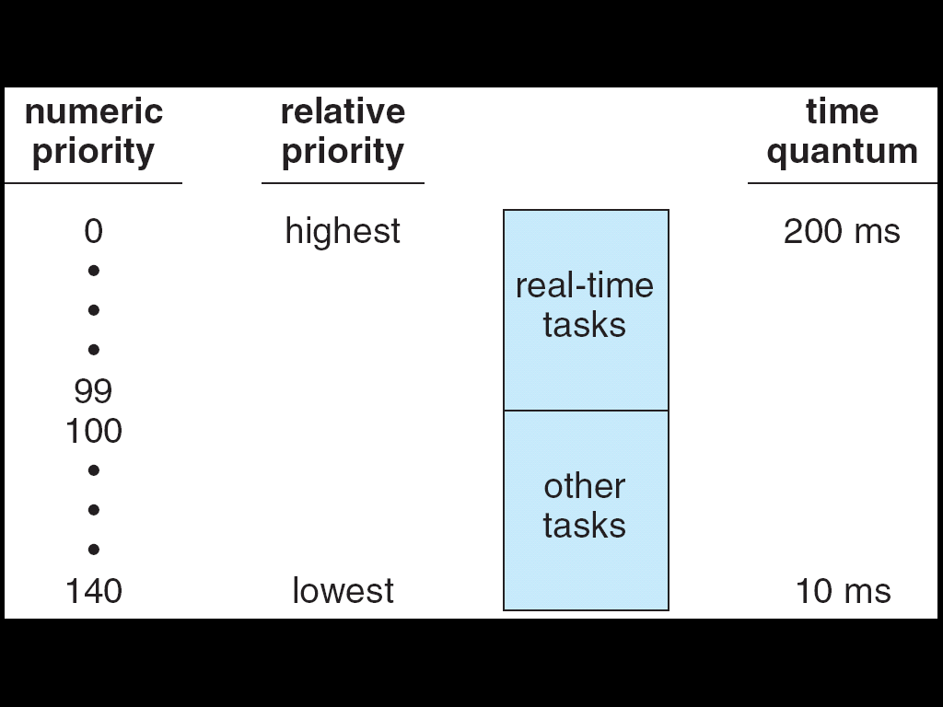
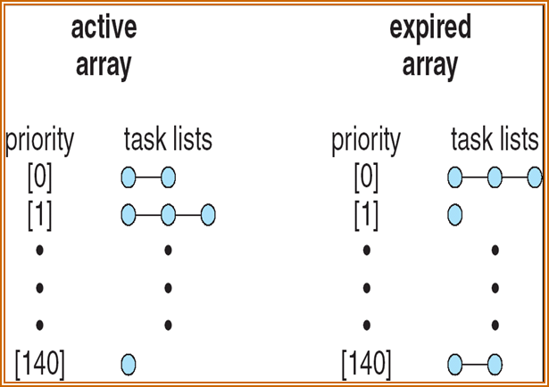
Relationship Between Priorities and Time-quantum
fixed
higher priority with longer time quanta
Active Lists and Expired Lists
new tasks may come consecutively

Slide 63
Linux Scheduling in Version 2.6.23 +
Completely Fair Scheduler (CFS)
Scheduling classes
  Each has specific priority
  Scheduler picks highest priority task in highest scheduling class
  Rather than quantum based on fixed time allotments, based on proportion of CPU time (allocated ratio)
  2 scheduling classes included: default and real-time, others can be added
Quantum calculated based on nice value from -20 to +19
  Lower value is higher priority
  Calculates targeted latency – interval of time during which task should run at least once
  Targeted latency can increase if say number of active tasks increases
nice to other tasks
Instead of time quantum

Slide 64
Linux Scheduling in Version 2.6.23 +
CFS scheduler maintains per task virtual run time: vruntime
  Associated with decay factor based on priority of task – lower priority is higher decay rate
  Normal default priority (nice value = 0) yields virtual run time = actual run time
To decide next task to run, scheduler picks task with lowest virtual run time
lower-priority runs for 200 ms, its vruntime > 200 ms.
higher-priority runs for 200 ms, its vruntime < 200 ms.

Slide 65
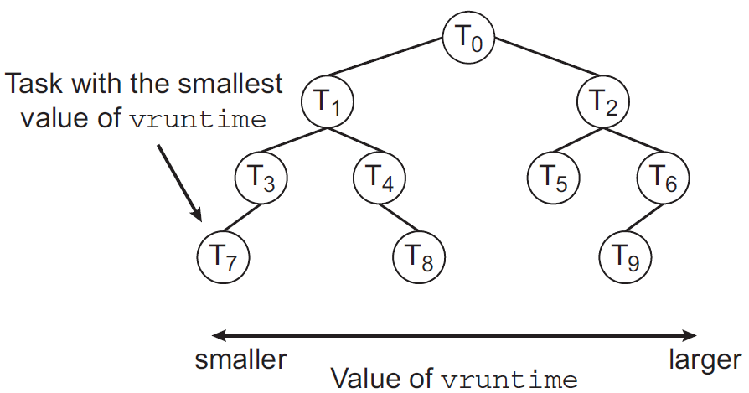
CFS Performance
Each runnable task is placed in a red-black tree - a balanced binary search tree whose key is based on the value of vruntime.
Guibas and Sedgewick 1978
Insert, Delete, Search: O(lgN)

Slide 66
CFS Performance
Insert, Delete: O(lgN)
When a task becomes runnable, it is added to the tree. If a task on the tree is not runnable, it is removed.
Generally speaking, tasks that have been given less processing time (smaller values of vruntime) are toward the left side of the tree, and tasks that have been given more processing time are on the right side.
According to the properties of a binary search tree, the leftmost node has the smallest key value, which means that it is the task with the highest priority.
Because the red-black tree is balanced, navigating it to discover the leftmost node will require O(lgN) operations.

Slide 67
CFS Performance
Linux scheduler caches this value in the variable rb leftmost, and thus
determining which task to run next requires only retrieving the cached value.
CPU-bound: lower-priority, vruntime > 200 ms.
I/O-bound: higher-priority, vruntime < 200 ms.
When the I/O-bound task becomes eligible to run, will preempt the CPU-bound task.

Slide 68
Windows Scheduling
priority-based preemptive scheduling
real-time threads can preempt non-real-time
32-level priority scheme
Priority class and relative priority combine to give numeric priority
Base priority is NORMAL within the class
If quantum expires, priority lowered, but never below base
If no run-able thread, runs idle thread.

Slide 69
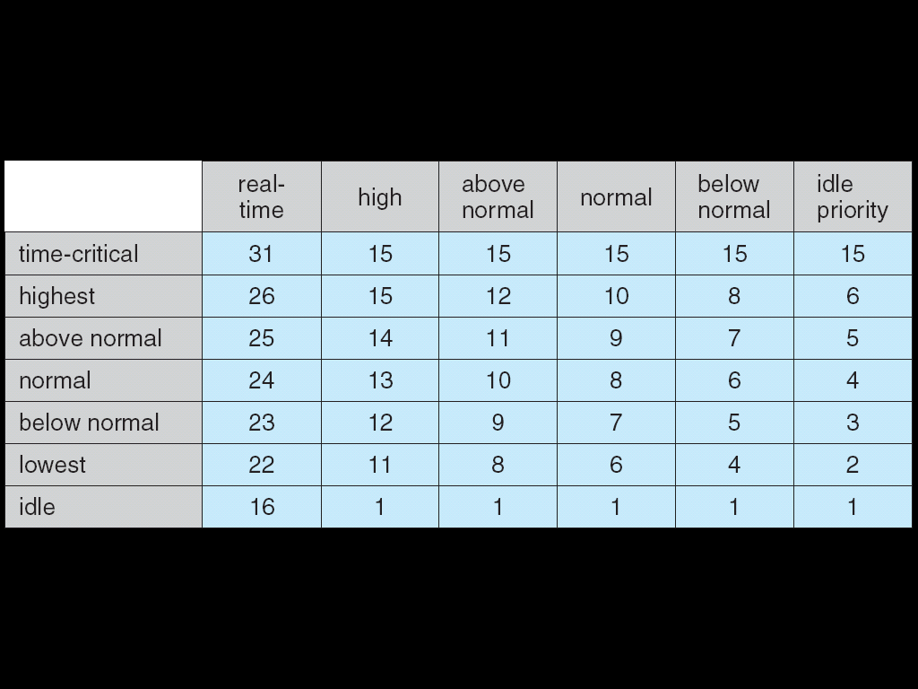
Windows Priorities
Base priorities: 24, 13, 10, 8, 6, 4.
Demote and upgrade
For interactive: (foreground process) Increases 3 times (time slices) longer before preemption.

Slide 70
Windows Priorities
If wait occurs, priority boosted depending on what was waited for.
Foreground window given 3x priority boost.
Windows 7 added user-mode scheduling (UMS)
  UMS is not intended to be used directly by the programmer.
  An application can create and schedule multiple threads without involving the Windows kernel scheduler.
  UMS schedulers come from programming language libraries, like C++ Concurrent Runtime (ConcRT) framework.
scheduled on the available cores

Slide 71
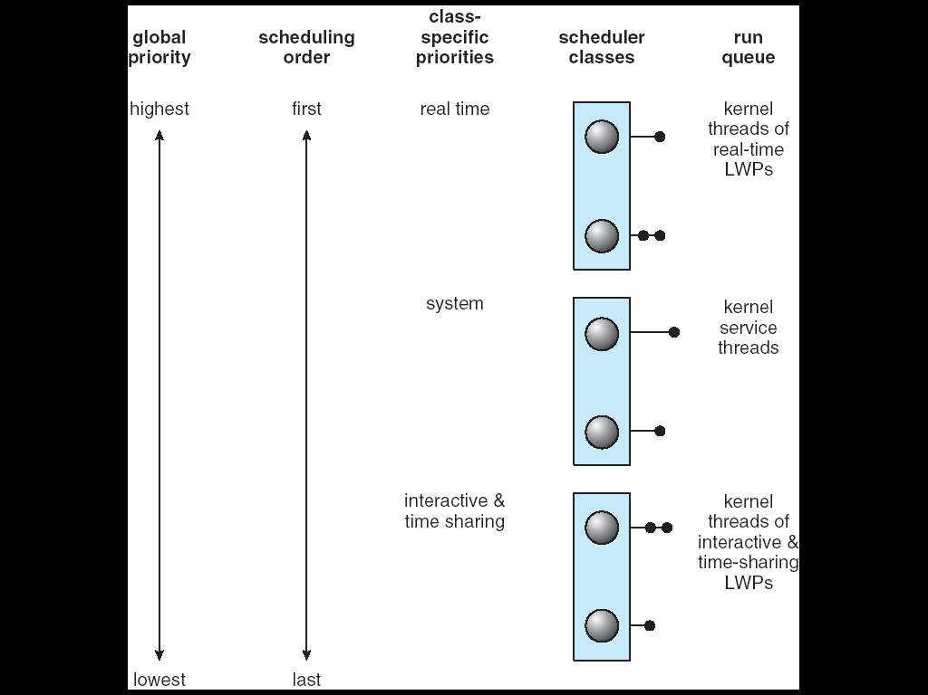
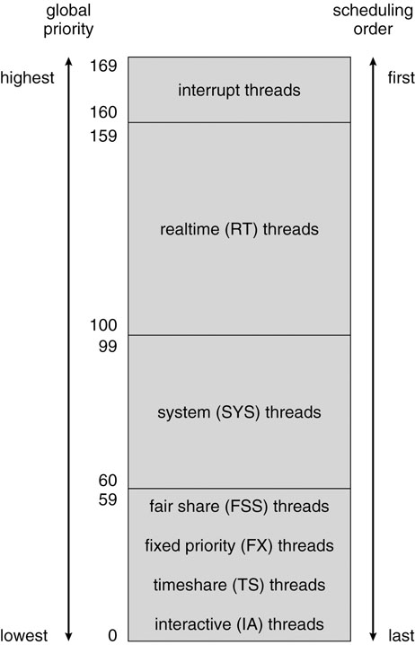
Solaris 2 Scheduling (1) priority-based scheduling
Solaris 9
provides controls for
the specific amounts
of CPU execution time
between different
fair share groups

Slide 72
Solaris 2 Scheduling (2)
Four classes of scheduling: real-time -> system -> time sharing -> interactive.
A process starts with one LWP and is able to create new LWPs as needed. Each LWP inherits the scheduling class and priority of the parent process. Default : time sharing (multilevel feedback queue)
Inverse relationship between priorities and time slices: the high the priority, the smaller the time slice.
Interactive processes typically have a higher priority; CPU-bound processes have a lower priority.

Slide 73
Solaris 2 Scheduling (3)
Uses the system class to run kernel processes, such as the scheduler and page daemon. The system class is reserved for kernel use only.
Threads in the real-time class are given the highest priority to run among all classes.
There is a set of priorities within each class. However, the scheduler converts the class-specific priorities into global priorities. (round-robin queue)

Slide 74
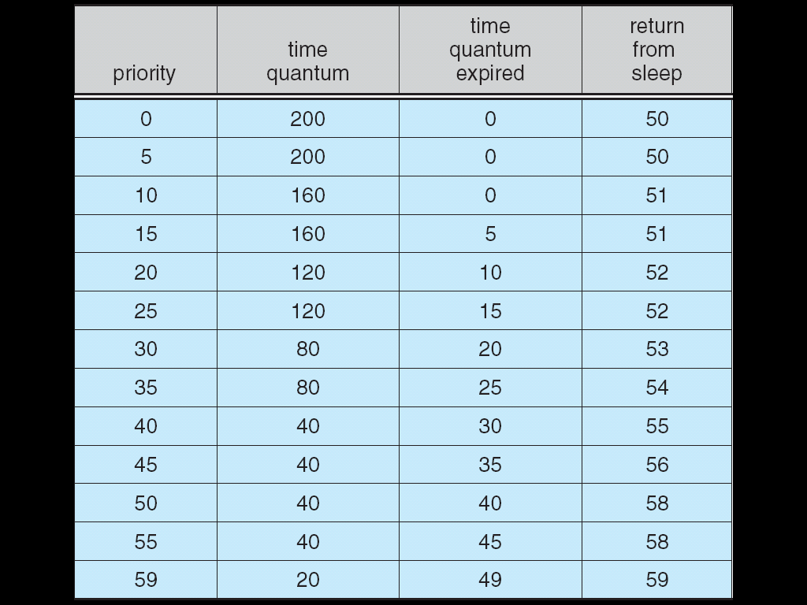
Solaris Dispatch Table,
Time-sharing and Interactive classes

Slide 75
Algorithm Evaluation
Criteria to select a CPU scheduling algorithm may include several measures, such as:
  Maximize CPU utilization under the constraint that the maximum response time is 1 second
  Maximize throughput such that turnaround time is (on average) linearly proportional to total execution time
Evaluation methods ?
  deterministic modeling
  queuing models
  simulations
  implementation

Slide 76
Deterministic modeling (1)
Analytic evaluation
  Input: a given algorithm and a system workload to
  Output: performance of the algorithm for that workload
Deterministic modeling
  Taking a particular predetermined workload and defining the performance of each algorithm for that workload.

Slide 77
Deterministic modeling (2)
FCFS
SJF
RR (q = 10)
Process Burst Time
P1 10
P2 29
P3 3
P4 7
P5 12
P1
P2
P3
P4
P5
AWT = 28 ms
0 10 39 42 49 61
P3
P4
P1
P5
P2
AWT = 13 ms
0 3 10 20 32 61
P1
P2
P3
P4
P5
P2
P5
P2
AWT = 23 ms
0 10 20 23 30 40 50 52 61

Slide 78
Deterministic Modeling (3)
J: A simple and fast method. It gives the exact numbers, allows the algorithms to be compared.
L: It requires exact numbers of input, and its answers apply to only those cases. In general, deterministic modeling is too specific, and requires too much exact knowledge, to be useful.
Usage
  Describing algorithm and providing examples
  A set of programs that may run over and over again
  Indicating the trends that can then be proved

Slide 79
Queuing Models (1)
Queuing network analysis
  Using
    the distribution of service times (CPU and I/O bursts)
    the distribution of process arrival times
  The computer system is described as a network of servers. Each server has a queue of waiting processes.
  Determining
    utilization, average queue length, average waiting time, and so on

Slide 80
Queuing Models (2)
Little's formula (for a stable system):
n = λ × W
Queuing analysis can be useful in comparing scheduling algorithms, but it also has limitations.
L: Queue model is only an approximation of a real system. Thus, the result is questionable.
  The arrival and service distributions are often defined in unrealistic, but mathematically tractable, ways.
  Besides, independent assumptions may not be true.
14 persons in queue =
7 arrives/per second ×
2 seconds waiting
  λ : average arrival rate
  n : average queue length
queue
server
W: average waiting time

Slide 81
Simulations
Simulations involve programming a model of the system. Software data structures represent the major components of the system.
J: Simulations get a more accurate evaluation of scheduling algorithms.
L: 1. expensive (several hours of computer time).
    2. large storage
    3. coding a simulator can be a major task
Generating data to drive the simulator
  a random number generator.
  trace tapes: created by monitoring the real system, recording the sequence of actual events.

Slide 82
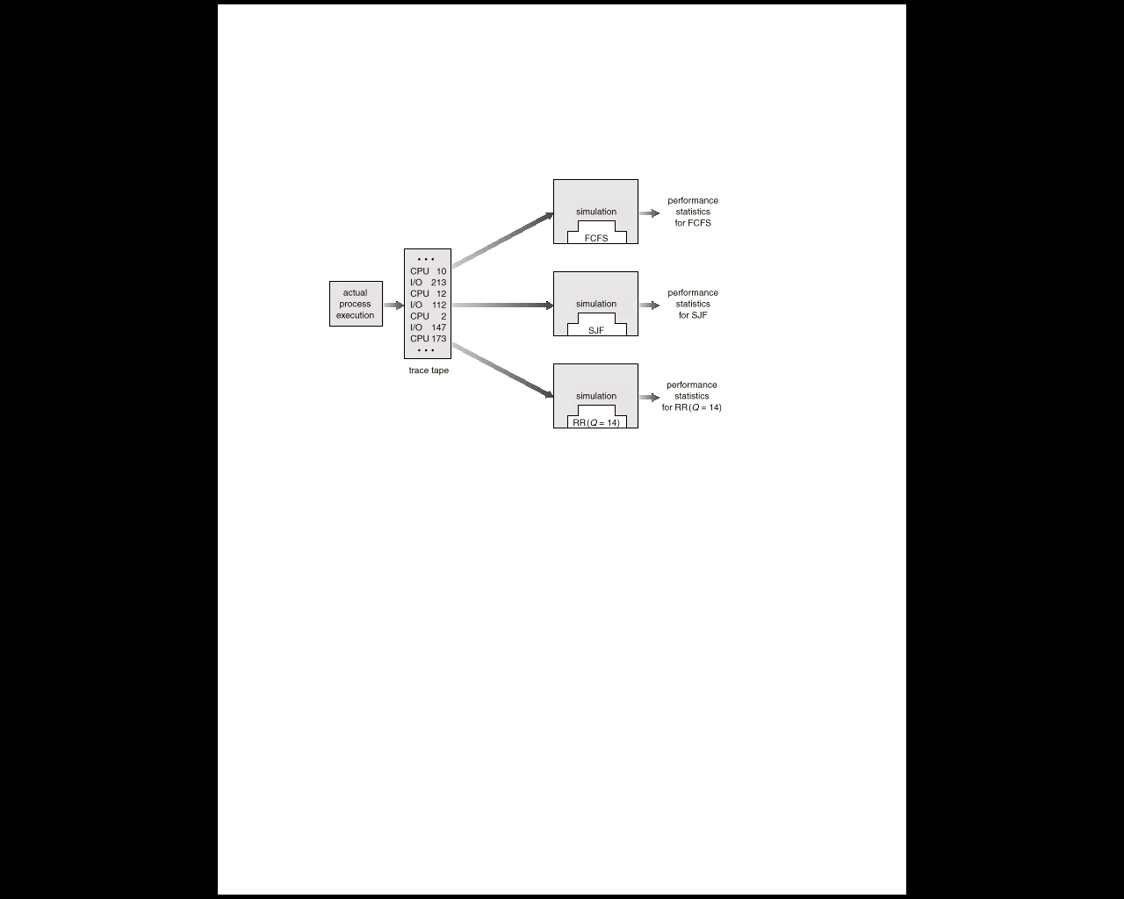
Evaluation of CPU Schedulers by Simulation

Slide 83
Implementation
Put data into a real system and see how it works.
J: The only accurate way
L: 1. cost is too high
    2. environment will change (All methods have this problem!)
      e.g., To avoid moving to a lower priority queue, a user may output a meaningless char on the screen regularly to keep itself in the interactive queue.

Slide 84
Java Thread Scheduling (1)
Preemptive, priority-based scheduling (FIFO queue)
Time slicing:
  Java does not indicate whether or not threads are time-sliced or not – it is up to the particular implementation of the JVM.
  All threads have an equal amount of CPU time on a system that does not perform time slicing, a thread may yield control of the CPU with the yield() method. Cooperative multitasking.
  Thread.yield();

Slide 85
Java Thread Scheduling (2)
Thread priorities:
  Threads are given a priority when they are created and – unless they are changed explicitly by the program – they maintain the same priority throughout their lifetime; the JVM does not dynamically alter priorities.
  The priority of a thread can also be set explicitly with the setPriority() method. The priority can be set either before a thread is started or while a thread is active.
Java-Based Round-robin Scheduler

Slide 86
Time-Slicing
Since the JVM Doesn’t Ensure Time-Slicing, the yield() Method
May Be Used:
while (true) {
// perform CPU-intensive task
. . .
Thread.yield();
}
This Yields Control to Another Thread of Equal Priority

Slide 87
Thread Priorities
Priority Comment
Thread.MIN_PRIORITY Minimum Thread Priority
Thread.MAX_PRIORITY Maximum Thread Priority
Thread.NORM_PRIORITY Default Thread Priority
Priorities May Be Set Using setPriority() method:
setPriority(Thread.NORM_PRIORITY + 2);

