Slide 1
Chapter 5
Process Synchronization
Part I: Basics

Slide 2
Outline
Background
The Critical-Section Problem
Peterson’s Solution
Synchronization Hardware
Mutex Locks and Semaphores

Slide 3
Background
Concurrent access to shared data may result in data inconsistency.
Maintaining data consistency requires mechanisms to ensure the orderly execution of cooperating processes.
Shared-memory solution to bounded-buffer problem allows at most n – 1 items in buffer at the same time. A solution where all n buffers are used is:
  Suppose that we modify the producer-consumer code by adding a variable counter, initialized to 0 and incremented each time a new item is added to the buffer

Slide 4
Bounded-Buffer (1)
Shared data
      #define BUFFER_SIZE 10
      typedef struct {
      . . .
      } item;
      item buffer[BUFFER_SIZE];
      int in = 0;
      int out = 0;
      int counter = 0;

Slide 5
Bounded-Buffer (2)
Producer process
item nextProduced;
while (1) {
while (counter == BUFFER_SIZE)
; /* do nothing */
buffer[in] = nextProduced;
in = (in + 1) % BUFFER_SIZE;
counter++;
}

Slide 6
Bounded-Buffer (3)
Consumer process
item nextConsumed;
while (1) {
while (counter == 0)
; /* do nothing */
nextConsumed = buffer[out];
out = (out + 1) % BUFFER_SIZE;
counter--;
}

Slide 7
Bounded Buffer (4)
The statements
counter++;
counter--;
must be performed atomically.
Atomic operation means an operation that completes in its entirety without interruption.

Slide 8
Bounded Buffer (5)
The statement “count++” may be implemented in machine language as:
register1 = counter
register1 = register1 + 1
counter = register1
The statement “count--” may be implemented as:
register2 = counter
register2 = register2 – 1
counter = register2

Slide 9
Bounded Buffer (6)
If both the producer and consumer attempt to update the buffer concurrently, the assembly language statements may get interleaved.
Interleaving depends upon how the producer and consumer processes are scheduled.

Slide 10
Race Condition
Assume counter is initially 5. One interleaving of statements (race condition) is:
producer: register1 = counter (register1 = 5)
producer: register1 = register1 + 1 (register1 = 6)
consumer: register2 = counter (register2 = 5)
consumer: register2 = register2 – 1 (register2 = 4)
producer: counter = register1 (counter = 6)
consumer: counter = register2 (counter = 4)
The value of counter may be either 4 or 6, where the correct result should be 5.

Slide 11
Race Condition
Race condition: The situation where several processes access and manipulate shared data concurrently. The final value of the shared data depends upon which process finishes last.
To prevent race conditions, concurrent processes must be synchronized.

Slide 12
The Critical-Section Problem
n processes all competing to use some shared data
Each process has a code segment, called critical section, in which the shared data is accessed.
Problem – ensure that when one process is executing in its critical section, no other process is allowed to execute in its critical section.

Slide 13
Solution to Critical-Section Problem (1)
1. Mutual Exclusion. If process P_{i} is executing in its critical section, then no other processes can be executing in their critical sections.
Progress. If no process is executing in its CS and there exist some processes that wish to enter their CS, then
  (1) only those not in RS can participate the decision of “the next”, and
  (2) this selection cannot be postponed indefinitely.

Slide 14
Solution to Critical-Section Problem (2)
3. Bounded Waiting. A bound must exist on the number of times that other processes are allowed to enter their CSs after a process has made a request to enter its CS and before that request is granted.
Assume that each process executes at a nonzero speed.
No assumption concerning relative speed of the n processes.

Slide 15
Initial Attempts to Solve Problem
Only 2 processes, P₀ and P₁
General structure of process P_{i} (other process P_{j})
do {
entry section
critical section
exit section
remainder section
} while (1);

Slide 16
Algorithm 1
Shared variables
  int turn;
  initially turn = 0
  turn = i ⇒ P_{i} can enter its critical section
Process P_{i}
do {
while (turn != i) ;
critical section
turn = j;
reminder section
} while (1);
Satisfies mutual exclusion, but not progress
Executing sequence: P_{i}, P_{j}, P_{i}, P_{j,} P_{i}, P_{j}, …

Slide 17
Algorithm 2 (1)
Shared variables
  boolean flag[2];
  initially flag [0] = flag [1] = false.
  flag [i] = true ⇒ P_{i} ready to enter its critical section
Process P_{i}
do {
flag[i] := true;
while (flag[j]) ;
critical section
flag [i] = false;
remainder section
} while (1);
Satisfies mutual exclusion, but not progress requirement.

Slide 18
Algorithm 2 (2)
May loop infinitely
If changes the order to be
while (flag[j]) ;
flag[i] := true;
then the condition of mutual exclusion will not hold.

Slide 19
Algorithm 3: A correct solution
Combined shared variables of algorithms 1 and 2.
Process P_{i}
do { /* Peterson’s solution
flag [i]:= true;
turn = j;
while (flag [j] and turn = j) ;
critical section
flag [i] = false;
remainder section
} while (1);
“turn” will be set for both i and j simultaneously, but only one (turn = i) or (turn = j) will last.
Meets all three requirements; solves the critical-section problem for two processes.

Slide 20
Algorithm 3 (2)
mutual exclusion
  At the moment that P_{i} enters its CS
  flag[i] = true
  either flag[j] = false, or flag[j] = true and turn = i
  If flag[j] = false, (later if P_{j} waits to enter)
    (flag[i] = true & turn = i) prevents P_{j} from entering its CS until P_{i} exits
  If flag[j] = true and turn = i, the same
progress
  suppose P_{i} wishes to enter CS
    if flag[j] = false, P_{i} can enter
    otherwise, turn allows either P_{i} or P_{j} to enter
bounded waiting: at most one entry of P_{j}

Slide 21
Bakery Algorithm
Critical section for n processes
Before entering its critical section, process receives a number. Holder of the smallest number enters the critical section.
If processes P_{i} and P_{j} receive the same number, if i < j, then P_{i} is served first; else P_{j} is served first.
The numbering scheme always generates numbers in increasing order of enumeration; i.e., 1,2,3,3,3,3,4,5...

Slide 22
Bakery Algorithm (2)
Notation
  lexicographical order (ticket #, process id #)
    (a, b) < (c, d) if a < c or if a = c and b < d
  max (a₀,…, a_{n-1})
Shared data
boolean choosing[n];
int number[n];
initialized to false and 0, respectively.

Slide 23
Bakery Algorithm (3)
do {
choosing[i] = true;
number[i] = max(number[0], number[1], …, number [n – 1])+1;
choosing[i] = false;
for (j = 0; j < n; j++) {
while (choosing[j]) ; /* Wait for the choosing of P_{j}
while ((number[j] != 0) && (number[j],j) < number[i], i)) ; /* smallest first
}
critical section
number[i] = 0;
remainder section
} while (1);

Slide 24
Bakery Algorithm (4)
Key for showing the correctness
  if P_{i} in CS, all other P_{k} has
    number[k] = 0, or
    (number[i], i) < (number[k], k)
mutual exclusion: OK
progress: OK (smallest first)
bounded waiting: OK
  Note that processes enter their CSs in a FCFS basis
  How many times ?

Slide 25
Synchronization Hardware (1)
Having the support of some simple hardware instructions, the CS problem can be solved very easily and efficiently.
The CS problem occurs because the modification of a shared variable of a process may be interrupted.
Two common hardware instructions that execute atomically
  Test-and-Set
  Swap

Slide 26
Synchronization Hardware (2)
Test and modify the content of a word atomically.
boolean TestAndSet(boolean &target) {
boolean rv = target;
target = true;
return rv;
}

Slide 27
Mutual Exclusion with Test-and-Set
Shared data:
boolean lock = false;
Process P_{i}
do {
while (TestAndSet(&lock)) ;
critical section
lock = false;
remainder section
}

Slide 28
Bounded-waiting with Test-and-Set
Shared data:
boolean waiting[n] = false; lock = false;
Process P_{i}
do {
waiting [i] = true; Key = true;
while (waiting [i] && Key)
Key = TestAndSet(&lock)) ;
waiting [i] = false;
critical section
j = (i + 1)% n;
while ((j != i) && !waiting [j])
j = (j + 1)% n;
if (j == i) lock = false;
else wait[j] = false;
remainder section } while (true);
A process exiting the critical section either sets lock to false or sets waiting[j] to false. Proceed is OK.
Bounded-waiting is met: Scan the array waiting in the cyclic ordering (i+1, i+2, …, n-1, 0, …, i-1). Any process waiting to enter will thus do so within n-1 turns.
Unfortunately, implementing Test-and-Set instructions on SMP is not trivial.

Slide 29
Synchronization Hardware
Atomically swap two variables.
void Swap(boolean &a, boolean &b) {
boolean temp = a;
a = b;
b = temp;
}

Slide 30
Mutual Exclusion with Swap
Shared data (initialized to false):
boolean lock; /*global variable
Process P_{i}
do {
key = true;
while (key == true)
Swap(lock, key);
critical section
lock = false;
remainder section
}

Slide 31
Semaphores
Synchronization tool that does not require busy waiting.
Semaphore S – integer variable (By Dijkstra)
can only be accessed via indivisible (atomic) operations
wait (S) : P operation
while S ≤ 0; /*no-op;
S--;
signal (S) : V operation
S++;
Dutch proberen, to test
atomic
Dutch verhogen, to increment

Slide 32
Critical Section of n Processes
Shared data:
semaphore mutex; /* initially mutex = 1
Process P_{i}:
do {
wait(mutex);
critical section
signal(mutex);
remainder section
} while (1);,
Mutual exclusion: Yes
Progress: Yes
Bounded waiting: Yes using a queue

Slide 33
  A more complicated example
  (Initially, all semaphores a ~ g are 0)
  begin
  parbegin
  begin S₁; signal(a); signal(b); end;
  begin wait(a); S₂; S₄; signal(c); signal(d); end;
  begin wait(b); S₃; signal(e); end;
  begin wait(c); S₅; signal(f); end;
  begin wait(d); wait(e); S₆; signal(g); end;
  begin wait(f); wait(g); S₇; end;
  parend
  end
S₁
S₁
a
b
S₂
S₂
S₃
S₃
S₄
S₄
e
c
d
S₅
S₆
S₅
S₆
f
g
S₇
S₇

Slide 34
Semaphore Implementation(1)
The main disadvantage of mutual-exclusion solutions is busy waiting (wasting CPU cycles in the loops of enter section).
A CS has better be as short as possible
The semaphore defined before also has the same problem. Thus, the type of semaphore is also called a spinlock (“spin” while waiting for the lock).

Slide 35
Semaphore Implementation(2)
To overcome the need for busy waiting, we can modify the definition of P and V, using block and wakeup operations. And define a semaphore as a record typedef struct {
int value;
struct process *L;
} semaphore;

Slide 36
Semaphore Implementation (3)
Semaphore operations now defined as
wait(S):
S.value--;
if (S.value < 0) {
add this process to S.L;
block;
}
signal(S):
S.value++;
if (S.value <= 0) {
remove a process P from S.L;
wakeup(P);
}

Slide 37
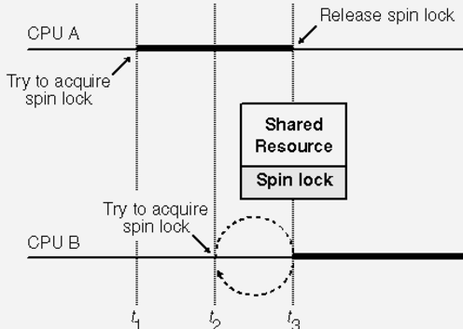
Semaphore Implementation (4)
signal(S) and wait(S) should be atomic. This situation is a CS problem (no two processes can executed wait() and signal() on the same semaphore simultaneously).
Solutions
  uniprocessor system: inhibit interrupts during the execution of signal and wait operations
  multiprocessor system, interrupt does not work here
spin locks for SMP
context switch takes T time,
upper bound for holding a spin lock is < 2T.

Slide 38
Semaphore Implementation (5)
Note that busy waiting have not be completely eliminated.
  It is removed from the entry to the CSs of application programs.
  It is limited to CSs of signal and wait operations, which are short.

Slide 39
Semaphore as a General Synchronization Tool
Execute B in P_{j} only after A executed in P_{i}
Use semaphore flag initialized to 0
Code:
P_{i} P_{j}
 
A wait(flag)
signal(flag) B

Slide 40
Deadlocks and Starvation
The using of semaphores may cause deadlocks
Starvation – indefinite blocking. A process may never be removed from the semaphore queue in which it is suspended
  For example: waiting queues are implemented in LIFO order.
P₀
(Initially, A=B=1)
P₁
wait(B);
wait(A);
S₁
signal(B);
signal(A);
wait(A);
wait(B);
S₀
signal(A);
signal(B);
deadlock

Slide 41
Priority Inversion
We have three processes, L, M, and H, whose priorities follow the order L < M < H.
  H require resource R, which is being accessed by L. H would wait for L to finish using R.
  Now, M becomes runnable, preempting L. Indirectly, a process with a lower priority--process M--has affected how long H must wait for L to relinquish R.
Priority inheritance protocol
  Allow process L to temporarily inherit the priority of H until L had finished using R.

Slide 42
Two Types of Semaphores
Counting semaphore – integer value can range over an unrestricted domain.
Binary semaphore – integer value can range only between 0 and 1; can be simpler to implement.
Can implement a counting semaphore S as a binary semaphore.

Slide 43
Implementing S as a Binary Semaphore
Data structures:
binary-semaphore S1, S2;
int C:
Initialization:
S1 = 1
S2 = 0
C = initial value of counting semaphore S

Slide 44
Implementing S
wait operation /* S1=1, S2=0 and C=S initially
wait(S1);
C--;
if (C < 0) {
signal(S1);
wait(S2);
}
signal(S1);
signal operation
  wait(S1);
  C ++;
  if (C <= 0)
  signal(S2);
  else
  signal(S1);
while S ≤ 0;
S--;
Wait (S)
Signal(S)

Slide 45
Process Synchronization
PART II

Slide 46
Outline
Classical Problems of Synchronization
Monitors
Synchronization Examples
Alternative Approaches
Serializability and Concurrency-control Algorithms
Critical Regions

Slide 47
Classical Problems of Synchronization
Bounded-Buffer Problem
Readers and Writers Problem
Dining-Philosophers Problem
The three problems are important, because they are
  examples for a large class of concurrency-control problems.
  used for testing nearly every newly proposed synchronization scheme.
Semaphores are used for synchronization in our solutions.
(2 separate resources)

Slide 48
Bounded-Buffer Problem
buffer of size n
Shared data
semaphore full, empty, mutex;
Initially:
full = 0, /* # of full slots
empty = n, /* # of empty slots
mutex = 1
producer
consumer

Slide 49
Bounded-Buffer Problem
Producer
Consumer
do {
...
produce an item in nextp
...
wait(empty);
wait(mutex);
  ...
add nextp to buffer
...
signal(mutex);
signal(full);
} while (1);
do {
wait(full);
wait(mutex);
...
remove an item from buffer to nextc
...
signal(mutex);
signal(empty);
...
consume the item in nextc
...
} while (1);
0, iff no item
0, iff no buffer
free one
buffer
add one item

Slide 50
Readers-Writers Problem (1)
each writer is required to have exclusive access to the shared object.
At the same time, either several reads, or only a write
Shared data
semaphore mutex, wrt;
readcount: (0, initially; # of current readers)
mutex: (1, initially; mutual exclusion for readcount)
wrt: (1, initially)
    mutual exclusion for writers
    It also is used by the first-in and last-out readers

Slide 51
Readers-Writers Problem (2)
If a writer is in the CS and n readers are waiting, then
  one (1st) is queued on wrt
  the other n-1 are queued on mutex
When a writer executes signal(wrt), either the waiting readers or a single writer are resumed. The selection is made by the scheduler.

Slide 52
Readers-Writers Problem (3)
Two variations (priorities of readers and writers)
No reader will be kept waiting unless a writer has already obtained permission to use the shared object.
(Thus, no reader should wait for other readers to finish simply because a writer is waiting.) Writers may starve
Once a writer is ready, that writer performs its write as soon as possible.
(Thus, if a writer is waiting to access the object, no new readers may start reading.) Readers may starve

Slide 53
Readers-Writers Problem (4)
for the first solution
reader
first-in
writer
wait(mutex);
readcount++;
if (readcount == 1) wait(wrt);
signal(mutex);
...
reading is performed
...
wait(mutex);
readcount--;
if (readcount == 0) signal(wrt);
signal(mutex);
wait(wrt);
...
writing is performed
...
signal(wrt);
update
readcount

Slide 54
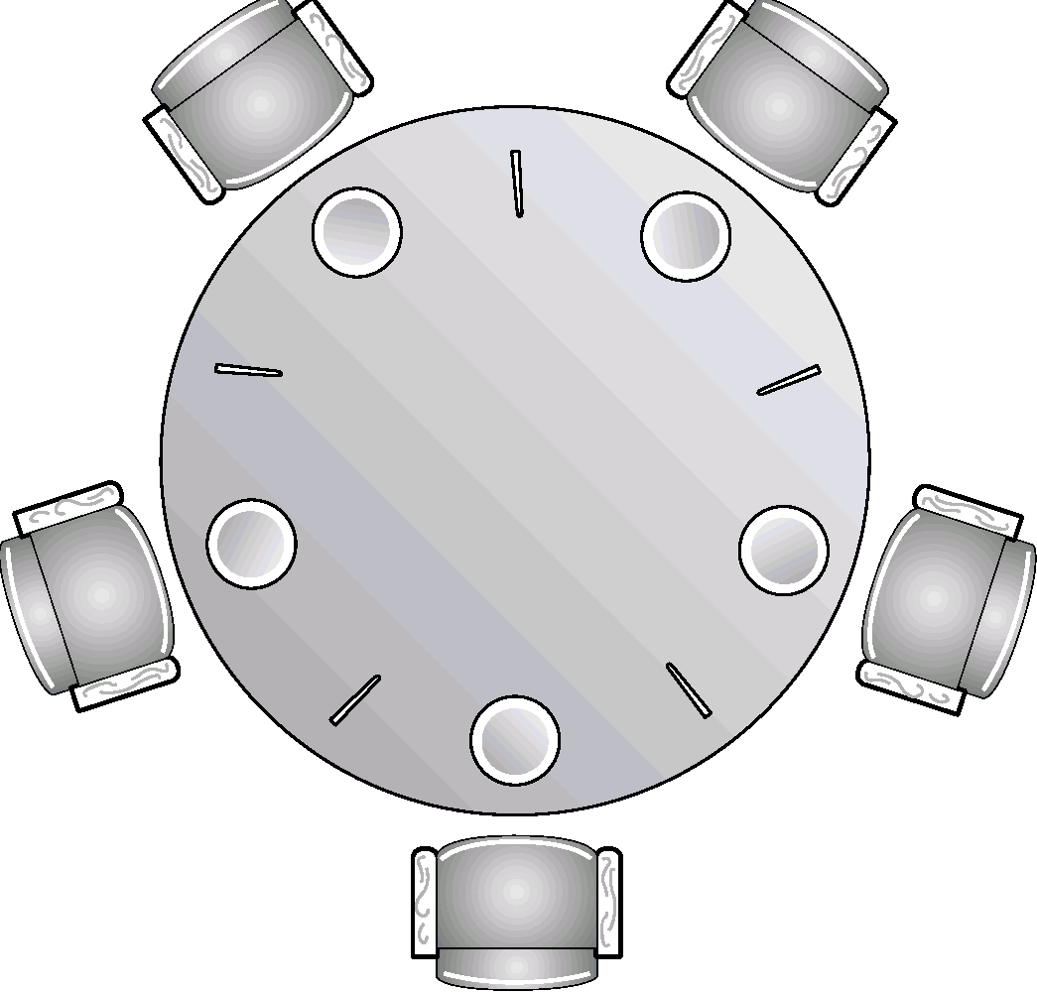
Dining-Philosophers Problem (1)
five philosophers, either thinking or eating
to eat, two chopsticks are required
taking one chopstick at a time
Shared data
semaphore chopstick[5];
  Initially all values are 1
3
3
2
4
2
4
1
5
1
5

Slide 55
Dining-Philosophers Problem(2)
philosopher i
get chopsticks
left
right
do {
wait(chopstick[i]);
wait(chopstick[(i+1) % 5]);
...
eat
...
signal(chopstick[i]);
signal (chopstick[(i+1) % 5]);
...
think
...
} while(1);
free chopsticks
left
right
deadlock !

Slide 56
Dining-Philosophers Problem (3)
Possible solutions to the deadlock problem
  Allow at most four philosophers to be sitting simultaneously at the table.
  Allow a philosopher to pick up her chopsticks only if both chopsticks are available (note that she must pick them up in a critical section).
  Use an asymmetric solution; that is,
    odd philosopher: left first, and then right
    an even philosopher: right first, and then left
Besides deadlock, any satisfactory solution to the DPP problem must avoid the problem of starvation.

Slide 57
Incorrect use
Semaphores provide a convenient and effective mechanism for process synchronization.
However, incorrect use may result in timing errors.
signal(mutex);
...
critical section
...
wait(mutex);
wait(mutex);
...
critical section
...
incorrect order
(not mutual exclusive)
forgotten
...
critical section
...
signal(mutex);
wait(mutex);
...
critical section
...
wait(mutex);
typing error
(deadlock)

Slide 58
Monitor: A High-level Language Constructs
The representation of a monitor type consists of
  declarations of variables whose values define the state of an instance of the type
  procedures or functions that implement operations on the type.
A procedure within a monitor can access only variables defined in the monitor and the formal parameters.
The local variables of a monitor can be used only by the local procedures.
The monitor construct ensures that only one process at a time can be active within the monitor.

Slide 59
Monitors
High-level synchronization construct that allows the safe sharing of an abstract data type among concurrent processes.
monitor monitor-name
{
shared variable declarations
procedure body P1 (…) {
. . .
}
procedure body P2 (…) {
. . .
}
procedure body Pn (…) {
. . .
}
{
initialization code
}
}

Slide 60
Monitors – condition variables
To allow a process to wait within the monitor, a condition variable must be declared, as
condition x, y;
Condition variable can only be used with the operations wait and signal.
  The operation
  x.wait();
  means that the process invoking this operation is suspended until another process invokes
  x.signal();
  The x.signal operation resumes exactly one suspended process. If no process is suspended, then the signal operation has no effect.

Slide 61
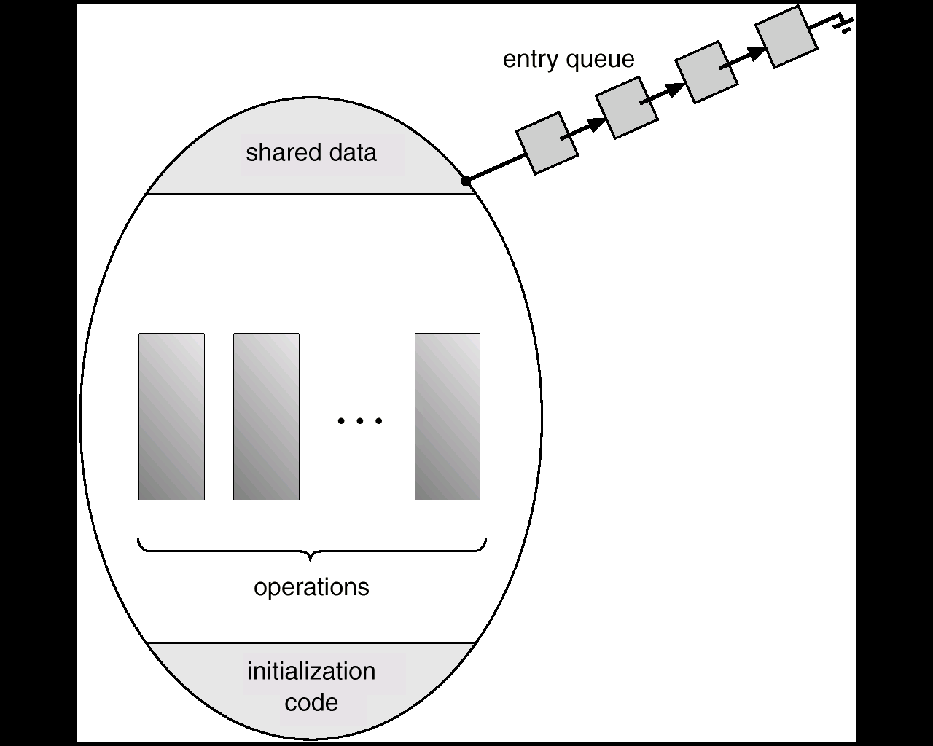
Schematic View of a Monitor

Slide 62
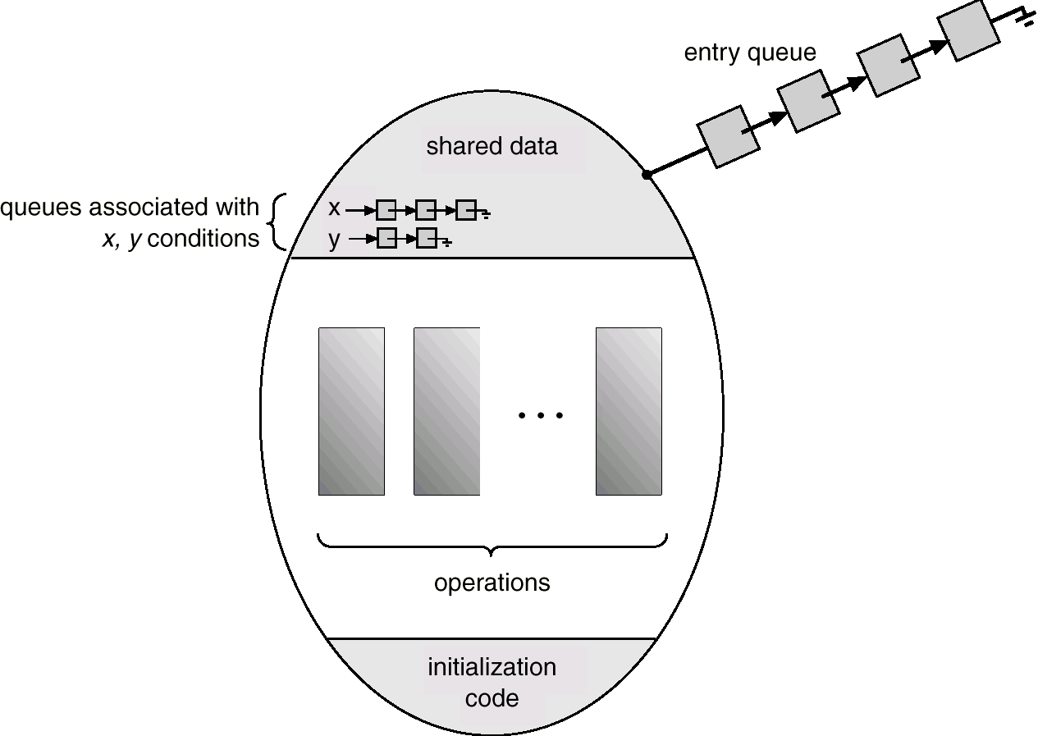
Monitor With Condition Variables (1)

Slide 63
Monitor With Condition Variables (2)
Suppose Q executes x.wait and then P executes x.signal.
Both P and Q are in the monitor, one must wait.
Two possibilities for the implementation:
  (a) P either waits Q leaves, or waits another condition
  (b) Q either waits P leaves, or waits another condition
Possibility (b) seems more reasonable
signal and wait
signal and continue

Slide 64
Monitor With Condition Variables (3)
However, if Q waits, the logical condition for which Q is waiting may no longer hold by the time Q is resumed.
Concurrent Pascal (using a compromise)
  When P executes x.signal, it leaves immediately, and Q is resumed immediately.
  L: less powerful (a process cannot signal more than one process)

Slide 65
Dining Philosophers Example
monitor dp
{
enum {thinking, hungry, eating} state[5];
condition self[5];
void pickup(int i) // following slides
void putdown(int i) // following slides
void test(int i) // following slides
void init() {
for (int i = 0; i < 5; i++)
state[i] = thinking;
}
}

Slide 66
void pickup(int i) {
state[i] = hungry;
test[i];
if (state[i] != eating)
self[i].wait();
}
void putdown(int i) {
state[i] = thinking; /*allow neighbors to eat
// test left and right neighbors
test((i+4) % 5);
test((i+1) % 5);
}
try to eat
left
right

Slide 67
try to let P_{i} eat
(if it is hungry)
void test(int i) {
if ( (state[(i + 4) % 5] != eating) &&
(state[i] == hungry) &&
(state[(i + 1) % 5] != eating)) {
state[i] = eating;
self[i].signal();
}
}
void init() { /* initialization */
for (int i = 0, i < 5; i++)
state[i] = thinking; }}
if P_{i} is suspended,
resume it
if P_{i} is not suspended,
no effect

Slide 68
An illustration
P₃
thinking
❸
P₄
4
3
P₂
hungry
self[2].wait;
0
2
1
❶
P₀
P₁
❷
eating;
putdown(1)
test (0) ;
test (2) ;
if P₃ is not eating ⇒ self[2].signal
thinking

Slide 69
Monitor Implementation
Using Semaphores (1)
Variables
semaphore mutex; // (initially = 1)
semaphore next; // (initially = 0)
int next-count = 0;
Each external procedure F will be replaced by
Mutual exclusion within a monitor is ensured.
wakeup a
suspended process
compiler
wait(mutex);
body of F;
if next-count>0 then signal(next)
else signal(mutex);
body of F
allow others
to enter
the monitor

Slide 70
Monitor Implementation
Using Semaphores (2)
For each condition variable x, we have:
semaphore x-sem; // (initially = 0)
int x-count = 0;
The operation x.wait can be implemented as:
x-count++;
if (next-count > 0)
signal(next);
else
signal(mutex);
wait(x-sem);
x-count--;

Slide 71
Monitor Implementation
Using Semaphores (3)
The operation x.signal can be implemented as:
if (x-count > 0) {
next-count++;
signal(x-sem);
wait(next);
next-count--;
}
  A signaling process must WAIT until the resumed process either leaves or waits.
  NEXT: the signaling processes may suspend themselves.
no effect, if no process is waiting
wakeup a waiting process

Slide 72
Resuming Processes within a Monitor (1)
Process-resumption order: Which of the suspended processes should be resumed next?
  FIFO
  Conditional-wait construct: x.wait(c), when x.signal is executed, process with smallest associated priority number is resumed next.
    c – integer expression evaluated when the wait operation is executed.
    value of c (a priority number) stored with the name of the process that is suspended.

Slide 73
Resuming Processes within a Monitor (2)
Example: ResourceAllocator Monitor
  monitor Resource Allocator
  { boolean busy;
  condition x;
  void acquire (int time) { /* time: the maximum time it plans to use */
  if (busy) x.wait(time); busy = TRUE;}
  void release () {
  busy = FALSE; x.signal();}
  initialization_code() {
  busy = FALSE; }
Acquire-release access
  R.acquire(t); … access the resource; … R.release(t)
Unfortunately, the monitor concept cannot guarantee that the access sequence will be observed, e.g.
  Without gaining permission, never release, release a resource that it never requested, …
Scheduling is done according to the built-in monitor-scheduling.

Slide 74
Resuming Processes within a Monitor (3)
Previously, we have to worry about the correct use of semaphores. Now, we have to worry about the correct use of Monitors, with which the compiler can no longer assist us.
Check two conditions to establish correctness:
  User processes must always make their calls on the monitor in a correct sequence.
  Must ensure that an uncooperative process does not ignore the mutual-exclusion gateway provided by the monitor and try to access the shared resource directly, without using the access protocols.
  The inspection may be possible for a small system, it needs other solutions. (Chapter 14)
Languages have incorporated the idea of the monitor: concurrent Pascal, Mesa, C#, Java, …
Resource-access operations within the ResourceAllocator Monitor.
The scheduling is done by the built-in monitor scheduling algorithms.

Slide 75
Synchronization Examples
Solaris
Windows
Linux
Pthreads

Slide 76
Solaris Synchronization (1)
Implements a variety of locks to support multitasking, multithreading (including real-time threads), and multiprocessing.
Uses adaptive mutexes for efficiency when protecting data from short code segments.
Uses condition variables and readers-writers locks when longer sections of code need access to data.
on another core
Spinlock if running
block otherwise

Slide 77
Solaris Synchronization (2)
Uses turnstiles to order the list of threads waiting to acquire either an adaptive mutex or reader-writer lock.
  A turnstile is a queue structure containing threads blocked on a lock.
To prevent a priority inversion, turnstiles are organized according to a priority-inheritance protocol
  Temporarily inherit the priority of the high-priority thread (blocked on this lock)

Slide 78
Windows Synchronization (1)
Uses interrupt masks to protect access to global resources on uniprocessor systems.
Uses spinlocks on multiprocessor systems.
(The kernel ensures that a thread will never be preempted while holding a spinlock.)
Provides dispatcher objects which may act as with mutexes and semaphores.
  Dispatcher objects may also provide events. An event acts much like a condition variable.

Slide 79
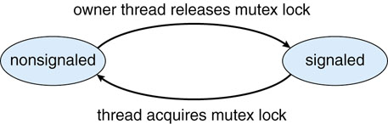
Windows Synchronization (2)
Dispatcher objects, signaled or nonsignaled
  signaled state: an object is available and a thread will not block when acquiring the object.
  nonsignaled state: an object is NOT available and a thread WILL block when acquiring the object.
When the state for the object moves to signaled, the kernel checks and calls (if exists) one thread or possibly more threads
  mutex: one thread
  event: all threads

Slide 80
Windows Synchronization (3)
A critical-section object is a user-mode mutex that can often be acquired and released without kernel intervention.
On a multiprocessor system, a critical-section object first uses a spinlock while waiting for the other thread to release the object.
If it spins too long, the acquiring thread will then allocate a kernel mutex and yield its CPU.
Critical-section objects are particularly efficient because the kernel mutex is allocated only when there is contention for the object.
In practice, there is very little contention, so the savings are significant.

Slide 81
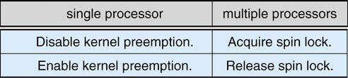
Linux Synchronization
Linux (2.6 and after):
  fully preemptive: preempt when running in the kernel
  provides spin locks, semaphores, reader-writer locks
  SMP: spin locks for short duration
  Single processor: replaced by enabling and disabling kernel preemption
  preempt_count (# of locks held): >0, not safe to preempt the kernel; =0 can be interrupts

Slide 82
Pthreads Synchronization
Pthreads API is OS-independent
provides mutex locks, condition variables
non-portable extensions: read-write locks, spin locks

Slide 83
Alternative Approaches
Transactional Memory
OpenMP
Functional Programming Languages
As the number of processing cores increases, it becomes increasingly difficult to design multithreaded applications that are free from race conditions and deadlocks.
Notes:
83

Slide 84
Transactional Memory (1)
Using synchronization mechanisms such as locks and semaphores involves many potential problems, such as deadlocks and scalability. (locking does not scale well)
Provides an alternative strategy for developing thread-safe concurrent applications.
TM is a sequence of memory read-write operations that are atomic.
Adv: The TM system -not the developer- is responsible for guaranteeing atomically.
Notes:
84

Slide 85
Transactional Memory (2)
software TM vs. hardware TM
  STM: works by inserting instrumentation code inside transaction blocks.
  Compiler: insert codes and manages where statements may run concurrently, and where specific low-level locking is required.
  HTM: uses hardware cache hierarchies and cache coherency protocol to manage and resolve conflicts involving shared data residing in separate processors’ caches. No special code instrumentation.
Notes:
85

Slide 86
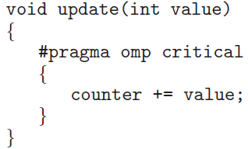
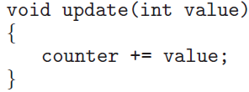
OpenMP
OpenMP provides the compiler directive #pragma omp critical, in which only one thread may be active at a time for ensuring that threads do not generate race conditions.
The critical-section compiler directive behaves much like a binary semaphore or mutex lock, ensuring that only one thread at a time is active in the critical section.
Disadvantages: (1) application developers must still identify possible race conditions and adequately protect shared data using the compiler directive.
  (2) deadlock is still possible when two or more critical sections are identified.

Slide 87
Functional Programming Languages
Procedural (Imperative) languages are used for implementing algorithms that are state-based (variables and other data structures).
program state is mutable, as variables may be assigned different values over time.
Functional programming languages offer a different paradigm than procedural languages in that they do not maintain state.
  That is, once a variable has been defined and assigned a value, its value is immutable—it cannot change. They need not be concerned with issues such as race conditions and deadlocks.

Slide 88
Functional Programming Languages
Essentially, most of the problems addressed in this chapter are nonexistent in functional languages.
Functional languages, such as Erlang and Scala has gained significant attention because of its support for concurrency and the ease with which it can be used to develop applications that run on parallel systems.
Scala is also object-oriented. In fact, much of the syntax of Scala is similar to the popular object-oriented languages Java and C#.

Slide 89
Serializability and Concurrency-control Algorithms
Serializability
Locking protocol
Timestamp-based protocols

Slide 90
System Model
atomically executed: operations happen as a single logical unit of work, in its entirely, or not at all.
If two critical sections are instead executed concurrently, the result is equivalent to their sequential execution in some unknown order.
Using database-systems techniques in operating systems.
Notes:
90

Slide 91
Transactions
Transaction - collection of instructions or operations that performs single logical function
  Transaction is a series of read and write operations.
  Terminated by commit (transaction successful) or abort (transaction failed) operation.
  Aborted transaction must be rolled back to undo any changes it performed.
Notes:
91

Slide 92
Types of Storage Media
Volatile storage – information stored here does not survive system crashes
Nonvolatile storage – Information usually survives crashes
Stable storage – Information never lost
  Not actually possible, so approximated via replication or RAID to devices with independent failure modes
Notes:
92

Slide 93
Log-Based Recovery
Record to stable storage information about all modifications by a transaction
Most common is write-ahead logging
  Log on stable storage, each log record describes single transaction write operation, including transaction name, data item name, old value, new value.
  <T_{i} starts> written to log when transaction T_{i} starts
  <T_{i} commits> written when T_{i} commits
Log entry must reach stable storage before operation on data occurs
Notes:
93

Slide 94
Serializability (1)
serial schedule: A schedule where each transaction is executed atomically.
Schedule A
T₀ T₁
read(A)
write(A)
read(B)
write(B)
read(A)
write(A)
read(B)
write(B)
nonserial schedule: allow two transactions to overlap their execution.
Schedule B
T₀ T₁
read(A)
write(A)
read(A)
write(A)
read(B)
write(B)
read(B)
write(B)

Slide 95
Serializability (2)
O_{i} and O_{j} conflict if they access the same data item and at least one of them is a write.
Conflict serializable: A schedule S can be transformed into a serial schedule S′ by a series of swaps of nonconflicting operations.
Schedule B ⇒ Schedule A
r(A)₁w(A)₁ r(B)₀w(B)₀⇒ r(B)₀w(B)₀r(A)₁w(A)₁
Swap the read(B) of T₀ with the write(A) of T₁
Swap the read(B) of T₀ with the read(A) of T₁
Swap the write(B) of T₀ with the write(A) of T₁
Swap the write(B) of T₀ with the read(A) of T₁
Schedule B will produce the same final state as well some serial schedule.

Slide 96
Locking Protocol (1)
One way to ensure serializability is to associate with each data item a lock, and require that each transaction follow a locking protocol that governs how locks are acquired and released.
Two lock modes
  Shared: allows read but not write
  Exclusive: allows both read and write
Two-phase locking protocol: requires that each transaction issue lock and unlock in two phases: growing and shrinking.
The order between every pair of conflicting transactions is determined at execution time.

Slide 97
Locking Protocol (2)
growing phase: may obtain lock, but can not release any lock.
shrinking phase: may release lock, but can not obtain any lock.
Initially, a transaction is in the growing phase. The transaction acquires locks as needed. Once the transaction releases a lock, it enters the shrinking phase, and no more lock requests can be issued.
The two-phase locking protocol ensures conflict serializability. It does not, however, ensure freedom from deadlock.

Slide 98
Timestamp-based Protocols (1)
Select the order among transactions in advance
Timestamps could be
  System clock
  Logical counter
Implementation
  W-timestamp(Q): denotes the largest timestamp of any transaction that executed write(Q) successfully.
  R-timestamp(Q): denotes the largest timestamp of any transaction that executed read(Q) successfully.
These timestamps are updated whenever a new read(Q) or write(Q) instruction is executed.

Slide 99
Timestamp-based Protocols (2)
Timestamp-based protocols
  Suppose T_{i} issues read(Q):
    If TS(T_{i}) < W-timestamp(Q), [read a value of Q that was already overwritten] read(Q) is rejected, and T_{i} is rolled back.
    If TS(T_{i}) > W-timestamp(Q), read(Q) is executed, and R-timestamp(Q) is set to the maximum of R-timestamp(Q) and TS(T_{i}).

Slide 100
Timestamp-based Protocols (2)
Timestamp-based protocols
  Suppose T_{i} issues write(Q):
    If TS(T_{i}) < R-timestamp(Q), [the value of Q that is producing was needed previously and T_{i} assumed that this value would never be produced] write(Q) is rejected, and T_{i} is rolled back.
    If TS(T_{i}) < W-timestamp(Q), [is attempting to write an obsolete value] write(Q) is rejected, and T_{i} is rolled back.
    Otherwise, write(Q) is executed.

Slide 101
Timestamp-based Protocols (3)
A transaction that is rolled back by the concurrency-control scheme as a results of the issuing of either a read or write is assigned a new timestamp and is restarted.
T₂ T₃
read(B) 10:00
read(B) 10:01
write(B)
read(A)
read(A)
write(A)
TS(T₂) < TS(T₃)
The timestamp-ordering protocol ensures conflict serializability. The protocol ensures freedom from deadlock because no transaction ever waits.
Assume a transaction is assigned a timestamp
immediately before its first operation.

Slide 102
Example, Use of the Timestamp-based Protocol
A partial schedule for several data items for transactions with timestamps 1, 2, 3, 4, 5
T₁=1
T₂=2
T₃=3
T₄=4
T₅=5
read(Y)
RTS(Y)=2
read(X)
RTS(X)=5
read(Y)
RTS(Y)=2
write(Y)
WTS(Y)=3
write(Z)
WTS(Z)=3
read(Z)
RTS(Z)=5
read(Z or Y)
read(X)
abort
write(Z)
abort
write(Y)
write(Z)

Slide 103
Testing Serializability of a Schedule
Input: A Schedule S for a set of transactions T₁, …, T_{k}.
Output: A determination whether S is serializable, and if so, a serial schedule equivalent to S.
Method: Let S be s schedule of actions a₁, …, a_{n}. Create a digraph (precedence graph) G, whose nodes correspond to the transactions.
T_{j} → T_{s} if a_{i} =T_{j} : UNLOCK a_{m} and a_{p} is the next action following a_{i} of the form T_{s}: LOCK a_{m}.
If G has a cycle, then S is not serializable.
If G has no cycle, then find a linear order by topological sorting.
Theorem. The above algorithm correctly determines if a schedule is serializable.

Slide 104
Two-phase Locking guarantees Serializability
Theorem: If S is any schedule of two-phase locking, then S is serializable.
Proof: Suppose not, by the above theorem, the precedence graph G for S has a cycle, T₁, T₂, …, T_{p}, T₁.
Then some lock by T₂ following an unlock by T₁; some lock by T₃ following an unlock by T₂, and so on.
Finally, some lock by T₁ following an unlock by T_{p}. Therefore, a lock of T₁ follows an unlock of T₁, contradicting the assumption that T₁ is a two-phase. #

Slide 105
Critical Regions (1)
High-level synchronization construct
A shared variable v of type T, is declared as:
v: shared T
Variable v accessed only inside statement
region v when B do S
where B is a boolean expression.
When statement S is being executed, no other process can access variable v.
S is executed only when B is true.

Slide 106
Critical Regions (2)
Regions referring to the same shared variable exclude each other in time.
When a process tries to execute the region statement, the Boolean expression B is evaluated.
If B is true, statement S is executed.
If it is false, the process is delayed until B becomes true and no other process is in the region associated with v.

Slide 107
Example – Bounded Buffer
Shared data:
struct buffer {
int pool[n];
int count, in, out; }
Initially,
count=0
in=out=0
producer
consumer
region buffer when (count < n) {
pool[in] := nextp;
in := (in+1) % n;
count ++; }
region buffer when (count > 0) {
nextc := pool[out];
out := (out +1) % n;
count := count --; }

Slide 108
Implementation region x when B do S
Associate with the shared variable x, the following variables:
semaphore mutex, first-delay, second-delay;
int first-count, second-count;
Mutually exclusive access to the critical section is provided by mutex.
If a process cannot enter the critical section because the Boolean expression B is false,
  it initially waits on the first-delay semaphore;
  moved to the second-delay semaphore
before it is allowed to reevaluate B.

Slide 109
Implementation
Keep track of the number of processes waiting on first-delay and second-delay, with first-count and second-count respectively.
The algorithm assumes a FIFO ordering in the queuing of processes for a semaphore.
For an arbitrary queuing discipline, a more complicated implementation is required.

Slide 110
Implementation of the Conditional-region construct
1st:
P1
P2
New: P1, P2, P3, P4
2nd:
S: P3
wait(mutex);
while(!B) {
first_count++;
if(second-count > 0)
signal(second_delay);
else signal(mutex);
wait(first_delay);
first_count--;
second_count++;
if(first-count > 0)
signal(first_delay);
else signal(second_delay);
wait(second_delay);
second_count--;
}
S;
if(first-count > 0)
signal(first_delay);
else if (second-count > 0)
signal(second_delay);
else signal(mutex);
2nd:P1
 Success:P3
1st:
P1,P2

Slide 111
Implementation of the Conditional-region construct
P1, P2, P3, P4
How to check
  Copy all of them in Q1 to Q2.
  Check Q2 one by one.
  Otherwise let the new comer in.
When to check
  Someone leaves the CS.
  The new comer checks B but fails, and Q2 is not empty.
Why needs two queues? Fairness?
  Check B if in Q2.
  Move to Q2 if someone left the CS.
Q1: P1, P2
Q2: P1, P2
P3
Q1: P1, P2
Q1: P1, P2, P4

Slide 112
Implementation of the Conditional-region construct (2)
P1, P2, P3, P4
How to check
  Copy all of them in Q1 to Q2.
  Check Q2 one by one.
  Otherwise let the new comer in.
When to check
  Someone leaves the CS.
  The new comer checks B but fails, and Q2 is not empty.
Q1: P1, P2
Q2: P1
P2
P3
P2
Q1: P1
Q1: P1
Q1: P4
P1

Slide 113
Windows Synchronization (2)
#include <windows.h>
HANDLE Mutex;
Mutex = CreateMutex(NULL, FALSE, NULL);
#include <stdlib.h> /*required for rand() */
#include "buffer.h"
void *producer(void *param) {
  buffer item item;
  while (true) {
  /* sleep for a random period of time */
  sleep(...);
  /* generate a random number */
  item = rand();
  if (insert item(item))
  fprintf("report error condition");
  else
  printf("producer produced %d\n",item);
}
void *consumer(void *param) {
buffer item item;
while (true) {
/* sleep for a random period of time */
sleep(...);
if (remove item(&item))
fprintf("report error condition");
else
printf("consumer consumed %d\n",item);
}

